Slide 1
23rd Annual Conference on Global Economic Analysis
Trade and climate change policies under a global supply chains perspective
Costantini V.ª, Fusacchia I.ª, Paglialunga E.^{b}, Salvatici L.ª
ª Department of Economics and CRES, University of Roma Tre, Italy
^{b} Department of Economics, Politics and Society, University of Urbino, Italy
"Global Economic Analysis Beyond 2020" June 17-19, 2020

Slide 2
Outline
Background on linkages between trade and climate change
New developments in embedded emissions concept under a GSC approach
Model design and scenario building
Preliminary results
Conclusions

Slide 3
The multiple linkages between trade and climate change
The multiple linkages and feedbacks between climate change and international trade are often scrutinised with ex-ante simulations addressing specific linkages rather than being based on a systemic approach.
We propose a comprehensive policy impact evaluation that includes direct and indirect linkages between climate change and trade, and addresses mutual causal relations and dynamic feedback loops, taking inspiration from a complexity approach developed for optimal policy mix design (Costantini et al., 2019).
We provide a decomposition of emissions along the Global Supply Chains (GSCs) inspired by the procedure in GTAP code developed by Antimiani et al. (2018) in order to quantify the emissions embedded in trade flows.
Introduction Background Model design Model results Conclusions

Slide 4
Direct and indirect impacts of climate change on trade
CLIMATE CHANGE
Truong (2010)
PHYSICAL DAMAGES
ENVIRONMENTAL POLICIES
Tamiotti et al. (2009); Dellink et al. (2017)
Chen and Woodland (2013);
Porter and van der Linde (1995);
Vogel (1995); Perkins and Neumayer (2012)
PRODUCTION
INFRASTRUCTURE
R&D INVESTMENTS
COMPETITIVENESS
TRADE
Introduction Background Model design Model results Conclusions

Slide 5
Direct and indirect impacts of trade on climate change
TRADE
Tamiotti et al., 2009
Cole and Elliott (2003)
Managi et al. (2008)
SCALE EFFECT
COMPOSITION EFFECT
TECHNIQUE EFFECT
TRANSPORTS
TECHNOLOGY TRANSFER
Antweiler, Copeland and Taylor (2001)
Grossman and Krueger (1993)
PRODUCTION
EMISSIONS
CLIMATE CHANGE
Introduction Background Model design Model results Conclusions

Slide 6
Emissions and Global Supply Chains (GSCs)
Changes in CO₂ emissions linked to trade are bidirectional:
  the increasing complexity in different stages composing the GSCs both at the sector and regional level might cause an increase in intermediate trade: production of consumable items requires more international transportation shipment, that is a high-carbon intensity sector (Meng et al., 2018);
  the increasing connections along the GSCs might help fostering positive externalities in the form of knowledge spillovers and technology co-creation, including the deployment and diffusion of cleaner and more efficient production processes, bringing to a global reduction in emissions (Costantini et al., 2017).
Within the International Climate Agreement debate, there is still no consensus on which perspective is best to be adopted for achieving challenging environmental targets as for the carbon-free society envisaged by the Paris Agreement:
  Producer vs Consumer responsibility in the analysis of greenhouse gas emissions.
Introduction Background Model design Model results Conclusions

Slide 7
Emissions and Global Supply Chains (GSCs)
The evaluation of unilateral environmental policies cannot rely only on the measurement of domestic emissions (e.g., territorial emission accounting methods).
Trade should be taken into account in a comprehensive and systemic view in order to reallocate the emissions along the GSCs.
  A demand perspective for historical data are provided by the OECD statistics on CO2 Emissions Embodied In International Trade And Domestic Final Demand, (Yamano and Guilhoto, 2020).
  Environmentally extended Multi-Region Input-Output (MRIO) techniques (Miller and Blair, 2009; Tukker and Dietzenbacher, 2013) to measure pollutions that has been emitted anywhere in the world along GSCs.
Introduction Background Model design Model results Conclusions

Slide 8
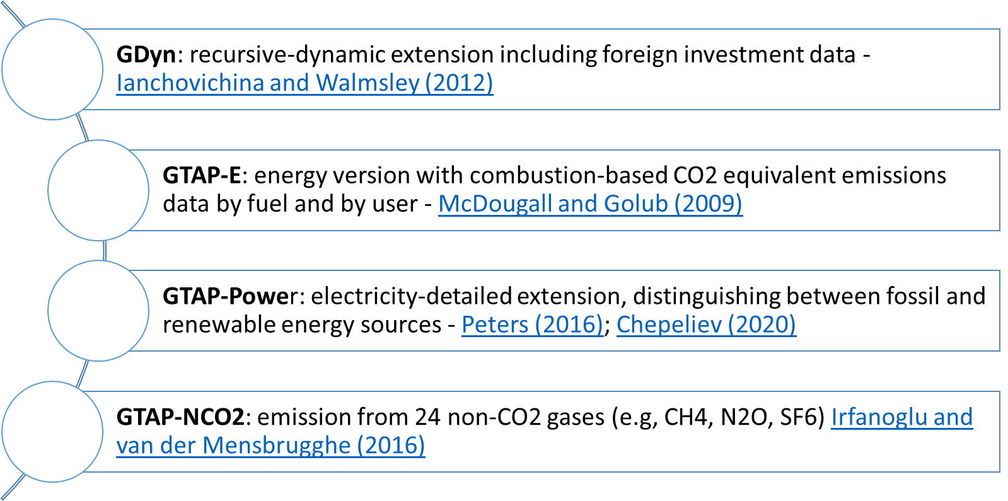
Model and Data
Model novelties:
GTAP-EiT: energy-related emissions (CO₂ and Non-CO₂, N2O-CH4-Fgas) embedded in trade allocated along the GSC
Endogenous technological change for renewable energies and energy efficiency (Green Technology database)
Introduction Background Model design Model results Conclusions

Slide 9
Model – Region and sector aggregation
33 regions
Individual countries: | Australia, Brazil, Canada, China, Colombia and Peru, India, Indonesia, Japan, Malaysia, Mexico, New Zealand, Philippines, Russian Federation, South Africa, South Korea, Turkey, UK, USA
European aggregates: | EU27, EFTA countries, Rest of Europe
EU trade partners: | GSP, GSP plus, Everything But Arms countries
African aggregates: | Africa developing countries, Africa energy exporters, Africa North
Asian aggregates: | Middle East & Asian energy exporters, Rest of East Asia, Rest of Asian countries
Latin America aggregates: | Rest of Andean countries, Rest of Mercosur, Rest of Latin America
36 sectors
Agriculture | Rice, Cereal grains, Other primary, Vegetable and fruit, Livestock, Ruminant meat, Other meat, Fishery, Dairy
ETS manufacturing | Paper and publ., Chemical, Mineral, Metal product, Ferrous metal
High-tech manufacturing | Pharmaceutics, Motor vehicles, Transport equipment, Electronics and electronic equipment, Machinery
Low-tech manufacturing | Beverages and tobacco, Processed food, Sugar, Textile, Wood, Other manufacturing
Energy | Coal, Oil crude, Natural gas and LNG, Electricity from fossil fuels, Electricity from RES, Oil products
Transport | Road and railway transport, Air transport, Water transport
Service | Service private, Service public
Introduction Background Model design Model results Conclusions

Slide 10
Data - Baseline scenario (BAU)
Data sources for 2014-2020: Eurostat, World Development Indicators (WDI) World Bank, CEPII, ILO, IEA energy balances, GECO (Global Energy and Climate Outlook) reference case (Keramidas et al., 2020) + EUREF for EU countries (European Commission, 2016).
BAU for the time span 2025-2050: Population, GDP, Skilled and Unskilled labour force, energy-related CO2-eq emissions, Electricity production by fossil fuels (FF) and renewable energy sources (RES) from GECO+EUREF+CEPII.
Introduction Background Model design Model results Conclusions

Slide 11
Data - Policy scenario
GECO 1.5C° policy scenario applied to energy-related CO2-eq emissions.
Unilateral EU abatement policy → emission target for the EU obtained with:
  Pigouvian Carbon Tax (equivalent to a carbon price for the cost-effectiveness criterion)
By 2030 our policy scenario respects the European Green Deal targets:
    50% of electricity produced by RES
    Domestic emissions reduced by 40% w.r.t. 1990 levels
By 2050 our policy scenario respects the Paris Agreement mitigation targets:
  Domestic emissions by 2050 are abated by 90% w.r.t. BAU
Introduction Background Model design Model results Conclusions

Slide 12
EU emissions pattern
 | 2025 | 2030 | 2035 | 2040 | 2045 | 2050
EU27 Carbon tax | 35 | 45 | 111 | 135 | 591 | 1,874
(USD per ton of CO2-eq, real price)
Introduction Background Model design Model results Conclusions

Slide 13
Energy and emission intensities: EU vs RoW
Introduction Background Model design Model results Conclusions

Slide 14
EU Energy mix
Introduction Background Model design Model results Conclusions

Slide 15
EU specialization
Introduction Background Model design Model results Conclusions

Slide 16
EU trade specialization
Introduction Background Model design Model results Conclusions

Slide 17
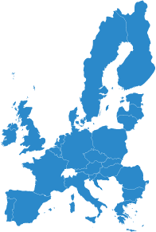

EU GSC-related emissions in trade
FINAL GOODS PRODUCTION FOR DOMESTIC MARKET
EU CONSUMPTION
Domestic emissions
+
Foreign emissions
FINAL GOODS IMPORTS
CO2
CO2
CO2
EU EXPORTS
INTERMEDIATE INPUTS
Domestic emissions
+
Foreign emissions
CO2
CO2
CO2
CO2
CO2
CO2

Slide 18
GSCs and emissions
Introduction Background Model design Model results Conclusions

Slide 19
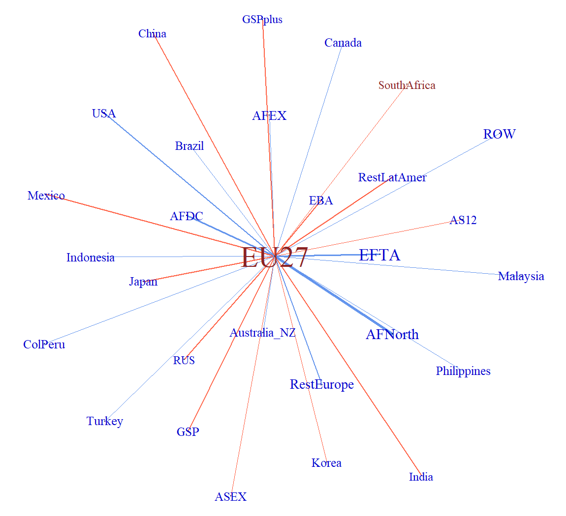
Network analysis
EMBEDDED EMISSIONS in exports
Edges: emissions associates with intermediate flows for EU production of exports
Nodes: emissions due to forward linkages in the world trading system
RED nodes and edges: reduction w.r.t. BAU (larger size, larger decrease)
BLUE nodes and edges: increase w.r.t. BAU (larger size, larger increase)
Comparison between 2050 policy and 2050 BAU (as the ratio policy/BAU).
Introduction Background Model design Model results Conclusions

Slide 20
Bilateral and multilateral trade
Comparison between 2050 policy and 2050 BAU (absolute change, Mt CO2-eq)
Introduction Background Model design Model results Conclusions

Slide 21
CONCLUSIONS
Reaching the Paris Agreement emissions target with a unilateral climate policy implemented by the EU can bring to a carbon leakage effect (estimated around 50% in 2050 in our policy scenario).
Despite the increase in production and consumption of renewable energies and the massive reduction in fossil fuels consumption, the emission content of EU production reduces less than expected due to emissions embedded in intermediate inputs imported from countries without emission abatement targets.
Embedded emissions in imports calculated with a GSC approach are higher than emissions embedded in imports related to the final stage of the GSC.
  Policy implication I: a border tax adjustment could be only a partial solution to leakage
  Policy implication II: investments in Clean Energy Technologies could be a more effective and feasible solution from a unilateral climate policy perspective
  Policy implication III: cooperative solutions with knowledge co-creation and technology transfer could be the best way forward for a win-win solution
Introduction Background Model design Model results Conclusions

Slide 22
23rd Annual Conference on Global Economic Analysis
THANK YOU FOR YOUR ATTENTION!
Introduction Background Model design Model results Conclusions

Slide 23
APPENDIX

Slide 24
APPENDIX – Regional aggregation
Region name | Description
AFDC | Africa developing countries
AFEX | Africa energy exporters
AFNorth | Africa North
AS12 | Asian countries 1+2
ASEX | Middle East and Asian energy exporters
Australia_NZ | Australia & New Zeland
Brazil | Brazil
Canada | Canada
China | China
EBA | Everything but arms countries
EFTA | EFTA countries
EU27 | European Union members
RestEurope | Balcan, Western, Eastern Europe
GSP | GSP countries
GSPplus | GSP plus countries
Region name | Description
India | India
Indonesia | Indonesia
Japan | Japan
Korea | South Korea
RestLatAmer | LatAm + ANDEAN + MERCOSUR
Malaysia | Malaysia
Mexico | Mexico
Philippines | Philippines
ColPeru | Colombia and Peru
ROW | Rest of the world
RUS | Russian Federation
SouthAfrica | South Africa
Turkey | Turkey
USA | USA
Introduction Background Model design Model results Conclusions

Slide 25
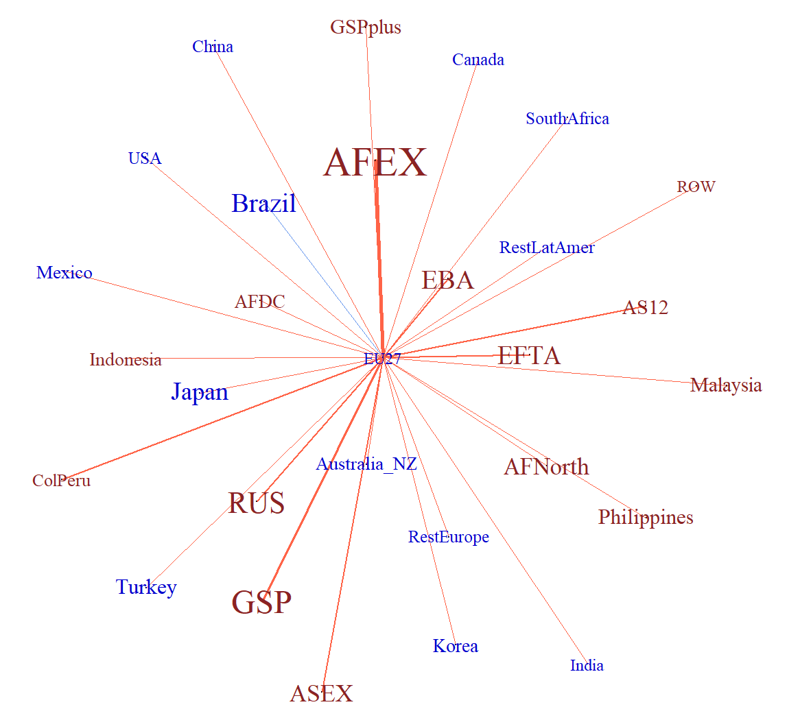
Network analysis
EMBEDDED EMISSIONS in eu exports
EMBEDDED VALUE ADDED IN EU EXPORTS
Comparison between 2050 policy and 2050 BAU (as the ratio policy/BAU).
Nodes: emissions (VA) due to forward linkages in the world trading system
Edges: emissions (VA) associates with intermediate flows for EU production of exports
RED nodes and edges: reduction w.r.t. BAU (larger size, larger decrease)
BLUE nodes and edges: increase w.r.t. BAU (larger size, larger increase)
Introduction Background Model design Model results Conclusions

Slide 26
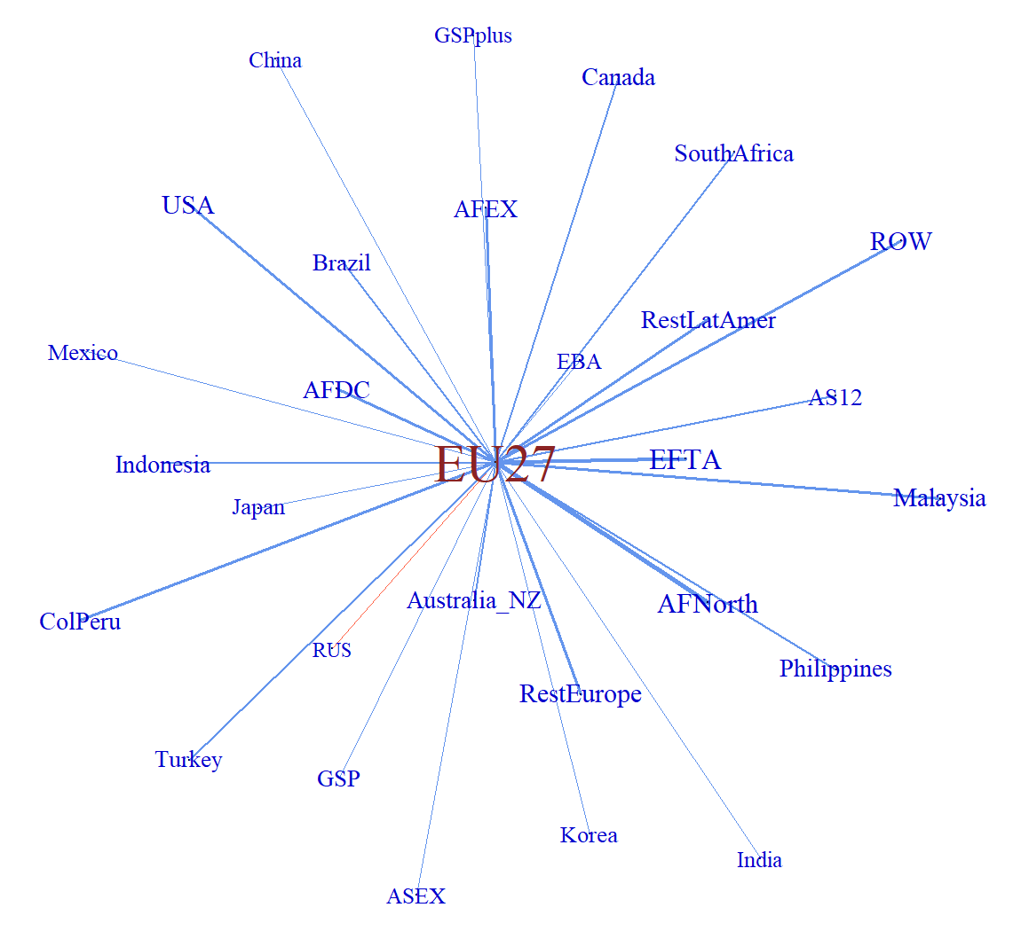
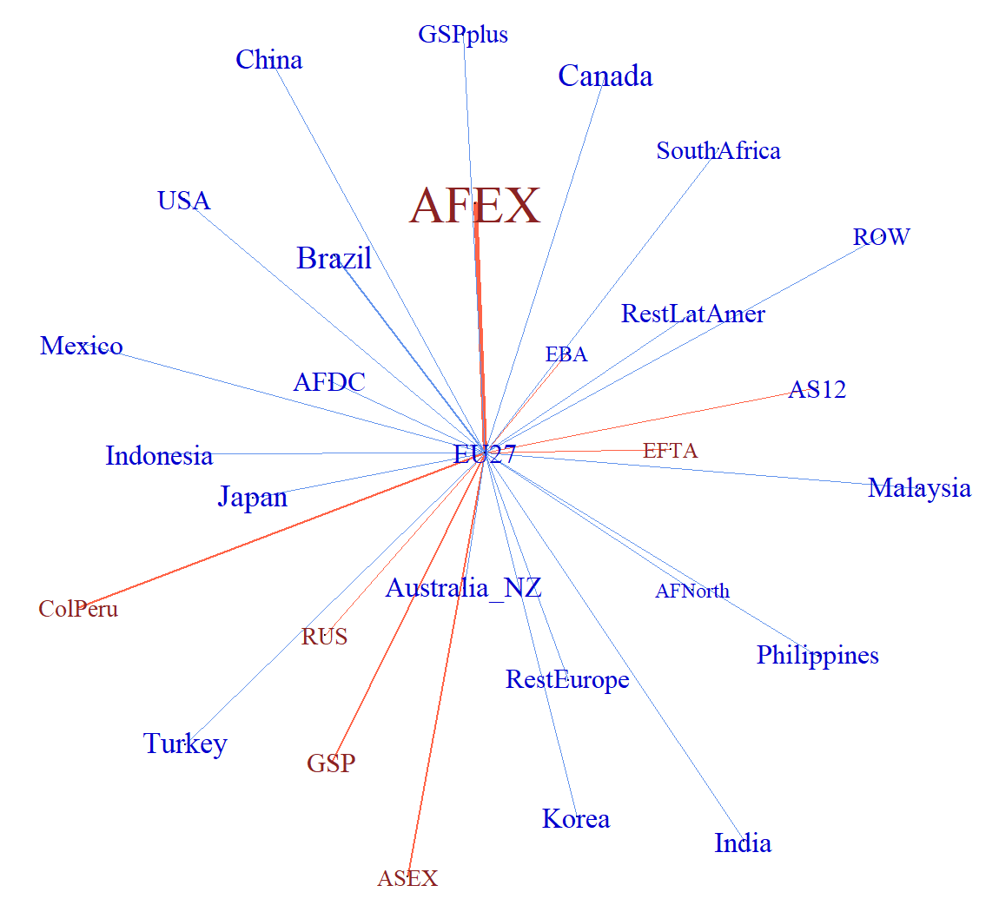
EU FINAL DEMAND
EMBEDDED EMISSIONS in eu FINAL DEMAND
EMBEDDED VALUE ADDED IN EU FINAL DEMAND
Introduction Background Model design Model results Conclusions

Slide 27
APPENDIX - EU export
Introduction Background Model design Model results Conclusions

