Slide 1

USING INPUT OUTPUT ANALYSIS
TO EXPLAIN ECONOMIC DIVERSIFICATION AND
STRUCTURAL TRANSFORMATION
GTAP Conference
Using Input-output links to Measure the Potential for Service-Led Development in Formerly Transition economies and Central-West Asia.
Kristina Baris, Asian Development Bank (ADB)
Based on work jointly with Valerie Mercer-Blackman (World Bank), Krizia Anne Garay (ADB), and Joseph Mariasingham (ADB)

Slide 2

OUTLINE
THE MAIN RESULTS
Agglomeration index is able to measure the linkages in domestic economy.
01
KEY
FINDINGS
02
Role of services in growth is increasing.
03
Service-led growth is a viable route to development.

Slide 3

  Literature on structural transformation has yet to measure the contribution of inter-sectorial linkages in domestic production and in GVCs on economic development.
    Developing economies such as FSU countries do not fit into the traditional development route.
    Trade data is insufficient to show what is happening in domestic economy.
MOTIVATION
    The indirect value added contribution of non-tradable services to production and development has not been properly measured.

Slide 4
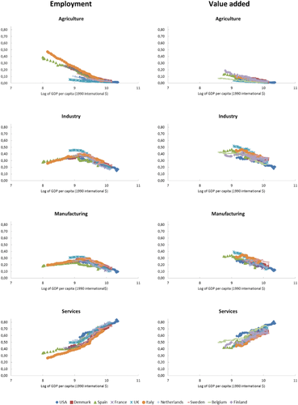
  What we know from structural change literature is based on advanced economies’ trends.
  Moreover, manufacturing has become a more difficult route to growth.
Arguments against concerns of Premature deindustrialization
Contribution of services is not properly measure
Services is no longer constrained by domestic demand.
Growing linkages of services with other sectors!
Sectoral Shares of Employment and Nominal Value Added – Selected European Countries and the USA from GGDC 10‐Sector, 1947–2011.
Source: Van Neuss (2018), replicated by authors based on GGDC 10‐Sector Database (see wileyonlinelibrary.com).

Slide 5
  Traditional indicators of export diversification do not show a clear picture of whether countries are diversified.
Share of top 3 goods in total exports
Export diversification (as share of top 3 goods in total exports) show that transition economies do not come out as diversified.
Source: Calculated using data from Word Development Indicators in Haver Analytics (accessed 23 August 2019).

Slide 6
  …while the share of manufacture value added in GDP provides a mixed picture.
30

Slide 7
  Looking at export complexity, FSU countries export has improved in general…
…BUT like other traditional indicators, this measure does not include non-tradable services.

Slide 8
  Therefore, trade models cannot be used as evidence of economic diversification “within” the economy.
WHY?
Domestic production structures of sectors and the contribution of non-tradable services are not captured.
Difficulty of measuring the role of infrastructure and collective services?
Difficulty of measuring embedded services and digital services

Slide 9
  I-O analysis provide all the tools to understand inter-sectorial relations within an economy.
  Economic diversification using input output linkages will shed some light on three basic questions:
STRUCTURAL TRANSFORMATION: Has a particular sector changed over time? Has it helped to induce the growth of other possibly non-tradable sectors in the economy?
Which sectors represent key sectors due to their strong and extensive linkages with other sectors?
What is the role of services in economic diversification: Have sectors with strong links to other sectors also eventually established a comparative advantage across countries? How does this link to GVCs?

Slide 10
Data and Methodology: Illustrating IO Linkages and Agglomeration
Economic block | Color code
Primary
Low-technology manufacturing
Medium- to high-technology manufacturing
Infrastructure services
Business services
Personal and public services
Sector Codes
1 | Agriculture, Hunting, Forestry and Fishing | 19 | Sale, Maintenance and Repair of Motor Vehicles and Motorcycles; Retail Sale of Fuel
2 | Mining and Quarrying | 20 | Wholesale Trade and Commission Trade, Except of Motor Vehicles and Motorcycles
3 | Food, Beverages and Tobacco | 21 | Retail Trade, Except of Motor Vehicles and Motorcycles; Repair of Household Goods
4 | Textiles and Textile Products | 22 | Hotels and Restaurants
5 | Leather, Leather and Footwear | 23 | Inland Transport
6 | Wood and Products of Wood and Cork | 24 | Water Transport
7 | Pulp, Paper, Paper , Printing and Publishing | 25 | Air Transport
8 | Coke, Refined Petroleum and Nuclear Fuel | 26 | Other Supporting and Auxiliary Transport Activities; Activities of Travel Agencies
9 | Chemicals and Chemical Products | 27 | Post and Telecommunications
10 | Rubber and Plastics | 28 | Financial Intermediation
11 | Other Non-Metallic Mineral | 29 | Real Estate Activities
12 | Basic Metals and Fabricated Metal | 30 | Renting of M&Eq and Other Business Activities
13 | Machinery, Nec | 31 | Public Admin and Defence; Compulsory Social Security
14 | Electrical and Optical Equipment | 32 | Education
15 | Transport Equipment | 33 | Health and Social Work
16 | Manufacturing, Nec; Recycling | 34 | Other Community, Social and Personal Services
17 | Electricity, Gas and Water Supply | 35 | Private Households with Employed Persons
18 | Construction

Slide 11
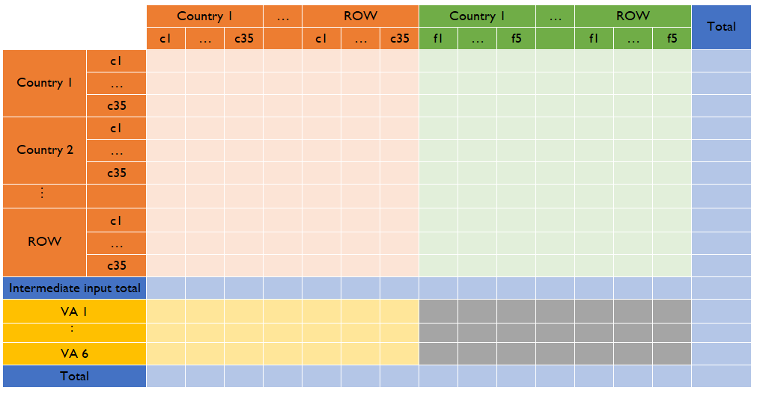









A Stylized Representation of a Multi-Regional Input-Output Table
Intermediate Use $\left(GN\right)$
Final Demand $\left(GF_{n}\right)$
DATA USED
ADB MRIO:
62 economies + RoW
35 industries
2000, 2007-2018
WIOD:
43 economies + RoW
mapped to 35 industries
2000-2006
Intermediate Inputs $\left(GN\right)$
$$Z$$
$$f$$
Total Sector Output $\left(GN\right)$
$$x$$
Value Added $\left(V_{n}\right)$
$$v′$$
$$x′$$
ADB = Asian Development Bank; WIOD = World Input-Output Database

Slide 12
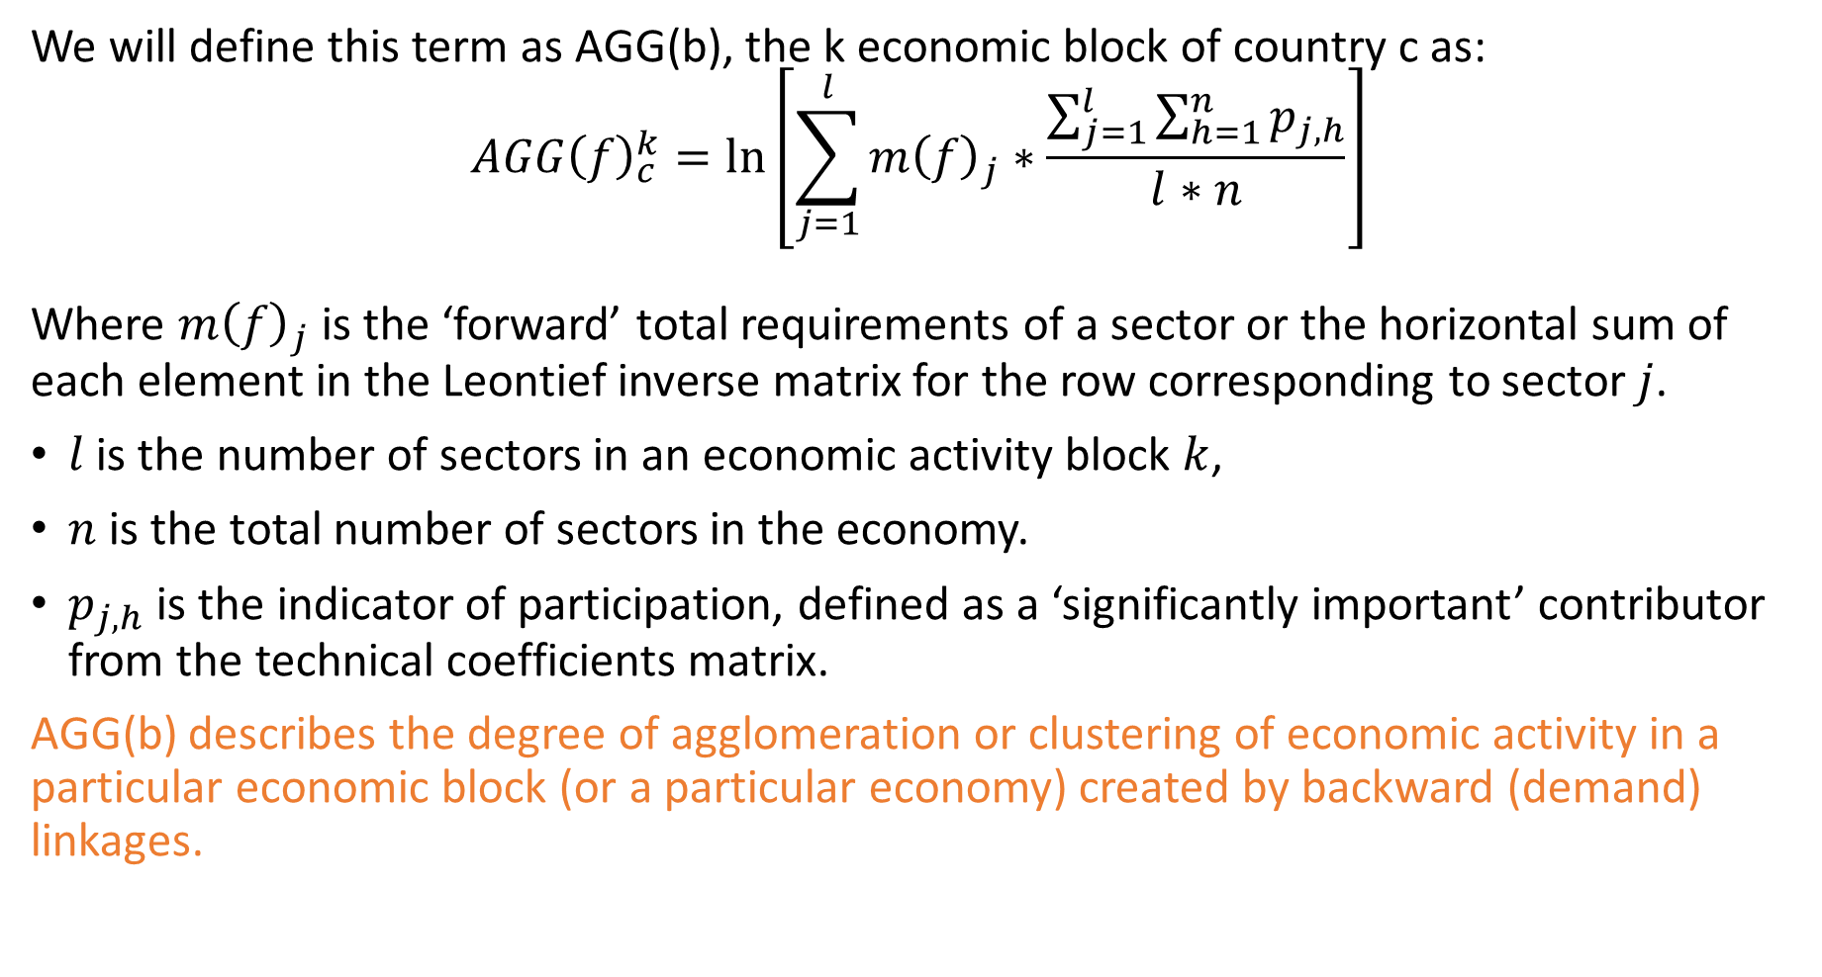
Agglomeration Index
We will define this term as AGG(b), the k economic block of country c as:
$$AGG{\left(f\right)}_{c}^{k}=\ln\left[\sum_{j=1}^{l}{m{\left(f\right)}_{j}}∗\frac{\sum_{j=1}^{l}{\sum_{h=1}^{n}{p_{j,h}}}}{l∗n}\right]$$
Where $m{\left(f\right)}_{j}$ is the ‘forward’ total requirements of a sector or the horizontal sum of each element in the Leontief inverse matrix for the row corresponding to sector $j$.
$l$ is the number of sectors in an economic activity block $k$,
$n$ is the total number of sectors in the economy.
$p_{j,h}$ is the indicator of participation, defined as a ‘significantly important’ contributor from the technical coefficients matrix.
AGG(b) describes the degree of agglomeration or clustering of economic activity in a particular economic block (or a particular economy) created by backward (demand) linkages.

Slide 13
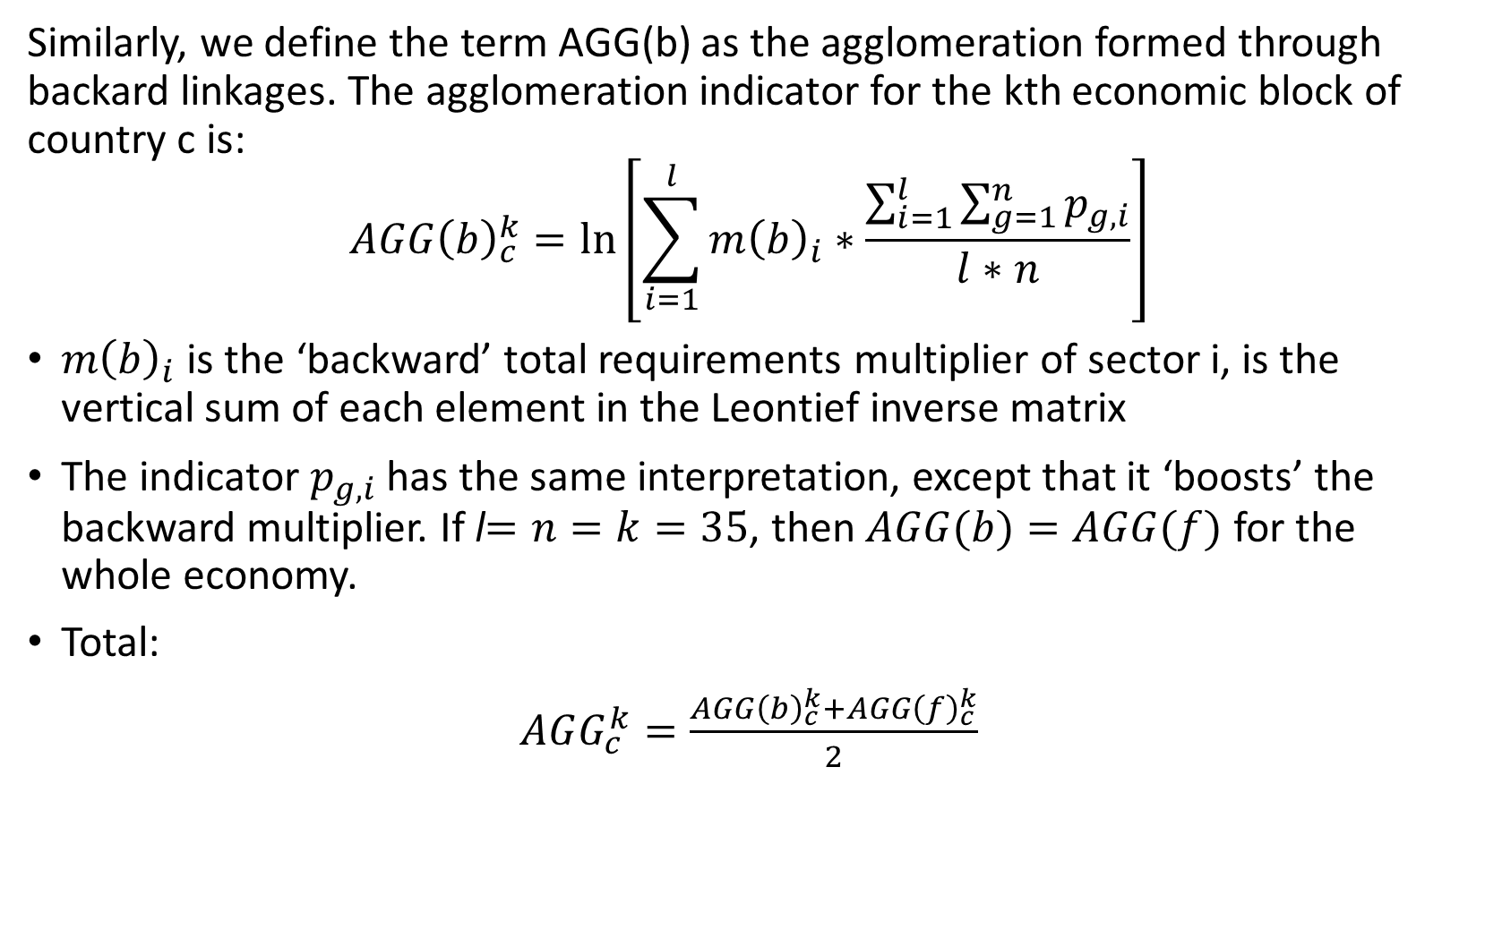
Agglomeration Index
Similarly, we define the term AGG(b) as the agglomeration formed through backard linkages. The agglomeration indicator for the kth economic block of country c is:
$$AGG{\left(b\right)}_{c}^{k}=\ln\left[\sum_{i=1}^{l}{m{\left(b\right)}_{i}}∗\frac{\sum_{i=1}^{l}{\sum_{g=1}^{n}{p_{g,i}}}}{l∗n}\right]$$
$m{\left(b\right)}_{i}$ is the ‘backward’ total requirements multiplier of sector i, is the vertical sum of each element in the Leontief inverse matrix
The indicator $p_{g,i}$ has the same interpretation, except that it ‘boosts’ the backward multiplier. If l$=n=k=35$, then $AGG(b)=AGG(f)$for the whole economy.
Total:
$AGG_{c}^{k}=\frac{AGG{\left(b\right)}_{c}^{k}+AGG{\left(f\right)}_{c}^{k}}{2}$

Slide 14
Linking Goods and Services:
Input-Output Direct Requirements
OECD
Australia
Canada
Estonia
Latvia
Lithuania
United States
People’s Republic of China
Viet Nam
Russia
Kazakhstan
Kyrgyz Republic

Slide 15
While traditional diversification indices shows an undiversified Central Asia, our agglomeration index reveals diversification in the domestic economy.
Country | Rank |  | Total agglomeration index
 | 2017 | 2000 | 2017 | 2000
People's Republic of China | 1 | 1 | 2.72 | 2.68
Russia | 2 | 20 | 2.38 | 2.11
Thailand | 3 | 6 | 2.36 | 2.32
Republic of Korea | 4 | 19 | 2.36 | 2.13
Malaysia | 6 | 46 | 2.32 | 1.83
Canada | 7 | 12 | 2.30 | 2.17
Australia | 11 | 4 | 2.20 | 2.33
United States | 13 | 8 | 2.15 | 2.30
Kazakhstan | 34 | 22 | 1.89 | 2.06
OECD average | 37 | 33 | 1.87 | 1.99
Viet Nam | 41 | 52 | 1.81 | 1.70
Kyrgyz Republic | 42 | 27 | 1.75 | 2.04
Among FSU countries, Russia and Central Asia show high agglomeration but has not improved since 2000.
Less developed countries have improved agglomeration scores over time.
Level of country development is not associated with agglomeration
Country Rankings for Key Economies based on Total Agglomeration Index

Slide 16
Business services show the highest agglomeration index.
 | Agglomeration index - forward
 | Primary | Low-technology manufacturing | Medium- to high-technology manufacturing | Infrastructure services | Business services | Personal and public services
Kazakhstan
2000 | 0.28 | -0.85 | 1.26 | 0.12 | 1.04 | 0.00
2007 | 0.03 | -1.25 | -0.70 | 0.58 | 1.23 | -3.51
2011 | 0.10 | -1.66 | 0.14 | 0.38 | 1.33 | 0.00
2017 | 0.15 | -1.50 | -0.26 | 0.59 | 1.37 | 0.00
Kyrgyz Republic
2000 | 1.72 | 0.04 | -0.12 | 0.91 | 0.28 | 0.00
2007 | 0.53 | -1.22 | -1.21 | -0.39 | 0.26 | 0.00
2011 | -0.28 | -0.86 | -0.32 | 0.46 | 0.93 | -3.49
2017 | 0.16 | -0.61 | -1.22 | 0.25 | 1.27 | -2.37
Russia
2000 | -0.70 | -0.47 | 0.67 | 0.50 | 1.37 | -1.58
2007 | -0.46 | -0.73 | 1.32 | 0.79 | 1.36 | -1.54
2011 | -0.54 | -0.82 | 1.33 | 0.70 | 1.40 | -1.55
2017 | -0.06 | -1.29 | 1.02 | 1.16 | 1.53 | -0.90
United States
2000 | -0.88 | -0.13 | 0.72 | 0.18 | 1.85 | -1.18
2007 | -0.58 | -0.31 | 0.80 | -0.34 | 1.83 | -1.33
2011 | -0.71 | -0.46 | 0.76 | -0.50 | 1.76 | -1.49
2017 | -0.97 | -0.31 | 0.47 | -0.37 | 1.85 | -1.19
OECD countries
2000 | -0.91 | -0.07 | 0.97 | 0.34 | 1.96 | -1.48
2007 | -0.75 | -0.22 | 0.93 | 0.08 | 1.96 | -1.33
2011 | -0.70 | -0.33 | 0.97 | 0.03 | 1.91 | -1.48
2017 | -0.79 | -0.34 | 0.86 | 0.21 | 1.96 | -1.66
Australia
2000 | -0.21 | -0.14 | 0.37 | 0.43 | 1.93 | -1.32
2007 | 0.01 | -0.18 | 0.13 | 0.60 | 1.98 | -1.50
2011 | -0.08 | -0.79 | -0.06 | 0.71 | 1.91 | -1.51
2017 | -0.03 | -1.12 | -0.18 | 0.78 | 1.89 | -1.70
Canada
2000 | -1.01 | -0.82 | -0.39 | 0.43 | 1.99 | -1.21
2007 | -0.56 | -0.56 | -0.45 | 0.41 | 2.02 | -1.20
2011 | -0.35 | -0.35 | -0.17 | 0.33 | 1.95 | -1.39
2017 | -0.35 | -0.69 | 0.05 | 0.48 | 2.04 | -1.10
No. of sectors | 2 | 7 | 7 | 6 | 8 | 5
 | Agglomeration index - backward
 | Primary | Low-technology manufacturing | Medium- to high-technology manufacturing | Infrastructure services | Business services | Personal and public services
Kazakhstan
2000 | -0.66 | 0.64 | 0.41 | 0.31 | 0.54 | -0.16
2007 | -0.91 | 0.01 | 0.16 | -0.08 | 0.39 | -0.18
2011 | -1.52 | 0.30 | 0.27 | 0.33 | 0.47 | -0.38
2017 | -0.92 | 0.20 | 0.24 | 0.55 | 0.13 | -0.16
Kyrgyz Republic
2000 | -0.78 | 0.72 | 0.78 | -0.05 | 0.47 | -0.49
2007 | -1.95 | -0.08 | -1.17 | -1.14 | 0.20 | -0.83
2011 | -1.62 | 0.46 | -0.09 | -0.41 | 0.44 | -0.58
2017 | -0.88 | 0.49 | 0.25 | -0.54 | 0.26 | -0.58
Russia
2000 | -0.64 | 0.63 | 0.76 | 0.30 | 0.12 | 0.27
2007 | -0.87 | 0.91 | 1.03 | 0.71 | 0.38 | 0.04
2011 | -0.84 | 0.83 | 1.08 | 0.69 | 0.35 | 0.01
2017 | -0.61 | 0.79 | 1.04 | 0.82 | 0.83 | -0.14
United States
2000 | -0.36 | 1.00 | 0.79 | 0.75 | 0.40 | -0.09
2007 | -0.82 | 0.94 | 0.74 | 0.66 | 0.42 | -0.13
2011 | -0.99 | 0.85 | 0.66 | 0.56 | 0.37 | -0.20
2017 | -0.75 | 0.88 | 0.62 | 0.50 | 0.33 | -0.10
OECD countries
2000 | -0.57 | 1.09 | 0.93 | 0.85 | 0.77 | -0.25
2007 | -0.80 | 1.16 | 0.89 | 0.79 | 0.61 | -0.25
2011 | -0.80 | 1.08 | 0.91 | 0.77 | 0.55 | -0.20
2017 | -0.68 | 1.06 | 0.98 | 0.75 | 0.50 | -0.21
Australia
2000 | -0.48 | 0.83 | 0.79 | 0.87 | 0.72 | -0.20
2007 | -0.50 | 0.97 | 0.68 | 0.80 | 0.80 | -0.14
2011 | -0.49 | 0.76 | 0.56 | 0.81 | 0.72 | -0.36
2017 | -0.70 | 0.71 | 0.73 | 0.74 | 0.60 | -0.44
Canada
2000 | -0.51 | 0.84 | 0.54 | 0.37 | 0.68 | -0.33
2007 | -0.43 | 0.96 | 0.60 | 0.41 | 0.66 | -0.27
2011 | -0.55 | 0.96 | 0.64 | 0.39 | 0.67 | -0.21
2017 | -0.43 | 1.04 | 0.84 | 0.47 | 0.68 | -0.36
No. of sectors | 2 | 7 | 7 | 6 | 8 | 5
The Agglomeration Index: Numerical results from 2000 to 2017

Slide 17
Business and professional services positively correlates to economic development…
Both direct and indirect contribution of business services to manufacturing matter more than other services, with the direct contribution mattering more in early stages of development and the indirect at later stages.
Source: Mercer-Blackman, V. and C. Ablaza. 2018. The Servicification of Manufacturing in Asia: Redefining the Sources of Labor Productivity. ADBI Working Paper 902. Tokyo: Asian Development Bank Institute.

Slide 18
…which is consistent with the servification of manufacturing.
Total (direct and indirect) contribution of services to manufacturing value added by sector (2000 and 2017)
Source: Authors’ computations based on ADB MRIO
Note: Figures represent the average input coefficient of services for all 62 countries. The original data is expressed in terms of one dollar of manufacturing output.

Slide 19
Particularly, through capturing the indirect contribution to manufacturing which are not captured in traditional trade.

Slide 20
OUTLINE
The level of aggregation masks the extent of linkages between two particular sectors.
01
CAVEATS &
The AGG index does not consider linkages to foreign production
02
FUTURE
RESEARCH
03
The AGG index is based on gross flows.
Employment linkages cannot be inferred directly.
04

Slide 21

Conclusions
The agglomeration index already shows the importance of indirect contribution of non-tradable services.
Business and professional service sectors contribute the most to development.
Central Asian countries are more diversified than what is shown by traditional indicators when linkages in the domestic economy is accounted for.
Contrary to premature industrialization, service-led growth may be a viable option for developing economies.

Slide 22
THANK YOU

Slide 23
Dot Plot Matrices

Slide 24
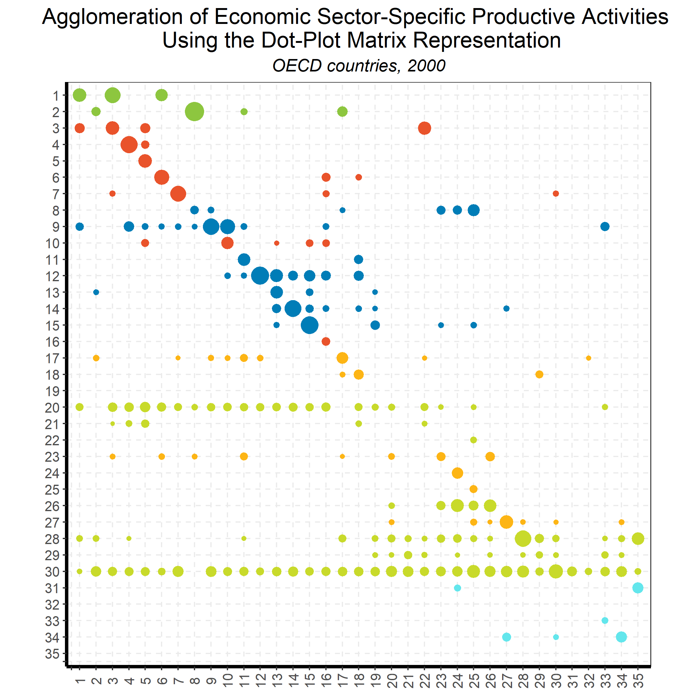
Linking Goods and Services:
Input-Output Direct Requirements
Back to country list

Slide 25
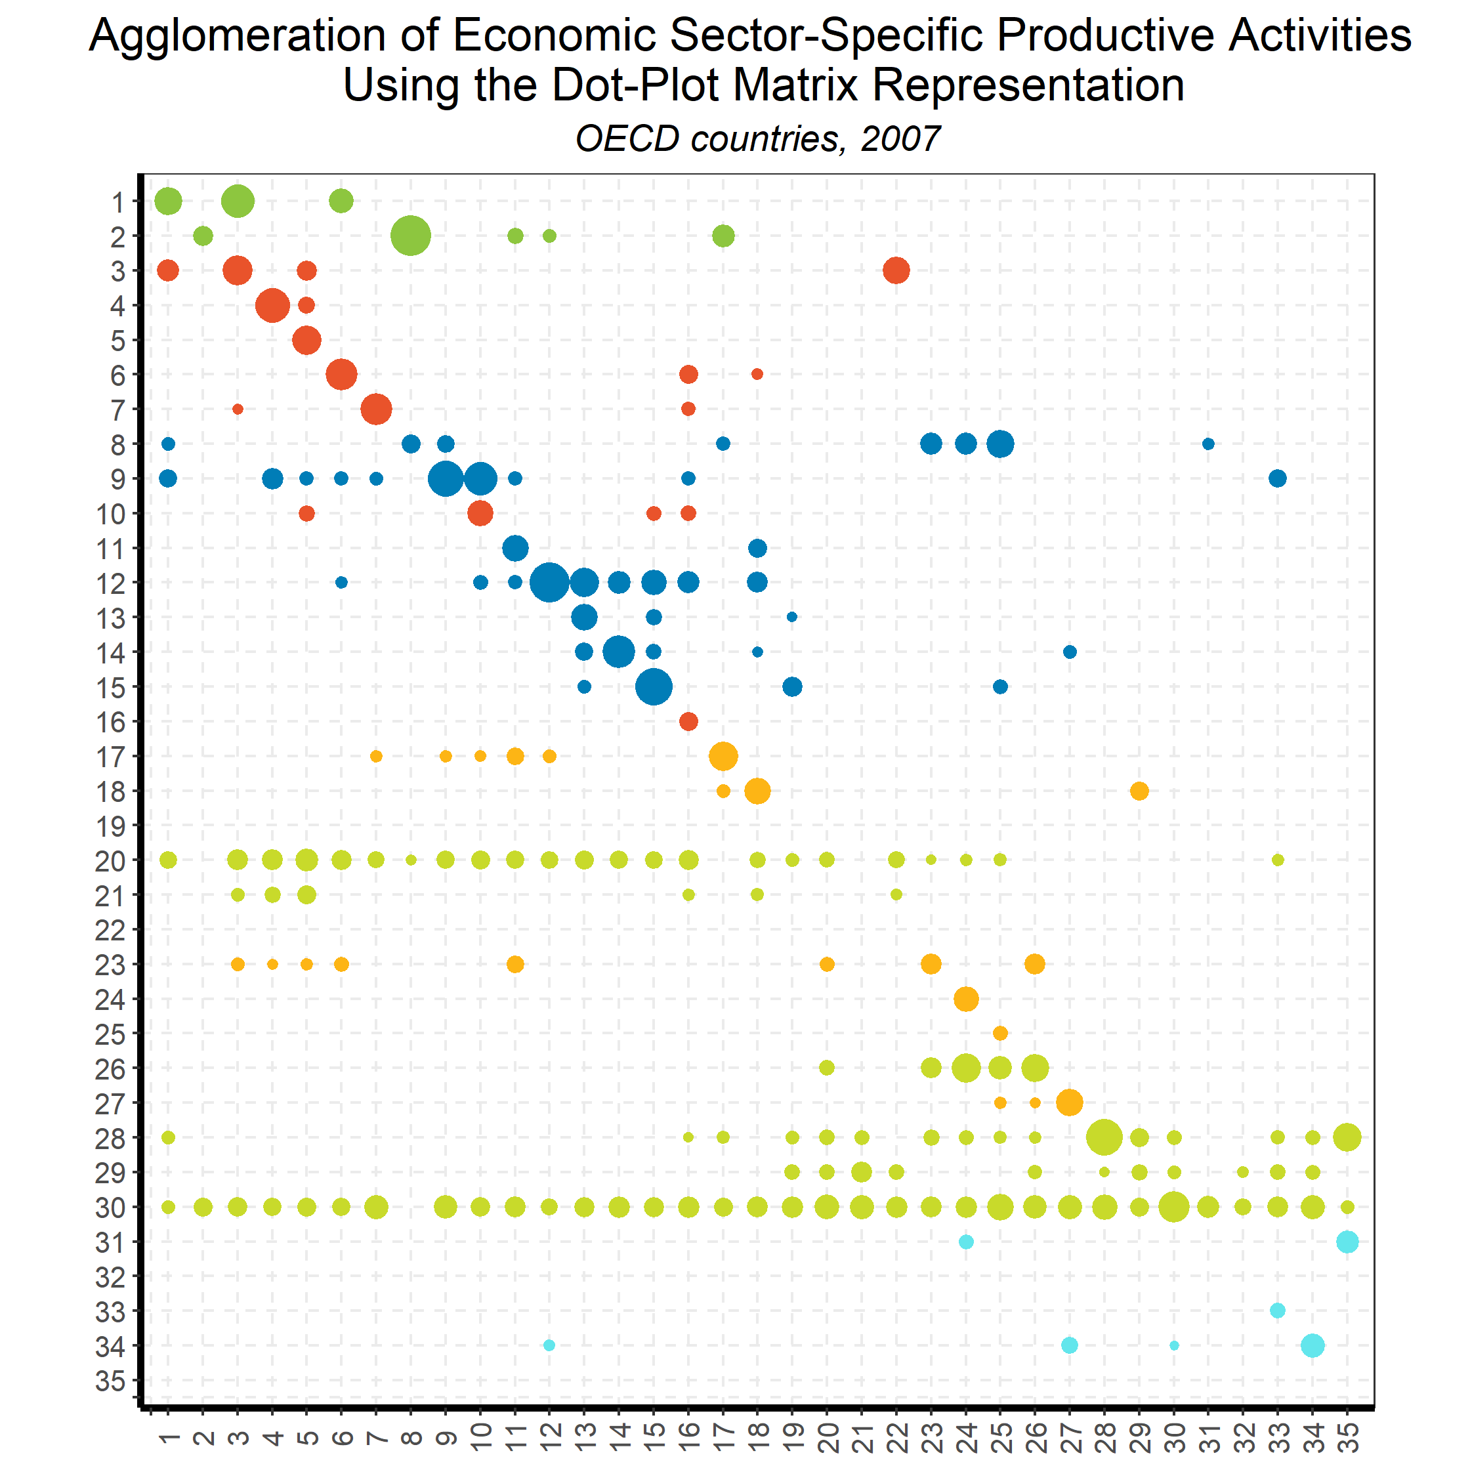
Linking Goods and Services:
Input-Output Direct Requirements
Back to country list

Slide 26
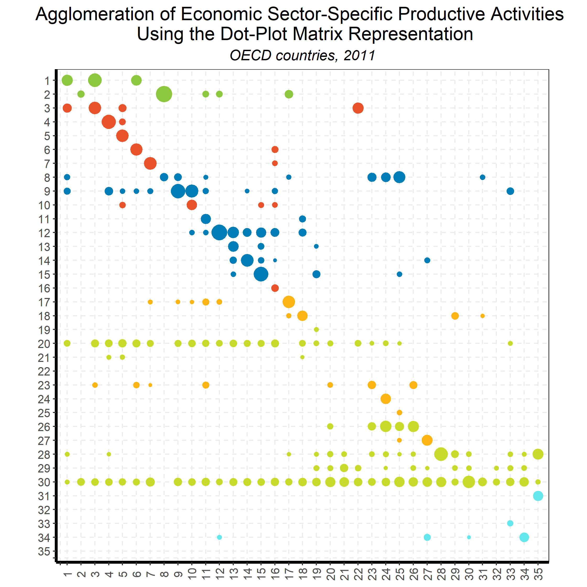
Linking Goods and Services:
Input-Output Direct Requirements
Back to country list

Slide 27
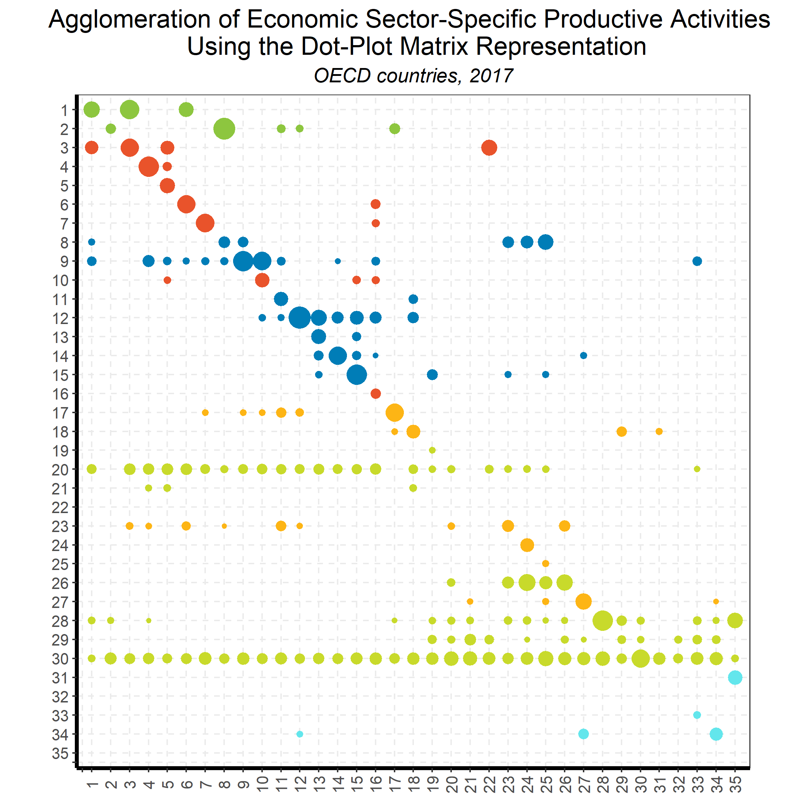
Linking Goods and Services:
Input-Output Direct Requirements
Back to country list

Slide 28
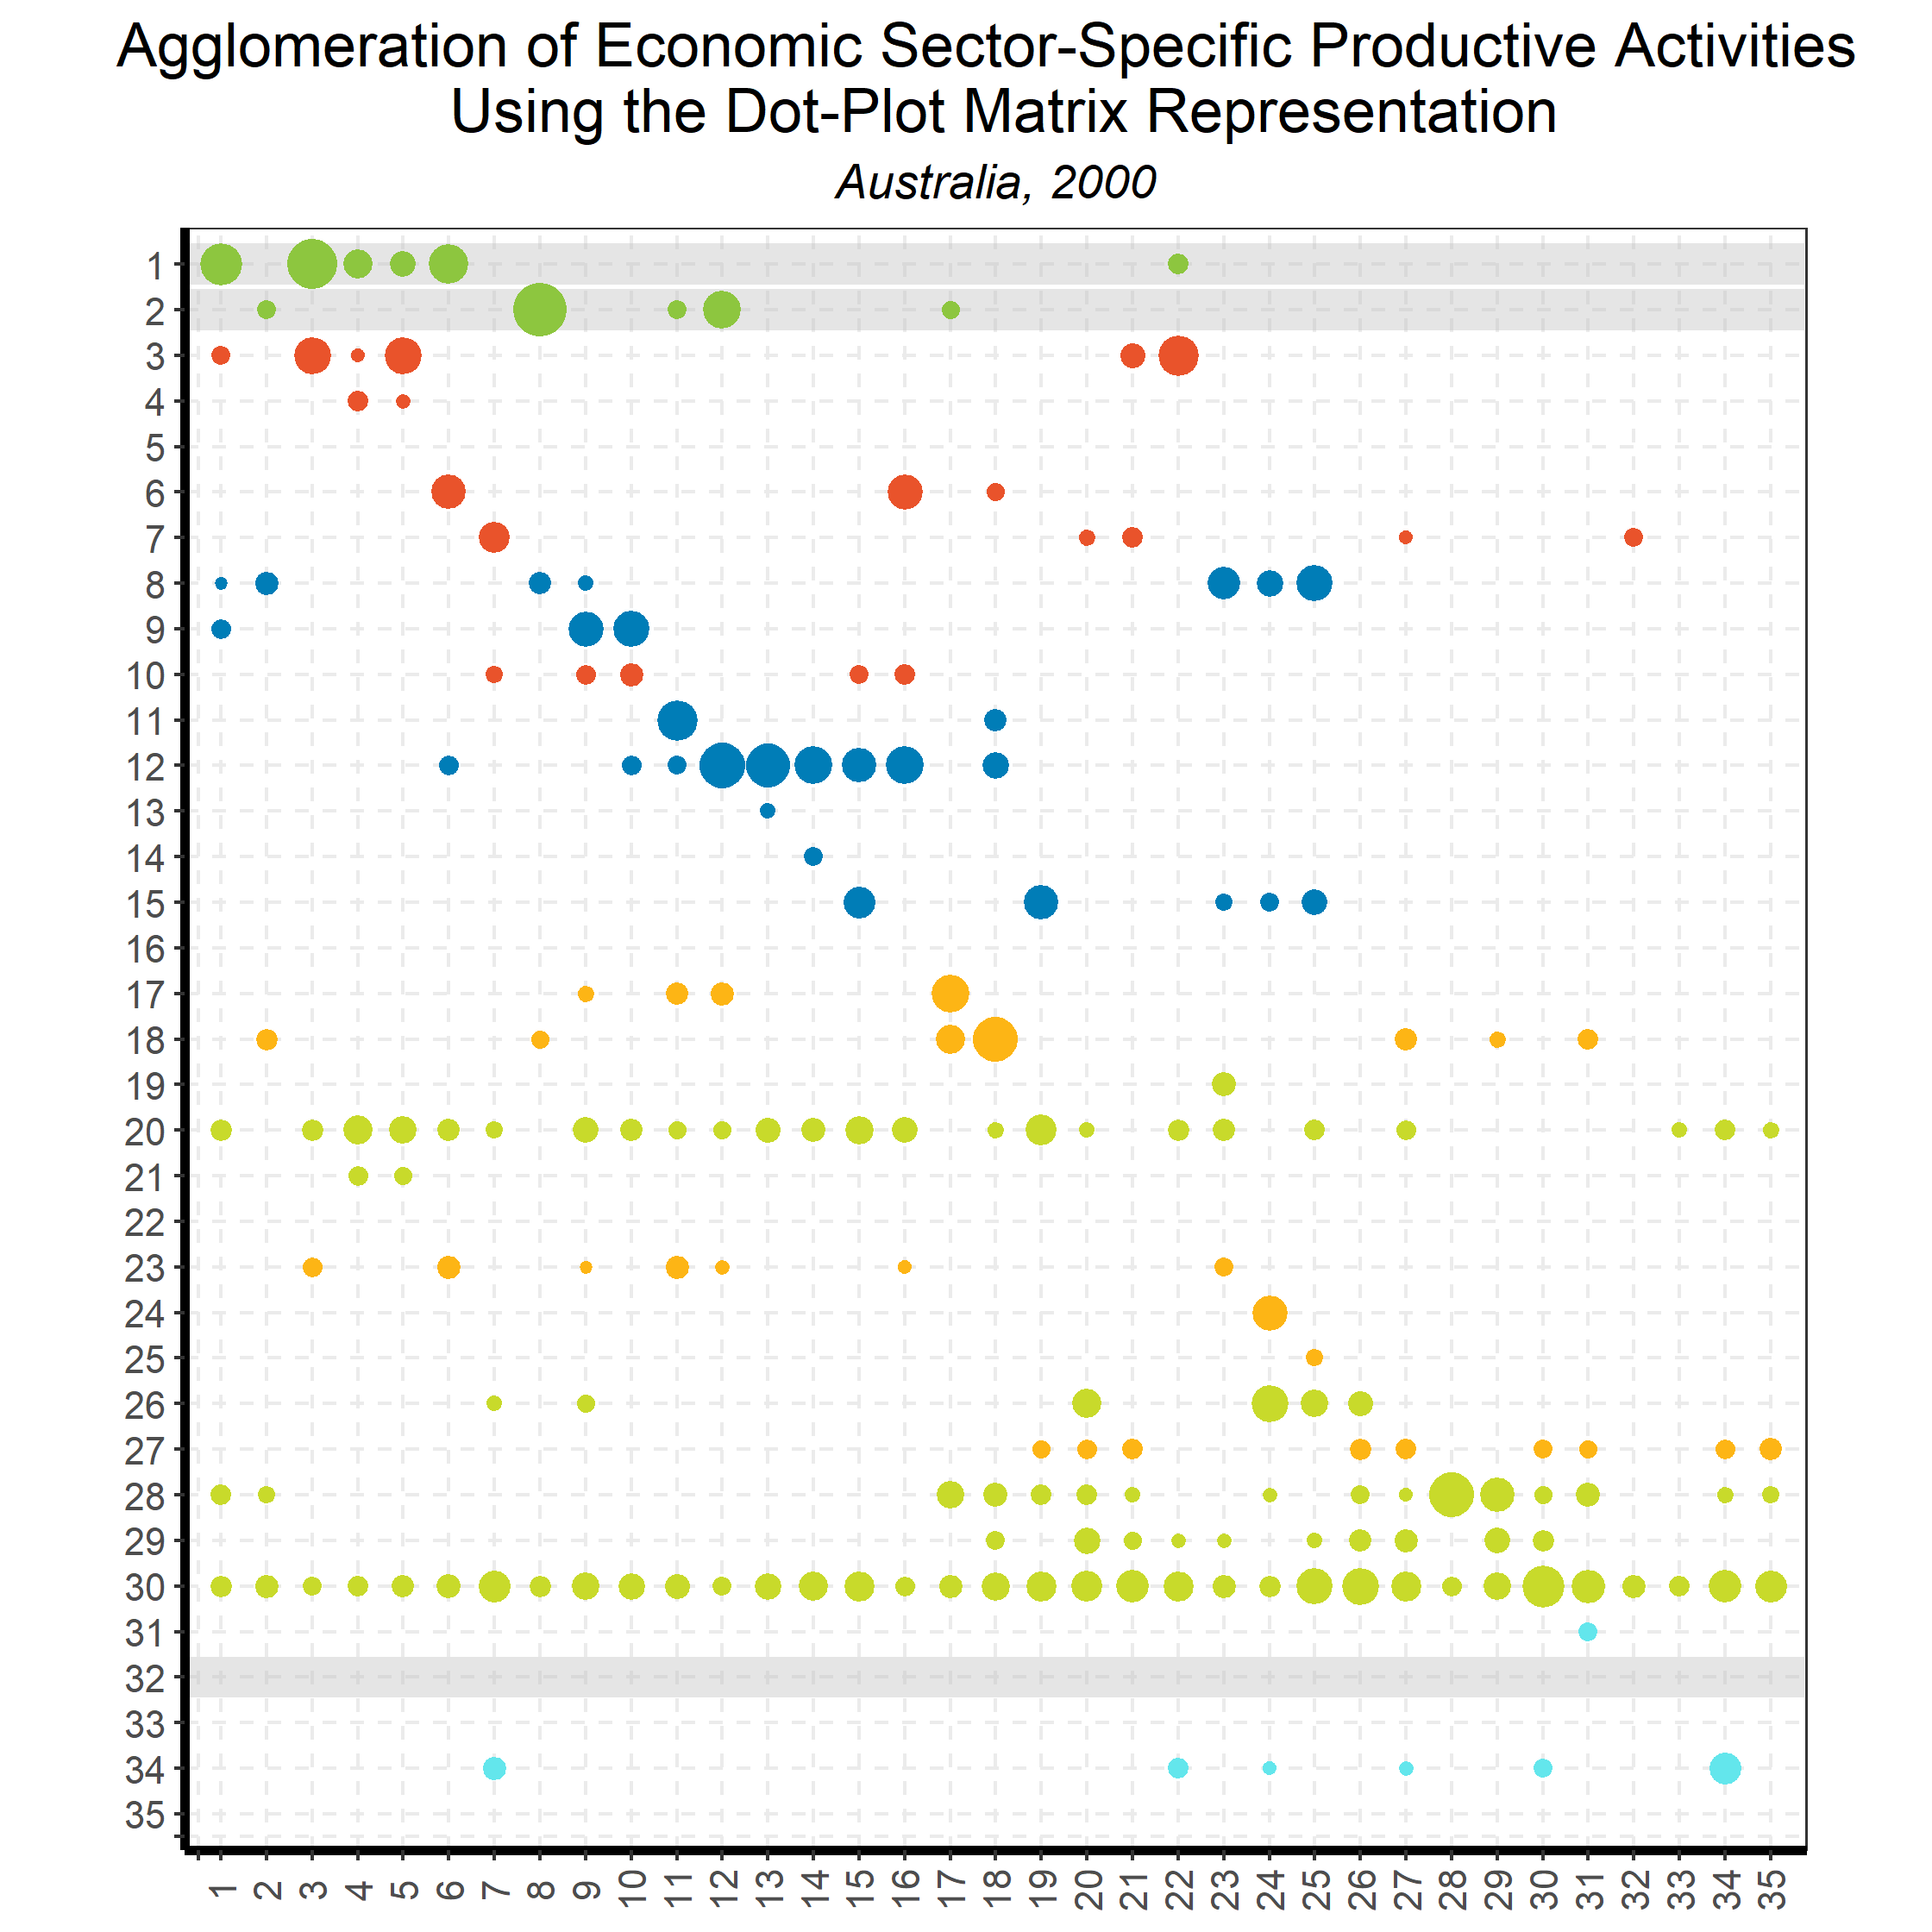
Linking Goods and Services:
Input-Output Direct Requirements
Back to country list

Slide 29
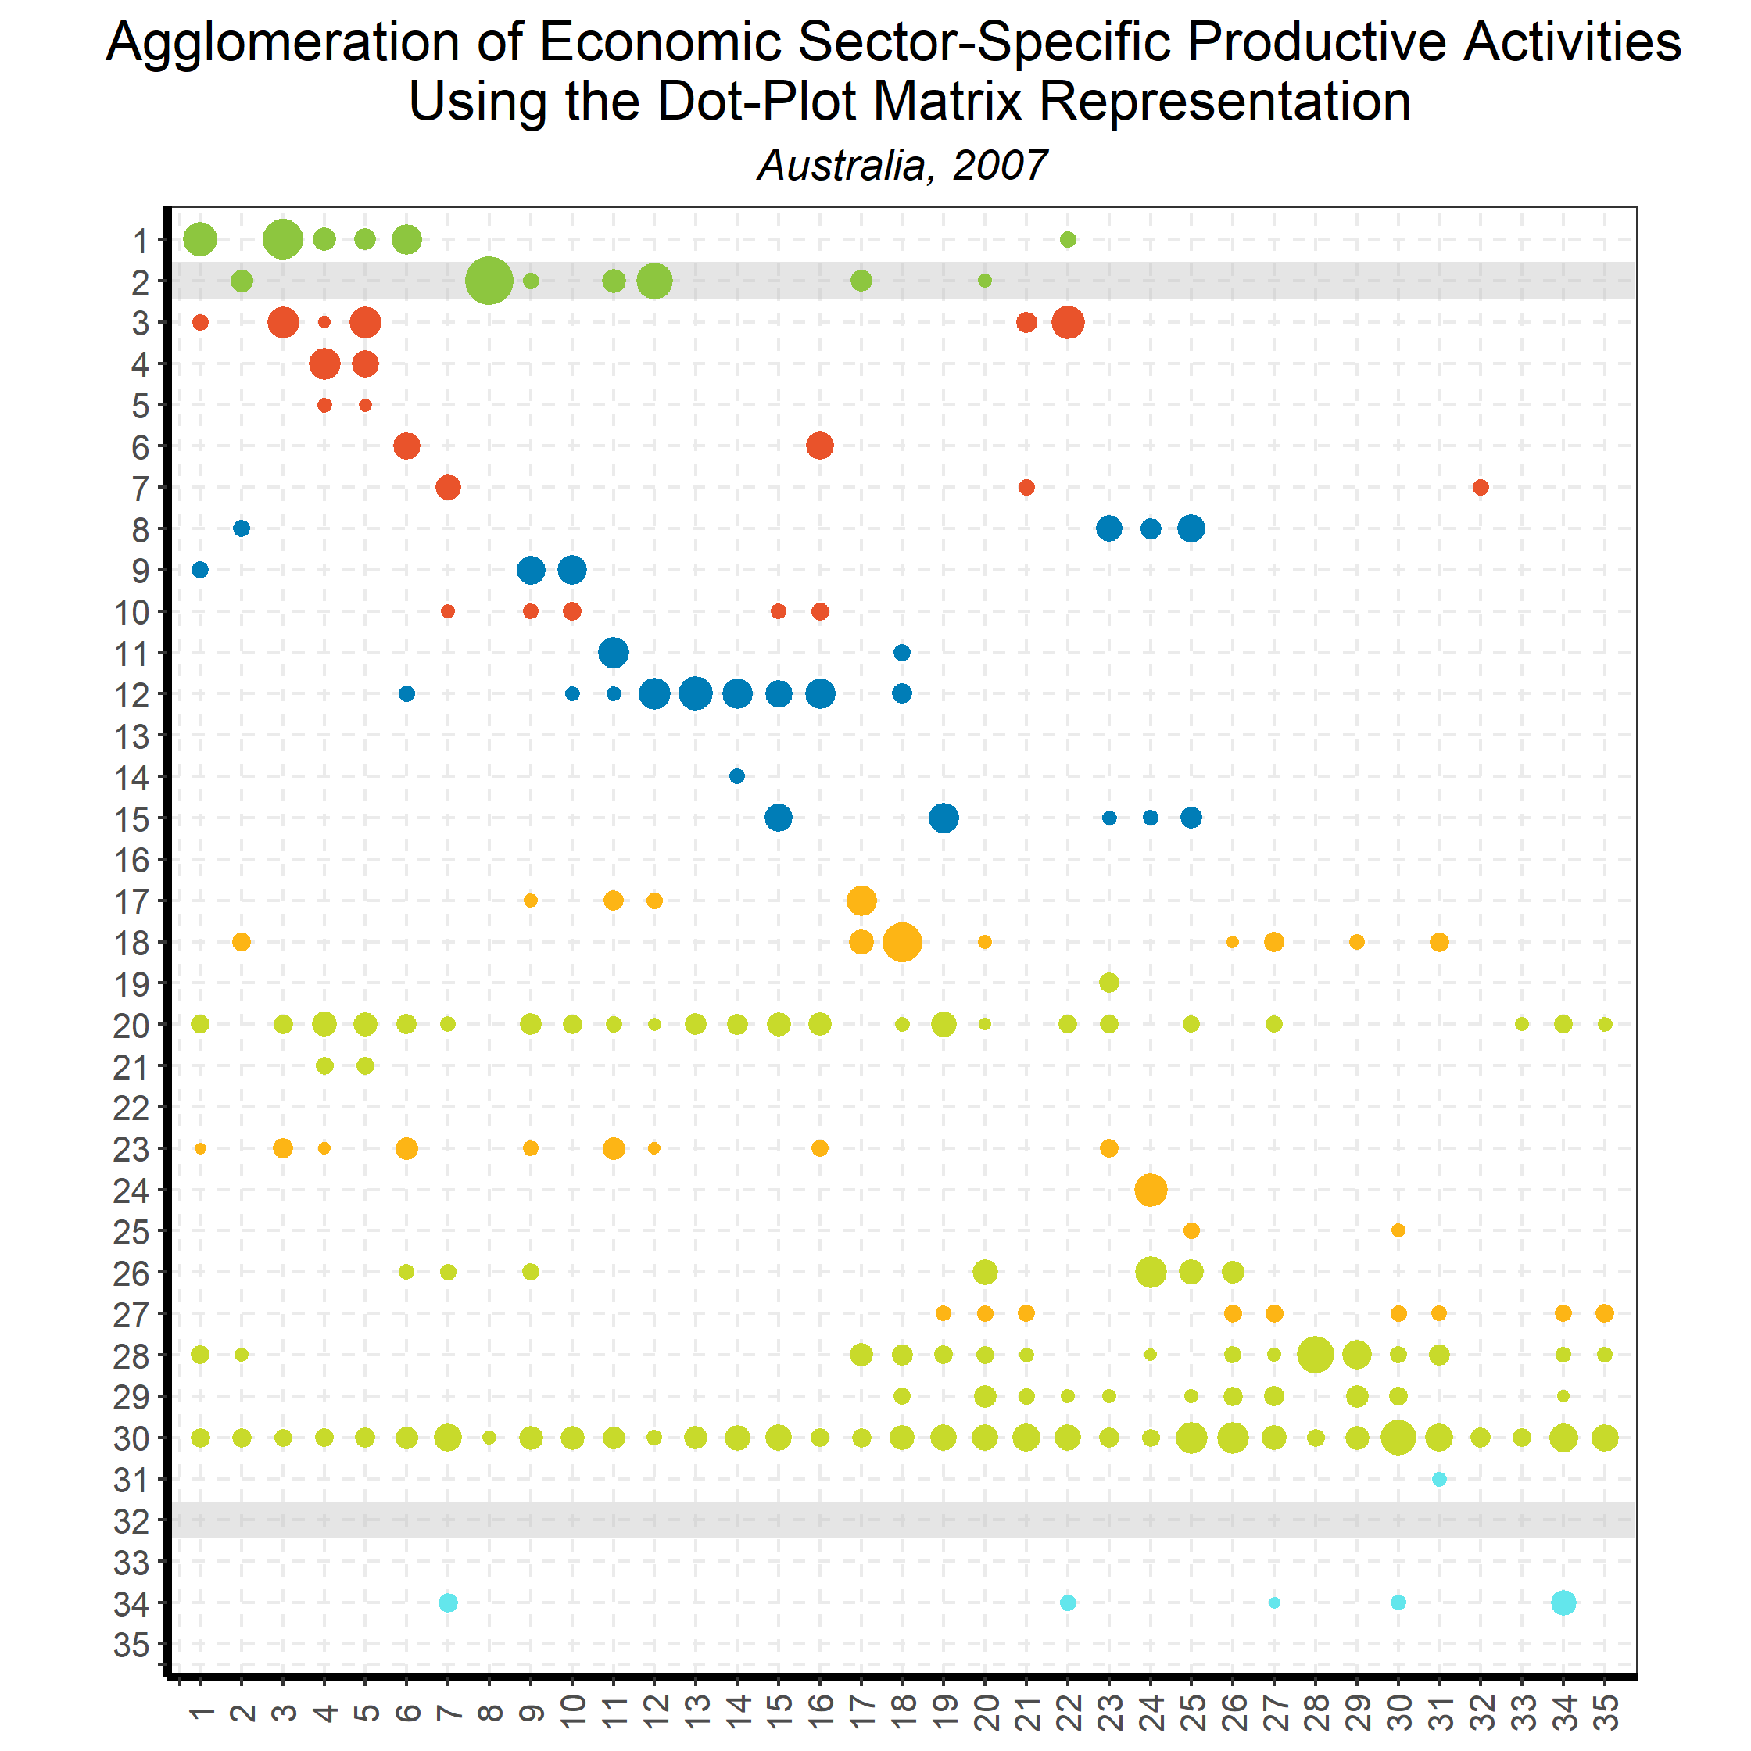
Linking Goods and Services:
Input-Output Direct Requirements
Back to country list

Slide 30
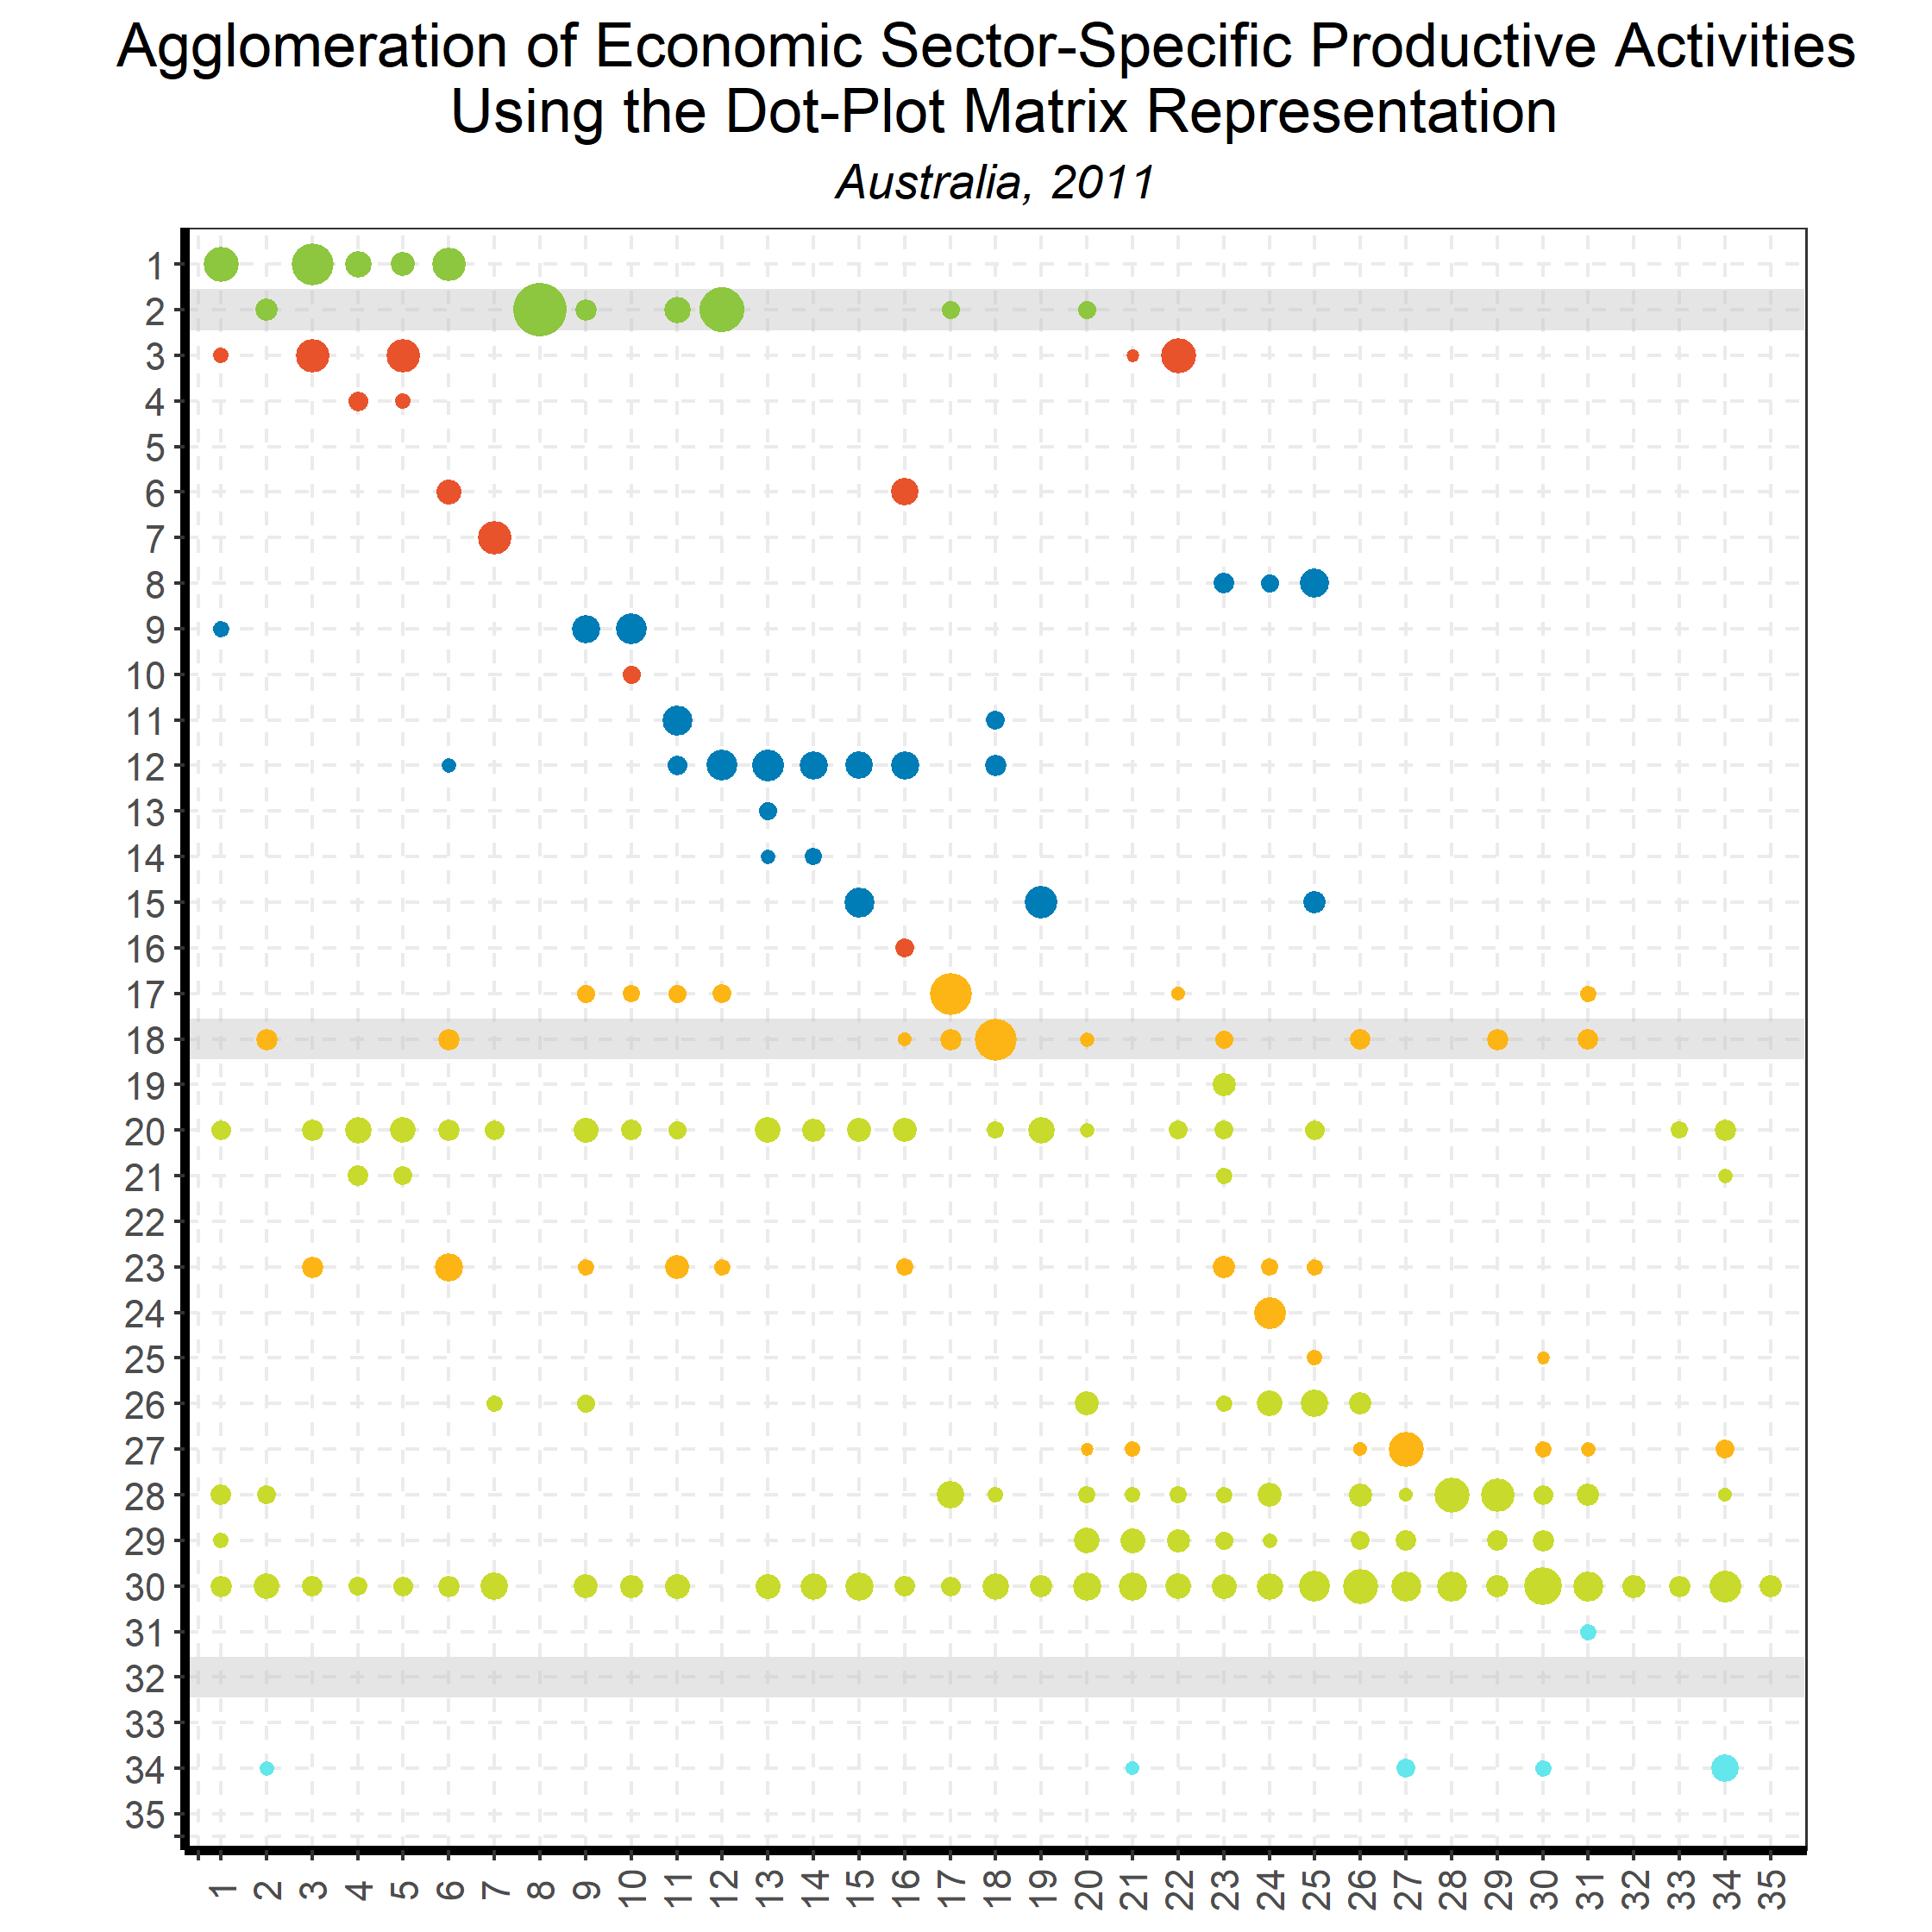
Linking Goods and Services:
Input-Output Direct Requirements
Back to country list

Slide 31
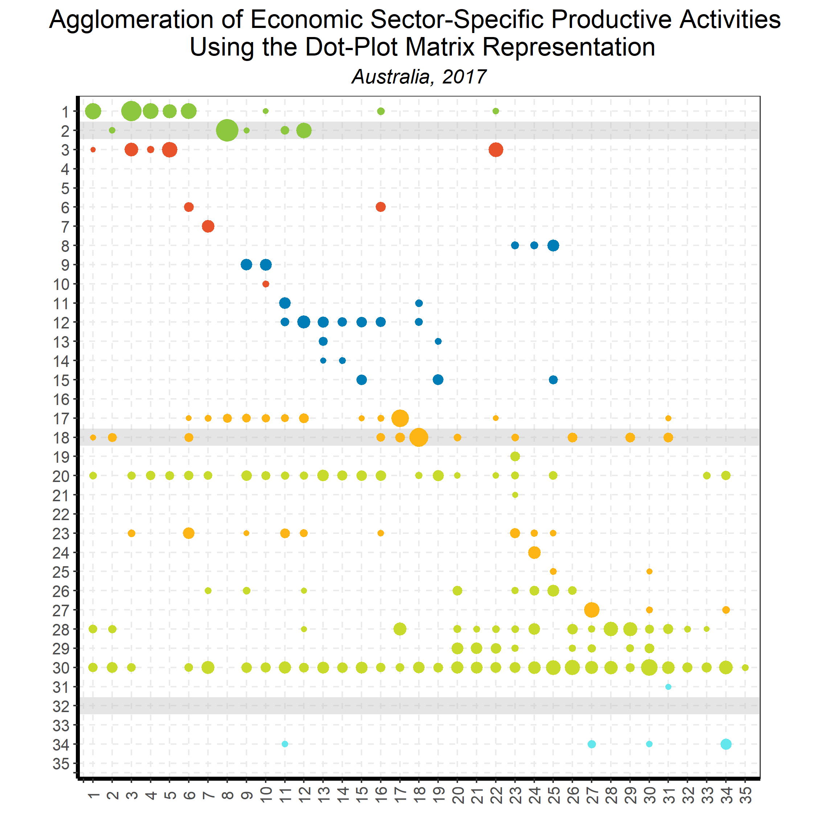
Linking Goods and Services:
Input-Output Direct Requirements
Back to country list

Slide 32
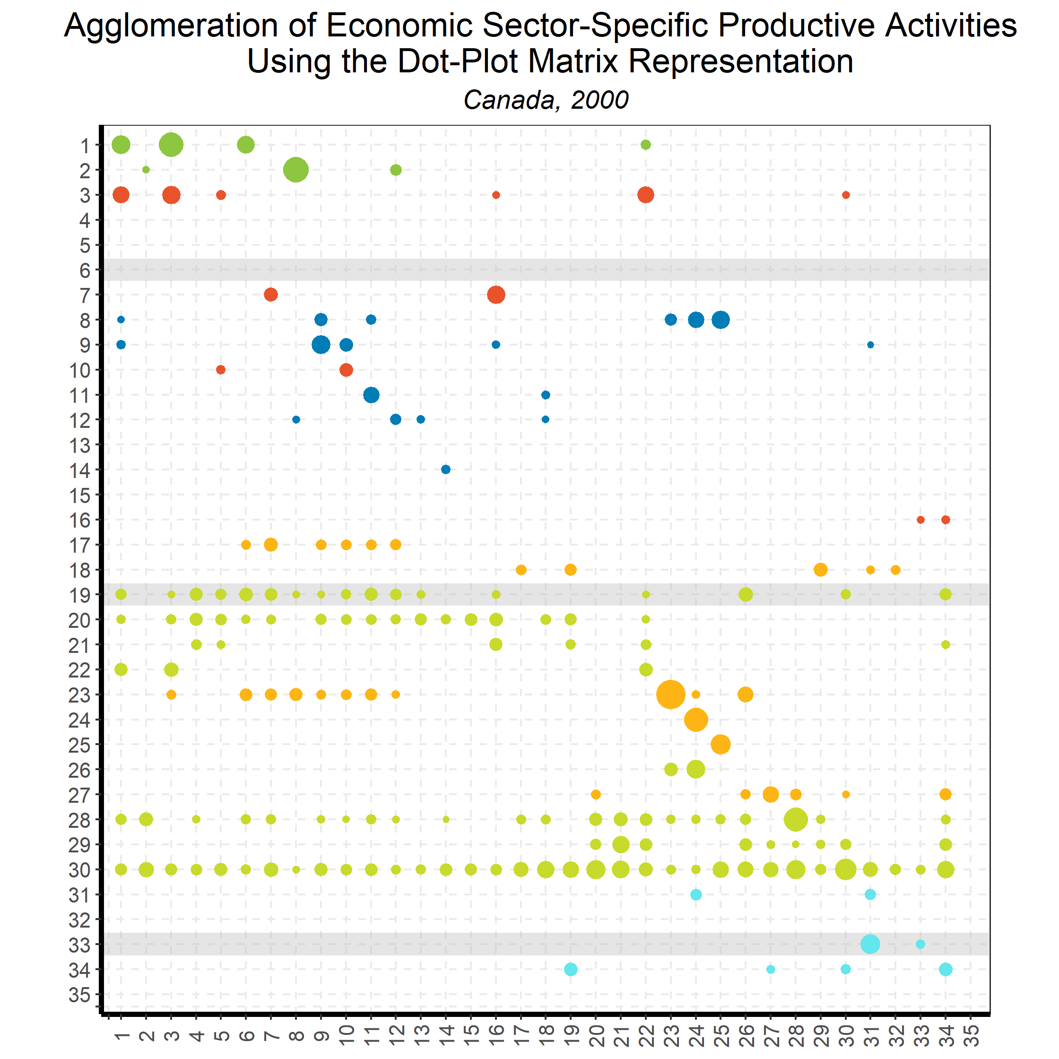
Linking Goods and Services:
Input-Output Direct Requirements
Back to country list

Slide 33
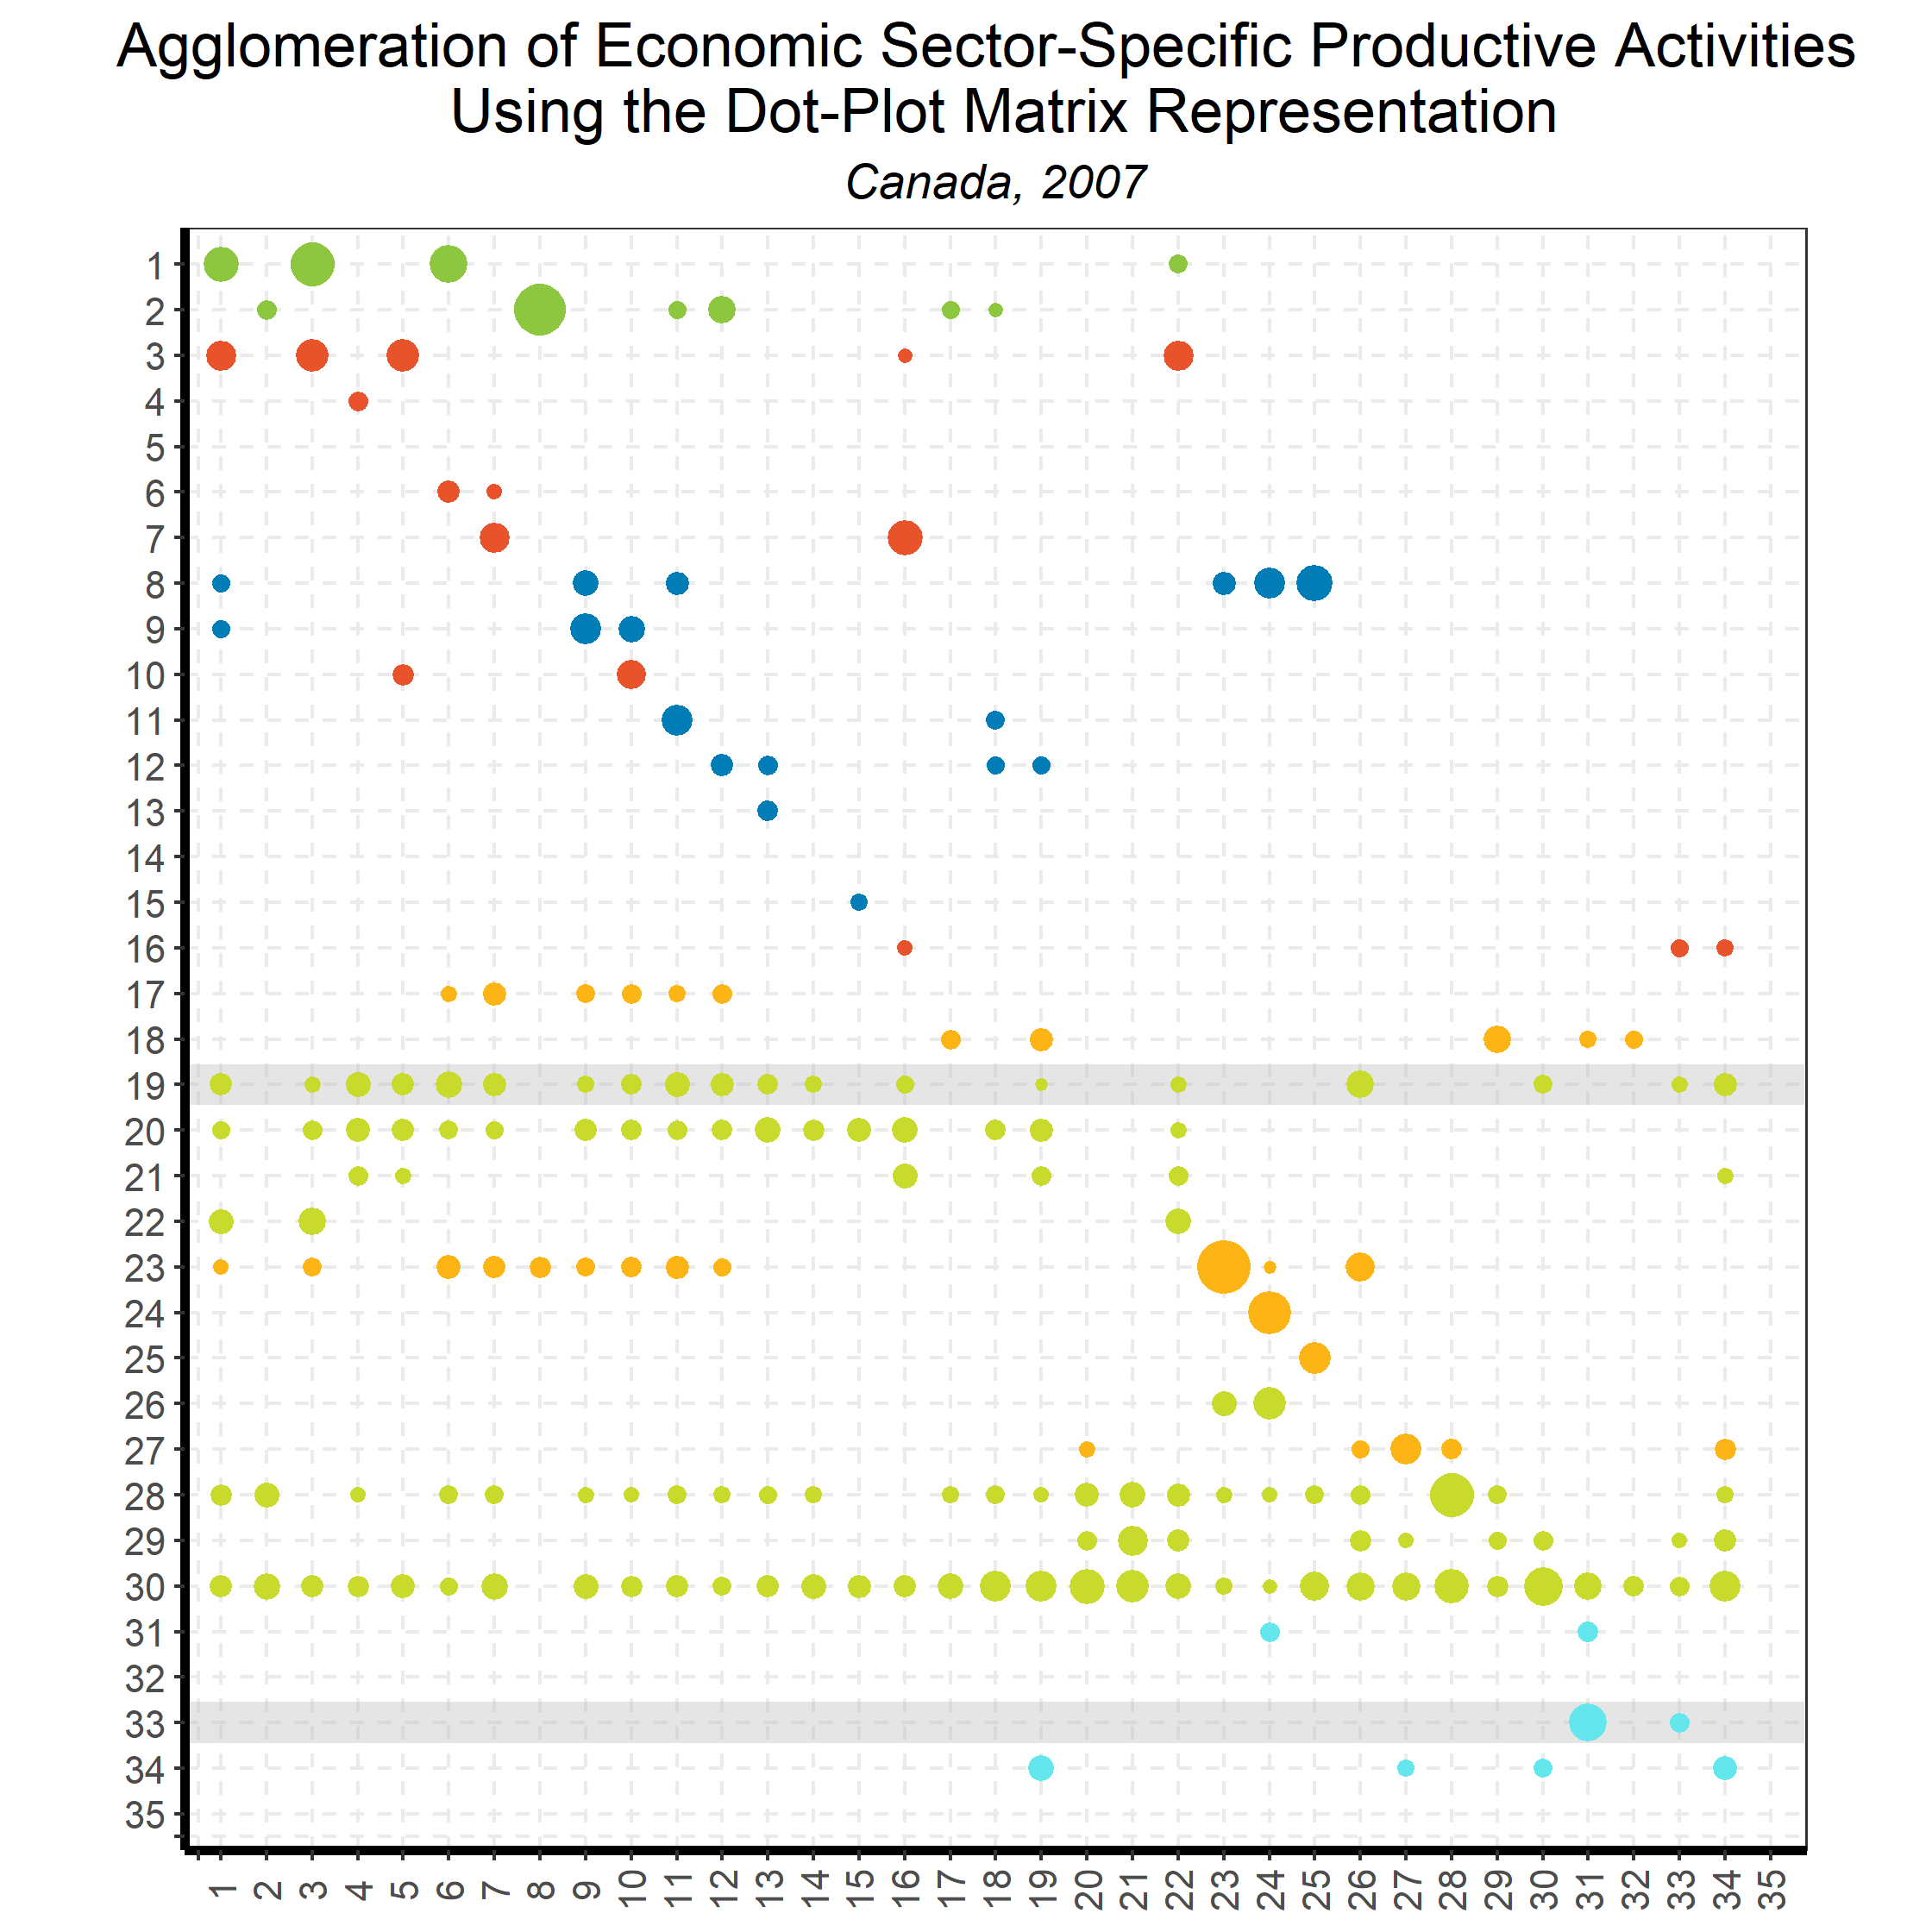
Linking Goods and Services:
Input-Output Direct Requirements
Back to country list

Slide 34
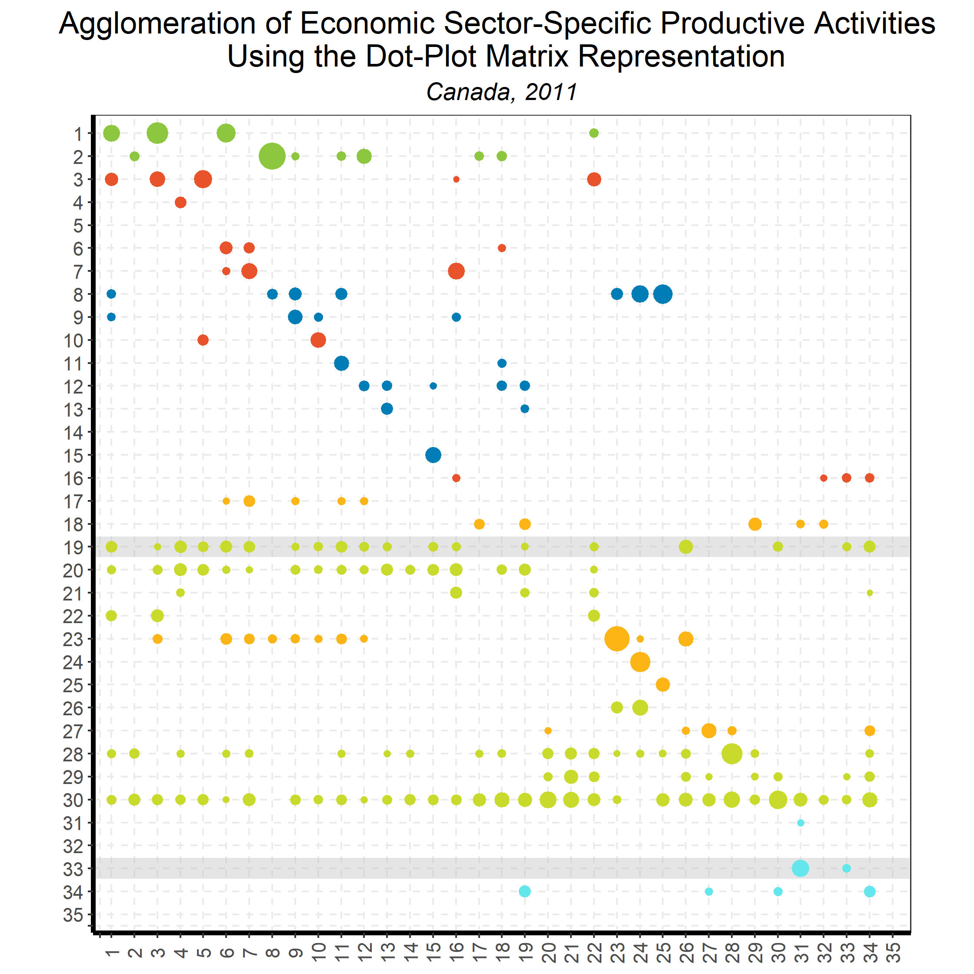
Linking Goods and Services:
Input-Output Direct Requirements
Back to country list

Slide 35
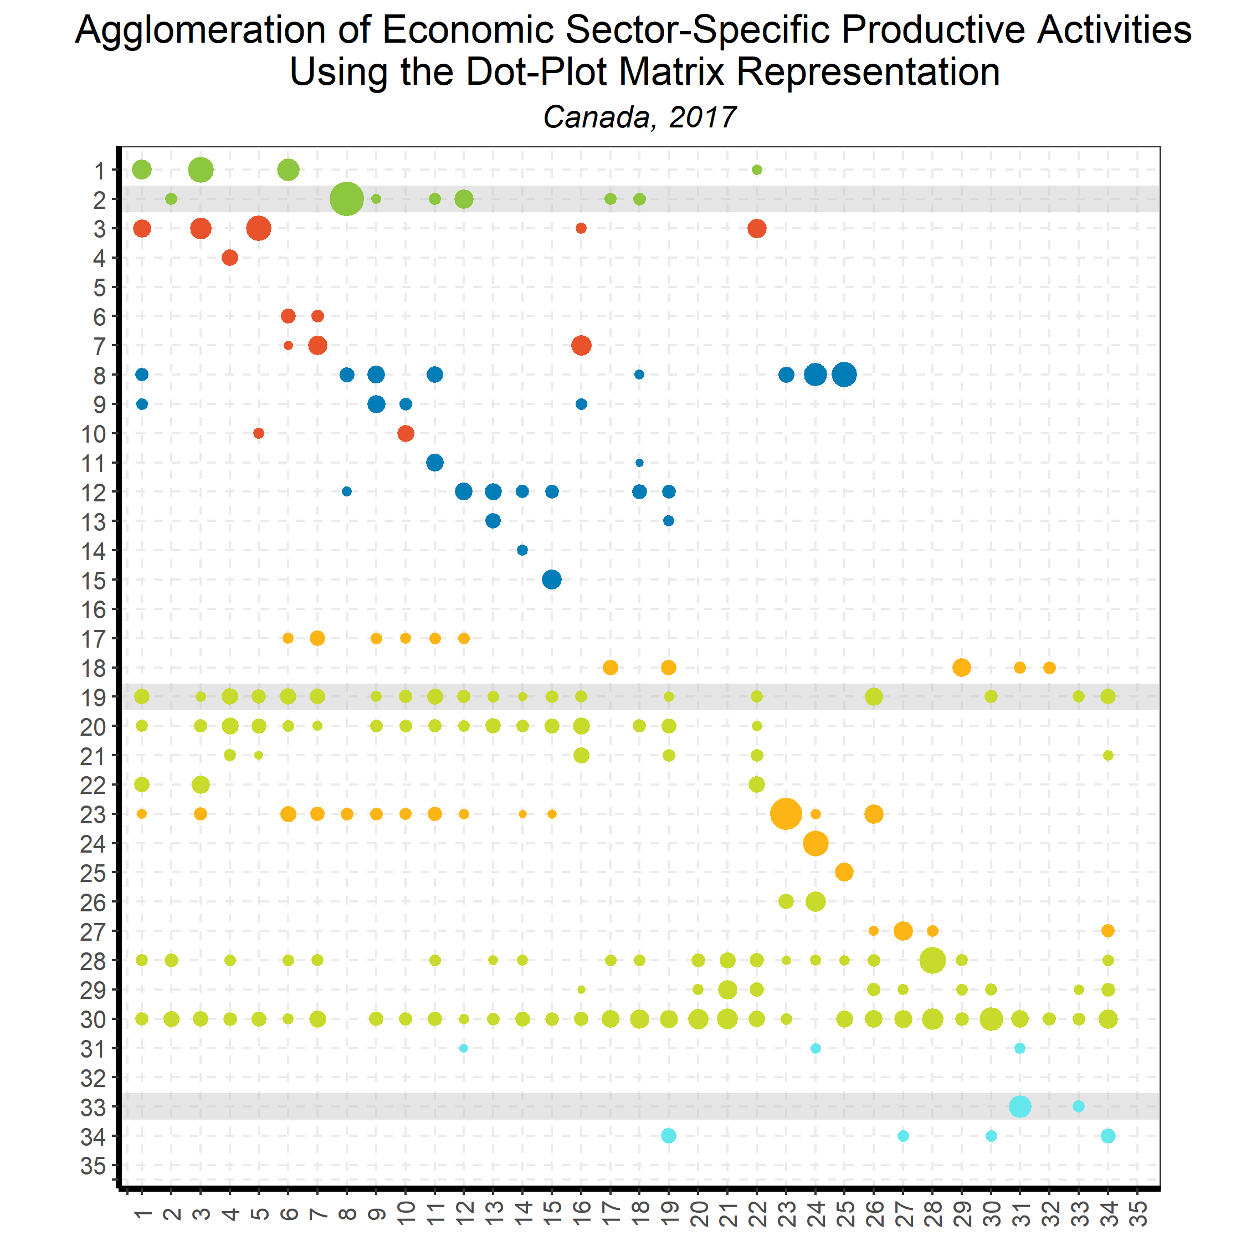
Linking Goods and Services:
Input-Output Direct Requirements
Back to country list

Slide 36
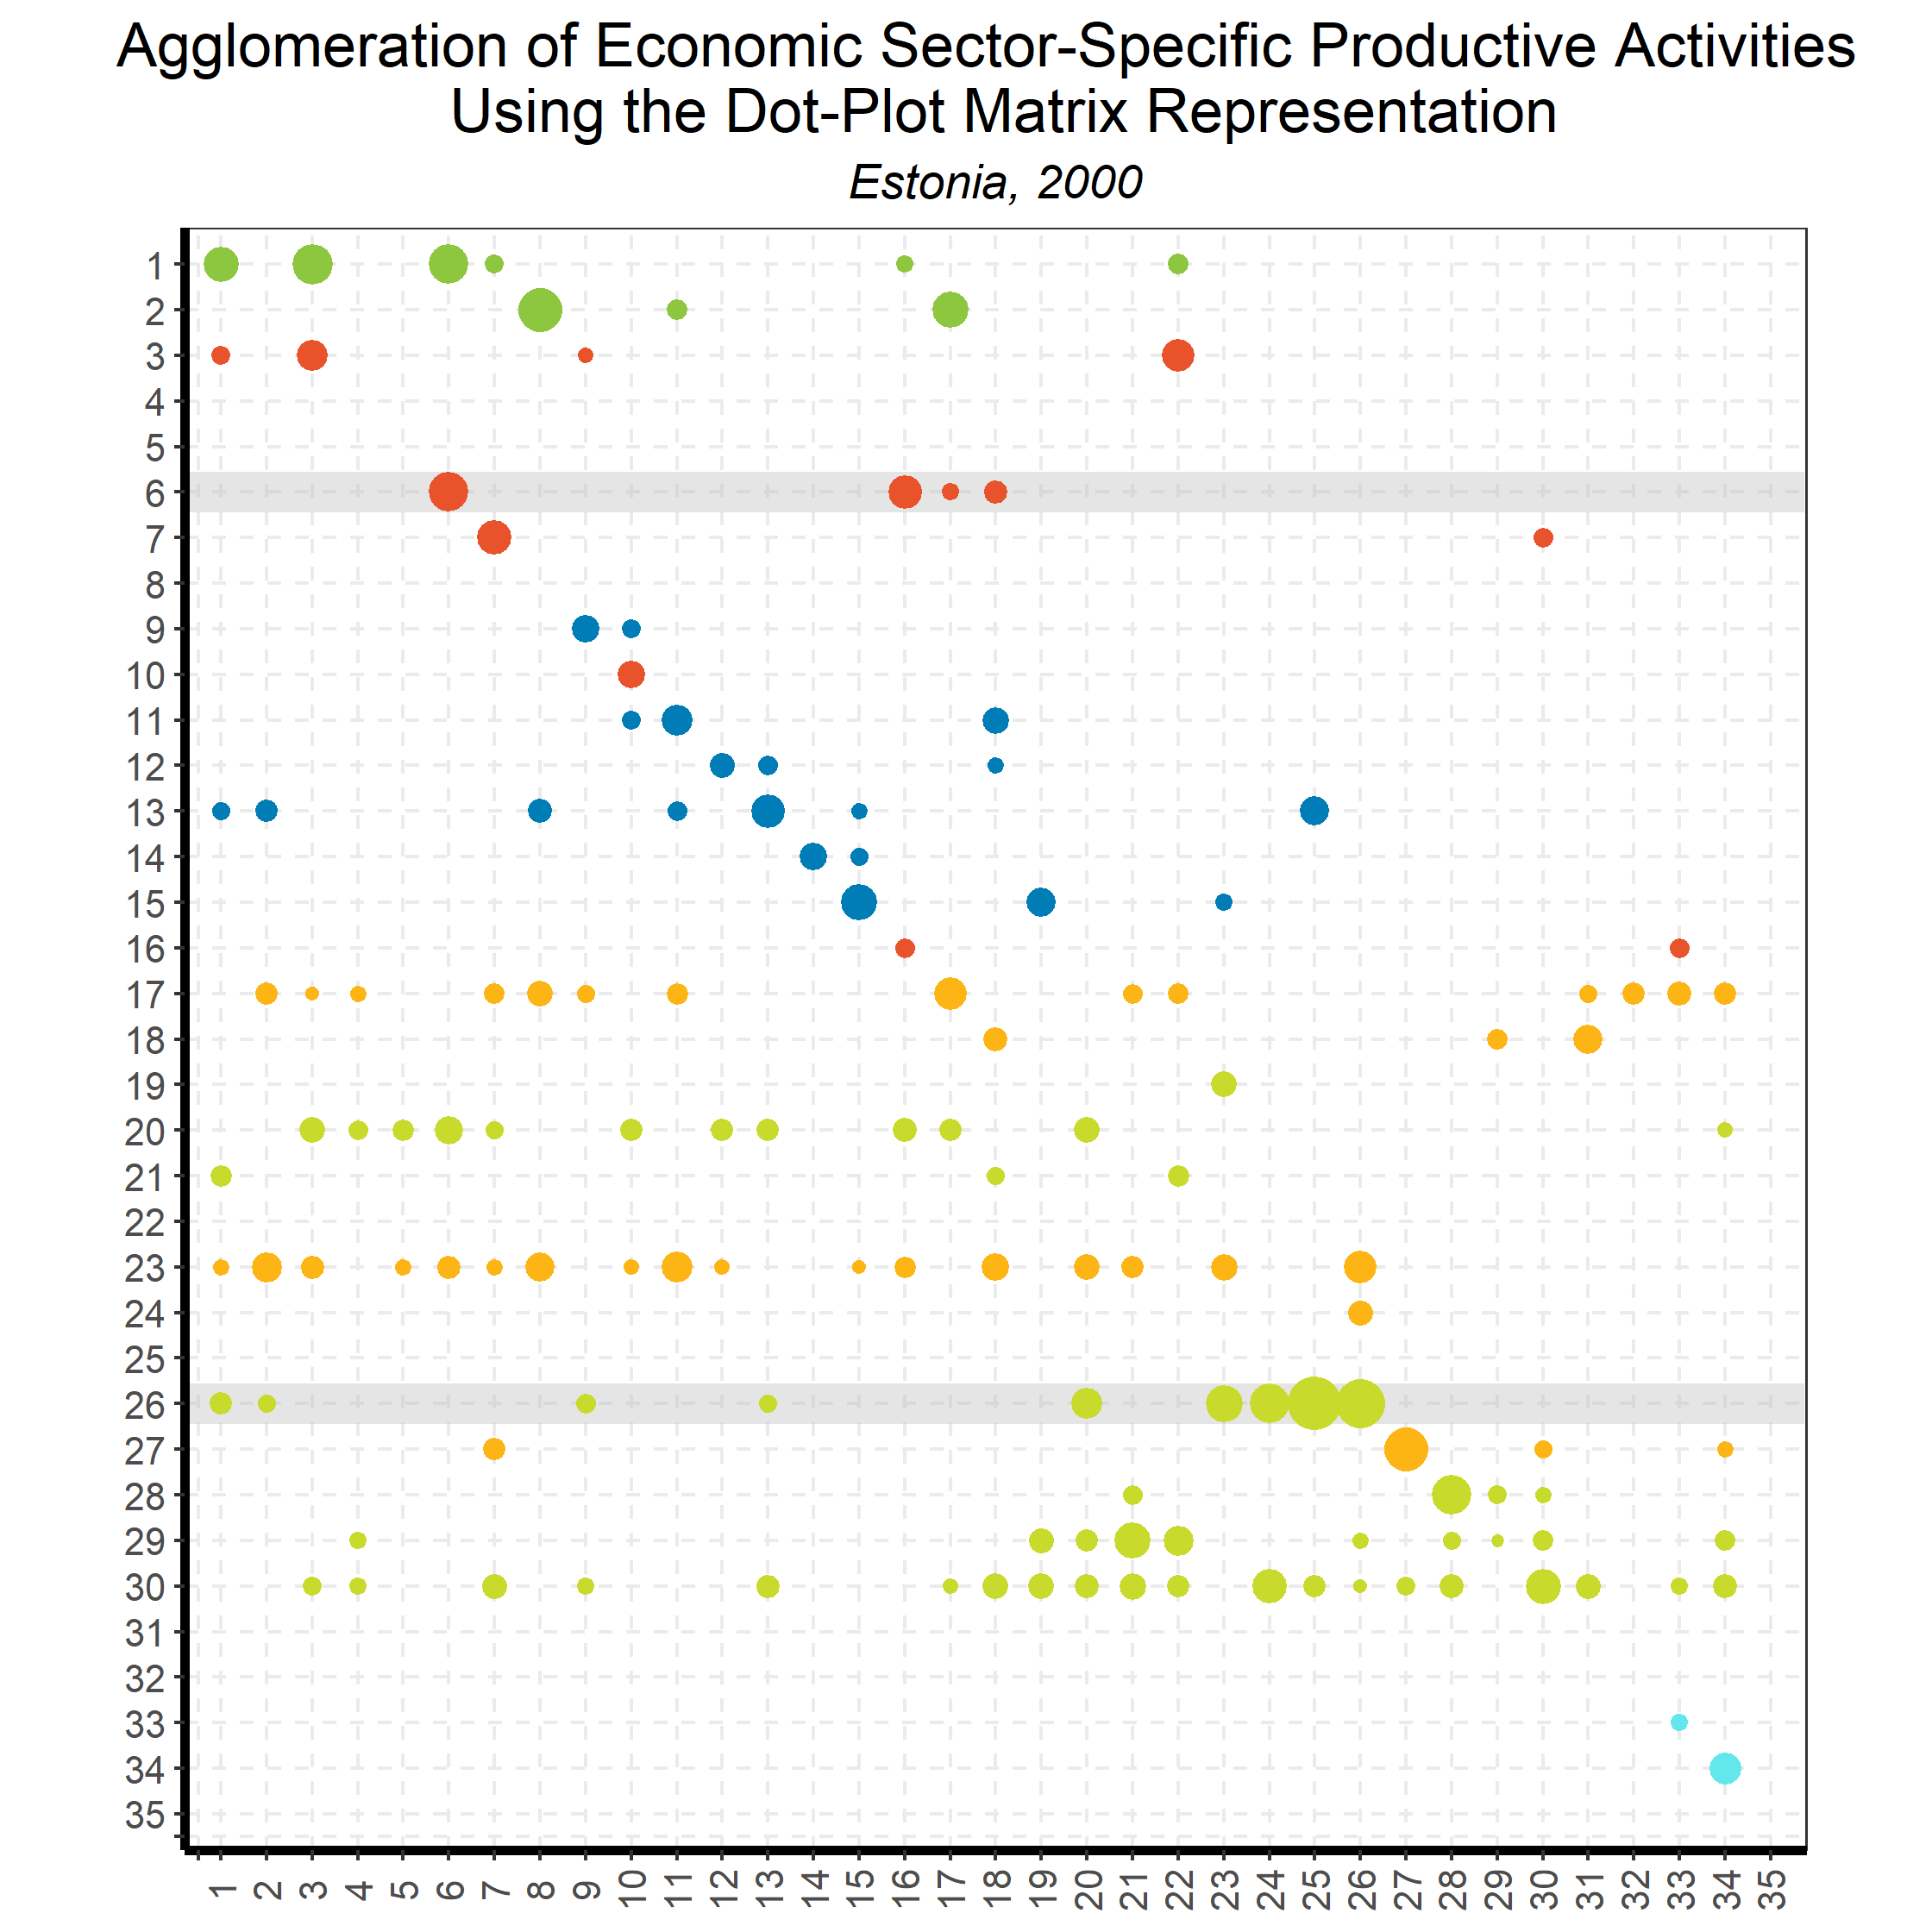
Linking Goods and Services:
Input-Output Direct Requirements
Back to country list

Slide 37
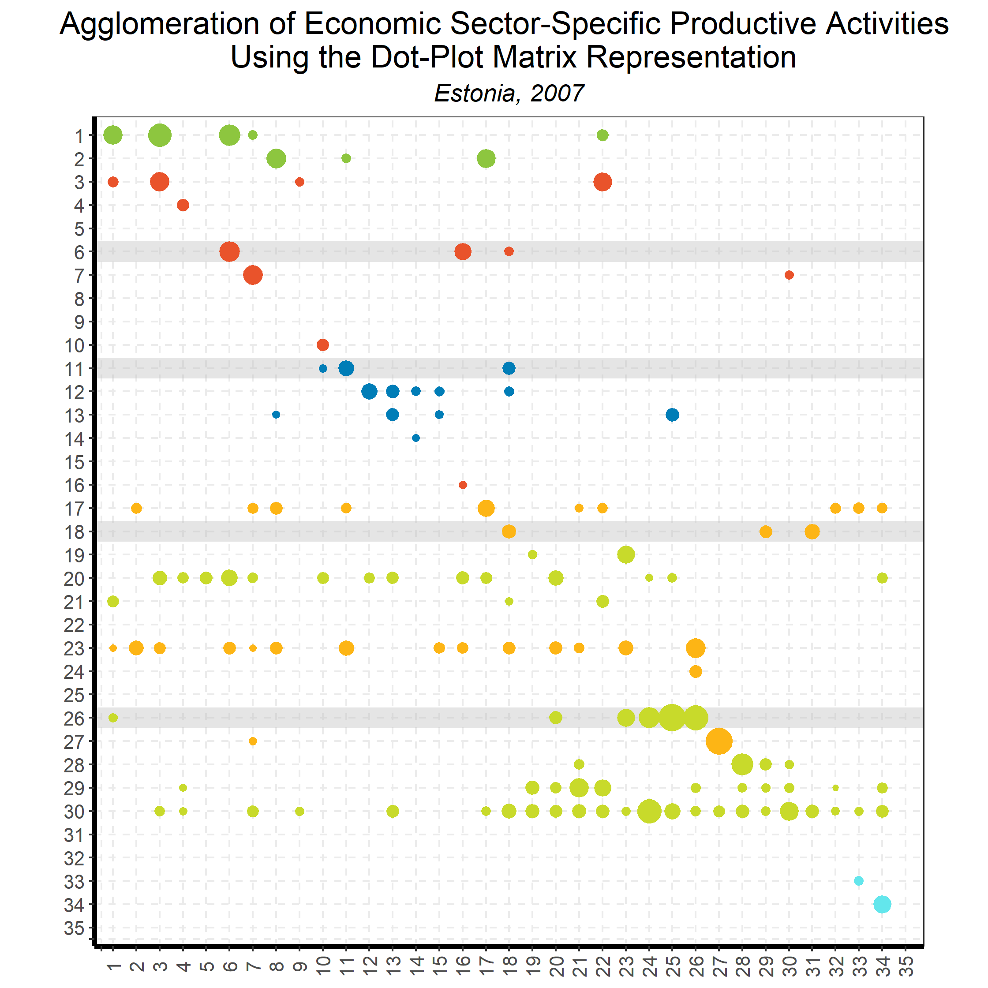
Linking Goods and Services:
Input-Output Direct Requirements
Back to country list

Slide 38
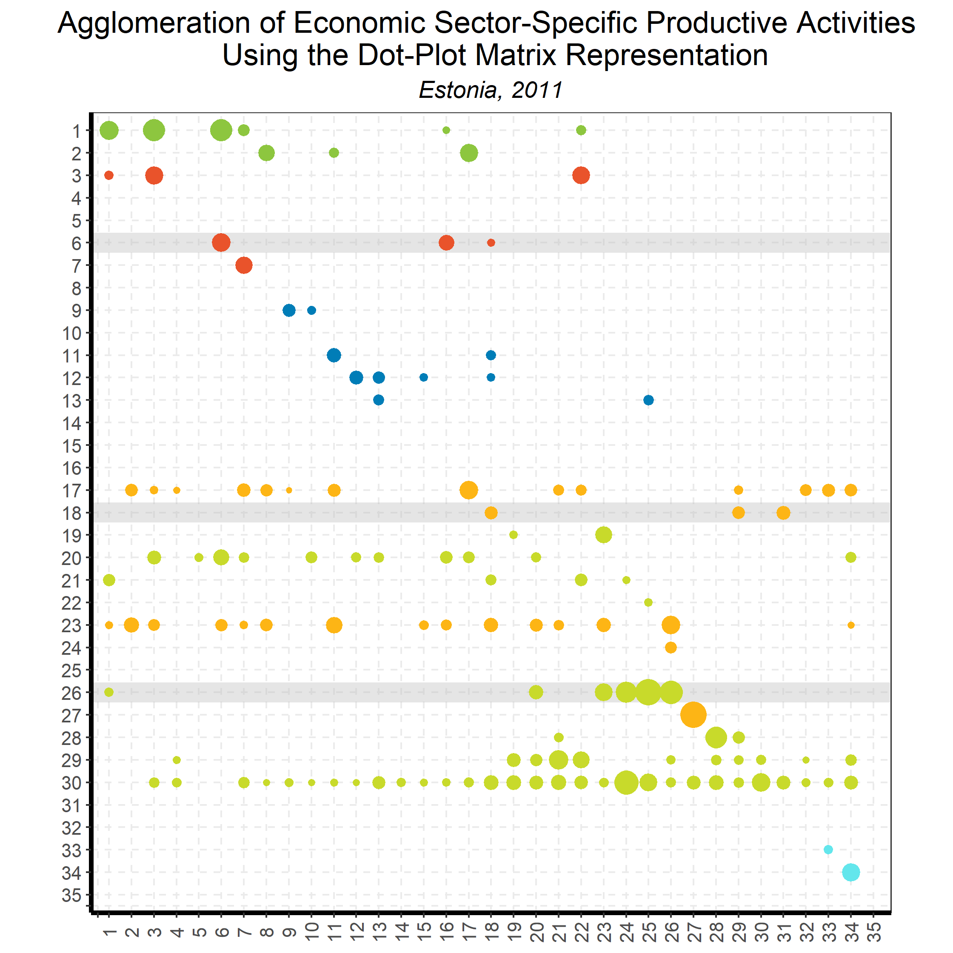
Linking Goods and Services:
Input-Output Direct Requirements
Back to country list

Slide 39
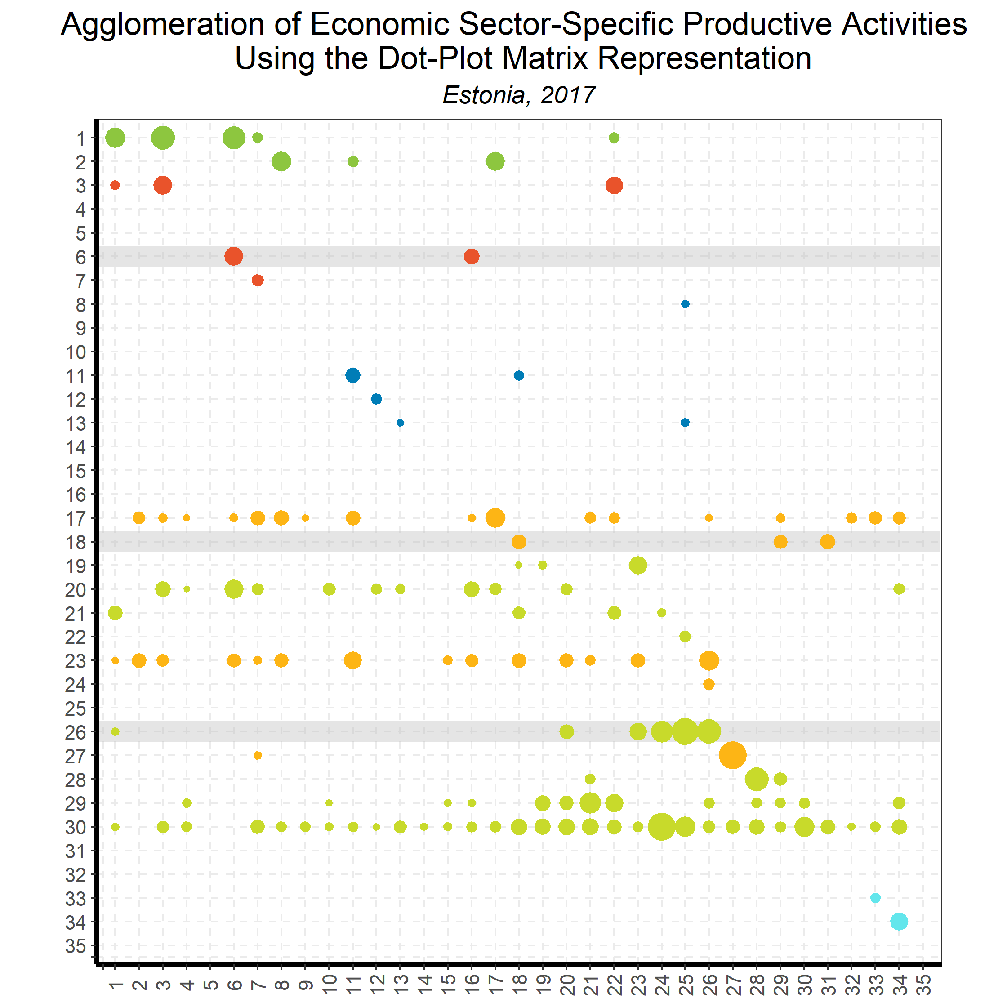
Linking Goods and Services:
Input-Output Direct Requirements
Back to country list

Slide 40
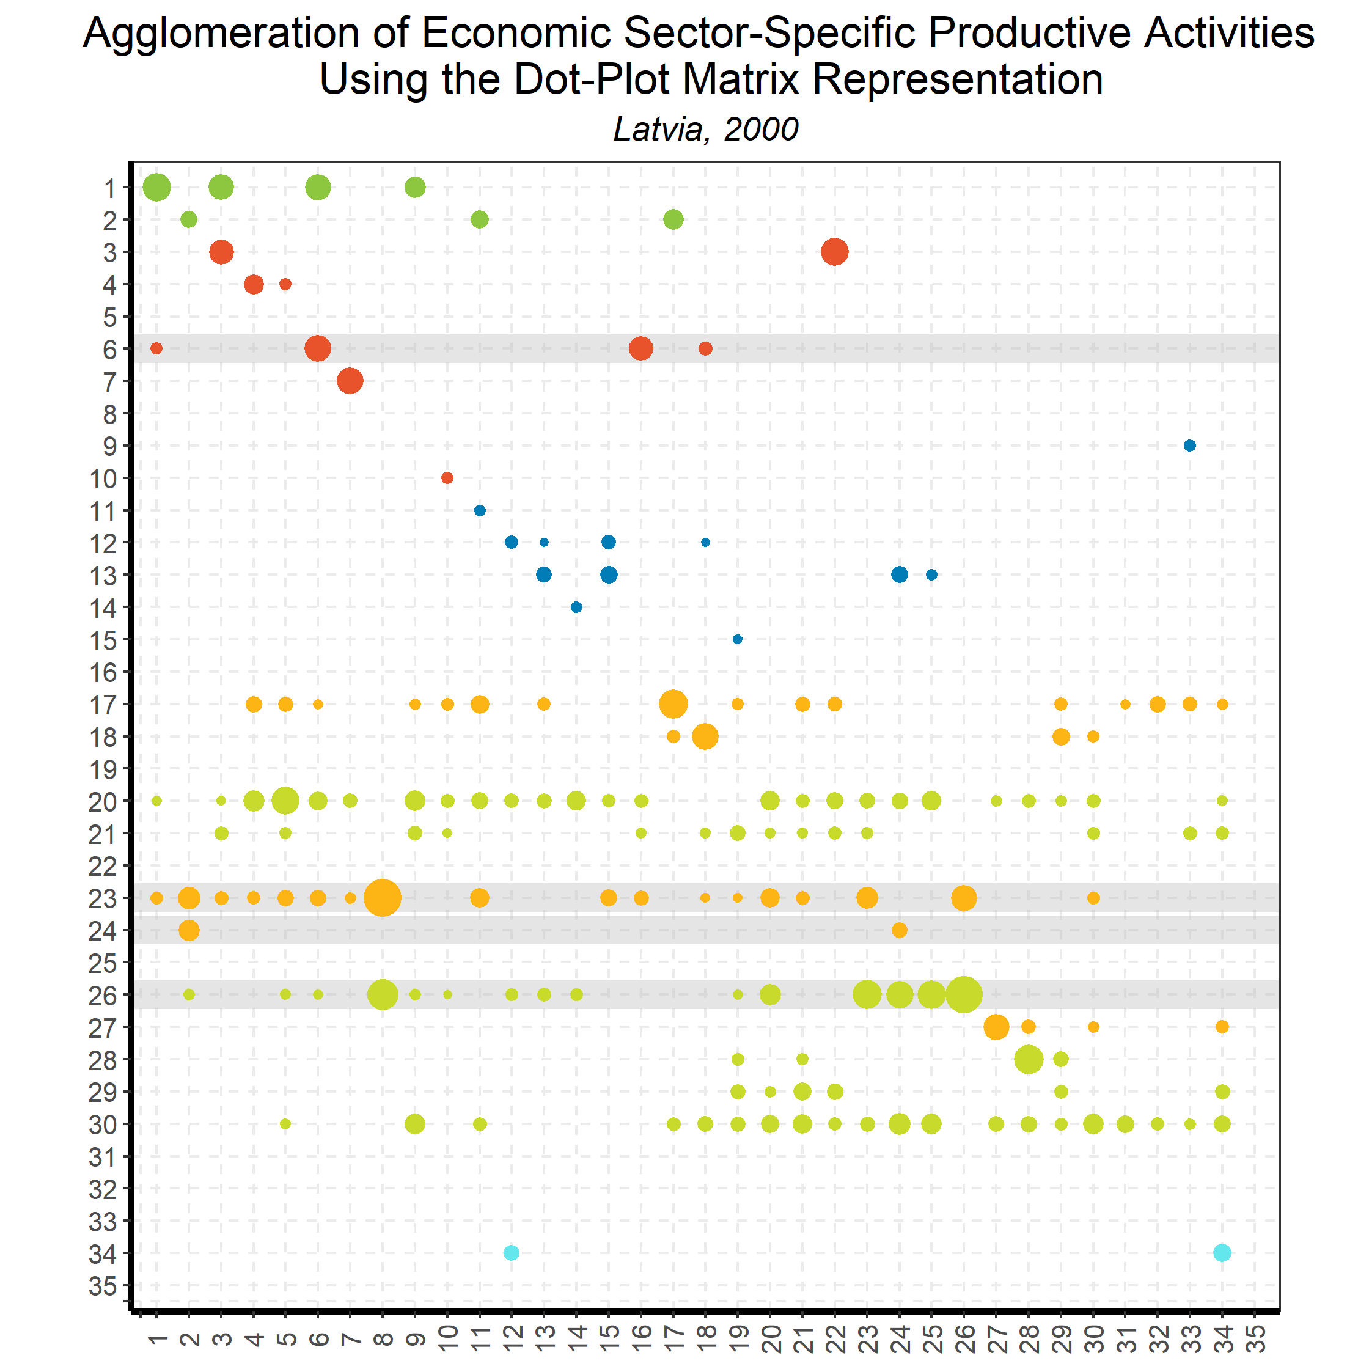
Linking Goods and Services:
Input-Output Direct Requirements
Back to country list

Slide 41
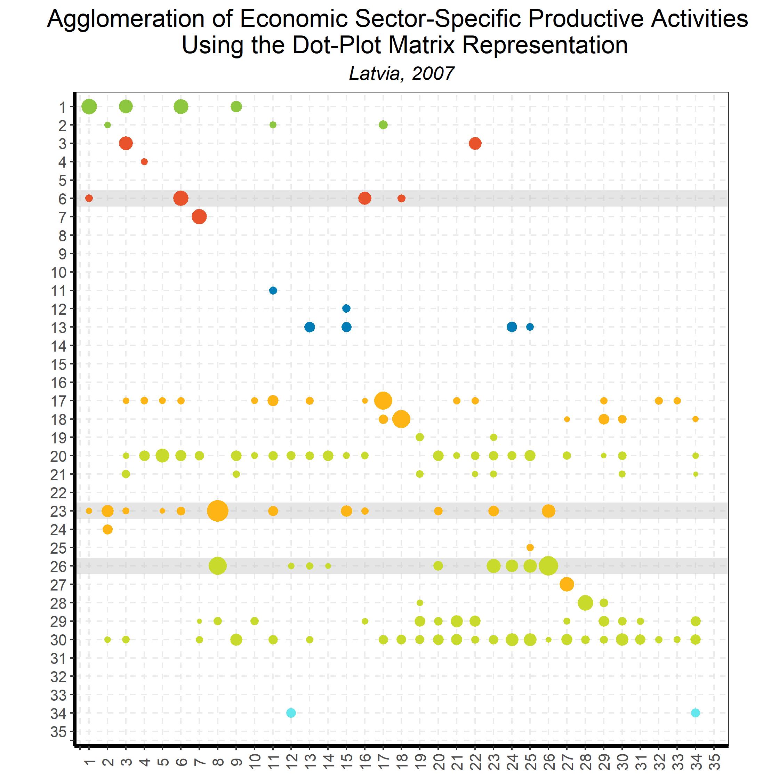
Linking Goods and Services:
Input-Output Direct Requirements
Back to country list

Slide 42
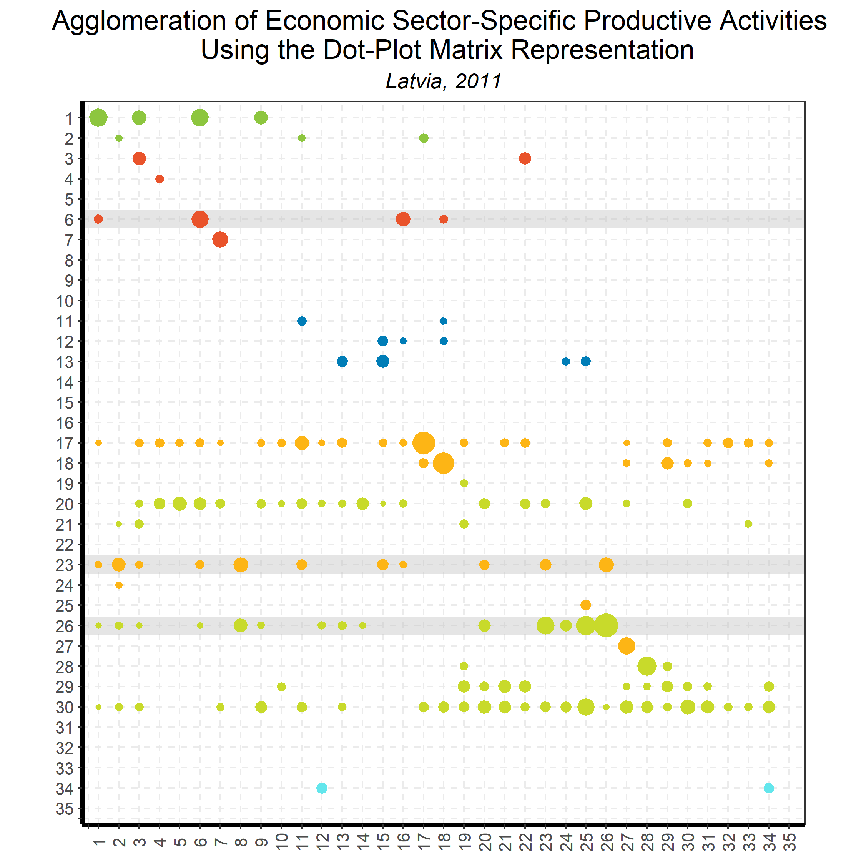
Linking Goods and Services:
Input-Output Direct Requirements
Back to country list

Slide 43
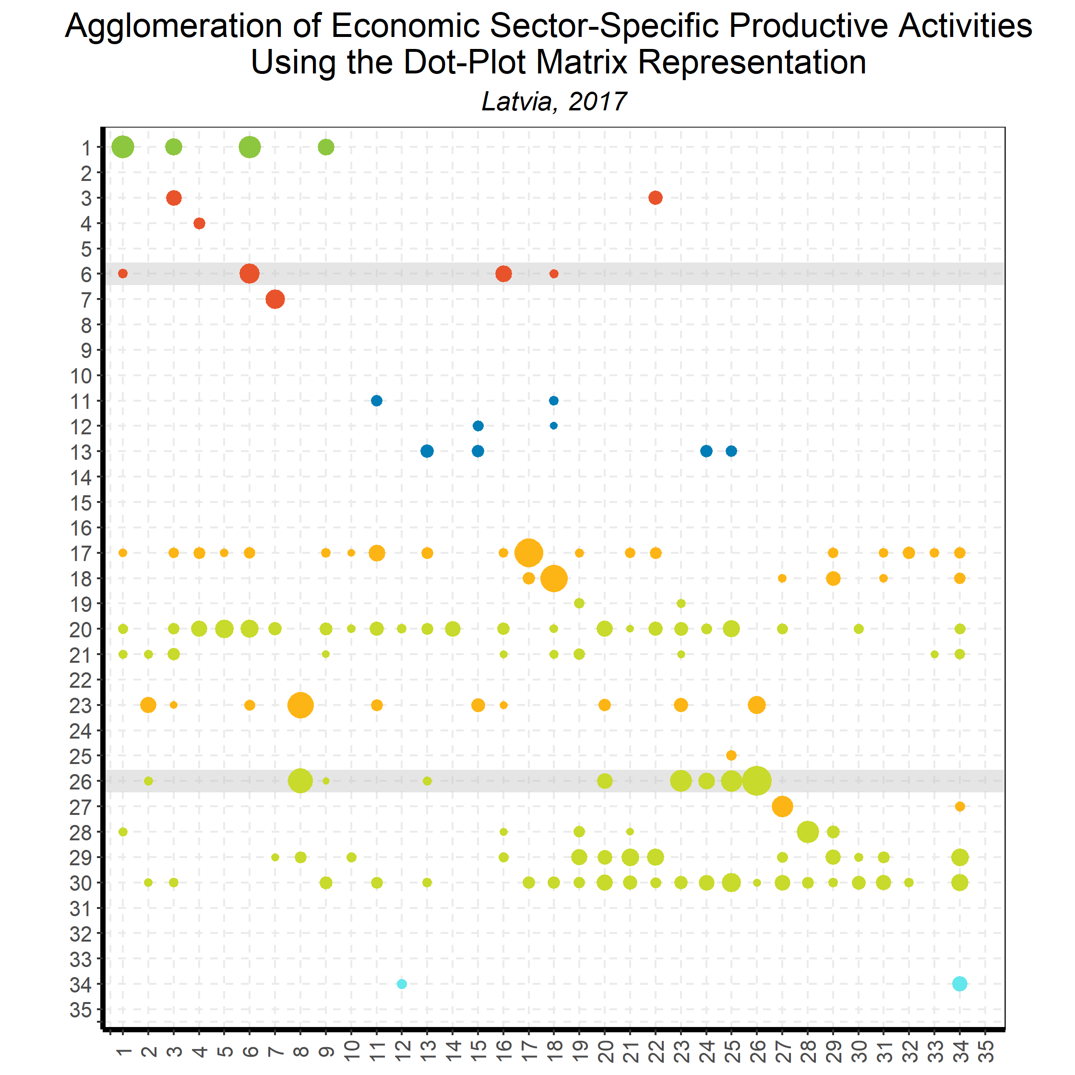
Linking Goods and Services:
Input-Output Direct Requirements
Back to country list

Slide 44
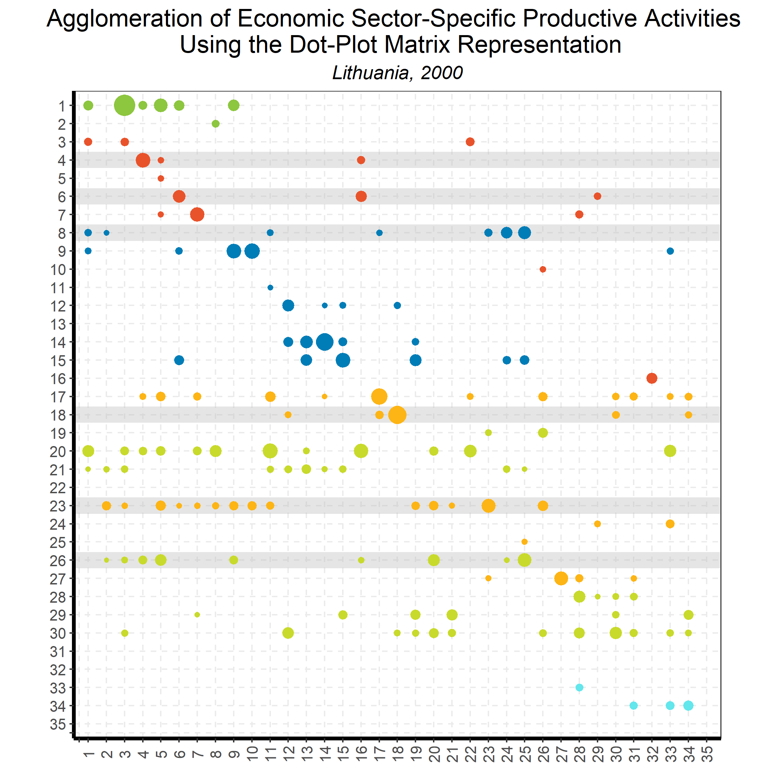
Linking Goods and Services:
Input-Output Direct Requirements
Back to country list

Slide 45
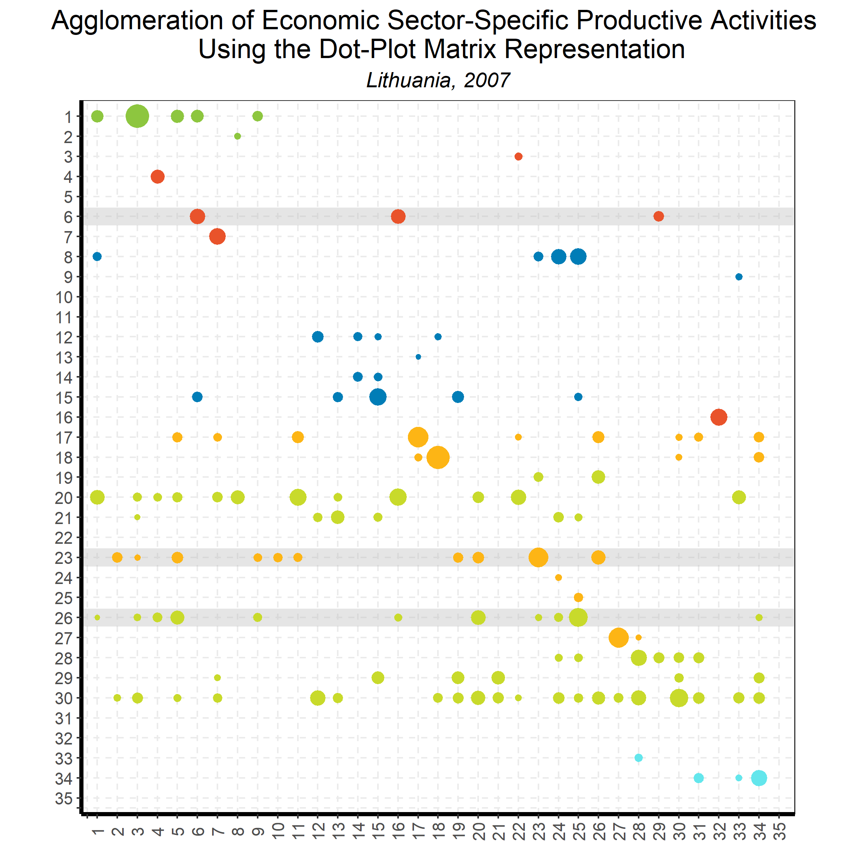
Linking Goods and Services:
Input-Output Direct Requirements
Back to country list

Slide 46
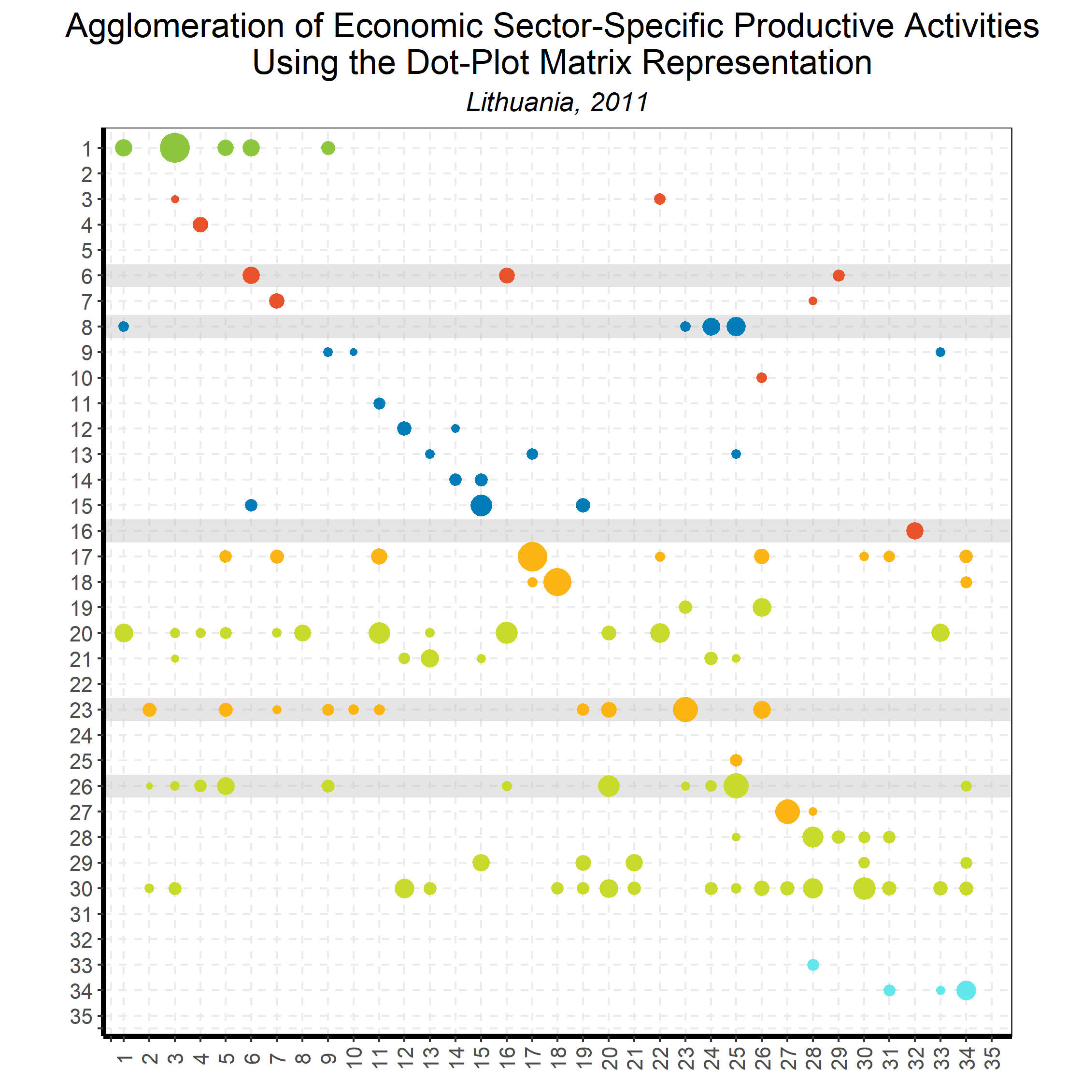
Linking Goods and Services:
Input-Output Direct Requirements
Back to country list

Slide 47
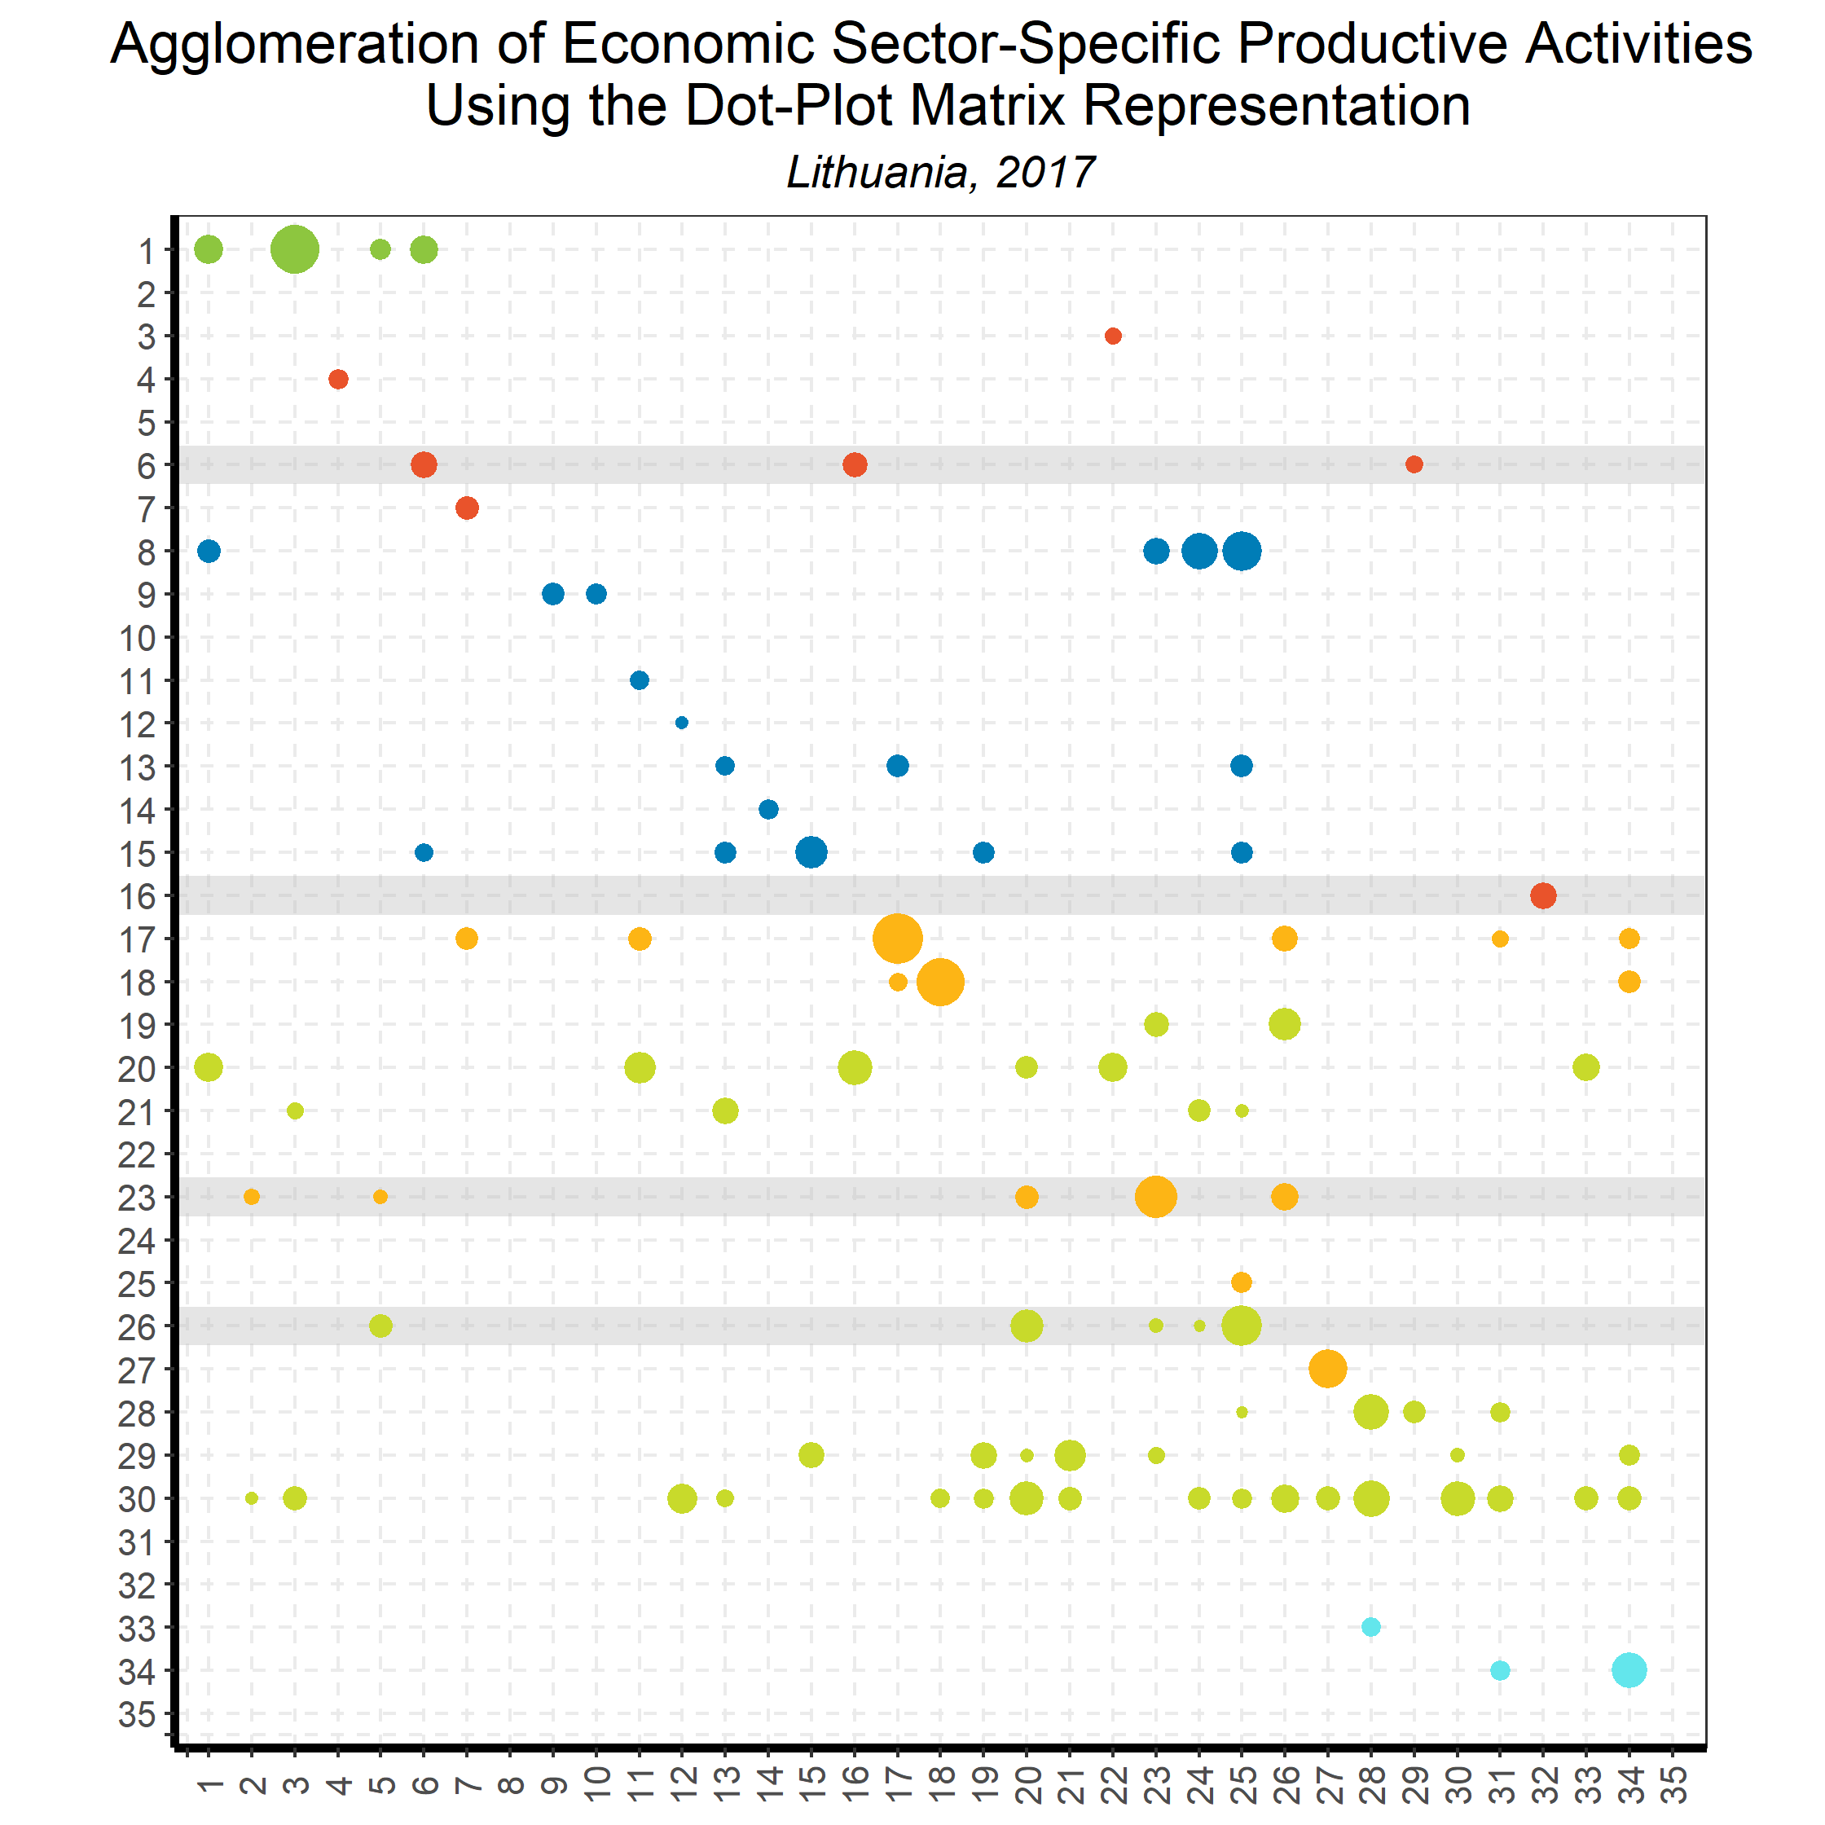
Linking Goods and Services:
Input-Output Direct Requirements
Back to country list

Slide 48
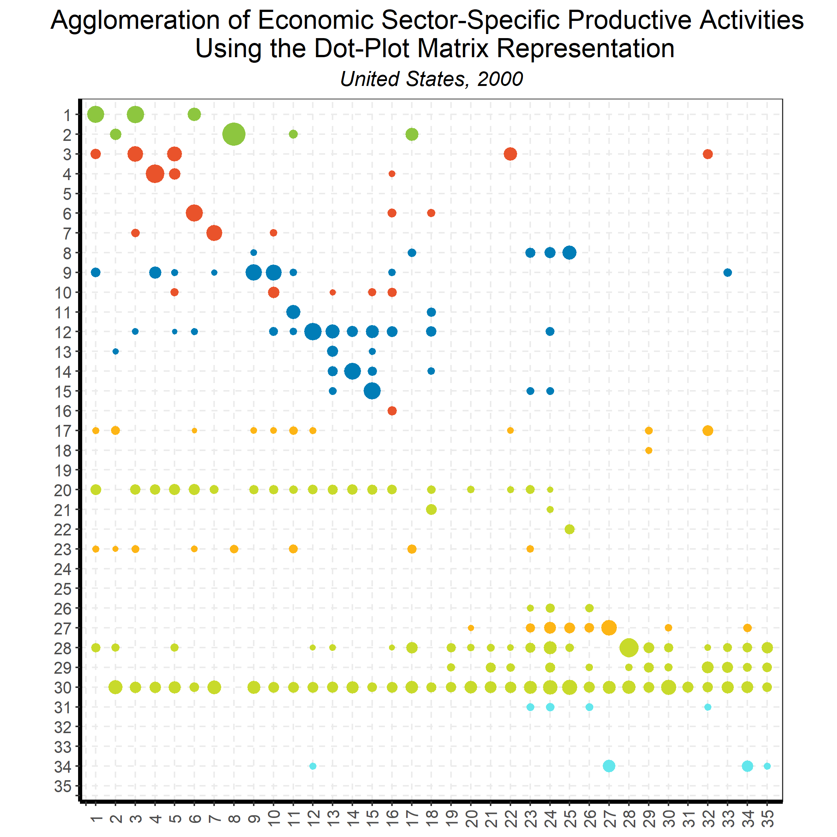
Linking Goods and Services:
Input-Output Direct Requirements
Back to country list

Slide 49
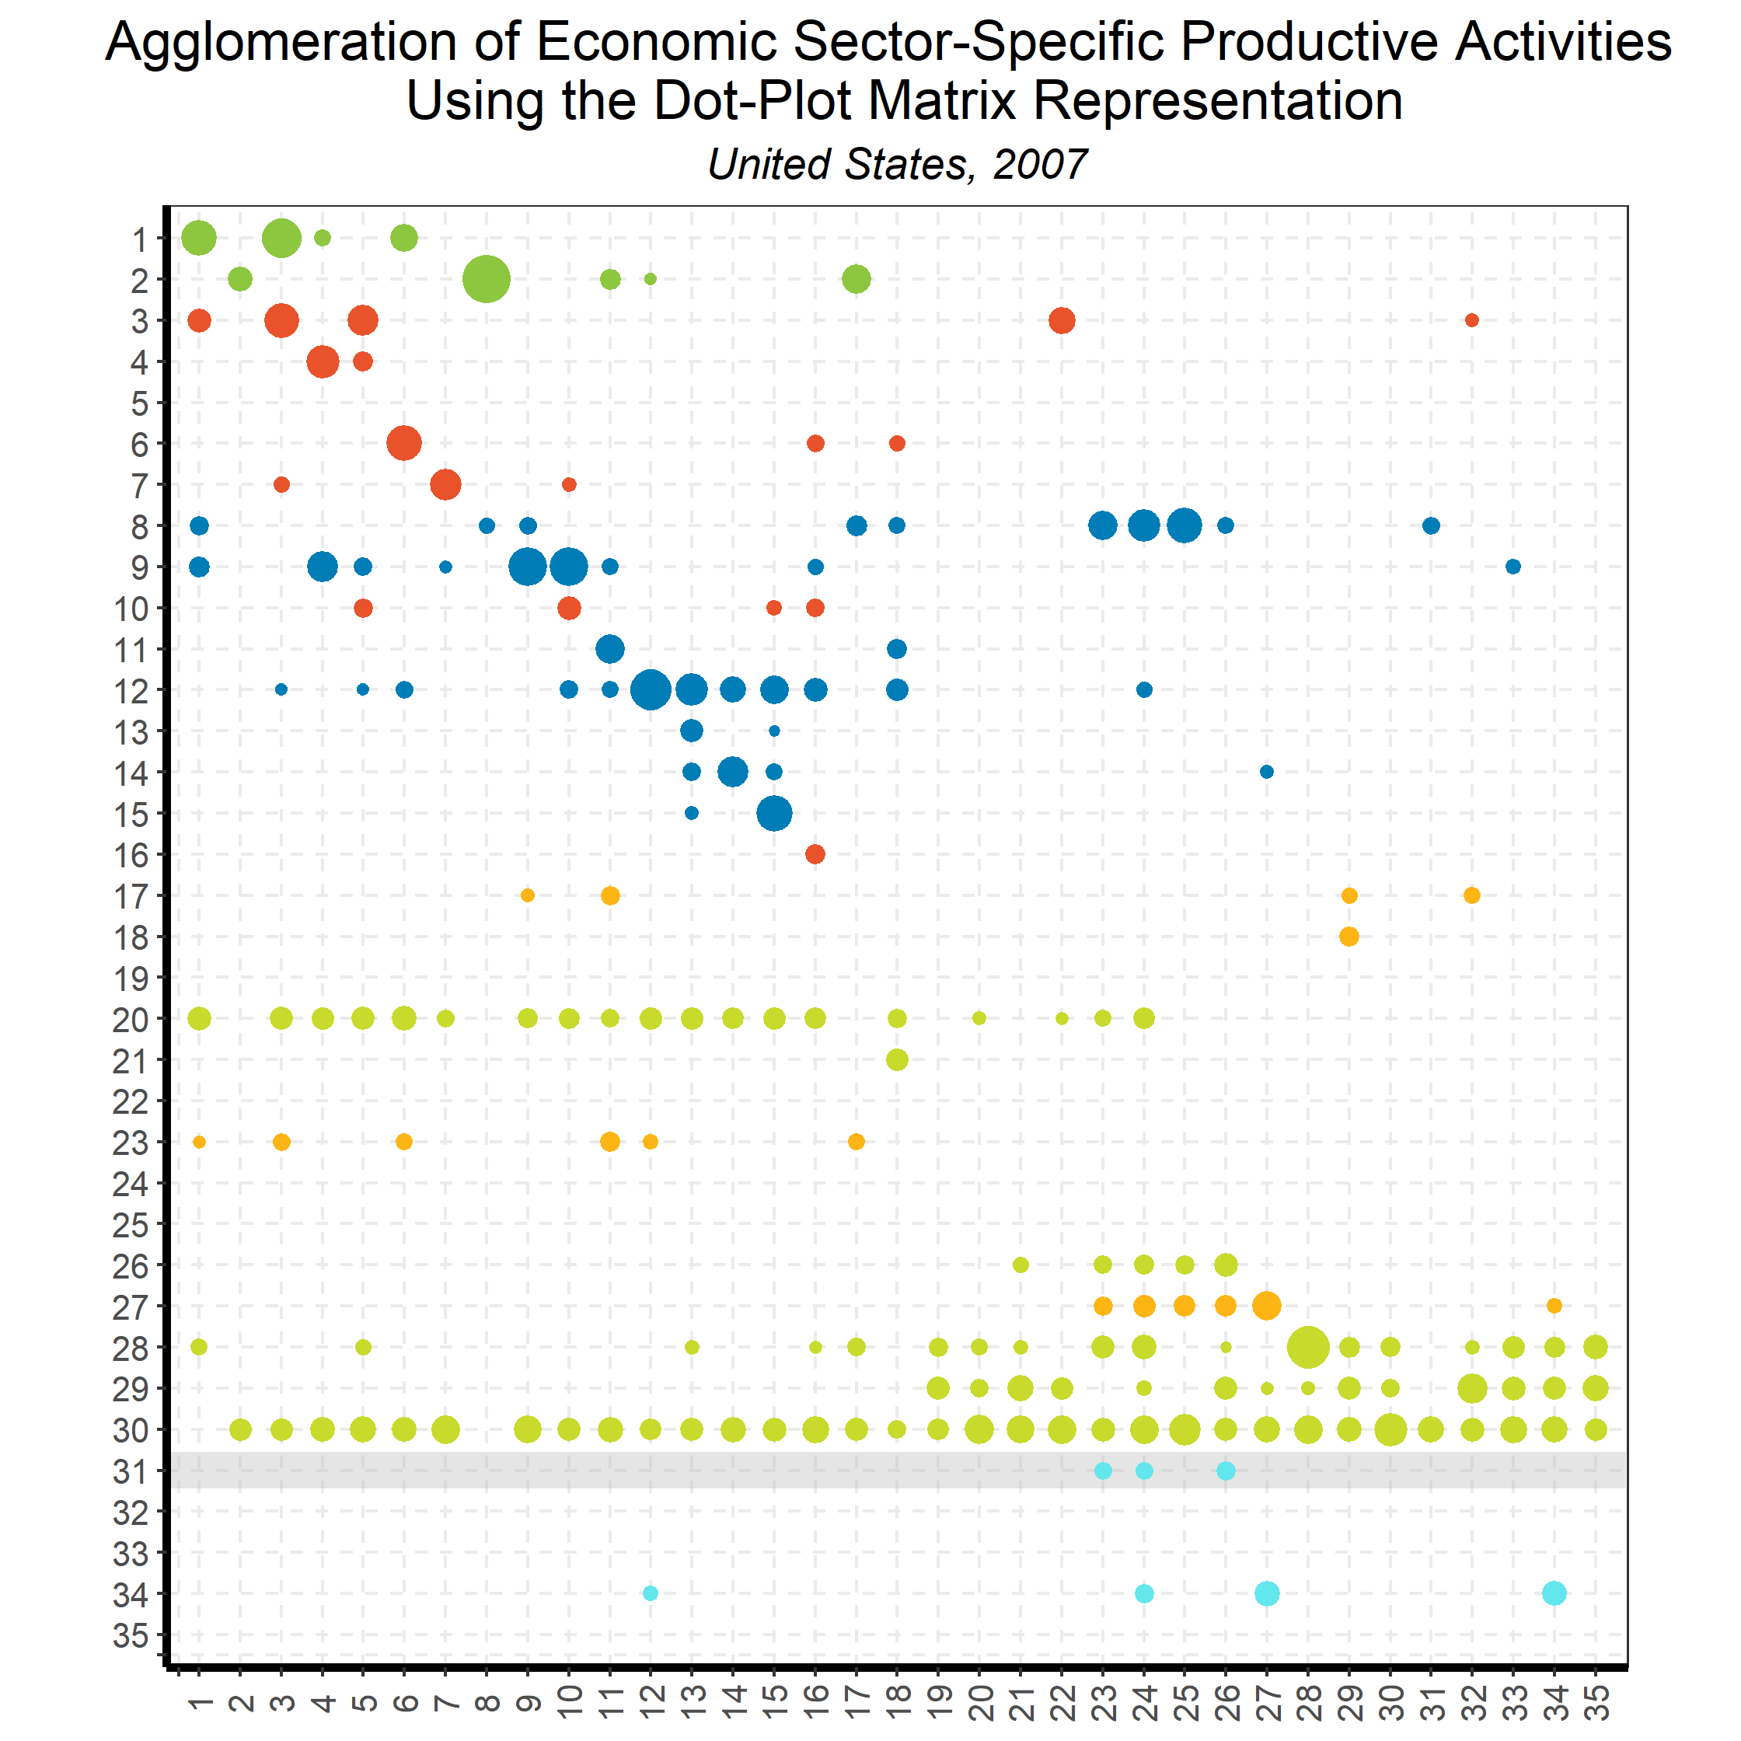
Linking Goods and Services:
Input-Output Direct Requirements
Back to country list

Slide 50
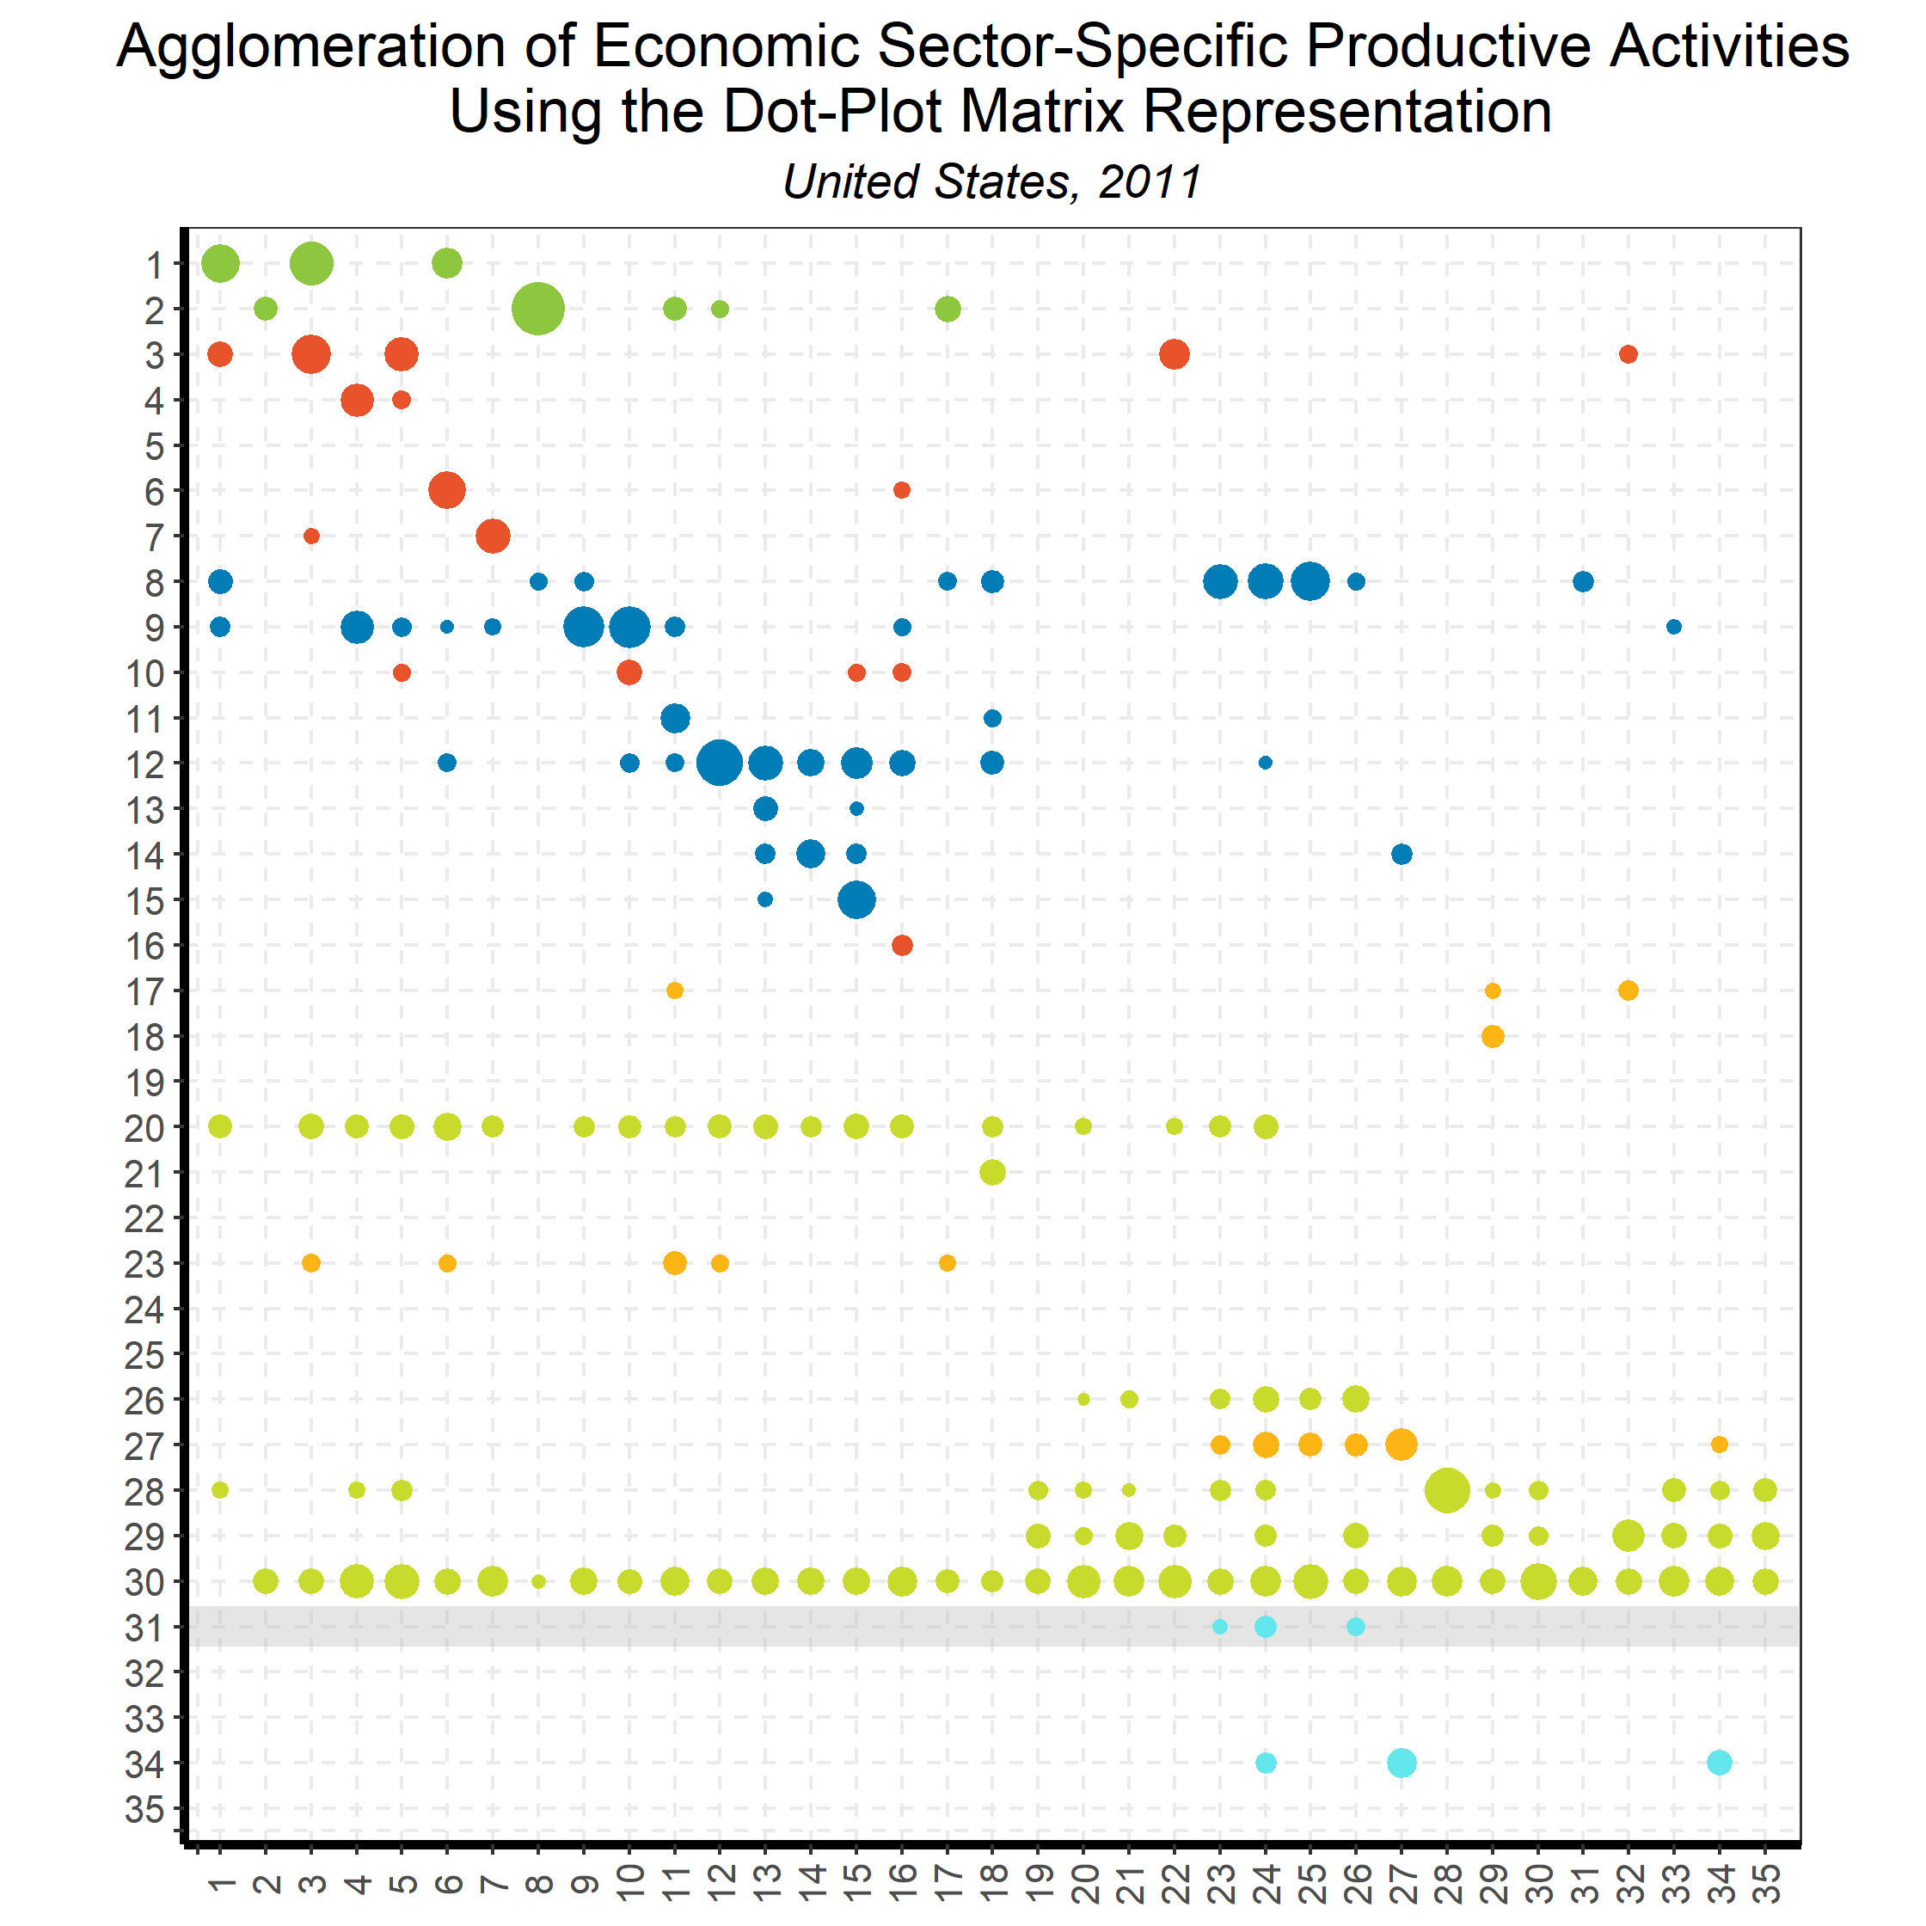
Linking Goods and Services:
Input-Output Direct Requirements
Back to country list

Slide 51
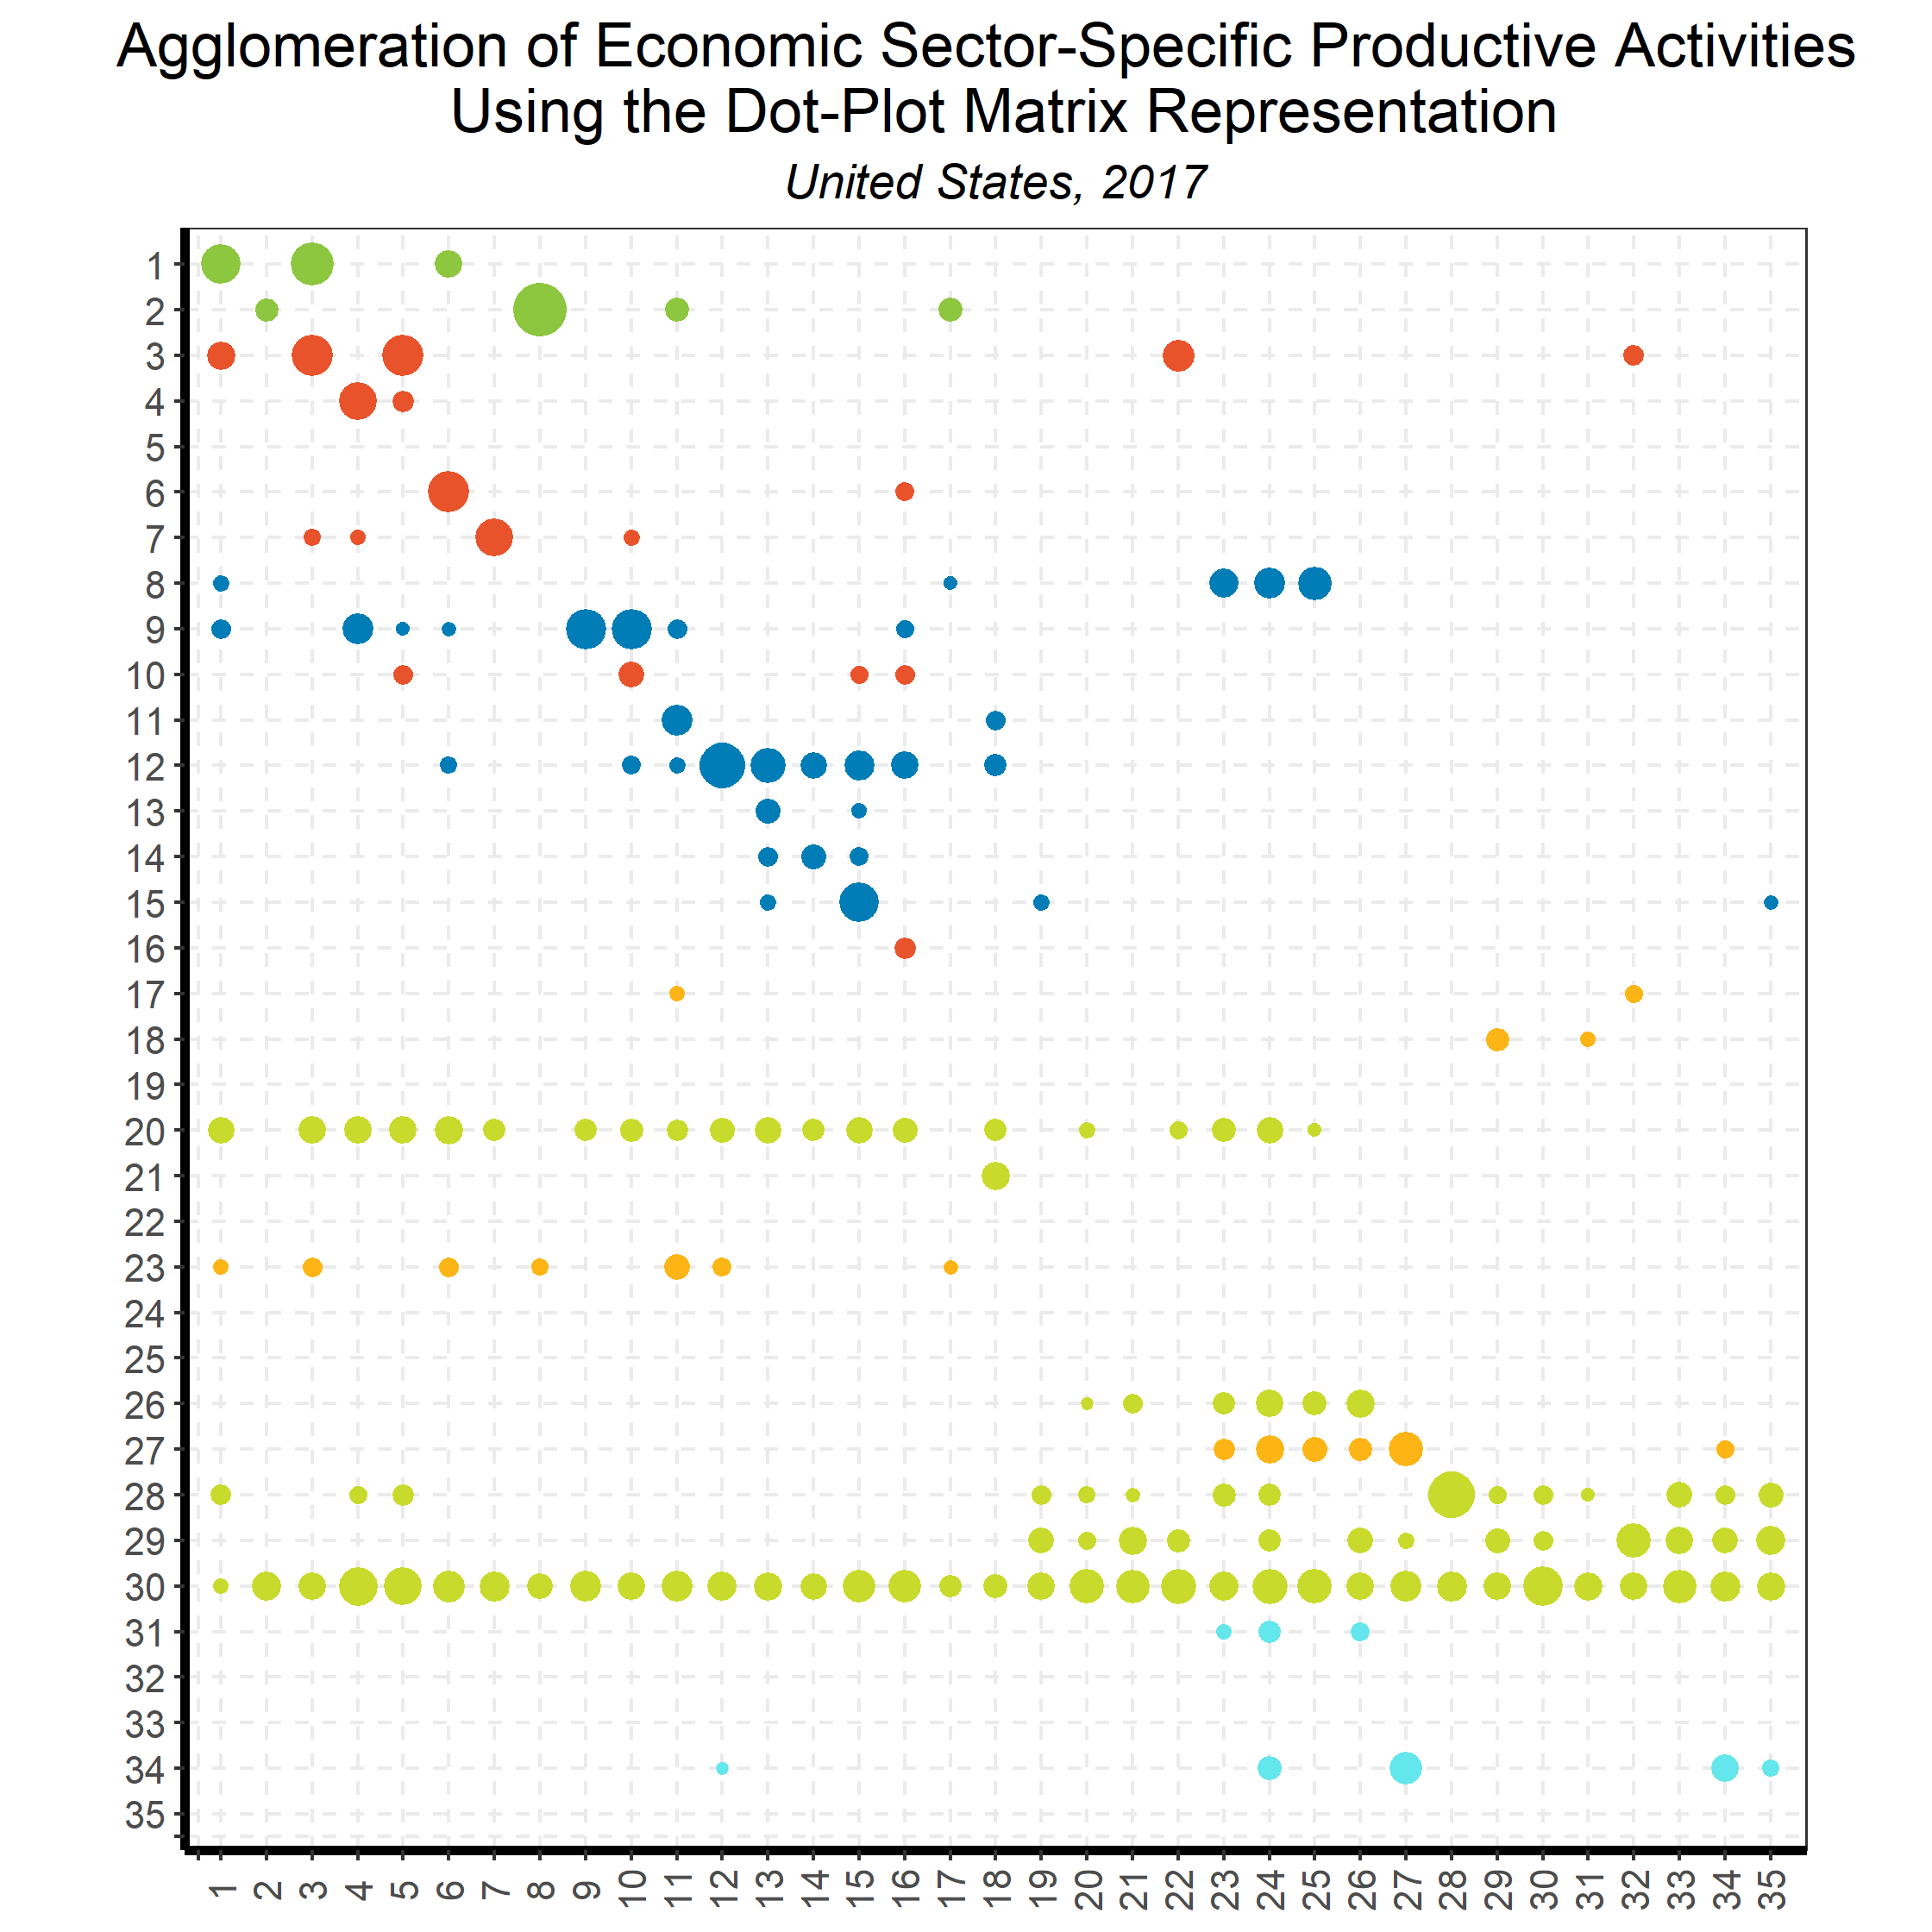
Linking Goods and Services:
Input-Output Direct Requirements
What separates advanced economies from emerging markets is invariably the strong ‘forward links’ of sector 30 - Rental of machinery and equipment and other business and professional services
The pattern of a dot-plot matrix for a specific country generally changes little over time (since 2000) for high-income economies
Some of the dot-plot matrices is the size of the diagonal.
Back to country list

Slide 52
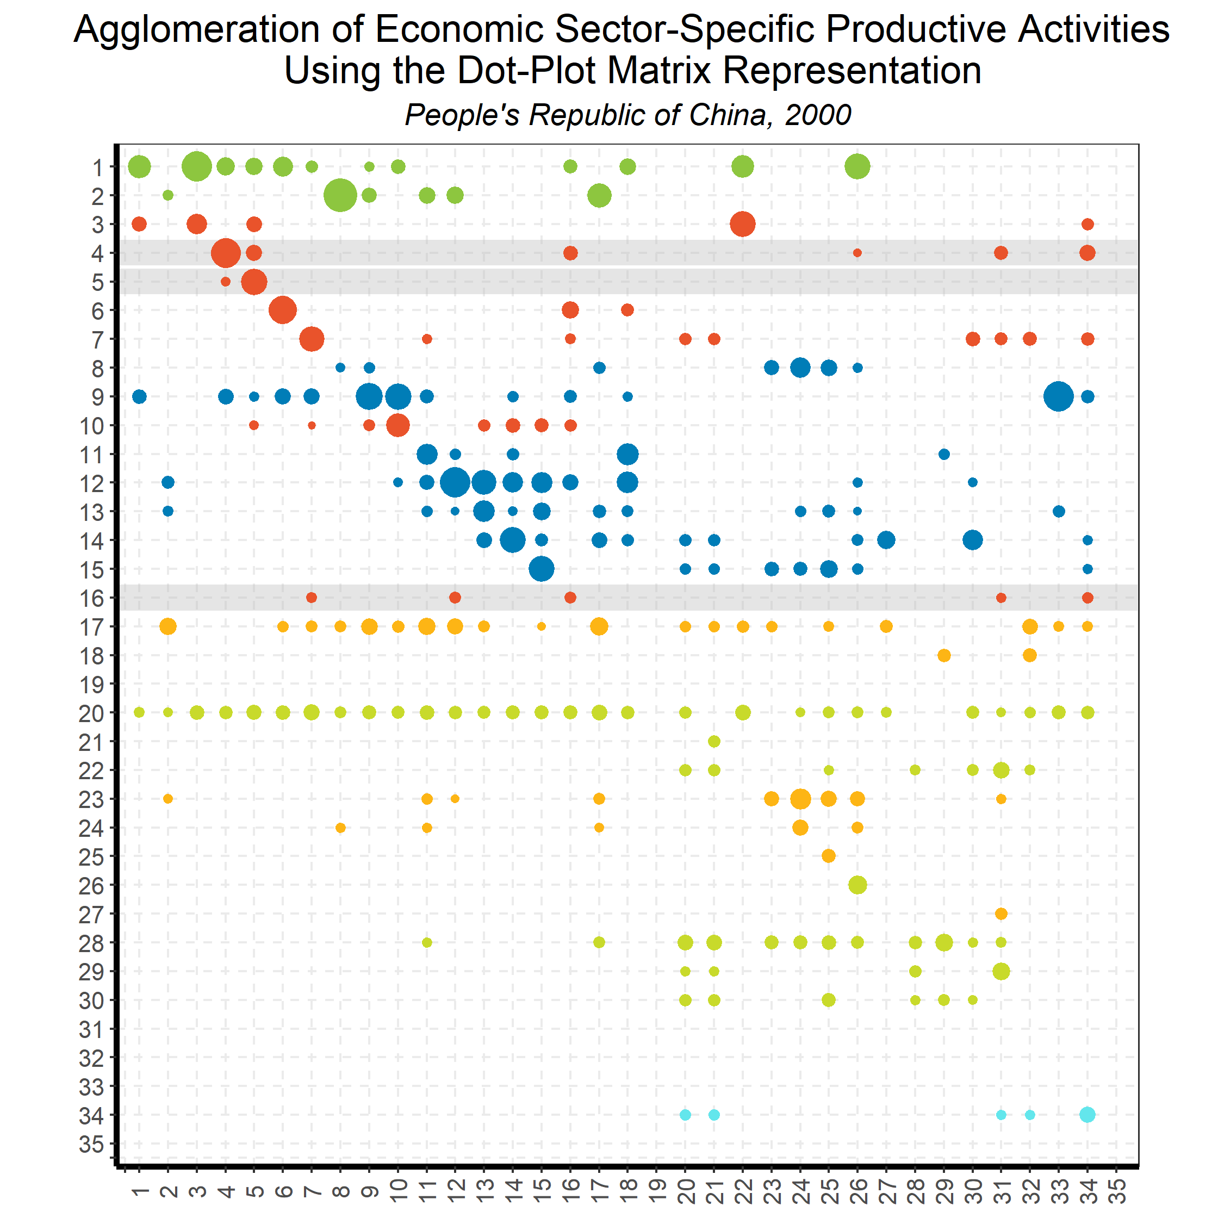
Linking Goods and Services:
Input-Output Direct Requirements
Back to country list

Slide 53
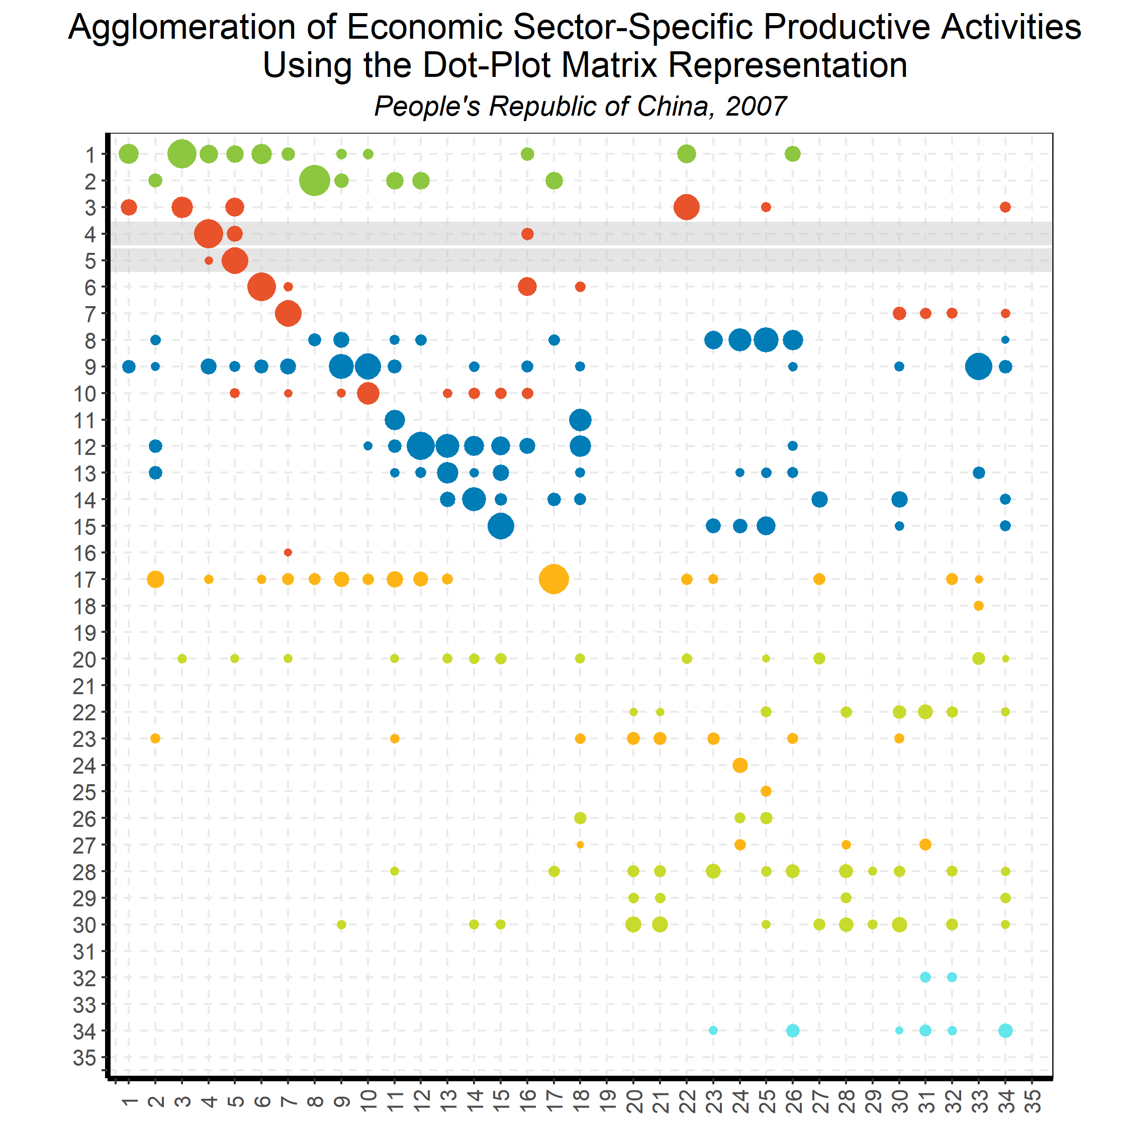
Linking Goods and Services:
Input-Output Direct Requirements
Back to country list

Slide 54
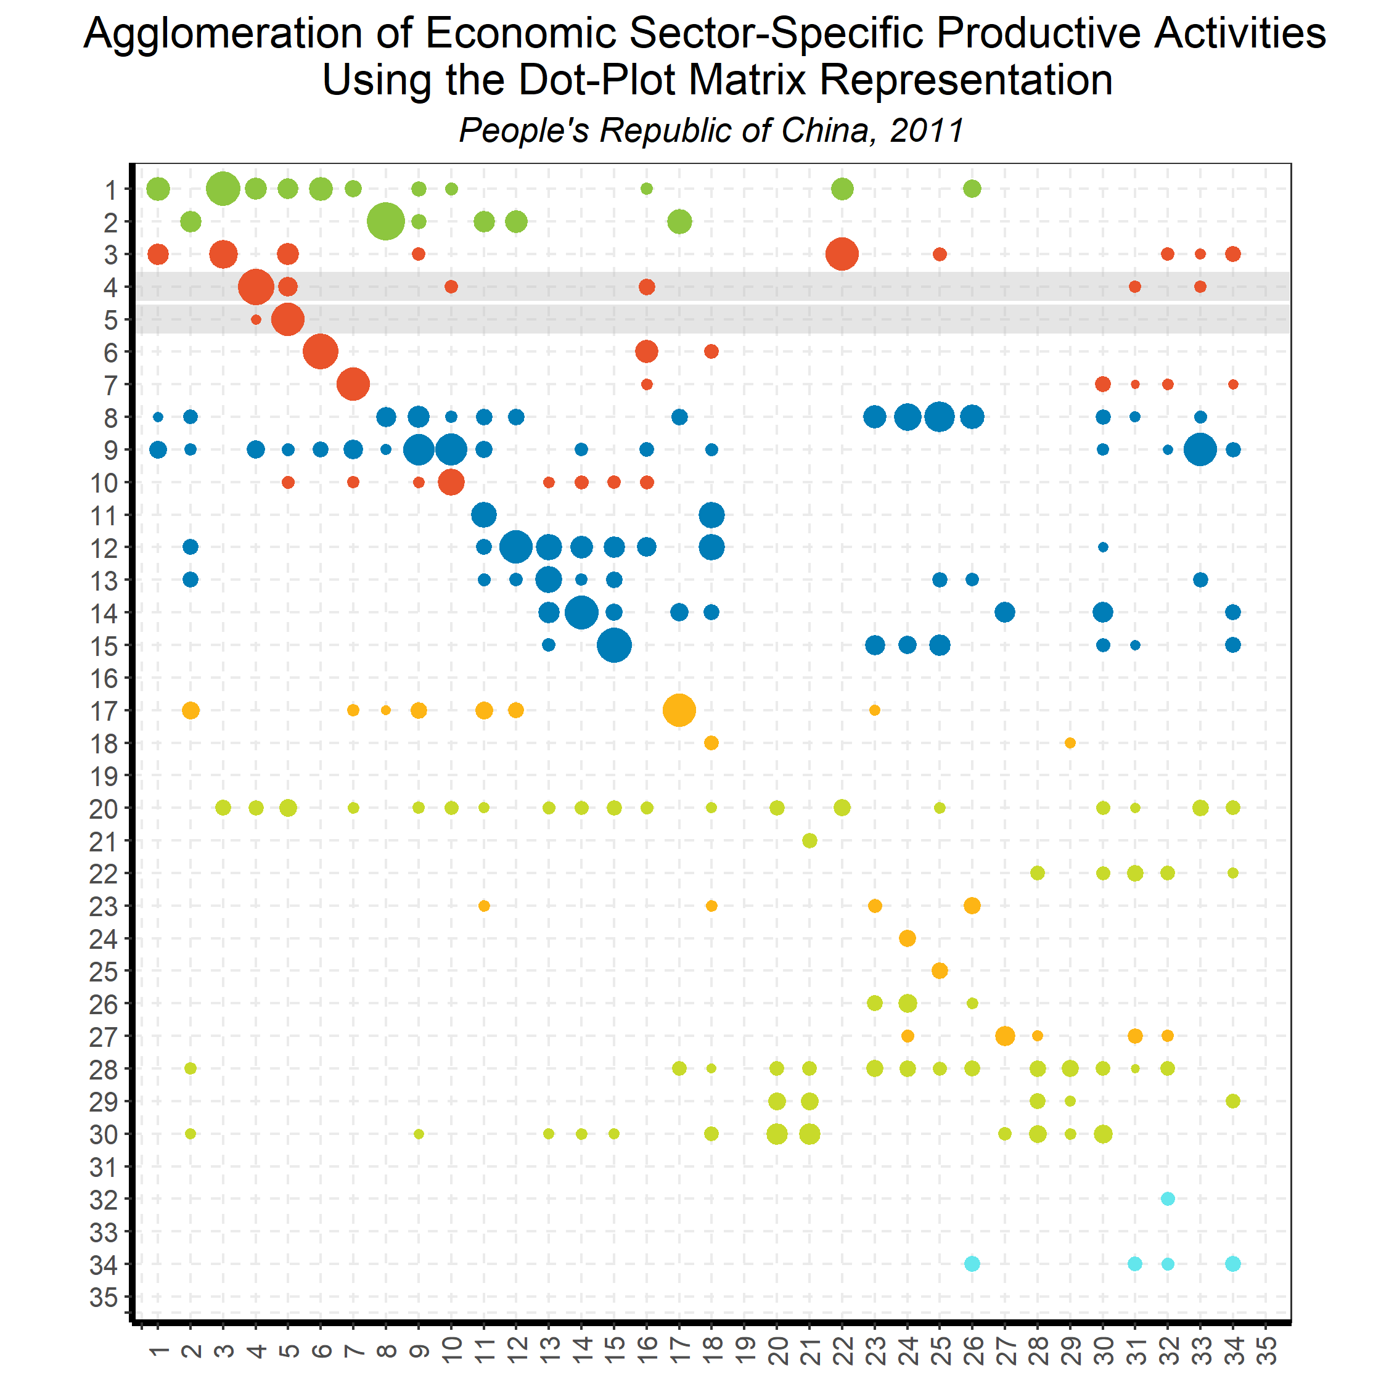
Linking Goods and Services:
Input-Output Direct Requirements
Back to country list

Slide 55

Linking Goods and Services:
Input-Output Direct Requirements
Back to country list

Slide 56
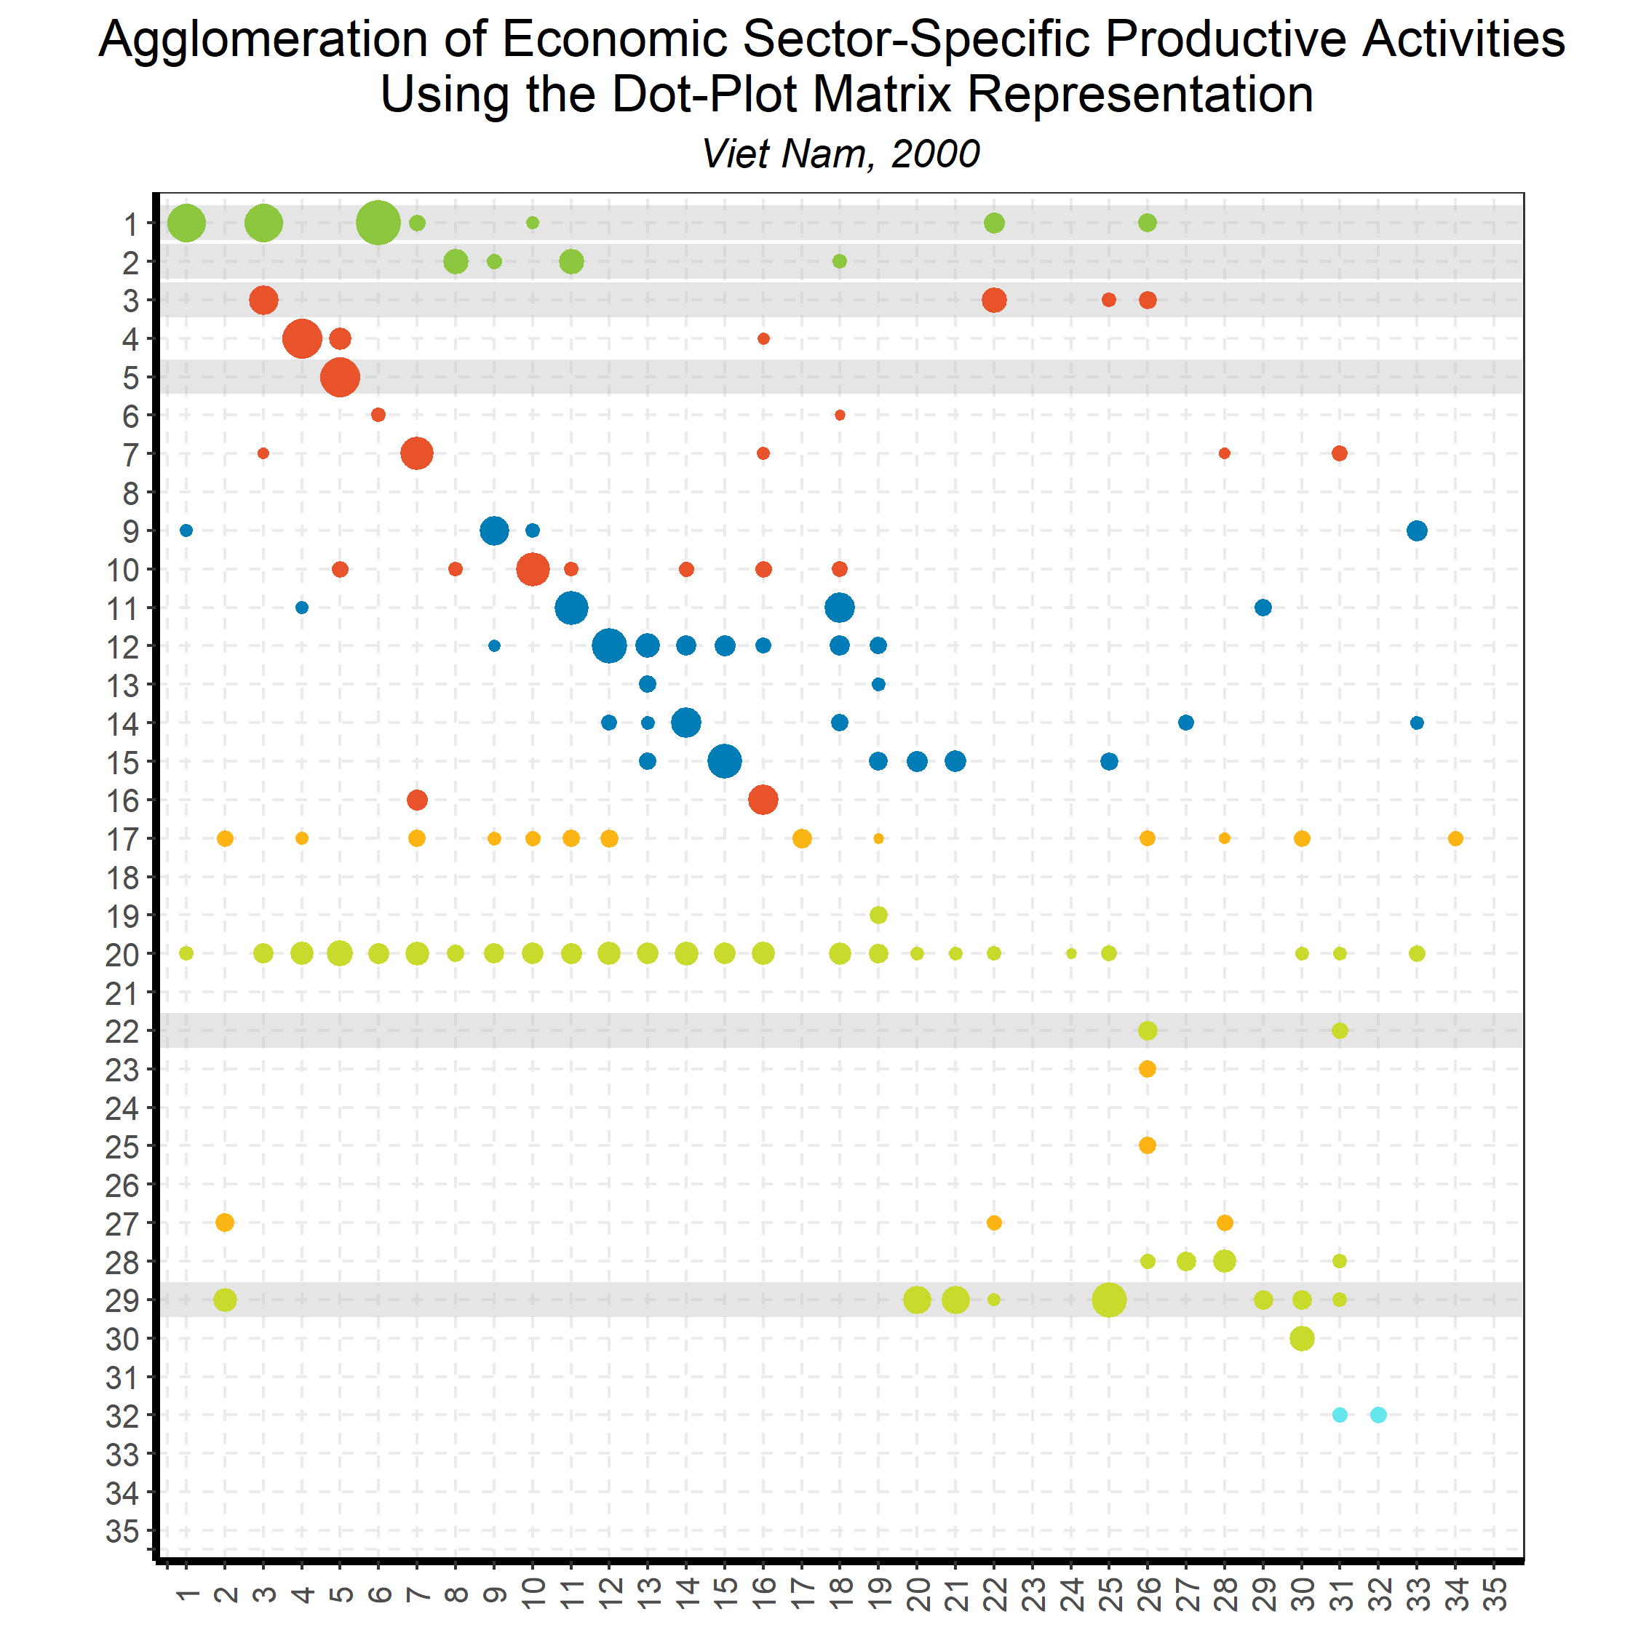
Linking Goods and Services:
Input-Output Direct Requirements
Back to country list

Slide 57
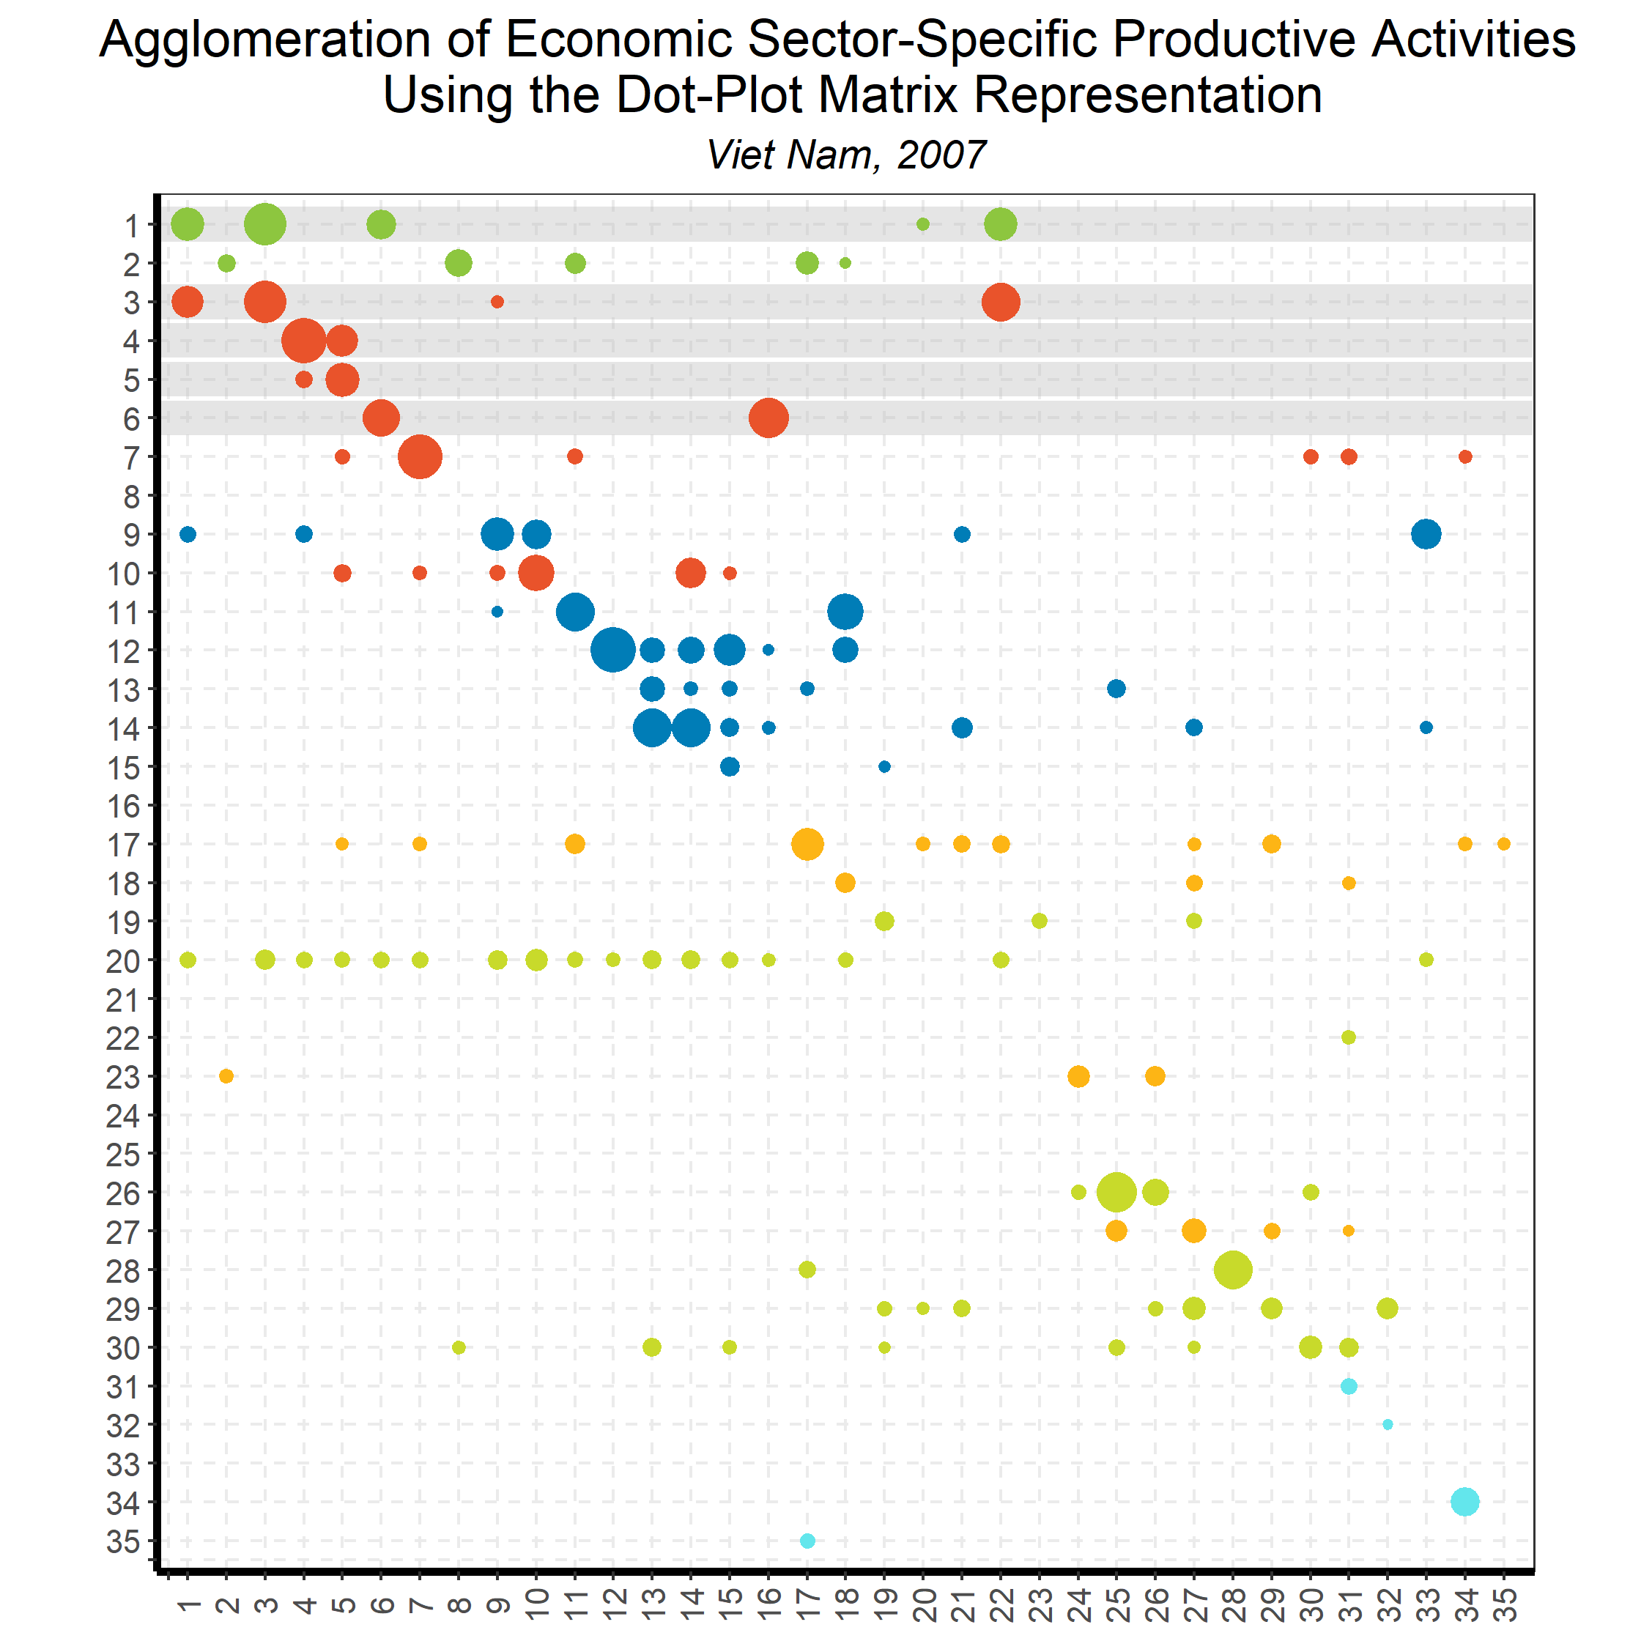
Linking Goods and Services:
Input-Output Direct Requirements
Back to country list

Slide 58
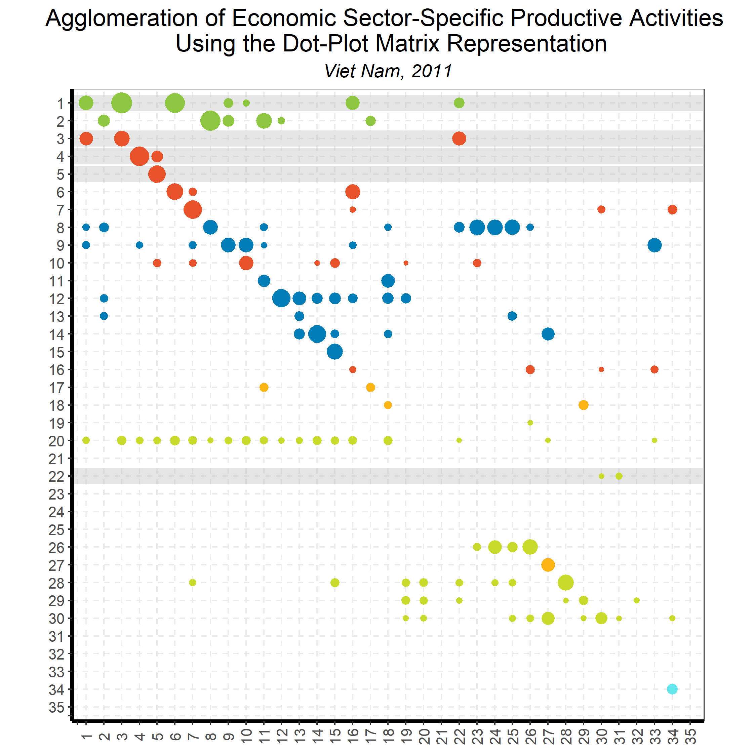
Linking Goods and Services:
Input-Output Direct Requirements
Back to country list

Slide 59
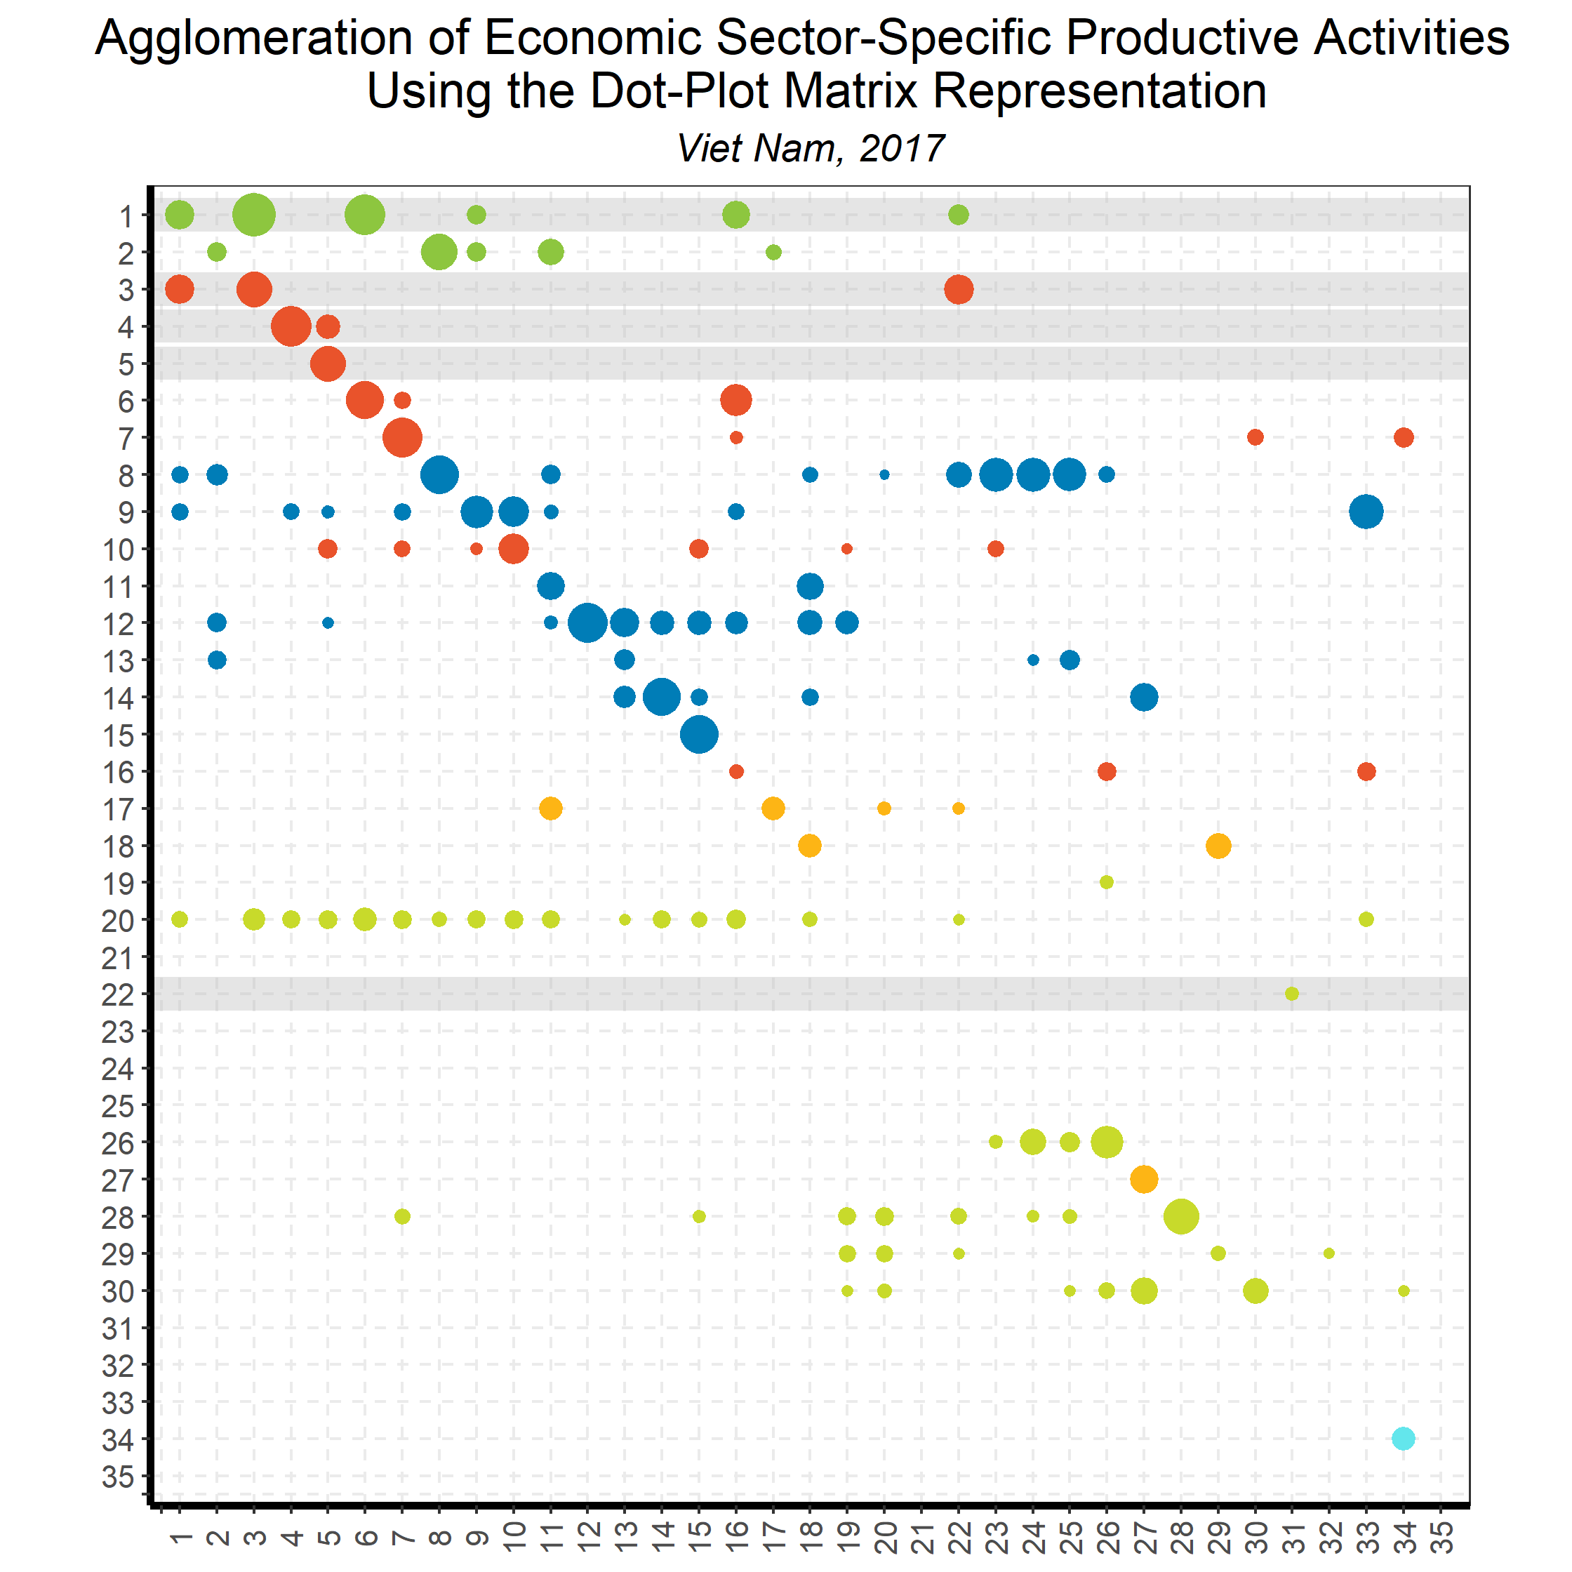
Linking Goods and Services:
Input-Output Direct Requirements
Back to country list

Slide 60
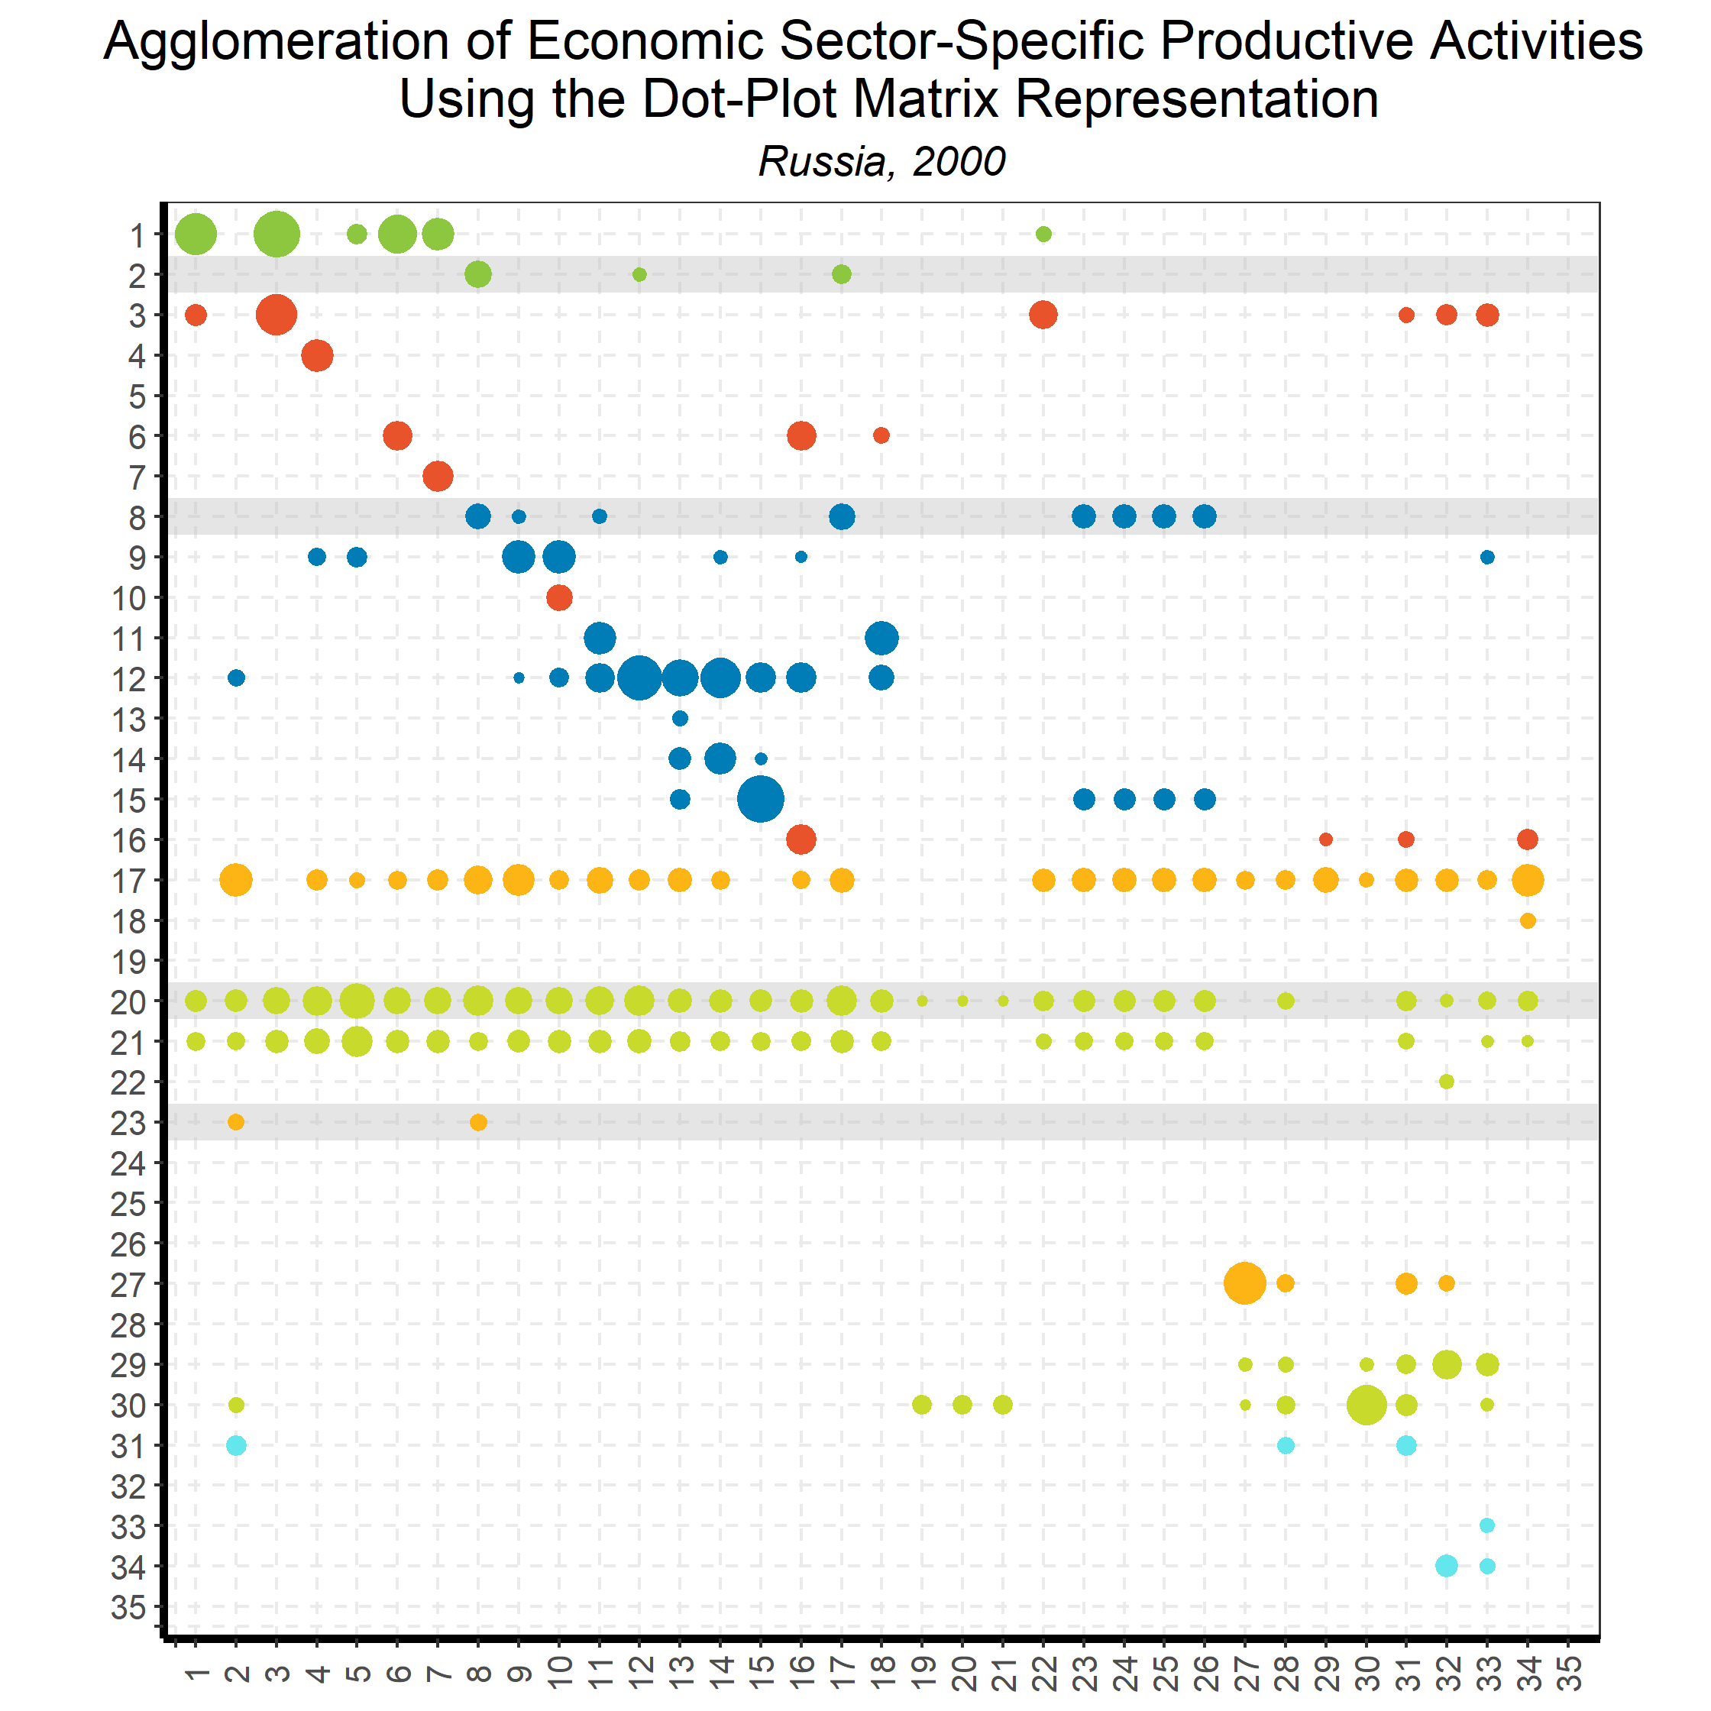
Linking Goods and Services:
Input-Output Direct Requirements
Back to country list

Slide 61
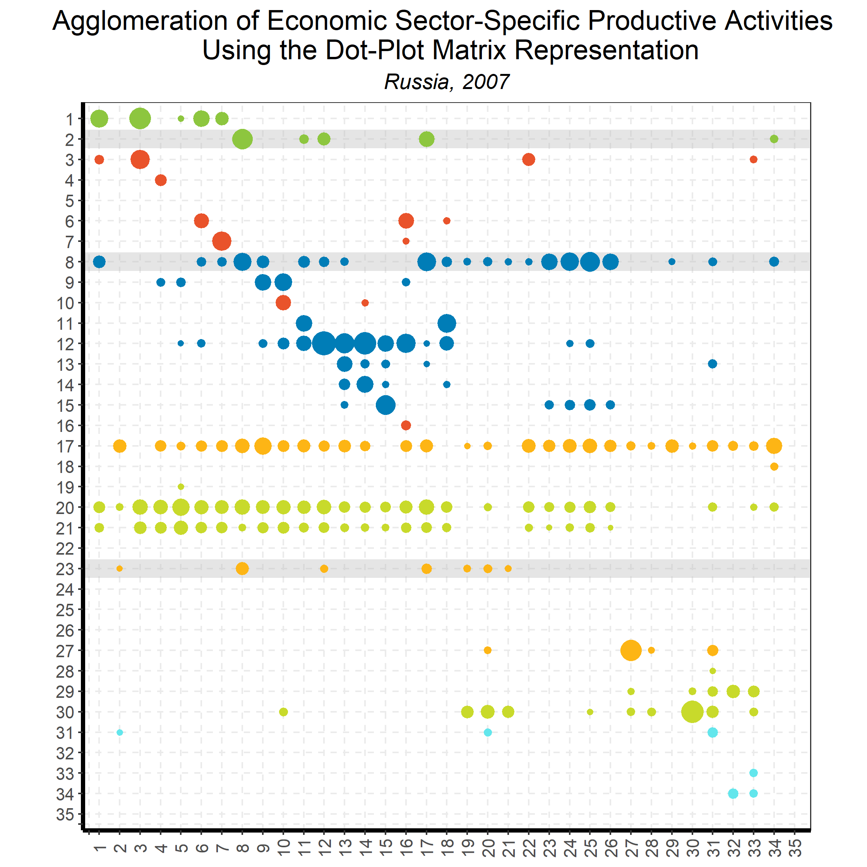
Linking Goods and Services:
Input-Output Direct Requirements
Back to country list

Slide 62
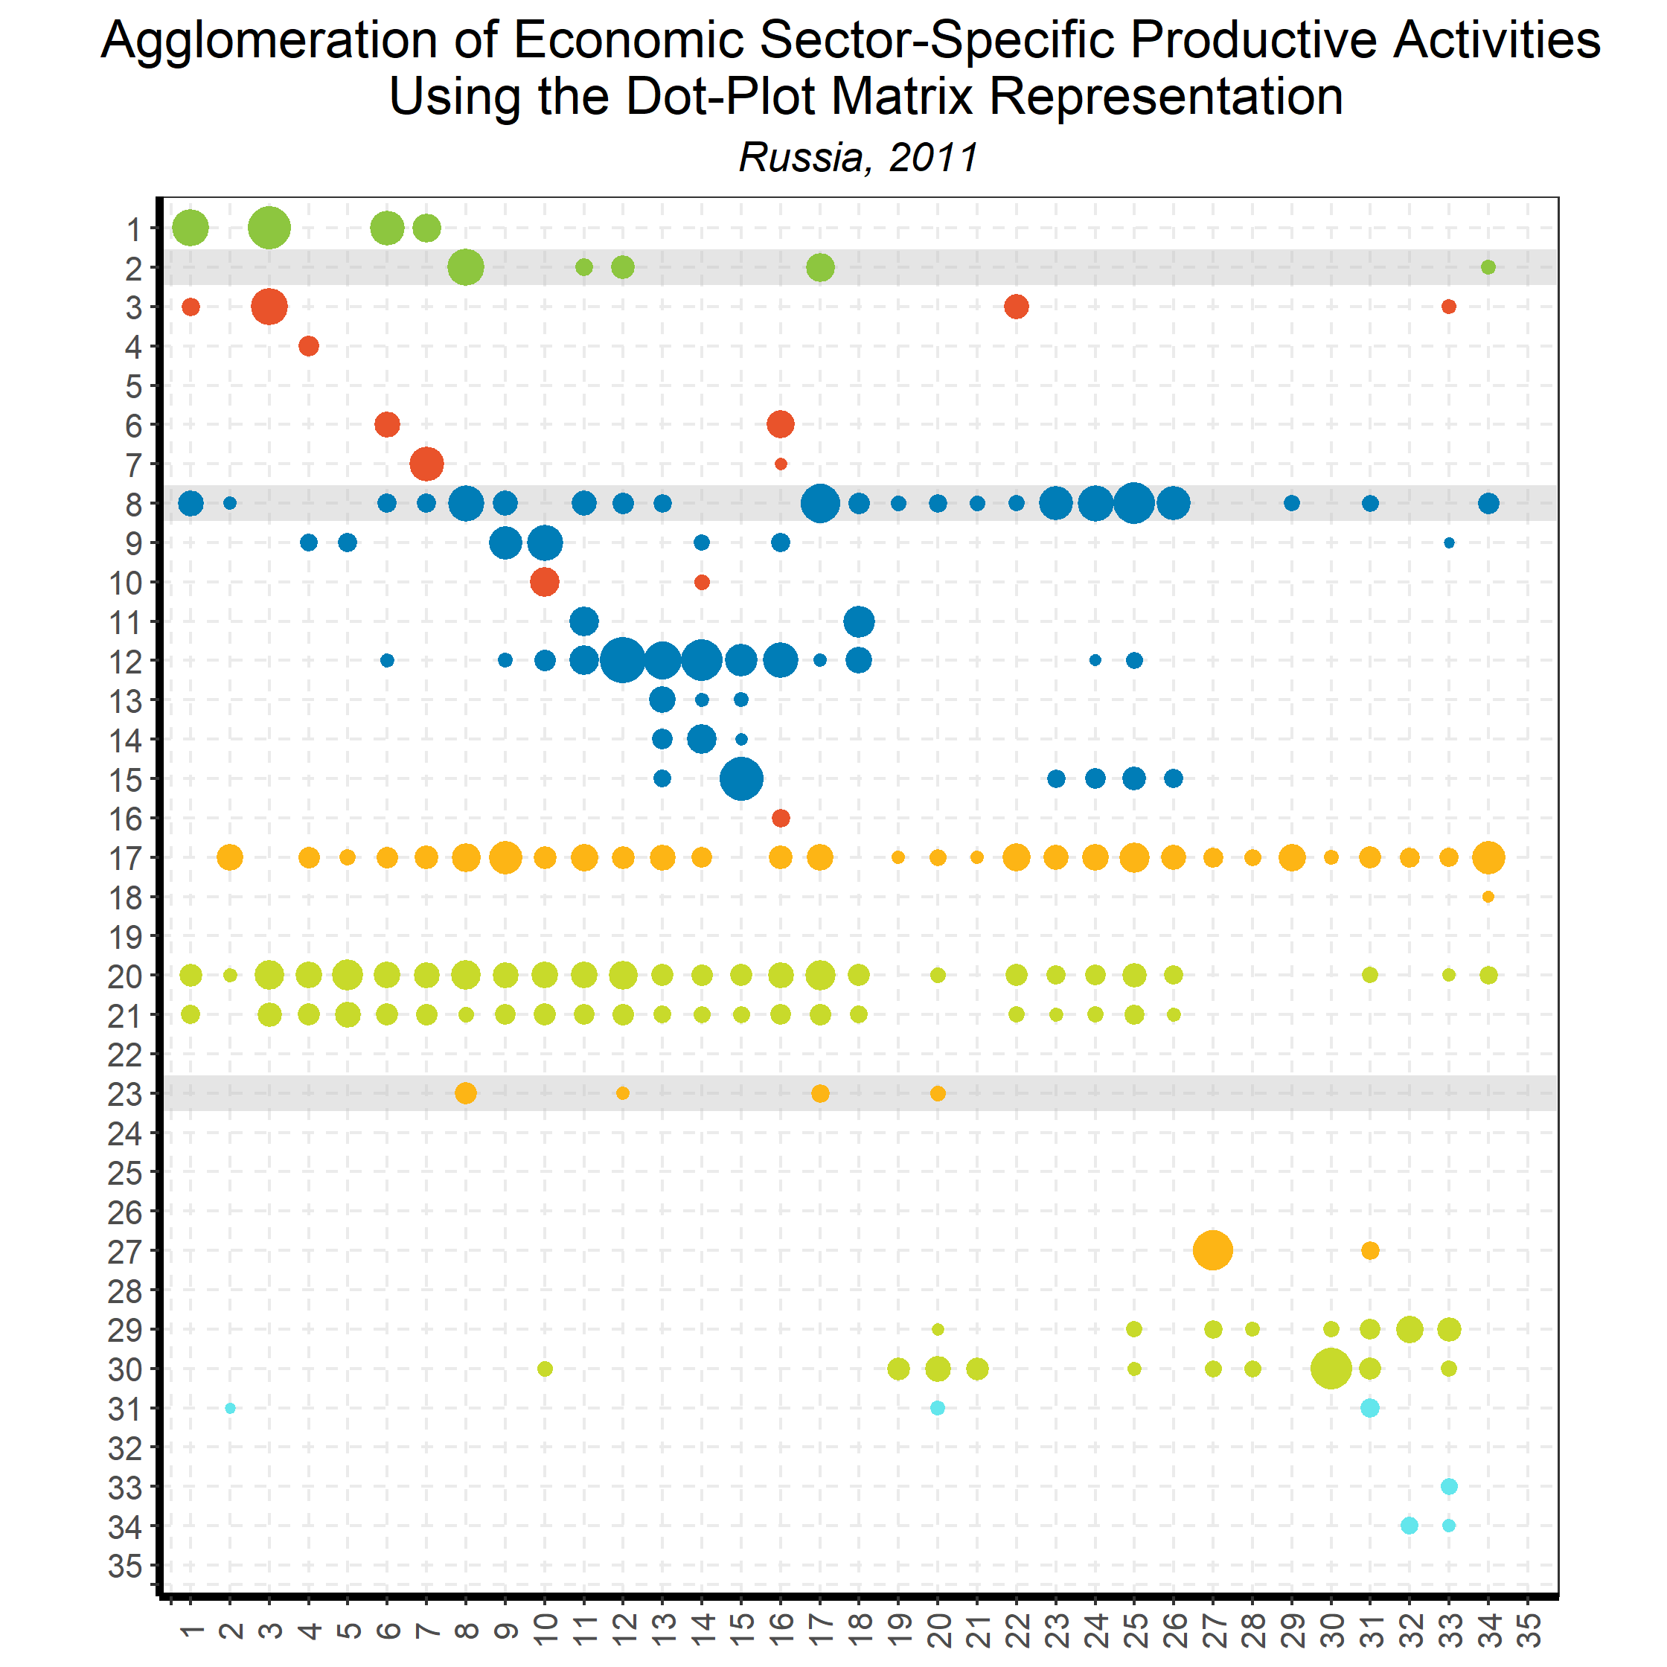
Linking Goods and Services:
Input-Output Direct Requirements
Back to country list

Slide 63
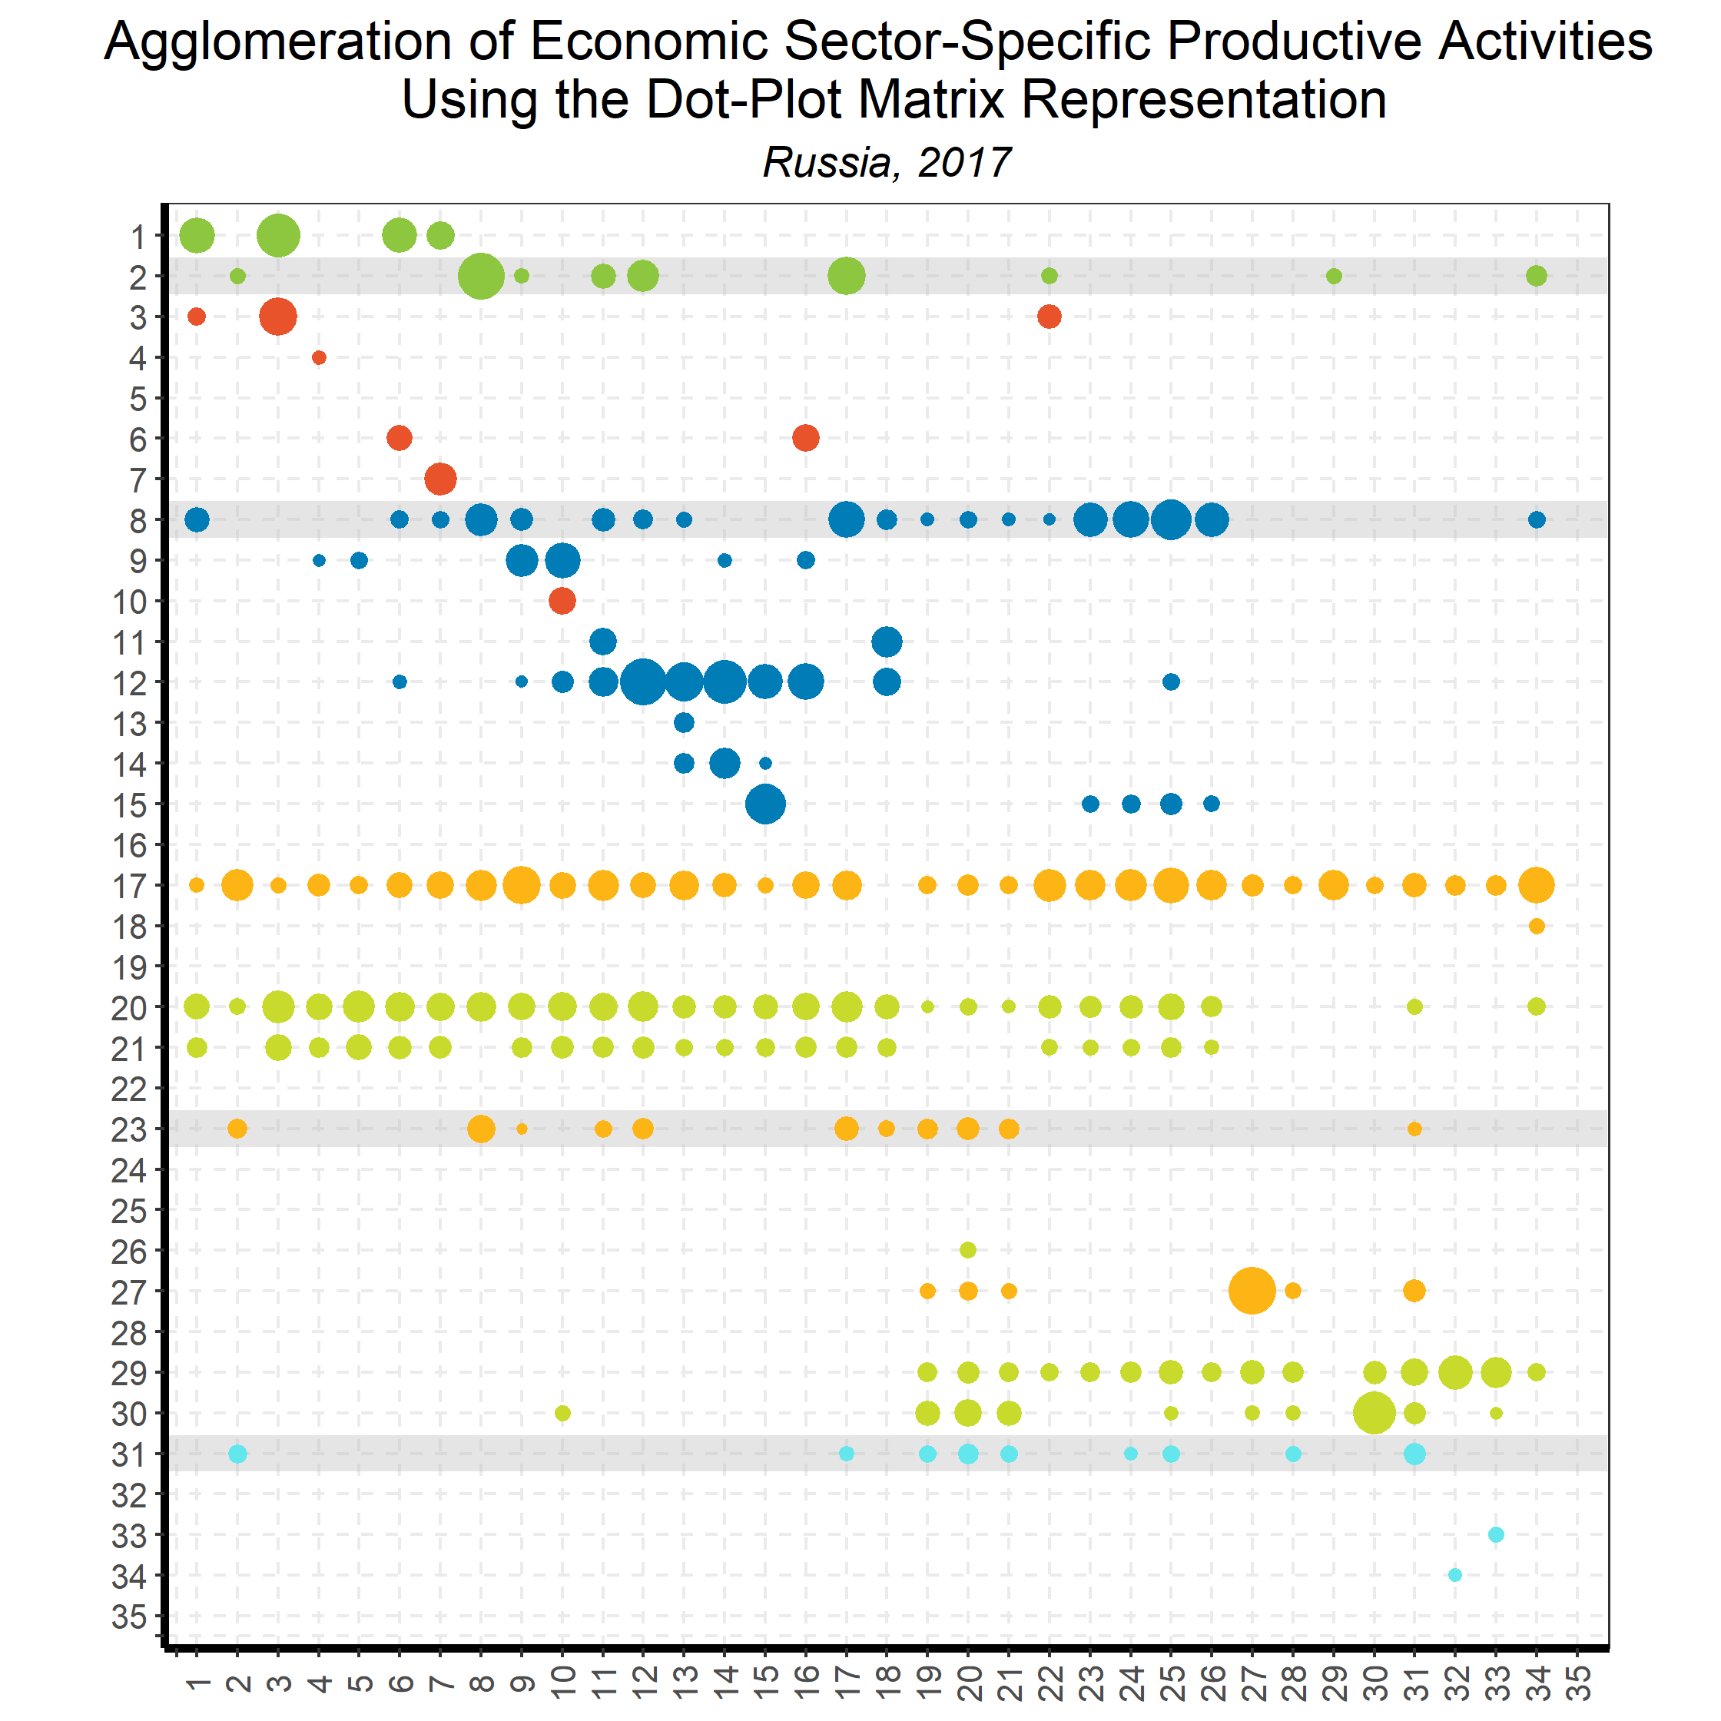
Linking Goods and Services:
Input-Output Direct Requirements
Back to country list

Slide 64
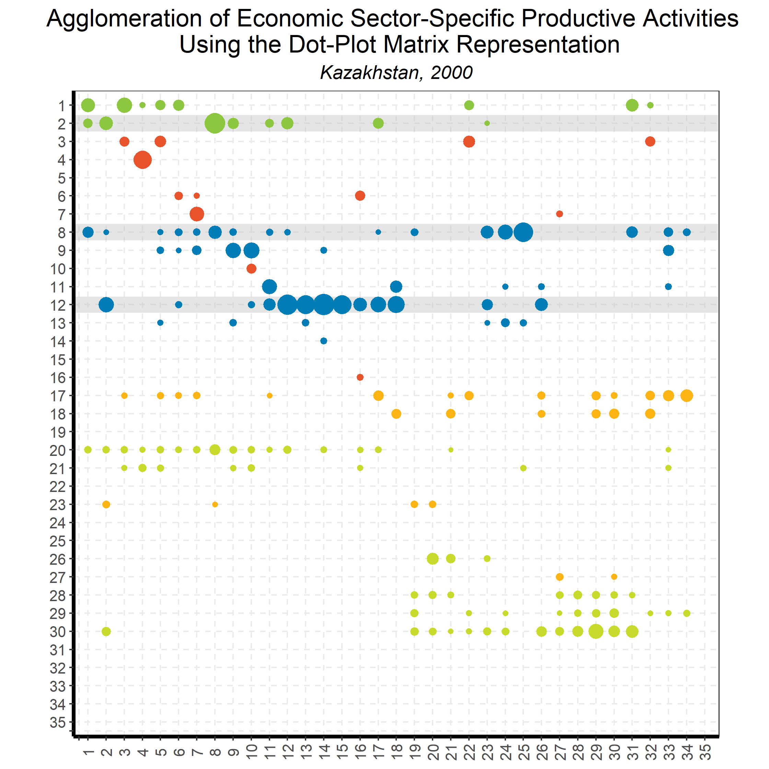
Linking Goods and Services:
Input-Output Direct Requirements
Back to country list

Slide 65
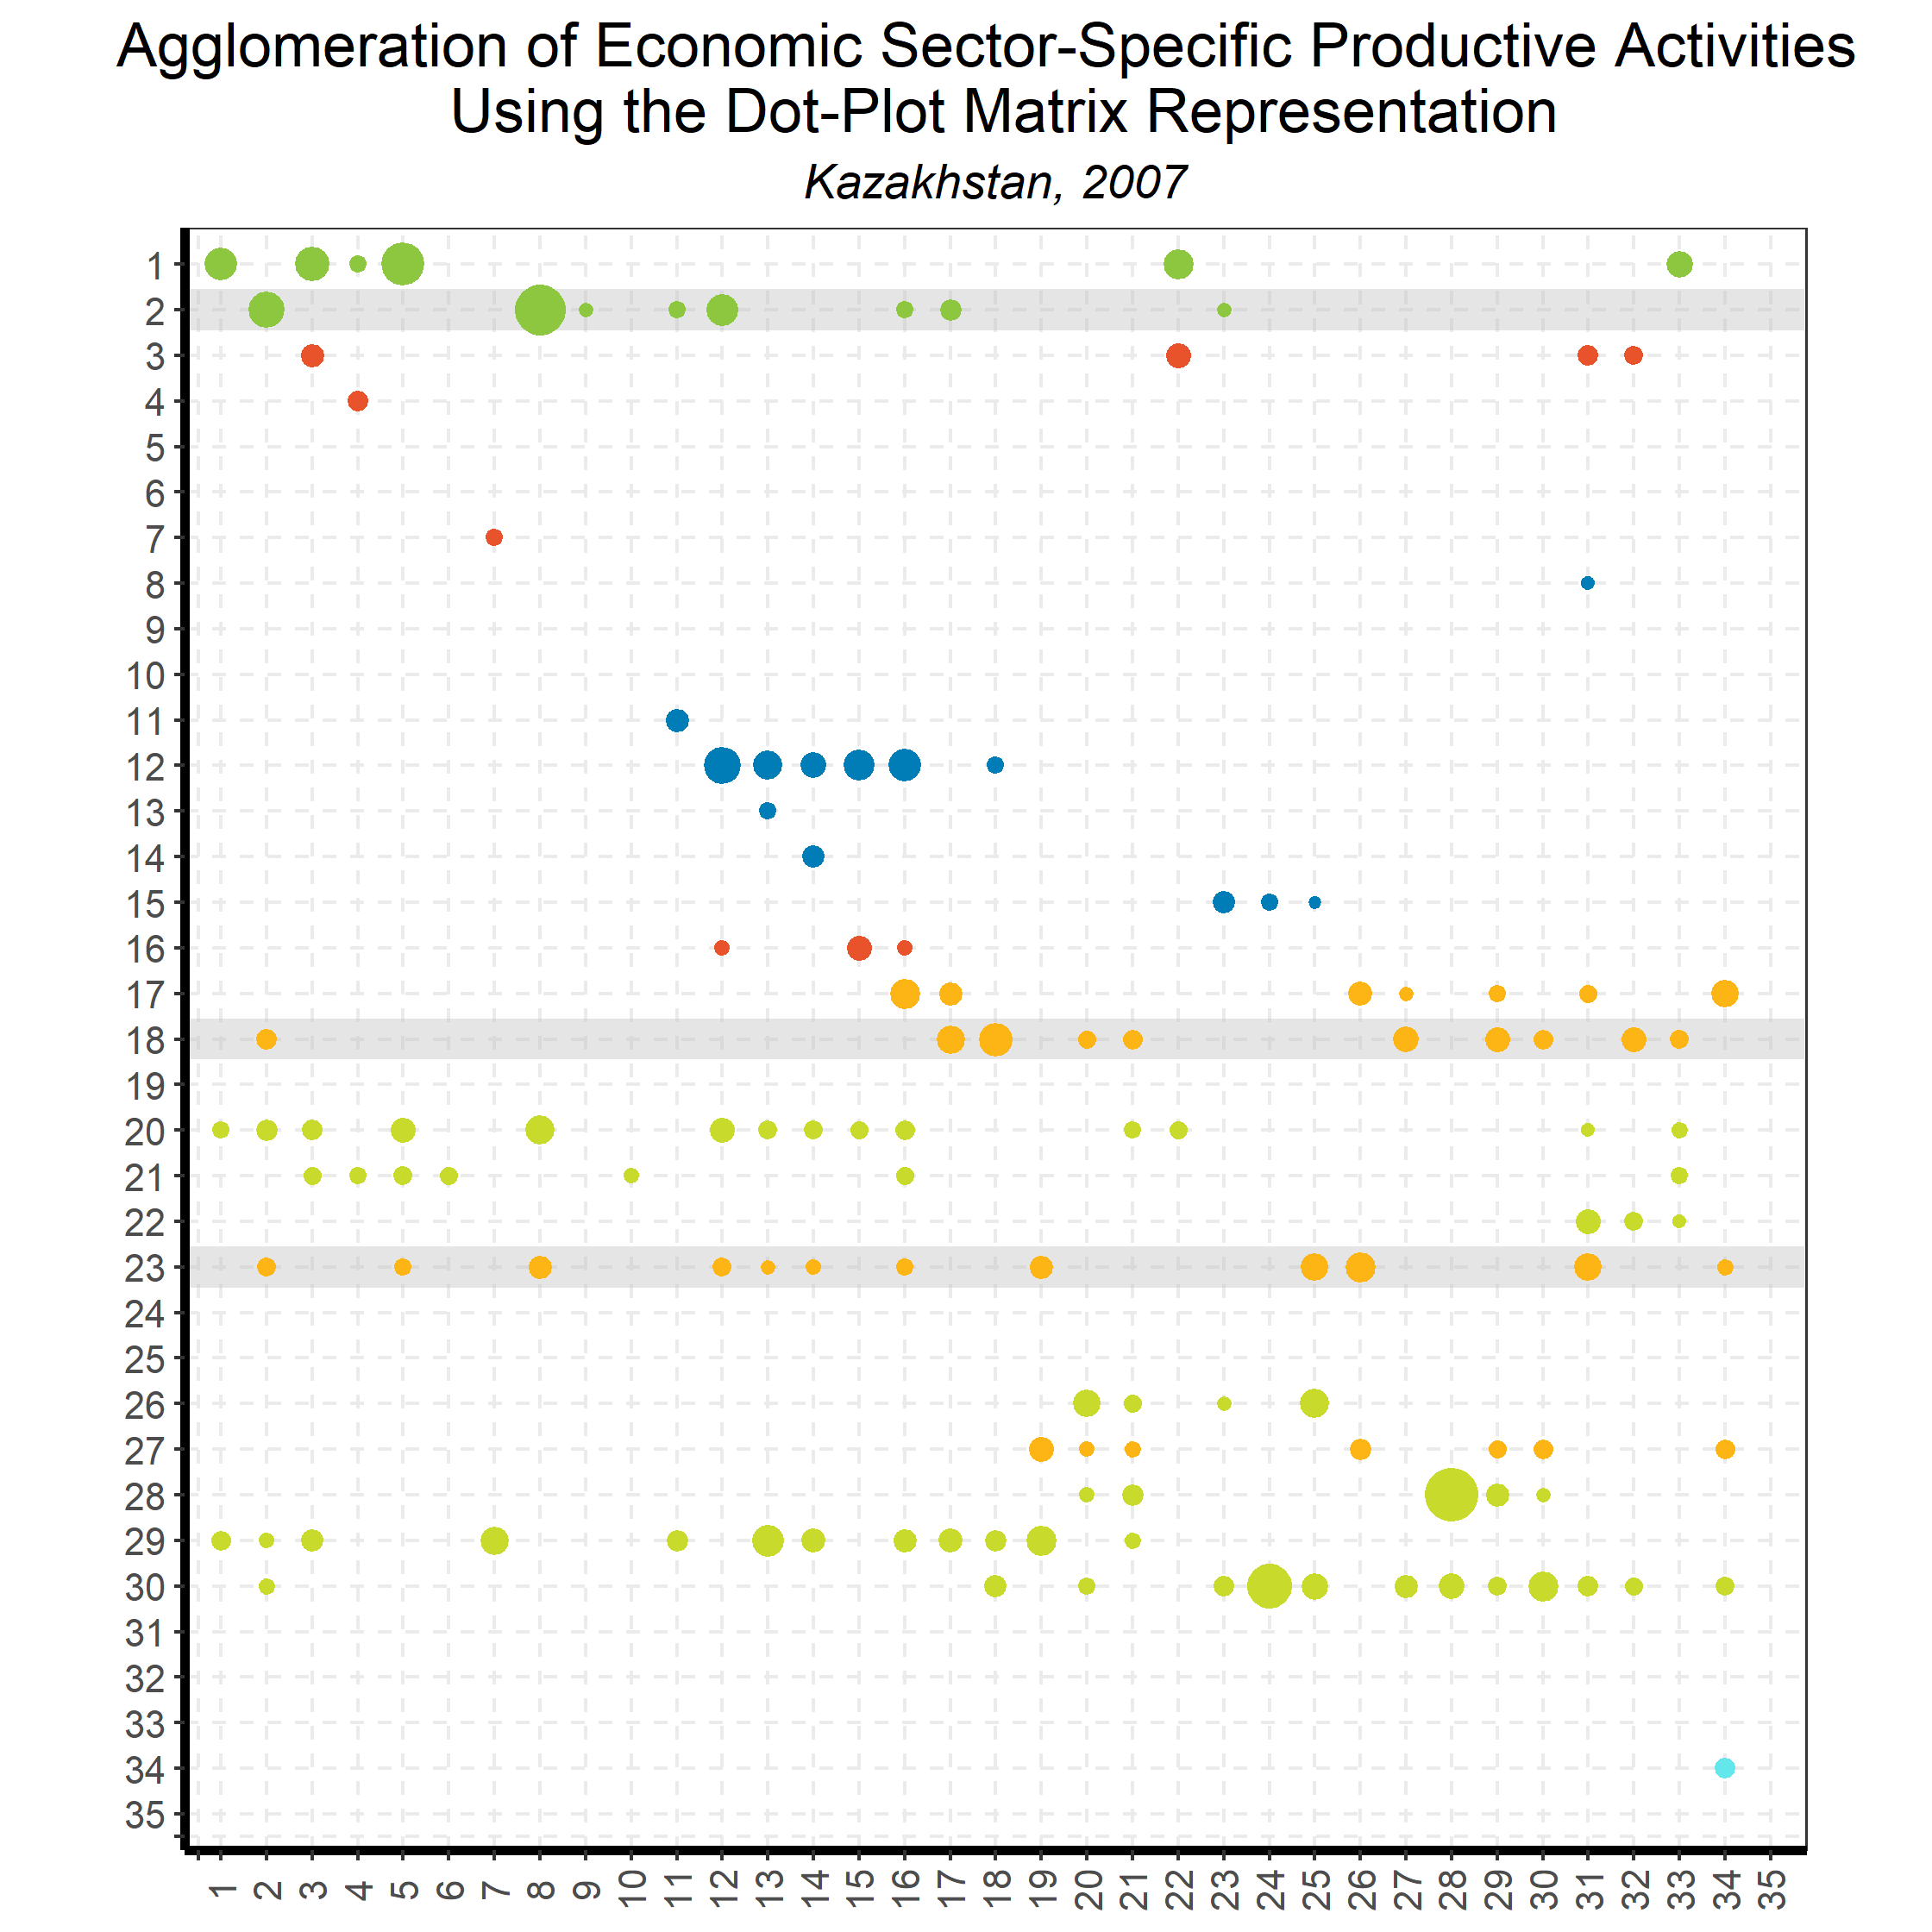
Linking Goods and Services:
Input-Output Direct Requirements
Back to country list

Slide 66
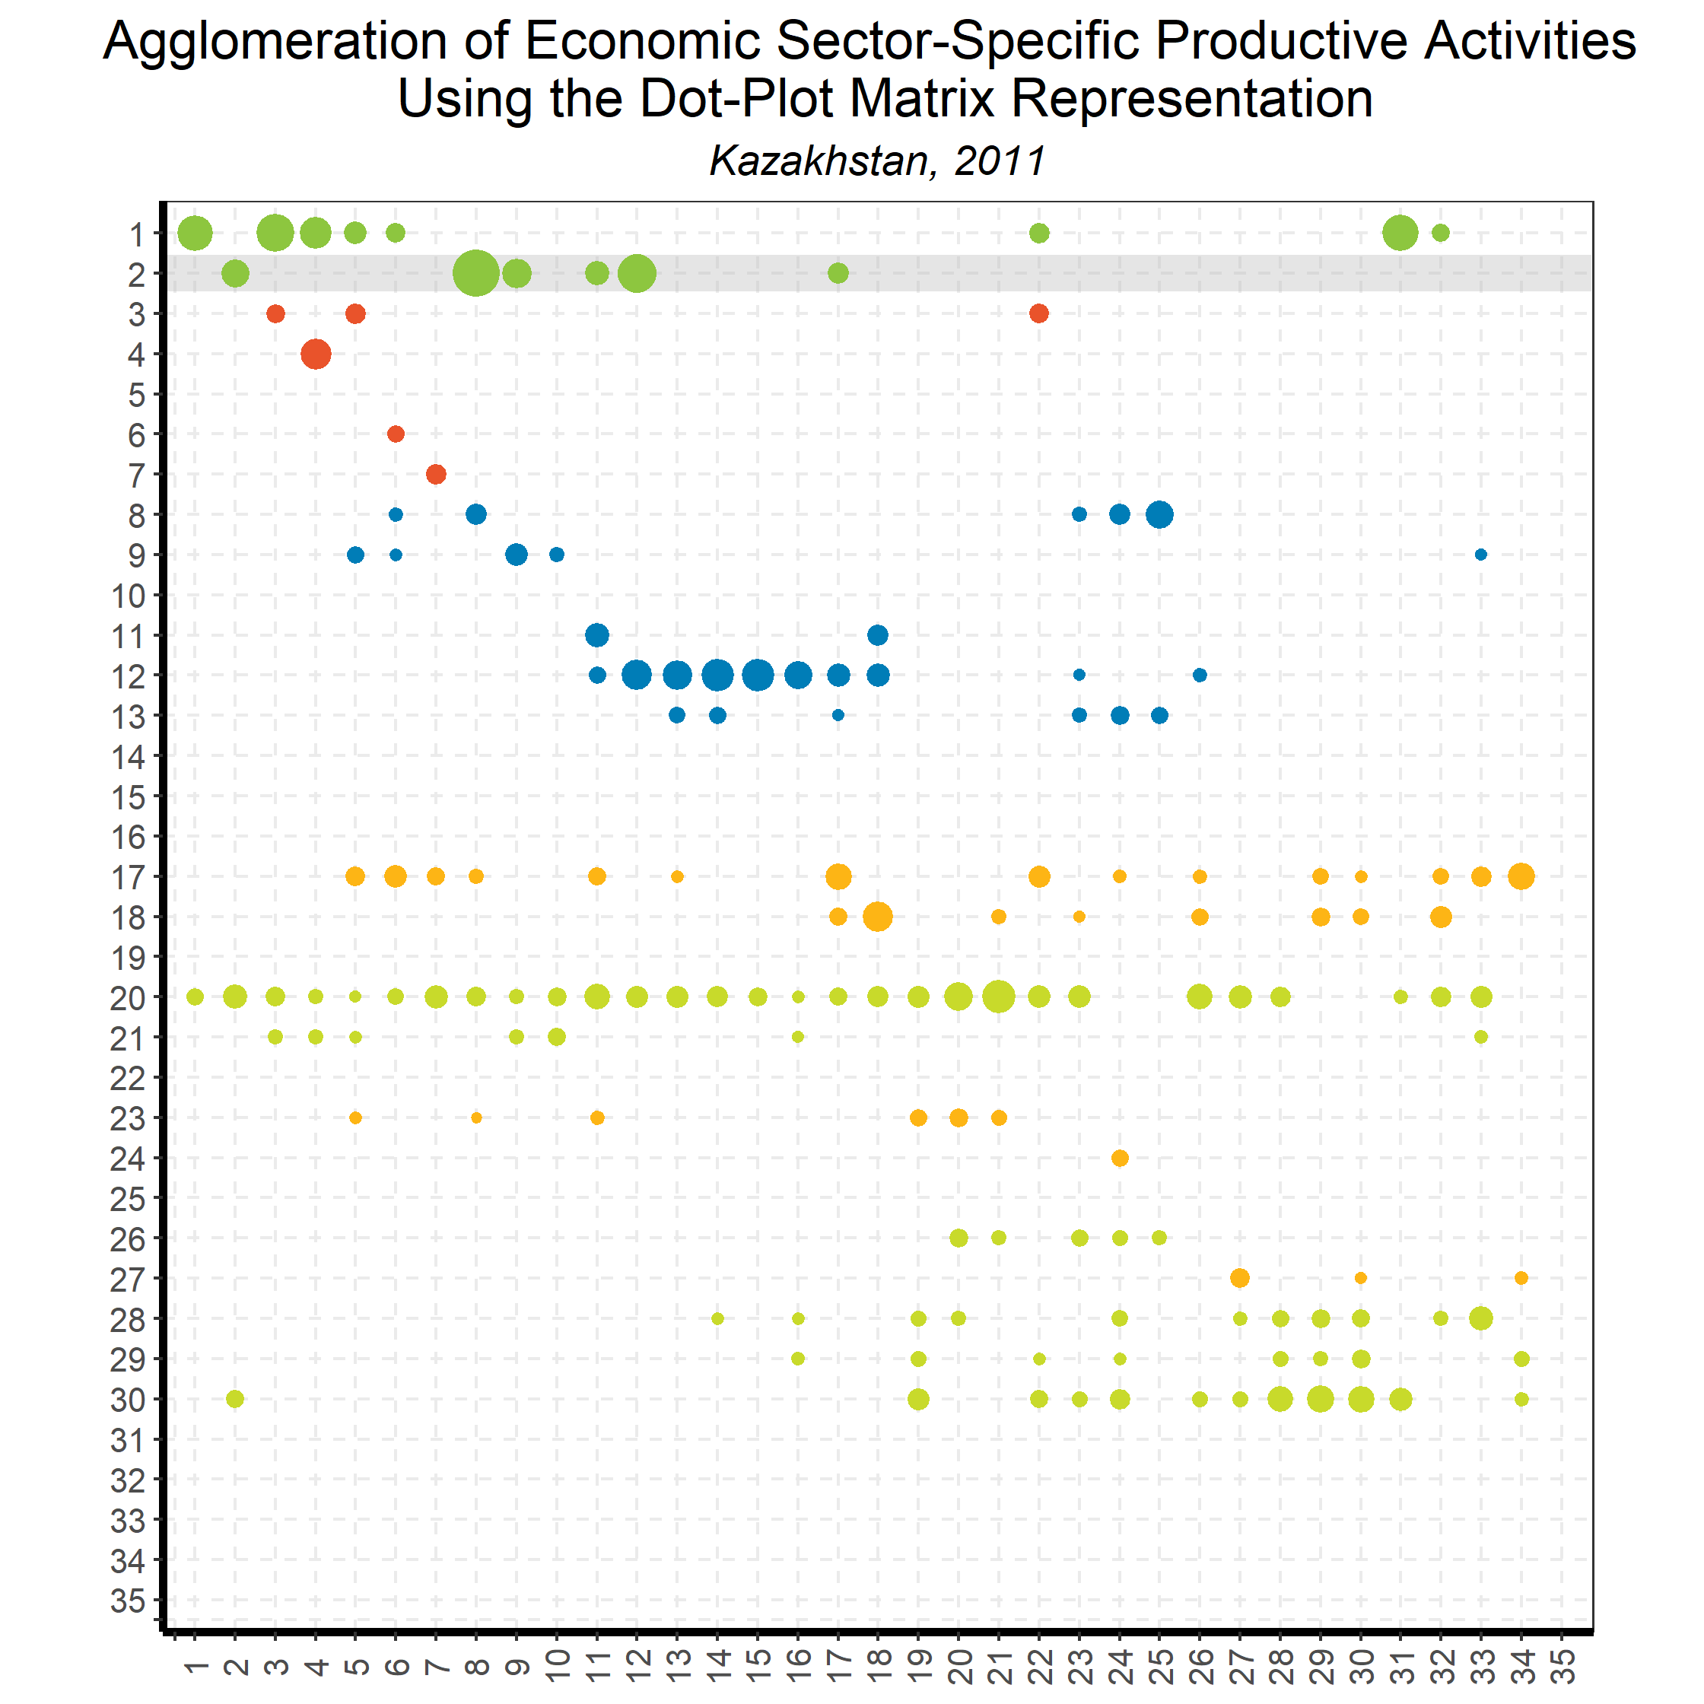
Linking Goods and Services:
Input-Output Direct Requirements
Back to country list

Slide 67
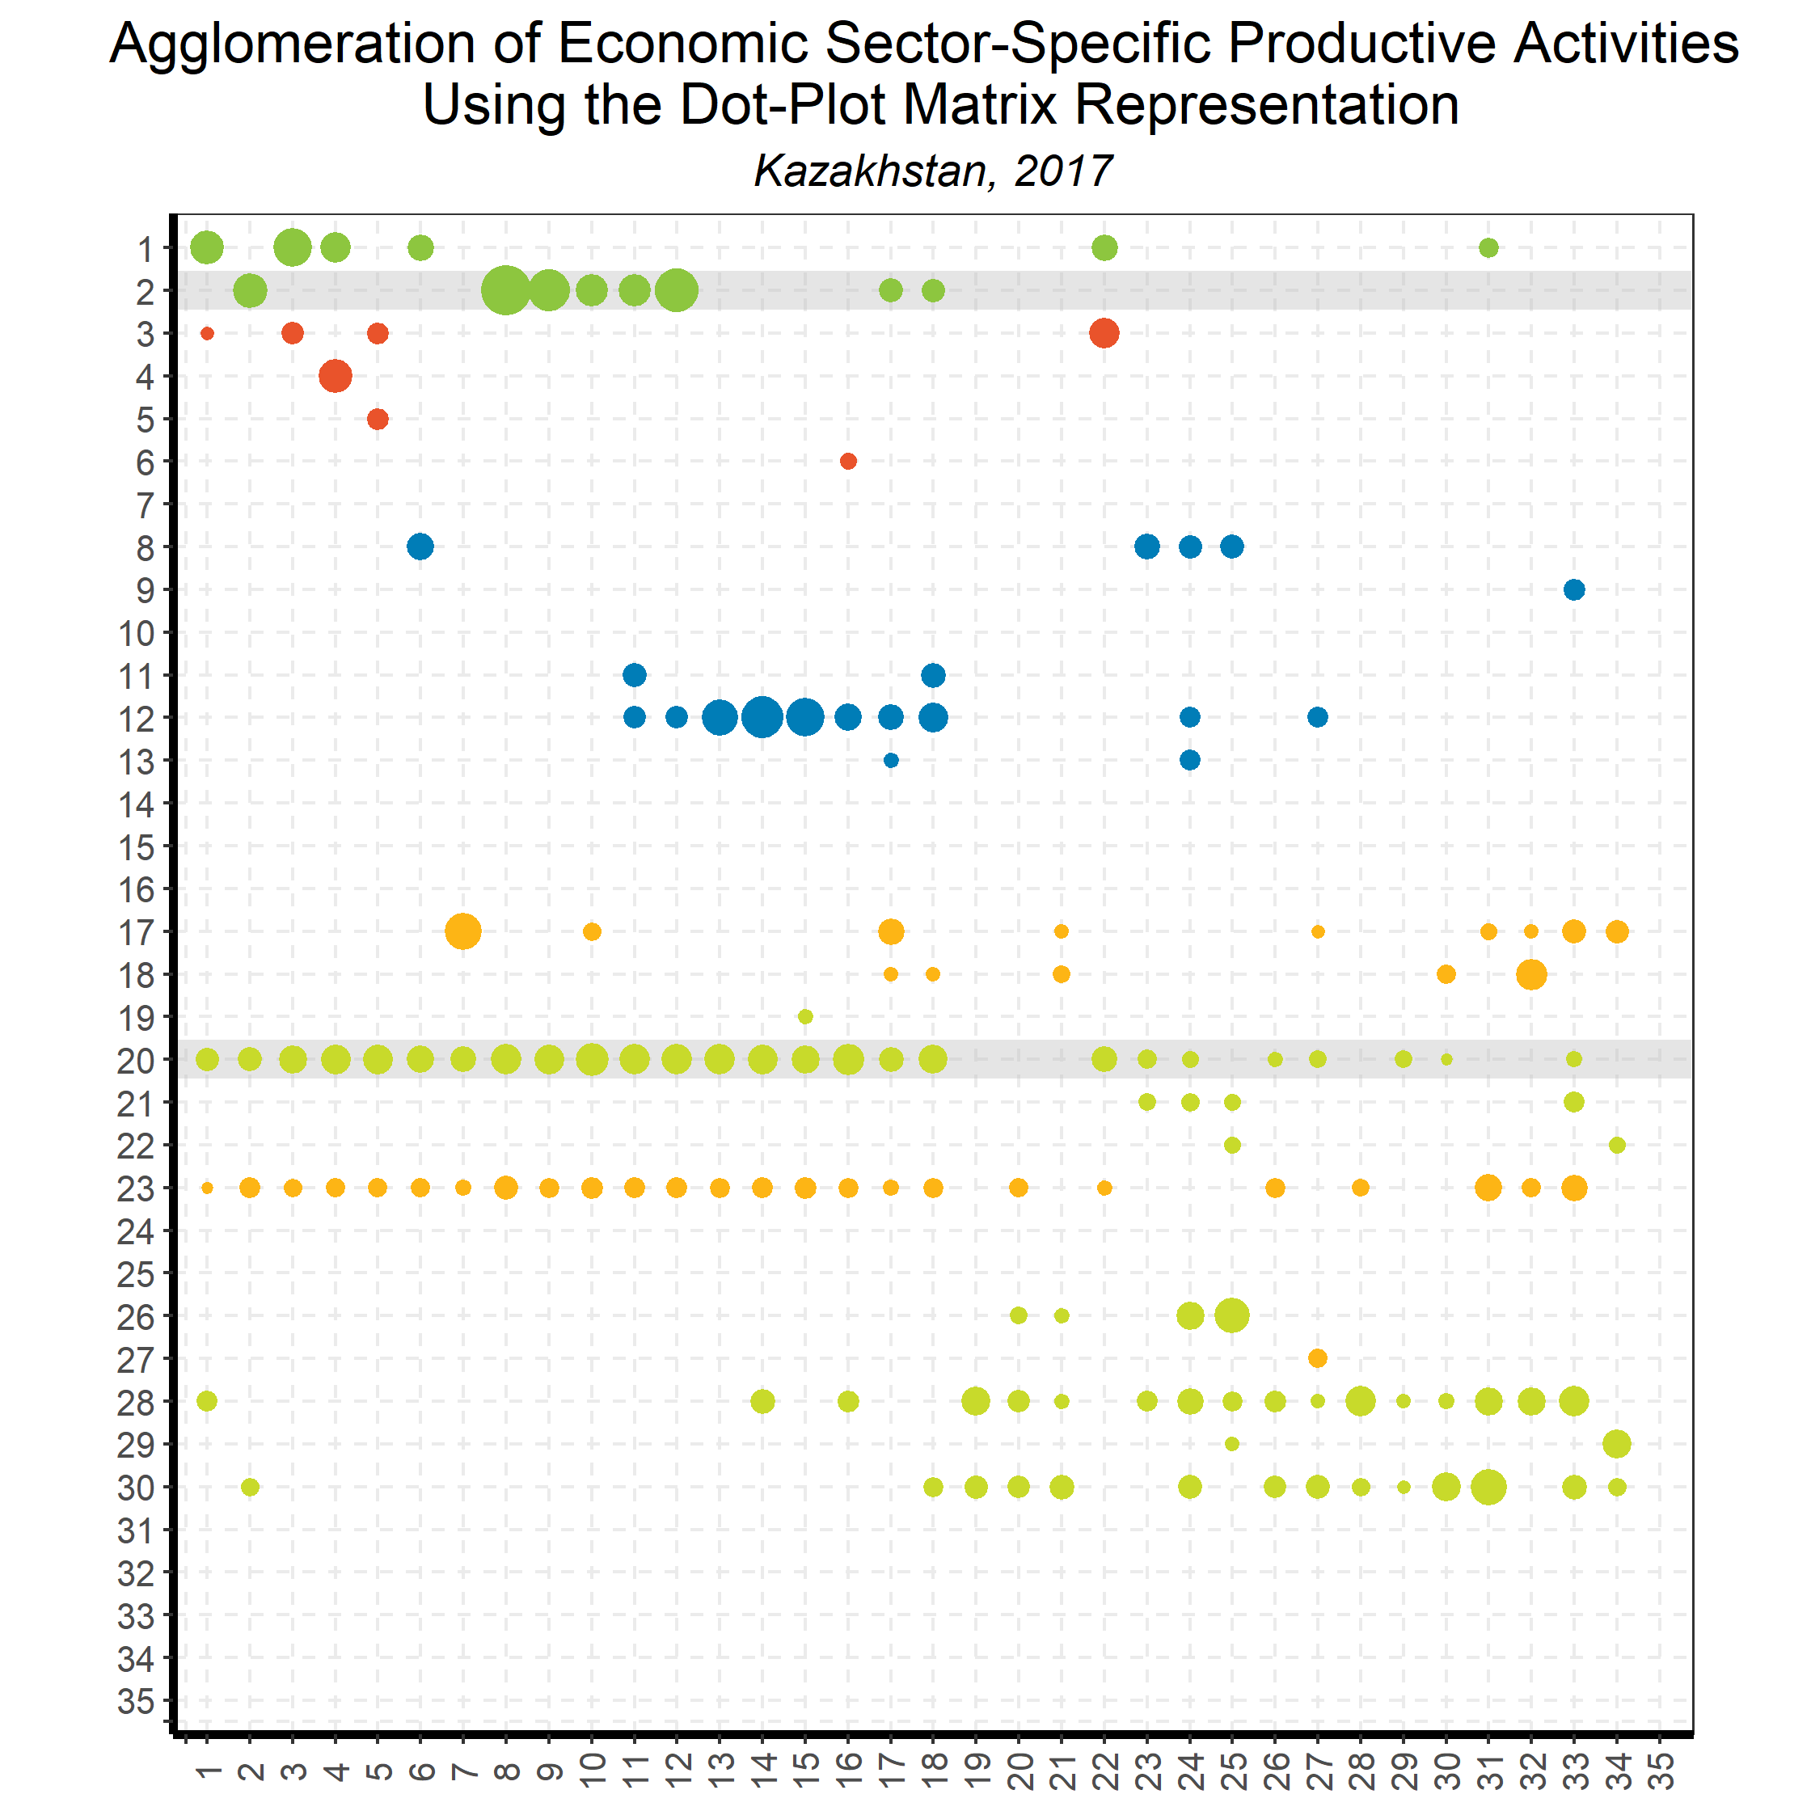
Linking Goods and Services:
Input-Output Direct Requirements
Back to country list

Slide 68
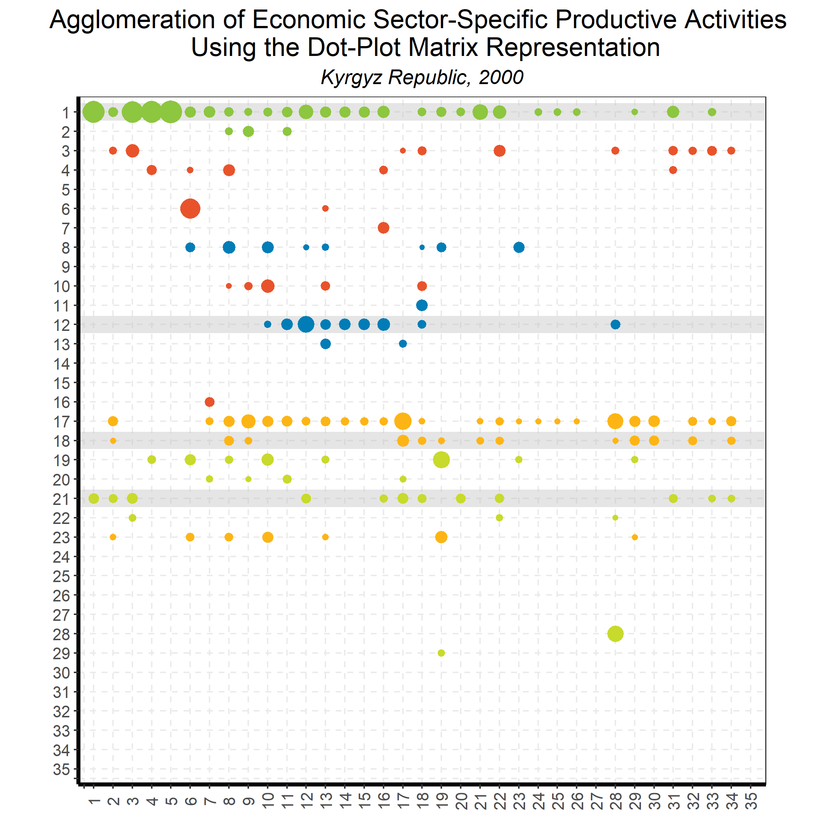
Linking Goods and Services:
Input-Output Direct Requirements
Back to country list

Slide 69
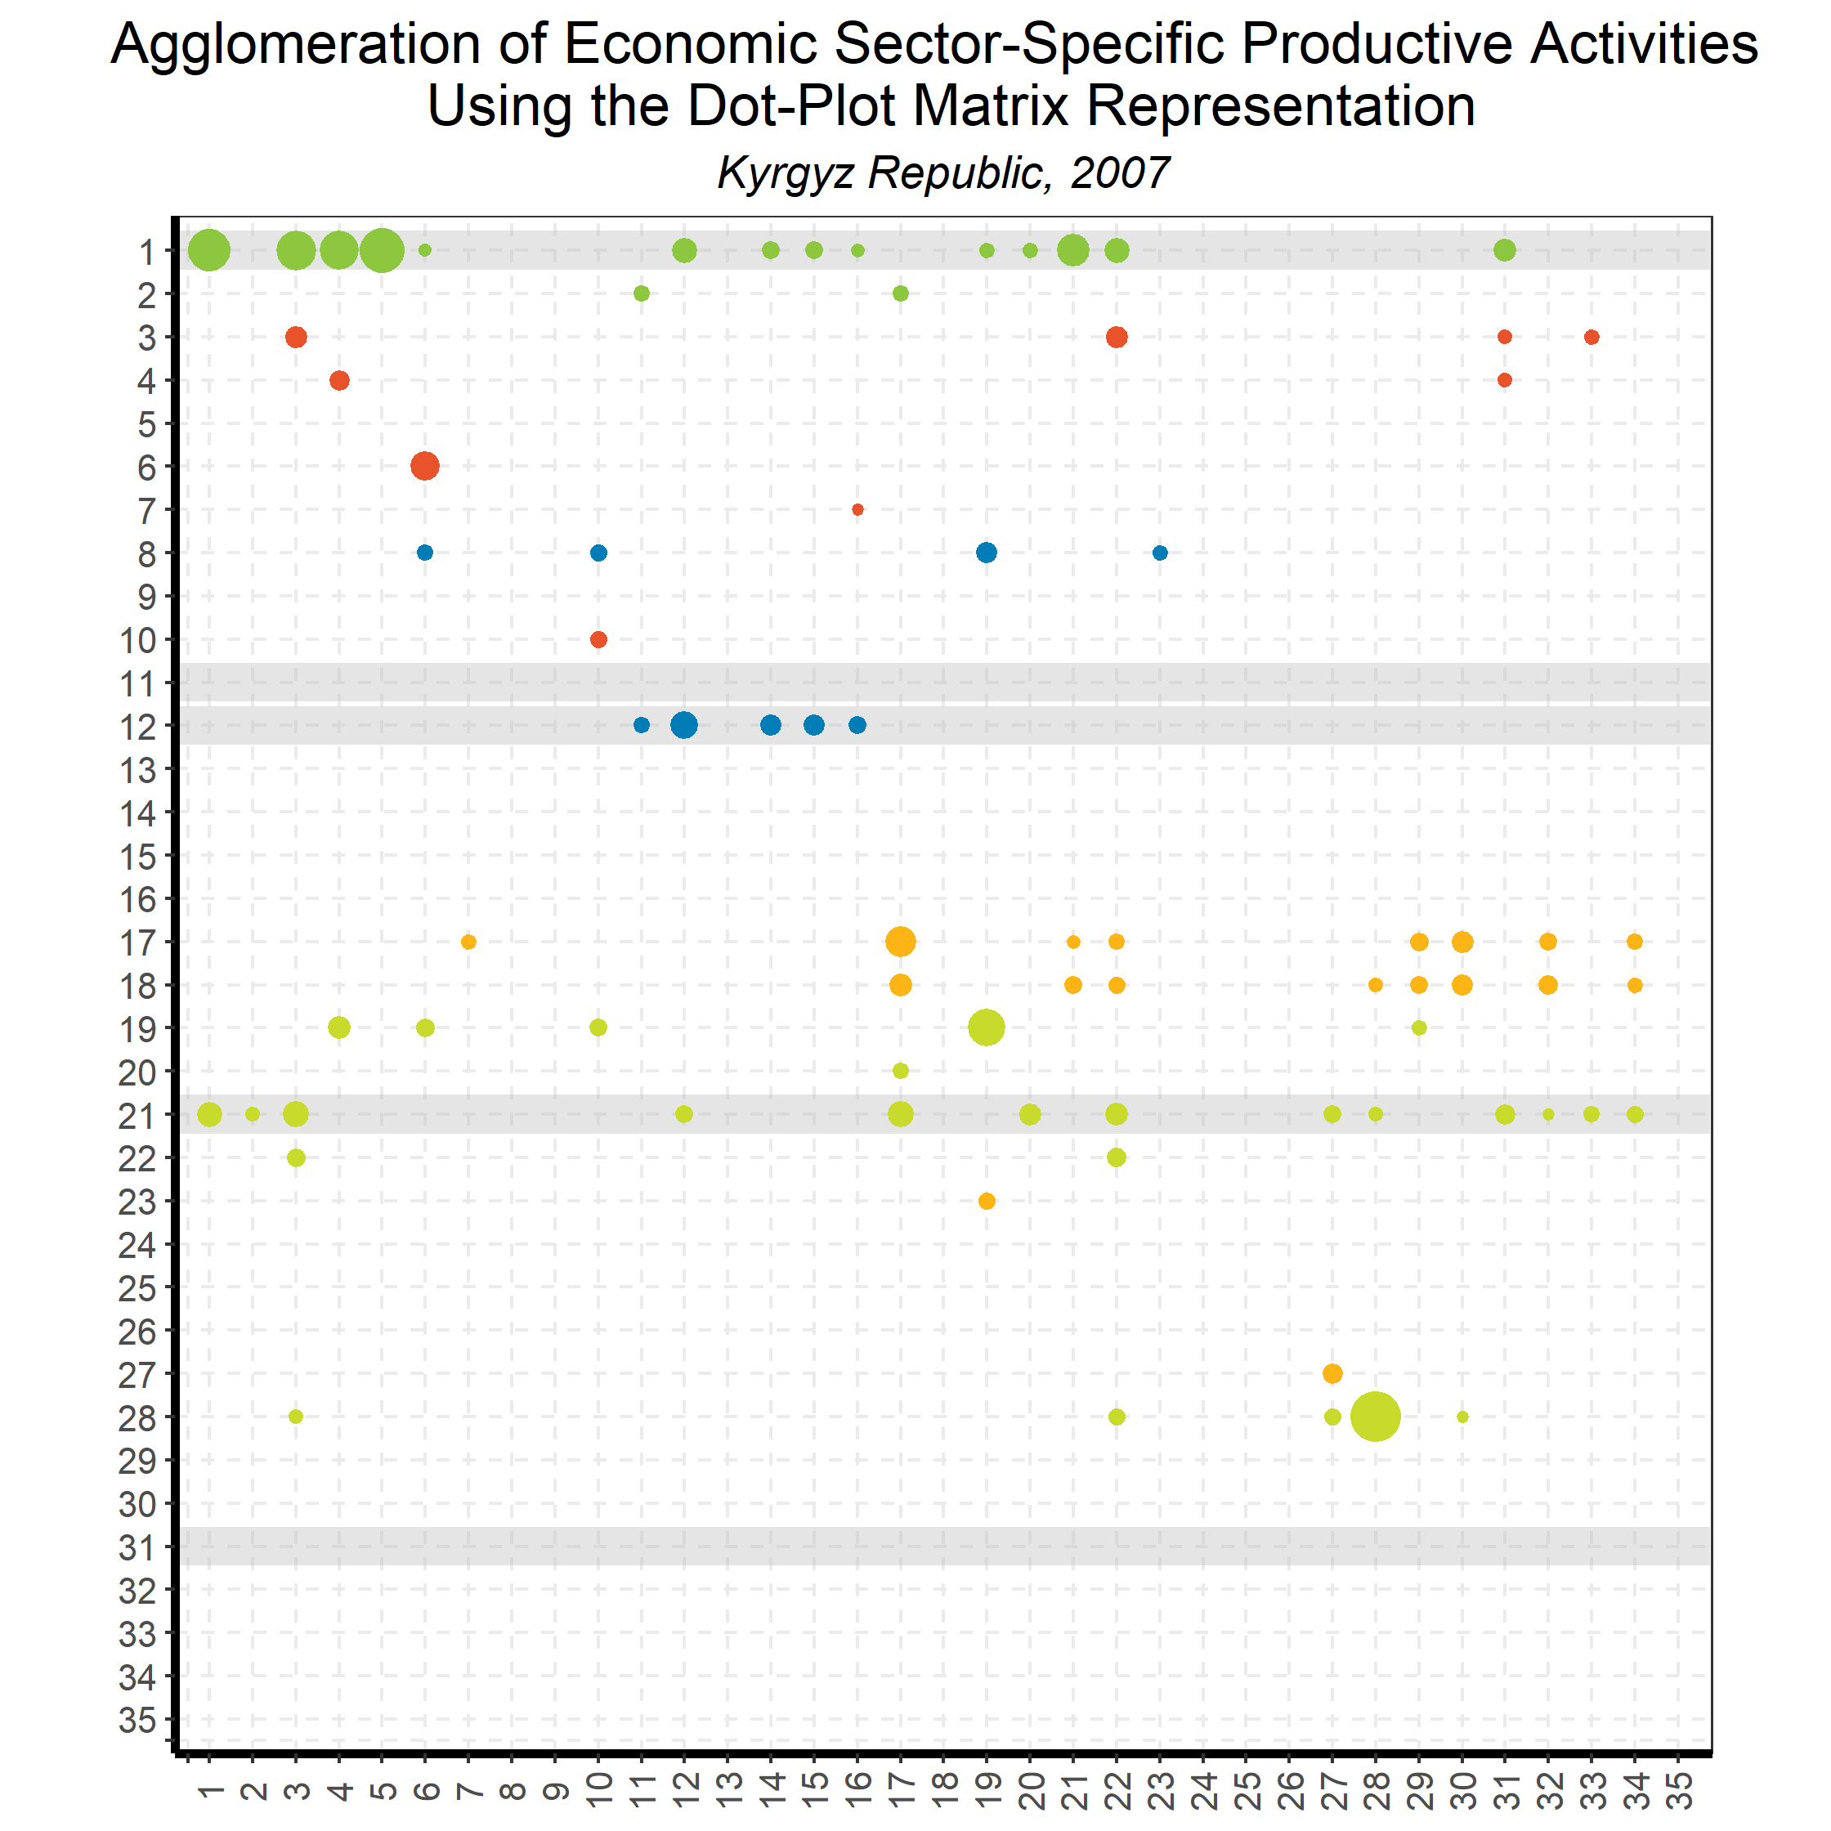
Linking Goods and Services:
Input-Output Direct Requirements
Back to country list

Slide 70
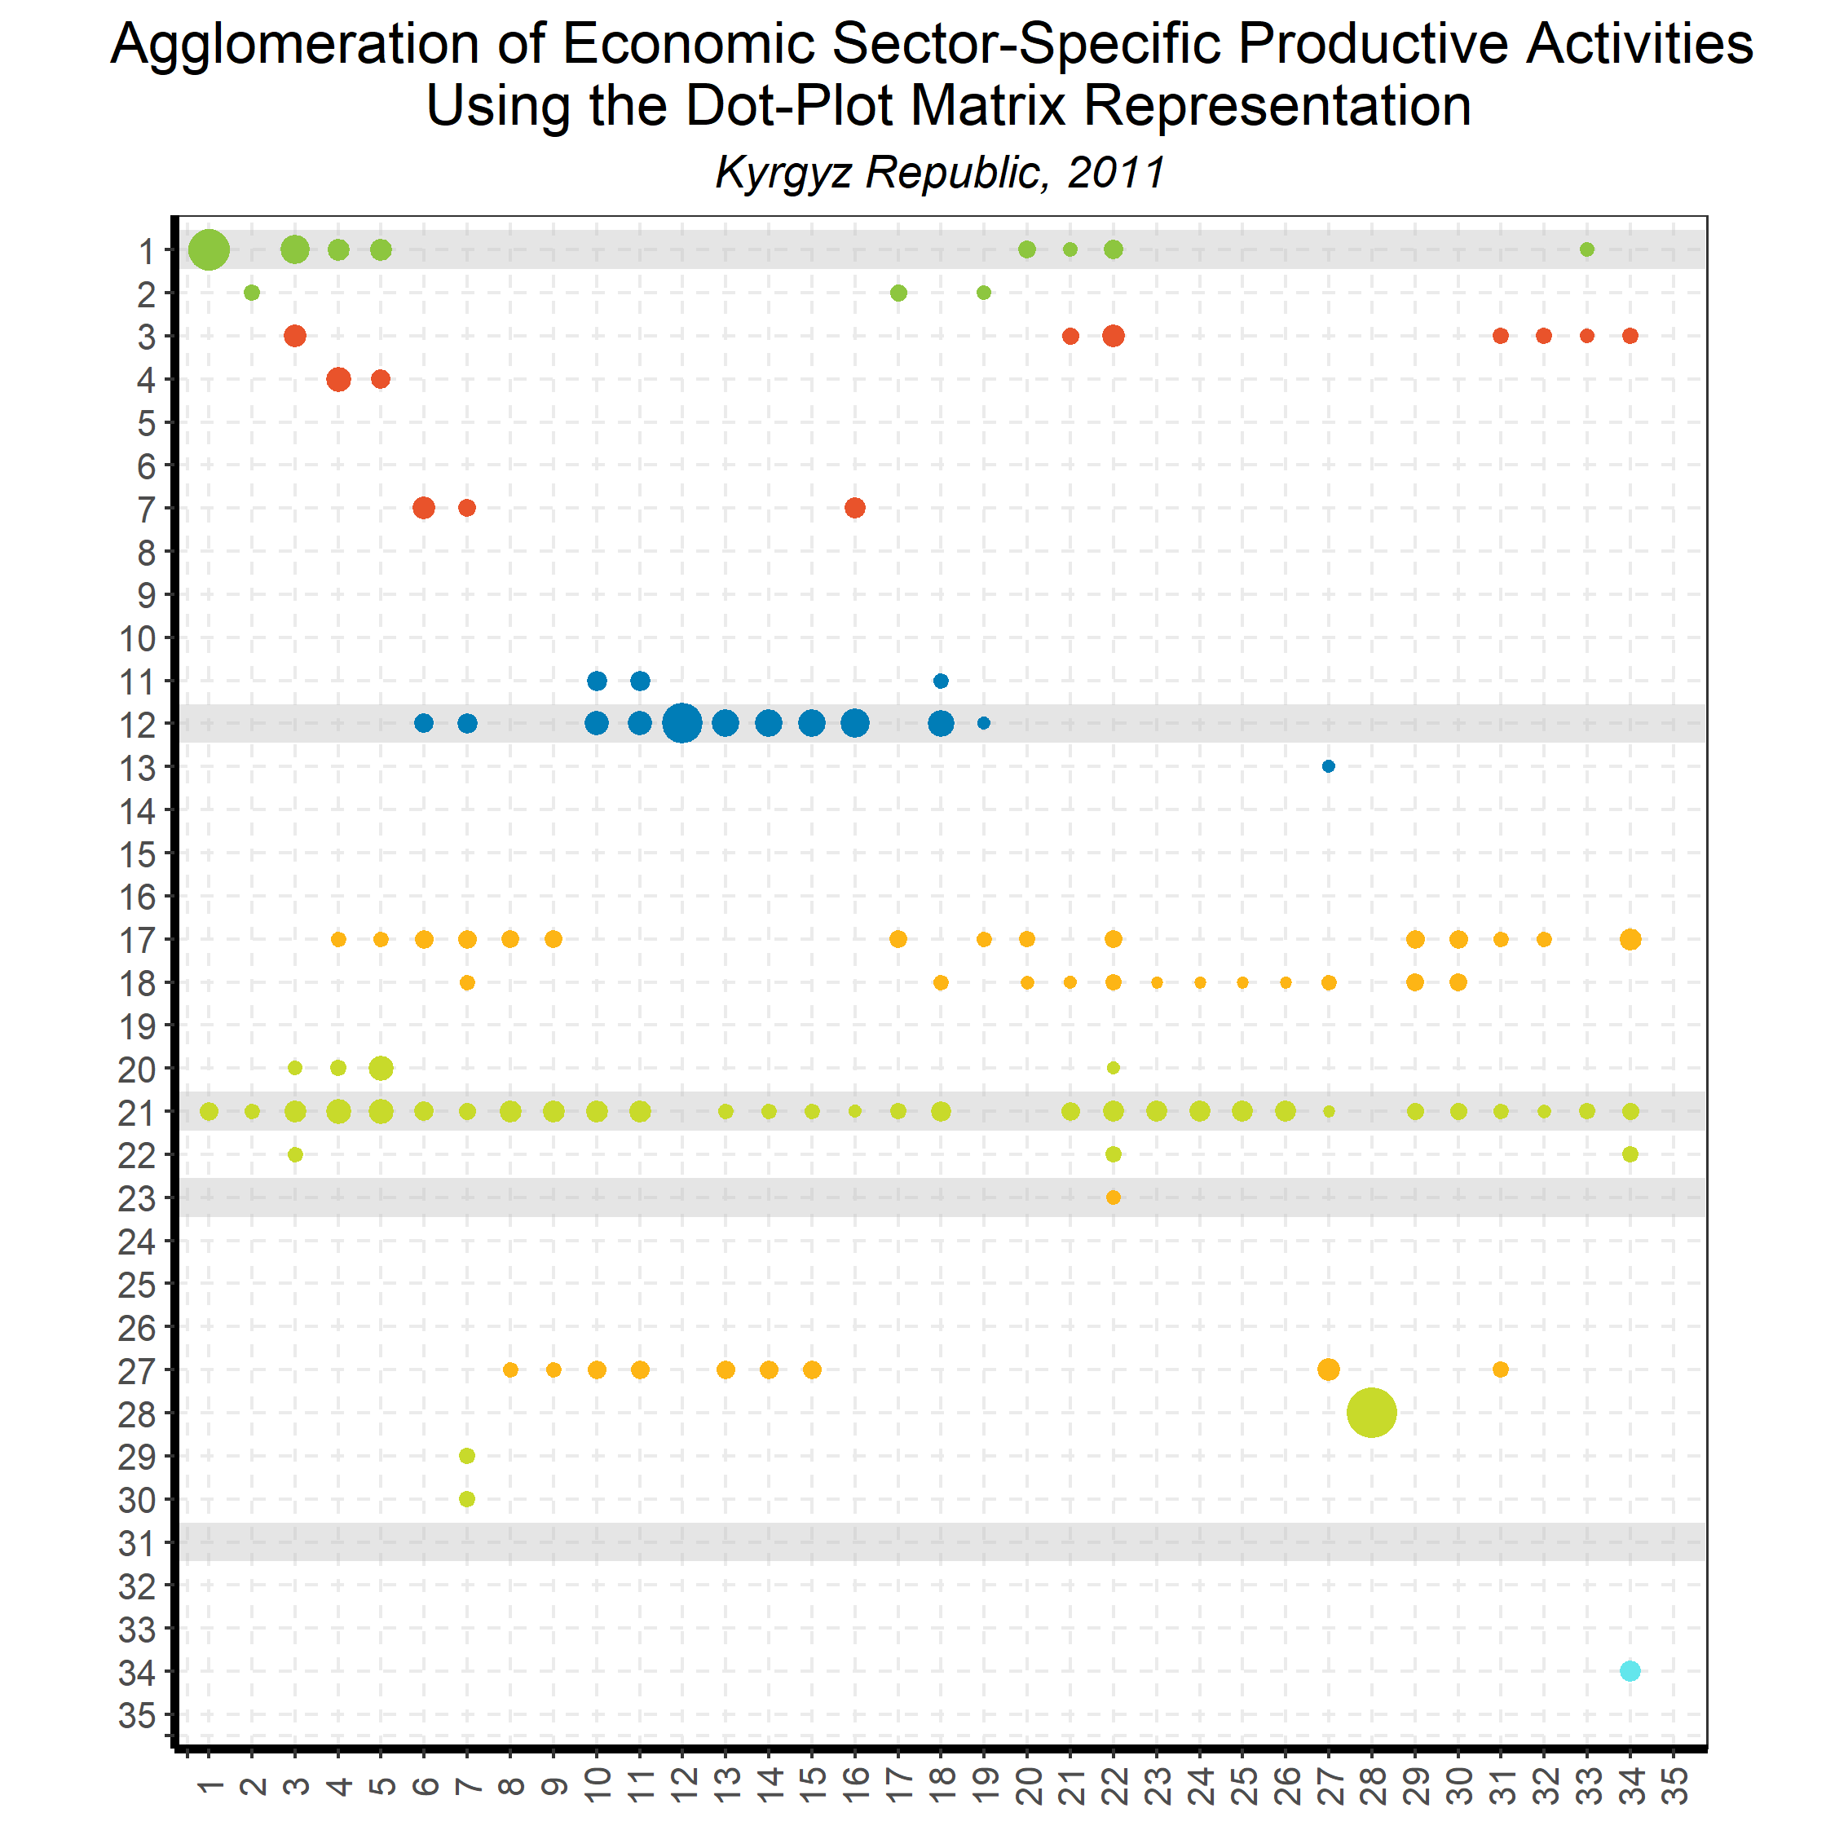
Linking Goods and Services:
Input-Output Direct Requirements
Back to country list

Slide 71

Linking Goods and Services:
Input-Output Direct Requirements
Back to country list

Slide 72
The Agglomeration Index:
Numerical results

Slide 73
The Agglomeration Index: Numerical results for Russia from 2000 to 2017
 | Country | RUS | 1
 | Threshold | 0.02
Economic block | Agglomeration index - overall
 | 2000 | 2007 | 2008 | 2009 | 2010 | 2011 | 2012 | 2013 | 2014 | 2015 | 2016 | 2017
Primary | -0.67 | -0.66 | -0.73 | -0.54 | -0.75 | -0.69 | -0.78 | -0.70 | -0.70 | -0.57 | -0.35 | -0.34
Low-technology manufacturing | 0.08 | 0.09 | 0.09 | 0.13 | 0.06 | 0.01 | -0.01 | -0.11 | -0.06 | 0.05 | -0.26 | -0.25
Medium- to high-technology manufacturing | 0.71 | 1.17 | 1.22 | 1.21 | 1.19 | 1.21 | 1.12 | 1.09 | 1.10 | 1.19 | 1.00 | 1.03
Infrastructure services | 0.40 | 0.75 | 0.72 | 0.81 | 0.81 | 0.69 | 0.65 | 0.70 | 0.82 | 0.81 | 0.96 | 0.99
Business services | 0.75 | 0.87 | 0.88 | 1.03 | 0.99 | 0.87 | 0.86 | 0.99 | 1.14 | 1.09 | 1.18 | 1.18
Personal and public services | -0.65 | -0.75 | -0.59 | -0.59 | -0.71 | -0.77 | -0.75 | -0.41 | -0.26 | -0.28 | -0.56 | -0.52
Economic block | Agglomeration index - backward
 | 2000 | 2007 | 2008 | 2009 | 2010 | 2011 | 2012 | 2013 | 2014 | 2015 | 2016 | 2017
Primary | -0.64 | -0.87 | -0.65 | -0.63 | -0.96 | -0.84 | -0.98 | -0.97 | -0.83 | -0.60 | -0.61 | -0.61
Low-technology manufacturing | 0.63 | 0.91 | 0.92 | 0.91 | 0.86 | 0.83 | 0.81 | 0.80 | 0.83 | 0.90 | 0.78 | 0.79
Medium- to high-technology manufacturing | 0.76 | 1.03 | 0.99 | 1.11 | 1.13 | 1.08 | 1.05 | 1.03 | 1.04 | 1.07 | 1.01 | 1.04
Infrastructure services | 0.30 | 0.71 | 0.80 | 0.76 | 0.75 | 0.69 | 0.63 | 0.70 | 0.80 | 0.80 | 0.80 | 0.82
Business services | 0.12 | 0.38 | 0.34 | 0.55 | 0.51 | 0.35 | 0.33 | 0.50 | 0.66 | 0.63 | 0.82 | 0.83
Personal and public services | 0.27 | 0.04 | 0.08 | 0.05 | -0.03 | 0.01 | -0.11 | 0.00 | 0.18 | 0.17 | -0.21 | -0.14
Economic block | Agglomeration index - forward
 | 2000 | 2007 | 2008 | 2009 | 2010 | 2011 | 2012 | 2013 | 2014 | 2015 | 2016 | 2017
Primary | -0.70 | -0.46 | -0.80 | -0.44 | -0.54 | -0.54 | -0.57 | -0.43 | -0.57 | -0.54 | -0.08 | -0.06
Low-technology manufacturing | -0.47 | -0.73 | -0.74 | -0.65 | -0.74 | -0.82 | -0.84 | -1.03 | -0.94 | -0.80 | -1.30 | -1.29
Medium- to high-technology manufacturing | 0.67 | 1.32 | 1.46 | 1.30 | 1.25 | 1.33 | 1.18 | 1.15 | 1.15 | 1.32 | 0.98 | 1.02
Infrastructure services | 0.50 | 0.79 | 0.63 | 0.86 | 0.86 | 0.70 | 0.66 | 0.70 | 0.84 | 0.82 | 1.13 | 1.16
Business services | 1.37 | 1.36 | 1.41 | 1.50 | 1.47 | 1.40 | 1.40 | 1.48 | 1.62 | 1.55 | 1.54 | 1.53
Personal and public services | -1.58 | -1.54 | -1.25 | -1.24 | -1.38 | -1.55 | -1.40 | -0.83 | -0.71 | -0.72 | -0.90 | -0.90

Slide 74
The Agglomeration Index: Numerical results for Kazakhstan from 2000 to 2017
 | Country | KAZ | 1
 | Threshold | 0.02
Economic block | Agglomeration index - overall
 | 2000 | 2007 | 2008 | 2009 | 2010 | 2011 | 2012 | 2013 | 2014 | 2015 | 2016 | 2017
Primary | -0.19 | -0.44 | -0.44 | -0.39 | -0.42 | -0.71 | -0.55 | -0.59 | -0.59 | -0.59 | -0.52 | -0.39
Low-technology manufacturing | -0.11 | -0.62 | -0.60 | -0.44 | -0.71 | -0.68 | -0.72 | -0.66 | -0.78 | -0.75 | -0.75 | -0.65
Medium- to high-technology manufacturing | 0.84 | -0.27 | 0.01 | 0.12 | 0.24 | 0.21 | -0.13 | 0.02 | -0.04 | 0.04 | 0.01 | -0.01
Infrastructure services | 0.21 | 0.25 | 0.33 | 0.47 | 0.44 | 0.35 | 0.29 | 0.43 | 0.43 | 0.52 | 0.50 | 0.57
Business services | 0.79 | 0.81 | 0.97 | 0.93 | 0.93 | 0.90 | 0.69 | 0.76 | 0.57 | 0.63 | 0.61 | 0.75
Personal and public services | 0.00 | -1.84 | -1.45 | -1.17 | 0.00 | 0.00 | 0.00 | 0.00 | 0.00 | 0.00 | 0.00 | 0.00
Economic block | Agglomeration index - backward
 | 2000 | 2007 | 2008 | 2009 | 2010 | 2011 | 2012 | 2013 | 2014 | 2015 | 2016 | 2017
Primary | -0.66 | -0.91 | -1.03 | -1.14 | -1.03 | -1.52 | -1.10 | -1.21 | -1.23 | -1.21 | -1.06 | -0.92
Low-technology manufacturing | 0.64 | 0.01 | 0.15 | 0.37 | 0.26 | 0.30 | -0.09 | 0.18 | 0.11 | 0.18 | 0.16 | 0.20
Medium- to high-technology manufacturing | 0.41 | 0.16 | 0.49 | 0.54 | 0.41 | 0.27 | 0.13 | 0.22 | 0.18 | 0.26 | 0.18 | 0.24
Infrastructure services | 0.31 | -0.08 | 0.00 | 0.15 | 0.39 | 0.33 | 0.21 | 0.26 | 0.38 | 0.45 | 0.47 | 0.55
Business services | 0.54 | 0.39 | 0.51 | 0.45 | 0.45 | 0.47 | 0.21 | 0.36 | -0.04 | 0.00 | 0.00 | 0.13
Personal and public services | -0.16 | -0.18 | -0.09 | 0.05 | -0.37 | -0.38 | -0.23 | -0.40 | -0.15 | -0.12 | -0.18 | -0.16
Economic block | Agglomeration index - forward
 | 2000 | 2007 | 2008 | 2009 | 2010 | 2011 | 2012 | 2013 | 2014 | 2015 | 2016 | 2017
Primary | 0.28 | 0.03 | 0.15 | 0.36 | 0.18 | 0.10 | -0.01 | 0.04 | 0.05 | 0.03 | 0.02 | 0.15
Low-technology manufacturing | -0.85 | -1.25 | -1.35 | -1.24 | -1.67 | -1.66 | -1.35 | -1.50 | -1.67 | -1.67 | -1.67 | -1.50
Medium- to high-technology manufacturing | 1.26 | -0.70 | -0.48 | -0.31 | 0.08 | 0.14 | -0.38 | -0.17 | -0.26 | -0.19 | -0.16 | -0.26
Infrastructure services | 0.12 | 0.58 | 0.66 | 0.78 | 0.49 | 0.38 | 0.37 | 0.60 | 0.49 | 0.60 | 0.54 | 0.59
Business services | 1.04 | 1.23 | 1.44 | 1.41 | 1.40 | 1.33 | 1.17 | 1.17 | 1.17 | 1.25 | 1.22 | 1.37
Personal and public services | 0.00 | -3.51 | -2.80 | -2.39 | 0.00 | 0.00 | 0.00 | 0.00 | 0.00 | 0.00 | 0.00 | 0.00

Slide 75
The Agglomeration Index: Numerical results for Kyrgyz Republic from 2000 to 2017
 | Country | KGZ | 1
 | Threshold | 0.02
Economic block | Agglomeration index - overall
 | 2000 | 2007 | 2008 | 2009 | 2010 | 2011 | 2012 | 2013 | 2014 | 2015 | 2016 | 2017
Primary | -0.35 | -0.24 | -0.27 | -0.28 | -0.29 | -0.29 | -0.29 | -0.25 | -0.37 | -0.59 | -0.47 | -0.37
Low-technology manufacturing | 0.35 | 0.40 | 0.22 | 0.22 | 0.10 | -0.01 | -0.12 | -0.22 | -0.22 | -0.22 | -0.28 | -0.21
Medium- to high-technology manufacturing | 0.58 | 0.40 | 0.35 | 0.47 | 0.32 | 0.25 | 0.24 | 0.25 | 0.27 | 0.27 | 0.27 | 0.27
Infrastructure services | 0.65 | 0.70 | 0.66 | 0.72 | 0.81 | 0.76 | 0.73 | 0.79 | 0.79 | 0.79 | 0.76 | 0.76
Business services | 1.33 | 1.39 | 1.37 | 1.39 | 1.35 | 1.31 | 1.26 | 1.19 | 1.21 | 1.23 | 1.24 | 1.25
Personal and public services | -0.76 | -0.82 | -0.85 | -0.91 | -0.92 | -0.93 | -0.91 | -1.02 | -1.01 | -0.97 | -1.07 | -1.07
Economic block | Agglomeration index - backward
 | 2000 | 2007 | 2008 | 2009 | 2010 | 2011 | 2012 | 2013 | 2014 | 2015 | 2016 | 2017
Primary | -0.48 | -0.50 | -0.59 | -0.57 | -0.66 | -0.49 | -0.50 | -0.42 | -0.50 | -0.70 | -0.81 | -0.70
Low-technology manufacturing | 0.83 | 0.97 | 0.82 | 0.85 | 0.84 | 0.76 | 0.76 | 0.67 | 0.67 | 0.68 | 0.68 | 0.71
Medium- to high-technology manufacturing | 0.79 | 0.68 | 0.59 | 0.73 | 0.60 | 0.56 | 0.55 | 0.67 | 0.69 | 0.70 | 0.72 | 0.73
Infrastructure services | 0.87 | 0.80 | 0.78 | 0.83 | 0.88 | 0.81 | 0.78 | 0.75 | 0.76 | 0.77 | 0.74 | 0.74
Business services | 0.72 | 0.80 | 0.82 | 0.82 | 0.79 | 0.72 | 0.63 | 0.56 | 0.57 | 0.58 | 0.60 | 0.60
Personal and public services | -0.20 | -0.14 | -0.20 | -0.32 | -0.34 | -0.36 | -0.31 | -0.52 | -0.52 | -0.44 | -0.45 | -0.44
Economic block | Agglomeration index - forward
 | 2000 | 2007 | 2008 | 2009 | 2010 | 2011 | 2012 | 2013 | 2014 | 2015 | 2016 | 2017
Primary | -0.21 | 0.01 | 0.04 | 0.00 | 0.09 | -0.08 | -0.09 | -0.09 | -0.24 | -0.48 | -0.12 | -0.03
Low-technology manufacturing | -0.14 | -0.18 | -0.39 | -0.40 | -0.63 | -0.79 | -1.00 | -1.11 | -1.11 | -1.11 | -1.24 | -1.12
Medium- to high-technology manufacturing | 0.37 | 0.13 | 0.11 | 0.20 | 0.03 | -0.06 | -0.08 | -0.16 | -0.15 | -0.17 | -0.18 | -0.18
Infrastructure services | 0.43 | 0.60 | 0.53 | 0.62 | 0.74 | 0.71 | 0.69 | 0.83 | 0.81 | 0.82 | 0.78 | 0.78
Business services | 1.93 | 1.98 | 1.93 | 1.95 | 1.92 | 1.91 | 1.90 | 1.82 | 1.85 | 1.89 | 1.89 | 1.89
Personal and public services | -1.32 | -1.50 | -1.50 | -1.49 | -1.50 | -1.51 | -1.51 | -1.52 | -1.51 | -1.50 | -1.70 | -1.70

Slide 76
The Agglomeration Index: Numerical results for Australia from 2000 to 2017
 | Country | AUS | 1
 | Threshold | 0.02
Economic block | Agglomeration index - overall
 | 2000 | 2007 | 2008 | 2009 | 2010 | 2011 | 2012 | 2013 | 2014 | 2015 | 2016 | 2017
Primary | -0.35 | -0.24 | -0.27 | -0.28 | -0.29 | -0.29 | -0.29 | -0.25 | -0.37 | -0.59 | -0.47 | -0.37
Low-technology manufacturing | 0.35 | 0.40 | 0.22 | 0.22 | 0.10 | -0.01 | -0.12 | -0.22 | -0.22 | -0.22 | -0.28 | -0.21
Medium- to high-technology manufacturing | 0.58 | 0.40 | 0.35 | 0.47 | 0.32 | 0.25 | 0.24 | 0.25 | 0.27 | 0.27 | 0.27 | 0.27
Infrastructure services | 0.65 | 0.70 | 0.66 | 0.72 | 0.81 | 0.76 | 0.73 | 0.79 | 0.79 | 0.79 | 0.76 | 0.76
Business services | 1.33 | 1.39 | 1.37 | 1.39 | 1.35 | 1.31 | 1.26 | 1.19 | 1.21 | 1.23 | 1.24 | 1.25
Personal and public services | -0.76 | -0.82 | -0.85 | -0.91 | -0.92 | -0.93 | -0.91 | -1.02 | -1.01 | -0.97 | -1.07 | -1.07
Economic block | Agglomeration index - backward
 | 2000 | 2007 | 2008 | 2009 | 2010 | 2011 | 2012 | 2013 | 2014 | 2015 | 2016 | 2017
Primary | -0.48 | -0.50 | -0.59 | -0.57 | -0.66 | -0.49 | -0.50 | -0.42 | -0.50 | -0.70 | -0.81 | -0.70
Low-technology manufacturing | 0.83 | 0.97 | 0.82 | 0.85 | 0.84 | 0.76 | 0.76 | 0.67 | 0.67 | 0.68 | 0.68 | 0.71
Medium- to high-technology manufacturing | 0.79 | 0.68 | 0.59 | 0.73 | 0.60 | 0.56 | 0.55 | 0.67 | 0.69 | 0.70 | 0.72 | 0.73
Infrastructure services | 0.87 | 0.80 | 0.78 | 0.83 | 0.88 | 0.81 | 0.78 | 0.75 | 0.76 | 0.77 | 0.74 | 0.74
Business services | 0.72 | 0.80 | 0.82 | 0.82 | 0.79 | 0.72 | 0.63 | 0.56 | 0.57 | 0.58 | 0.60 | 0.60
Personal and public services | -0.20 | -0.14 | -0.20 | -0.32 | -0.34 | -0.36 | -0.31 | -0.52 | -0.52 | -0.44 | -0.45 | -0.44
Economic block | Agglomeration index - forward
 | 2000 | 2007 | 2008 | 2009 | 2010 | 2011 | 2012 | 2013 | 2014 | 2015 | 2016 | 2017
Primary | -0.21 | 0.01 | 0.04 | 0.00 | 0.09 | -0.08 | -0.09 | -0.09 | -0.24 | -0.48 | -0.12 | -0.03
Low-technology manufacturing | -0.14 | -0.18 | -0.39 | -0.40 | -0.63 | -0.79 | -1.00 | -1.11 | -1.11 | -1.11 | -1.24 | -1.12
Medium- to high-technology manufacturing | 0.37 | 0.13 | 0.11 | 0.20 | 0.03 | -0.06 | -0.08 | -0.16 | -0.15 | -0.17 | -0.18 | -0.18
Infrastructure services | 0.43 | 0.60 | 0.53 | 0.62 | 0.74 | 0.71 | 0.69 | 0.83 | 0.81 | 0.82 | 0.78 | 0.78
Business services | 1.93 | 1.98 | 1.93 | 1.95 | 1.92 | 1.91 | 1.90 | 1.82 | 1.85 | 1.89 | 1.89 | 1.89
Personal and public services | -1.32 | -1.50 | -1.50 | -1.49 | -1.50 | -1.51 | -1.51 | -1.52 | -1.51 | -1.50 | -1.70 | -1.70

Slide 77
The Agglomeration Index: Numerical results for Canada from 2000 to 2017
 | Country | CAN | 6
 | Threshold | 0.02
Economic block | Agglomeration index - overall
 | 2000 | 2007 | 2008 | 2009 | 2010 | 2011 | 2012 | 2013 | 2014 | 2015 | 2016 | 2017
Primary | -0.76 | -0.49 | -0.88 | -0.37 | -0.36 | -0.45 | -0.45 | -0.46 | -0.53 | -0.40 | -0.38 | -0.39
Low-technology manufacturing | 0.01 | 0.20 | 0.32 | 0.31 | 0.31 | 0.30 | 0.30 | 0.27 | 0.11 | 0.15 | 0.14 | 0.17
Medium- to high-technology manufacturing | 0.08 | 0.08 | 0.08 | 0.29 | 0.20 | 0.24 | 0.28 | 0.32 | 0.32 | 0.41 | 0.42 | 0.45
Infrastructure services | 0.40 | 0.41 | 0.33 | 0.41 | 0.41 | 0.36 | 0.37 | 0.34 | 0.38 | 0.51 | 0.49 | 0.48
Business services | 1.33 | 1.34 | 1.34 | 1.34 | 1.31 | 1.31 | 1.31 | 1.31 | 1.31 | 1.34 | 1.34 | 1.36
Personal and public services | -0.77 | -0.74 | -0.72 | -0.80 | -0.80 | -0.80 | -0.80 | -0.80 | -0.82 | -0.70 | -0.73 | -0.73
Economic block | Agglomeration index - backward
 | 2000 | 2007 | 2008 | 2009 | 2010 | 2011 | 2012 | 2013 | 2014 | 2015 | 2016 | 2017
Primary | -0.51 | -0.43 | -0.52 | -0.43 | -0.45 | -0.55 | -0.55 | -0.55 | -0.56 | -0.43 | -0.43 | -0.43
Low-technology manufacturing | 0.84 | 0.96 | 0.99 | 0.97 | 0.96 | 0.96 | 0.96 | 0.96 | 0.92 | 1.00 | 0.99 | 1.04
Medium- to high-technology manufacturing | 0.54 | 0.60 | 0.60 | 0.73 | 0.62 | 0.64 | 0.67 | 0.70 | 0.66 | 0.78 | 0.79 | 0.84
Infrastructure services | 0.37 | 0.41 | 0.29 | 0.42 | 0.43 | 0.39 | 0.40 | 0.36 | 0.43 | 0.50 | 0.50 | 0.47
Business services | 0.68 | 0.66 | 0.66 | 0.70 | 0.67 | 0.67 | 0.67 | 0.68 | 0.67 | 0.68 | 0.68 | 0.68
Personal and public services | -0.33 | -0.27 | -0.22 | -0.22 | -0.22 | -0.21 | -0.21 | -0.21 | -0.39 | -0.30 | -0.36 | -0.36
Economic block | Agglomeration index - forward
 | 2000 | 2007 | 2008 | 2009 | 2010 | 2011 | 2012 | 2013 | 2014 | 2015 | 2016 | 2017
Primary | -1.01 | -0.56 | -1.23 | -0.31 | -0.28 | -0.35 | -0.36 | -0.36 | -0.51 | -0.36 | -0.34 | -0.35
Low-technology manufacturing | -0.82 | -0.56 | -0.35 | -0.35 | -0.35 | -0.35 | -0.35 | -0.41 | -0.71 | -0.70 | -0.70 | -0.69
Medium- to high-technology manufacturing | -0.39 | -0.45 | -0.44 | -0.16 | -0.21 | -0.17 | -0.11 | -0.06 | -0.03 | 0.03 | 0.04 | 0.05
Infrastructure services | 0.43 | 0.41 | 0.37 | 0.40 | 0.40 | 0.33 | 0.33 | 0.33 | 0.33 | 0.51 | 0.48 | 0.48
Business services | 1.99 | 2.02 | 2.03 | 1.99 | 1.94 | 1.95 | 1.95 | 1.95 | 1.95 | 2.00 | 1.99 | 2.04
Personal and public services | -1.21 | -1.20 | -1.21 | -1.39 | -1.39 | -1.39 | -1.39 | -1.39 | -1.25 | -1.09 | -1.10 | -1.10

Slide 78
The Agglomeration Index: Numerical results for Estonia from 2000 to 2017
 | Country | EST | 14
 | Threshold | 0.02
Economic block | Agglomeration index - overall
 | 2000 | 2007 | 2008 | 2009 | 2010 | 2011 | 2012 | 2013 | 2014 | 2015 | 2016 | 2017
Primary | -0.75 | -1.09 | -1.00 | -1.05 | -1.06 | -1.02 | -0.97 | -1.09 | -1.02 | -1.07 | -0.97 | -1.05
Low-technology manufacturing | -0.13 | -0.31 | -0.43 | -0.52 | -0.48 | -0.61 | -0.80 | -0.65 | -0.70 | -0.59 | -0.81 | -0.69
Medium- to high-technology manufacturing | -0.02 | -0.49 | -0.53 | -0.50 | -0.55 | -0.60 | -0.98 | -0.64 | -0.69 | -0.57 | -0.87 | -0.94
Infrastructure services | 0.45 | 0.26 | 0.28 | 0.28 | 0.39 | 0.33 | 0.23 | 0.35 | 0.28 | 0.38 | 0.28 | 0.34
Business services | 0.90 | 0.87 | 0.88 | 0.97 | 0.92 | 0.88 | 0.86 | 0.87 | 0.90 | 0.92 | 0.82 | 0.92
Personal and public services | -1.66 | -1.73 | -1.72 | -1.72 | -1.68 | -1.68 | -1.73 | -1.70 | -1.70 | -1.69 | -2.19 | -1.78
Economic block | Agglomeration index - backward
 | 2000 | 2007 | 2008 | 2009 | 2010 | 2011 | 2012 | 2013 | 2014 | 2015 | 2016 | 2017
Primary | -0.75 | -1.21 | -1.03 | -1.16 | -1.18 | -1.20 | -1.09 | -1.23 | -1.08 | -1.21 | -0.95 | -1.10
Low-technology manufacturing | 0.46 | 0.23 | 0.21 | 0.25 | 0.34 | 0.21 | 0.02 | 0.18 | 0.07 | 0.28 | 0.04 | 0.28
Medium- to high-technology manufacturing | 0.18 | -0.18 | -0.10 | 0.06 | -0.01 | -0.12 | -0.34 | -0.17 | -0.17 | -0.06 | -0.39 | -0.24
Infrastructure services | 0.16 | 0.14 | 0.10 | -0.03 | 0.05 | 0.14 | 0.05 | 0.14 | 0.13 | 0.20 | 0.08 | 0.11
Business services | 0.51 | 0.44 | 0.41 | 0.53 | 0.47 | 0.40 | 0.39 | 0.40 | 0.39 | 0.40 | 0.36 | 0.41
Personal and public services | -0.58 | -0.71 | -0.70 | -0.71 | -0.62 | -0.63 | -0.71 | -0.64 | -0.64 | -0.63 | -0.91 | -0.81
Economic block | Agglomeration index - forward
 | 2000 | 2007 | 2008 | 2009 | 2010 | 2011 | 2012 | 2013 | 2014 | 2015 | 2016 | 2017
Primary | -0.74 | -0.97 | -0.96 | -0.94 | -0.94 | -0.84 | -0.84 | -0.96 | -0.96 | -0.92 | -0.99 | -0.99
Low-technology manufacturing | -0.72 | -0.84 | -1.06 | -1.29 | -1.30 | -1.44 | -1.61 | -1.48 | -1.47 | -1.46 | -1.66 | -1.65
Medium- to high-technology manufacturing | -0.22 | -0.80 | -0.97 | -1.06 | -1.09 | -1.08 | -1.63 | -1.10 | -1.20 | -1.08 | -1.34 | -1.65
Infrastructure services | 0.74 | 0.38 | 0.45 | 0.60 | 0.73 | 0.52 | 0.41 | 0.56 | 0.43 | 0.56 | 0.49 | 0.57
Business services | 1.30 | 1.31 | 1.36 | 1.42 | 1.37 | 1.37 | 1.33 | 1.35 | 1.40 | 1.44 | 1.28 | 1.43
Personal and public services | -2.74 | -2.75 | -2.73 | -2.74 | -2.73 | -2.74 | -2.75 | -2.75 | -2.76 | -2.75 | -3.46 | -2.75

Slide 79
The Agglomeration Index: Numerical results for Latvia from 2000 to 2017
 | Country | LVA | 29
 | Threshold | 0.02
Economic block | Agglomeration index - overall
 | 2000 | 2007 | 2008 | 2009 | 2010 | 2011 | 2012 | 2013 | 2014 | 2015 | 2016 | 2017
Primary | -0.95 | -1.13 | -1.02 | -0.86 | -0.82 | -0.85 | -0.90 | -0.77 | -0.78 | -1.16 | -1.24 | -1.30
Low-technology manufacturing | -0.22 | -0.46 | -0.51 | -0.34 | -0.54 | -0.47 | -0.47 | -0.43 | -0.44 | -0.48 | -0.48 | -0.54
Medium- to high-technology manufacturing | -0.26 | -0.69 | -0.52 | -0.40 | -0.34 | -0.49 | -0.29 | -0.44 | -0.46 | -0.62 | -0.71 | -0.65
Infrastructure services | 0.70 | 0.53 | 0.65 | 0.75 | 0.83 | 0.68 | 0.69 | 0.69 | 0.67 | 0.61 | 0.57 | 0.58
Business services | 1.33 | 1.12 | 1.12 | 1.20 | 1.29 | 1.07 | 1.12 | 1.13 | 1.12 | 1.13 | 1.07 | 1.06
Personal and public services | -1.65 | -1.79 | -1.66 | -1.65 | -1.61 | -1.70 | -1.66 | -1.70 | -1.70 | -1.46 | -1.60 | -1.64
Economic block | Agglomeration index - backward
 | 2000 | 2007 | 2008 | 2009 | 2010 | 2011 | 2012 | 2013 | 2014 | 2015 | 2016 | 2017
Primary | -0.91 | -1.13 | -0.89 | -0.65 | -0.56 | -0.57 | -0.67 | -0.46 | -0.47 | -0.58 | -0.70 | -0.81
Low-technology manufacturing | 0.54 | 0.33 | 0.26 | 0.46 | 0.33 | 0.35 | 0.35 | 0.44 | 0.41 | 0.37 | 0.38 | 0.27
Medium- to high-technology manufacturing | 0.40 | 0.25 | 0.30 | 0.39 | 0.40 | 0.24 | 0.38 | 0.33 | 0.29 | 0.11 | 0.08 | 0.06
Infrastructure services | 0.39 | 0.35 | 0.41 | 0.42 | 0.58 | 0.39 | 0.43 | 0.42 | 0.41 | 0.40 | 0.40 | 0.42
Business services | 0.84 | 0.52 | 0.54 | 0.64 | 0.73 | 0.49 | 0.52 | 0.50 | 0.50 | 0.48 | 0.36 | 0.42
Personal and public services | -0.54 | -0.81 | -0.57 | -0.56 | -0.48 | -0.63 | -0.57 | -0.63 | -0.63 | -0.57 | -0.44 | -0.50
Economic block | Agglomeration index - forward
 | 2000 | 2007 | 2008 | 2009 | 2010 | 2011 | 2012 | 2013 | 2014 | 2015 | 2016 | 2017
Primary | -0.98 | -1.13 | -1.15 | -1.06 | -1.07 | -1.12 | -1.14 | -1.09 | -1.10 | -1.74 | -1.77 | -1.78
Low-technology manufacturing | -0.98 | -1.26 | -1.28 | -1.15 | -1.41 | -1.30 | -1.30 | -1.30 | -1.29 | -1.32 | -1.34 | -1.34
Medium- to high-technology manufacturing | -0.91 | -1.63 | -1.34 | -1.18 | -1.07 | -1.21 | -0.97 | -1.21 | -1.21 | -1.36 | -1.51 | -1.37
Infrastructure services | 1.02 | 0.70 | 0.89 | 1.07 | 1.08 | 0.97 | 0.96 | 0.97 | 0.94 | 0.82 | 0.74 | 0.73
Business services | 1.83 | 1.72 | 1.69 | 1.76 | 1.85 | 1.65 | 1.72 | 1.76 | 1.75 | 1.77 | 1.77 | 1.71
Personal and public services | -2.75 | -2.76 | -2.75 | -2.74 | -2.75 | -2.76 | -2.76 | -2.76 | -2.76 | -2.35 | -2.77 | -2.77

Slide 80
The Agglomeration Index: Numerical results for Lithuania from 2000 to 2017
 | Country | LTU | 27
 | Threshold | 0.02
Economic block | Agglomeration index - overall
 | 2000 | 2007 | 2008 | 2009 | 2010 | 2011 | 2012 | 2013 | 2014 | 2015 | 2016 | 2017
Primary | -1.01 | -1.47 | -1.66 | -1.23 | -1.25 | -1.56 | -1.51 | -1.59 | -1.68 | -1.94 | -1.51 | -1.83
Low-technology manufacturing | -0.02 | -0.67 | -0.60 | -0.35 | -0.42 | -0.55 | -0.65 | -0.64 | -0.64 | -0.73 | -0.85 | -1.06
Medium- to high-technology manufacturing | 0.29 | -0.33 | -0.24 | -0.11 | -0.37 | -0.31 | -0.44 | -0.44 | -0.23 | -0.51 | -0.82 | -0.66
Infrastructure services | 0.23 | 0.12 | 0.05 | 0.11 | 0.14 | -0.01 | -0.08 | 0.01 | -0.05 | -0.11 | -0.11 | -0.26
Business services | 0.65 | 0.65 | 0.67 | 0.67 | 0.64 | 0.58 | 0.55 | 0.56 | 0.54 | 0.48 | 0.48 | 0.25
Personal and public services | -1.25 | -1.32 | -1.31 | -1.36 | -1.15 | -1.34 | -1.38 | -1.38 | -1.38 | -1.39 | -1.31 | -1.63
Economic block | Agglomeration index - backward
 | 2000 | 2007 | 2008 | 2009 | 2010 | 2011 | 2012 | 2013 | 2014 | 2015 | 2016 | 2017
Primary | -0.87 | -1.45 | -1.63 | -0.98 | -1.01 | -1.44 | -1.31 | -1.47 | -1.64 | -1.91 | -1.31 | -1.68
Low-technology manufacturing | 0.56 | 0.11 | 0.11 | 0.27 | 0.16 | 0.02 | -0.07 | -0.04 | -0.04 | -0.20 | -0.33 | -0.61
Medium- to high-technology manufacturing | 0.35 | -0.17 | -0.12 | -0.05 | -0.13 | -0.18 | -0.25 | -0.31 | -0.15 | -0.58 | -0.43 | -0.81
Infrastructure services | -0.16 | 0.05 | 0.02 | 0.02 | -0.07 | -0.11 | -0.21 | -0.07 | -0.15 | -0.12 | -0.16 | -0.05
Business services | 0.29 | 0.14 | 0.15 | 0.18 | 0.17 | 0.12 | 0.11 | 0.13 | 0.13 | 0.13 | 0.00 | -0.17
Personal and public services | -0.43 | -0.57 | -0.55 | -0.65 | -0.45 | -0.60 | -0.68 | -0.69 | -0.69 | -0.69 | -0.78 | -0.87
Economic block | Agglomeration index - forward
 | 2000 | 2007 | 2008 | 2009 | 2010 | 2011 | 2012 | 2013 | 2014 | 2015 | 2016 | 2017
Primary | -1.16 | -1.49 | -1.68 | -1.49 | -1.50 | -1.68 | -1.71 | -1.71 | -1.72 | -1.98 | -1.70 | -1.98
Low-technology manufacturing | -0.59 | -1.44 | -1.31 | -0.98 | -1.00 | -1.12 | -1.23 | -1.24 | -1.24 | -1.25 | -1.37 | -1.51
Medium- to high-technology manufacturing | 0.23 | -0.49 | -0.36 | -0.18 | -0.62 | -0.45 | -0.63 | -0.58 | -0.31 | -0.44 | -1.21 | -0.51
Infrastructure services | 0.61 | 0.19 | 0.08 | 0.20 | 0.35 | 0.09 | 0.06 | 0.10 | 0.05 | -0.10 | -0.07 | -0.47
Business services | 1.02 | 1.16 | 1.18 | 1.15 | 1.12 | 1.03 | 1.00 | 1.00 | 0.94 | 0.83 | 0.96 | 0.67
Personal and public services | -2.07 | -2.08 | -2.07 | -2.07 | -1.85 | -2.08 | -2.08 | -2.08 | -2.08 | -2.08 | -1.84 | -2.38

Slide 81
The Agglomeration Index: Numerical results for United States from 2000 to 2017
 | Country | USA | 43
 | Threshold | 0.02
Economic block | Agglomeration index - overall
 | 2000 | 2007 | 2008 | 2009 | 2010 | 2011 | 2012 | 2013 | 2014 | 2015 | 2016 | 2017
Primary | -0.62 | -0.70 | -0.74 | -0.84 | -0.85 | -0.85 | -0.79 | -0.85 | -0.71 | -0.84 | -0.87 | -0.86
Low-technology manufacturing | 0.43 | 0.31 | 0.28 | 0.18 | 0.16 | 0.20 | 0.32 | 0.30 | 0.28 | 0.26 | 0.28 | 0.29
Medium- to high-technology manufacturing | 0.76 | 0.77 | 0.80 | 0.61 | 0.66 | 0.71 | 0.72 | 0.68 | 0.71 | 0.54 | 0.55 | 0.55
Infrastructure services | 0.47 | 0.16 | 0.29 | 0.10 | 0.05 | 0.03 | 0.05 | 0.05 | 0.16 | 0.13 | 0.12 | 0.06
Business services | 1.13 | 1.12 | 1.08 | 1.00 | 1.04 | 1.06 | 1.06 | 1.08 | 1.13 | 1.08 | 1.09 | 1.09
Personal and public services | -0.63 | -0.73 | -0.73 | -0.75 | -0.74 | -0.84 | -0.82 | -0.77 | -0.73 | -0.69 | -0.72 | -0.64
Economic block | Agglomeration index - backward
 | 2000 | 2007 | 2008 | 2009 | 2010 | 2011 | 2012 | 2013 | 2014 | 2015 | 2016 | 2017
Primary | -0.36 | -0.82 | -0.83 | -0.87 | -0.98 | -0.99 | -0.85 | -0.99 | -0.84 | -0.74 | -0.75 | -0.75
Low-technology manufacturing | 1.00 | 0.94 | 0.89 | 0.77 | 0.78 | 0.85 | 0.91 | 0.92 | 0.92 | 0.85 | 0.87 | 0.88
Medium- to high-technology manufacturing | 0.79 | 0.74 | 0.74 | 0.61 | 0.62 | 0.66 | 0.69 | 0.66 | 0.69 | 0.58 | 0.61 | 0.62
Infrastructure services | 0.75 | 0.66 | 0.75 | 0.64 | 0.61 | 0.56 | 0.59 | 0.59 | 0.63 | 0.57 | 0.56 | 0.50
Business services | 0.40 | 0.42 | 0.38 | 0.24 | 0.33 | 0.37 | 0.33 | 0.37 | 0.44 | 0.33 | 0.33 | 0.33
Personal and public services | -0.09 | -0.13 | -0.13 | -0.16 | -0.16 | -0.20 | -0.15 | -0.20 | -0.14 | -0.05 | -0.10 | -0.10
Economic block | Agglomeration index - forward
 | 2000 | 2007 | 2008 | 2009 | 2010 | 2011 | 2012 | 2013 | 2014 | 2015 | 2016 | 2017
Primary | -0.88 | -0.58 | -0.66 | -0.80 | -0.73 | -0.71 | -0.73 | -0.71 | -0.58 | -0.94 | -0.99 | -0.97
Low-technology manufacturing | -0.13 | -0.31 | -0.32 | -0.41 | -0.47 | -0.46 | -0.27 | -0.32 | -0.36 | -0.32 | -0.31 | -0.31
Medium- to high-technology manufacturing | 0.72 | 0.80 | 0.87 | 0.61 | 0.69 | 0.76 | 0.76 | 0.71 | 0.73 | 0.51 | 0.50 | 0.47
Infrastructure services | 0.18 | -0.34 | -0.17 | -0.44 | -0.50 | -0.50 | -0.50 | -0.50 | -0.30 | -0.31 | -0.32 | -0.37
Business services | 1.85 | 1.83 | 1.77 | 1.75 | 1.75 | 1.76 | 1.79 | 1.79 | 1.83 | 1.84 | 1.86 | 1.85
Personal and public services | -1.18 | -1.33 | -1.33 | -1.33 | -1.33 | -1.49 | -1.48 | -1.33 | -1.32 | -1.33 | -1.33 | -1.19

Slide 82
The Agglomeration Index: Numerical results for People’s Republic of China from 2000 to 2017
 | Country | CHN | 8
 | Threshold | 0.02
Economic block | Agglomeration index - overall
 | 2000 | 2007 | 2008 | 2009 | 2010 | 2011 | 2012 | 2013 | 2014 | 2015 | 2016 | 2017
Primary | 0.06 | 0.10 | 0.13 | 0.24 | 0.18 | 0.24 | 0.23 | 0.20 | 0.22 | 0.23 | 0.22 | 0.16
Low-technology manufacturing | 0.97 | 0.84 | 0.87 | 1.03 | 0.95 | 0.96 | 1.01 | 1.05 | 1.03 | 1.03 | 1.02 | 1.03
Medium- to high-technology manufacturing | 1.59 | 1.55 | 1.56 | 1.65 | 1.63 | 1.66 | 1.72 | 1.73 | 1.72 | 1.74 | 1.77 | 1.79
Infrastructure services | 0.89 | 0.86 | 0.79 | 0.73 | 0.64 | 0.54 | 0.56 | 0.58 | 0.65 | 0.66 | 0.64 | 0.65
Business services | 1.12 | 0.84 | 0.92 | 0.99 | 0.97 | 0.94 | 0.98 | 1.04 | 1.06 | 1.13 | 1.06 | 1.10
Personal and public services | -0.60 | -0.39 | -0.48 | -0.40 | -0.49 | -0.58 | -0.61 | -0.62 | -0.62 | -0.58 | -0.67 | -0.54
Economic block | Agglomeration index - backward
 | 2000 | 2007 | 2008 | 2009 | 2010 | 2011 | 2012 | 2013 | 2014 | 2015 | 2016 | 2017
Primary | -0.62 | -0.54 | -0.55 | -0.33 | -0.44 | -0.35 | -0.33 | -0.41 | -0.40 | -0.39 | -0.39 | -0.38
Low-technology manufacturing | 1.11 | 1.10 | 1.11 | 1.19 | 1.14 | 1.13 | 1.19 | 1.23 | 1.28 | 1.28 | 1.29 | 1.28
Medium- to high-technology manufacturing | 1.36 | 1.27 | 1.29 | 1.42 | 1.36 | 1.37 | 1.44 | 1.46 | 1.50 | 1.55 | 1.57 | 1.56
Infrastructure services | 0.98 | 1.05 | 1.08 | 1.07 | 1.01 | 0.96 | 1.00 | 1.01 | 1.05 | 1.10 | 1.06 | 1.07
Business services | 1.05 | 0.68 | 0.73 | 0.73 | 0.70 | 0.67 | 0.71 | 0.77 | 0.72 | 0.72 | 0.69 | 0.75
Personal and public services | 0.56 | 0.48 | 0.45 | 0.57 | 0.59 | 0.60 | 0.54 | 0.52 | 0.49 | 0.56 | 0.39 | 0.43
Economic block | Agglomeration index - forward
 | 2000 | 2007 | 2008 | 2009 | 2010 | 2011 | 2012 | 2013 | 2014 | 2015 | 2016 | 2017
Primary | 0.73 | 0.74 | 0.82 | 0.80 | 0.79 | 0.82 | 0.80 | 0.81 | 0.83 | 0.84 | 0.82 | 0.70
Low-technology manufacturing | 0.83 | 0.59 | 0.64 | 0.87 | 0.76 | 0.79 | 0.83 | 0.88 | 0.79 | 0.78 | 0.76 | 0.77
Medium- to high-technology manufacturing | 1.82 | 1.83 | 1.84 | 1.88 | 1.90 | 1.95 | 1.99 | 1.99 | 1.94 | 1.94 | 1.97 | 2.01
Infrastructure services | 0.81 | 0.68 | 0.49 | 0.39 | 0.28 | 0.13 | 0.13 | 0.15 | 0.26 | 0.22 | 0.22 | 0.23
Business services | 1.19 | 1.00 | 1.11 | 1.26 | 1.24 | 1.21 | 1.26 | 1.31 | 1.39 | 1.54 | 1.44 | 1.45
Personal and public services | -1.76 | -1.26 | -1.40 | -1.38 | -1.57 | -1.76 | -1.75 | -1.75 | -1.73 | -1.71 | -1.72 | -1.52

Slide 83
The Agglomeration Index: Numerical results for Viet Nam from 2000 to 2017
 | Country | VIE | 48
 | Threshold | 0.02
Economic block | Agglomeration index - overall
 | 2000 | 2007 | 2008 | 2009 | 2010 | 2011 | 2012 | 2013 | 2014 | 2015 | 2016 | 2017
Primary | -0.84 | -0.90 | -0.69 | -0.37 | -0.28 | -0.27 | -0.25 | -0.30 | -0.33 | -0.41 | -0.44 | -0.52
Low-technology manufacturing | 0.31 | 0.30 | 0.33 | 0.54 | 0.46 | 0.43 | 0.46 | 0.41 | 0.37 | 0.41 | 0.40 | 0.37
Medium- to high-technology manufacturing | 0.31 | 0.46 | 0.48 | 0.62 | 0.67 | 0.64 | 0.69 | 0.64 | 0.60 | 0.64 | 0.67 | 0.67
Infrastructure services | -0.48 | -0.05 | -0.30 | -0.67 | -0.67 | -0.77 | -0.67 | -0.68 | -0.69 | -0.53 | -0.55 | -0.62
Business services | 0.48 | 0.36 | 0.18 | 0.50 | 0.58 | 0.51 | 0.55 | 0.51 | 0.50 | 0.49 | 0.47 | 0.40
Personal and public services | -1.88 | -1.30 | -1.94 | -2.29 | -2.28 | -2.28 | -2.28 | -2.27 | -2.27 | -2.27 | -2.28 | -2.33
Economic block | Agglomeration index - backward
 | 2000 | 2007 | 2008 | 2009 | 2010 | 2011 | 2012 | 2013 | 2014 | 2015 | 2016 | 2017
Primary | -1.38 | -1.33 | -1.29 | -0.90 | -0.79 | -0.80 | -0.79 | -0.82 | -0.84 | -0.85 | -0.86 | -0.86
Low-technology manufacturing | 0.52 | 0.42 | 0.44 | 0.68 | 0.64 | 0.63 | 0.64 | 0.65 | 0.63 | 0.62 | 0.61 | 0.61
Medium- to high-technology manufacturing | 0.28 | 0.46 | 0.43 | 0.52 | 0.50 | 0.47 | 0.52 | 0.45 | 0.40 | 0.42 | 0.45 | 0.38
Infrastructure services | -0.55 | 0.06 | 0.23 | 0.12 | 0.12 | 0.12 | 0.14 | 0.11 | 0.09 | 0.12 | 0.07 | 0.07
Business services | 0.33 | 0.07 | -0.22 | 0.15 | 0.30 | 0.18 | 0.27 | 0.18 | 0.18 | 0.21 | 0.20 | 0.13
Personal and public services | -0.93 | -0.51 | -1.08 | -1.06 | -1.04 | -1.05 | -1.05 | -1.04 | -1.04 | -1.04 | -1.04 | -1.16
Economic block | Agglomeration index - forward
 | 2000 | 2007 | 2008 | 2009 | 2010 | 2011 | 2012 | 2013 | 2014 | 2015 | 2016 | 2017
Primary | -0.30 | -0.47 | -0.10 | 0.17 | 0.22 | 0.26 | 0.29 | 0.22 | 0.18 | 0.04 | -0.02 | -0.18
Low-technology manufacturing | 0.09 | 0.18 | 0.22 | 0.39 | 0.28 | 0.22 | 0.28 | 0.17 | 0.11 | 0.19 | 0.19 | 0.13
Medium- to high-technology manufacturing | 0.35 | 0.45 | 0.54 | 0.73 | 0.84 | 0.81 | 0.86 | 0.83 | 0.81 | 0.86 | 0.89 | 0.95
Infrastructure services | -0.41 | -0.15 | -0.84 | -1.47 | -1.46 | -1.66 | -1.47 | -1.47 | -1.48 | -1.18 | -1.17 | -1.31
Business services | 0.63 | 0.64 | 0.57 | 0.84 | 0.87 | 0.83 | 0.84 | 0.83 | 0.82 | 0.77 | 0.74 | 0.67
Personal and public services | -2.82 | -2.09 | -2.81 | -3.51 | -3.51 | -3.51 | -3.51 | -3.51 | -3.51 | -3.51 | -3.51 | -3.50

Slide 84
The Agglomeration Index: Numerical results for OECD countries in ADB MRIO from 2000 to 2017
 | Country | OECD | 64
 | Threshold | 0.02
Economic block | Agglomeration index - overall
 | 2000 | 2007 | 2008 | 2009 | 2010 | 2011 | 2012 | 2013 | 2014 | 2015 | 2016 | 2017
Primary | -0.74 | -0.78 | -0.76 | -0.72 | -0.76 | -0.75 | -0.75 | -0.75 | -0.75 | -0.73 | -0.74 | -0.74
Low-technology manufacturing | 0.51 | 0.47 | 0.43 | 0.42 | 0.40 | 0.38 | 0.39 | 0.39 | 0.37 | 0.35 | 0.36 | 0.36
Medium- to high-technology manufacturing | 0.95 | 0.91 | 0.90 | 0.88 | 0.91 | 0.94 | 0.94 | 0.97 | 0.95 | 0.96 | 0.96 | 0.92
Infrastructure services | 0.59 | 0.43 | 0.49 | 0.44 | 0.41 | 0.40 | 0.42 | 0.42 | 0.44 | 0.44 | 0.44 | 0.48
Business services | 1.36 | 1.29 | 1.28 | 1.27 | 1.24 | 1.23 | 1.20 | 1.22 | 1.20 | 1.22 | 1.21 | 1.23
Personal and public services | -0.87 | -0.79 | -0.87 | -0.76 | -0.84 | -0.84 | -0.93 | -0.93 | -0.93 | -0.96 | -0.96 | -0.93
Economic block | Agglomeration index - backward
 | 2000 | 2007 | 2008 | 2009 | 2010 | 2011 | 2012 | 2013 | 2014 | 2015 | 2016 | 2017
Primary | -0.57 | -0.80 | -0.80 | -0.69 | -0.80 | -0.80 | -0.80 | -0.80 | -0.79 | -0.68 | -0.67 | -0.68
Low-technology manufacturing | 1.09 | 1.16 | 1.15 | 1.12 | 1.07 | 1.08 | 1.10 | 1.12 | 1.07 | 1.04 | 1.04 | 1.06
Medium- to high-technology manufacturing | 0.93 | 0.89 | 0.86 | 0.92 | 0.90 | 0.91 | 0.92 | 0.97 | 0.97 | 1.01 | 1.02 | 0.98
Infrastructure services | 0.85 | 0.79 | 0.80 | 0.80 | 0.78 | 0.77 | 0.71 | 0.71 | 0.77 | 0.76 | 0.75 | 0.75
Business services | 0.77 | 0.61 | 0.61 | 0.54 | 0.55 | 0.55 | 0.52 | 0.52 | 0.49 | 0.48 | 0.47 | 0.50
Personal and public services | -0.25 | -0.25 | -0.25 | -0.20 | -0.20 | -0.20 | -0.20 | -0.21 | -0.21 | -0.26 | -0.27 | -0.21
Economic block | Agglomeration index - forward
 | 2000 | 2007 | 2008 | 2009 | 2010 | 2011 | 2012 | 2013 | 2014 | 2015 | 2016 | 2017
Primary | -0.91 | -0.75 | -0.72 | -0.76 | -0.72 | -0.70 | -0.71 | -0.71 | -0.71 | -0.77 | -0.80 | -0.79
Low-technology manufacturing | -0.07 | -0.22 | -0.28 | -0.28 | -0.27 | -0.33 | -0.33 | -0.33 | -0.33 | -0.34 | -0.33 | -0.34
Medium- to high-technology manufacturing | 0.97 | 0.93 | 0.94 | 0.84 | 0.92 | 0.97 | 0.96 | 0.97 | 0.94 | 0.90 | 0.90 | 0.86
Infrastructure services | 0.34 | 0.08 | 0.18 | 0.09 | 0.04 | 0.03 | 0.12 | 0.12 | 0.12 | 0.12 | 0.12 | 0.21
Business services | 1.96 | 1.96 | 1.94 | 2.00 | 1.92 | 1.91 | 1.89 | 1.92 | 1.92 | 1.95 | 1.95 | 1.96
Personal and public services | -1.48 | -1.33 | -1.48 | -1.32 | -1.48 | -1.48 | -1.66 | -1.66 | -1.66 | -1.65 | -1.65 | -1.66

