Slide 1
U.S. trade policy and gender
A retrospective examination of gender and sector-specific outcomes
Tamara Gurevich, David Riker, and Marinos Tsigas
Disclaimer: This presentation is solely meant to represent the opinions and professional research of individual authors, and is not meant to represent in any way the views of the U.S. International Trade Commission or any of its individual Commissioners.

Slide 2
This work builds on a USITC report
A 2016 USITC report quantified the Economic Impact of Trade Agreements Implemented Under Trade Authorities Procedures since 1984
An econometric model of trade was combined with a simulation model of the global economy to estimate the impact of the U.S. bilateral and regional agreements on sector-level bilateral trade in goods and services
The econometric analysis was based on gravity models of trade that estimated the total tariff equivalents of the barriers to cross-border trade that were removed by the trade agreements, including both tariffs and nontariff measures

Slide 3
Estimates of the average impact of U.S. bilateral and regional trade agreements on barriers to cross-border trade
Groups of sectors | Percent reduction in the tariff equivalents of the barriers to cross-border trade
Grains, crops | 6.6
Livestock, meats | 6.1
Extraction | 0.0
Light manufacturing | 4.9
Heavy manufacturing | 4.3
Tradable services | 3.5
Table 3.2 in Economic Impact of Trade Agreements Implemented Under Trade Authorities Procedures

Slide 4
Economy-wide effects of the U.S. bilateral and regional trade agreements in force in 2004 and 2012, Aggregate economic impacts, percent change
Annual impact in 2004 Annual impact in 2012
Real GDP 0.13 0.21
Total U.S. exports 2.58 3.56
Total U.S. imports 2.77 2.30
Total employment of highly skilled workers 0.07 0.13
Total employment of less skilled workers 0.06 0.11
Table 3.2 in Economic Impact of Trade Agreements Implemented Under Trade Authorities Procedures

Slide 5
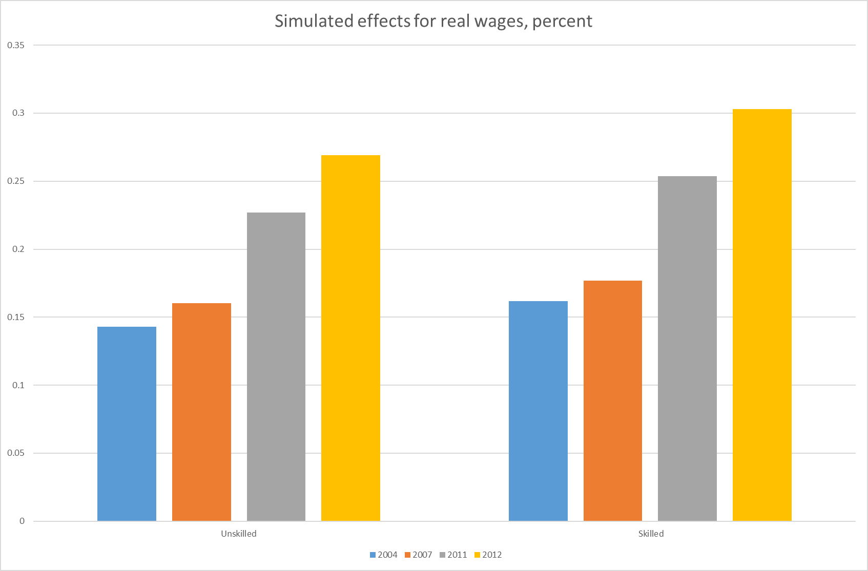
Economic Impact of Trade Agreements Implemented Under Trade Authorities Procedures, 2016 Report

Slide 6
Step 1: Consider workers of different genders instead of skill levels
With same model specification but changed labor data for the United States, we simulated the Economic Impact of Trade Agreements Implemented Under Trade Authorities Procedures since 1984
σ_{VA}
σ_{VA}
Skilled Unskilled Labor Labor
Capital Other
Female Male Capital Other
Labor Labor
In USITC Report
In this work

Slide 7
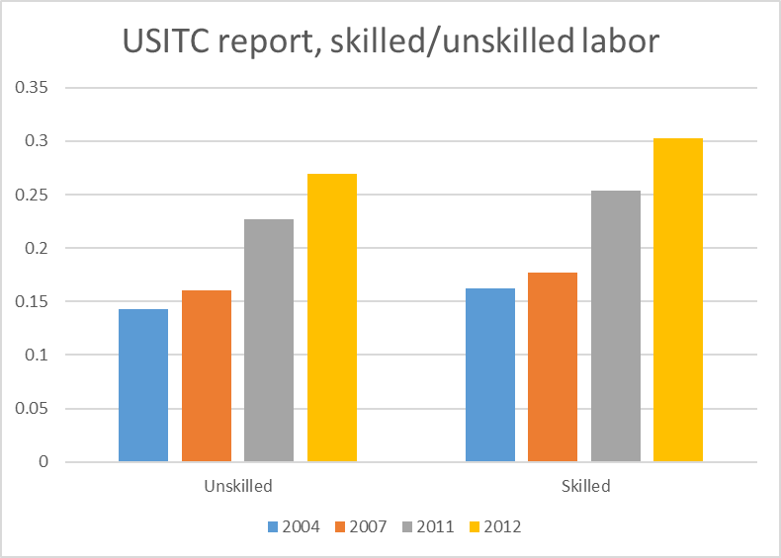
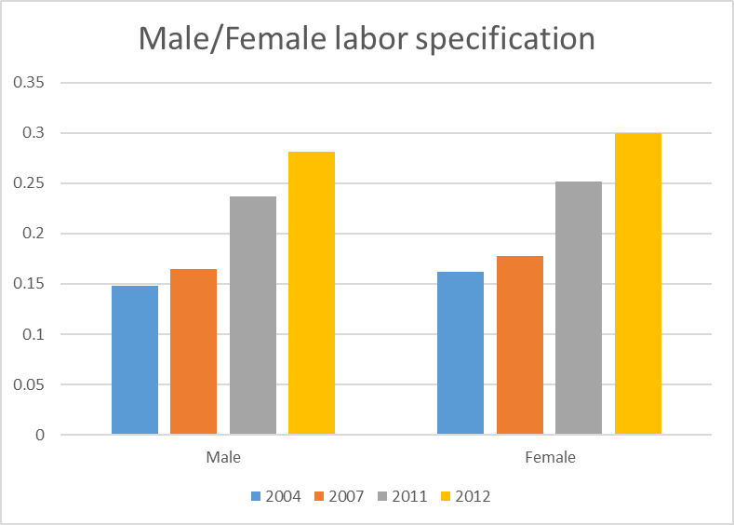
Simulated effects for real wages, percent

Slide 8
Step 2: Modifications to labor data
Workers in the U.S. are split by
  Gender
  Broad occupation (e.g., management, sales)
  Level of education (college graduates vs non-college graduates)
Current Population Survey (CPS)
  March CPS annual
  2004, 2007, 2011, and 2012
Matched to GTAP on sector level

Slide 9
More on labor split
Five broad occupation categories:
  Management, Business, Science, and Arts
  Service (e.g., healthcare support, protective services, food preparation)
  Sales and Office
  Natural Resources, Construction, and Maintenance
  Production, Transportation, and Material Moving
Two skill levels in each occupation:
  Below college
  College or above
Gender

Slide 10
Substitution
Twenty labor types in each GTAP sector:
  For each gender,
    Five occupation types
  For each occupation,
    Two education types
All primary factors are under a single CES function for VA

Slide 11
We then changed the labor substitutions at the sector level: simulated effects were not affected for different σ_{LAB} values
In USITC Report
In this work
σ_{VA}
σ_{VA}
Skilled Unskilled Labor Labor
Capital Other
Labor Capital Other
σ_{LAB}
Female Male
High skilled Low skilled
Management . . . Production

Slide 12
Real wage effects of US trade policies, by year, occupation, and education, percent change

Slide 13
Observations
U.S. AVEs are low, so we should not expect large effects for primary factors
For aggregate U.S. labor groups(skilled/unskilled, female/male), we find that cost shares in the wage bill are close to 50-50
In this particular analysis, the “non-traded services” sector employs 50% of the U.S. labor force in about equal gender proportions and it is not affected directly by trade policy
  This big sector keeps simulated gender differences very small
There are U.S. sectors with relatively high tariffs (textiles, apparel, shoes) and these sectors are affected by trade policy changes, but these sectors employ small labor forces, with high female labor shares
  If these sectors are concentrated geographically, then there are going to be important effects in some places

Slide 14
Thank you

