Slide 1
The Versatility and Specificity of PE Models for Trade Policy Analysis
Saad Ahmad and David Riker
(U.S. International Trade Commission)
GTAP 2020 Virtual Conference
Presentation represents the views of the authors and not the views of the U.S. International Trade Commission or any of its individual Commissioners. This presentation should be cited as the work of the authors only, and not as an official U.S. International Trade Commission document.

Slide 2
Motivation
Trade agreements increasingly feature policies addressing non-tariff measures (NTM), rules of origin (ROO), intellectual property (IP), and digital trade that are not easily accounted for in CGE trade models
In such cases, partial equilibrium (PE) models can assist by examining impact of policies on specific industries and sectors
These effects can then be incorporated into an economy-wide analysis of the trade agreement
We review some recent PE models developed by USITC staff for analyzing the impact of industry-specific trade policies.

Slide 3
Why PE models?
PE models can capture distinct features of a particular sector such as imperfect competition or scale economies
Greater flexibility when it comes to designing the policy experiment so that it reflects the nuances of the policy change taking place in a given sector
By focusing on narrowly defined products or industries, a PE model is better able to adapt to practical data limitations than GE counterparts

Slide 4
Three PE Applications
Analyze the effect on U.S. cross-border e-commerce shipments as a result of Canada and Mexico increasing the value of de minimis thresholds under USMCA
Estimate the impact of changes in Rules of Origin for the automotive sector in the USMCA
Determine the effects in the domestic market from a change in the fixed costs of foreign firms

Slide 5
Model 1: Background
De minimis is the threshold at which imports into a country are exempt from taxes, duties and some customs paperwork
Under USMCA, both Canada and Mexico increased their de minimis thresholds to $117 for express shipments
Higher de minimis thresholds should reduce costs of low-value cross-border e-commerce transactions in these countries

Slide 6
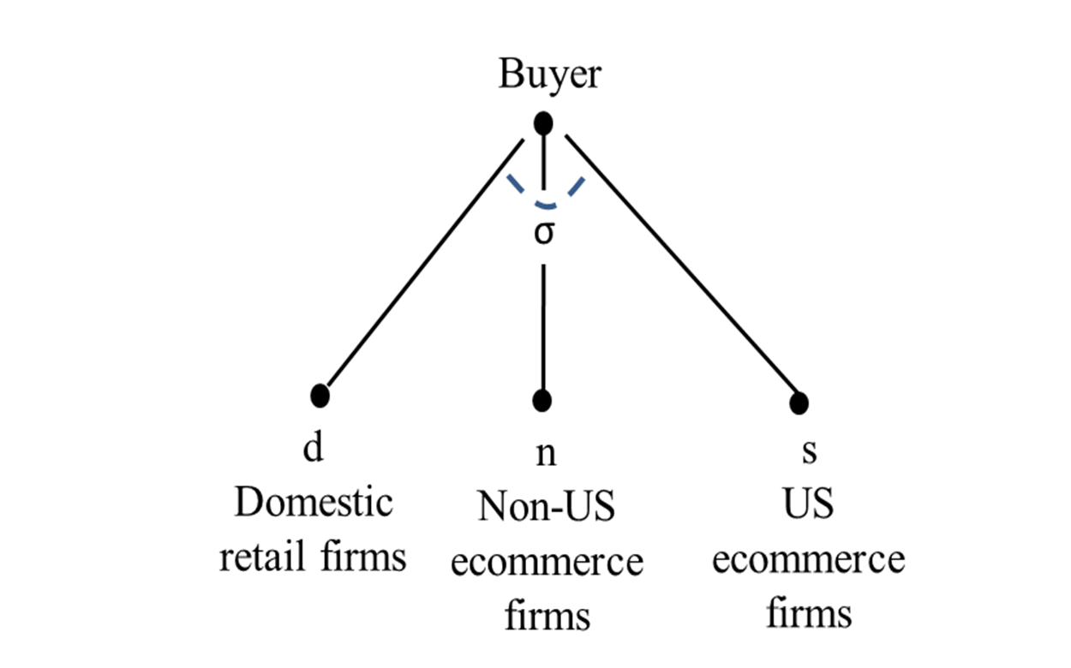
Model 1: Demand
Domestic consumers view alternate retail channels as imperfect substitutes for one another
Substitute between each retail channel at a constant rate given by the elasticity of substitution σ

Slide 7
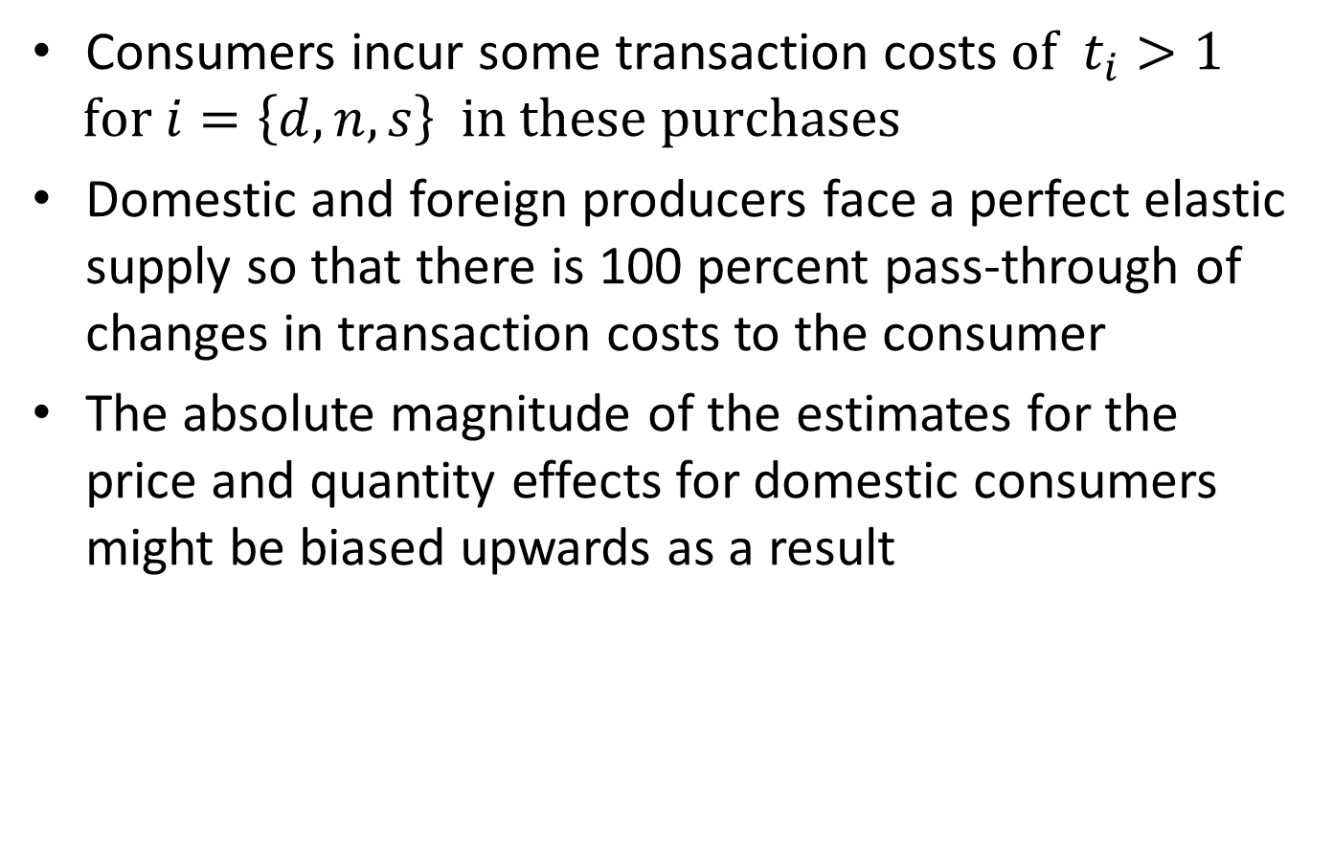
Model 1: Supply
Consumers incur some transaction costs $of t_{i}>1$
$for i=\left\{d,n,s\right\} in these purchases$
Domestic and foreign producers face a perfect elastic supply so that there is 100 percent pass-through of changes in transaction costs to the consumer
The absolute magnitude of the estimates for the price and quantity effects for domestic consumers might be biased upwards as a result

Slide 8
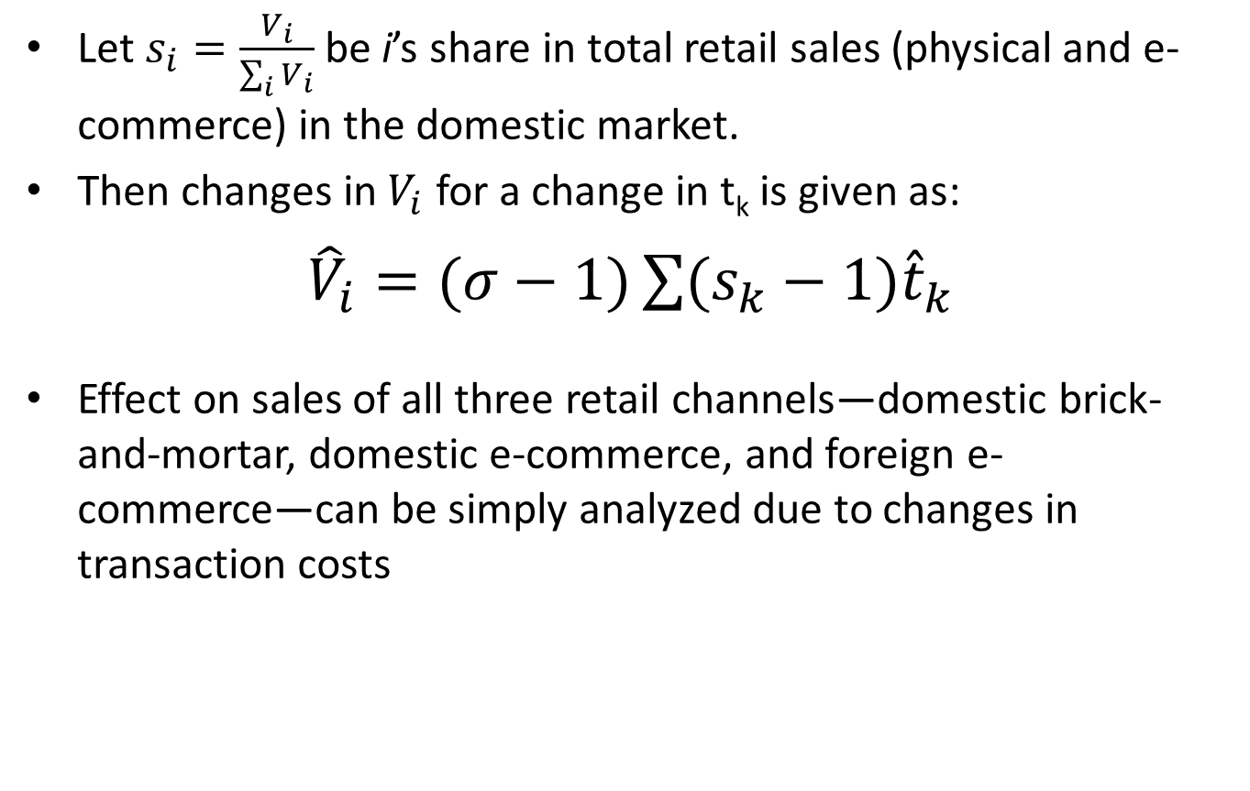
Model 1: Equilibrium
Let $s_{i}=\frac{V_{i}}{\sum_{i}{V_{i}}}$ be i’s share in total retail sales (physical and e-commerce) in the domestic market.
Then changes in${ V}_{i}$ for a change in t_{k} is given as:
${\hat{V}}_{i}=\left.(σ−1)\sum{(s_{k}−1})\right.{\hat{t}}_{k}$
Effect on sales of all three retail channels—domestic brick-and-mortar, domestic e-commerce, and foreign e-commerce—can be simply analyzed due to changes in transaction costs

Slide 9
Model 1: Data Requirements
  Market shares of brick-and-mortar firms, non-US e-commerce firms and US e-commerce firms in the Canadian and Mexican retail industry
  Change in total ad valorem costs due to changes in de minimis (average sales tax rate, average duty rate, brokerage fees, number of additional days in customs, distribution of parcels that are below the new de minimis thresholds)
  Elasticity of substitution to determine the shift in consumption from to changes in the relative prices of retail goods across the three sources

Slide 10
Model 1: Results
Market shares obtained from industry groups
AVE reductions in transaction cost were estimated at 1.4% for Canada and 1.1% percent for Mexico
Substitution elasticity of about 4.3 between online (e-commerce) and offline (brick-and-mortar) retail merchants
Find the value of express shipments from U.S. e-commerce firms to Canada expected to increase by $333 million and to Mexico by $91 million as a result of higher de minimis
Smaller values for the elasticity of substitution lead to a smaller increase in sales.

Slide 11
Model 2: Background
Rules of Origin (ROO) determine the eligibility of imports for preferential tariff treatment under trade agreements
New ROO in USMCA for the auto sector significantly increase the regional content required in vehicles and parts as well as new labor regulations
A thorough analysis requires firm-level information on the global configuration of the supply chains for each vehicle model and an assessment of their response:
  How adjustments in sourcing will affect production costs?
  How changes in costs will be passed through into prices?
  How competitors will response to the price increases of firms with cost increases?

Slide 12
Model 2: Demand
A detailed firm-level PE model of passenger vehicle and light truck markets in North America at the level of 393 individual vehicle models developed
Four groups of vehicle classes: subcompact and compact cars, mid-size and full-size cars, multi-passenger vehicles, and pickup trucks.
Demand for these differentiated vehicle models captured using linear demand curves
Price coefficients were calibrated to elasticity values from studies on consumer demand for motor vehicles.

Slide 13
Model 2: Supply
Imperfect competition among the 22 domestic and foreign manufacturers that sell vehicles in each North American market segment
Bertrand-Nash competition in prices, with firms choosing their own prices (for their multiple vehicle models) to maximize their joint profits across their products, taking the prices of their competitors as given
Initial marginal cost of producing each vehicle model was calibrated to initial prices and market shares using the first-order conditions under profit-maximizing pricing

Slide 14
Model 2: Policy Shock
Supply chains vary across manufacturers, and even across vehicle models within the same manufacturer.
Some vehicles and parts assembled in the United States, Mexico, or Canada, while others imported
Differences in supply chains across passenger vehicle and light truck models would likely result in different responses:
  Some manufacturers already meet the new ROOs and so would not make any changes to their supply chains
  Other firms may not be willing to make the changes necessary to meet the new ROO and instead lose their tariff preferences
  A third group would be able to comply with the new ROO, but only after making adjustments to their sourcing of core parts

Slide 15
Model 2: Results
The model estimates that the new ROO requirements will have a negative impact on consumers
The average price increase would range from 0.37 percent for pickup trucks to 1.61 percent for small cars
Small cars are more heavily affected by the changes in ROOs because they tend to source more outside North America,
The increase in U.S. production of core parts, due to the reshoring effects of the new ROO, has a positive effect on industry employment
The reduction in U.S. vehicle production has negative effect on industry employment, but these effects are relatively small

Slide 16
Model 3: Overview
A PE model to capture how foreign firms respond to changes in NTMs that affect fixed, rather than variable costs
The model is designed for data available at the industry level
Homogenous firms producing a unique variety under monopolistic competition (Krugman, 1980)
Firms pay a fixed cost to enter each market
An upward sloping labor supply curve to capture the “partial” nature of the analysis

Slide 17
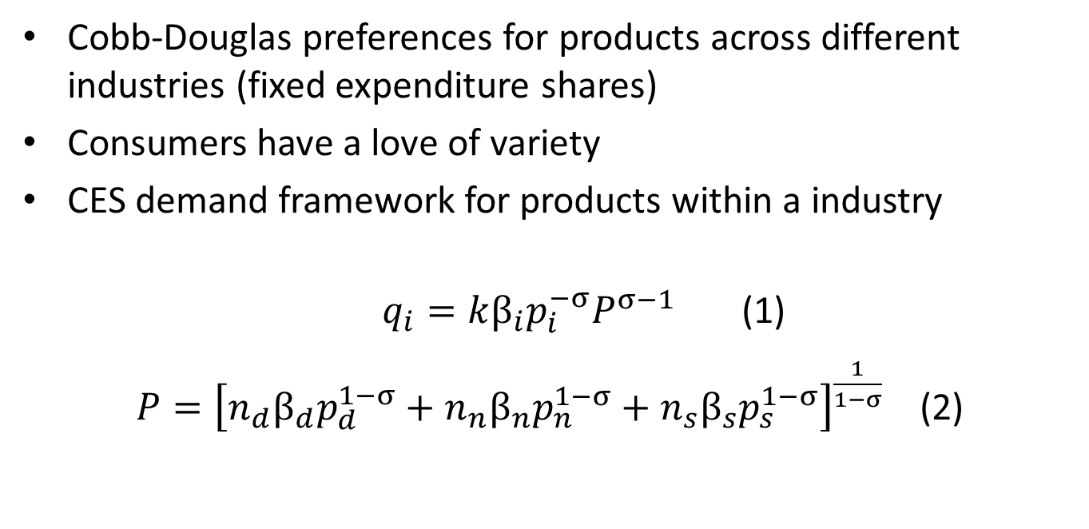
Model 3: Demand
Cobb-Douglas preferences for products across different industries (fixed expenditure shares)
Consumers have a love of variety
CES demand framework for products within a industry
$q_{i}=k{β_{i}p}_{i}^{−σ}P^{σ−1}$ (1)
$P={\left[n_{d}{β_{d}p}_{d}^{1−σ}+n_{n}β_{n}p_{n}^{1−σ}+n_{s}β_{s}p_{s}^{1−σ}\right]}^{\frac{1}{1−σ}}$ (2)

Slide 18
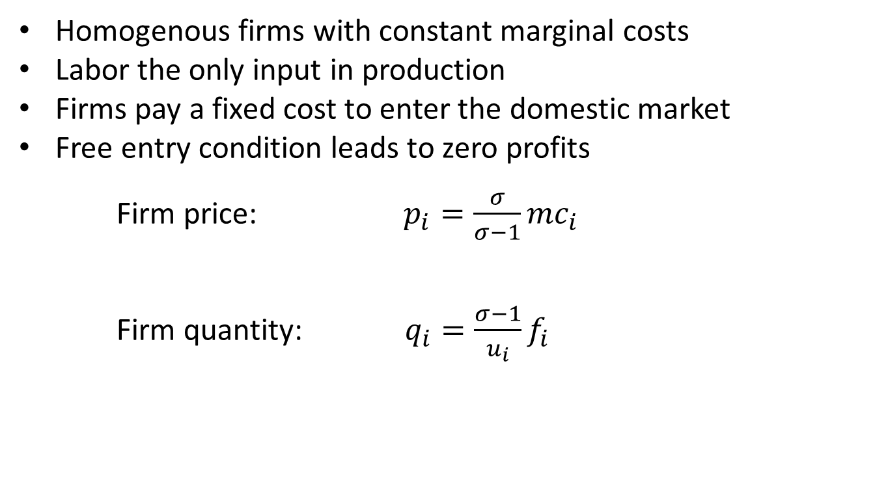
Model 3: Supply
Homogenous firms with constant marginal costs
Labor the only input in production
Firms pay a fixed cost to enter the domestic market
Free entry condition leads to zero profits
Firm price: $p_{i}=\frac{σ}{σ−1}mc_{i}$
Firm quantity: $q_{i}=\frac{σ−1}{u_{i}}f_{i}$

Slide 19
Model 3: Equilibrium
In a general equilibrium model, number of firms is given by a labor market clearing condition (total labor used by all firms has to equal the total number of workers in the country)
We relax this assumption for partial equilibrium analysis
Sector has an upward sloping labor curve so that increases in wages can cause a change in labor supply and the ultimate number of firms operating in the market
Thus labor supply is endogenous in this model

Slide 20
Model 3: Policy Shock
A NTM is converted into a change in the fixed costs of a foreign firms serving the domestic market
The change in fixed costs only affects the optimal quantity produced by firms of subject country
All other firms not affected by the NTM shock continue to produce the same quantity as before
A new equilibrium is then solved for the number of firms due to the change in fixed costs

Slide 21
Model 3: Simulation Results
A reduction in fixed costs by 10 percent increases the total revenues of foreign firms by 17 percent while decreases total revenues of domestic firms by 4 percent
A higher elasticity of substitution corresponds to a lower fixed cost for subject firms in the baseline and so a reduction in fixed costs has less overall effect for market participants
Reducing the labor supply elasticity leads to smaller changes in revenues of firms, the sluggishness in labor markets limiting growth in labor supply and thus the corresponding number of new firms as a result of the reduction in fixed costs

Slide 22
Conclusion
New PE tools to analyze complex trade provisions such as de minimis and ROOs as well as the effects of NTMs targeting fixed costs of foreign firms
Manageable data requirements makes it easier to use in practical applications
Given their versatility, PE models are well-suited for challenging ex-ante quantification of other, non-tariff policies found in modern trade agreements, such as domestic regulations, investment, competition, and intellectual property rights.

