Slide 1
GTAP Trade Policies Simulations: When Does “Firm Heterogeneity” Need to be Considered?
MENG, Xue HUANG, Peng
17-19 June 2020

Slide 2

Why does raise this question?
More and more realistic factors are included in the quantitative models, which would complicate research models.
We should also pay attention to select applicable model to study certain research question.
It’s not always ‘the more complex the better’.

Slide 3
Outlines
1. The Effects of Firm Heterogeneity in Trade Policy
2. GTAP Model: Amington v.s. Firm Heterogeneity
3. Scenarios and Data
4. Major Simulation Results
5. Conclusions
6. Suggestions on Model Applications
7. Further Research

Slide 4
1. The Effects of Firm Heterogeneity in Trade Policy
1.1 Policy effects of “firm heterogeneity” varies theoretically
Melitz (2003): set up a trade model of firm heterogeneity incorporating firm-level productivity differences.
Arkolakis et al. (2012): believed that firm heterogeneity implications had little impact on aggregate welfare gain, and summarized that firm heterogeneity was ‘not much’ different from the firm homogeneity in terms of explaining welfare gains.
Melitz & Redding(2015): noted that welfare gains in firm heterogeneity model are not only affected by domestic trade share and trade elasticity, also prone to production and trade costs on micro structure.

Slide 5
1.2 Is it necessary to incorporate “firm heterogeneity” into trade policy practices?
Q1: Would all trade policies affect firm entry and exit, or only particular trade policies would?
Q2: Is there a threshold value defining the impact of trade policies on firm entry and exit? In other words, to what extent will trade policies start affecting firm entry and exit?

Slide 6
1.3 Research Question in This Paper
GTAP model simulation
  standard GTAP: Hertel and Tsigas (1997), Corong et. al (2017)
  GTAP-HET: incorporate firm heterogeneity in to standard GTAP model
For which policy simulation, the standard GTAP model is enough to solve the problem, which would be necessary to apply the GTAP-HET model, so as to be able to grasp the effect of firm heterogeneity?
This paper:
  Compare the simulation results in both models
  To simulate tariff and non-tariff policies separately
  To shock the perfect competition sector and monopolistic competition sector separately
  To answer above question through comparative analysis

Slide 7
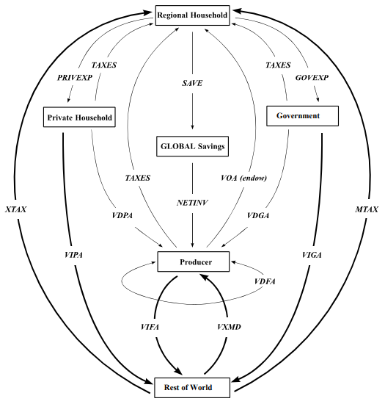
2. GTAP Model: Amington v.s.
Firm Heterogeneity
2.1 Standard GTAP
Source: Brockmeier(1996).

Slide 8
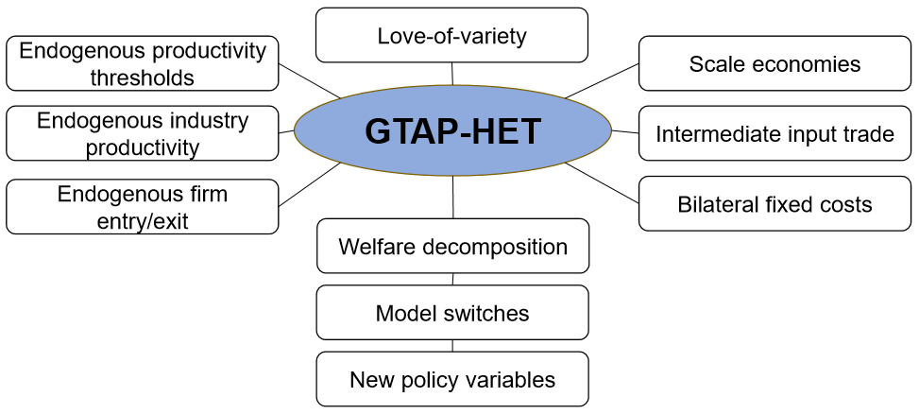
2.2 GTAP-HET: introducing firm heterogeneity into the standard GTAP model
Source: Akgul et al. (2016).

Slide 9
3. Scenarios and Data
A typical example of how firms’ behaviour reacted to the trade policy
As of July 2018, the United States has imposed a 25% tariff on part of Chinese products – as punitive measures on Chinese products based on the decisions of the “Section 301 investigation”. As U.S. and China placed retaliatory tariffs on more and more goods, some multinational companies had to reschedule production network, close down parts of plants located in China, and shifted overseas.

Slide 10
Aggregation:
13 Regions x
6 Sectors
Economy | ASEAN | Australia | Canada | China | EU (27) | Japan | Rest of World
 | South Korea | Mexico | New Zealand | Switzerland | the United Kingdom | the United States
Economic Sector | GTAP Classification No. | Market Structure
Agriculture, forestry and fishing | No.1-14 | Perfect competition
Mining and quarrying | No.15-18 | Monopolistic competition
Light-Manufactures | No.19-31、35、36 | Perfect competition
Tech-intensive Manufactures | No.34, 40, 42-44 | Monopolistic competition
Other Manufactured Products | No.32, 33, 37-39, 41, 45 | Perfect competition
Service Industry | No.46-65 | Perfect competition

Slide 11

Scenarios
Scenario A
  A1. the U.S. imposed a 25% tariff on China’s light industry (Perfect competition) in GTAP-HET model (Melitz).
  A2. the U.S. imposed a 25% tariff on China’s light industry in standard GTAP model (Amington).
Scenario B
  B1. the U.S. imposed a 25% tariff on China’s tech-intensive industry (Monopolistic competition) in GTAP-HET model (Melitz).
  B2. the U.S. imposed a 25% tariff on China’s tech-intensive industry in standard GTAP model (Amington).

Slide 12

Scenarios
Scenario C
  C1. the production costs of China’s light industry exporting to the U.S. increased by 25% in GTAP-HET model (Melitz).
  C2. the production costs of China’s light industry exporting to the U.S. increased by 25% in standard GTAP model (Amington).
Scenario D
  D1. the production costs of China’s tech-intensive industry exporting to the U.S. increased by 25% in GTAP-HET model (Melitz).
  D2. the production costs of China’s tech-intensive industry exporting to the U.S. increased by 25% in standard GTAP model (Amington).

Slide 13
4. Major Simulation Results
4.1 The Overall Impact
Policies | Model | Economy | Perfect competition Sector |  |  |  | Monopolistic competition Sector
 |  |  | Real GDP | Total Output | Goods Exports | Goods Imports | Real GDP | Total Output | Goods Exports | Goods Imports
Tariff Policies | Standard GTAP | China | -0.04 | 0.09 | -0.14 | -0.92 | -0.13 | -0.01 | -0.52 | -2.71
 |  | U.S. | -0.08 | -0.01 | -1.39 | -0.84 | -0.10 | 0.07 | -1.10 | -1.96
 | GTAP-HET | China | 0.15 | 0.09 | -1.32 | -0.85 | -0.47 | -0.15 | -0.27 | -4.41
 |  | U.S. | -0.11 | 0.00 | -0.82 | -0.94 | 0.08 | 0.13 | -5.89 | -1.79
Non-tariff Policies (production costs of export) | Standard GTAP | China | -0.04 | 0.09 | -0.16 | -0.96 | -0.13 | -0.01 | -0.58 | -2.83
 |  | U.S. | -0.16 | 0.01 | -1.11 | -0.79 | -0.19 | 0.10 | -0.55 | -1.95
 | GTAP-HET | China | 0.16 | 0.09 | -1.38 | -0.89 | -0.47 | -0.15 | -0.25 | -4.48
 |  | U.S. | -0.18 | 0.02 | -0.71 | -0.87 | 0.06 | 0.14 | -5.97 | -1.75

Slide 14
4.2 Impacts on Sectors
Model | Economy | Variable | Perfect competition Sector |  |  | Monopolistic competition Sector
 |  |  | Light Industry | Tech-inten. Industry | Other Manu | Light Industry | Tech-inten. Industry | Other Manu
Standard GTAP | China | Output | -1.51 | 1.40 | 0.77 | 1.00 | -2.60 | 1.00
 |  | Export | -10.26 | 3.20 | 2.60 | 6.05 | -9.40 | 5.88
 |  | Import | -2.48 | -0.80 | -0.90 | -3.03 | -4.72 | -2.68
 | U.S. | Output | 1.43 | -0.86 | -0.38 | -0.14 | 1.82 | -0.04
 |  | Export | -1.90 | -2.05 | -1.11 | -0.58 | -2.60 | -0.63
 |  | Import | -7.55 | 0.52 | 0.33 | 0.55 | -6.02 | 0.27
GTAP-HET | China | Output | -1.99 | 2.30 | 0.24 | 1.60 | -4.30 | 1.70
 |  | Export | -13.05 | 4.25 | -0.27 | 9.93 | -14.17 | 10.03
 |  | Import | -0.83 | -2.46 | 0.38 | -4.92 | -6.84 | -4.26
 | U.S. | Output | 1.54 | -0.90 | -0.17 | -1.17 | 4.44 | -1.72
 |  | Export | -0.92 | -1.79 | -0.33 | -7.57 | -5.79 | -6.68
 |  | Import | -7.79 | 0.63 | -0.02 | 4.35 | -10.22 | 3.24
Table 5: Tariff Policy

Slide 15
Model | Economy | Variable | Perfect competition Sector |  |  | Monopolistic competition Sector
 |  |  | Light Industry | Tech-inten. Industry | Other Manu | Light Industry | Tech-inten. Industry | Other Manu
Standard GTAP | China | Output | -1.56 | 1.43 | 0.80 | 1.09 | -2.69 | 1.08
 |  | Export | -10.60 | 3.27 | 2.68 | 6.28 | -9.88 | 6.13
 |  | Import | -2.60 | -0.83 | -0.94 | -3.15 | -4.93 | -2.81
 | U.S. | Output | 1.72 | -0.74 | -0.28 | -0.05 | 2.37 | 0.17
 |  | Export | -1.59 | -1.71 | -0.85 | 0.12 | -1.98 | -0.10
 |  | Import | -6.34 | 0.31 | 0.19 | 0.17 | -5.58 | 0.04
GTAP-HET | China China | Output | -2.06 | 2.38 | 0.24 | 1.66 | -4.39 | 1.70
 |  | Export | -13.51 | 4.38 | -0.30 | 10.11 | -14.38 | 10.22
 |  | Output | -1.56 | 1.43 | 0.80 | 1.09 | -2.69 | 1.08
 | U.S. U.S. | Export | -10.60 | 3.27 | 2.68 | 6.28 | -9.88 | 6.13
 |  | Import | -2.60 | -0.83 | -0.94 | -3.15 | -4.93 | -2.81
 |  | Output | 1.72 | -0.74 | -0.28 | -0.05 | 2.37 | 0.17
Table 5: non-tariff policy

Slide 16

5. Conclusions and Analysis of the Mechanism of “Firm Heterogeneity”
Under Same Policy: “Firm Heterogeneity” plays a more significant role when Policy shock is imposed on Monopolistic competition sectors
Under Different Policies: No Significant Role of “Firm Heterogeneity” is Observed

Slide 17


6.Suggestions on Model Applications
Sectors be of monopolistic-competition type
No matter tariff policy or non-tariff policy
GTAP-HET model is suggested
For example, the first product list from U.S. Section 301 mainly targets Chinese electronic products and mechanical equipment.

Slide 18

Sectors be of perfect-competition type
No matter tariff policy or non-tariff policy
Standard GTAP model is suggested
For example, the third product list from U.S. Section 301 concentrates on Chinese clothing and other manufactured goods.

Slide 19

7. Further Research
Different perspectives are required to further explore.
Theoretical foundation and simulation approach also need to be further refined to advance the depth of research.

Slide 20
Thanks for your attention!
Any comments?

