Slide 1
June 2020
23th Annual Conference on Global Economic Analysis
“Global Economic Analysis Beyond 2020”
Analysis of Japanese power supply beyond 2020 using
the GTAP-E-Power model
Akiko Higashi, Ken Itakura, Yushi Inoue,
Hiroaki Otake, Kohei Takagi and Junya Kuga
Notes:
1

Slide 2
Table of Contents
1. Introduction
2. Background of Japanese power sector and plan for
Japanese power sector
3. Procedures for creating GTAP-E-Power Database
4. Methodology for analyzing the change in the
structure of Japanese power sector in Japan
5. Analysis of Japanese power supply beyond 2020
6. Conclusion
2

Slide 3
1. Introduction

Slide 4
Subject Matters
＊Data survey concerning the structure of
power supply in Japan after 2011.
＊Update of the GTAP-E-power database to
GTAP 10.0 adapted to a new aggregation.
＊Analysis of the effect of the change in the
Japanese power supply beyond 2020 by
comparing the simulation results of four
scenarios using the GTAP-E-Power Model.
4
4
4

Slide 5
2. Background of Japanese power
sector and plan for Japanese
power sector
2.1. Time-series data concerning total
power generated in Japan
2.2. Plan for Japanese power sector

Slide 6
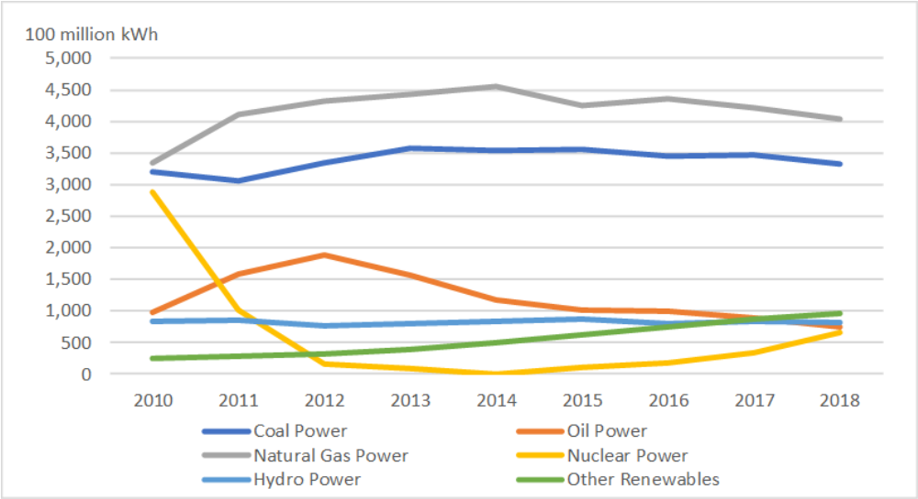
2.1 Time-series data concerning total power
generated in Japan (1)
Total power generated in Japan from 2010 to 2018
（Fiscal Year,100 million kWh）
6
6
Source: Agency for Natural Resources and Energy of the Ministry of Economy, Trade, and Industry of Japan.

Slide 7
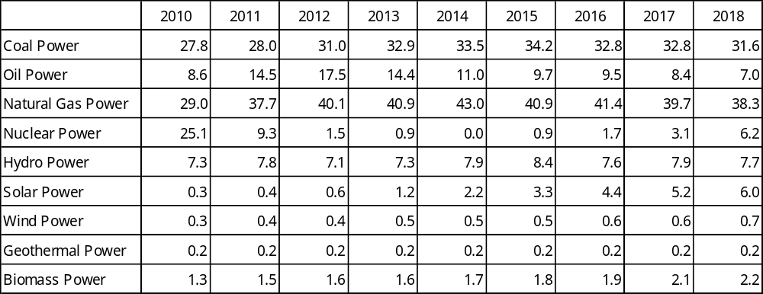
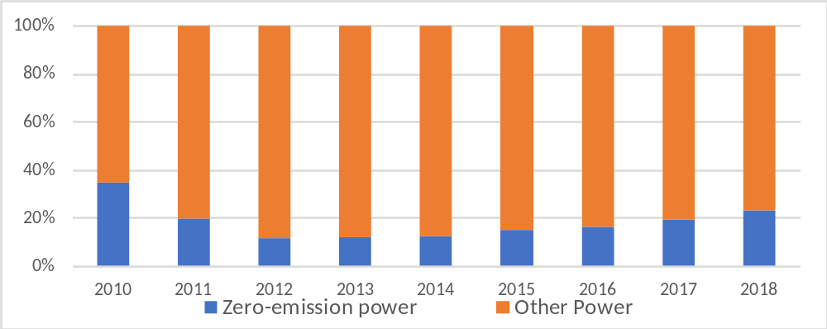
2.1 Time-series data concerning total power
generated in Japan (2)
Share of powers generated in Japan from 2010 to 2018 （Fiscal Year, percentage）
7
7
7
Source: Agency for Natural Resources and Energy of the Ministry of Economy, Trade, and Industry of Japan. Percentage is
calculated by the authors.

Slide 8
2.2 Plan for Japanese power sector
・The Fifth Strategic Energy Plan (2018) points out
four Japanese structural issues.
- vulnerability due to high dependency on overseas
energy resources,
- mid- to long-term changes in the energy demand
structure (population decline, etc.),
- instability of resource prices (increased energy
demand in emerging countries, etc.),
- increasing global greenhouse gas emissions.
・Zero-emission power source ratio is expected to
reach about 44% in FY2030.
8
8

Slide 9
3. Procedures for creating
GTAP-E-Power Database
3.1. Overview of the GTAP-E model and the
GTAP-E-Power model
3.2. Procedures for creating database for the
GTAP-E-Power model

Slide 10
3.1 Overview of the GTAP-E model and the
GTAP-E-Power model (1)
The GTAP-E-Power model breaks down the power sector in the framework of the GTAP-E model.
The main feature of the GTAP-E model is that it has the production structure with energy substitution; inter-fuel substitution and fuel-factor substitution.

Slide 11
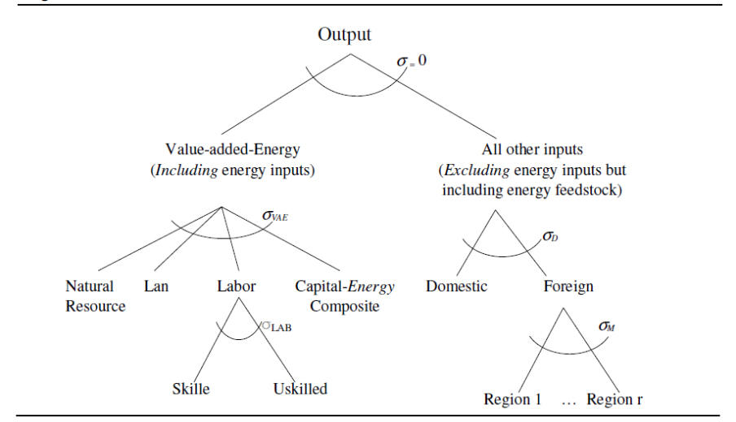
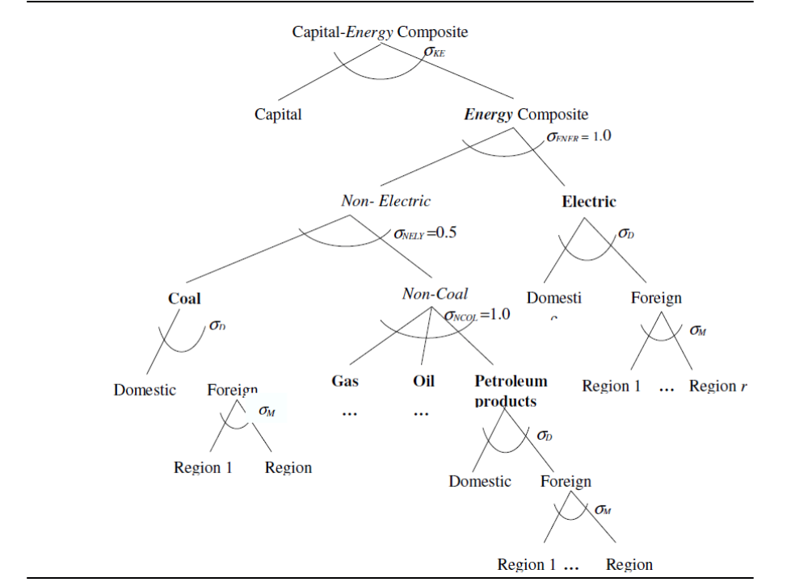
3.1 Overview of the GTAP-E model and the
GTAP-E-Power model (2)
GTAP-E Production Structure
GTAP-E Capital-Energy Composite Structure
Source: Burniaux and Truong (2002), Figure 16, p.31.
Notes:
モデルの

Slide 12
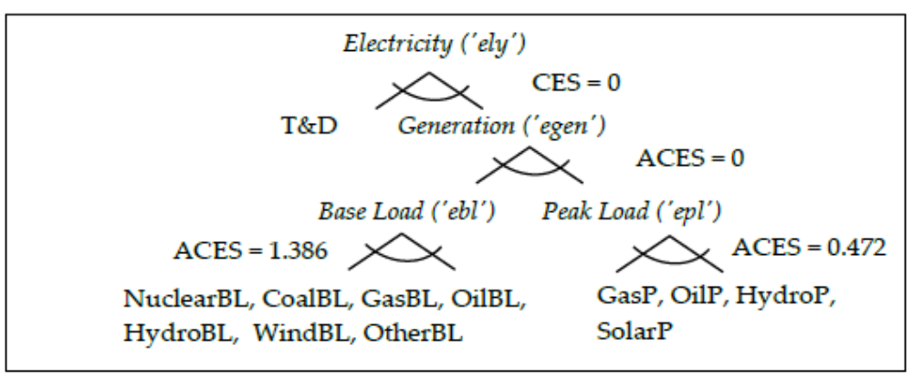
3.1 Overview of the GTAP-E model and the
GTAP-E-Power model (３)
In the GTAP-Power model electricity is classified into 12, and separated into base and power and peak load power.
Nested electric power substitution in GTAP-E-Power.
Source: Peters (2016b), Figure 2, P.167.

Slide 13
3.2 Procedures for creating GTAP 10.0 database
for the GTAP-E-Power model (1)
The original GTAP-E-Power model database is based on the GTAP 9.0 (base year : 2011).
The GTAP 10.0 database (latest benchmark year is 2014) was released for the GTAP-E database and GTAP-Power database in February 2020.
From GTAP 10.0 database for the GTAP-E model and GTAP-Power model, this research creates the GTAP 10.0 database for the GTAP-E-Power model.

Slide 14
3.2 Procedures for creating GTAP 10.0 database
for the GTAP-E-Power model (2)
Data for the GTAP-E-Power model can be
created from GTAP-Power model
(Basedata.Har, Gsdvole.HAR and CO2.HAR)
and GTAP-E model (Basedata.HAR).
Parameters for the GTAP-E-Power model can be created from default.prm of GTAP-Power model and GTAP-E model.
Some parameters taken from the GTAP-E model need to be modified for power sectors; most of them take the value zero.

Slide 15
4. Methodology for analyzing the
change in the structure of
Japanese power sector
4.1. Overview of previous studies
4.2. Methodology for analyzing the change in
the structure of Japanese power sector
using the GTAP-E-Power model
4.3. Aggregation of regions and sectors
15

Slide 16
4.1 Overview of previous studies
Analysis of the impact of power trends on the
economy in Japan using the CGE model;
・Hagiwara (2001); the Great Hanshin-Awaji Earthquake
・Ishikura and Ishikawa (2011), Yamazaki and Ochiai
(2011), Tachi and Ochiai (2011) ; the Great East
Japan Earthquake;
Analysis of the effects of Japan’s electricity policy (long-term climate mitigation policy studies); AIM/CGE Model, AIM/Enduse Model, DNE21 Model, DNE21+ Model, IEEJ Model and TIMES-Japan Model.
16
16
Notes:
16

Slide 17
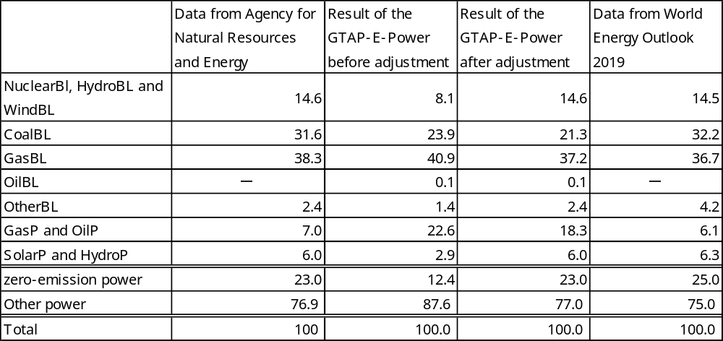
4.2 Methodology for analyzing the change in the
structure of Japanese power sector in Japan (1)
The simulation covers two periods: from 2014 to 2018 and from 2019 to 2030 .
It is necessary to adjust the result of the power supply of the first period in order to reflect the reality.
Share of Japan’s power in 2018 (percentage)
17
17
Source: Agency for Natural Resources and Energy of the Ministry of Economy, Trade, and Industry of Japan and World
Energy Outlook 2019. Results of the GTAP-E-Power model is simulated by the authors.
Notes:
17

Slide 18
4.2 Methodology for analyzing the change in the
structure of Japanese power sector in Japan (2)
For the second period, simulations are performed for four scenarios.
Shock values will be set
- Only for real GDP, labor force, and the population
growth rate of each country (Scenario 1).
- Real GDP, labor force, and the population growth
rate of each country and the zero-emission power
setting in Stated Policies Scenario, Current
Policies Scenario and Sustainable Development
Scenario of WEO 2019.
18
18

Slide 19
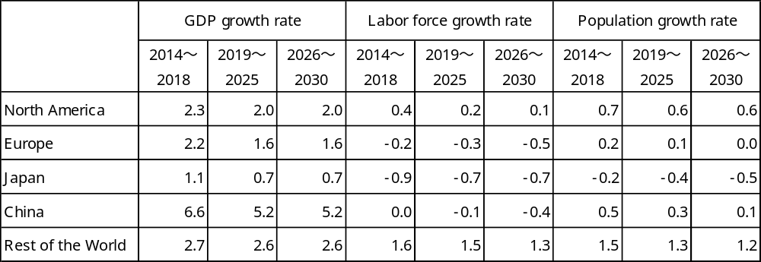
4.2 Methodology for analyzing the change in the
structure of Japanese power sector in Japan (3)
Macro shock values for all scenarios
(average annual growth rate, percentage)
Source: GDP growth rate from 2014 to 2018 is taken from World Bank (2019) and from 2019 to 2030
from World Energy Outlook 2019. Labor force growth rate and population growth rate are taken
from United Nations Population Division (2019). Labor force corresponds to the population from
15 to 64 years old.
19
19
19

Slide 20
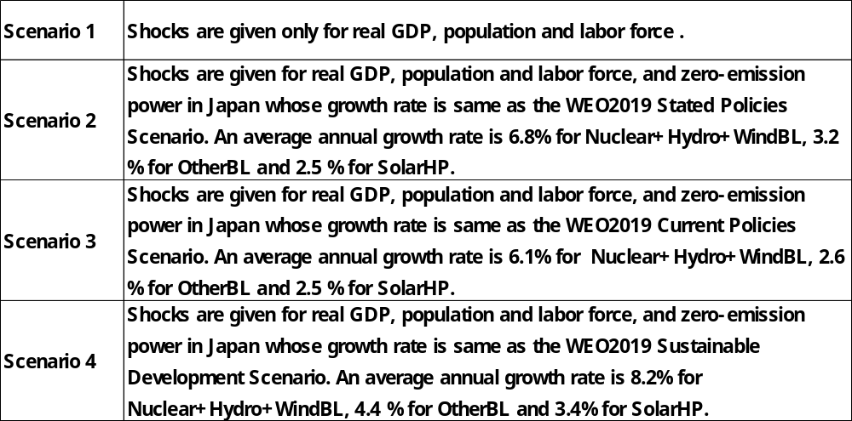
4.2 Methodology for analyzing the change in the
structure of Japanese power sector in Japan (4)
Contents of scenarios
20
20
20
20
20

Slide 21
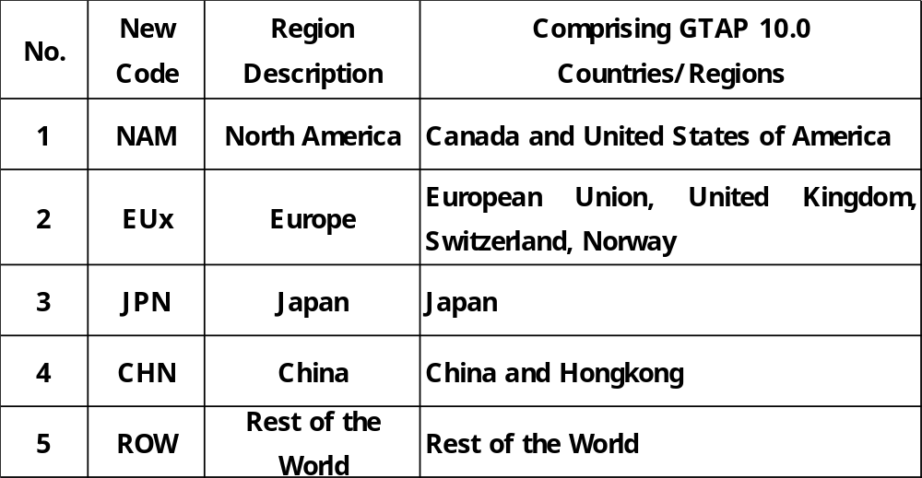
4.3 Aggregation of regions and sectors (1)
Regional Disaggregation
21
21
21
21
21
21

Slide 22
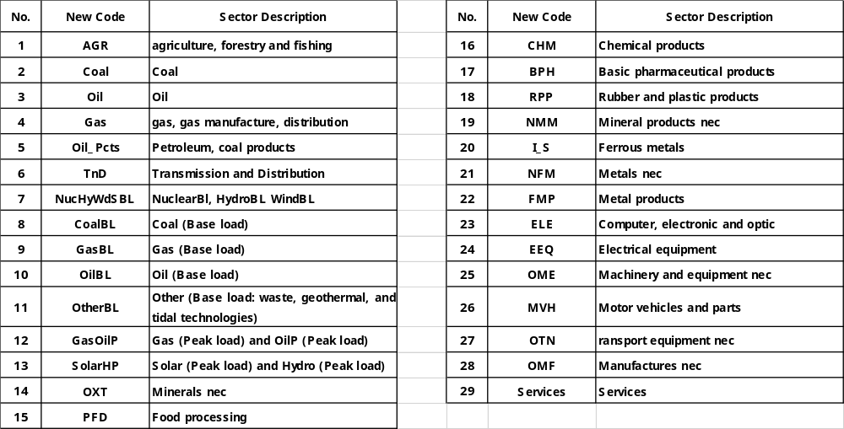
4.3 Aggregation of regions and sectors (2)
Sectoral Disaggregation
22

Slide 23
5. Analysis of Japanese power
supply beyond 2020
5.1. Macroeconomic changes
5.2. Changes in power sector
5.3. Changes in industrial output
5.4. Changes in exports
5.5. Changes in imports
23
23

Slide 24
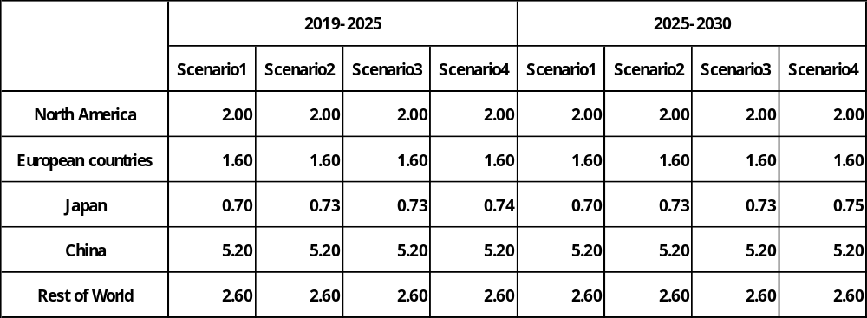
5.1 Macroeconomic changes (1)
Changes in average annual growth rate of Real GDP
(percentage)
Source: the authors.
24
24
24

Slide 25

5.1 Macroeconomic changes (2)
Changes in average annual growth rate of Real Exports
(percentage)
Source: the authors.
25
25
25
25
Notes:
3

Slide 26
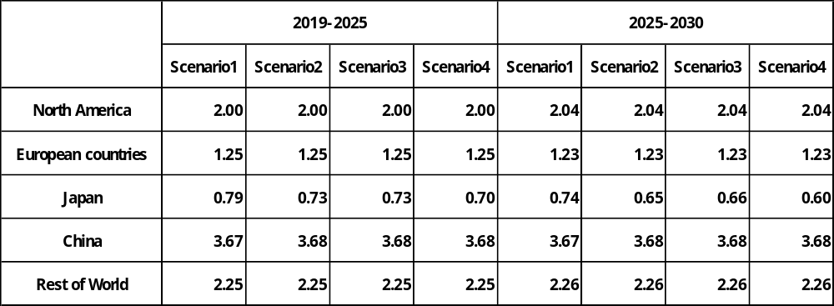
5.1 Macroeconomic changes (3)
Changes in average annual growth rate of Real Imports
(percentage)
Source: the authors.
26
26
26
26
26
26
26
26
26

Slide 27
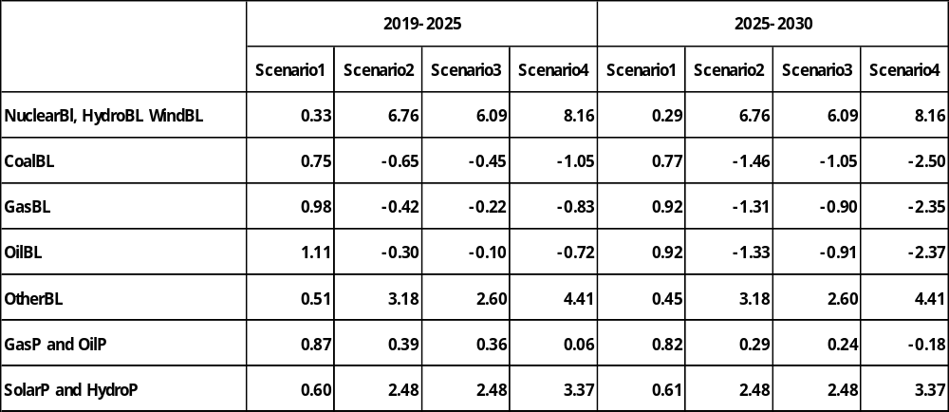
5.2 Changes in power sector (1)
Impacts on Japan’s industrial output: annual growth rate of
power sectors (percentage)
Source: the authors.
27
27
27
27
27
27
27
27
27
27
27
27
27
27
27

Slide 28
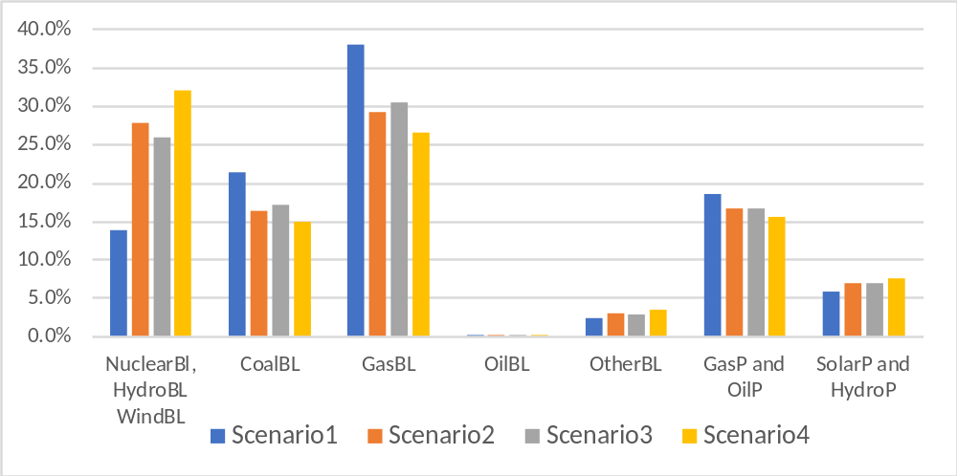
5.2 Changes in power sector (2)
Power supply configuration in 2030 in Japan (percentage)
Source: the authors.
28
28
28
28
28
28
28
28
28
28
28
28
28
28
28
28
28
28
28
28
28
28

Slide 29
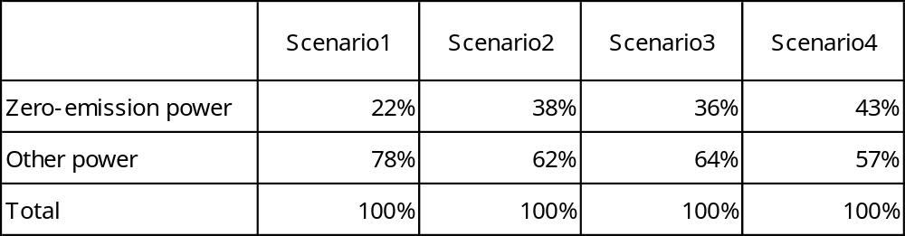
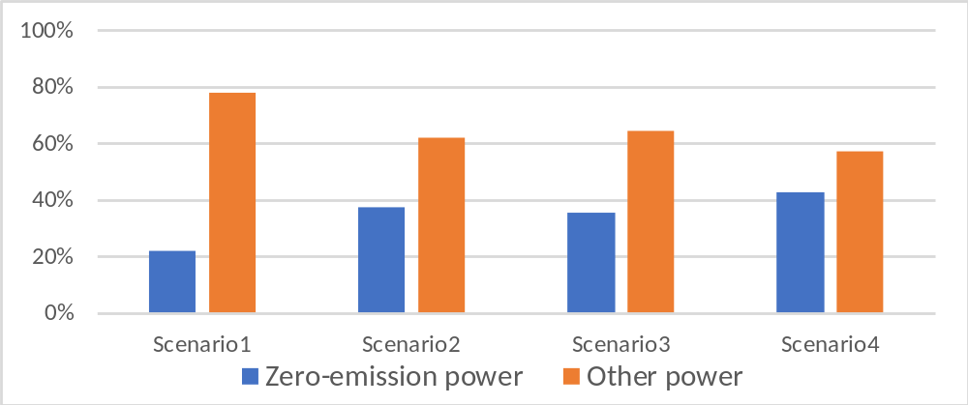
5.2 Changes in power sector (3)
Power supply configuration in 2030 in Japan:
Zero-emission power and other power (percentage)
29
29
29
29
29
29
29
29
29
29
29
29
29
29
29
29
29
29
29
29
29
29
29
29
29
29
29
29
29
29
29
29
29
29
29
29
29
29
29
29
29
29
29
29
29
29
29
29
29
29
29
29
29
29
29
29
29
29
29
29
29
29
29
29
29
29
29
29
29
29
29
29
29
29
29
29
29
29
29
29
29
29
29
29
29
29
29
29
29
29
29
29
29
29
29
29
29
29
29
29
29
29
29
29
29
29
29
29
29
29
29
29
29
29
29
29
Source: the authors.
29

Slide 30
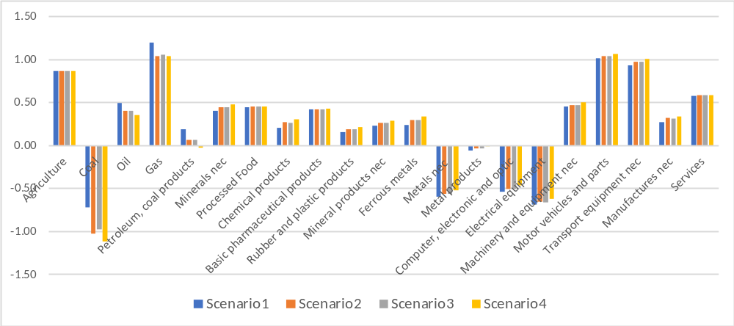
5.3 Changes in industrial output
Impacts on Japan’s industrial output: annual growth rate of non-power sectors
from 2026 to 2030 (percentage)
Source: the authors.
30
30
30
30
30
30
30
30
30
30
30
30
30
30
30
30
30
30
30
30
30
30
30
30
30
30
30
30
30
30
30
30
30
30
30
30
30
30
30
30
30
30
30
30
30
30
30
30
30
30
30
30
30
30
30
30
30
30
30
30
30
30
30
30
30
30
30
30
30
30
30
30
30
30
30
30
30
30
30
30
30
30
30
30
30
30
30
30
30
30
30
30
30
30
30
30
30
30
30
30
30
30
30
30
30

Slide 31
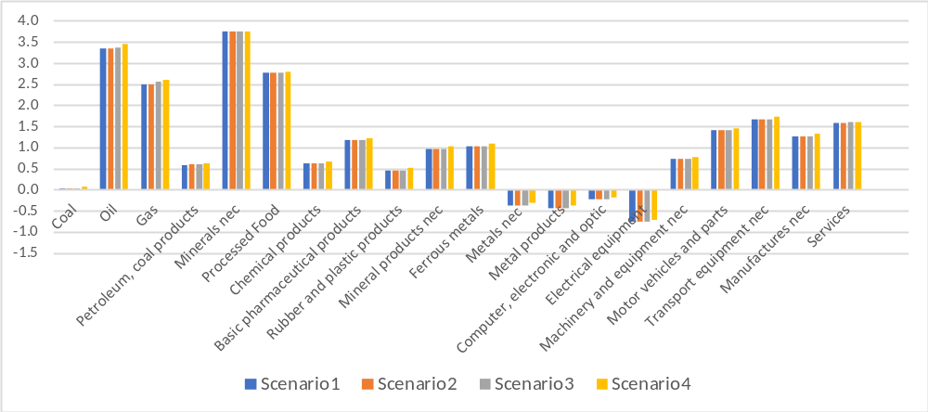
5.4 Changes in exports
Impacts on Japan’s exports by commodity: annual growth rate from
2026 to 2030 (percentage)
Source: the authors.
31
31
31
31
31
31
31
31
31
31
31
31
31
31
31
31
31
31
31
31
31
31
31
31
31
31
31
31
31
31
31
31
31
31
31
31
31
31
31
31
31
31
31
31
31
31
31
31
31
31
31
31
31
31
31
31
31
31
31
31
31
31
31
31
31
31
31
31
31
31
31
31
31
31
31
31
31
31
31
31
31
31
31
31
31
31
31
31
31
31
31
31
31
31
31
31
31
31
31
31
31
31
31
31

Slide 32
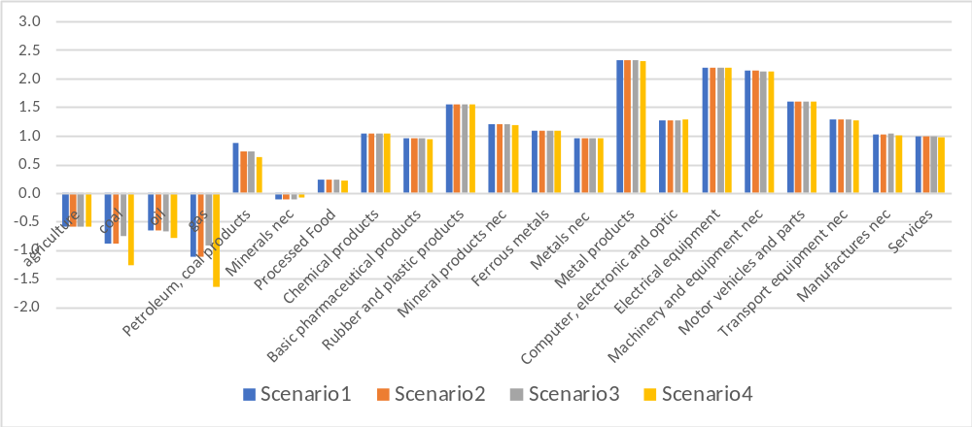
5.5 Changes in Imports
Impacts on Japan’s imports by commodity: annual growth rate from
2026 to 2030 (percentage)
Source: the authors.
32
32
32
32
32
32
32
32
32
32
32
32
32
32
32
32
32
32

Slide 33
6. Conclusion
33
33
33
33
33
33
33
33

Slide 34
The simulation results show that if Japan were to make great effort and keep zero-emission power in Japan at the same growth rate as the Sustainable Development Scenario of WEO 2019 from 2019 to 2030, the share of zero-emission power in 2030 would be about 43 %, close to the government’s goal.
An increase in zero-emission power leads to a reduction in fossil fuel power and has a positive effect on the Japanese GDP growth rate.
34
34
34
34
34
34
34
34
34

