Slide 1
The long-term effects of soil erosion: a global economic analysis
DRAFT: NOT FOR PUBLICATION
Martina Sartori
24th GTAP conference

Slide 2
Motivation and aim
The socio-economic consequences of soil erosion are poorly investigated
  Many country specific direct-impact analyses: overestimate the impacts and
  The only reference global study is Sartori et al. (2019): 33.7 ml tonnes of agri-food losses and 8 bl$ GDP
  Long-term studies lack
This study employs an interdisciplinary approach to assess the long-term structural economic and non-economic impacts of soil erosion at the global scale

Slide 3
Methodology and data
Country-level estimates of future soil erosion by water are estimated by Borrelli et al. (2020) at the year 2070
  employ a high spatial resolution Revised Universal Soil Loss Equation (RUSLE)-based semi-empirical modelling approach
  three alternative combinations of Shared Socioeconomic Pathway and Representative Concentration Pathway (SSP-RCP) scenarios: SSP1-RCP2.6, SSP2-RCP4.5, and SSP5-RCP8.5
Soil erosion rates are converted into land productivity losses, to feed the Modular Applied GeNeral Equilibrium Tool (the MAGNET global CGE model, Woltjer and Kuiper, 2014)

Slide 4
Why MAGNET?
Calibrated to the GTAP10 2014 database, at its the core the GTAP model (Hertel, 1997) plus:
  explicitly characterises the rigidity in agricultural factor markets (e.g., land transfer between different agricultural activities)
  land availability measured through the use of biophysical data on available agricultural land areas (from IMAGE model)
  a region specific asymptotic endogenous agricultural land supply function signals available land areas corresponding to changes in the real rental rate of land
  the potential for bringing additional land into agricultural production is limited to the maximum potentially available land

Slide 5
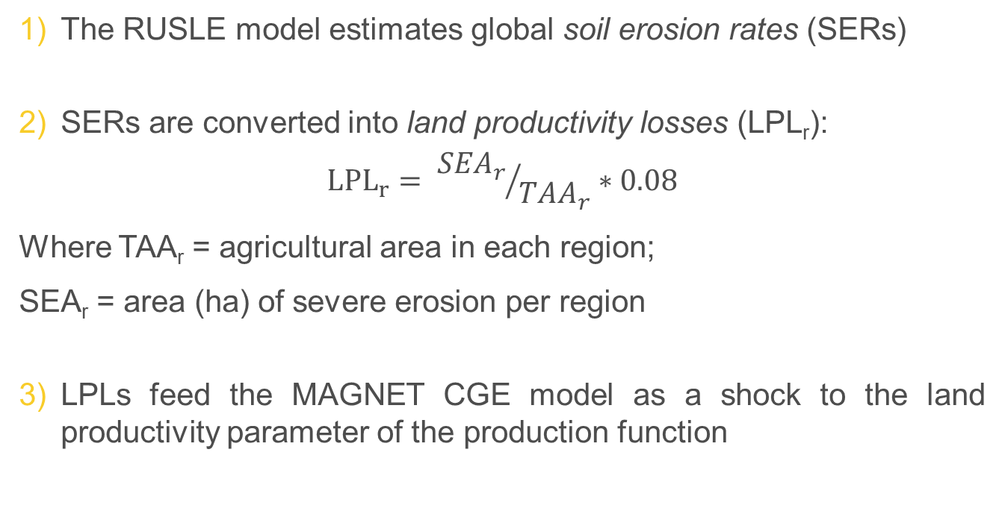
Modeling steps
The RUSLE model estimates global soil erosion rates (SERs)
SERs are converted into land productivity losses (LPL_{r}):
$${LPL}_{r}= {{SEA}_{r}}/{{TAA}_{r}}∗0.08$$
  Where TAA_{r} = agricultural area in each region;
  SEA_{r} = area (ha) of severe erosion per region
LPLs feed the MAGNET CGE model as a shock to the land productivity parameter of the production function

Slide 6
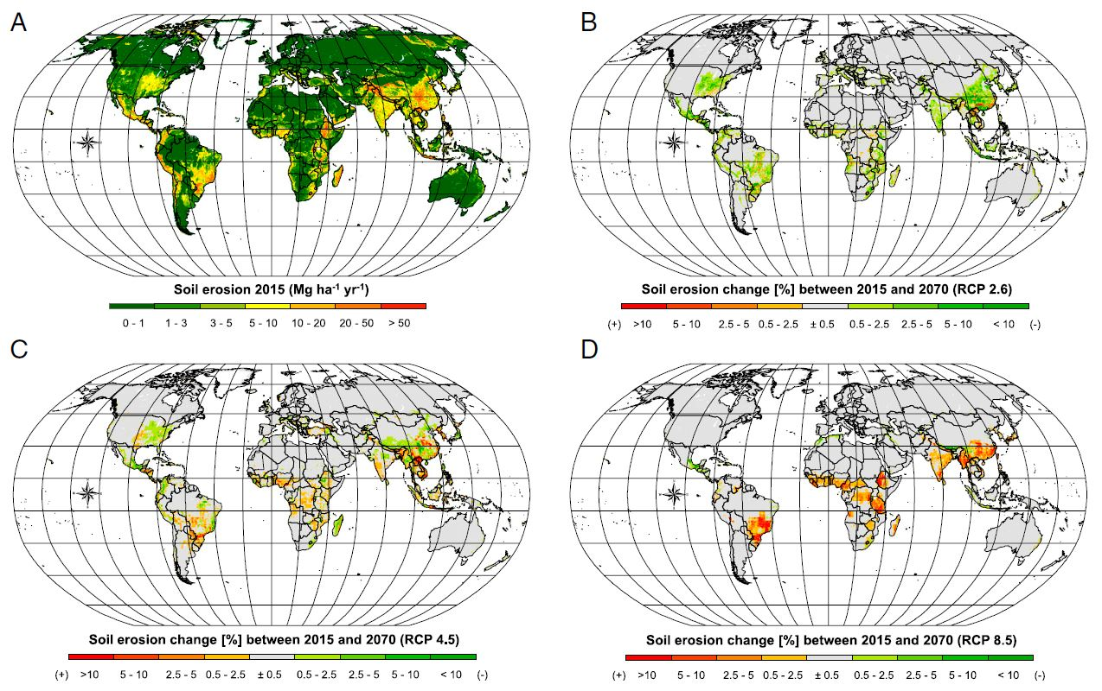
Soil erosion estimates (from RUSLE)

Slide 7
Caveats
Uncertainty affects:
  soil erosion estimates as outputs of the biophysical model
  assumption that land productivity losses occur only in severely eroded land
  No distinction between crops, land productivity losses are uniformly applied to crop activities
Different temporal and spatial scales of the models involved: site-specific soil erosion data have to be adapted at the larger (national) spatial scale of the CGE model

Slide 8
Next steps
Running scenarios with many disaggregated single countries
Feeding the JRC single country CGE model (DEMETRA) with MAGNET output (country-level studies for African economies)

Slide 9

Thank you
© European Union 2021
Unless otherwise noted the reuse of this presentation is authorised under the CC BY 4.0 license. For any use or reproduction of elements that are not owned by the EU, permission may need to be sought directly from the respective right holders.
Slide xx: element concerned, source: e.g. Fotolia.com; Slide xx: element concerned, source: e.g. iStock.com
Notes:
Update/add/delete parts of the copy right notice where appropriate.
More information: https://myintracomm.ec.europa.eu/corp/intellectual-property/Documents/2019_Reuse-guidelines%28CC-BY%29.pdf

