Slide 1
The Impact of RCEP on Chinese Regional Economy
From Global Value Chains Perspective
Lingling ZHOU，Chen PAN ，
Tsinghua University
Jianwu HE ，Shantong LI
Development Research Center of the State Council，PRC

Slide 2
I. Introduction
In November 15th 2020, RCEP members officially have established the Regional Comprehensive Economic Partnership (RCEP).
RCEP will connect about 30% of the world’s people and output and will generate significant gains.
RCEP has become the largest free trade agreement negotiation in the world.
RCEP would not only liberalize trade barriers on goods and services and free up investment flows, but would also enhance trade facilitation, encourage the development of global value chains.

Slide 3
I. Introduction
From global value chains perspective, what impact will RCEP have on the Chinese regional economy?
And what is the effect of RCEP on Chinese regional industries?
These answers to a number of quantitative questions will help us to understand the impact of trade liberalization on Chinese regional economy.

Slide 4
II. Literature Review
Recently, there are many studies on RCEP. Previous studies show that RCEP will greatly promote Chinese economic development and promote my country's foreign trade growth.
In particular, the members of RCEP are China's important trading partners, and regional trade agreements play a vital role in the economic growth of the members,(see Athukorala 2016; Li et al. 2016;Gilbert et al., 2018; Itakura ,2018)

Slide 5
II. Literature Review
In addition, RCEP would have a strong reshaping effect on the division of labor in the global value chains (Baldwin and Lopez-Gonzalez, 2015).
RCEP will also promote the flow of FDI among trading partners (Li, 2014; Du and Guo, 2021).
Generally speaking, previous literatures have explained the economic effects of RCEP from different perspectives, but few literatures discuss the impact of RCEP on China's regional economy.

Slide 6
III. Models, Scenarios and Model Connection
1. CGE Model
We simulate the impacts of RECP on China’s exports based on GTAP model. This model is a global computable general equilibrium model which is a multi-sector, multi-region computable general equilibrium (CGE) model of global trade.
The model setting in this paper follows a short-term closure assumption, with labor supply as an exogenous variable, and the wage level is adjusted according to labor supply and demand. The return on capital (ROC) is fixed and capital supply is used as an endogenous variable.

Slide 7
III. Models, Scenarios and Model Connection
2. Scenarios
Scenario 1 (RCEP15): In Scenario 1, we assume that 10 ASEAN countries, China, Japan, Korea, Australia, and New Zealand will realize trade liberalization.
Scenario 2 (RCEP16):In Scenario 2, we assume that 10 ASEAN countries, China, Japan, Korea, India, Australia and New Zealand will reach final agreement on the RCEP and realize trade liberalization..

Slide 8
III. Models, Scenarios and Model Connection
3. Data Aggregation
According to the simulation results, the soft-connection between GTAP model and China’s regional input-output model is applied to assess impacts of RCEP on China’s regional economy.
To reduce the computational burden, we have aggregated the data to 15 countries/regions (as shown in Table 1) and 16 sectors (see tables 2)..

Slide 9
III. Models, Scenarios and Model Connection
4. Model Connection
The basic logical framework is shown in Figure 1.
Impacts of GDP and Export by province
RCEP
Global Computable General Equilibrium Model
Impacts on Exports by Industry
Chinese Multi – Region Input Output Model
Figure 1 Logical Framework

Slide 10
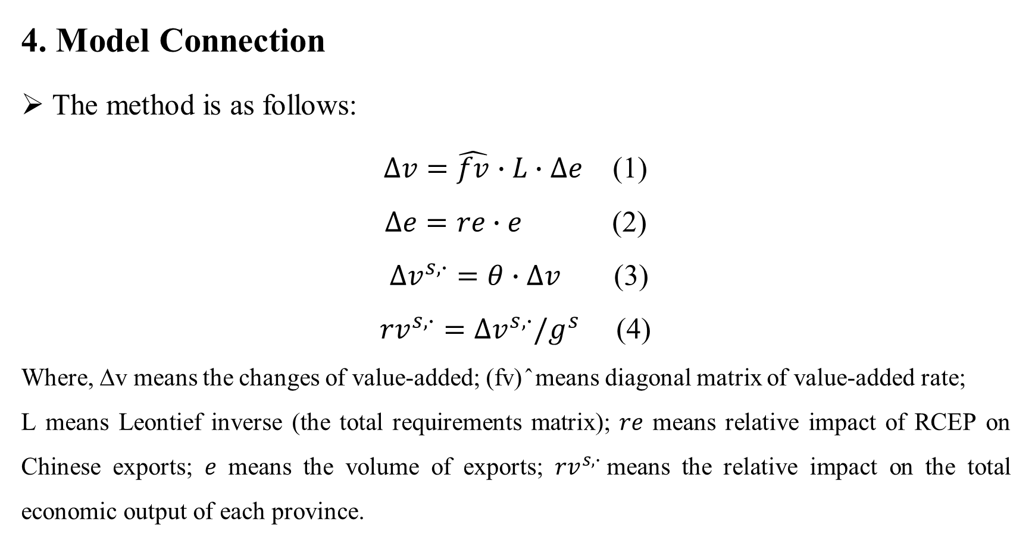
III. Models, Scenarios and Model Connection
4. Model Connection
The method is as follows:
$∆v=\hat{fv}∙L∙∆e$ (1)
$∆e=re∙e$ (2)
$∆v^{s,∙}=θ∙∆v$ (3)
${rv}^{s,∙}=∆v^{s,∙}/g^{s}$ (4)
Where, ∆v means the changes of value-added; (fv) ̂ means diagonal matrix of value-added rate;
L means Leontief inverse (the total requirements matrix); 𝑟𝑒 means relative impact of RCEP on Chinese exports; 𝑒 means the volume of exports; ${rv}^{s,∙}$means the relative impact on the total economic output of each province.

Slide 11
IV. Preliminary Results
National Level
Table 3 RCEP ’s Impact on Chinese Macroeconomic in Different Scenarios（%）
Variable | S1(RCEP15) | S2(RCEP16)
Real GDP | 0.138 | 0.177
GDP Deflator | 0.447 | 0.733
Welfare（$Million） | 23513 | 34191
Real Export | -1.249 | -1.885
Real Import | 0.070 | 0.032
Trade Balance（$Million） | -97760 | -122714
Terms of Trade | 0.256 | 0.516
CPI | 0.426 | 0.671
Investment | 2.071 | 2.634
Capital | 2.071 | 2.634

Slide 12
IV. Preliminary Results
Provincial Level
Table 4 RCEP ’s Impact on Chinese Provincial GDP (%)
Region | S1(RCEP15) | S2(RCEP16) | Region | S1(RCEP15) | S2(RCEP16)
Anhui | -0.447 | -0.445 | Jiangxi | 0.008 | 0.008
Beijing | 0.910 | 0.903 | Jilin | 2.555 | 2.536
Chongqing | -1.332 | -1.322 | Liaoning | -0.905 | -0.898
Fujian | -0.040 | -0.039 | Ningxia | -21.433 | -21.266
Gansu | -3.030 | -3.005 | Qinghai | 19.020 | 18.855
Guangdong | 1.090 | 1.077 | Shaanxi | -0.801 | -0.796
Guangxi | -9.482 | -9.423 | Shandong | 0.006 | 0.006
Guizhou | -3.915 | -3.880 | Shanghai | -0.048 | -0.047
Hainan | -5.457 | -5.419 | Shanxi | 0.171 | 0.170
Hebei | -11.088 | -11.005 | Sichuan | -0.846 | -0.840
Heilongjiang | 1.820 | 1.802 | Tianjin | -0.103 | -0.102
Henan | 0.398 | 0.395 | Tibet | -0.135 | -0.133
Hubei | -0.004 | -0.004 | Xinjiang | 1.975 | 1.963
Hunan | 0.130 | 0.129 | Yunnan | -0.703 | -0.698
Inner Mongolia | -0.705 | -0.697 | Zhejiang | -0.262 | -0.260
Jiangsu | 0.825 | 0.819

Slide 13
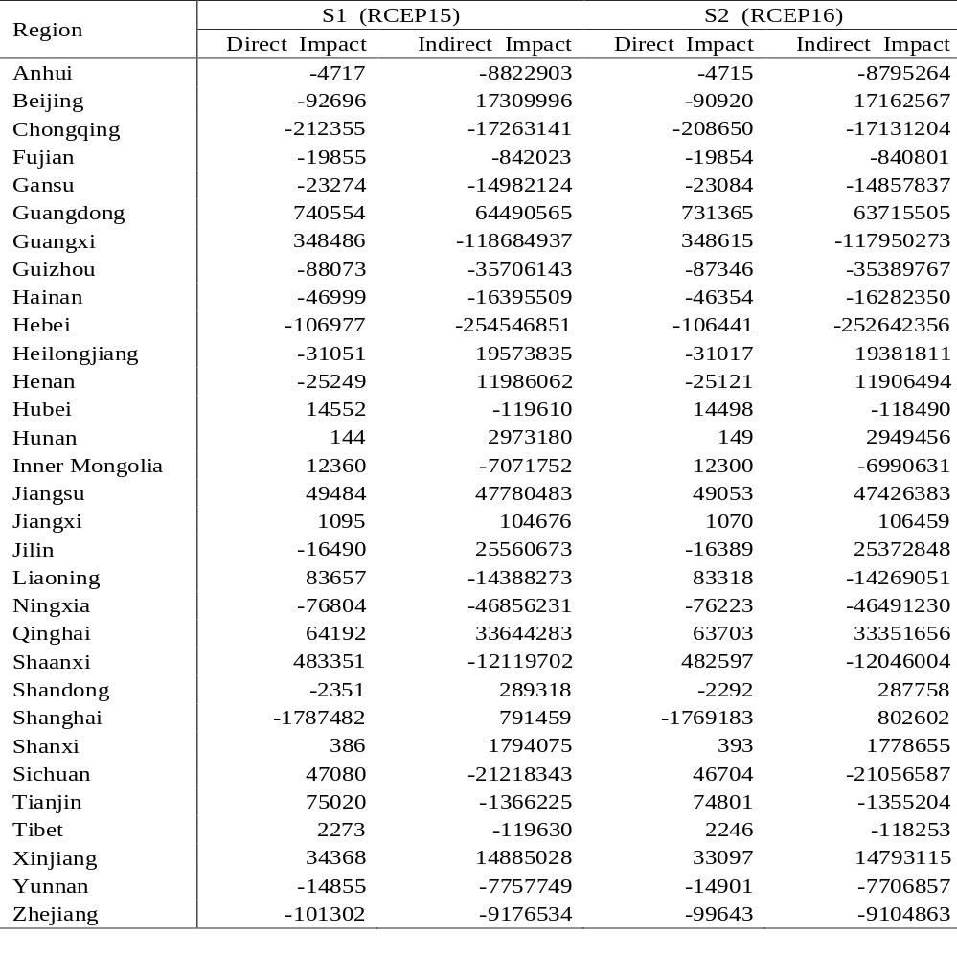
Table 5 Direct and Indirect Impact of RCEP on Chinese Provincial Export ($million)

Slide 14
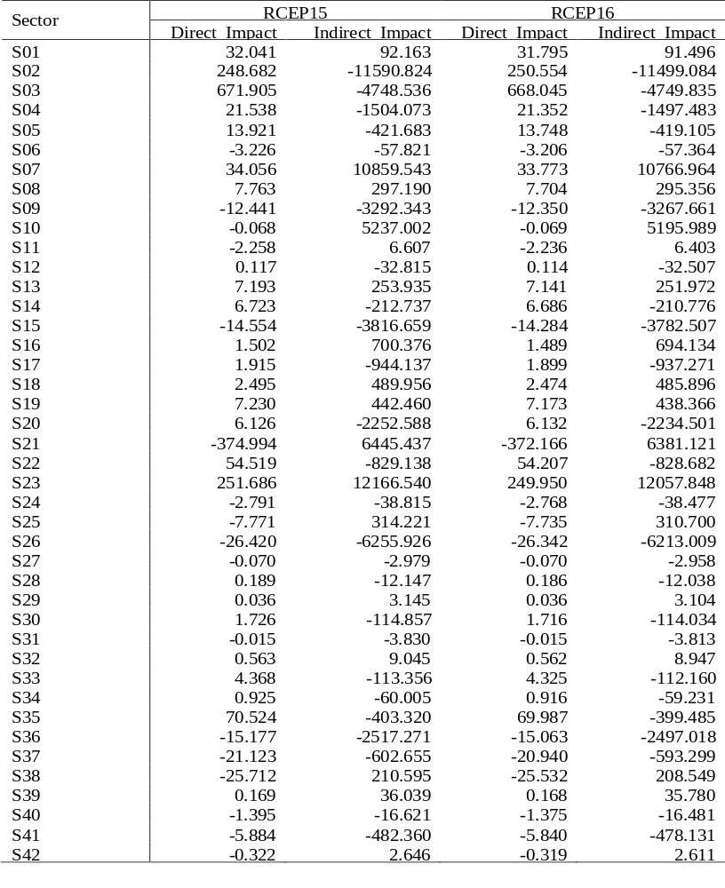
IV. Preliminary Results
Industry Level
Table 6 Direct and Indirect Impact of RCEP on China’s Industrial Export ($million)
In summary, RCEP has a certain role in promoting the export of agriculture and labor-intensive manufacturing industries.
It has a certain restraining effect on technology-intensive industries and service industries.
Because tariff cuts in agricultural and food products are slightly higher and, more importantly, reductions in NTBs in services trade are assumed to be larger.

Slide 15
V. Conclusion
Firstly, from a national perspective, RCEP will have huge economic effects on members, such as GDP, welfare, and trade..
Secondly, from a provincial perspective, RCEP would promote the economy of most provinces. RCEP has a greater promotion effect on the economy of coastal areas, while it has a certain inhibitory effect on inland areas.
Thirdly, from an industrial perspective, impact of RCEP on exports of different industries is different. RCEP has a certain role in promoting the export of agriculture and labor-intensive manufacturing industries.

Slide 16
Thank you very much!

