Slide 1
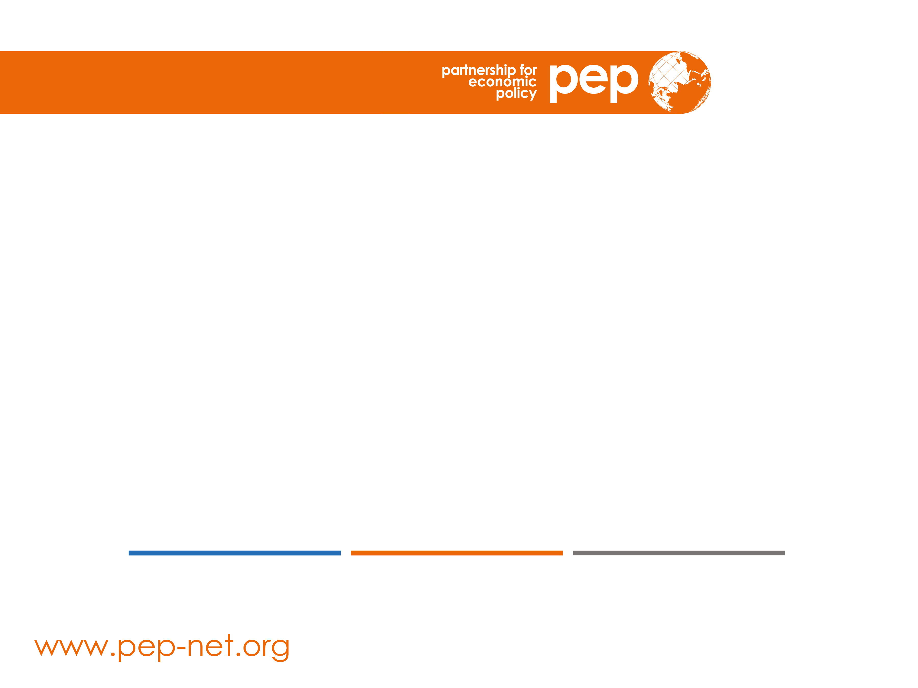
Simulations of policy responses and interventions to promote inclusive adaptation to and recovery from the COVID-19 crisis in Zimbabwe
GTAP VIRTUAL CONFERENCE, June 2021
Margaret Chitiga, Ramos Mabugu, Helene Maisonnave and Martin Henseler

Slide 2
Outline
Introduction, Objectives and Context
Method and structure of production and labour market
Data base
COVID-19 Shocks and Simulations
Results
Key Findings and Policy Recommendations

Slide 3
Context
COVID-19 in Zimbabwe
On March 20, 2020, Zimbabwe reported its first confirmed coronavirus disease (COVID-19) case.
Upon confirmation of its first positive case, government declared the pandemic a State of National Disaster and acted early to suppress the transmission of the virus by placing a nationwide lockdown regime with severe restrictions on travel and movement of people.
  By 16th of May 2021, the country was still on level 2 national lockdown.
The lockdown measures required closures of certain businesses and public places, bolstering of hygiene control and general behavioural controls.

Slide 4
Objective
Computable General Equilibrium Model (CGE) and Microsimulation
Undertake a credible, quantified analysis of the impact of alternative COVID-19 recovery plans
    Impact
    Mitigation and
    Recovery
On key economic indicators
    Macroeconomic (GDP, unemployment, trade)
    Sectoral (production, labour demand etc.)
    Social (Poverty, inequality)
    Gender (Women, Men)
Using a Zimbabwean CGE model (2019 SAM) linked to a household survey microsimulation model (2017 PICES)
Develop analysis nationwide, across diverse sectors and socioeconomic categories – in particular gender and rural/urban regions.

Slide 5
Production and Labour Market -- Standard
Total output
Gross Value added
Intermediate goods and services
Labour
Capital
Domestic
Foreign
Skilled
Unskilled
Land
Agricultural capital
Non-Agricultural capital
Notes:
In a standart CGE model the production and the labour market are modelled in the way as displayed on this slide.
Capital and labour are used to created gross value added which together with intermediate goods and services (from demestic markets and imports) represent the output.
Capital can be differentiated into land, agricultural capital and non-agricultural capital.
Often the labour market is differentiated as skilled or unskilled labour, sometimes also differentiated as rural and urban labour.
Our study adresses the evaluation of economic wide impacts and the socio-economic impacts of COVID-19 and possible response policies. Since the socio-economic impacts are created from changes on the labour markets (increase of unemployment) we target a more detailed representation of the labour market.
We differentiate into agricultural labour market –as the labour market which employs most of the people particularly in rural regions and the non-agricultural labour market, which employs less workers but provides higher wages, particularly in urban regions.

Slide 6
Production and Labour Market – Disaggregated
Total output
Agricultural output
Non-Agricultural output
Gross Value added
Intermediate goods and services
Gross Value added
Intermediate goods and services
Labour
Capital
Domestic
Foreign
Labour
Capital
Domestic
Foreign
Land
Agricultural capital
Rural
Urban
Non-Agricultural capital
Agricultural
permanent
Agricultural
temporary
Agricultural
Own Account
Skilled
Rural
Unskilled
Rural
Skilled
Urban
Unskilled
Urban
Notes:
… as displayed here, in order to consider the impacts on the labour markets in as detailed a fashion as possible

Slide 7
Notes:
The disaggregated labourr types contribute in different shares to the different industries.
This slide shows the share of wage bills for the agricultural sectors differentiated into men (in blue signs) and women (in pink signs) for the different contract forms: permanent (blue), temporary (green) and own account family workers (orange).
The columns for men and women sum up in total to 100% for each industry.
In large scale farming the share of women is about 22% significantly smaller than for men with nearly 80%.
Small scale farming with 60% female workers dominates over male work with about 40%, all of them are assumed to be own account workers or contributing family workers. In fishery and forestry sector, we assume more men than women working in that sector.

Slide 8
Notes:
In non-agricultural labour markets the share of wage bills for male workers is much higher especially for the urban workers, which have higher wages than the rural workers.
Only in services are men and women nearly comparable in shares of wages and this industry is heavily impacted by COVID-19 shocks.

Slide 9
Notes:
The shares of male and female labour in different sectors for different wages result in different labour income for rural and urban households.
This graph illustrates only the share of labour income in total income, income from capital and transfers would add up the colums to 100%.
In rural households the income from female work is half of the share of men‘s work. However, adding up the income from agricultural activities (permanent, temporary and own-account), women‘s income reaches comparble share (at 5%) as men. Note that wages in agricultural acitivties are comparably low, but the number of workers is high.
Thus, these graphs only represent the share of income, not the numbers of workers behind them.

Slide 10
Notes:
A comparable ratio between income from female and male work can be found in the income of urban households. Women contribute with urban works half of the share of men.

Slide 11
Microsimulation: Top-Down Approach
Top Down - Bottom Up
CGE model
Price index
Household income
… poor households
… rich households
Scenario
BAU
Scenario
BAU
Poverty lines
Income distributions
Poverty index
in scenario
Poverty index
in BAU
versus
Change in poverty

Slide 12
Modelling the impact of the COVID-19 Pandemic, Mitigation and Recovery Plan
Step 1: prepare a baseline with no COVID-19 pandemic projection to 2025 (BAU)
  no new policies beyond 2019 initial measures
Step 2: distinguish two main channels of pandemic transmission to the economy
  ‘International’ channel of transmission
  ‘Domestic’ channel of transmission
Step 3: distinguish two scenarios of the severity of the pandemic
  ‘MILD’ COVID-19 impact
  ‘SEVERE’ COVID-19 impact
Step 4: distinguish three elements of the Plan/Interventions
  ‘MITIGATION’ or stimulus measures
  ‘RECOVERY’ but neutral measures
  More ambitious GENDER recovery programme (sector and labour based)

Slide 13
Modelling (Continued)
Hypothesis for the severe scenario
 | 2020 | 2021 | 2022
International channels
Decrease in exports (all commodities) | -27.2% | -27.2% | -5%
Decrease in world price of primary commodity exports | -4.7% | -4.7% | -2%
Decrease in world prices for imports | -25.8% | -25.8% | -15%
Increase in remittances | +33%
Domestic channels
Decrease in productivity for the sectors | - 2% for mildly affected -5% for moderate -7 % for largely affected -15 % for severely affected | - 2% for mildly affected -3% for moderate -5% for largely affected -10% for severely affected | - 1% for mildly affected -2% for moderate -3% for largely affected -5% for severely affected
Increase in transportation cost | 2%

Slide 14
Modelling (Continued)
Scenario Design
As mitigation measures, we simulate a fiscal package being implemented in 2020 and 2021
To analyse the effectiveness of this recovery policy under different impact-recovery scenarios, we apply this measure to the severe scenarios.
As gender policy, the scenarios consist of measures that grant higher subsidies to the most female intensive sectors rather than an economy-wide policy applied between 2022 and 2024.
  The first policy subsidises the employment of women in the non-agricultural sectors, by making their employment costs lower for the producer.
  The second policy subsidises capital in the agricultural sectors.
  In this presentation we focus on the results for the severe scenarios

Slide 15
Scenario: Mitigation
Notes:
This and the following graphs show how the response policies are implmented in the years in terms of budget allocation per sectors or labour (e.g. female labour). On the left the absolute value is displayed and on the right the relative share in each year is displayed.

Slide 16
Step 4: Recovery Scenario

Slide 17
Step 4: Gender 1 Scenario

Slide 18
Step 4: Gender 2 Scenario

Slide 19
Research results
Impact on selected macroeconomic indicators – severe COVID-19
 | SEVE_COVID |  | SEVE_MITIG |  | SEVE_ RECOV |  | SEVE_GENDE |  | SEVE_GEND2
 | 2021 | 2025 | 2021 | 2025 | 2021 | 2025 | 2021 | 2025 | 2021 | 2025
GDP real | -8.41 | -1.65 | -7.63 | -2.91 | -7.63 | -2.92 | -7.63 | -2.93 | -7.63 | -2.93
Total investment | -38.12 | -2.71 | -92.92 | -4.85 | -92.92 | -4.89 | -92.92 | -4.89 | -92.92 | -4.90
Consumer price index | -1.91 | 1.31 | -0.55 | 2.45 | -0.55 | 2.47 | -0.55 | 2.47 | -0.55 | 2.49
Total HH.cons.rura | -6.47 | -0.52 | 2.57 | -1.03 | 2.57 | -1.04 | 2.57 | -1.04 | 2.57 | -1.05
Total HH.cons.urba | -5.56 | -0.48 | -0.84 | -0.90 | -0.84 | -0.90 | -0.84 | -0.90 | -0.84 | -0.90
Notes: SEVE_COVID = Scenario assuming severe impacts and longer lasting recovery shock from COVID-19, SEVE_MITIG = Scenario SEVE-COVID with mitigation measures, SEVE-RECOV = SEVE-MITIG with recovery measures, SEVE_GENDE = SEVE_RECOV with gender specific recovery measures, SEVE_GEND2 = SEVE_RECOV with alternative gender specific recovery measures, rura = rural, urba = urban, HH.cons = total household consumption, UN = unemployment rate, Agri.Perm. = agricultural workers with permanent contracts, Agri.Temp. = agricultural workers with temporary contracts, skil = skilled workers, unsk = unskilled workers.
Macroeconomic impacts of the COVID-19 pandemic are substantial since the economy simultaneously gets affected on both the demand and supply side.
This combined effect results in a reduction by 8.4% in GDP and a reduction by 38.1% in total investment for 2021 in the severe scenario.
Without any government mitigation measures, what is striking is that even after five years, the GDP levels are still below the BAU levels under both COVID scenarios.
The persistence in economic decline is an indication of the need for intervention.

Slide 20
Research results
Impact on employment – severe COVID-19
 | SEVE_COVID |  | SEVE_MITIG |  | SEVE_ RECOV |  | SEVE_GENDE |  | SEVE_GEND2
 | 2021 | 2025 | 2021 | 2025 | 2021 | 2025 | 2021 | 2025 | 2021 | 2025
UN Agri.Perm.Men | 19.11 | -0.65 | 3.62 | -0.98 | 3.62 | -0.99 | 3.62 | -0.99 | 3.62 | -0.82
UN Agri.Perm.Women | 20.55 | -0.63 | 4.23 | -0.93 | 4.23 | -0.94 | 4.23 | -0.94 | 4.23 | -0.77
UN Agri.Temp.Men | 21.62 | -0.62 | 4.69 | -0.90 | 4.69 | -0.91 | 4.69 | -0.91 | 4.69 | -0.74
UN Agri.Temp.Women | 21.62 | -0.62 | 4.69 | -0.90 | 4.69 | -0.91 | 4.69 | -0.91 | 4.69 | -0.74
UN skil.rura.Men | 4.91 | -0.01 | 4.54 | 0.00 | 4.54 | 0.00 | 4.54 | 0.00 | 4.54 | -0.01
UN skil.rura.Women | 5.57 | -0.03 | 3.54 | -0.05 | 3.54 | -0.05 | 3.54 | -0.05 | 3.54 | -0.06
UN unsk.rura.Men | 13.12 | -0.20 | 11.40 | -0.37 | 11.40 | -0.37 | 11.40 | -0.37 | 11.40 | -0.38
UN unsk.rura.Women | 11.49 | -0.27 | 6.03 | -0.61 | 6.03 | -0.62 | 6.03 | -0.62 | 6.03 | -0.63
UN skil.urba.Men | 5.16 | 0.00 | 4.95 | 0.02 | 4.95 | 0.02 | 4.95 | 0.02 | 4.95 | 0.02
UN skil.urba.Women | 4.35 | -0.11 | 1.85 | -0.19 | 1.85 | -0.20 | 1.85 | -0.20 | 1.85 | -0.20
UN unsk.urba.Men | 17.87 | -0.19 | 16.26 | -0.34 | 16.26 | -0.34 | 16.26 | -0.34 | 16.26 | -0.36
UN unsk.urba.Women | 12.07 | -0.33 | 6.02 | -0.69 | 6.02 | -0.70 | 6.02 | -0.70 | 6.02 | -0.71
Notes: SEVE_COVID = Scenario assuming severe impacts and longer lasting recovery shock from COVID-19, SEVE_MITIG = Scenario SEVE-COVID with mitigation measures, SEVE-RECOV = SEVE-MITIG with recovery measures, SEVE_GENDE = SEVE_RECOV with gender specific recovery measures, SEVE_GEND2 = SEVE_RECOV with alternative gender specific recovery measures, rura = rural, urba = urban, HH.cons = total household consumption, UN = unemployment rate, Agri.Perm. = agricultural workers with permanent contracts, Agri.Temp. = agricultural workers with temporary contracts, skil = skilled workers, unsk = unskilled workers.
The decline in the economy, together with the original shocks, cause an increase in unemployment.

Slide 21
Research results
Impact on employment – severe COVID-19 (Continued)
In the agricultural sectors, female unemployment is higher (+4.3 percentage points) than male unemployment (+4.02 percentage points for male).
In the case of temporary workers, male and female experience an increase in unemployment rate of 4.6 percentage points.
For private non-agricultural sectors, unskilled workers face a higher increase in unemployment than skilled workers.
In rural areas, male unskilled unemployment rate increases by 2.4 percentage points while female unskilled unemployment rate increases by 1.8 percentage points.
Skilled workers in rural areas also face an increase in their unemployment rate, but the increase is relatively lower at 0.9 percentage points for men and 1.2 percentage points for women.
In urban areas, there is a similar pattern with the unemployment rate increasing more for unskilled workers than for skilled.

Slide 22
Research results
Macro simulation results with mitigation
The mitigation plan offers some relief to the activities and provides cash transfers to households and firms.
In 2021, the mitigation measures help to reduce the GDP losses by 0.77 percentage points in the severe scenario.
The mitigation measures help in reducing unemployment for both men and women.
Decreases in the unemployment rate for women are more noticeable compared to the BAU in 2021, which means that the mitigation measures result in sectors hiring more women than in the baseline, as some targeted sectors are women intensive.

Slide 23
Research results
Macro simulation results with mitigation (Continued)
Rural households are particularly benefitting from the government mitigation plan, with an increase of their income by 14.8%, compared to 7.2% for urban households.
At the macroeconomic level, the mitigation measures clearly help households and the different activities.
However, the fiscal package is sharply decreasing government savings, which is reducing total investment, hampering future growth.
Despite the benefits of fiscal package under the mitigation scenario being great in the short run, the consequences on total investment in the long run are dramatic.

Slide 24
Research results
Impact on the production in selected sectors
 | SEVE_COVID |  | SEVE_MITIG |  | SEVE_ RECOV |  | SEVE_GENDE |  | SEVE_GEND2
 | 2021 | 2025 | 2021 | 2025 | 2021 | 2025 | 2021 | 2025 | 2021 | 2025
Production
Agriculture Large Scale Farming | -22.09 | -1.54 | -7.96 | -2.24 | -7.96 | -2.25 | -7.96 | -2.26 | -7.96 | -2.30
Agriculture Small Scale Farming | -3.75 | -2.24 | -3.94 | -4.30 | -3.94 | -4.33 | -3.94 | -4.33 | -3.94 | -4.18
Mining | -21.33 | -2.97 | -14.74 | -4.71 | -14.74 | -4.76 | -14.74 | -4.74 | -14.74 | -4.78
Food | -7.68 | -1.89 | 4.33 | -2.99 | 4.33 | -3.01 | 4.33 | -3.01 | 4.33 | -2.98
Construction | -24.51 | -3.88 | -56.12 | -6.62 | -56.12 | -6.68 | -56.12 | -6.68 | -56.12 | -6.71
Business | -2.20 | -1.57 | 4.18 | -3.11 | 4.18 | -3.13 | 4.18 | -3.13 | 4.18 | -3.15
Notes: SEVE_COVID = Scenario assuming severe impacts and longer lasting recovery shock from COVID-19, SEVE_MITIG = Scenario SEVE-COVID with mitigation measures, SEVE-RECOV = SEVE-MITIG with recovery measures, SEVE_GENDE = SEVE_RECOV with gender specific recovery measures, SEVE_GEND2 = SEVE_RECOV with alternative gender specific recovery measures.
Less impacted are agriculture food and businesses sectors.
Small scale farming, mining and construction sectors face higher production
losses in 2025.
The mitigation measures help most of the sectors to reduce the losses in 2021
and in 2025.
The construction sector is hit more severely because of the public
funds that have been spent in mitigation measures and not into investments.

Slide 25
Research results
Impact on labour demand in selected sectors
 | SEVE_COVID |  | SEVE_MITIG |  | SEVE_ RECOV |  | SEVE_GENDE |  | SEVE_GEND2
 | 2021 | 2025 | 2021 | 2025 | 2021 | 2025 | 2021 | 2025 | 2021 | 2025
Labour demand
Agriculture Large Scale Farming | -26.42 | 0.74 | -5.95 | 1.06 | -5.95 | 1.07 | -5.95 | 1.07 | -5.95 | 0.86
Agriculture Small Scale Farming | 0.18 | -0.06 | -0.07 | -0.11 | -0.07 | -0.11 | -0.07 | -0.11 | -0.07 | -0.11
Mining | -19.58 | 0.02 | -6.87 | -0.57 | -6.87 | -0.59 | -6.87 | -0.58 | -6.87 | -0.59
Food | -8.22 | 0.74 | 13.30 | 1.34 | 13.30 | 1.34 | 13.30 | 1.34 | 13.30 | 1.45
Construction | -21.07 | -2.62 | -64.75 | -5.06 | -64.75 | -5.10 | -64.75 | -5.10 | -64.75 | -5.12
Business | 6.51 | 0.36 | 19.20 | 0.84 | 19.20 | 0.85 | 19.20 | 0.85 | 19.20 | 0.85
Notes: SEVE_COVID = Scenario assuming severe impacts and longer lasting recovery shock from COVID-19, SEVE_MITIG = Scenario SEVE-COVID with mitigation measures, SEVE-RECOV = SEVE-MITIG
with recovery measures, SEVE_GENDE = SEVE_RECOV with gender specific recovery measures, SEVE_GEND2 = SEVE_RECOV with alternative gender specific recovery measures.
Without mitigation measures the less impacted sectors (except small scale
farming) reach close to the output of the baseline.
The total labour demand reacts accordingly, laying off more workers from the sectors which reduce their production more strongly – Large scale farming, mining, construction.
More men than women are working in mining and construction sectors, whereas women are more represented in the less impacted sectors of agriculture and food production. Thus, in 2021 the unemployment rate for men decreases more.

Slide 26
Research results
Impact on households - severe COVID-19
 | SEVE_COVID |  | SEVE_MITIG |  | SEVE_ RECOV |  | SEVE_GENDE |  | SEVE_GEND2
 | 2021 | 2025 | 2021 | 2025 | 2021 | 2025 | 2021 | 2025 | 2021 | 2025
Households rural
Total income | -11.66 | 0.50 | 3.39 | 0.83 | 3.39 | 0.83 | 3.39 | 0.84 | 3.39 | 0.84
Income from labour | -13.16 | 0.99 | -6.27 | 1.70 | -6.27 | 1.71 | -6.27 | 1.71 | -6.27 | 1.69
Income from capital | -13.40 | -0.46 | -4.57 | -0.96 | -4.57 | -0.97 | -4.57 | -0.97 | -4.57 | -0.91
Income from transfers | -4.73 | 0.08 | 44.02 | 0.21 | 44.02 | 0.21 | 44.02 | 0.21 | 44.02 | 0.22
Savings | -0.85 | 1.40 | -0.98 | 2.63 | -0.98 | 2.65 | -0.98 | 2.65 | -0.98 | 2.67
Households urban
Total income | -9.86 | 0.60 | -1.76 | 1.12 | -1.76 | 1.12 | -1.76 | 1.13 | -1.76 | 1.14
Income from labour | -10.72 | 0.76 | -8.04 | 1.39 | -8.04 | 1.40 | -8.04 | 1.40 | -8.04 | 1.42
Income from capital | -13.57 | 0.24 | -8.80 | 0.60 | -8.80 | 0.60 | -8.80 | 0.61 | -8.80 | 0.62
Income from transfers | -7.19 | 0.13 | 16.99 | 0.32 | 16.99 | 0.32 | 16.99 | 0.32 | 16.99 | 0.33
Savings | -0.87 | 1.40 | -0.39 | 2.63 | -0.39 | 2.65 | -0.39 | 2.65 | -0.39 | 2.66
The increase in unemployment rates and drop in wage rates in the sectors lead,
in 2021, to a decrease in income of households and consequently, to a drop of
their consumption.
In the mitigation scenario, the income of households increases due to
increased income from transfers from the government as part of the mitigation
measures.

Slide 27
Research results
Impact on firms - severe COVID-19
 | SEVE_COVID |  | SEVE_MITIG |  | SEVE_ RECOV |  | SEVE_GENDE |  | SEVE_GEND2
 | 2021 | 2025 | 2021 | 2025 | 2021 | 2025 | 2021 | 2025 | 2021 | 2025
Firms
Income from transfers | -13.57 | 0.24 | -8.80 | 0.60 | -8.80 | 0.60 | -8.80 | 0.61 | -8.80 | 0.62
Disposable income | -13.57 | 0.24 | -8.80 | 0.60 | -8.80 | 0.60 | -8.80 | 0.61 | -8.80 | 0.62
In 2021, firms’ income is decreasing given the decrease in capital income, and so are its savings.
Firm incomes recover better with recovery policies, including gender sensitive policies

Slide 28
Research results
Impact on government - severe COVID-19
 | SEVE_COVID |  | SEVE_MITIG |  | SEVE_ RECOV |  | SEVE_GENDE |  | SEVE_GEND2
 | 2021 | 2025 | 2021 | 2025 | 2021 | 2025 | 2021 | 2025 | 2021 | 2025
Government
Total income | -13.20 | 0.05 | -20.56 | 0.15 | -20.56 | 0.15 | -20.56 | 0.15 | -20.56 | 0.16
Income from transfers | -9.01 | 0.68 | -0.25 | 1.27 | -0.25 | 1.28 | -0.25 | 1.29 | -0.25 | 1.30
Income from other taxes on production | -14.97 | 0.07 | -201.76 | 0.19 | -201.76 | 0.20 | -201.76 | 0.20 | -201.76 | 0.20
Income from other taxes on products and imports | -15.19 | -0.40 | -20.48 | -0.67 | -20.48 | -0.68 | -20.48 | -0.67 | -20.48 | -0.67
Government’s income is decreasing during the pandemic given the reduction in the receipts from direct and indirect taxes.
Overall, total savings in the economy is decreasing leading to a drop in total investment.
The incomes of firms and of the government recover in 2025 with recovery policies

Slide 29
Poverty results
Change of poverty indices in percentage points compared to the BAU.
Scenario/Year | Poverty Index | Recovery scenarios
 |  | COVID rura | COVID urba | MITIG rura | MITIG urba | RECOV rura | RECOV urba | GENDE rura | GENDE urba | GEND2 rura | GEND2 urba
SEVE 2020 | FGT0 | 1.85 | 1.85 | -1.02 | 0.10 | -1.02 | 0.10 | -0.19 | 1.38 | -1.02 | 0.10
 | FGT1 | 1.91 | 0.83 | -1.25 | 0.06 | -1.25 | 0.06 | -0.28 | 0.58 | -1.25 | 0.06
 | FGT2 | 1.60 | 0.41 | -1.02 | 0.03 | -1.02 | 0.03 | -0.24 | 0.29 | -1.02 | 0.03
SEVE 2025 | FGT0 | 0.67 | 0.99 | 1.26 | 1.67 | 1.26 | 1.67 | 1.26 | 1.67 | 1.29 | 1.69
 | FGT1 | 0.73 | 0.38 | 1.39 | 0.72 | 1.40 | 0.73 | 1.40 | 0.73 | 1.41 | 0.73
 | FGT2 | 0.61 | 0.19 | 1.16 | 0.36 | 1.17 | 0.36 | 1.17 | 0.36 | 1.18 | 0.36
Notes: ZimStat2019 = indicators provided by ZIMSTAT (2019b) for the year 2017, Base = indicators computed for the year 2017 as base for the simulated year 2021 and 2025, COVID = Scenario without recovery policy , MITIG = Scenario with mitigation measures, RECOV = scenario with mitigation and recovery measures, GENDE = scenario with mitigation and gender specific recovery measures, GEND2 = scenario with mitigation and alternative gender specific recovery measures, MILD = Scenario assuming mild impacts and fast recovery shock from COVID-19 in the year 2021 or 2025, SEVE = Scenario assuming severe impacts and longer lasting recovery shock from COVID-19 in the year 2021 or 2025, rura = rural households, urba = urban households.

Slide 30
Inequality
Notes:
Without response policies the Gini-Index is nearly unchanged in the mild COVID-19 impact, the marginal decrease results from the slight shift of the function to the left tail of the function.
This means that inequality reduces marginally because more households become poor.
Under severe COVID-19 impact the Gini-Index increases by 0,1 percentage points, because urban households are less and differently affected than rural households.
The policy response help to decrease inequality by 0,4 to 0,6 percentage points in the short run in 2021. In 2025 this positive impact is crowded out.

Slide 31
Key findings
The ongoing COVID-19 pandemic is having devastating effects on an economy that was already in decline prior to onset of the pandemic.
Negative economic growth, growing unemployment, poverty and inequality are exacerbated by the pandemic
Measures to contain the pandemic have negatively affected economic activity with mining and services impacted the most.
Women are particularly in a vulnerable economic situation to the pandemic as the majority of women and woman-led households are facing the biggest impact through income loss, food insecurity and care-giving burdens.
Recovery policies with a gender focus are required to mitigate the negative impacts from COVID-19 on women

Slide 32
Conclusions
The mitigation measures are helping women in particular.
The side effect of the mitigation measures is the negative impact on investment in the long run.
The recovery scenarios help to get the sectors back to production, which is welcome as it leads to an increase in investment.
For the gender scenarios, both the mitigation and recovery scenarios show interesting results, particularly for institutions.
  In the first scenario, women's employment is increasing in all job categories. The declines in the unemployment rate are particularly strong for unskilled women, whether they work in urban or rural areas.
  In the second scenario, the employment effects are positive, but not particularly favourable to women.
Notes:
Although the business as usual values are still not reached, the economy gets closer to reaching where it would have been had there been no COVID-19 pandemic.

Slide 33
Policy recommendations
Key policy recommendations to support mitigation, recovery and growth in the short to medium run for Zimbabwe)
Extend, the mitigation measures that were put in place as part of an initial relief/recovery spending package
Domestic resource mobilisation should be a key priority over the next few years with the aim of increasing revenue to GDP ratio.
Create and implement a new mechanism, a ‘Recovery and Investment-driven Scenario Plan’ – that explicitly encourages public investments and enables production

Slide 34
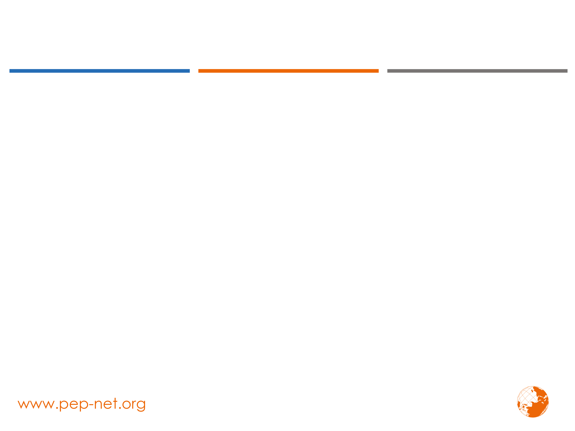

Thank you !
This research was carried out by (insert institutions, partners, etc.)
With technical and financial support from the Partnership for Economic Policy (PEP)
Under the PEP research and capacity building initiative for
“COVID-19 Responses for Equity”
Supported by:

