Slide 1
Land for Fish:
A scenario based CGE analysis of the effects of aquaculture production on agricultural markets
Tobias Heimann and Ruth Delzeit

Slide 2
Introduction

Slide 3
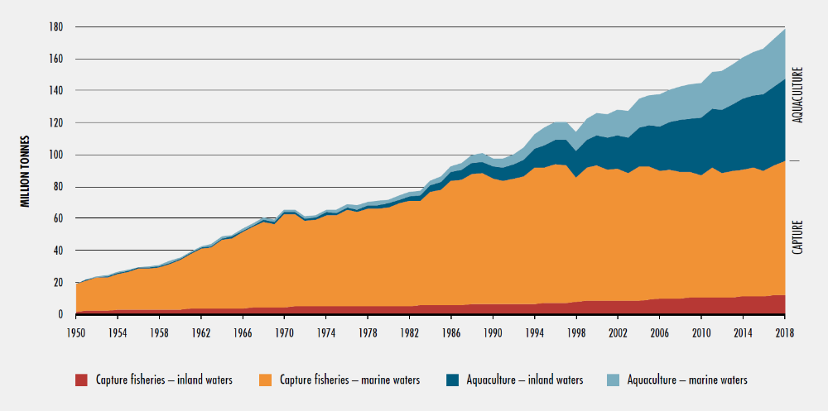
World Capture Fisheries and Aquaculture Production
Introduction
Source: FAO (2020)

Slide 4
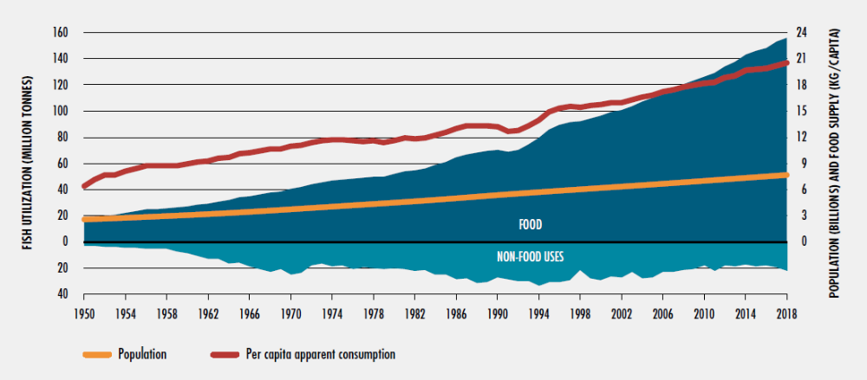
World Fish Utilization and Apparent Consumption, 1950 -2018
Introduction
Source: FAO (2020)

Slide 5
Research Questions
Introduction
How large is the effect of aquaculture production on agricultural markets?
Which regions are the most affected?
How severe is the additional pressure on crop production if fishmeal is substituted by plant-based fodder?
What if ambitioned quotas limit wild catch, so that global fish stocks may be rebuilt to sustainable levels within 15-20 years?

Slide 6
Literature review
Introduction
Resource Economic Linkages of Capture and Aquaculture Fisheries
  Aquaculture production reliefes pressure on wild fish stocks… (Anderson 1985)
  … but excessive demand for fishmeal as fodder can be a threat for both fishing industries (Naylor et al., 2000; Merino et al., 2010 & 2012)
  „Fish In – Fish Out“ (FIFO) Ratio is the crucial parameter (Merino et al., 2012; Regnier & Schubert, 2017)
    Here: FIFO determined by technological progress and composition of farmed species.
Land use of aquaculture fish production
  Froehlich et al. 2018:
    Static agricultural sector model
    Minor effects on land use compared to livestock

Slide 7
Method

Slide 8
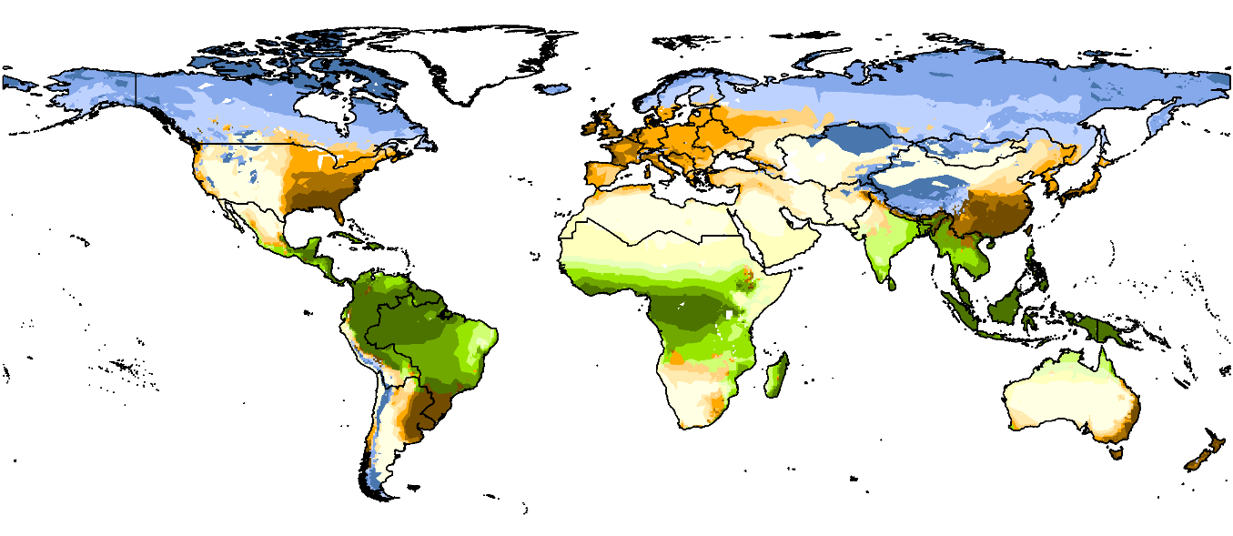
DART (Dynamic Applied Regional Trade)
Method
  Recursive-dynamic, multi-regional, multi-sectoral CGE model of the world economy
  Economy in each region competes with other economies under flexible price and market clearing
  Bilateral Trade
  GTAP9 database (2011)
  GTAP-AEZ

Slide 9
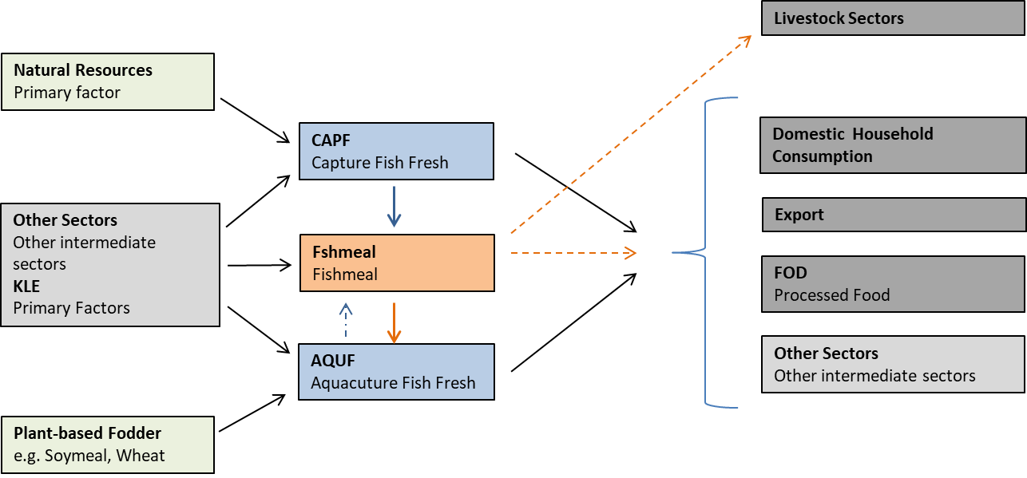
Fish sectors in DART-BIOFISH
Method
Average country level feed composition until 2018
Based on Pahlow et al. 2015, capturing:
  88% of global commercial feed-fed aquaculture fish.
  80% of total fed fish aquaculture from FAO FishStat.

Slide 10
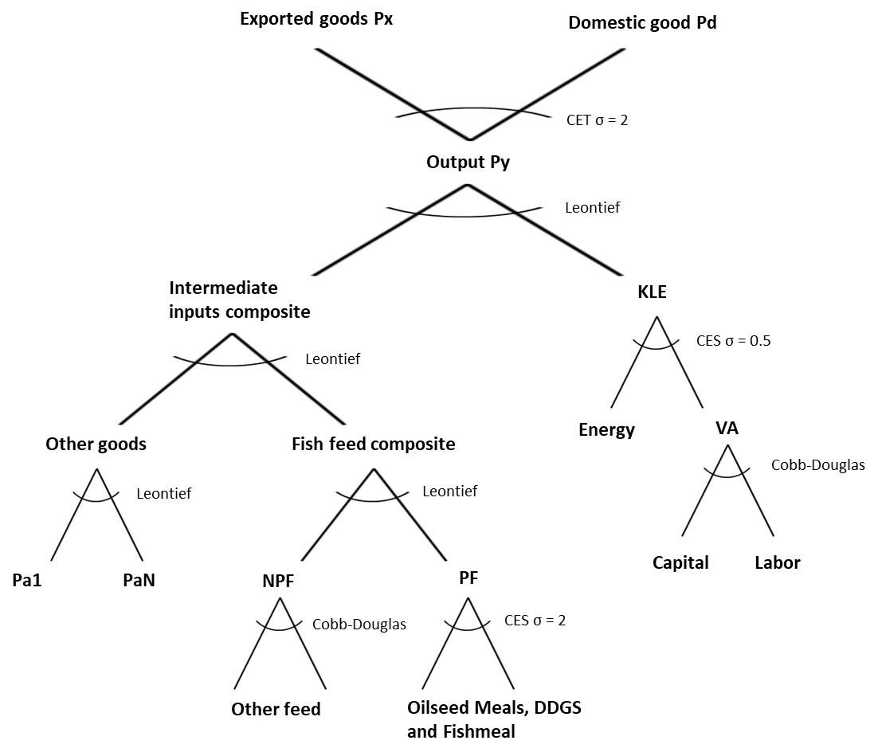
Production Structure of the Fish Sector
Method

Slide 11
Scenarios
Method
Scenario | FAO Projection (Baseline) | Achieve SDG 14 (SDG 14) | Fast Growth (Fast Growth) | Limited Fishmeal Supply (Lim. Fishmeal)
Sector
Capture Fisheries | Annual growth rate of region-specific FAO projection | Reduction by 5% p.a. from 2018 – 2023, then constant | Annual growth rate of region-specific FAO projection | Annual growth rate of region-specific FAO projection
Aquaculture Production | Annual growth rate of region-specific FAO projection | Annual growth rate of region-specific FAO projection | Double annual growth rate of region-specific FAO projection | Double annual growth rate of region-specific FAO projection
Fishmeal Production | Global production constant from 2018 - 2030 | Endogenous | Endogenous | Global production constant from 2018 - 2030

Slide 12
Results

Slide 13
Results

Slide 14
Results

Slide 15
Results
Table 1:
Global Production and Prices
Sector | Baseline Output 2030 | Output |  |  | Price
 |  | ∆ SGD 14 | ∆ Fast Growth | ∆ Lim. Fmeal | ∆ SGD 14 | ∆ Fast Growth | ∆ Lim. Fmeal
PDR | 359.24 | -0.1% | -0.1% | -0.1% | 0.4% | 0.6% | 0.8%
WHT | 321.27 | 0.1% | 0.3% | 0.2% | 0.8% | 1.6% | 2.1%
MZE | 311.80 | 0.1% | -0.4% | -0.6% | 0.9% | 1.7% | 2.5%
AGR | 2311.08 | -0.2% | -0.1% | -0.3% | 0.7% | 1.5% | 2.0%
RSD | 70.68 | 2.1% | 4.5% | 7.3% | 1.3% | 2.8% | 4.1%
SOY | 252.64 | 1.6% | 2.5% | 3.9% | 1.3% | 2.2% | 3.1%
OSDN | 130.56 | 0.7% | 1.2% | 2.0% | 0.8% | 1.5% | 2.1%
OLVS | 986.74 | 0.8% | -0.5% | -0.6% | 1.4% | -0.5% | -0.3%
ILVS | 1388.51 | 1.2% | -1.8% | -2.1% | 0.6% | 0.7% | 1.1%
AQUF | 113.14 | 1.6% | 32.9% | 32.9% | 3.9% | -18.3% | -18.1%
CAPF | 254.00 | -21.8% | 0.0% | 0.0% | 37.6% | 2.7% | 3.6%
FSHmeal | 27.58 | -17.6% | 22.8% | 0.0% | 27.8% | 4.2% | 31.1%
RSDmeal | 24.89 | 7.3% | 16.0% | 26.2% | 3.2% | 8.1% | 10.6%
SOYmeal | 180.22 | 4.8% | 7.4% | 11.6% | 1.4% | 2.7% | 3.8%
OSDNmeal | 16.24 | 12.5% | 25.2% | 34.4% | 2.1% | 4.2% | 8.2%
RSDoil | 22.93 | 2.9% | 5.9% | 9.7% | -4.8% | -12.0% | -16.5%
SOYoil | 75.79 | 3.9% | 6.6% | 10.3% | -3.8% | -5.9% | -9.2%
OSDNoil | 20.74 | 4.5% | 8.1% | 10.7% | -3.0% | -5.2% | -7.2%
BDIE | 22.96 | 8.4% | 18.2% | 23.4% | -1.9% | -3.6% | -4.6%
Crop Sectors
Animal Sectors
Feed Sectors
Veg. Oils

Slide 16
Results
Table 2: Regional Land-Use Change
Region | Crop / Land Use | Area Baseline 2030 (in 1000 ha) | ∆ SGD 14 | ∆ Fast Growth | ∆ Lim. Fishmeal
BRA | SOY | 44833 | 1,2% | 1,8% | 2,7%
 | C_B | 7814 | -0,4% | -0,6% | -0,9%
 | AGR | 11160 | -1,2% | -1,6% | -2,5%
 | Pasture | 174717 | -0,1% | -0,5% | -0,7%
PAC | SOY | 32524 | 0,3% | 1,8% | 2,4%
 | AGR | 9179 | -1,0% | -1,7% | -2,4%
 | Pasture | 140668 | 1,8% | -0,2% | -0,3%
USA | SOY | 54524 | 1,9% | 2,7% | 4,4%
 | AGR | 48502 | -1,3% | -1,0% | -1,8%
 | WHT | 14496 | -2,3% | -1,6% | -2,8%
 | MZE | 26116 | 0,5% | -1,0% | -1,5%
CHN | RSD | 6903 | 6,6% | 14,1% | 23,4%
 | SOY | 3657 | 3,0% | 3,2% | 5,7%
 | OSDN | 6022 | 1,6% | 2,9% | 5,3%
 | AGR | 59942 | -0,5% | -0,8% | -1,3%
 | Pasture | 376264 | 0,1% | -0,7% | -0,9%
Global change in soy area (lim. fishmeal supply): 1.2 Times Area of the Netherlands

Slide 17
Results
Table 3: Regional Changes in Food and Staple Crop Prices
Price Difference to Baseline in 2030
Region | Wheat |  | Maize |  | Paddy Rice |  | Food |  | Processed Meat
 | ∆ SDG 14 | ∆ Lim. Fmeal | ∆ SDG 14 | ∆ Lim. Fmeal | ∆ SDG 14 | ∆ Lim. Fmeal | ∆ SDG 14 | ∆ Lim. Fmeal | ∆ SDG 14 | ∆ Lim. Fmeal
BRA | 1,8% | 3,9% | 1,8% | 3,9% | 1,8% | 4,0% | 0,8% | 1,5% | 0,9% | 1,3%
PAC | 1,1% | 3,2% | 1,2% | 3,2% | 1,3% | 3,3% | 5,1% | 2,2% | 3,8% | 2,0%
LAM | 1,0% | 1,7% | 1,0% | 1,9% | 1,0% | 1,9% | 0,9% | 0,4% | 1,0% | 0,5%
MEA | 0,6% | 1,2% | 0,5% | 1,1% | 0,5% | 1,2% | 0,4% | 0,2% | 0,4% | 0,2%
AFR | 0,4% | 1,2% | 0,5% | 1,2% | 0,5% | 1,2% | 2,9% | 0,2% | 2,0% | 0,3%
CHN | 1,0% | 2,5% | 1,1% | 2,6% | 1,1% | 2,6% | 0,9% | 0,4% | 0,9% | 0,6%
IND | 0,3% | 1,9% | 0,4% | 1,9% | 0,3% | 2,1% | 0,6% | -0,6% | 0,9% | -1,8%
EAS | 0,6% | 1,1% | 0,0% | 0,0% | 0,8% | 1,3% | 0,6% | 0,3% | 0,9% | 0,6%
MAI | 1,0% | 2,4% | 0,4% | 2,6% | 0,4% | 2,6% | 1,5% | -0,1% | 1,4% | -0,7%
ROA | 0,6% | 2,2% | 0,6% | 2,3% | 0,5% | 2,1% | 1,6% | -1,2% | 1,3% | -0,3%
RNE | 0,9% | 2,1% | 0,8% | 1,9% | 0,8% | 1,8% | 1,6% | -0,2% | 2,2% | 0,9%
CAN | 1,6% | 4,1% | 1,4% | 3,5% | 1,6% | 3,9% | 1,0% | 0,5% | 0,8% | 0,7%
USA | 1,5% | 2,7% | 1,4% | 2,7% | 1,5% | 2,8% | 0,8% | 0,4% | 1,1% | 0,9%

Slide 18
Sensitivity Analysis

Slide 19
Production Structure of the Fish Sector
Sensitivity Analysis
← Determines FiFo-Ratio

Slide 20
Sensitivity Analysis
Fish Feed Composition by Scenario and Elasticity

Slide 21
Sensitivity Analysis
Table 4: Quantity and Price Differences between Elasticity Specifications
Sector | Difference σ = 4 to σ = 1
 |  | Quantity |  |  | Price
 | ∆ SDG14 | ∆ Fast Growth | ∆ Lim. Fishmeal | ∆ SDG14 | ∆ Fast Growth | ∆ Lim. Fishmeal
PDR | 0,0% | 0,0% | 0,0% | 0,0% | -0,1% | -0,3%
WHT | 0,0% | 0,1% | 0,1% | -0,1% | -0,2% | -0,3%
MZE | -0,1% | 0,0% | -0,1% | 0,0% | -0,2% | -0,4%
FOD | 0,1% | 0,0% | 0,1% | -0,2% | -0,1% | -0,3%
AQUF | 1,9% | -0,4% | -0,4% | -2,6% | -0,3% | -1,3%
CAPF | 0,0% | 0,0% | 0,0% | -9,8% | -5,1% | -13,8%
FSHMEAL | -17,7% | -2,3% | -24,4% | -12,8% | -5,1% | -23,6%
RSD | -0,9% | -3,1% | -4,5% | -0,3% | -1,2% | -1,8%
SOY | 0,6% | 1,3% | 2,0% | 0,1% | 0,3% | 0,3%
OSDN | -0,3% | -0,8% | -1,5% | -0,2% | -0,5% | -0,9%
Food Crops
Fish Sectors
Oilseed Crops

Slide 22
Conclusion

Slide 23
Conclusion
Effects on agricultural markets:
  Double aquaculture growth rate > achieving sustainable wild fish stocks
  Expansion of rapeseed and soybean production (CHN, BRA, USA, PAC)
  Small price effects on staple crops
Expanding aquaculture leads to higher prices for capture fish
Need to consider Trade-Offs: SDG 14 vs. SDG 15 vs. SDG 2
FIFO ratio plays important role for fish fodder composition…
  …but besides for fishmeal and oilseed meals, low variation in production quantity and prices of other agricultural commodities.

Slide 24
End

Slide 25
Regional aggregation of DART-BIOFISH
Method
Central and South America |  | Europe
BRA | Brazil | FSU | Rest of former Soviet Union
PAC | Paraguay, Argentina, Uruguay, Chile | CEU | Central European Union with Belgium, France, Luxembourg, Netherlands
LAM | Rest of Latin America | DEU | Germany
 |  | MEE | Eastern European Union with Austria, Czech Republic, Estonia, Hungary, Latvia, Lithuania, Poland, Slovakia, Slovenia, Romania, Bulgaria, Croatia
Middle East and Africa |  | MED | Mediterranean with Cyprus, Greece, Italy, Malta, Portugal, Spain
MEA | Middle East and Northern Africa | NWE | North-Western European Union with Denmark, Finland, Ireland, Sweden, United Kingdom
AFR | Sub-Saharan Africa | RNE | Rest of Northern Europe: Switzerland, Norway, Lichtenstein, Iceland
Asia |  | Northern America
CHN | China, Hong Kong | CAN | Canada
IND | India | USA | United States of America
EAS | Eastern Asia with Japan, South Korea, Taiwan, Singapore
MAI | Malaysia, Indonesia | Oceania
ROA | Rest of Asia | ANC | Australia, New Zealand, Rest of Oceania
RUS | Russia
Notes:
040 3918 1053

Slide 26
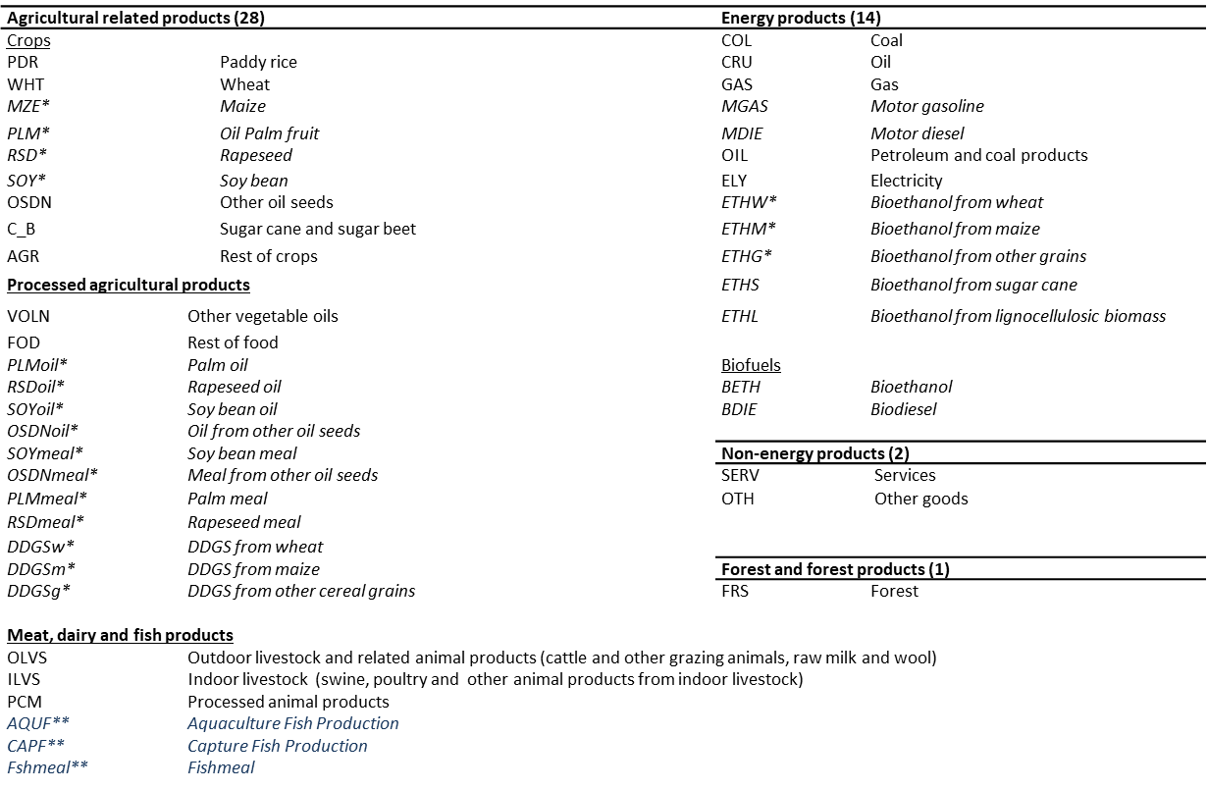
Sectoral aggregation of DART-BIOFISH
Method

Slide 27
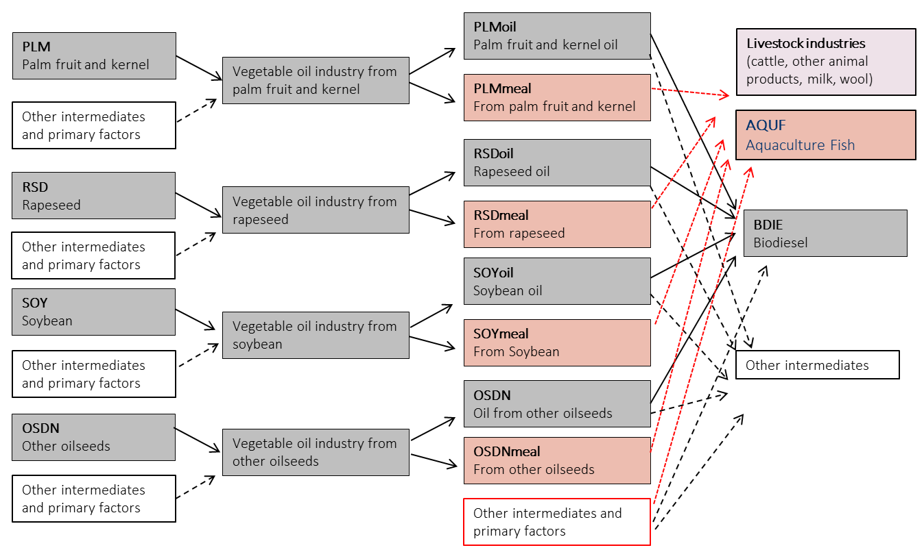
Oilseed industry in DART-BIOFISH
Method

Slide 28
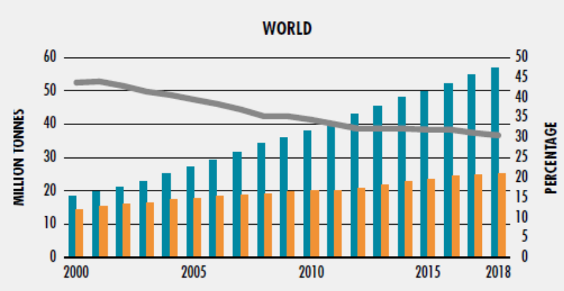
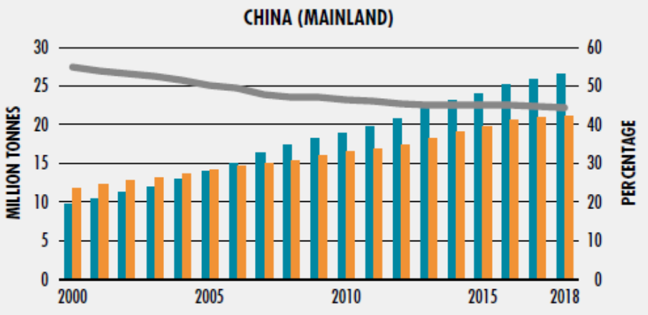
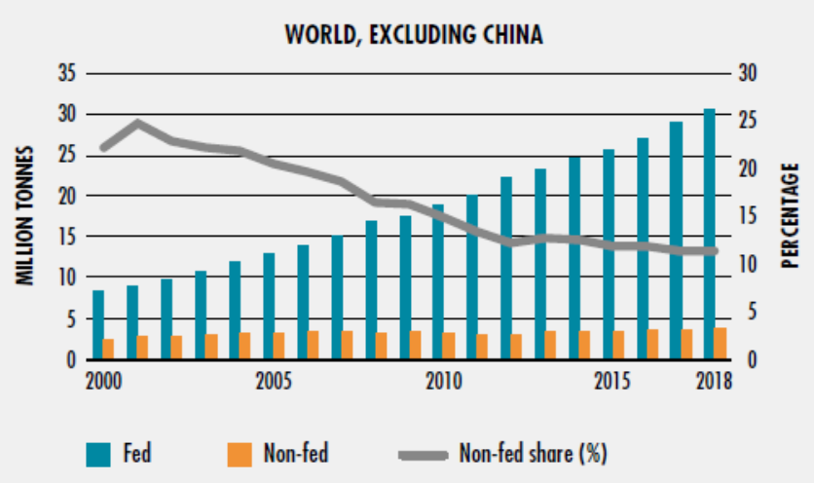
Fed and Non-Fed Aquaculture Production, 2000 - 2018
Introduction
Source: FAO (2020)

Slide 29
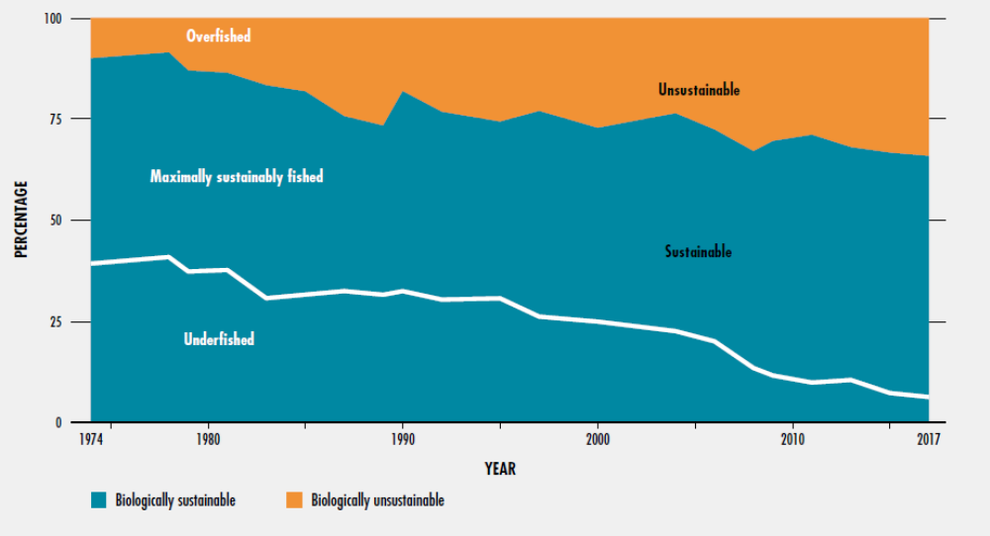
Global Trends in the State of Marine Fish Stocks, 1974-2017
Introduction
Source: FAO (2020)

Slide 30
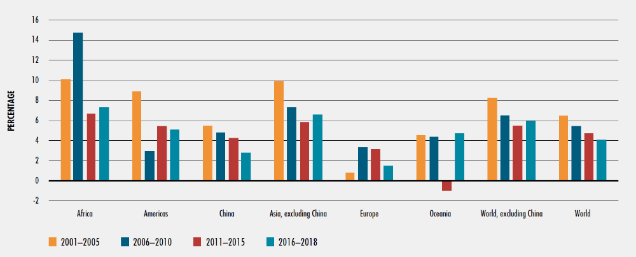

Slide 31
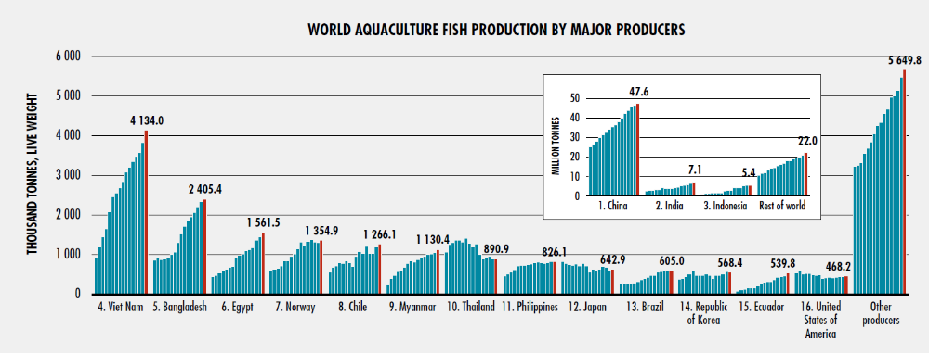
Introduction
Source: FAO (2020)

Slide 32
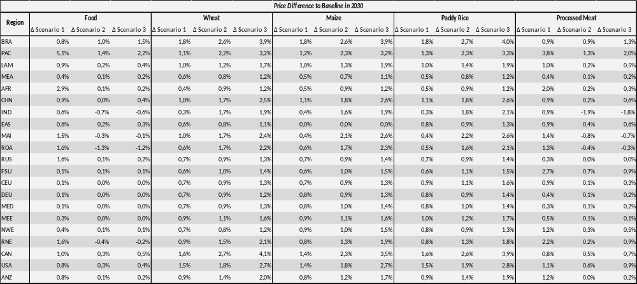
Results
Table 3: Regional Changes in Food and Staple Crop Prices

