Slide 1

THE REGIONAL ECONOMIC IMPACTS OF CLIMATE CHANGE ON FAMILY FARMING AND LARGE-SCALE AGRICULTURE IN BRAZIL: A COMPUTABLE GENERAL EQUILIBRIUM APPROACH
24th Annual Conference on Global Economic Analysis
"Global Food System: Opportunities and Challenges"
Tarik Tanure (UFPR)
Edson Domingues (UFMG)
Aline Magalhães (UFMG)

Slide 2
introduction
Climate Change > agriculture as a vector > economic and social impacts
Brazil, a country of great territorial extension and whose agricultural sector plays an important economic role, may be severely affected by the phenomenon, with possible impacts on the supply, price, and stability of international food trade.
The Brazilian agricultural production structure is heterogeneous. Producers are distinguished in the use of inputs, productive factors, types of crops and in the linkage to the domestic and foreign markets. Family farming is largely linked to food security and food production for the domestic market, while large-scale agriculture stands out in commodity production and the foreign market. The analysis of the impacts of CC on agriculture and its potential economic effects should address the productive and regional specificities of farmers.
Family farming in the context of climate change: vulnerability

Slide 3
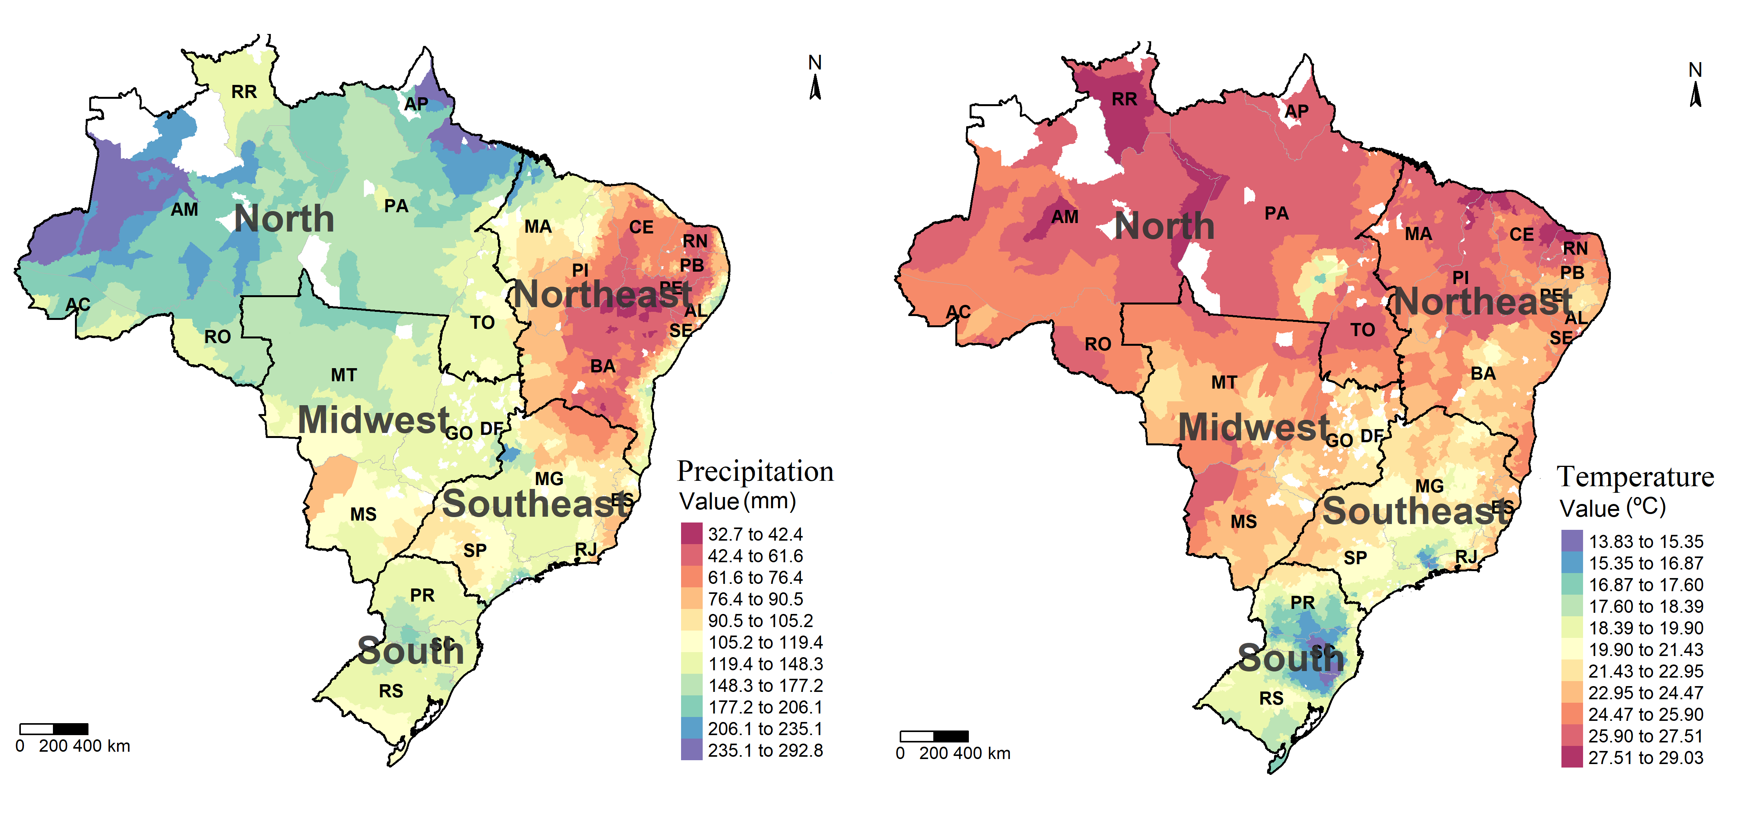
Figure 1: Historical Precipitation and Temperature (1971/2005) (mm) (ºC)
Source: Own elaboration based on Terrestrial Air Temperature and Precipitation

Slide 4
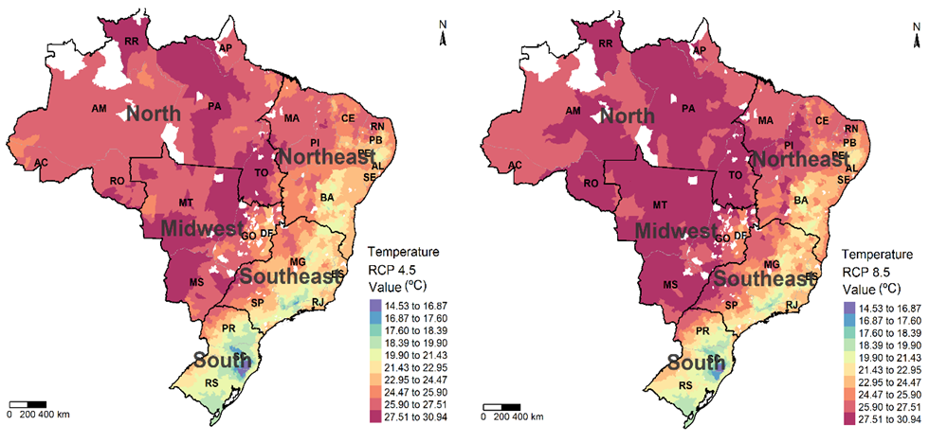
Figure 2: Average Temperature Projected by RCP 4.5 and RCP 8.5 (ºC) (mm) (2050)
Source: Own development based on Chou et al., (2014)

Slide 5
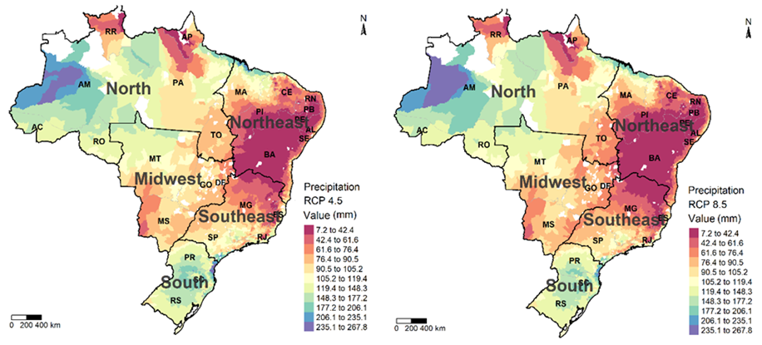
Figure 3: Average Temperature and Precipitation Projected by RCP 4.5 and RCP 8.5 (ºC) (mm) (2050)
Source: Own development based on Chou et al., (2014)

Slide 6
AIM
The objective of this work is to analyze the regional economic impacts of climate change on agricultural production of family farmers and large-scale agriculture in Brazil, as well as to analyze its indirect economic effects, according to scenarios RCP 4.5 and RCP 8.5 (IPCC, 2014), between the years 2021 and 2050.
i) What are the economic, direct, and indirect impacts triggered by the effects of climate change on agriculture?
ii) What are the effects on the production of family farmers and large-scale agriculture?
iii) What are the regional effects of the phenomenon?
Thus, the work seeks to indicate the direction and magnitude of the economic impacts arising from climate change on Brazilian agriculture, through explicit modeling of the family farming and large-scale agricultural sectors, considering its productive and regional specificities.

Slide 7
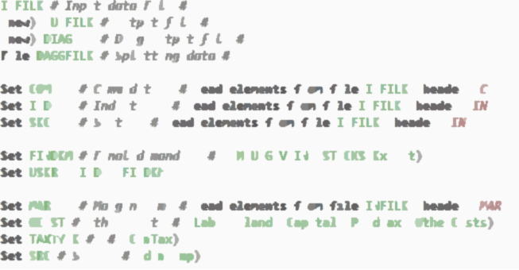
Methodology : CGE
Computable General Equilibrium (CGE);
Based on the TERM model (HORRIDGE; MADDEN; WITTWER, 2005)
General characteristics:
bottom-up regional disaggregation, 64 Sectors (42 Agricultural Sectors), 27 Federation Units;
Specific modeling of family farming and large-scale agriculture sectors;

Slide 8
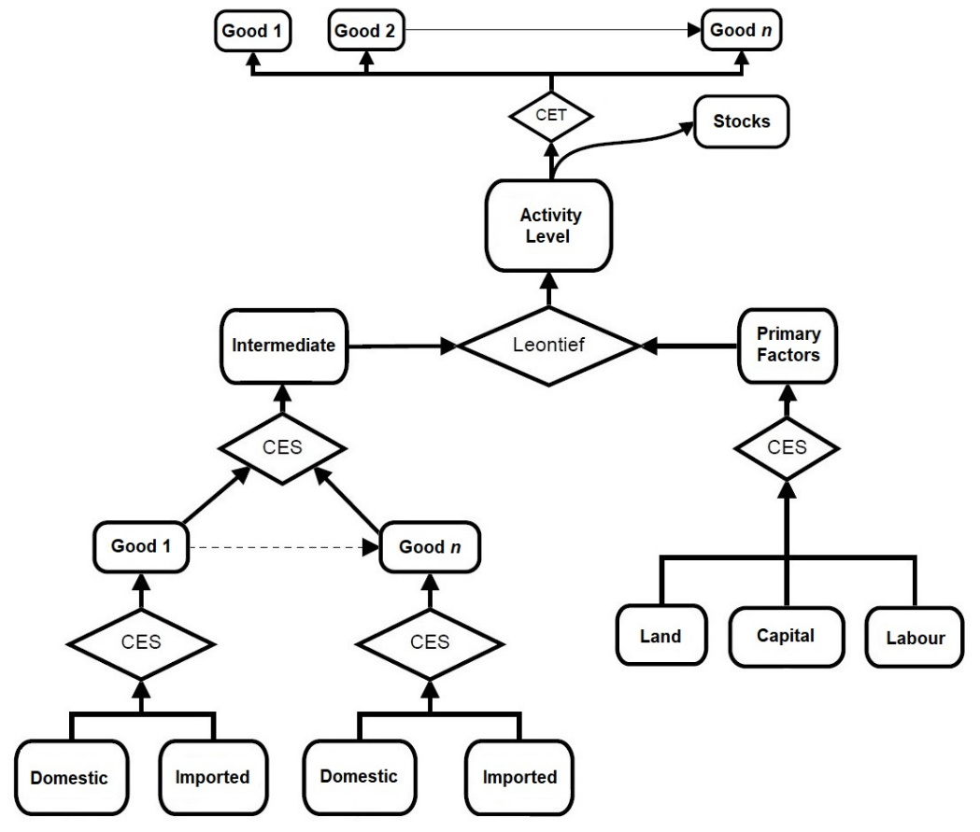
In the AGRO-BR model, the productive sectors act in perfect competition, achieving zero profit. Each industry produces only one product on a constant scale of production.
Sectors allocate primary and intermediate factors in order to minimize production cost, subject to production functions of the Leontief and CES type.
Primary and intermediate factors are demanded in fixed proportions.
Land is used only by agricultural, livestock, forestry and aquaculture sectors.
Family Farming x Large-scale: Distinguished by Production; Number of workers; Number of machinery and equipment; Exportation; Self-consumption.
Production structure

Slide 9
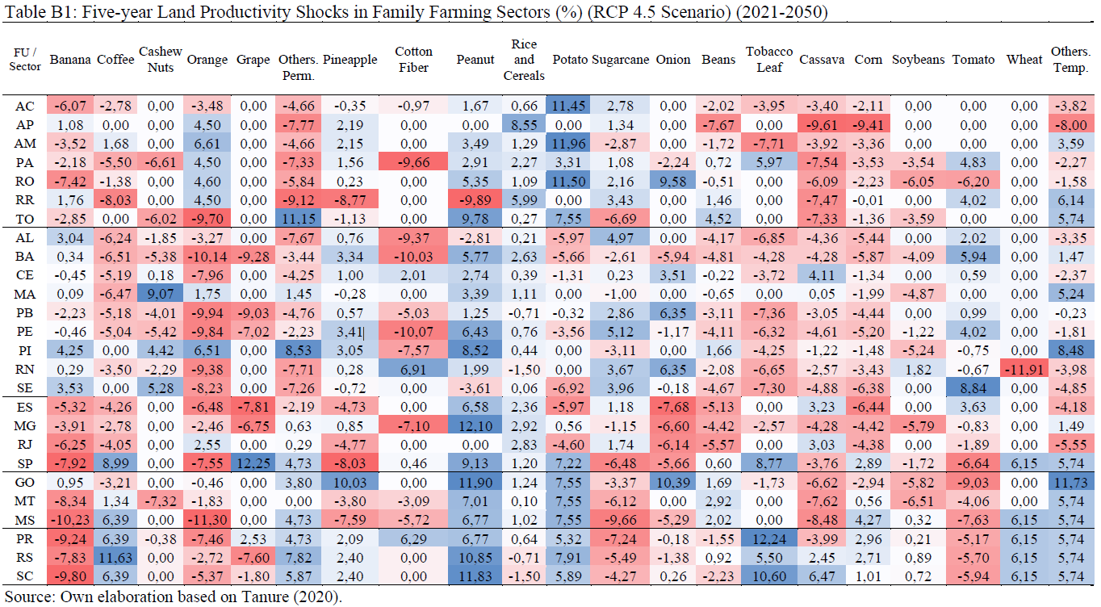
Database

Slide 10
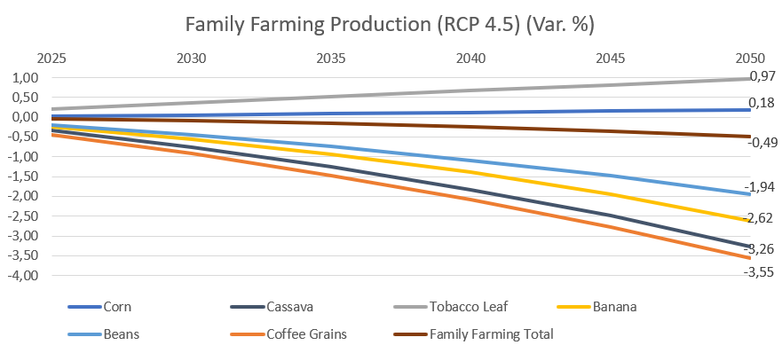
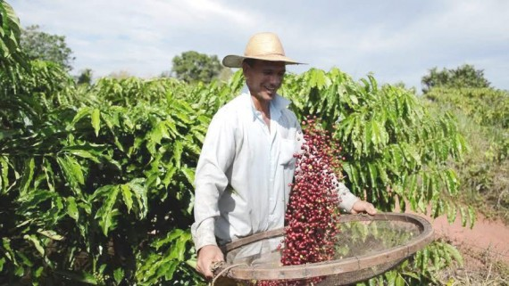
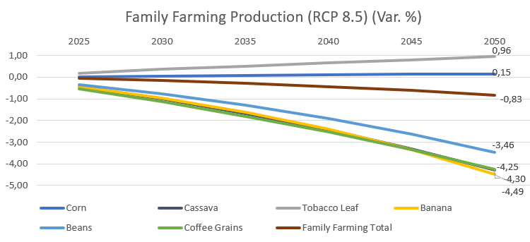
Results and discussion: Family farming sectors
Important sectors for food security are negatively affected, such as the cassava, bean and banana-producing sector.
Positive highlight for the Tobacco and Corn grain sector.
On average, the family farming sector shows a retraction in both scenarios.

Slide 11
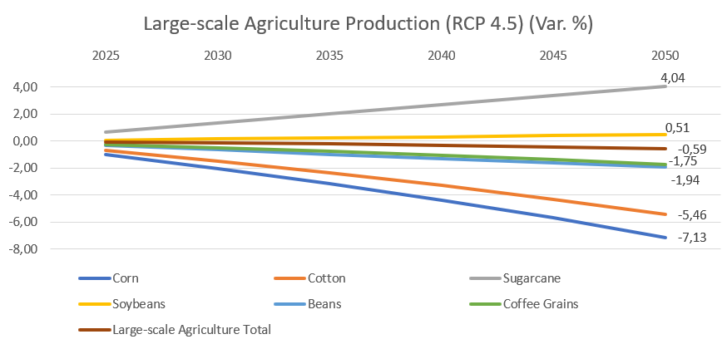
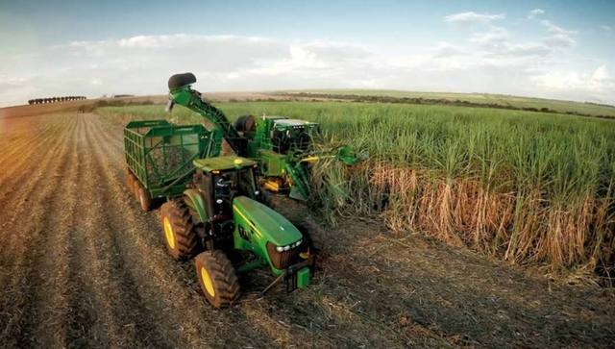
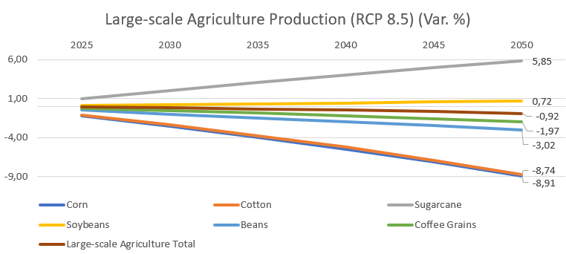
Large-scale agriculture sectors
Sectors benefited: Sugarcane and Soybeans
Negative highlights: Cotton, Corn, Coffee and Beans.
Negative impacts on the trade balance
On average, the large-scale agriculture sector shows a decline in both scenarios.

Slide 12
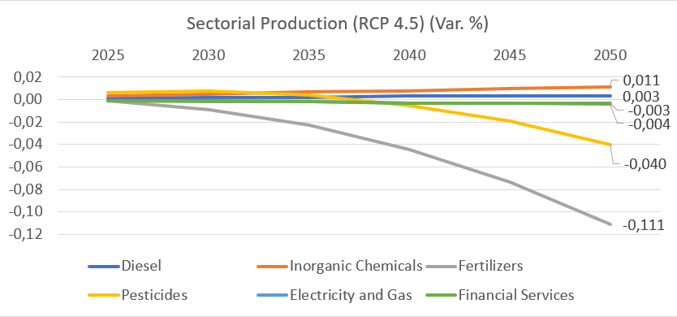
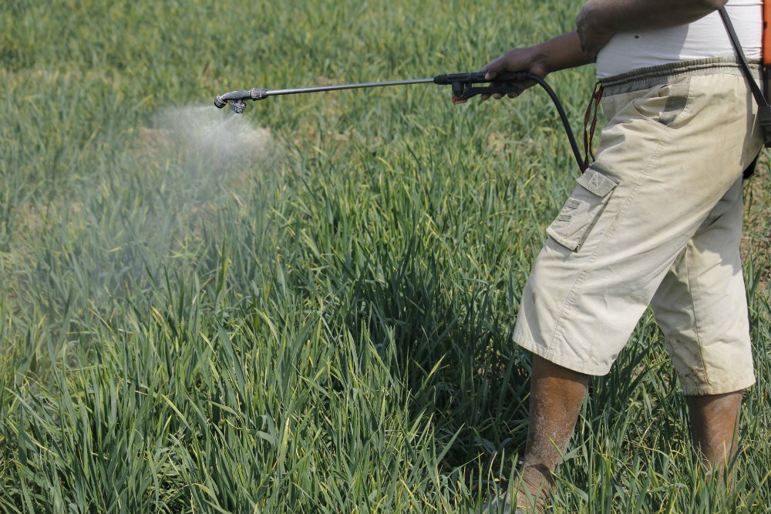
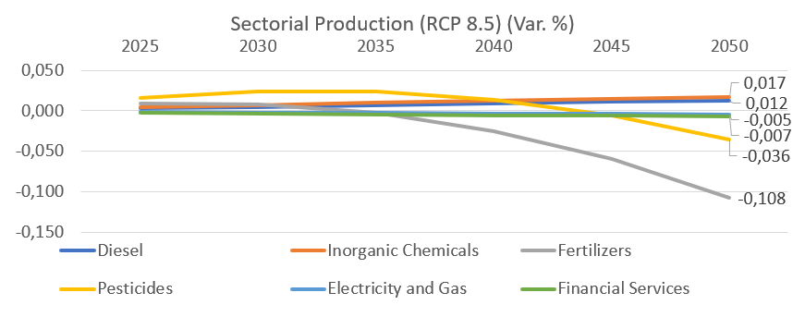
Main supply sectors for agriculture
Indirectly affected sectors
Those who have the agricultural sectors as the main consumers, are most affected;
Agricultural Pesticides and Fertilizers

Slide 13
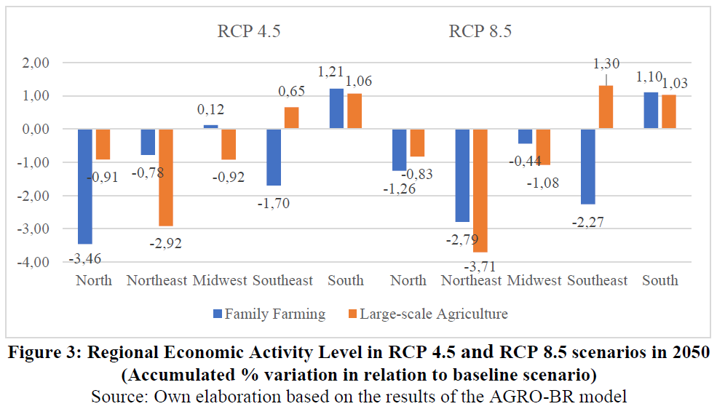
Regional Results by Family Farming and Large-scale agriculture

Slide 14
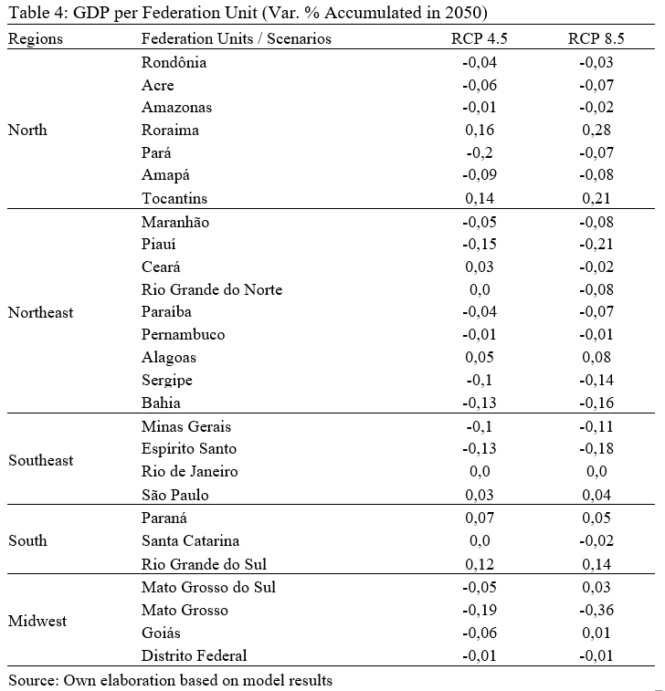
Results for the GDP of the Federation Units
The Federation Units of the North, Northeast and Midwest regions would be negatively affected on average.
Pará, Bahia, Maranhão, Piauí, Sergipe and Acre would have the greatest retractions.
Effects intensified over time.
Positive highlights: Tocantins, Roraima, Alagoas and Rio Grande do Sul

Slide 15
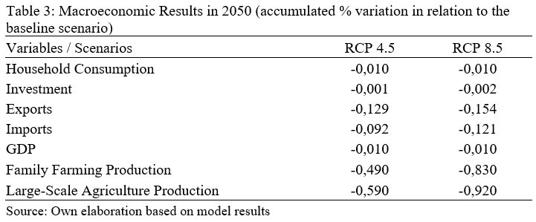
Macroeconomic Results
Decrease in aggregate exports as most large-scale agricultural sectors are negatively affected
Downturn in consumption, imports, level of investment, and price index due to the reduction in the level of activity
GDP retraction intensifies over time and in the 8.5 RCP scenario (pessimistic).
Small GDP retraction due to positive performance of SP, PR and RS.

Slide 16
Final Considerations
The accumulated economic downturn could generate losses between R$210 billion and R$490 billion in 2080, at the national level, with annual losses ranging from R$3.5 billion to R$8.1 billion.
Table 60: Summary of the results of the AGRO-BR model
Producers | Family Farming |  | Large-scale Agriculture
Impacts | Positive | Negative | Positive | Negative
Sectors | Tobacco Leaf, Peanut, Grape, Oct. Temporary | Cassava, Coffee, Corn, Banana and Beans | Sugarcane, Grape and Tobacco Leaf | Corn, Cotton, Beans, Coffee
FU | MA, PI, CE, SP, SC, PR, RS, GO, DF | Other FU´s | AP, CE, RN, SP, PR, SC e RS | Other FU´s
Regions | South | North, Northeast, Midwest and Southeast | South and Southeast | North, Northeast and Midwest
Source: Own elaboration based on the results of the AGRO-BR model

Slide 17
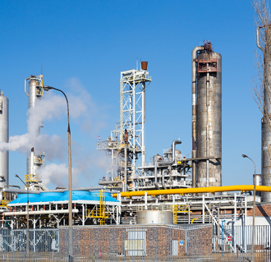
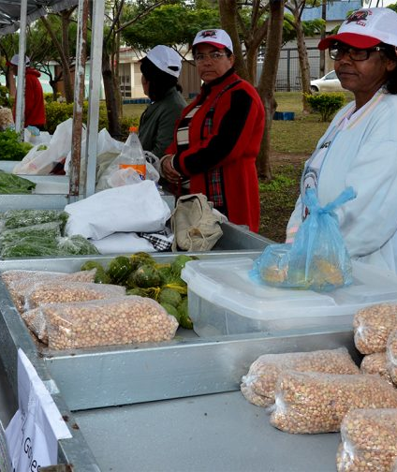
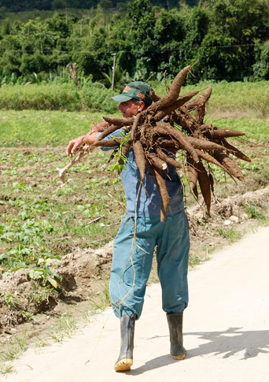
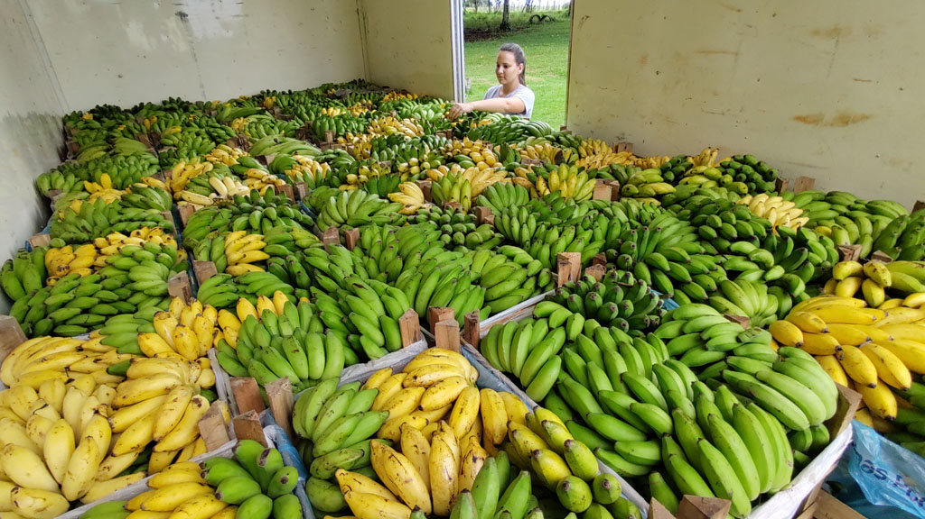
MAIN References
ASSUNÇÃO, J.; CHEIN, F. Climate change and agricultural productivity in Brazil: future perspectives. Environment and Development Economics, v. 21, n. 5, p. 581–602, 2016.
BRAGANÇA, A. A. Mudanças Climáticas, Adaptação e Agricultura no Brasil. REDECLIMA, 2015.
HORRIDGE, M, Madden, J & Wittwer, G 2005, 'The impact of the 2002–2003 drought on Australia', Journal of Policy Modeling, vol. 27, no. 3, pp. 285-308.
HORRIDGE, M. The TERM model and its data base. Centre of Policy Studies - General Paper n. G-219. [S.l.], p. 21. 2011.
IPCC, 2013. Fifth Assessment Report of the Intergovernmental Panel on Climate Change. Working Group I. Climate Change 2013 – The Physical Science Basis – Summary for Policy Makers. Switzerland , 2013.

