Slide 1

Easing the Effects of Austerity with Reforms:
A regional CGE experiment on Brazilian labor productivity
GTAP 24th Annual Conference on Global Economic Analysis
"Global Food System: Opportunities and Challenges"
GTAP Conference Scholars Program
June 24
Guilherme S. Cardoso
PhD Student
Federal University of Minas Gerais
Co-authors: Thiago Simonato, Débora Freire and Edson Domingues
(Federal University of Minas Gerais)
GTAP Conference Scholars Program Advisor: Mary Burfisher, Purdue University
guilherme-cardoso@cedeplar.ufmg.br

Slide 2
Motivation
Current agenda of fiscal austerity and reforms in Brazil:
    At the end of 2016, under the expansion of the primary deficits, increase of the public debt and investments fall, the Brazilian Congress approved a Constitutional Amendment known as "expenditure ceiling".
Fiscal austerity negative impacts on income/regional inequality through CGE models. (CARDOSO, 2019 and CARDOSO et al., 2019)

Slide 3
Theoretical Discussion
Expansionary Austerity: Fiscal consolidations may have an expansionary effect on output through expectations...
... if accompanied by a structural reforms agenda. (ALESINA et al.; 1999, 2012, 2016, 2018; GIAVAZZI and PAGANO ,1990; ARDAGNA, 2004)
The reforms increase the efficiency in which labor and capital are allocated on the economy (BOUIS et al., 2012; ALESINA, FAVERO and GIAVAZZI, 2018).
However, there is a slow convergence (RODRIK, 2017) and unless carefully planned, they might lead resources to unproductive sectors and fail even in the long run (BARDAKA et al., 2021).

Slide 4
Theoretical Discussion
Regional convergence in Brazil (Galeano e Feijó, 2013; Mendes et al, 2019; Ferreira e Diniz, 1995).
        In Brazil, it was the State developmentalism (investment strategy) that marked the industrialization and income increasing of the historically less developed regions, such as the North, Northeast and the Center-West of the country.

Slide 5
Main Question
How much should labor productivity increase to offset the contractionary regional impacts of the austerity in Brazil?

Slide 6
Methodology
The Enormous Regional Model (TERM)
Developed by the Centre of Policy Studies (CoPS), Victoria University, Australia.
Many applications for the Brazilian economy (Ferreira Filho and Horridge, 2014; Carvalho et al., 2017; Ribeiro et al., 2018; Cardoso et al., 2019)
Brazilian System of National Accounts 2015 (IBGE 2019).
Regionalization developed by Horridge (2012): Household Budget Survey (2008–2009); Annual List of Social Information (RAIS); and Foreign Trade Secretariat (SECEX).

Slide 7
Methodology
The Enormous Regional Model (TERM)
Single-Country model
Bottom-up structure: economic decisions are organized at the regional level (in this case, the 27 Federal Units in Brazil) and aggregated to the national level.
Neoclassical assumptions: Maximizing the utility of households; minimizing production costs; constant substitution elasticity function (CES) of the factors; market-clearing.
Recursive Dynamics
Linearization solution method (RunDynam, GEMPACK software)

Slide 8
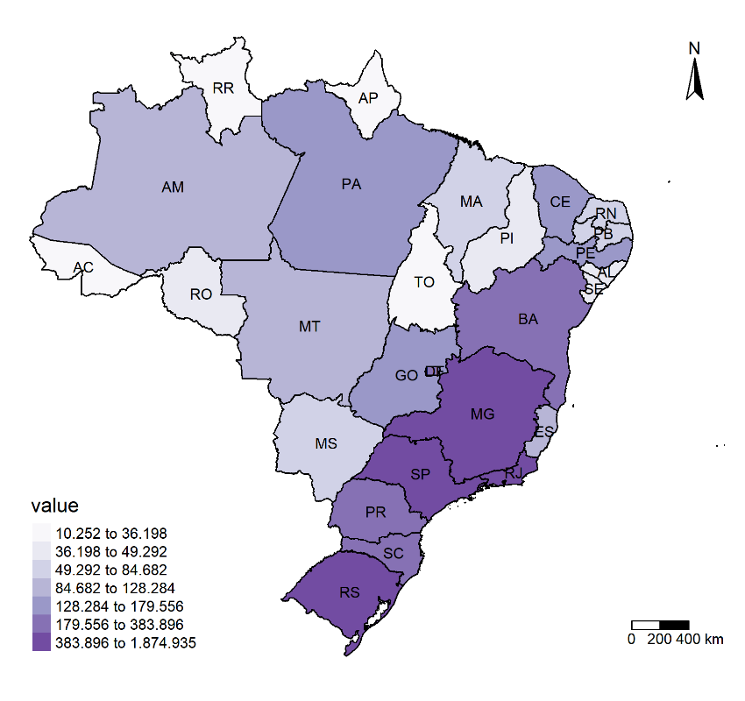
Database
Gross Regional Product (R$ million), Brazil, 2015.

Slide 9
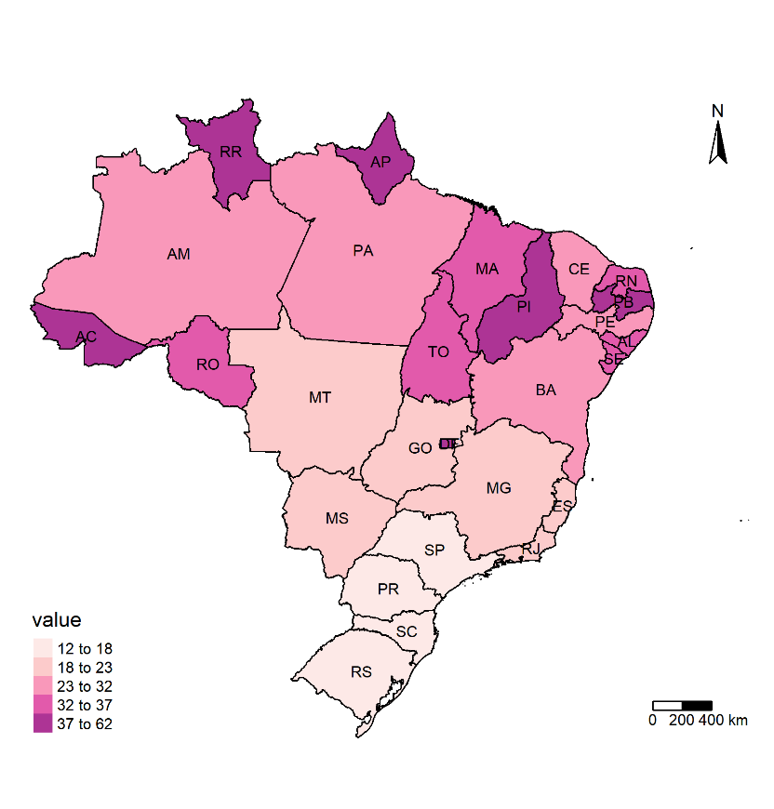
Database
Representativeness of General Government expenditure on each state (% of GRP), Brazil, 2015.

Slide 10
Simulation Strategy
Baseline closure (Standard)
Baseline shocks
(2016–2019) official macroeconomic observed data;
(2020-2021) Real GDP (National level) growth at 1% and 1.5%, respectively; (2022-2030) steady growth of 2.5% per year.
Policy closure: swap between real GDP, exogenous, with labor productivity, endogenous, for each region.
Policy shock: (2019-2030) Null-growth of the General Government expenditure (G = 0), at the National level.
    GDP is programed to grow equally to the baseline, sustained by labor productivity, in each region.

Slide 11
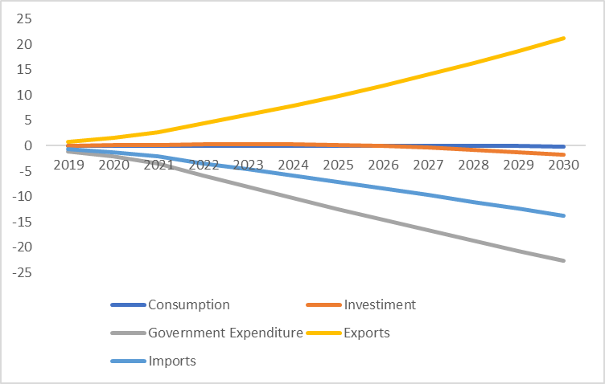
Results
Macroeconomic Results at the National level - Policy Scenario - Accumulated deviation (%) to the Baseline (2019-2030)
Notes:
Because of the shock, Government expenditure naturally decreases, it influences Aggregate Demand, consequently, prices; which impacts the Trade Balance; Consumption and Investment; although slightly negative, are sustained by labor productivity.

Slide 12
Results
Macroeconomic Results by Macroregion - Policy Scenario - Accumulated Deviation (%) from the Baseline (2030)

Slide 13
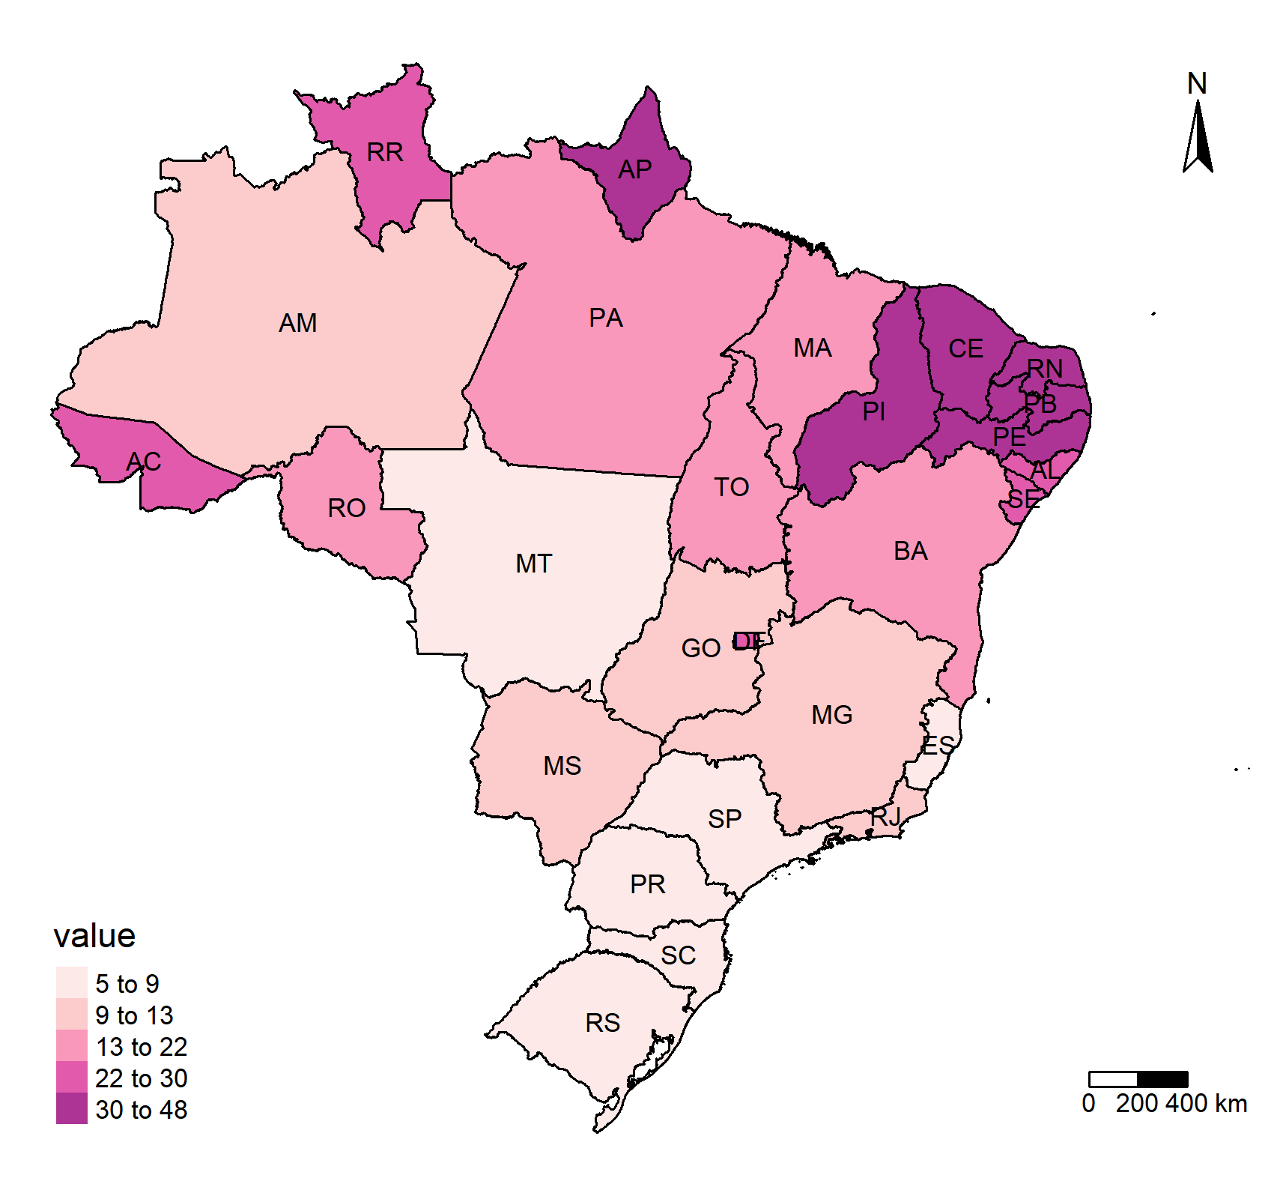
Results
Labor productivity accumulated growth, by Federative Unit (%) - Policy scenario (2030).

Slide 14
Analysis
Industrial Results: Policy scenario - Accumulated deviation (%) compared to the baseline (2030)

Slide 15
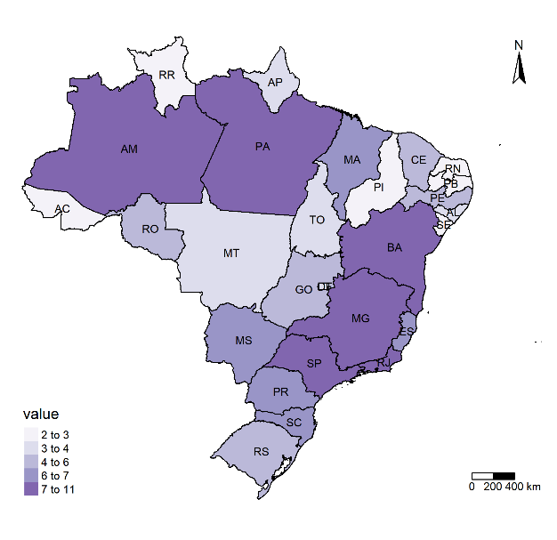
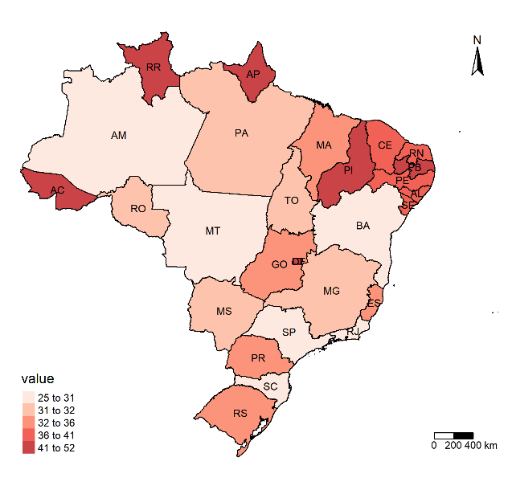
Analysis
Representativeness of the post-policy 20 Top/Bottom industries on each Federal Unit (% of the total Output) – 2015.

Slide 16
Conclusion
The labor productivity required to sustain GDP in face of a reduced government expenditure is spatially heterogeneous in the country.
The low perspective of household consumption; the absence of investments and high unemployment in some regions (in an industrial composition that has little benefit from fiscal austerity), makes such an increase illogical.
The combination of austerity and reforms agenda may increase Brazilian regional inequality.

Slide 17

GDP
Gov. share
Productivity result
Top industries
Bottom industries

Slide 18
Limitations
There is no dissociation between federative entities (Federal / State)
Fiscal Module (transfers between government and institutions)
Household Extended Income (Atkinson, 2016) (the model also does not capture the direct effects of cuts in public services in the household welfare, only the indirect effects, through economic activity)
The current crisis caused by the COVID-19 pandemic has exposed the vulnerabilities of countries whose role of the State has been mitigated by austerity policies. The effects of the pandemic are systemic, but require special attention to the already fragile labor market and labor productivity in some peripheral economies, as well as the access to basic health services and public policies to deal with adverse situations.

Slide 19
Easing the Effects of Austerity with Reforms:
A regional CGE experiment on Brazilian labor productivity
GTAP 24th Annual Conference on Global Economic Analysis
"Global Food System: Opportunities and Challenges"
GTAP Conference Scholars Program
June 24
Guilherme S. Cardoso
PhD Student
Federal University of Minas Gerais
Co-authors: Thiago Simonato, Débora Freire and Edson Domingues
(Federal University of Minas Gerais)
GTAP Conference Scholars Program Advisor: Mary Burfisher, Purdue University
guilherme-cardoso@cedeplar.ufmg.br

