Slide 1
To Have and Have Not - Evaluating the costs and benefits of the welfare state with an AGE model of Finland with Intergenerational Accounting
Juha Honkatukia
Risto Vaittinen

Slide 2
Background
Finnish health, social care expenditures are almost entirely publicly funded. Currently, around 7 % relative to the GDP.
Expenditures heavily dependent on age structure of population – in Finland, share of working-age population forecast to shrink into 2030s
Present government attempts to reform the care sectors
In this study, we try to assess (some) of the more tractable elements of the reform
Data for care sector cost and employment forecast bases on registers kept by National Institute for Health and Welfare

Slide 3
What is driving increasing public health expenditure in Finland
High unit costs per person for older people
The ageing of the population

Slide 4
Old Age Dependency Ratio (65+/15-64)

Slide 5
Integrating expenditure projections for health in a computable general equilibrium model
FINAGE/REFINAGE – dynamic, AGE model for Finland
Aggregation for CPA 12 level of comodities and 11 Industries
Public demand and income transfers at existing tiers:
  Central govt, municipalities, counties
  Pension and social security funds
Sectoral detail also for labour
Population by age, each cohort a neoclassical utility maximizer
Current goal: calibration to AWG and NIHW projections
Outcomes: links to macroeconomy, fiscal sustainability, intergenerational economic welfare measures -> policy analyses
Future extension: modelling of provision of private and public health services, policies

Slide 6
FINAGE-HEALTH extension
1) Reallocation of free public services from govt final consumption to households
2) households’ problem: in each region hhold chooses health & non-health consumption to maximize utility subject to budget constraint.

Slide 7
Total public health expenditures in Finland
(based on NIHW HILMO register data)

Slide 8
Unit Costs of Health Care by Age

Slide 9
Public Health Expenditures at 2015 prices

Slide 10
Decomposition of Growth in Health Expenditure Between 2015 and 2040

Slide 11
Modelling also covers income transfers

Slide 12
Earnings-related pensions
Statutory
  Benefit determination (broadly) uniform in different sectors and occupations
  Accrual of pension rights 1.5% of annual wage income
  Entitlements fully transferable
Defined Benefit, but
  Full-career based accrual (not final salary based)
  Gradually moving eligibilliy age for old age pensions
    2018- 2029 increases from 63 to 65 by 3 months in a year
    From 2030 on tied to life expectancy at age on 65
  Generation specific life-expectancy adjustment of benefit level
Included in general government in national accounts
  Expenditures 12% relative to GDP
  Contributions 9 % relative to GDP
Partly funded (providers run the PAYG part integrated)
  Private sector: insurance providers liable for the funded part, national risk-based solvency regulation
  Public sector: buffer funds

Slide 13
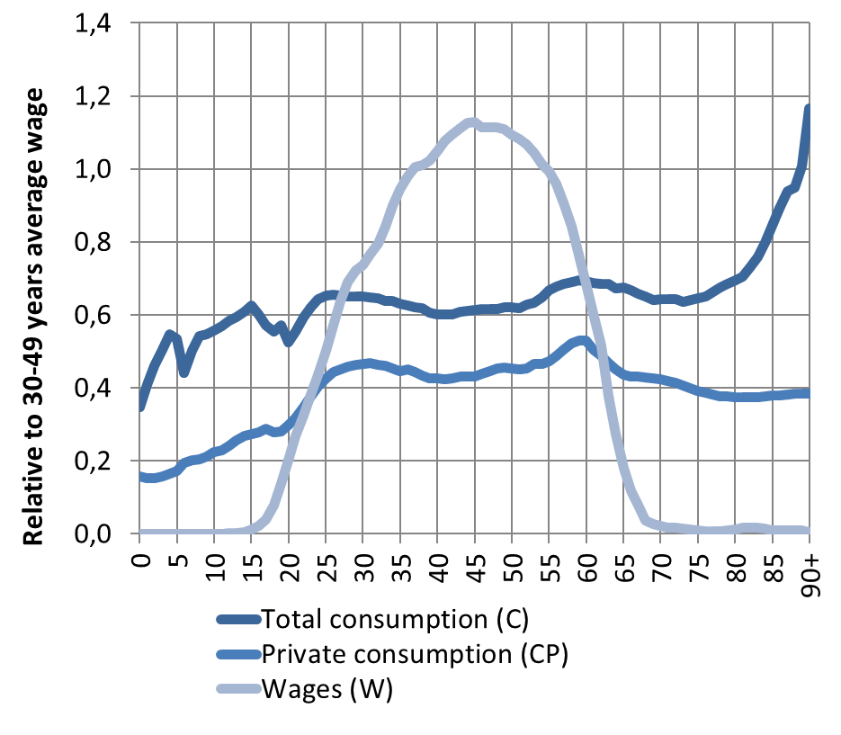
National Transfers Accounts (NTA): Finland 2017
Consumption and Wages by Age
NTA methodology
NTA goes beyond national accounts in two important new ways.
  breaks down national accounts by age.
  estimates transfers within families and households, between households, and through the public sector.
Based on existing surveys on private consumption, wages and administrative data on public consumption
National Transfer Accounts Manual: Measuring and Analysing the Generational Economy, UN Population Division, 2013

Slide 14
And policies, then?
Aging poses a twin problem for most regions in Finland – calls for central govt action
Shave 8 % (=1billion/a) from public spending in health care or generally)(in the 20s)
1) a uniform cut of 1 billion euros in free health service provision;
2) a uniform increase in payroll taxes, delivering an extra 1 billion euro

Slide 25
Conclusions
Aging poses a twin problem for Finland – calls for central govt action
Tools for policy analyses lacking, very limited potentail for analyses of intergenerational equity or like
We integrate generational accounting and CGE modelling, as well as register data to answer some of the policy questions
Shaving public spending on health care induces increased demand for private health care, but overall consumption falls, with old cohorts affected more than young ones
Increasing payroll taxes leads to smaller effects on the economy than cutting expenditures – effects larger for working-age population than older generations

