Slide 1



Waste management and circular economy in a CGE framework
GTAP Conference, June 2021
Heleen Bartelings, Monika Verma, Kirsten Boysen-Urban

Slide 2
Outline Presentation
Introduction MAGNET
Model Changes to include waste
Data collection needed for the new module
Baseline results: what to expect of the new module
Future scenario analysis

Slide 3
Modular Applied GENeral Equilibrium Tool
global economic model based on GTAP
Modular setup: ability to include or exclude modules depending on projects
Ability to include new sectors and commodities
141 regions, ~100 commodities
Runs from 2014-2050 or 2100
Allows for counterfactual analysis
Used by WECR, European Commission, TI, FAO and the OECD

Slide 4
Current modules in the MAGNET model
Endogenous R&D
Biofuel directives (1st,2nd & bio-electricity)
GHG emissions
Fisheries Aquaculture Fish-processing
Fully flexible CET land allocation
Multiple households
Endogenous land supply
Segmented factor markets
Nutrients in (private) consumption
Residue supply module
Labour supply module
CAP
Fully flexible CES production structure
Production quota
Waste Collection and treatment

Slide 5
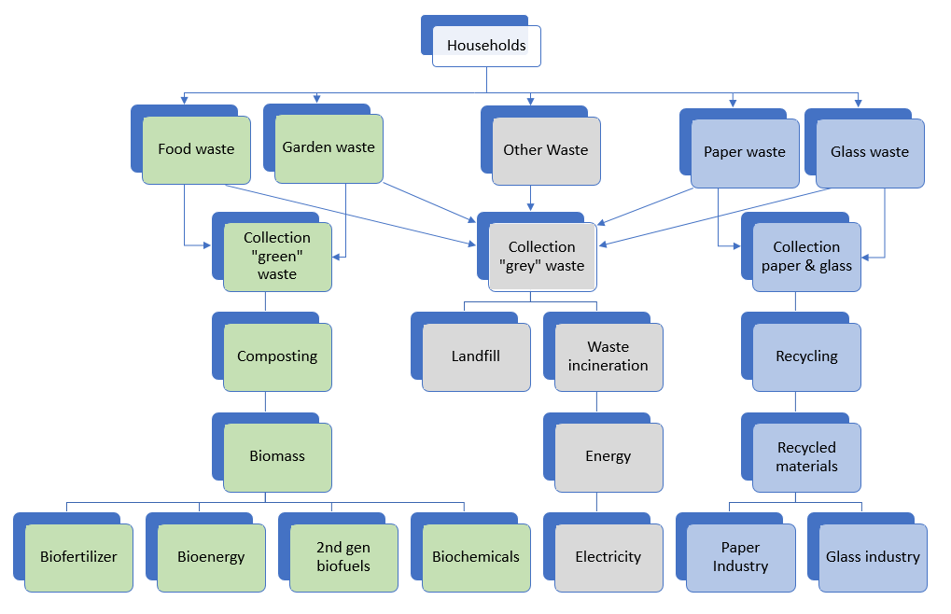
Model Changes: Waste in Magnet
Waste Generation
Waste Collection
Waste Treatment
Use waste materials

Slide 6
Model Changes: Waste as a margin commodity
Modeling waste:
Waste collection/treatment in GTAP in sector “WTR”
No link to consumption
Waste needs to be linked to consumption
Total Expenditure, private household
VPP(c,r)=
PPA(c,r)*QPA(c,r)
VMPP(c,r)
=PPMA(c,r)*QPMA(c,r)
VDPP(c,r)=
PPDA(c,r)*QPDA(c,r)
....
VPP(c,n)=
PPA(c,n)*QPA(c,n)
MPTAX(c,r)
VMPBA(c,r)=
PPMB(c,r)*QPMA(c,r)
DPTAX(c,r)
VDPBA(c,r)=
PPDB(c,r)*QPDA(c,r)
VMPB(c,r)=
PMS(c,r)*QPM(c,r)
MMARGB(c,wt,r)=
MMPDS(c,wt,r)*QRPM(c,wt,r)
VDPB(c,r)=
PDS(c,r)*QPD(c,r)
DMARGB(c,wt,r)=
DMPDS(c,wt,r)*QRPD(c,wt,r)
VMARGMB(c,wt,wc,r)=
PDS(wc,r)*QMARGM(c,wt,wc,r)
VMARGDB(c,wt,wc,r)=
PDS(wc,r)*QMARGD(c,wt,wc,r)
Notes:
Current gtap , data included but as aggregated sector
No link consumption which should be there
Solution: waste as margin commodity
Follow method gtap_m by Peterson (2006)
White cells normal demand
Green cells adjusted with waste

Slide 7
Database construction
Need Collected about:
Waste Generation
  Composition waste (garden, food, glass paper and other waste)
  By consumption commodity
Waste collection
  Collection rate
  Collection of food waste
  Collection costs & value
Treatment of waste and use of recycled and composted materials
  Treatment costs & value
  Emissions
Sources: World Bank, EU Fusions, RDC-Environment and Pira International
Notes:
Data intensive module
Data about: waste generation, collection and treatment
Sources

Slide 8
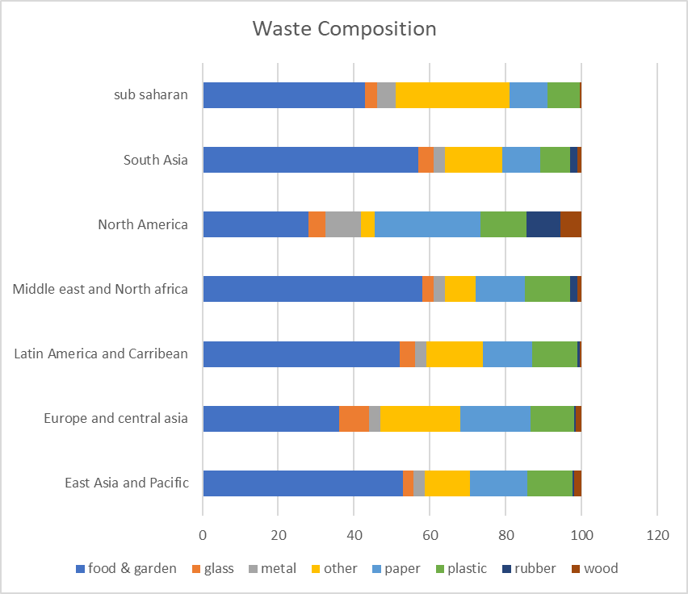
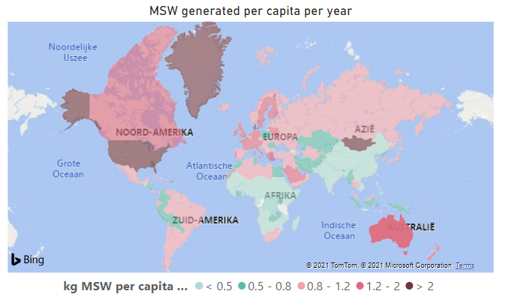
Data: Waste generation 2014
Total Municipal Waste generated in 2014 and its composition
Notes:
World bank developed database world, we translated that to 141 gtap regions,2014
Total waste generated shown on left
Composition show on the right
Quite some different waste materials. We focus on food and garden waste, paper glass and rest waste. Other materials for now left out.

Slide 9
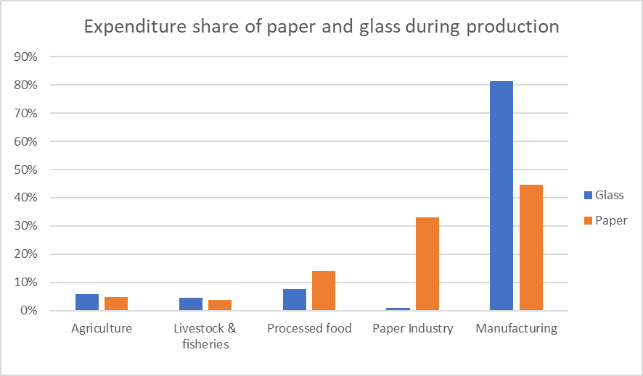
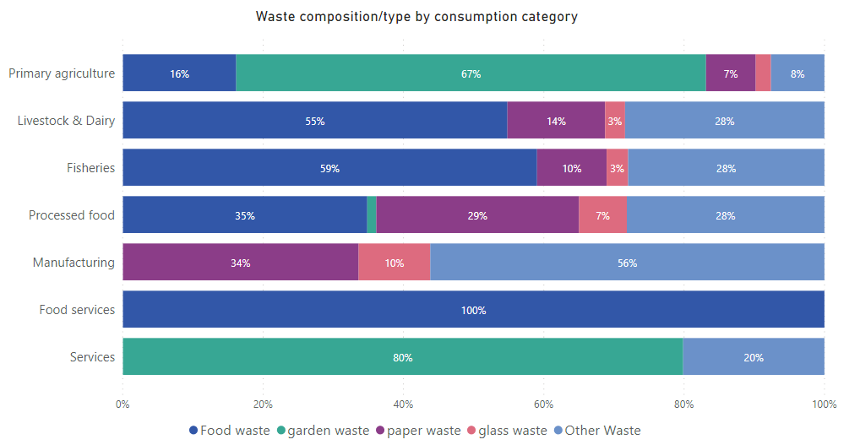
Attributing waste generation to consumption
No world-wide material flow data base available:
Waste generation linked to consumption based on weights calculated form GTAP intermediate expenditure data
For example:
The more paper is used to create a product
The more paper waste is produced during consumption of the product
Notes:
Watse gerantion needs to be linked to consumption of goods. No world wide database for this
Solution for now is weights based on intermediate expenditure data
Example paper
Ending up with results in the right corner.
Note that we link garden waste to dwellings therefore high garden waste in services

Slide 10
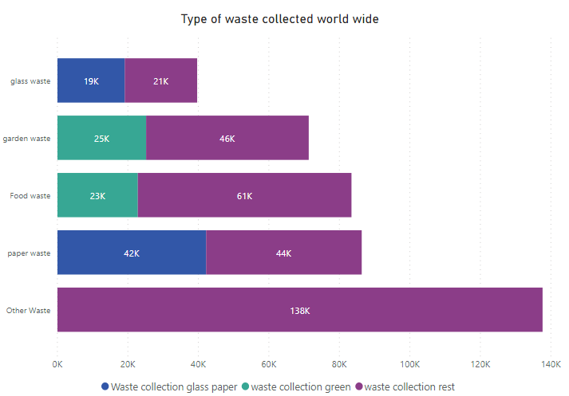
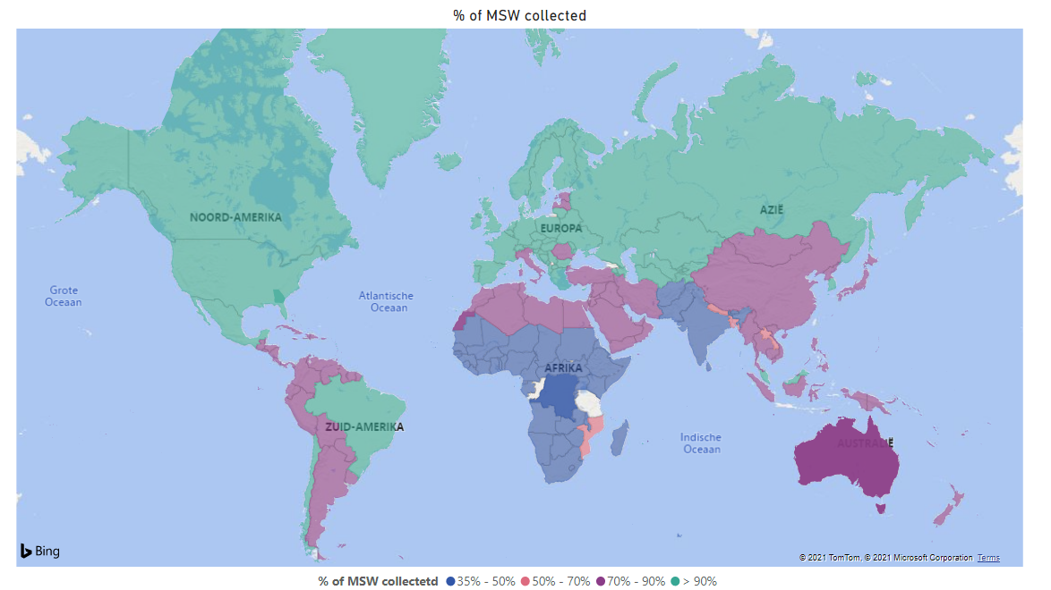
Data: Waste Collection 2014
Not all waste generated is collected and if collected still a lot is collected as rest waste:
Notes:
Waste collection: not all waste is collected, magnet does not account for dumping yet
Lots of waste not yet separately collected in 2014, about half for paper rest lower

Slide 11
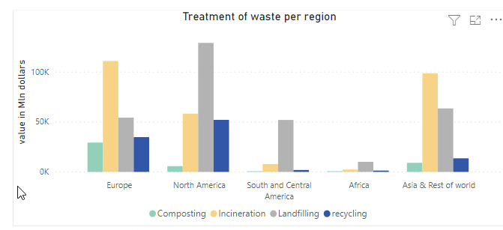
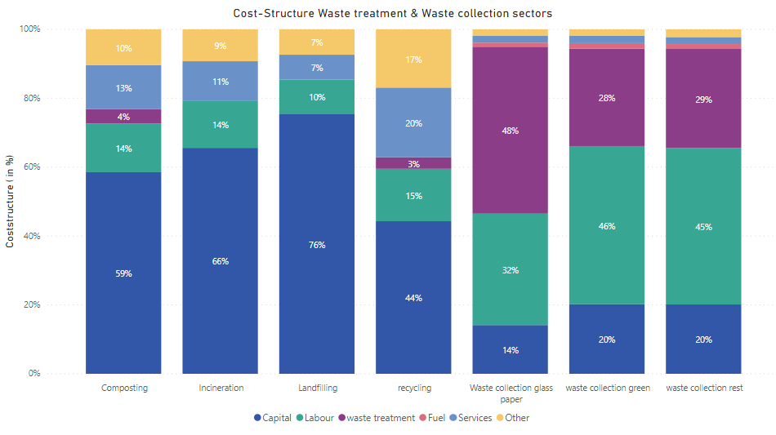
Data: Waste treatment 2014
Waste treatment differs a lot over regions
Landfilling still the dominant treatment option in many regions
Notes:
Treatment differs over the world, landfilling still very popular

Slide 12
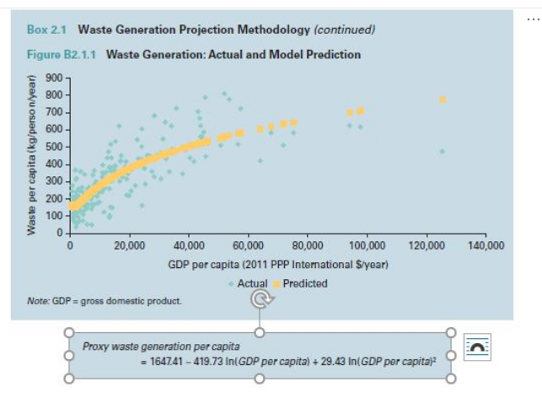
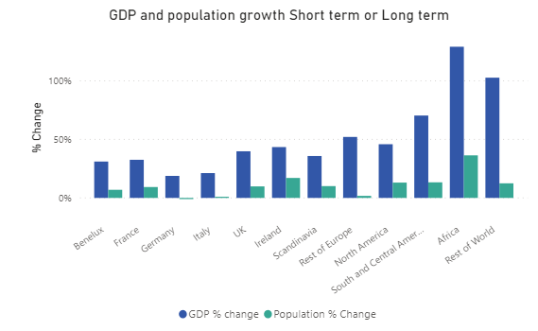
Baseline: Macro Assumptions and waste generation development
Notes:
Ssp2 baseline with wb project of waste growth per capita

Slide 13
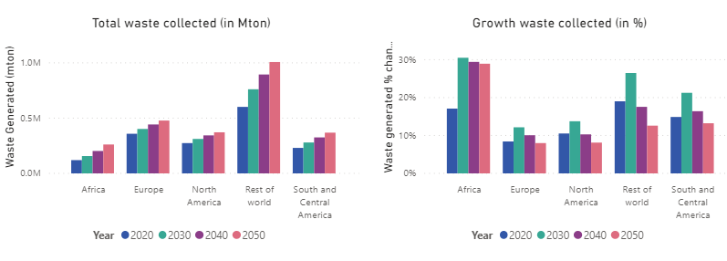
Baseline Results: Development waste
Notes:
Lets to large increase in waste, especially Africa high growth

Slide 14
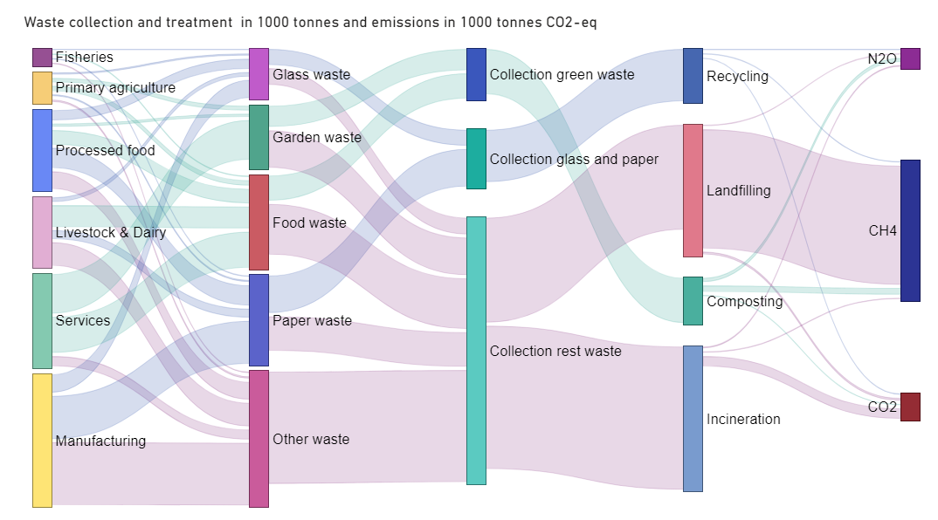
Baseline Results: Waste flows Europe 2050
Notes:
Overview Sankey:
Lots of waste come from manufacturing
30% composted, 50% recycled
Recycling composting little ghg gasses.
Landfilling contributes disproportional to ghg emissions still 40%

Slide 15
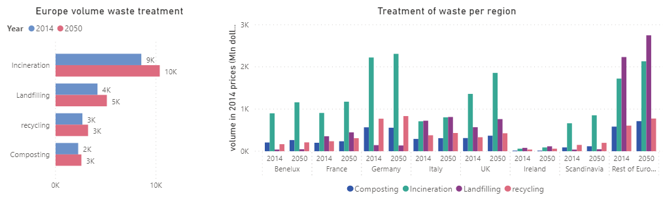
Baseline Results: Collection & Treatment
Notes:
Lots of differences MS
Incineration highest eu will stay that way

Slide 16
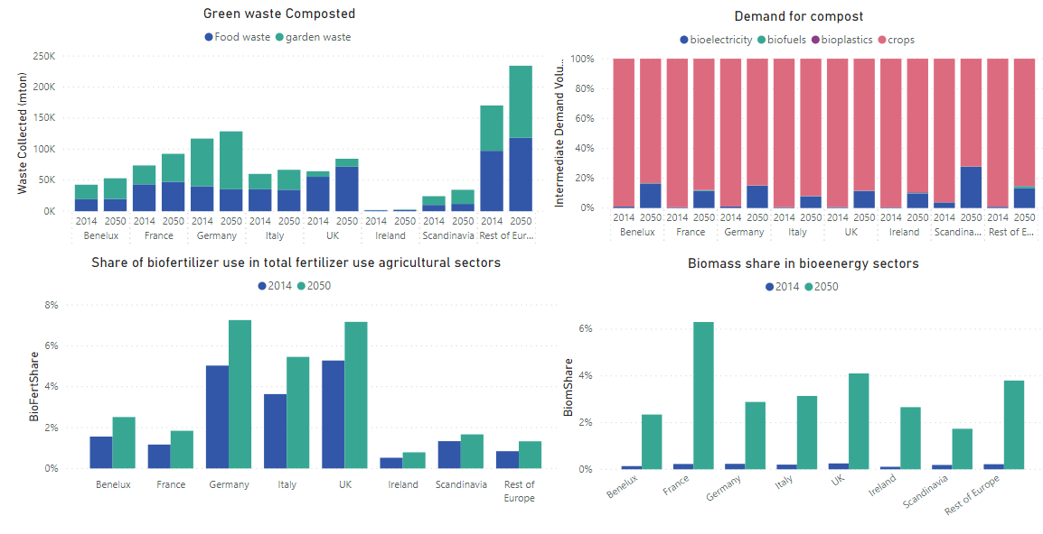
Baseline results: Zooming in on Green waste

Slide 17
Scenarios: Policy questions to answer
The benefit of modelling the cradle to grave flow of waste allows to run simulations mimicking interventions at every stage of waste stream. The framework can be used to simulate:
  Consumer waste reduction, food waste reduction
  Impact of rest waste taxation
  Impact of subsidizing green waste or recycled waste collection
  Impact of subsidizing recycling, composting

Slide 18
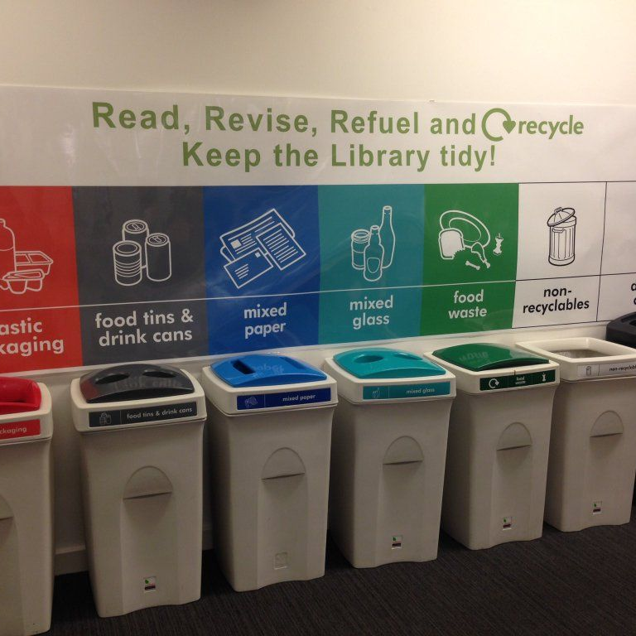
Thank You!
More information about MAGNET can be found at:
https://www.magnet-model.eu/

