Slide 1
The food security dimension of the African Continental Free Trade Area (AfCFTA)
24th Annual Conference on Global Economic Analysis
Simola A., Ferrari E., Boysen O., Nechifor V., Boulanger P.

Slide 2
The African Continental Free Trade Agreement (AfCFTA)
Starting point the AU assembly in 2012
Came into effect on January 1st 2021, signed by 54 countries
Objectives:
creation of a single market for goods and services
allowing free movement of people and investments
promotion of intra-African trade (between and beyond RECs)
improvement of competitiveness and facilitation of economic transformation

Slide 3
African trade before AfCFTA
The African Union: a market of 1.3 billion people and 3.4 trillion USD
A high share of trade with non-African countries
Mainly low value added commodities, e.g. agricultural products and natural resources
42% in intra-African trade and 75% in extra-African trade
→ AfCFTA to increase:
* share of intra-African trade
* value added share of all trade

Slide 4
Previous economic studies
Mevel and Karingi (2012), Jensen and Sandrey (2015), Saygili, Peters and Knebel (2018), Abrego et al. (2019), African Development Bank (2019), World Bank (2020)
Significant economic gains predicted from the agreement
higher output (GDP)
increased trade volumes – especially within Africa
Our focus on agriculture and food industry, and food security aspects

Slide 5
Comparison with previous studies (GDP)
 | year | tariff cuts | NTM reductions | tariffs | tariffs and NTMs
Mevel and Karingi | 2012 | all tariffs on intra-African trade | - | 0.2 | -
Jensen and Sandrey | 2015 | all tariffs on intra-African trade | 50% reduction | 0.7 | 1.6
Saygili, Peters and Knebel | 2018 | all tariffs on intra-African trade | - | 0.97 | -
Abrego et al. | 2019 | all import tariffs | 35% reduction | 0.037-0.053 | 1.89-7.6
ADB | 2019 | all tariffs on intra-African trade | 100% reduction | 0.1 | 1.25
WB | 2020 | 97% of tariffs on intra-African trade | 50% reduction within Africa and 20% reduction on exports | 0.13 | 2.24
JRC | 2021 | 97% of tariffs on intra-African trade | 50% reduction within Africa and 20% reduction on exports | 0.02 | 0.64-0.75

Slide 6
Comparison with previous studies (trade)
 | year | tariff cuts | NTM reductions | imports | exports
Jensen and Sandrey | 2015 | all tariffs on intra-African trade | 50% reduction |  | 6.28
ADB | 2019 | all tariffs on intra-African trade | 100% reduction | 33.8 | 44.3
WB | 2020 | 97% of tariffs on intra-African trade | 50% reduction within Africa and 20% reduction on exports | 19.58 | 18.84
JRC | 2021 | 97% of tariffs on intra-African trade | 50% reduction within Africa and 20% reduction on exports | 3.98 | 2.75

Slide 7
Method
MAGNET model
global CGE model that is based on GTAP data (v. 6) and model (v. 10)
recursive dynamics
highly modular
detailed representation of agriculture and food industries
several environmental indicators (e.g. GHG emissions and land use)

Slide 8
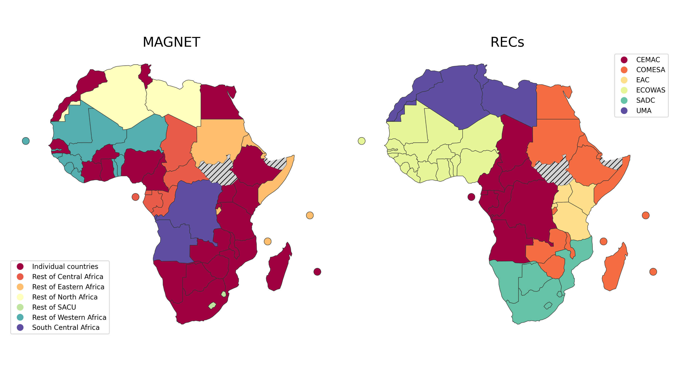

Slide 9
Baseline
The policy effects presented as deviations from a baseline
Our baseline based on the SSP2, i.e. middle-of-the-road prediction of global future
The database is updated from 2014 to 2020 with IMF’s World Economic Outlook data

Slide 10
Policy simulations
Implementation of AfCFTA 2020-2035
Tariff cuts (5 options)
Maximize tariff revenue REV
Maximize tariff revenue, after liberalizing agri-food sectors REV+agr
Maximize tariff revenue, after promoting industrialization REV+int
Maximize tariff revenue, after promoting competitive sectors REV+rca
Choose the one that maximizes GDP GDPmax
NTM reduction to 50%
In addition a 20% reduction for exports to third countries
Hypothetical (the actual ones will available in July 2021)

Slide 11
Results – macro level

Slide 12
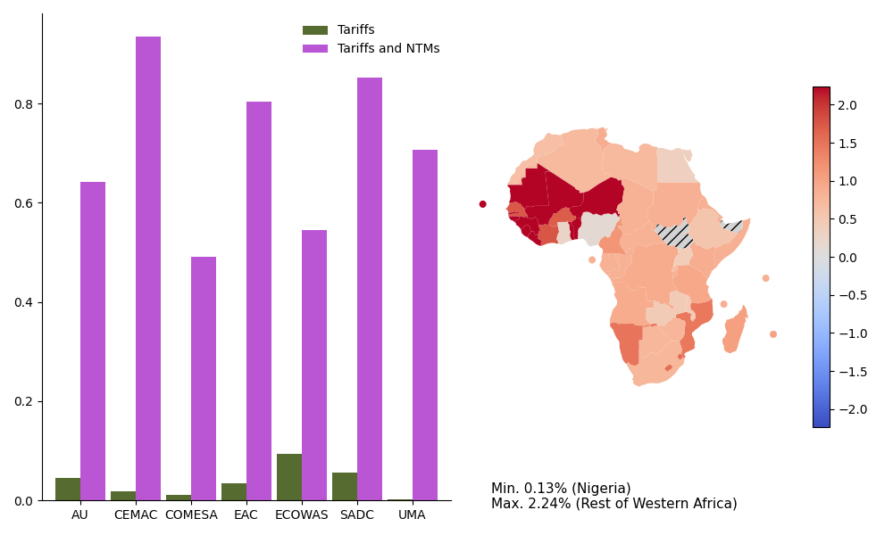
Results – GDP (2035)

Slide 13
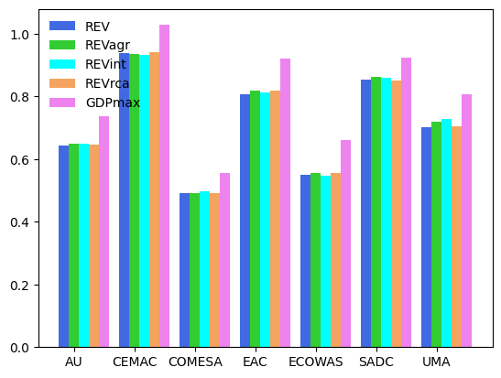
Results – GDP (2035)

Slide 14
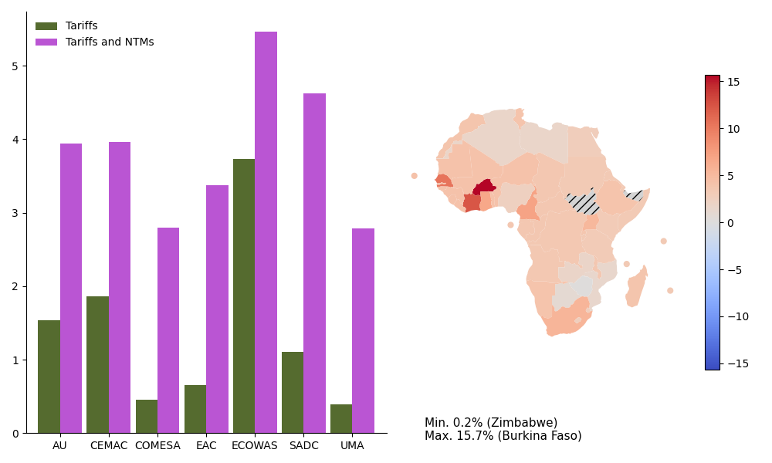
Results – imports (total; 2035)

Slide 15
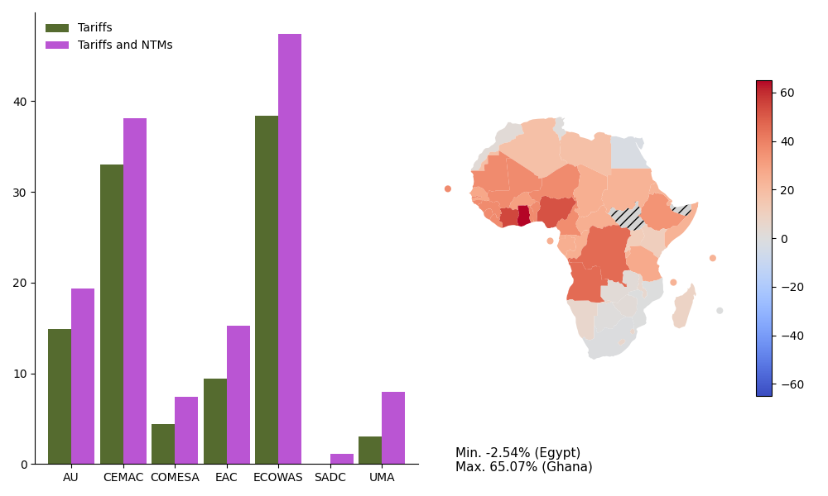
Results – imports (intra-African; 2035)

Slide 16
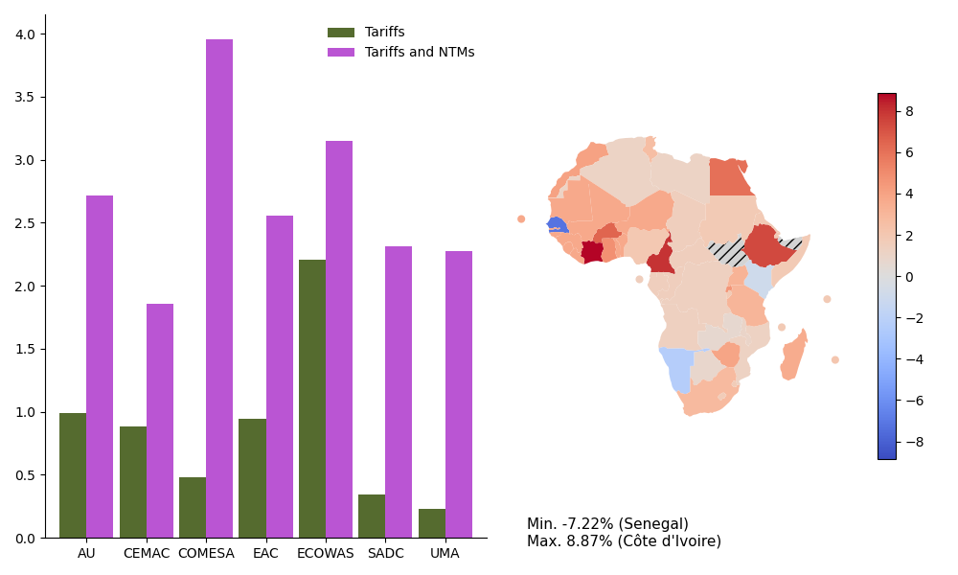
Results – exports (total; 2035)

Slide 17
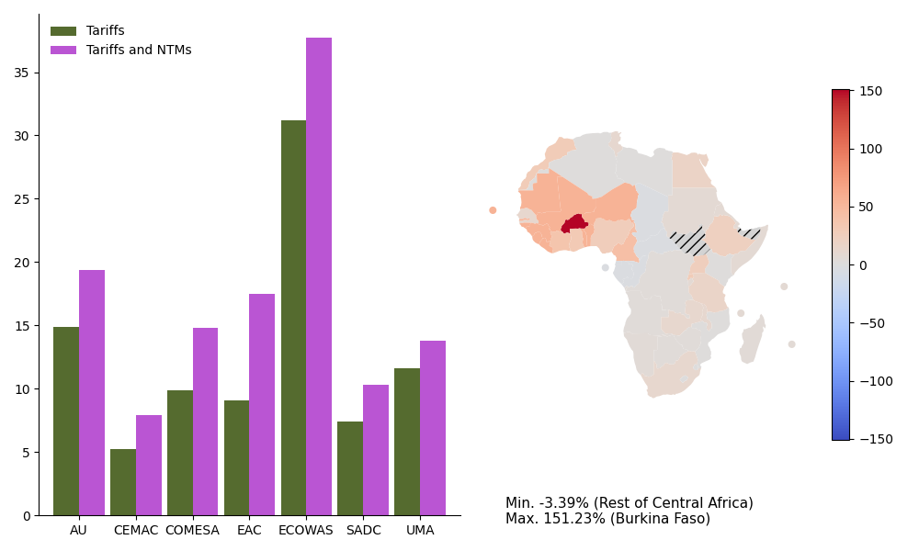
Results – exports (intra-African; 2035)

Slide 18
Results – agriculture and food security

Slide 19
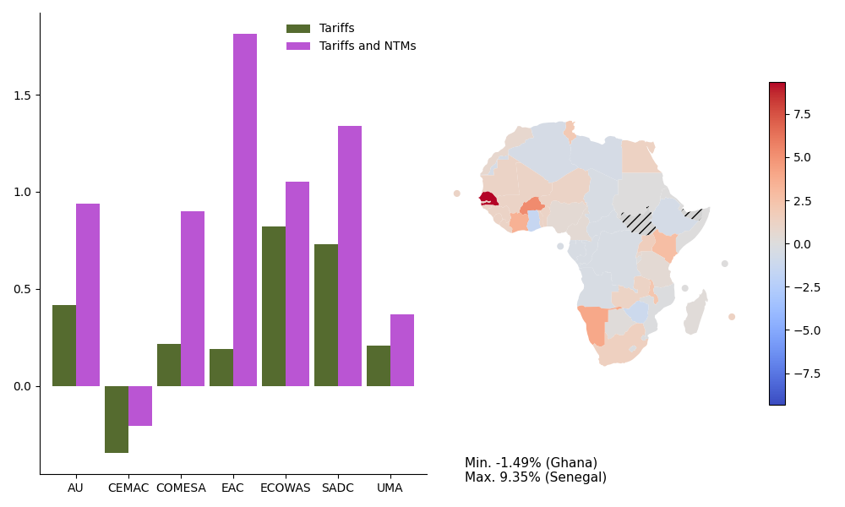
Results – disposable income (2035)

Slide 20
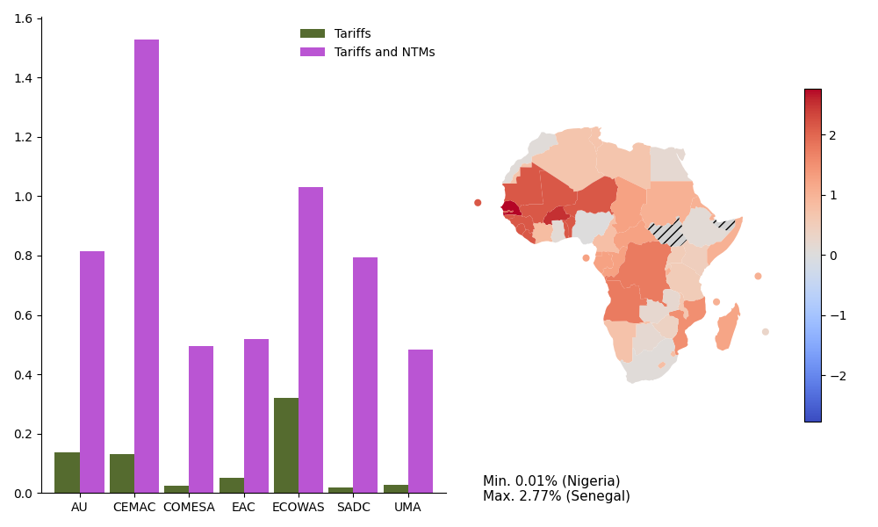
Results – food consumption (2035)

Slide 21
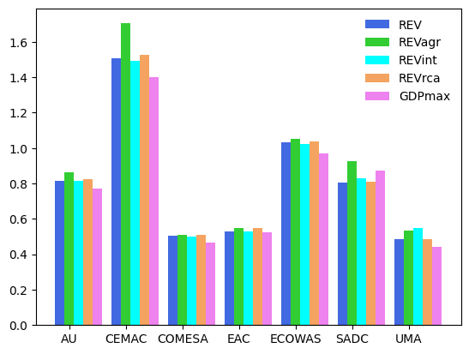
Results – food consumption (2035)

Slide 22
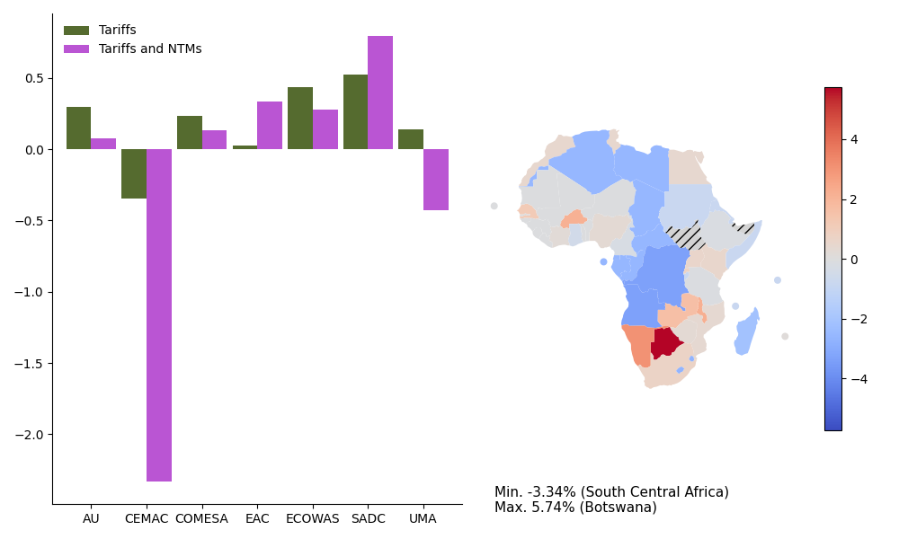
Results – primary agri production (2035)

Slide 23
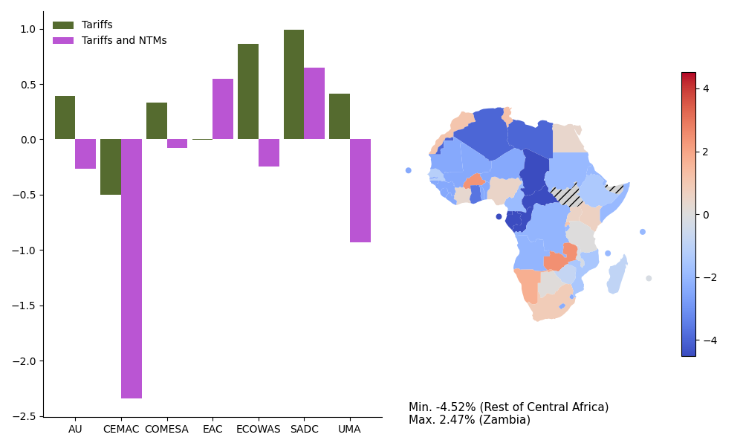
Results – processed food production (2035)

Slide 24
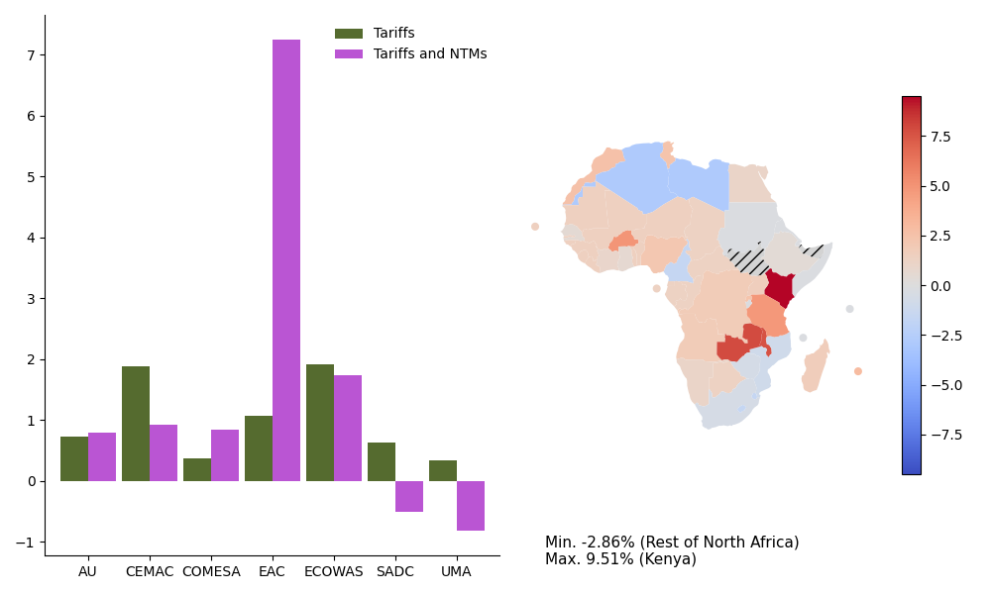
Results – primary agri imports (2035)

Slide 25
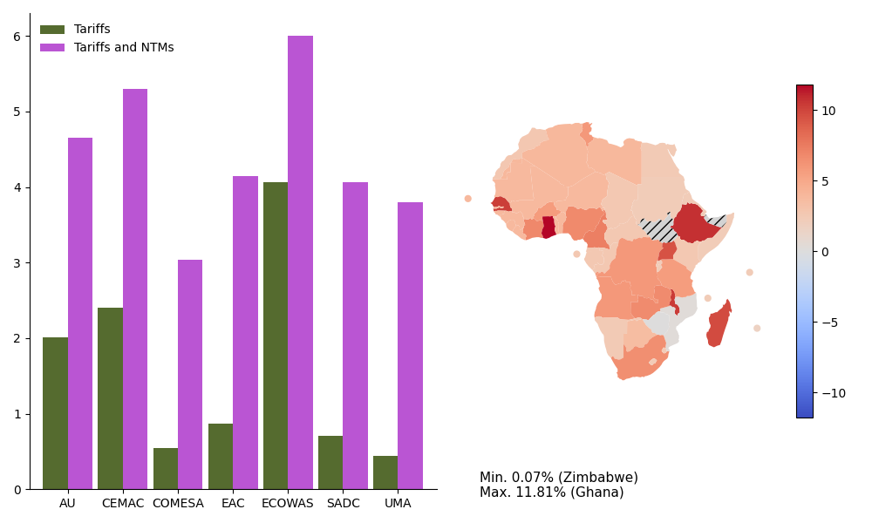
Results – processed food imports (2035)

Slide 26
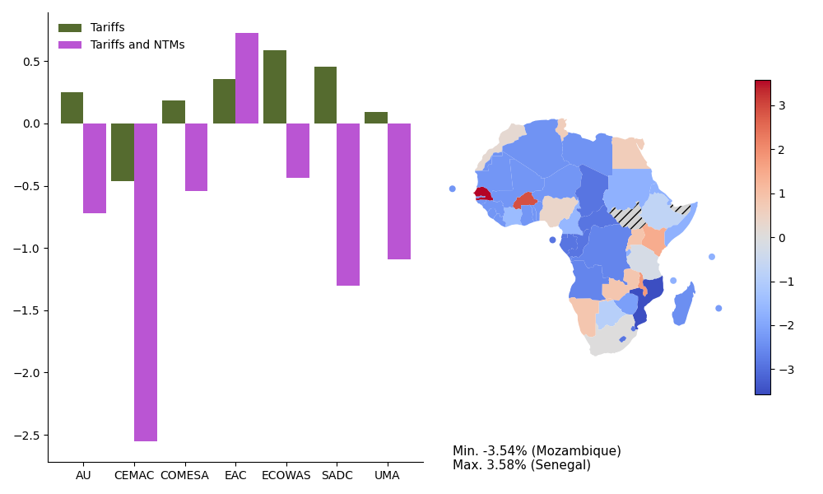
Results – food price index (2035)

Slide 27
Conclusions and policy recommendations
Overall effects are positive on food security:
food consumption increases throughout
food prices decrease in most of the regions
Production will be more regionally concentrated by commodities
Food imports will increase, mostly within Africa
especially the resource rich countries will become more dependent on imports

Slide 28
Thank you
This presentation has been prepared for internal purposes. The information and views expressed in it do not necessarily reflect an official position
of the European Commission or of the European Union.
Except otherwise noted, © European Union (2021). All Rights Reserved

Slide 29





Keep in touch
EU Science Hub: ec.europa.eu/jrc
@EU_ScienceHub
EU Science Hub – Joint Research Centre
EU Science, Research and Innovation
EU Science Hub
Notes:
Delete/update as appropriate

Slide 30
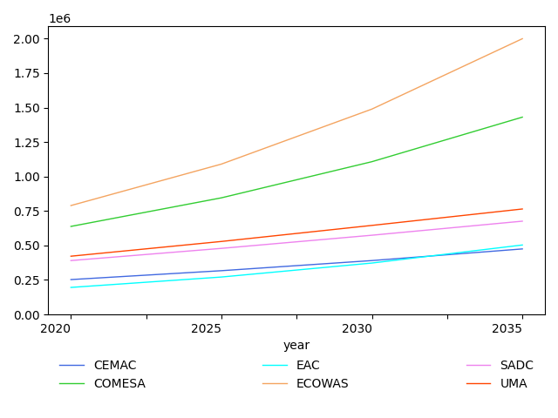
GDP growth by RECs (baseline)

Slide 31
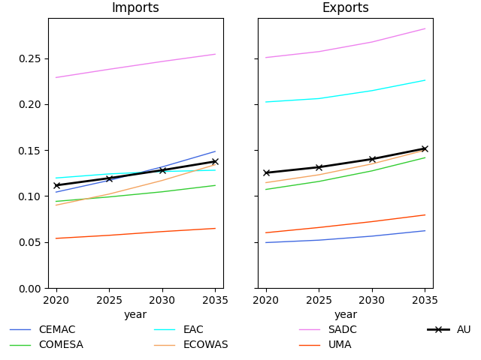
Shares of intra-African trade of all trade (baseline)

Slide 32
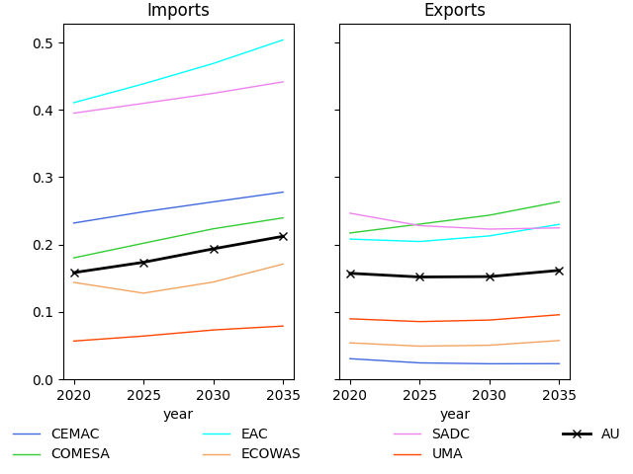
Shares of primary agricultural commodities of all trade (baseline)

Slide 33
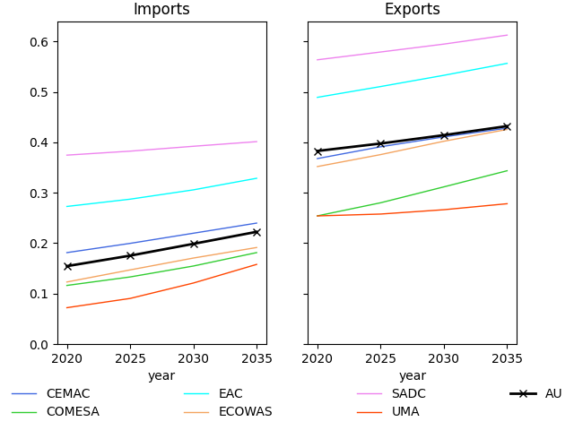
Shares of processed food commodities of all trade (baseline)

Slide 34
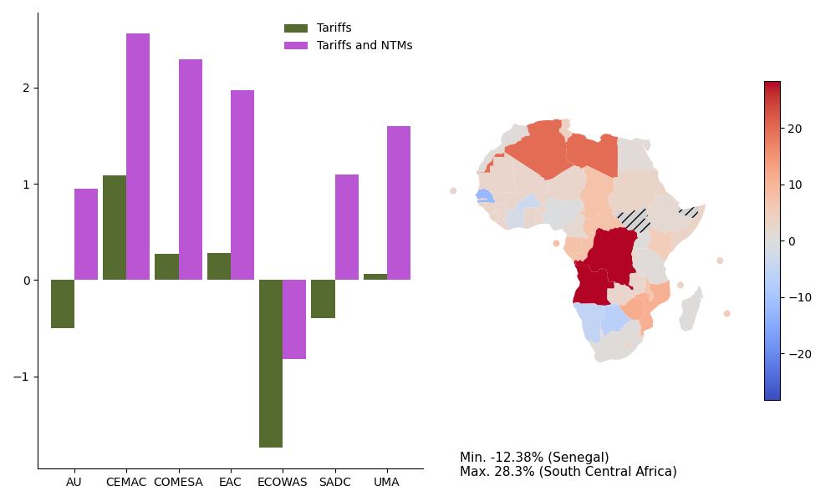
Results – primary agri exports (2035)

Slide 35
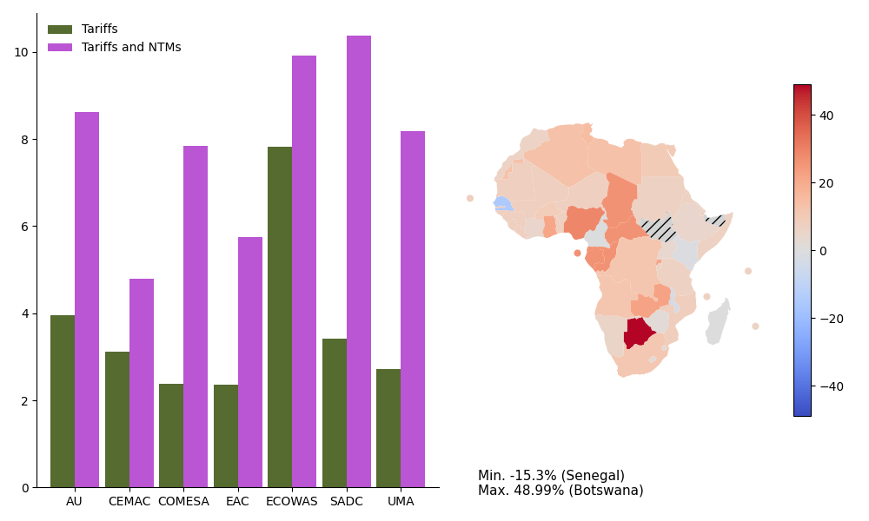
Results – processed food exports (2035)

Slide 36
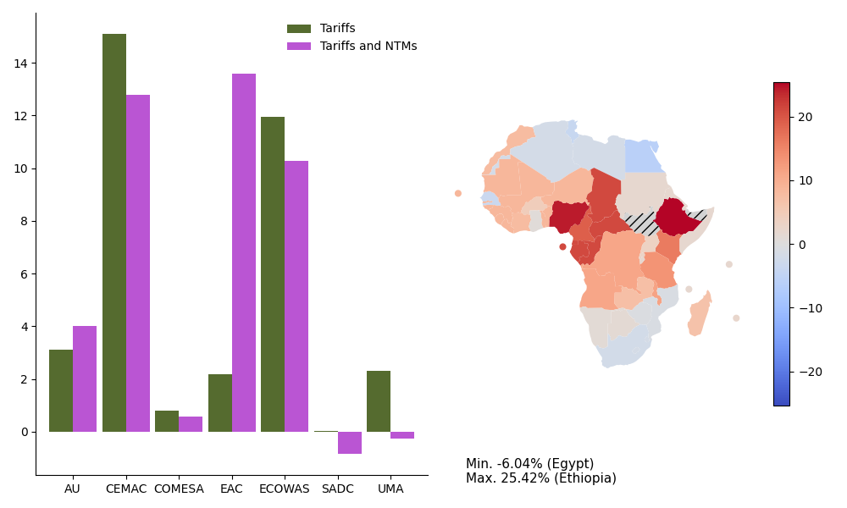
Results – primary agri imports (Africa; 2035)

Slide 37
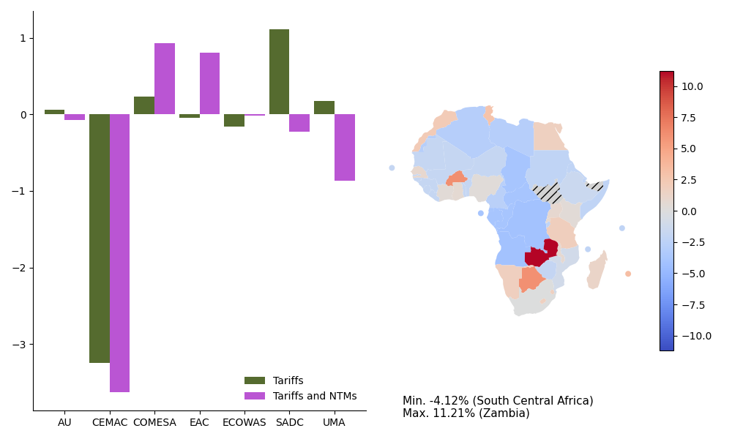
Results – primary agri imports (ROW; 2035)

Slide 38
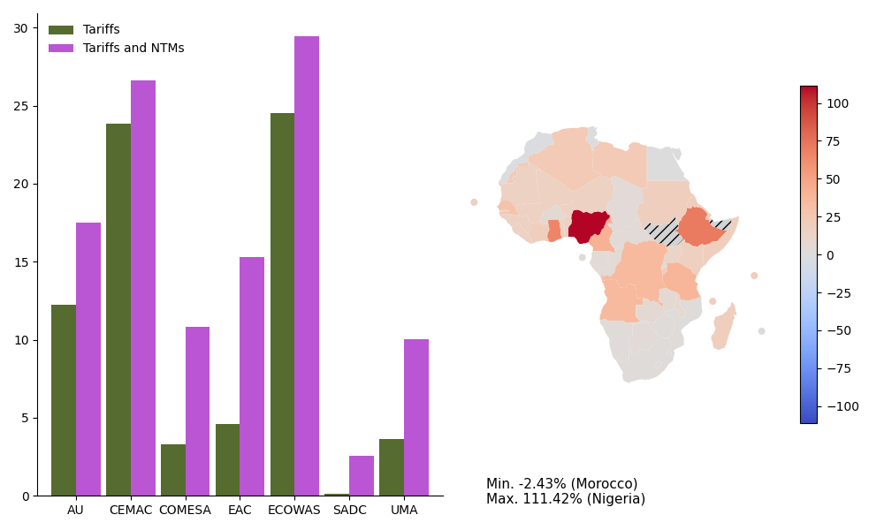
Results – processed food imports (Africa;2035)

Slide 39
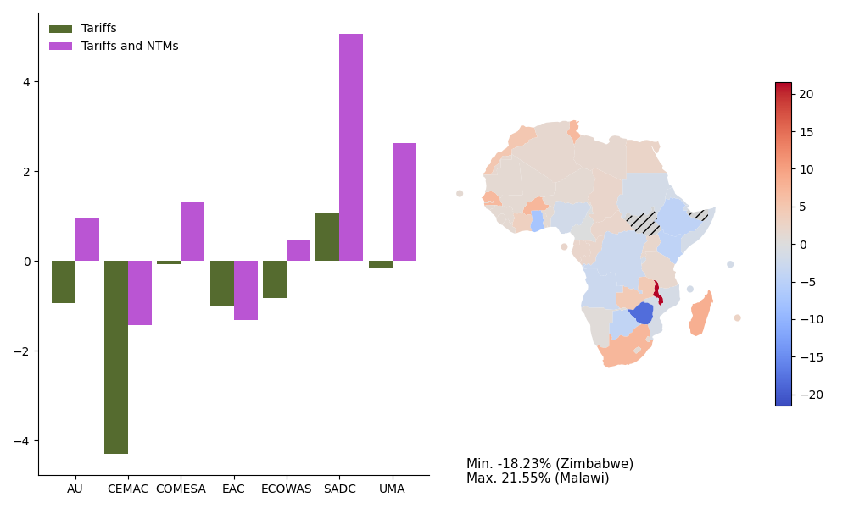
Results – processed food imports (ROW;2035)

