Slide 1



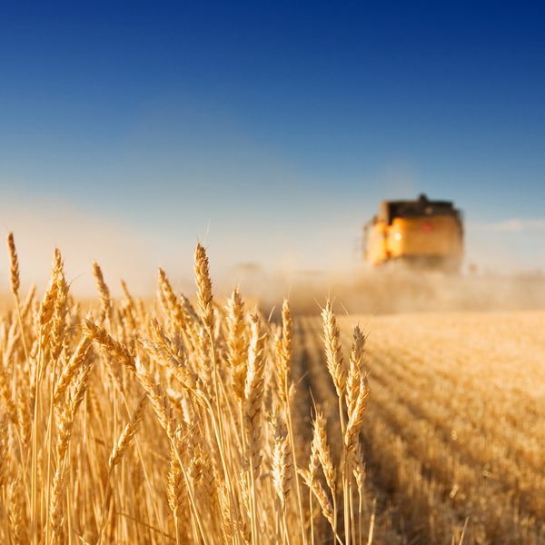

Healthier but Wasteful? Changes in food loss and waste along global supply chains with healthier diets
Alessandro Gatto, Maksym Chepeliev, Marijke Kuiper and Hans van Meijl
Wageningen University & Wageningen Economic Research
DRAFT PAPER

Slide 2
Modelling circularity and beyond: challenges & key steps forward
CAPTURING PHYSICAL BIOMASS FLOWS
Tracing different biomass flows (feed, seed, other use, food) through global economy, quantifying magnitude and composition
Capturing intermediate and final biomass use, pointing total output changes in demand and in global trade
Tracing food quantities from farm to fork along
global supply chains, identifying intermediate and
final food use
Assessing feed-food-fuel-fibre (4Fs) competition
by analysing biomass trade and substitution
effects
CAPTURING PHYSICAL BIOMASS FLOWS
QUANTIFYING FOOD LOSS AND WASTE
Capturing food intake vs food availability based on FBS (omits retail & consumers waste which can be substantial)
2. Up-to-date global FLW database
Identify and quantify at which supply chain stages
FLW occurs
4. Identify in which region the FLW occurs to assess
spatial scope for policies like moving to a circular
economy
5. Asses impact of a change in diet on FLW
generation along global FSC
QUANTIFYING FOOD LOSS AND WASTE
No common definition (Delgado et al., 2020) nor reliable global measurement (Kuiper & Cui, 2021) available to date
Contrasts in target issues, methodological approaches and FSC specifications result in inconsistent estimates and databases (Xue et al., 2017)
Data mainly available in single metrics (e.g. Mtons), with impossibility of cross-cutting analyses on FLW
Most adopted estimates from Gustavsson et al. 2011, presents severe limitations due to inconsistent methodology and FLW definition
Available FLW data results contrasting with current data on household net food/calories intakes
Dollar-based quantities are insufficient to assess global challenges related to nutrition or impacts of resource circularity
For effective policy design crucial to identify what (biomass type) is used where (domestic vs imported) and by whom (sector inputs vs final demand)
Enhancing consistent linkages to technical models (interdisciplinary connection)
As economies change over time towards processed foods and food services, current data cannot be used in ex-ante assessments, nor provides guidance when diets change considerably
identifying
challenges
tackling
challenges
Notes:
Research on quantifying FLW at each stage of FSC is mainly missing

Slide 3
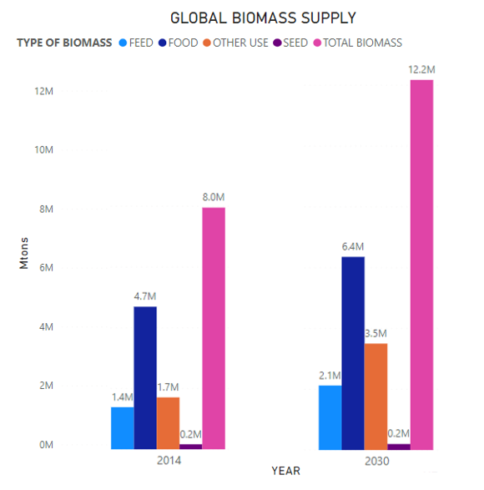
Core contribution (1): Capturing physical biomass flows
Placing a biomass balancing equation into a CGE framework
FAO – FBS: Domestic supply = Feed + Seed + Losses + Processing + Residuals + Food + Other uses (non-food) + Tourist consumption
FAO: Production + imports – exports = domestic supply = feed + seed + other uses + losses + food
(in GTAP framework)
Gustavsson et al, 2011: Production + imports – exports = domestic supply = losses + food
1. Definition incorporates feed, seed, other uses to losses
2. Losses exclude pre-harvest stage but expand FBS definition by including food waste
3. Non-edible food parts not considered as loss
Gatto et al.: Production + imports – exports = domestic supply = feed + seed + other uses + losses + waste + food
1. Singular accounting of domestic and imported feed, seed, other uses and food to trace changes in biomass demand
2. Losses include pre-harvest and account for waste at retail and consumption stages
3. Consistent physical accounting of biophysical flows from GTAP Nutritional database (GTAP Research Memorandum No. 37)
4. New FLW global database
Equation into MAGNET model framework
Feed, Seed, Other use biomass flows evolve with changes in dom/imp commodity use by activity (qfd, qfm)
Food & FLW biomass flows evolve with changes in dom/imp private hh consumption (qpd,qpm)
Current issues:
- Biomass balance does not hold during simulations (post-sim approach currently adopted)
- Structure of Input-output tables inconsistent with food and other use shares suggested by FAO
- Leontief Inverse method suitable for comparative static approaches but unsuitable for assessing structural changes during simulations
→ Temporal Leontief Inverse (Sonis & Hewings, 1998) more suited for dynamic simulations?
- High heterogeneity in implied prices between different biomass uses (feed, seed, etc.)
Notes:
In absolute terms, order of growing is
1.OTHER USES (+1.8 mln tons --- 43%)
2. FOOD (+1.7 mln tons --- 40%
3. FEED (+0.7 mln tons --- 17%)
4. SEED (+0.0 mln tons)
Current biomass imbalance (tot biomass vs sum of flows) : -878732,06 Mtons

Slide 4
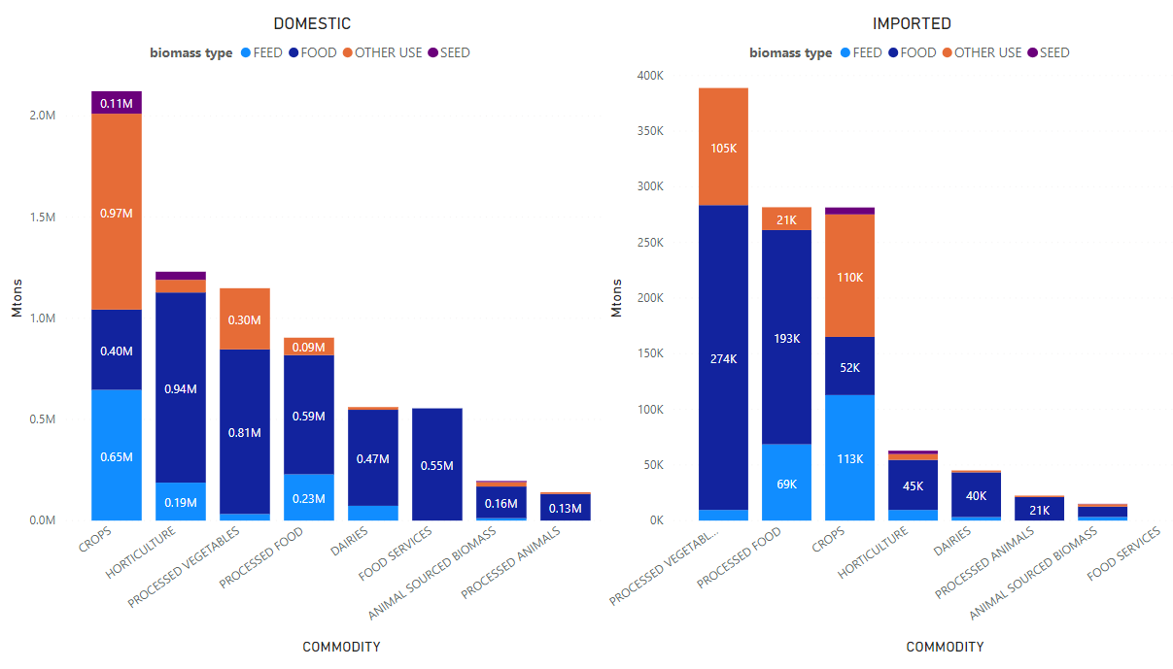
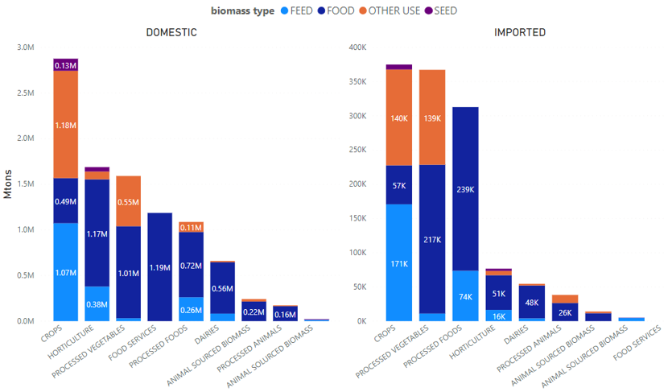
Benefits of core contribution (1): Assessing global biomass composition and demand patterns
BIOMASS DEMAND
Relative increase in biomass demand is highest for food and feed (increasing shares - mainly reallocated from other-use)
Food and feed demand mainly rising in South-East Asia and Sub-Saharan Africa while other-use demand rising drastically in South-East Asia
Imported biomass increases allocation to feed/food (high-income) and food/other-use (low-income)
Low-income regions shift from production of primary biomass (feed, seed) to processed biomass (food, other-use)
2014
2030
Notes:
Overall, global rising in biomass production mainly stimulated by relative increasing shares (demand) for food and feed.
STATEMENT 1: globally, OTHER USE HIGHEST INCREASE, RELATIVE CHANGES MAINLY INCREASE FOOD AND FEED and DECREASE OTHER USE
STATEMENT 2: INCREASING POPULATION AND PURCHASING POWER → SSA and SEA HIGHEST INCREASE FOOD DEMAND (DOM & IMP) ➔ SSA: fish (imports), SEA: dairies (imp), BOTH: processed foods (imp & dom) ---- OTHER USE DEMAND (dom & imp) RISING IN SEA (mainly crops and processed vegs)
STATEMENT 3: domestic food production increases → SUBSTITUTION EFFECTS: (BOTH DOMESTIC AND IMPORTS)
1. IMPORTED PRIMARY BIOMASS
LOW-INCOME → increasing FOOD shares (overall increasing demand for food highest)
2. IMPORTED PROCESSED BIOMASS
LOW-INCOME → from FEED to OTHER (low-income)
STATEMENT 4: high-income: drastic increase of food services thus reallocation to meet demand → primary to feed, processed to food
→ from FOOD to FEED increasing in domestic food production – decreasing demand for food imports – FEED up as meat cons remains highest)
→ from OTHER to FOOD (increase in demand for processed foods)
low-income: processed food previously allocated to feed-other uses goes to food → following increasing patterns of domestic production of processed food and other uses -- domestic FEED up = less need of imports)
1. CROPS and HORT shift from other non-food uses to food and feed. EU26, BRA, NAMO, LAC increase feed and food exports mainly to SSA and SEA. High-income regions increase share of imports allocation to feed while low-income regions to food.
2. ANIMAL BIOMASS shifts from other non-food uses to food in high-income regions and increases food shares in middle and low-income regions. Exports largely increase towards SSA (main fish) and SEA, decreasing in MENA (red meat), with EU26 facing a main increase in food exports.
3. DAIRIES shift from feed and other non-food use (main shift) to food in high-income regions and towards feed and food (main) in middle-income regions. Food shares increase in low-income regions. Demand for imported DAIRIES to food and feed mainly increases in SEA, with imports globally shifting allocation from feed to food use.
4. PROCESSED ANIMAL BIOMASS shifts from feed to other non-food uses in low and middle income regions and from other non-food uses to food in high-income regions. Imports globally shift from feed/food to other non-food uses with MENA, SEA mainly increasing imports demands.
5. PROCESSED VEGETAL BIOMASS shifts from feed to other non-food uses in low-income regions and from feed to food in high-income regions. Allocation of imports follows the same trend. Main rising demand from MENA, SEA and SSA
6. PROCESSED FOOD BIOMASS shifts from feed and other non- food uses to food both for domestic and imported biomass. Main increases in demand for imports derive from SEA and SSA.

Slide 5
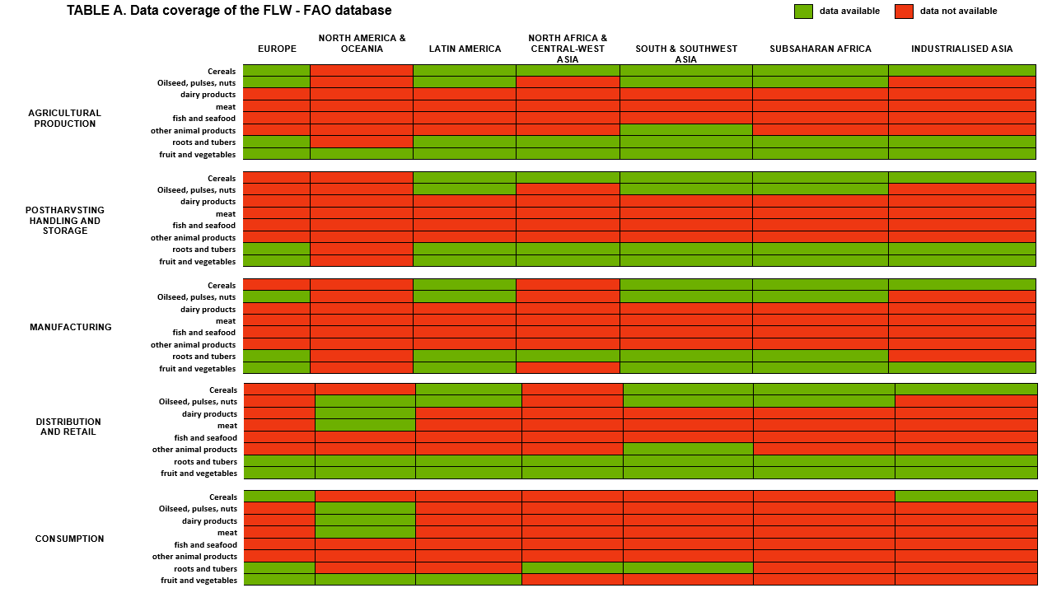
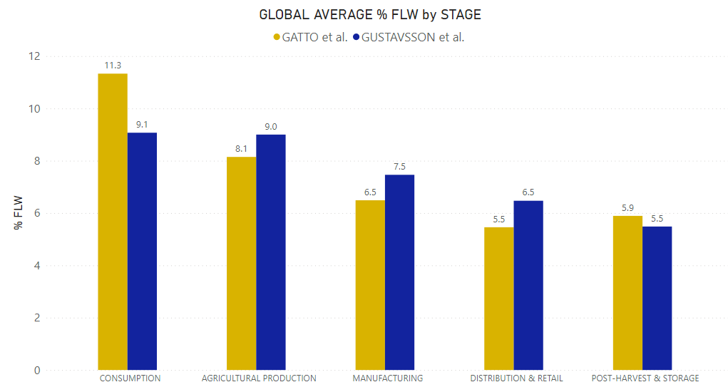
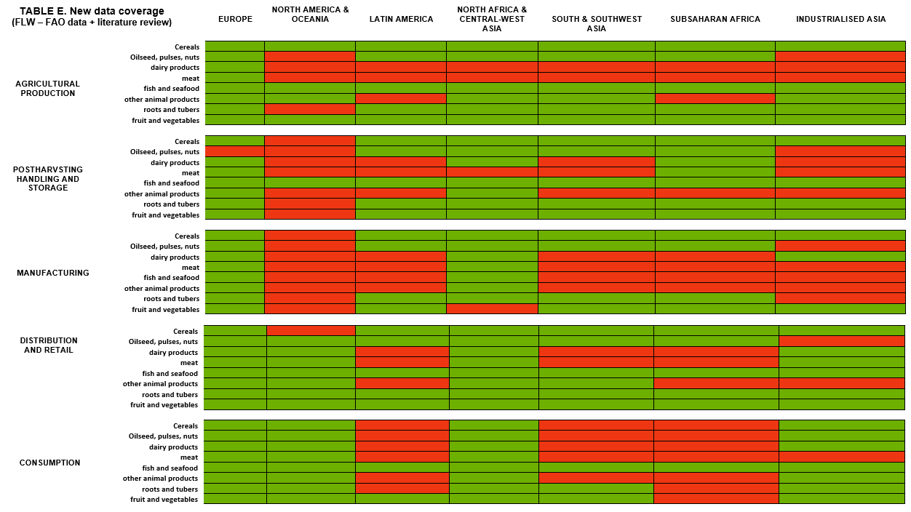
Core contribution (2): Quantifying net food intakes and FLW along global food supply chains
FAO – FLW database 2019
Most relevant data* published after 2011:
Increased global data coverage for Consumption and Manufacturing stage
Increased data coverage for High-income and Middle-income regions (less data generalisations)
Agricultural production estimates incorporate pre-harvest losses and rely on collected data rather than assumptions
Data for Sub-Saharan Africa, South-East Asia and Latin America & Caribbean at later stages of supply-chain still largely generalised
Up-to-date global estimates on
percentages of loss/waste of total food weight
along FSC (FAO-FLW 2019 data core)
Consistent FLW definition (UN – SDG 12.3)
Expanding supply chain and commodity coverage
Multidimensional database to allow simultaneous social-economic-environmental analyses on FLW
Gatto et al. database
* see for example Xue et al., 2017, Porter et al., 2016, OECD, 2021, FAO, 2019

Slide 6
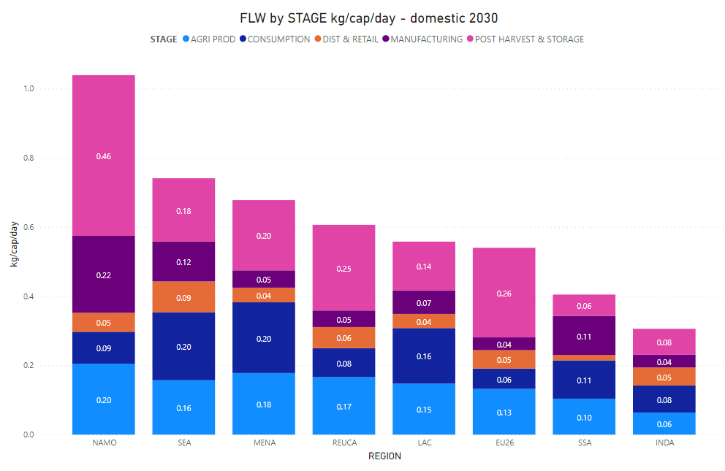
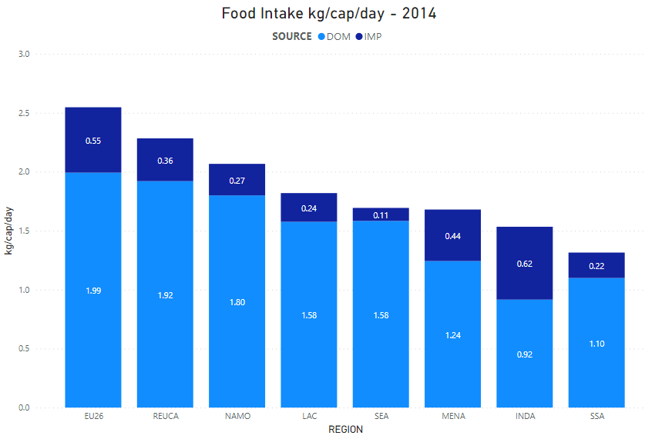
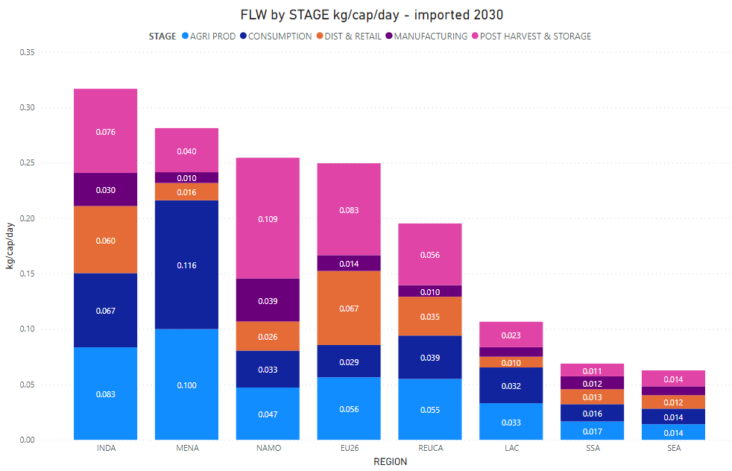
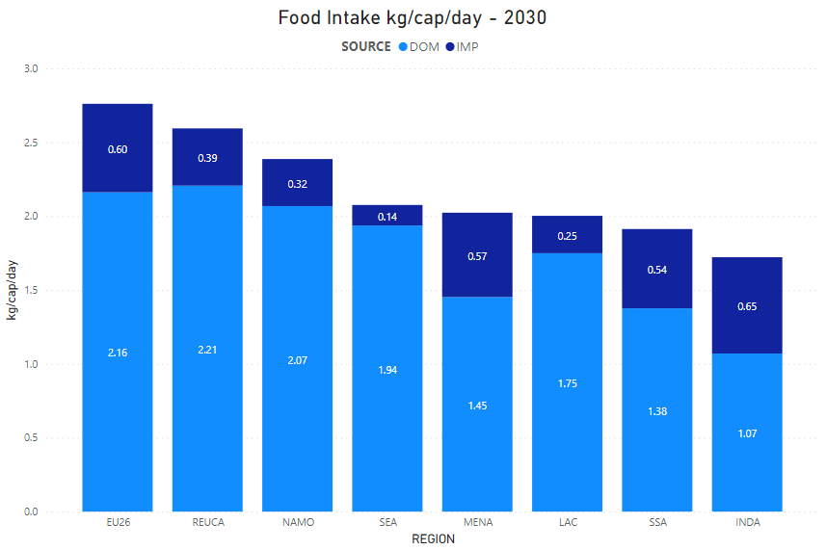
Benefits of core contribution (2): Food intake and quantification of global FLW
FOOD LOSS AND WASTE
Early stages of FSC represent highest shares in
middle-low and low-income regions
Increasing imports of processed commodities, result
in higher shares of manufacturing, distribution and
retail and consumption losses of imported FLW
Increasing consumption of imported processed
commodities (longer-food-chains) will result in FLW generation in other regions
Increasing losses at manufacturing stage, may
compromise FLW reuse due to quality of losses
FOOD CONSUMPTION
Consumption of Horticultural commodities
decreases in favor of processed vegetables
(mainly SUGAR and B_T) both domestic and imported
Shift of consumer preferences towards processed food results in reallocation of processed food biomass from feed/other-uses to food
Global increase in food supply from food services (mainly high-income regions)
Animal primary and processed biomass follows a linear growth (no drastic substitution effects in food bundles with rising incomes)
Notes:
FLW will differ in composition from the present FLW, because of more food processing
FOOD LOSS AND WASTE
Statement 1: despite decrease in HORT consumption (big share in low-income countries diets) still relevant share of FLW

Slide 7
MAGNET model and Scenario set - up
MODEL
SCENARIO
Model & data: MAGNET using GTAP V10 data (2014) with aggregation to GTAP - model 2014-2030
Basic drivers: SSP2 projections of population, TFP (via GDP projections), crop & livestock yields. NB: no extensive baseline calibration yet
Scenarios: SSP2 scenario (baseline) against EAT – Lancet 2019 dietary scenario
Focus: Biomass (food) availability, demand and trade; changes in FLW generation and trade-offs between FLW reduction (SDG 12.3) and (sustainable) nutrition (SDG 2)
Sustainable healthy diet:
“moving halfway to the Eat-Lancet diet (Willet et al., 2019)
recommendations”
Implementation:
- shock as fixed private household consumption per capita
(1323.8 grams/cap/day)
- split of EAT-Lancet commdities between GTAP commodities
(e.g. sweeteners intakes split in C_B and SUGAR)
- Consumption of food services or processed food represented in
in primary equivalents
→ proportional reallocation of primary commodities
(grams) to food services or processed food based on
EAT- Lancet target.
→ Current issue:
- Full shock through preference shifts is impossible for low income regions.

Slide 8
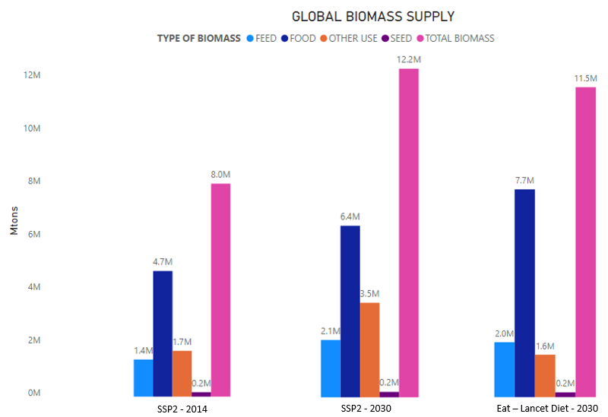
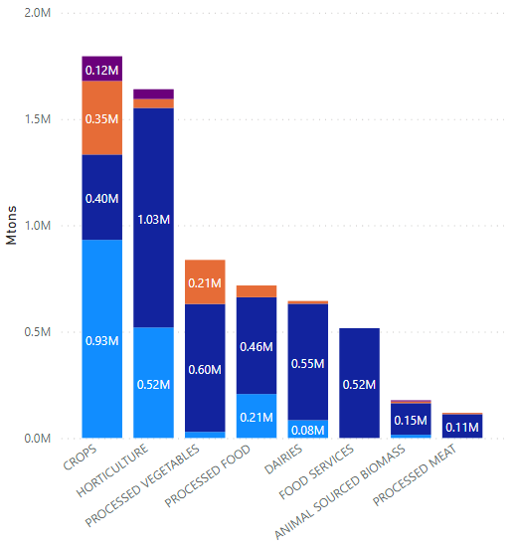
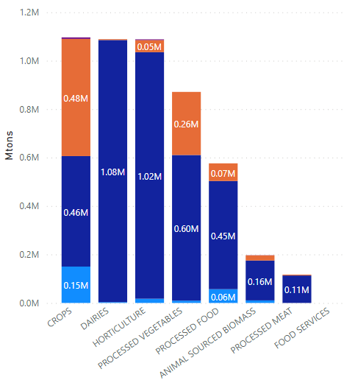
Results (1): global biomass composition and demand patterns with a healthy sustainable diet
BIOMASS DEMAND
Sourcing of biomass radically shifts towards Imports,
with domestic/import ratio decreasing from 3.3 to 1 (SSP2)
to 1.3 to 1 (Eat-Lancet diet)
Food and feed demand mainly rising in South-East Asia and Sub-Saharan Africa with other-use demand decreasing, mainly in high-income regions.
All regions drastically increase shares of food imports.
Despite imports of biomass for other-use and feed globally increase in absolute terms, relative shares of biomass for other-use and feed decrease towards food.
High-income regions decrease domestic production of biomass for feed and other-use, increasing imports. Low-income regions increase domestic production of biomass for all uses, simultaneously increasing biomass imports.
SSP2 scenario
2030
Eat Lancet diet scenario
2030
Notes:
PAY ATTENTION TO GRAPHS VALUES!!!
Statement 1: despite global biomass decreases with healthy diet imports drastically increase
Statement 2: feed increases less then BAU scenario
Statement 3: biomass substitution effect other/feed to food
Statement 4: source substitution effect in high income → less dom more imp

Slide 9
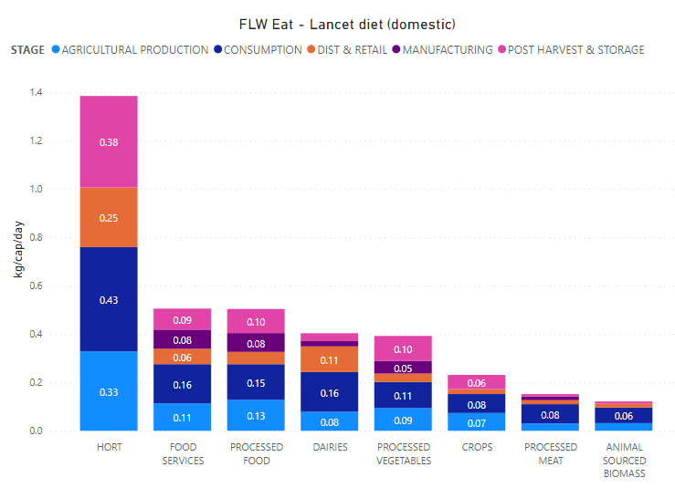
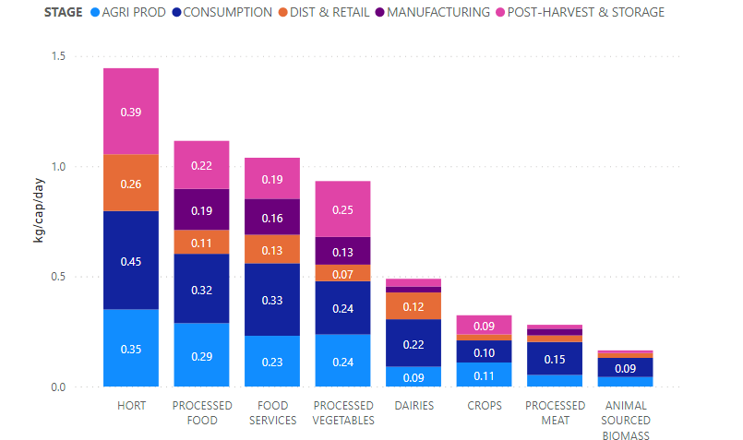
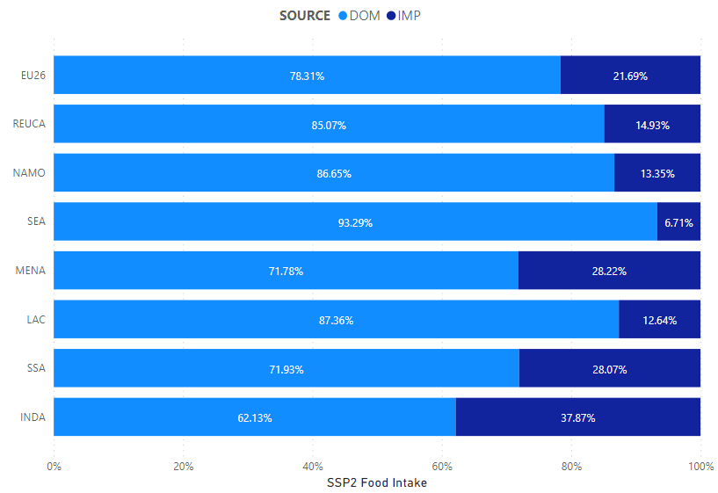
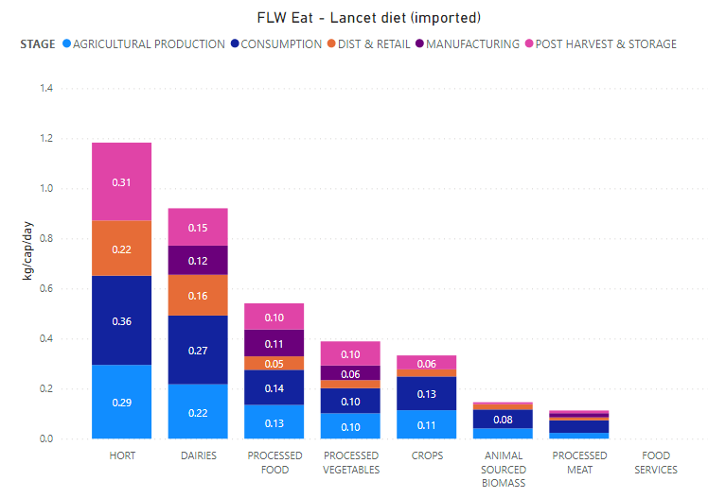
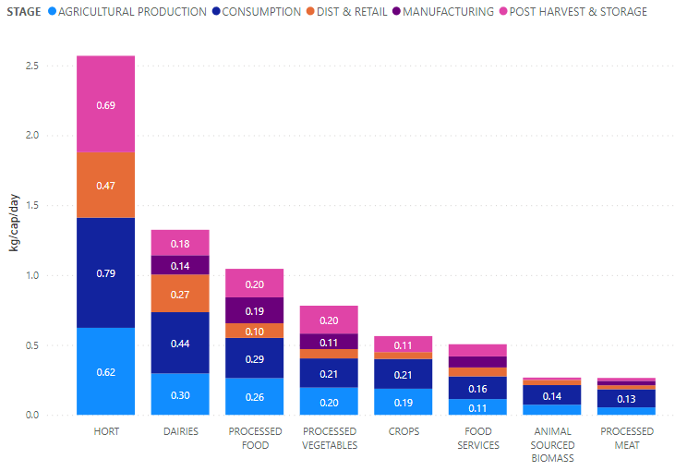
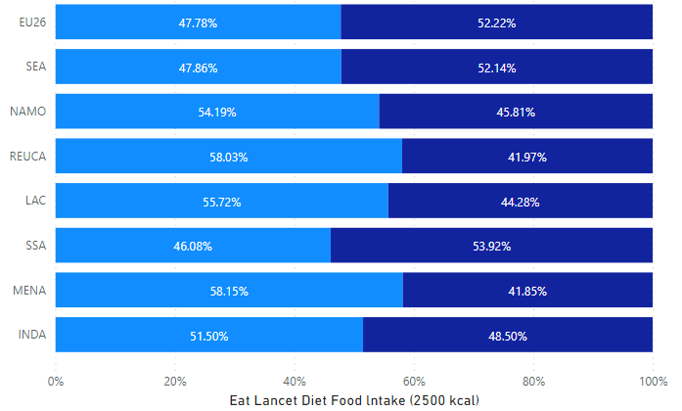
Results (2): Food intake and quantification of global FLW with a healthy sustainable diet
FOOD CONSUMPTION
With Eat-Lancet diet food consumption shifts towards primary commodities, globally decreasing consumption of processed meat, processed vegetables and other processed food.
Eat Lancet diet mainly increases food consumption of crops, horticulture and dairies, drastically varying the consumption source of primary commodities.
In low-income regions, domestic production of processed food commodities decreases less than in high-income regions, which become net importers of processed food commodities.
Food consumption from food services globally decreases, given increasing consumer preference for primary commodities.
FOOD LOSS AND WASTE
Global increase of FLW along FSC with healthy diets.
FLW increase in primary commodities (hort) and in dairies, while decreases for processed commodities, reflecting the decreasing consumption of processed food imposed by the diet.
Overall increase in FLW mainly driven by a rising waste generation at consumption stage, as well resulting from decreasing intakes of food processed food and food services.
Rising demand for primary commodities, increases local availability of FLW at early stages of FSC (mainly low-income regions) assisting potential biomass reuse.
Decreasing processed FLW in favor to primary FLW benefits the potential reuse of organic biomass as feed or fertilizer.
SSP2 scenario - 2030
Eat Lancet diet scenario - 2030
Notes:
Results 2 : changes in global FLW supply (evolving flows at each stage of FSC) in EAT-Lancet scenario – sentences with key findings by sectors and regions (stress space availability (dom vs imp) of FLW key for CE - list trade-offs)
FOOD – drastically shifts towards imported food, bad for food security
Stat 1: imports substitution effects: SSP2 main imports where processed meat, veg, food vs EAT – L main imports primary commodities – crops, dairies, hort most increase with lancet
Stat 2: biomass substitution effect: decrease domestic prim comm→ crops reallocated to other use, feed (main).
Stat 3: Source of processed remains the same (same imports) with Domestic production of processed commodities decreasing with lancet diet
Stat 4: food substitution effect: less processed food more primary commodities
FLW
st 1:
St 2: Early supply chain losses easing the link to agri businesses (feed, fert, fiber)
St 3: dist and retail and consumption losses in high income assist as well
St 4: despite potential environmental impact might increase – more horticulture lossess at post-harvest and agri prod = GHG emissions

Slide 10
Conclusions & further research
Conclusions
Next-steps:
→ Food security (SDG 2)
- An healthy and sustainable diet increases global
food availability only through increasing global trade
FLW DATA
→ Comparison (and update) of estimates with newly released
estimates from UNEP, 2021.
→ Food Loss and Waste (SDG 12.3)
Global FLW tend to increase with a healthy and sustainable diet
Spatial availability of FLW with a healthy and sustainable diet
can assist the creation of domestic material loops for circular
purposes
- Type (quality) of FLW enhances its employability as production
input
Modelling BIOMASS flows and FLW
→ development of methodological approach capable to
target and account structural changes in biomass flows
during simulations
→ Creating currently missing consistent links between kcal intakes
and FLW estimates
EAT-Lancet SCENARIO
→ ad-hoc adjustments to currently implement shock in
GTAP framework. Necessary to shock other variables or
reframe commodities to be shocked?
→ Environmental sustainability (SDG 13)
- A healthy and sustainable diet reduces overall global demand
for biomass, decreasing potential pressures on the environment
- The socio-environmental benefits of healthy and sustainable diet
are only preserved if rising FLW at early stage of FSC is properly
reused
Integrated analyses (forthcoming paper)
→ Creation of ad-hoc indicators to fully asses trade-offs and
synergies between Nutritional, Environmental and FLW
reduction targets
Notes:
FOOD SECURITY:
Healthier food, not processed food

Slide 11

Questions, comments, ideas?
Alessandro.gatto@wur.nl

Slide 12
References
Delgado, L., Schuster, M., & Torero, M. (2020). Quantity and quality food losses across the value Chain: A Comparative analysis. Food Policy, 101958. https://doi.org/10.1016/j.foodpol.2020.101958
FAO (2011). ‘Global Food Losses and Food Waste – Extent, Causes and Prevention’, Rome (2011). http://www.fao.org/docrep/014/mb060e/mb060e00.htm
Kuiper, M., & Cui, H. D. (2020). Using food loss reduction to reach food security and environmental objectives – A search for promising leverage points. Food Policy, 101915. https://doi.org/10.1016/j.foodpol.2020.101915
Leontief, W. (1970) The dynamic inverse, in: A.P. Carter and A. Brody (Eds) Contributions to Input–Output Analysis, pp. 17–46 (Amsterdam: North-Holland).
Porter, S. D., Reay, D. S., Higgins, P., & Bomberg, E. (2016). A half-century of production-phase greenhouse gas emissions from food loss & waste in the global food supply chain. Science of The Total Environment, 571, 721–729. https://doi.org/10.1016/j.scitotenv.2016.07.041
Sonis, M. and Hewings, G.J.D. (1998). Temporal Leontief inverse, Macroeconomic Dynamics, 2, pp. 89–114.
Xue, L., Liu, G., Parfitt, J., Liu, X., Van Herpen, E., Stenmarck, Å., O’Connor, C., Östergren, K., & Cheng, S. (2017). Missing Food, Missing Data? A Critical Review of Global Food Losses and Food Waste Data. Environmental Science & Technology, 51(12), 6618–6633. https://doi.org/10.1021/acs.est.7b00401
Willett, W., Rockström, J., Loken, B., Springmann, M., Lang, T., Vermeulen, S., Garnett, T., Tilman, D., DeClerck, F., Jonell, M., Clark, M., Gordon, L. J., Fanzo, J., Hawkes, C., Zurayk, R., Rivera, J. A., Afshin, A., Chaudhary, A., Herrero, M., … Murray, C. J. L. (2019). Food in the Anthropocene: The EAT–Lancet Commission on healthy diets from sustainable food systems. 393, 46.

