Slide 1
Infrastructure in CGE models: Alternative formulations, empirical evidence, and a new approach
Hans Lofgren
Martín Cicowiez
Draft
Presentation prepared for the 24th Annual Conference on
Global Economic Analysis, June 23-25, 2021

Slide 2
1. Introduction
The econometric literature suggests that investments in physical infrastructure have contributed strongly to economic growth, something that has convinced analysts to bring infrastructure into their CGE models.
Based on a review of the relevant literature, this paper proposes an alternative approach that overcomes some of the shortcomings that are identified.
In outline, we:
  review the econometric evidence linking infrastructure to growth;
  take stock of the treatment of infrastructure in CGE models;
  propose an alternative approach that is tested and compared to alternatives in the literature.

Slide 3
2. Econometric studies of the impact of infrastructure investment
The key reference for this review is Calderón and Servén (2014).
Across most country contexts, infrastructure investments have had a positive impact on GDP.
The strength of this positive relationship depends on contextual factors, including:
  Investment efficiency (spending → ↑ capital stock?);
  Relevance of the new physical capital to growth process (transportation, communications, and energy tend to be particularly relevant); and
  Impact of public investment on private investment is more positive –↑([crowding in] – [crowding out]) – if the business environment makes it easy for private producers to expand in response to new profit opportunities.

Slide 4
2. Econometric studies of the impact of infrastructure investment – cont.
Econometric studies have typically been based on a few macro indicators (GDP, infrastructure capital and investment), rarely addressing the roles of contextual factors like
  government financing mechanisms;
  infrastructure ownership (public, private);
  operations and maintenance (O&M) costs; or
  other policies (trade, tax, ….
The disaggregation of infrastructure has been very limited at best; sometimes infrastructure investments have even been lumped together with other public investments.
Impact evaluation studies of infrastructure projects may provide an alternative source of data.

Slide 5
3. Infrastructure in CGE models
CGE models have used a variety of formulations.
In the following review, we focus on the treatment of infrastructure-production links, for simplicity using Cobb-Douglas functions (also common in the literature) and abstracting from other features like factor nesting.
Models also differ in their treatment of contextual factors (like treatment of funding of infrastructure investment).

Slide 6
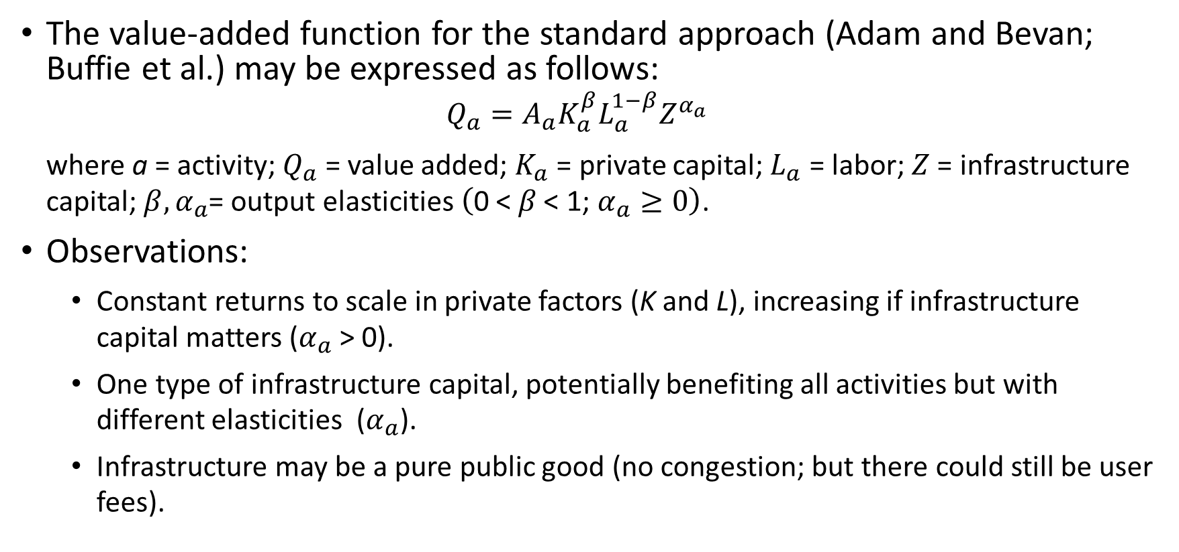
3. Infrastructure in CGE models – cont.
The value-added function for the standard approach (Adam and Bevan; Buffie et al.) may be expressed as follows:
  $$Q_{a}=A_{a}K_{a}^{β}L_{a}^{1−β}Z^{α_{a}}$$
  where a = activity; $Q_{a}$ = value added; $K_{a}$ = private capital; $L_{a}$ = labor; $Z$ = infrastructure capital; $β,α_{a}$= output elasticities $\left(\text{0 < }β\text{ < 1; }α_{a}≥0\right)$.
Observations:
  Constant returns to scale in private factors (K and L), increasing if infrastructure capital matters ($α_{a}$ > 0).
  One type of infrastructure capital, potentially benefiting all activities but with different elasticities ($α_{a}$).
  Infrastructure may be a pure public good (no congestion; but there could still be user fees).

Slide 7
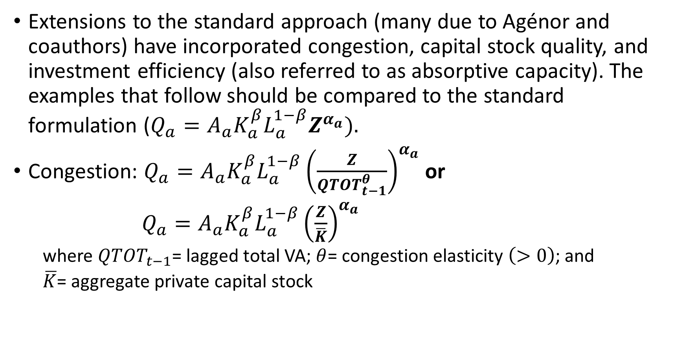
3. Infrastructure in CGE models – cont.
Extensions to the standard approach (many due to Agénor and coauthors) have incorporated congestion, capital stock quality, and investment efficiency (also referred to as absorptive capacity). The examples that follow should be compared to the standard formulation ($Q_{a}=A_{a}K_{a}^{β}L_{a}^{1−β}Z^{α_{a}}).$
Congestion: $Q_{a}=A_{a}K_{a}^{β}L_{a}^{1−β}{\left(\frac{Z}{{QTOT}_{t−1}^{θ}}\right)}^{α_{a}}$ or
$Q_{a}=A_{a}K_{a}^{β}L_{a}^{1−β}{\left(\frac{Z}{\overline{K}}\right)}^{α_{a}}$
  where ${QTOT}_{t−1}$= lagged total VA; $θ$= congestion elasticity $\left(>0\right)$; and
  $\overline{K}$= aggregate private capital stock

Slide 8
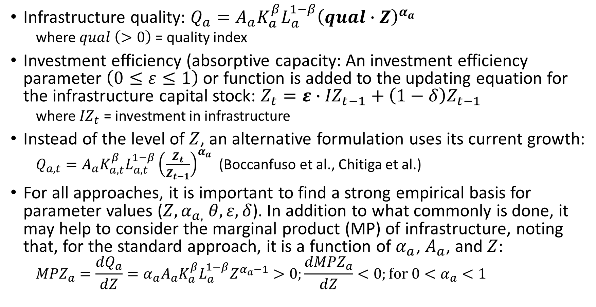
3. Infrastructure in CGE models – cont.
Infrastructure quality: $Q_{a}=A_{a}K_{a}^{β}L_{a}^{1−β}{\left(qual∙Z\right)}^{α_{a}}$
  where $qual \left(>0\right)$ = quality index
Investment efficiency (absorptive capacity: An investment efficiency parameter $\left(0≤ε≤1\right)$ or function is added to the updating equation for the infrastructure capital stock: $Z_{t}={ε∙IZ}_{t−1}+{\left(1−δ\right)Z}_{t−1}$
  where ${IZ}_{t}$ = investment in infrastructure
Instead of the level of $Z$, an alternative formulation uses its current growth:
  $Q_{a,t}=A_{a}K_{a,t}^{β}L_{a,t}^{1−β}{\left(\frac{Z_{t}}{Z_{t−1}}\right)}^{α_{a}}$ (Boccanfuso et al., Chitiga et al.)
For all approaches, it is important to find a strong empirical basis for parameter values ($Z, α_{a,} θ, ε, δ$). In addition to what commonly is done, it may help to consider the marginal product (MP) of infrastructure, noting that, for the standard approach, it is a function of $α_{a}$, $A_{a}$, and $Z$:
  $${MPZ}_{a}=\frac{{dQ}_{a}}{dZ}={α_{a}A}_{a}K_{a}^{β}L_{a}^{1−β}Z^{α_{a}−1}>0;\frac{{dMPZ}_{a}}{dZ}<0;for 0<α_{a}<1$$

Slide 9
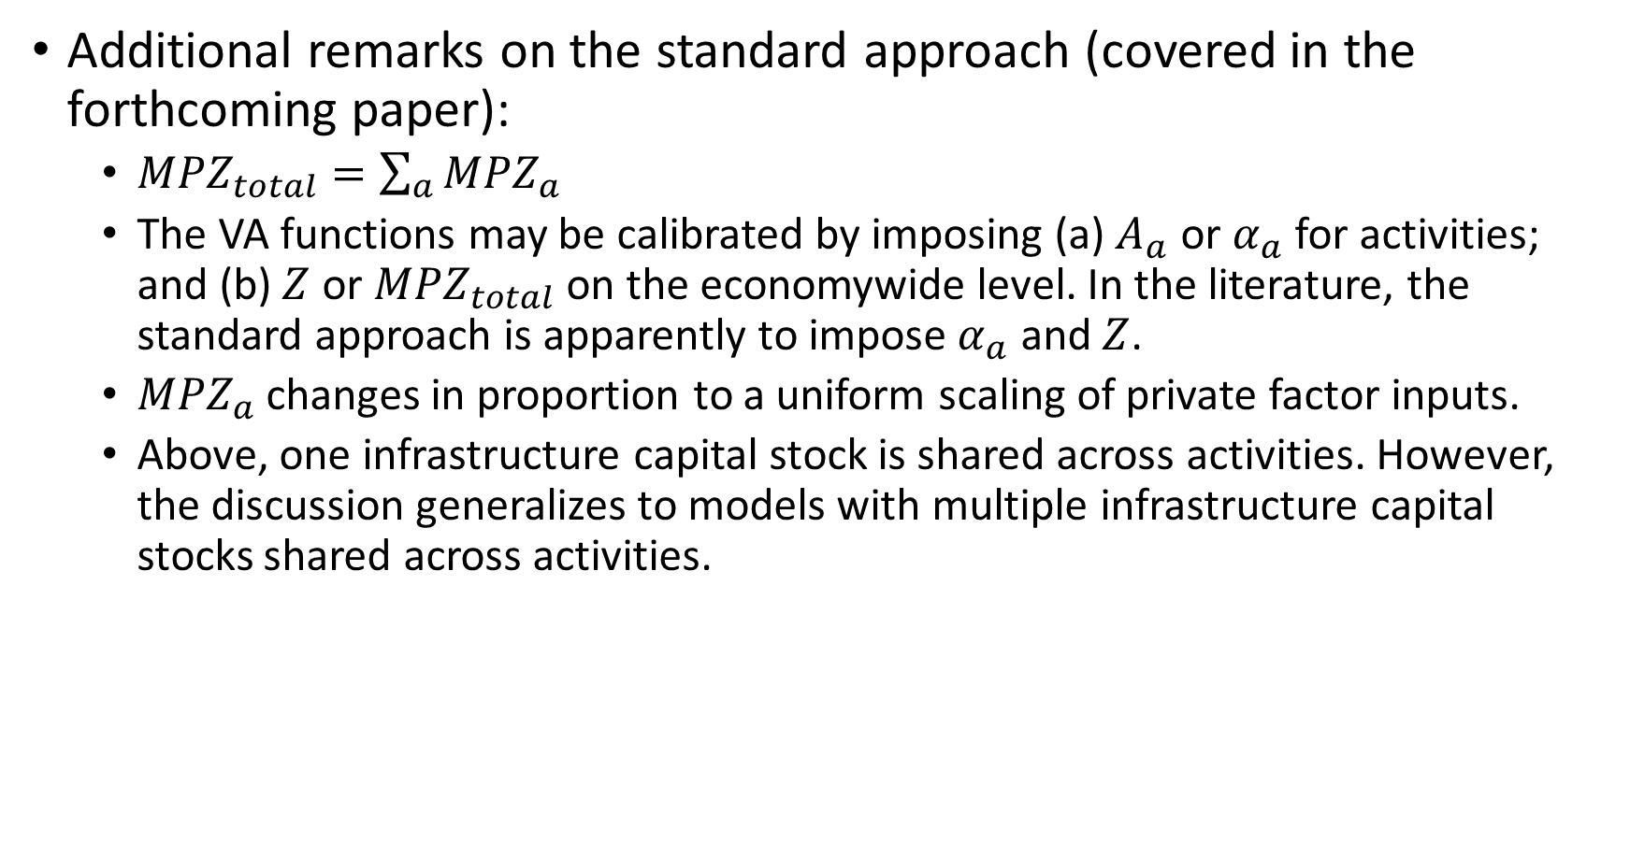
3. Infrastructure in CGE models – cont.
Additional remarks on the standard approach (covered in the forthcoming paper):
  ${MPZ}_{total}=\sum_{a}{{MPZ}_{a}}$
  The VA functions may be calibrated by imposing (a) $A_{a}$ or $α_{a}$ for activities; and (b) $Z$ or ${MPZ}_{total}$ on the economywide level. In the literature, the standard approach is apparently to impose $α_{a}$ and $Z$.
  ${MPZ}_{a}$changes in proportion to a uniform scaling of private factor inputs.
  Above, one infrastructure capital stock is shared across activities. However, the discussion generalizes to models with multiple infrastructure capital stocks shared across activities.

Slide 10
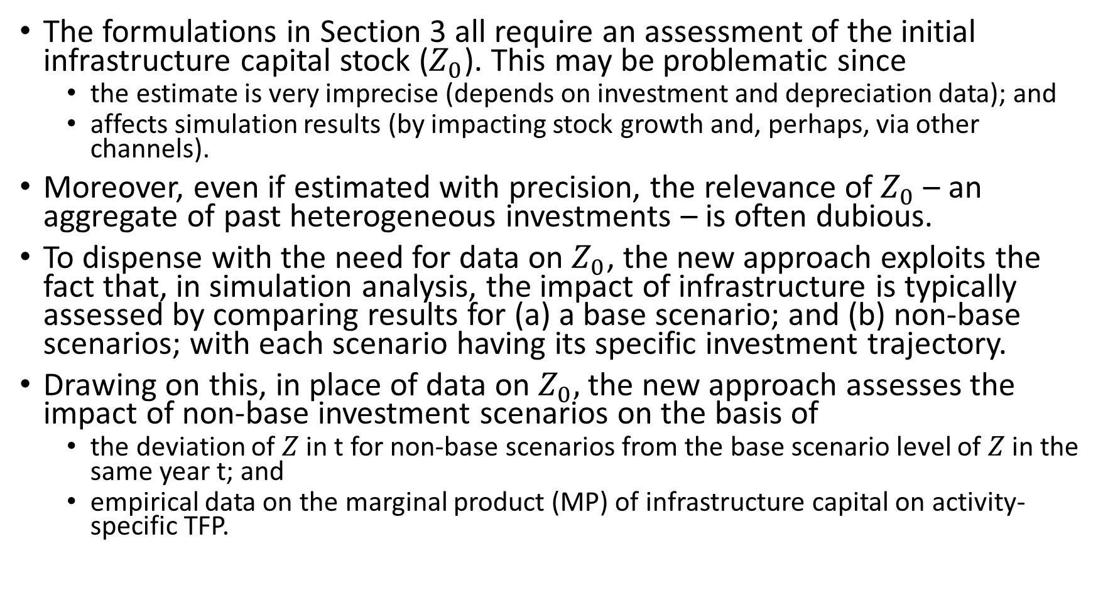
4. A new approach to infrastructure modeling
The formulations in Section 3 all require an assessment of the initial infrastructure capital stock ($Z_{0}$). This may be problematic since
  the estimate is very imprecise (depends on investment and depreciation data); and
  affects simulation results (by impacting stock growth and, perhaps, via other channels).
Moreover, even if estimated with precision, the relevance of $Z_{0}$ – an aggregate of past heterogeneous investments – is often dubious.
To dispense with the need for data on $Z_{0}$, the new approach exploits the fact that, in simulation analysis, the impact of infrastructure is typically assessed by comparing results for (a) a base scenario; and (b) non-base scenarios; with each scenario having its specific investment trajectory.
Drawing on this, in place of data on $Z_{0},$ the new approach assesses the impact of non-base investment scenarios on the basis of
  the deviation of $Z$ in t for non-base scenarios from the base scenario level of $Z$ in the same year t; and
  empirical data on the marginal product (MP) of infrastructure capital on activity-specific TFP.

Slide 11
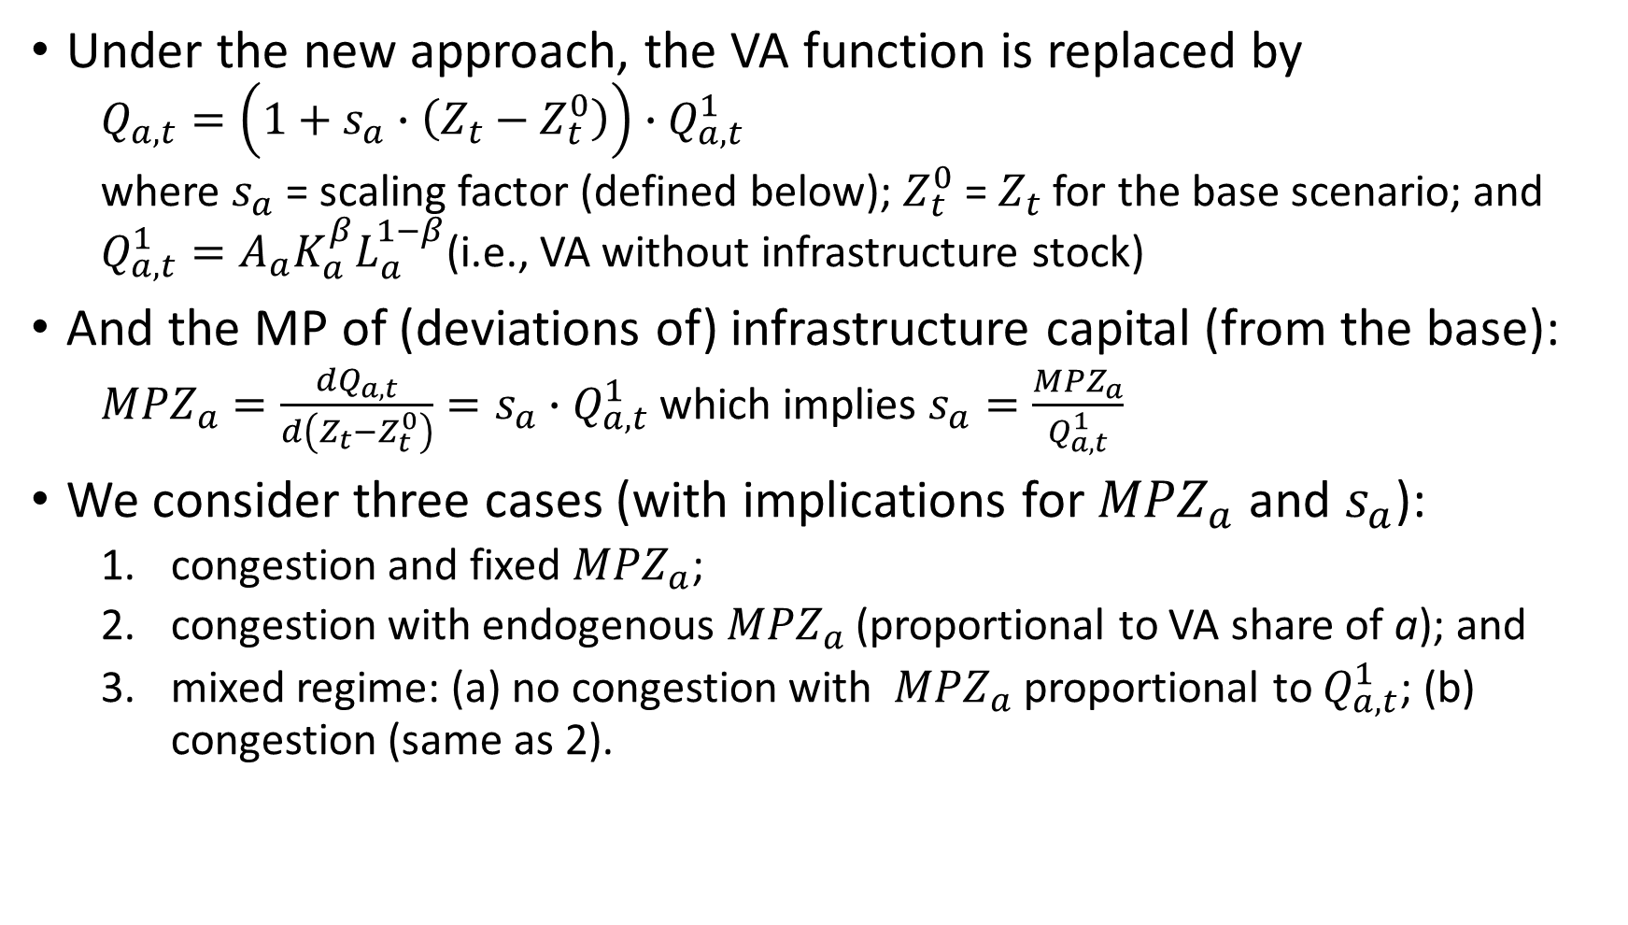
4. A new approach to infrastructure modeling - cont.
Under the new approach, the VA function is replaced by
  $$Q_{a,t}=\left(1+s_{a}∙\left(Z_{t}−Z_{t}^{0}\right)\right)∙Q_{a,t}^{1}$$
  where $s_{a}$ = scaling factor (defined below); $Z_{t}^{0}$ = $Z_{t}$ for the base scenario; and $Q_{a,t}^{1}=A_{a}K_{a}^{β}L_{a}^{1−β}$(i.e., VA without infrastructure stock)
And the MP of (deviations of) infrastructure capital (from the base):
  ${MPZ}_{a}=\frac{{dQ}_{a,t}}{d\left(Z_{t}−Z_{t}^{0}\right)}=s_{a}∙Q_{a,t}^{1}$ which implies $s_{a}=\frac{{MPZ}_{a}}{Q_{a,t}^{1}}$
We consider three cases (with implications for ${MPZ}_{a}$and $s_{a}$):
  congestion and fixed ${MPZ}_{a}$;
  congestion with endogenous ${MPZ}_{a}$(proportional to VA share of a); and
  mixed regime: (a) no congestion with ${MPZ}_{a}$ proportional to $Q_{a,t}^{1}$; (b) congestion (same as 2).

Slide 12
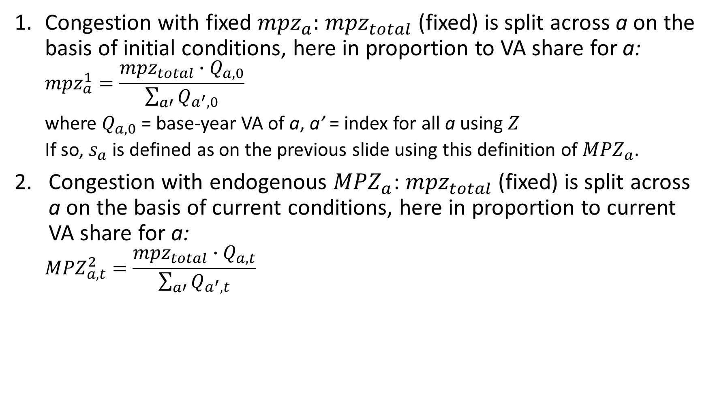
4. A new approach to infrastructure modeling - cont.
Congestion with fixed ${mpz}_{a}:$ ${mpz}_{total}$ (fixed) is split across a on the basis of initial conditions, here in proportion to VA share for a:
  $${mpz}_{a}^{1}=\frac{{mpz}_{total}∙Q_{a,0}}{\sum_{a′}{Q_{a^{′},0}}}$$
  where $Q_{a,0}$ = base-year VA of a, a’ = index for all a using $Z$
  If so, $s_{a}$ is defined as on the previous slide using this definition of ${MPZ}_{a}$.
Congestion with endogenous ${MPZ}_{a}$: ${mpz}_{total}$ (fixed) is split across a on the basis of current conditions, here in proportion to current VA share for a:
  $${MPZ}_{a,t}^{2}=\frac{{mpz}_{total}∙Q_{a,t}}{\sum_{a′}{Q_{a^{′},t}}}$$

Slide 13
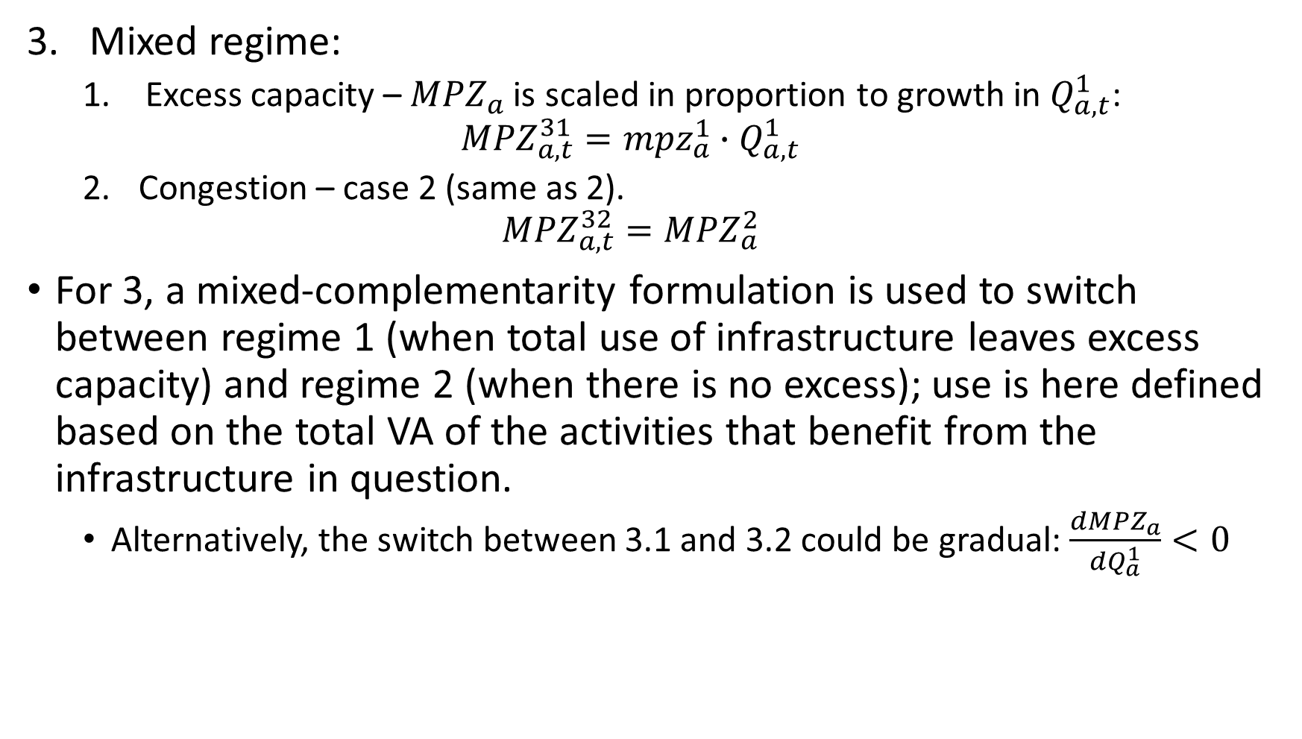
4. A new approach to infrastructure modeling - cont.
Mixed regime:
  Excess capacity – ${MPZ}_{a}$is scaled in proportion to growth in $Q_{a,t}^{1}$:
  $${MPZ}_{a,t}^{31}={mpz}_{a}^{1}∙Q_{a,t}^{1}$$
  Congestion – case 2 (same as 2).
  $${MPZ}_{a,t}^{32}={MPZ}_{a}^{2}$$
For 3, a mixed-complementarity formulation is used to switch between regime 1 (when total use of infrastructure leaves excess capacity) and regime 2 (when there is no excess); use is here defined based on the total VA of the activities that benefit from the infrastructure in question.
  Alternatively, the switch between 3.1 and 3.2 could be gradual: $\frac{d{MPZ}_{a}}{dQ_{a}^{1}}<0$

Slide 14
5. Implementing the new approach
The analysis is based on different variants of a simple two-sector (agriculture [a-agr] and non-agriculture [a-nagr]) model focused on the VA function, updated on the basis of exogenous growth in employment of labor and activity-specific capital, and in the economywide infrastructure capital stock.
The model variants represent the standard approach (from Section 3, here called case 0) and cases 1-3 (from Section 4).
Results are compared for a base scenario and a non-base scenario with more infrastructure investment than in the base.

Slide 15
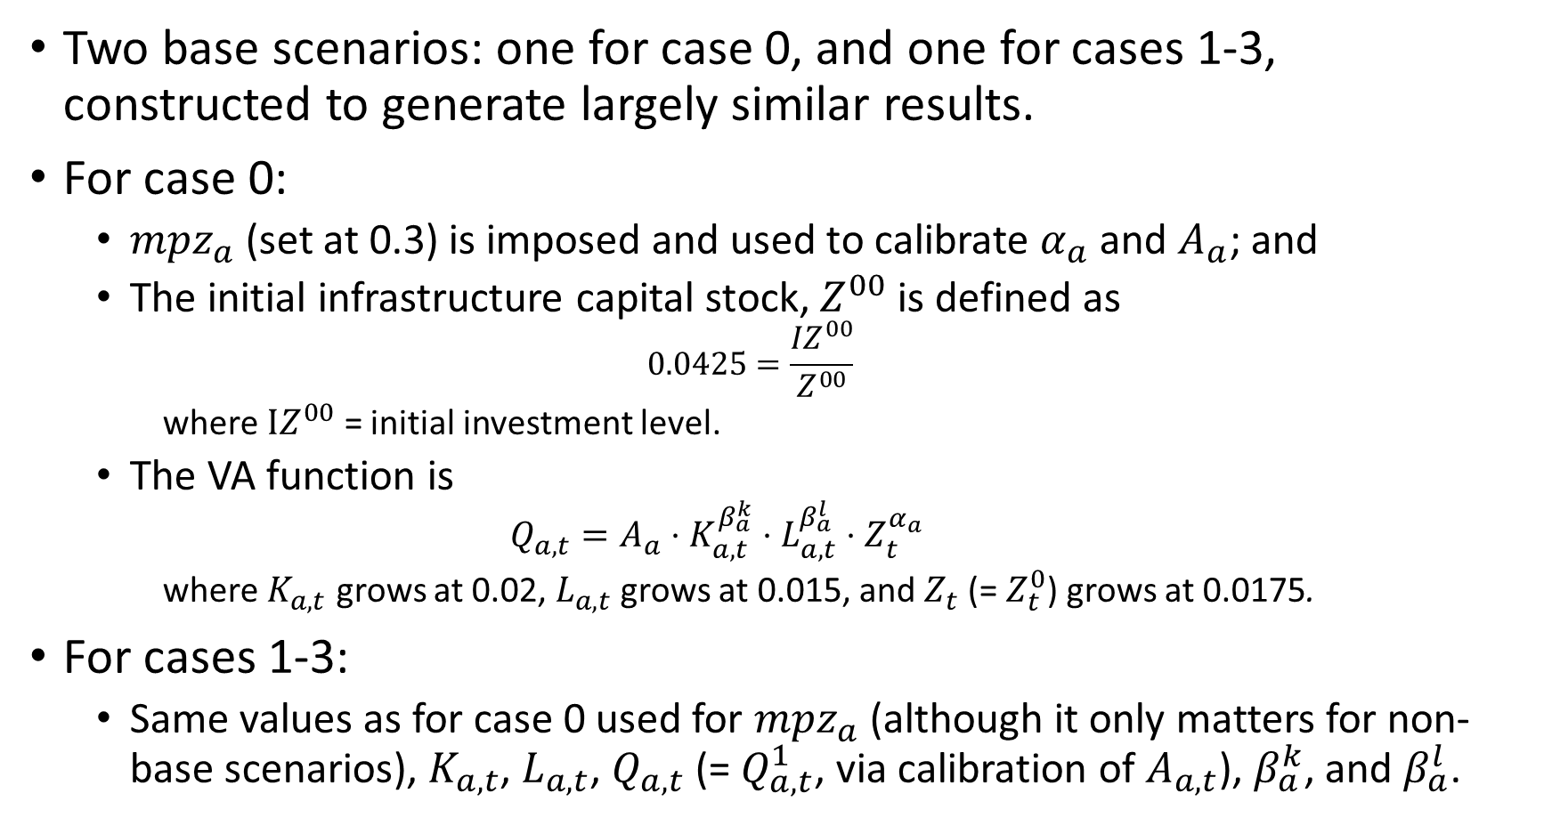
Calibration of base scenario and parameters
Two base scenarios: one for case 0, and one for cases 1-3, constructed to generate largely similar results.
For case 0:
  ${mpz}_{a}$(set at 0.3) is imposed and used to calibrate $α_{a}$ and $A_{a}$; and
  The initial infrastructure capital stock, $Z^{00}$ is defined as
  $$0.0425=\frac{{IZ}^{00}}{Z^{00}}$$
    where $IZ^{00}$ = initial investment level.
  The VA function is
    $$Q_{a,t}=A_{a}⋅K_{a,t}^{β_{a}^{k}}⋅L_{a,t}^{β_{a}^{l}}⋅Z_{t}^{α_{a}}$$
    where $K_{a,t}$ grows at 0.02, $L_{a,t}$ grows at 0.015, and $Z_{t}$ (= $Z_{t}^{0}$) grows at 0.0175.
For cases 1-3:
  Same values as for case 0 used for ${mpz}_{a}$(although it only matters for non-base scenarios), $K_{a,t}$, $L_{a,t}$, $Q_{a,t}$ (= $Q_{a,t}^{1}$, via calibration of $A_{a,t}$), $β_{a}^{k}$, and $β_{a}^{l}$.

Slide 16
Non-base scenario
A single non-base scenario is imposed on all 4 cases:
  a 25% increase in infrastructure investment compared to base in years 1-15 (no change in year 0)
In the following presentation of results, c0, c1, c2, and c3 refer to results for the non-base scenarios under cases 0-3.

Slide 17
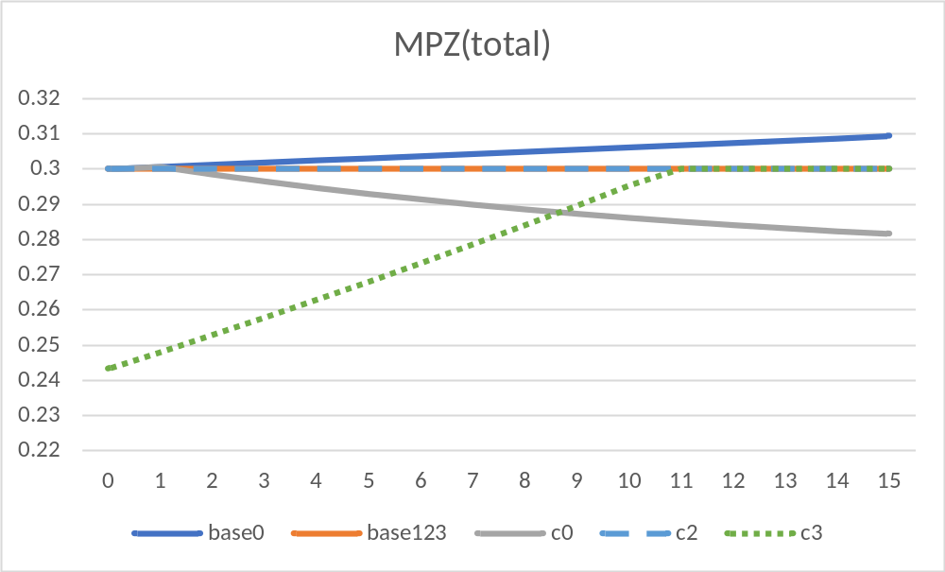
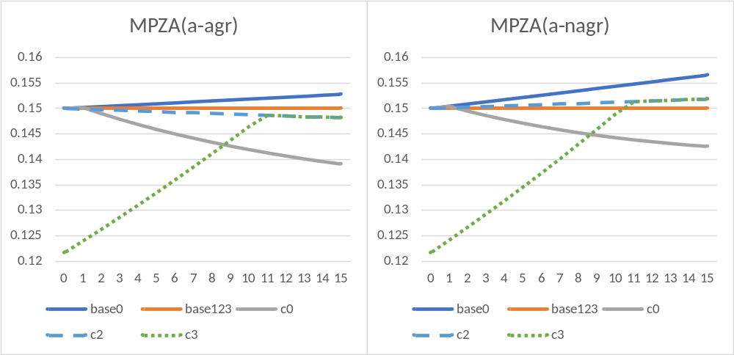
Non-base scenario: MPZ(total) and MPZ(a)

Slide 18
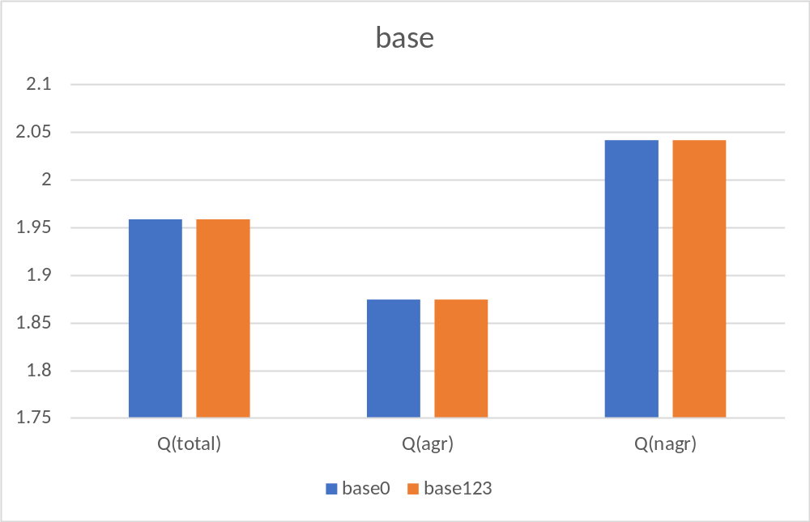
Base: total and sectoral VA – avg. growth/year periods 0-15 (%)

Slide 19
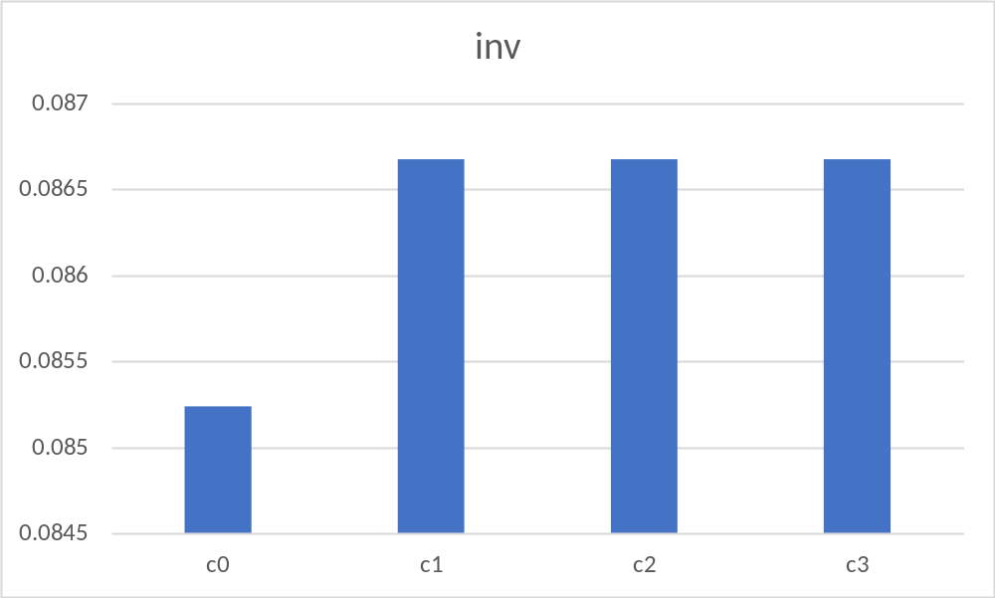
Total VA – avg. growth/year periods 0-15
(%-age point deviation from base)

Slide 20
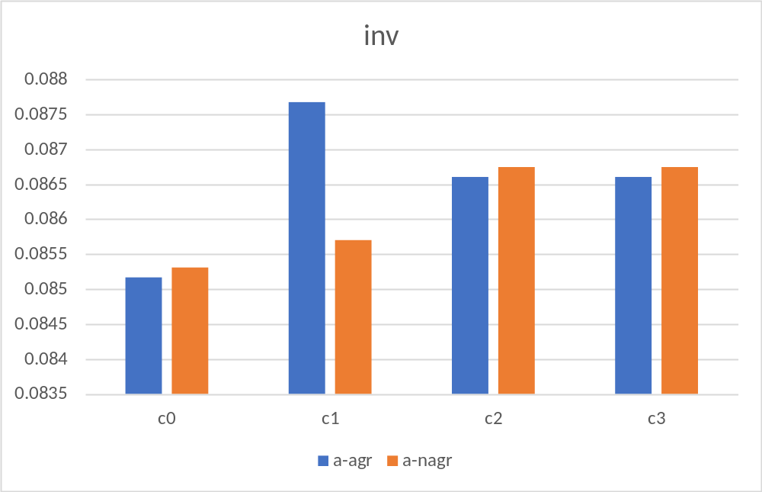
Sectoral VA -- avg growth/year periods 0-15 (%-age point deviation from base)

Slide 21
6. Concluding remarks
This presentation describes alternative approaches to the analysis of the impact of infrastructure investments in their economywide context.
Empirical data tend to be sketchy and aggregate, available as VA elasticities, marginal VA products, historical investment flows and, to a lesser extent, infrastructure stocks and depreciation rates.
In general, for the simple model and scenarios presented here, it is possible to generate identical or very similar results for the different approaches.
Criteria for approach selection: transparency, limited data needs, and ability to capture economic impacts of infrastructure investments under relevant alternative assumptions informed by empirical data.
Assumptions may differ along multiple dimensions, including:
  subsets of activities that benefit;
  strength of these benefits, initially and over time; and
  role of congestion: are the infrastructure services available with excess capacity or is congestion, at least potentially, an issue? If congestion is an issue, does it appear gradually or only once the service is fully utilized?

Slide 22
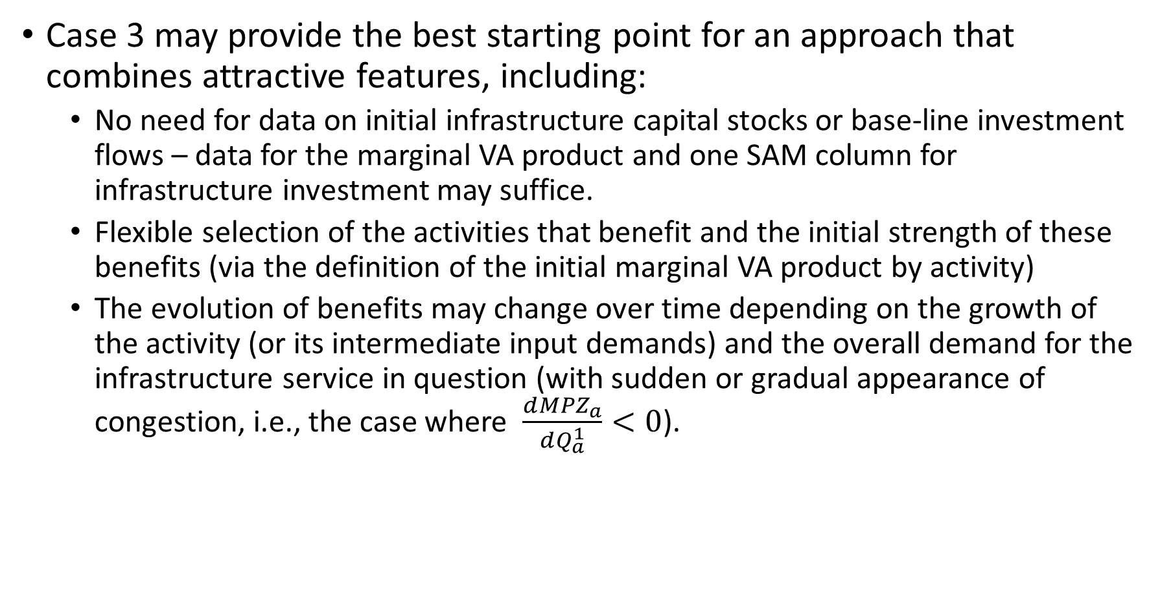
6. Concluding remarks – cont.
Case 3 may provide the best starting point for an approach that combines attractive features, including:
  No need for data on initial infrastructure capital stocks or base-line investment flows – data for the marginal VA product and one SAM column for infrastructure investment may suffice.
  Flexible selection of the activities that benefit and the initial strength of these benefits (via the definition of the initial marginal VA product by activity)
  The evolution of benefits may change over time depending on the growth of the activity (or its intermediate input demands) and the overall demand for the infrastructure service in question (with sudden or gradual appearance of congestion, i.e., the case where $\frac{d{MPZ}_{a}}{dQ_{a}^{1}}<0$).

Slide 23
References
Adam, C.S., and D. L. Bevan. 2006. Aid and the supply side: Public investment, export performance, and Dutch disease in low-income countries. World Bank Economic Review, Vol. 20, no. 2, pp. 261-290.
Agénor, P.-R. 2010. A theory of infrastructure-led development. Journal of Economic Dynamics and Control, Vol. 34. pp. 932–950.
Agénor, P.-R., N. Bayraktar, and K. El Aynaoui. 2005. Roads out of Poverty? Assessing the Links between Aid, Public Investment, Growth, and Poverty Reduction. World Bank Policy Research Working Paper 3490.
Boccanfuso, D., M. Joanis, P. Richard, and L. Savard. 2014. A comparative analysis of funding schemes for public infrastructure spending in Quebec, Applied Economics, Vol. 46, Issue 22, pp. 2653-2664.
Buffie, E. E., A. Berg, C. Pattillo, R. Portillo, and L.-F. Zanna. 2012. Public Investment, Growth, and Debt Sustainability: Putting Together the Pieces. IMF Working Paper WP/12/144.
Calderón, C., and L. Servén. 2014. Infrastructure, Growth, and Inequality: An Overview. World Bank Policy Research Working Paper 7034.
Chitiga, M., R. Mabugu, and H. Maisonnave. 2016. Analysing job creation effects of scaling up infrastructure spending in South Africa, Development Southern Africa.
Cicowiez, M., and H. Lofgren. 2017. A GEM for streamlined dynamic CGE analysis: structure, interface, data, and macro application. World Bank Policy Research Working Paper 8272.
Pinto Moreira, E., and N. Bayraktar. 2008. Foreign aid, growth and poverty: A policy framework for Niger. Journal of Policy Modeling.

