Slide 1
GTAP 2022 conference
How well have free trade agreements performed in reducing non-tariff measures? Estimation using the gravity model of international trade

Slide 2
Background and context
Changes in non-tariff measures (NTMs) key input for CGE modelling.
NTMs (and their changes) challenging to estimate, especially on a disaggregated level and as a result of a particular FTA.
Blanked reduction assumptions in NTMs relied upon as a result.
Our approach follows that of Baier et al (2019) in estimating the impact of FTAs on reducing NTMs.
We contribute to the existing literature in two ways;
        By breaking down the traditional group of “trade costs” into tariff and NTMs.
        Estimating NTMs on sectorial level (GTAP65)
We do this by looking at three scenarios; ‘average FTA’, ‘EU-Korea’ and ‘US-Korea’
Ultimate goal is to explore new methodologies for NTM estimation, which can be tailored to the contents of specific FTAs.

Slide 3
High-level conclusions
The results outlined in this presentation are those of an estimation exercise, i.e. before accounting for general equilibrium effects.
‘Average’ FTA scenario gives us results of lower magnitude, goods NTMs behave more ‘in line’ with expectations of FTA effect (NTM reduction) compared to individual FTAs (US-Korea, EU-Korea).
The results of both individual FTAs we examine (EU-Korea and US-Korea) are broadly in line with what the FTAs were expected to deliver in sectors that were the focus of the agreements.
We see some NTM increases, mainly in services sectors, likely to the limited number of observation in our data and the nature of ITPD-E to GTAP65 mapping.
Further work needed to make this fully operational in the context of CGE modelling (mainly to resolve the issue of insignificant results and NTM increases).

Slide 4
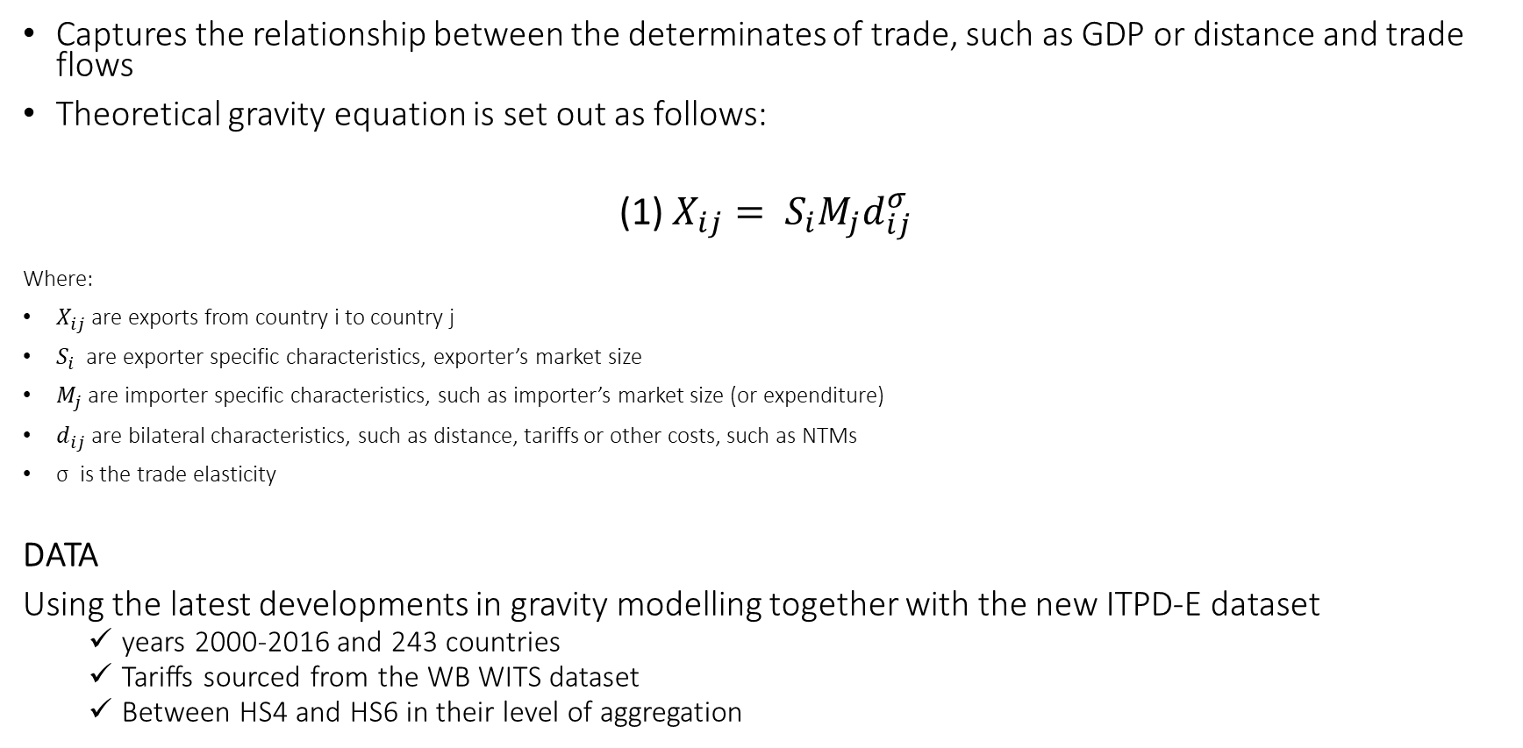
The gravity model of international trade
Captures the relationship between the determinates of trade, such as GDP or distance and trade flows
Theoretical gravity equation is set out as follows:
(1) $X_{ij}= S_{i}M_{j}d_{ij}^{σ}$
Where:
$X_{ij}$ are exports from country i to country j
$S_{i}$ are exporter specific characteristics, exporter’s market size
$M_{j}$ are importer specific characteristics, such as importer’s market size (or expenditure)
$d_{ij}$ are bilateral characteristics, such as distance, tariffs or other costs, such as NTMs
σ is the trade elasticity
DATA
Using the latest developments in gravity modelling together with the new ITPD-E dataset
  years 2000-2016 and 243 countries
  Tariffs sourced from the WB WITS dataset
  Between HS4 and HS6 in their level of aggregation

Slide 5
Gravity challenges and how to overcome them
Unobserved multilateral resistance terms (gravity theory), omitted variable bias
  Our regression uses importer-year and exporter-year fixed effects to account for these. These capture time-invariant country characteristics.
Endogeneity, omitted variable bias
  Using pair fixed effects, our model controls for the relationship between two countries, including distance or historical links. This reduces endogeneity.
  Using the following adjustment formula, we also adjust endogeneity of tariffs:
Zero trade flows and heteroskedasticity
  Using PPML (Poisson Pseudo Maximum Likelihood) estimator
Effects of globalisation
  Including intranational trade and a globalisation dummy interacted with a border variable.
$\left(2\right)\frac{X_{ij}}{{(1+τ_{ij})}^{σ}}= X_{i}M_{j}d_{ij}^{σ}$

Slide 6
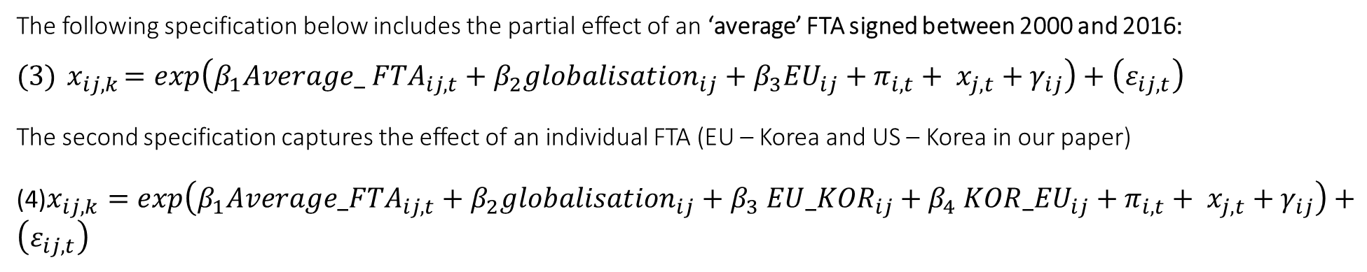
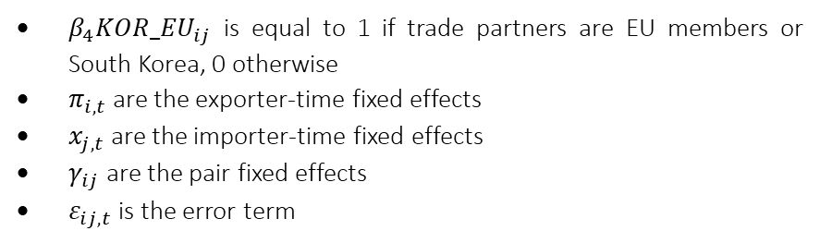

Model specification
The following specification below includes the partial effect of an ‘average’ FTA signed between 2000 and 2016$:$
$$(3){ x}_{ij,k}=exp\left(β_{1}{Average_ FTA}_{ij,t}+β_{2}{globalisation}_{ij}+β_{3}{EU}_{ij}+π_{i,t}+ x_{j,t}+γ_{ij}\right)+\left(ε_{ij,t}\right)$$
The second specification captures the effect of an individual FTA (EU – Korea and US – Korea in our paper)
(4)$x_{ij,k}=exp\left(β_{1}{Average_FTA}_{ij,t}+β_{2}{globalisation}_{ij}{+ β}_{3}{EU_KOR}_{ij}{+ β}_{4}{KOR_EU}_{ij}+π_{i,t}+ x_{j,t}+γ_{ij}\right)+\left(ε_{ij,t}\right)$
Where:
$x_{ij,k}$ is a trade flow between I and j in sector k
$β_{1}{Average_FTA}_{ij}$ is equal to 1 if i and j have signed an FTA at time t and 0 otherwise
$β_{2}{globalisation}_{ij}$ is equal to year at time t if exporter and importer differ, 0 otherwise to control for effects of openness, effectively creating another fixed effect variable.
$β_{3}{EU}_{ij}$ is equal to 1 if exporter and importer are both EU members, 0 otherwise
$β_{4}{KOR_EU}_{ij}$ is equal to 1 if trade partners are EU members or South Korea, 0 otherwise
$π_{i,t}$ are the exporter-time fixed effects
$x_{j,t}$ are the importer-time fixed effects
$γ_{ij}$ are the pair fixed effects
$ε_{ij,t}$ is the error term
Notes:
‘Average FTA’ variable in specification (1):
Residual removal of barriers other than tariffs
Change in NTMs following an ‘average FTA’ signed between 2000 – 2016
Results relative to “pre-FTA” state of the world between two partners
Effect excludes the impact of EU membership, which we control for in specification (1)
Partial effect (before third-country impacts are accounted for)
‘Individual FTAs’ in specification (2):
Residual removal of barriers other than tariffs
Directional impacts of FTAs (EU-Korea, US-Singapore) on NTMs
Results relative to “pre-FTA” state of the world between two partners (EU-Korea after the FTA came into effect vs. prior to 2011 when the agreement was signed)
Controlling for all other FTAs those countries signed (using the FTA dummy)
Partial effect (before third-country impacts are accounted for)

Slide 7
Limitations
Allowing for sectorial and FTA heterogeneity increases ‘noisiness’ of results due to fewer observations in our data.
Results should be interpreted as partial before third-country effects are accounted for.
Reductions in NTMs faced by exporters after an FTA comes into effect are inferred from changes in trade flows. It could be that a removal of NTMs does not directly translate into an increase in trade flows.
Despite controlling for it via fixed effects and tariff adjustment, some endogeneity could remain in our estimates.
FTA effects on trade flows may take a few years to transpire.
Elasticities used are GTAP Armingtons on GTAP65 level, tariff adjustment uses ‘trade elasticities’.

Slide 8
Results
Notes:
Statistically significant results are presented for presentational purposes

Slide 9
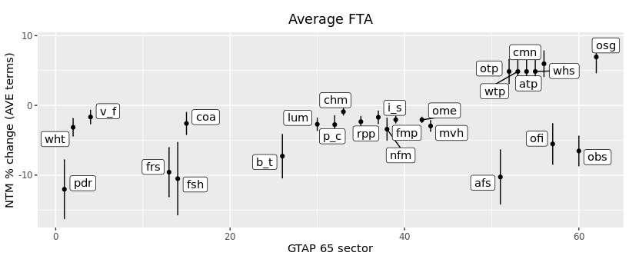
Average FTA results (AVE terms)
FTAs have reduced NTMs in agricultural sectors the most, some service sectors also saw a reduction.
This included rice (12.03%), fishing (10.51%) and forestry (9.58%).
The smallest NTM reductions were in chemicals, vegetables and fruit (v_f) and iron and steel (i_s).
NTM reductions in manufacturing sectors were clustered close together; most of them were in the range from 0.91% to 3.41% (AVE terms).
NTM increases mostly in services – noisiness of results due to granularity, fewer observations and ITPD-E to GTAP65 mapping.
Goods
Services

Slide 10
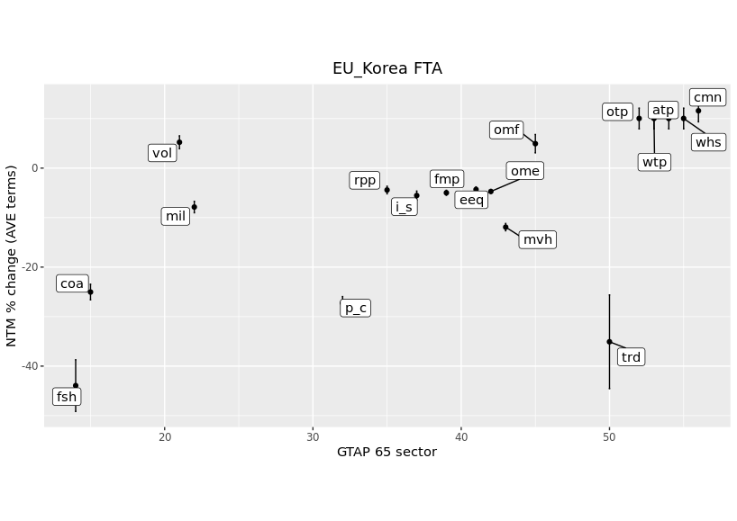
EU exports to Korea
Signed in 2009, applied from 2011
NTMs targeted mainly in automotive, pharmaceutical, medical devices and electronics sectors
NTM reductions in the automotive sector (mvh) of 11.92% (in AVE terms)
Electronics sector (eeq) of 4.31% in (AVE terms)
Services results mostly insignificant
Mostly in line with ex-ante expectations
Goods
Services
Notes:
To mention: ), a sizable portion (1/3) of the variation amongst FTAs originates from the is due to asymmetric effects “within pairs”. We therefore also allow for the effect of the FTA to vary directionally by including a dummy for directional pairs. The coefficients on the EU_KOR and KOR_EU variables can now be interpreted as the NTM reduction or increase faced by the EU when exporting to Korea and reduction or increase experienced by Korea when exporting to the EU respectively.

Slide 11
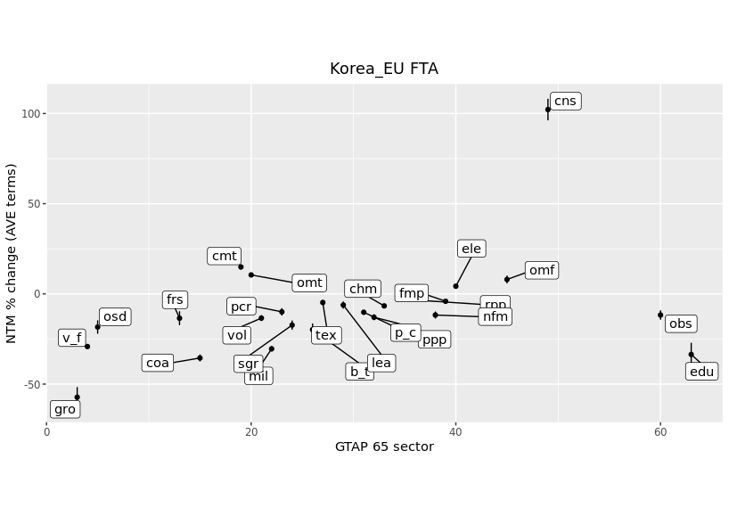
Korea exports to EU
Chemicals (chm) saw a reduction in NTMs of 6.65% and agricultural sectors experienced reductions in all significant NTMs, as high as 57.3% in ‘other grains’ (gro).
Korean exporters faced an increase in NTMs in the electronics sector (ele) of 4.26% (AVE terms) while the automotive sector came out as insignificant.
Goods
Services

Slide 12
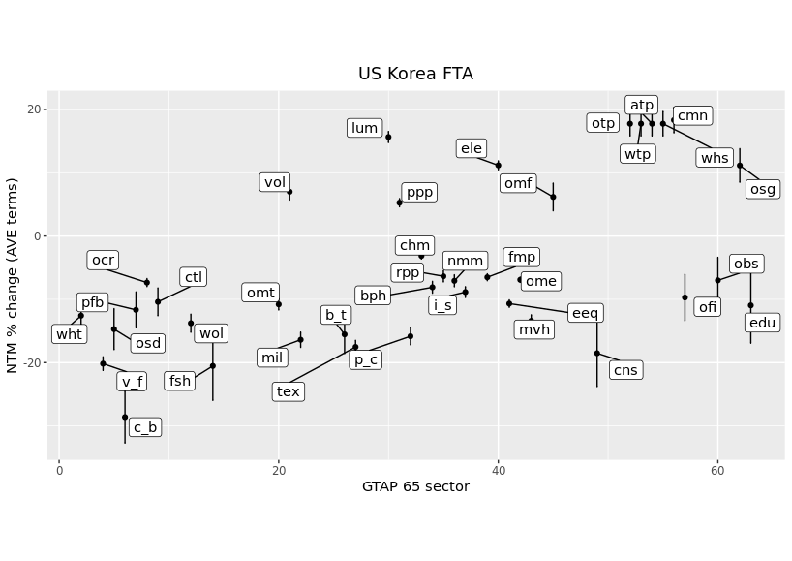
US exports to Korea
Came into force in 2012
Most NTM clauses were drafted to have a cross-sectoral impact
Aimed to harmonise automotive and testing standards
Data flow transfer liberalisation applied across services sectors, including finance and legal.
automotive sector (mvh) NTM were reduced by 13.4% as well manufacturing and electronics sectors (eeq, ome).
The FTA also lowered NTMs in agricultural sectors.
Reduction in other business services (obs) and financial services (ofi) NTM are as expected ex-ante and could be a result of IP or data flow transfer liberalisation.
Goods
Services

Slide 13
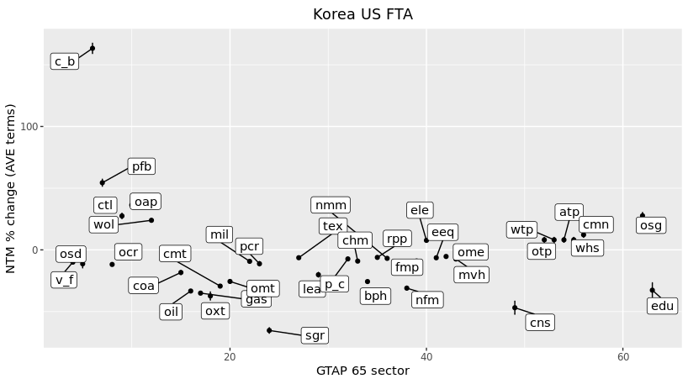
Korea exports to US
NTMs in the automotive sector (mvh) decreased by 7.39% in AVE terms as well as manufacture of machinery and equipment (ome)
The electronic manufacturing sector (eeq) saw a fall in NTMs of 6.41%
Manufacturing of computers (ele) saw an increase of 7.71%
Services sectors saw mostly an increase in NTMs, except for the education sector (edu).
Financial and business services came out as insignificant.
Goods
Services

Slide 14
Conclusion
Our model estimates the homogeneous impact of past FTAs on NTMs across GTAP65 sectors in three FTA scenarios with the aim to move away from blanked reductions.
‘Average’ FTA scenario gives us results of lower magnitude, goods NTMs behave more ‘in line’ with expectations of FTA effect (NTM reduction) compared to individual FTAs (US-Korea, EU-Korea).
The results of both individual FTAs we examine (EU-Korea and US-Korea) are broadly in line with what the FTAs were expected to deliver in sectors that were the focus of the agreements.
We see some NTM increases, mainly in services sectors, likely to the limited number of observation in our data and the nature of ITPD-E to GTAP65 mapping.
Overall, the impact on manufacturing sectors seems to be consistent across the three scenarios (slight reductions compared to agricultural sectors and services).
Further work needed to make this fully operational in the context of CGE modelling (mainly to resolve the issue of insignificant results and NTM increases).

