Slide 1
DOES NATURAL RESOURCES ENDOWMENT AFFECT EXPORT DIVERSIFICATION IN AFRICA? A CROSS-COUNTRY ANALYSIS
25th Annual Conference on Global Economic Analysis
"Accelerating Economic Transformation, Diversification and Job Creation"
Presented by:
Dieynaba NIASS
Faculty of Economics and Management (FASEG)
Cheikh Anta Diop University,
Dakar, Senegal
Virtual Conference
JUNE-2022

Slide 2
outline
Research issue
Objectives
Methodology and data
Results
Implications and Recommendations

Slide 3
RESEARCH ISSUE (1/4)
Africa is well endowed in natural resources:
  Minerals: around 30% of the world's mineral reserves with 8% and 7% for oil and natural gas (IDEA, 2017)
  Agriculture: 57% of labor force and source of income of 90% of the rural population(Kanu et al., 2014).
  In Africa, more than 45 countries have proven reserves of oil and/or natural gas (AfDB, 2015).
  Central Africa: 47% of its GDP
  North Africa: 30% of regional GDP
  West Africa: region that has the highest percentage of arable land
  East Africa: the most deprived part of the continent

Slide 4
RESEARCH ISSUE (2/4)
Natural resources occupy an important place in trade of Africa:
AfDB (2016):
Minerals: 70% of total export volume and around 28% of Africa's GDP
Oil rents: represent more than 50% of GDP.
For the African countries concerned, these natural endowments play an important role:
Structure of domestic production
Profile of their international trade

Slide 5
RESEARCH ISSUE (3/4)
Negative effects on:
The structural composition of sectoral productive activities
The international exchange of the countries
Slow down the process of economic emergence
The abundance of natural resources seems to go hand in hand with poor diversification (Jetter and Hassan, 2012).
Thus reflecting a phenomenon of resource curse (Sach and Warner, 1995 and 2001; Auty, 2001)

Slide 6
RESEARCH ISSUE (4/4)
The channels
Institutional degradation: Quality of institutions (Tornell and Lane, 1999; Leite and Weidmann, 1999, Belarbi et al. 2015; Devarajan et al., 2019 ).
RER: crowd out the industrial sector in developed countries (Ploeg, 2010), and the agricultural sector in developing countries (Liman et al., 2014): Dutch Disease
Africa’s large natural endowments may suggest that they have a negative impact on the possibility of diversifying trade.
Question:
  Does the abundance of natural resources constitute a brake on the diversification of African economies?

Slide 7
OBJECTIVES
Analyze the effect of natural resources on the diversification of Africa’s exports supply portfolio.
Specifically:
  Measure the extent of diversification or the concentration of exports in terms of product variety,
  Analyze the effect of natural resources on diversification of African exports,
  Identify eventual channels through which natural resources would affect the supply portfolio of African exports.

Slide 8
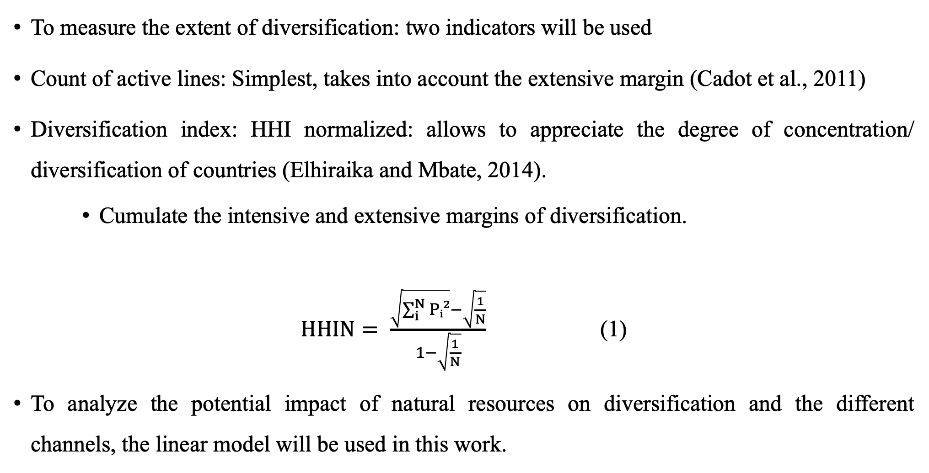
METHODOLOGY AND DATA (1/3)
To measure the extent of diversification: two indicators will be used
Count of active lines: Simplest, takes into account the extensive margin (Cadot et al., 2011)
Diversification index: HHI normalized: allows to appreciate the degree of concentration/ diversification of countries (Elhiraika and Mbate, 2014).
    Cumulate the intensive and extensive margins of diversification.
$HHIN= \frac{\sqrt{\sum_{i}^{N}{Pᵢ²}}−\sqrt{\frac{1}{N}}}{1−\sqrt{\frac{1}{N}}}$ (1)
To analyze the potential impact of natural resources on diversification and the different channels, the linear model will be used in this work.

Slide 9
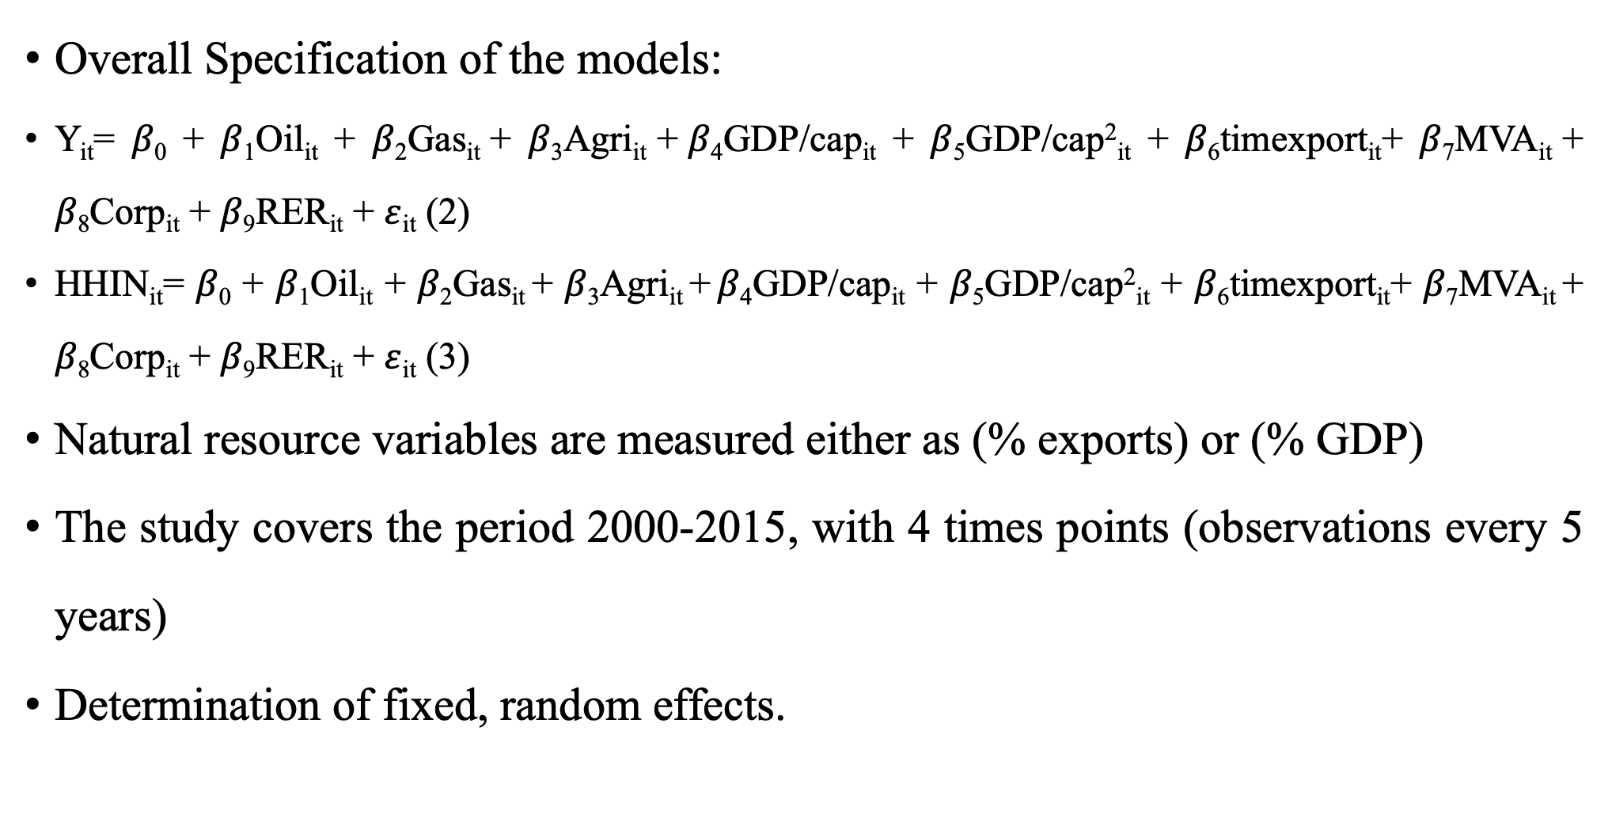
METHODOLOGY AND DATA(2/3)
Overall Specification of the models:
Y_{it}= 𝛽₀ + 𝛽₁Oil_{it} + 𝛽₂Gas_{it} + 𝛽₃Agri_{it} + 𝛽₄GDP/cap_{it} + 𝛽₅GDP/cap²_{it} + 𝛽₆timexport_{it}+ 𝛽₇MVA_{it} + 𝛽₈Corp_{it} + 𝛽₉RER_{it} + $ε$_{it} (2)
HHIN_{it}= 𝛽₀ + 𝛽₁Oil_{it} + 𝛽₂Gas_{it} + 𝛽₃Agri_{it} + 𝛽₄GDP/cap_{it} + 𝛽₅GDP/cap²_{it} + 𝛽₆timexport_{it}+ 𝛽₇MVA_{it} + 𝛽₈Corp_{it} + 𝛽₉RER_{it} + $ε$_{it} (3)
Natural resource variables are measured either as (% exports) or (% GDP)
The study covers the period 2000-2015, with 4 times points (observations every 5 years)
Determination of fixed, random effects.

Slide 10
METHODOLOGY AND DATA(3/3)
Sources of data
Variables | Definition | Sources
Trade by Product | Export of each african countries | COMTRADE
GDP per capita | Allow to mesure the level of economic development of countries | World Development Indicator /World Bank
Manufacturing added value%GDP | Captures the diversification of the productive structure | World Development Indicator /World Bank
Lead time to export | Provides information on the time and speed of export | Logistics Performance Index (LPI) /World Bank
Corruption perception index | Provides information on the role that institutions can play in the process of country diversification | Transparency International
Real exchange rate | The monetary value of an area and capture the effect of Dutch Disease | UNCTAD
Oil and natural Gas production | Weight of these sectors in export volume and the national production | Energy Information administration (EIA)
Oil and Gas prices | Allow to calculate totale production (in US $) ) | BP Statistical Review of World Energy
Agricultural production(US $) | Capture the main agricultural products suitable for processing | FAOStats

Slide 11
DESCRIPTION OF DATA (1/2)

Slide 12
DESCRIPTION OF THE DATA (2/2)

Slide 13
RESULTS (1/5)
Table 1: Overall results
VARIABLES | COUNT | HHIN
Oil/Export | -26.59* | 0.84**
 | (15.09) | (0.37)
Oil/GDP | 11.56 | -0.14
 | (7.75) | (0.19)
Gas/Export | -39.28 | 1.26
 | (34.84) | (0.85)
Gas/GDP | 24.35 | 0.31
 | (22.84) | (0.56)
Agri/Export | -13.42*** | 0.13
 | (3.70) | (0.09)
Agri/GDP | -3.01 | -0.29
 | (15.54) | (0.38)
GDP per capita | 0.11 | -0.00
 | (0.10) | (0.00)
GDP per capita squared | -0,00 | 0.00
 | (0.00) | (0.00)
Corruption | 14.37* | 0.09
 | (7.39) | (0.20)
RER | 1.70* | -0.01
 | (0.96) | (0.02)
Manufacturing added value | 15.94 | 0.10
 | (15.17) | (0.37)
Lead time to export | 12.45 | -0.75
 | (31.50) | (0.77)
Constant | 696.23 | 36.60***
 | (422.44) | (10.31)
Observations | 164 | 164
Prob>F | 0.0000*** | 0.0876*
Within | 0.3070 | 0.1811
Between | 0.2830 | 0.2369
Year dummies | Yes | Yes
Notes: standard errors in parentheses
* Significant at 10%
** Significant at 5%
*** Significant at 1%

Slide 14
RESULTS (2/5)
Table2: Results relative to exports
VARIABLES | COUNT | HHIN
Oil/Export | -10.774 | 0.83**
 | (13.232) | (0.32)
Gas/Export | -17.434 | 1.37**
 | (32.789) | (0.81)
Agri/Export | -14.339*** | 0.13
 | (3.570) | (0.09)
GDP per capita | 0.145** | -0.00
 | (0.063) | (0.00)
GDP per capita squared | -0.00** | 0.00
 | (0.00) | (0.00)
Corruption | 16.052** | 0.06
 | (7.295) | (0.20)
RER | 1.657* | -0.01
 | (0.947) | (0.02)
Manufacturing added value | 8.631* | 0.21
 | (13.323) | (0.34)
Lead time to export | -2.711 | -0.63
 | (27.813) | (0.75)
Constant | 720.661** | 33.50***
 | (358.337) | (9.67)
Observations | 164 | 164
Prob>F | 0.000** | 0.0400**
Within | 0.2655 | 0.1714
Between | 0.3326 | 0.2374
Year dummies | Yes | Yes
Notes: standard errors in parentheses
* Significant at 10%
** Significant at 5%
*** Significant at 1%

Slide 15
RESULTS (3/5)
Table 3: results relative to GDP
VARIABLES | COUNT | HHIN
Oil/GDP | 6.79 | 0.00
 | (7.58) | (0.18)
Gas/GDP | 6.95 | 0.75
 | (221.72) | (0.54)
Agri/GDP | -0.60 | -0.37
 | (16.31) | (0.38)
GDP per capita | 0.06 | -0.00
 | (0.10) | (0.00)
GDP per capita squared | -0.00 | 0.00
 | (0.00) | (0.00)
Corruption | 17.36** | -0.00
 | (8.65) | (0.20)
RER | 2.48** | -0.02
 | (0.99) | (0.02)
Manufacturing added value | 14.65 | 0.22
 | (14.96) | (0.35)
Lead time to export | -2.13 | -0.37
 | (33.01) | (0.78)
Constant | 158.89 | 46.58***
 | (399.10) | (9.43)
Observations | 164 | 164
Prob>F | 0.0085*** | 0.2118
Within | 0.2059 | 0.1257
Between | 0.1457 | 0.0360
Year dummies | Yes | Yes
Notes: standard errors in parentheses
* Significant at 10%
** Significant at 5%
*** Significant at 1%

Slide 16
RESULTS (4/5)
Table 4: Institutional and exchange rate channels and individual resources
Variables |  | 1 | 2 | 3 | 4
 | Oil/Export | -0.24** |  | -0.60
 |  | (0.14) |  | (1.21)
 | Gas/Export | 0.235 |  | -0.49
 |  | (0.392) |  | (3.12)
 | Agri/Export | -0.004 |  | -0.77** (0.34)
 |  | (0.04) | 0.06 |  | -0.31
 | Oil/PIB |  | (0.07) |  | (0.64)
 |  |  | 0.15 |  | 0.24
 | Gas/PIB |  | (0.22) |  | (1.94)
 | Agri/PIB |  | 0.33* |  | -0.42
 |  |  | (0.17) |  | (1.49)
 | Constant | 34.61*** | 30.40*** | 122.91*** | 107.62***
 |  | (1.441) | (1.08) | (15.89) | (9.42)
 | Observations | 164 | 164 | 164 | 164
 | Prob>F | 0.000*** | 0,000*** | 0.0799* | 0.3723
 | Within | 0.2996 | 0,3009 | 0.0905 | 0.0530
 | Between | 0.1068 | 0,1394 | 0.0885 | 0.0146
 | Year dummies | Yes | Yes | Yes | Yes
Notes: standard errors in parentheses
* Significant at 10%
** Significant at 5%
*** Significant at 1%

Slide 17
RESULTS (5/5)
Table 5: Overall estimation (with lagged variables)
VARIABLES | COUNT | HHIN
Oil/Export_lag | -35.49** | 0.19
 | (14.390) | (0.37)
Oil/GDP_lag | -6.45 | -0.03
 | (7.12) | (0.18)
Gas/Export_lag | -48.48 | 0.11
 | (45.44) | (1.14)
Gas/GDP_lag | 41.02* | -0.69
 | (22.41) | (0.56)
Agri/Export_lag | 5.04 | -0.07
 | (3.73) | (0.09)
Agri/GDP_lag | -31.39 | 0.17
 | (16.38) | (0.41)
GDP per capita | 0.05 | -0.00
 | (0.09) | (0.003)
GDP per capita squared | -0,00 | 0.00
 | (0.00) | (0.00)
Corruption | 19.25** | -0.02
 | (8.52) | (0.21)
RER | 2.29* | -0.03
 | (1.29) | (0.03)
Manufacturing added value | 13.17 | 0.37
 | (14.03) | (0.35)
Lead time to export | -4.29 | -0.56
 | (32.31) | (0.81)
Constant | 594.84 | 48.32***
 | (475.49) | (11.90)
Observations | 160 | 160
Prob>F | 0.0007*** | 0.4743
Within | 0.2939 | 0.1236
Between | 0.1006 | 0.724
Year dummies | Yes | Yes
Notes: standard errors in parentheses
* Significant at 10%
** Significant at 5%
*** Significant at 1%

Slide 18
IMPLICATIONS ET RECOMMANDATIONS(1/3)
These results imply that:
From the Exports point of view:
The presence of oil and agritural resources act negatively on diversification
From the point of view of economic activity (% GDP):
The presence of resources does not act on diversification

Slide 19
IMPLICATIONS ET RECOMMANDATIONS(2/3)
Channels:
Results show that channels capture the negative effect of natural resources (oil and agriculture) if they are analyzed from an export perspective
The negative effect of oil only goes through the channel of the degradation of institutions
That of agricultural resources through the exchange rate channel.

Slide 20
IMPLICATIONS ET RECOMMANDATIONS(3/3)
To reduce resource dependence, African states must:
Strengthen their level of institution by fighting corruption
Orient the agricultural sector to processing

Slide 21
THANK YOU FOR YOUR ATTENTION

