Slide 1
Implications of an EU Import Stop on Food:
A Dark Cloud with a Silver Lining?
Ferike Thom
Humboldt-University Berlin, Dep. International Trade and Development
Project food4future
GTAP conference, June 9, 2022

Slide 2
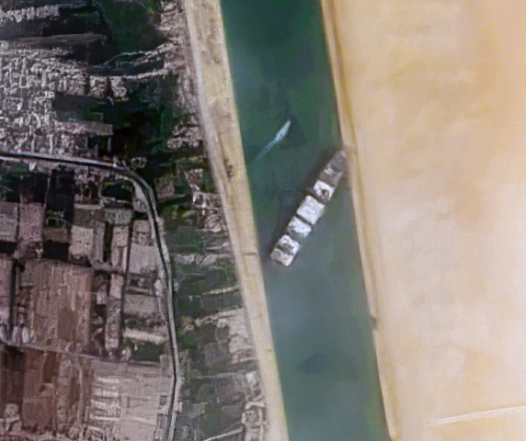
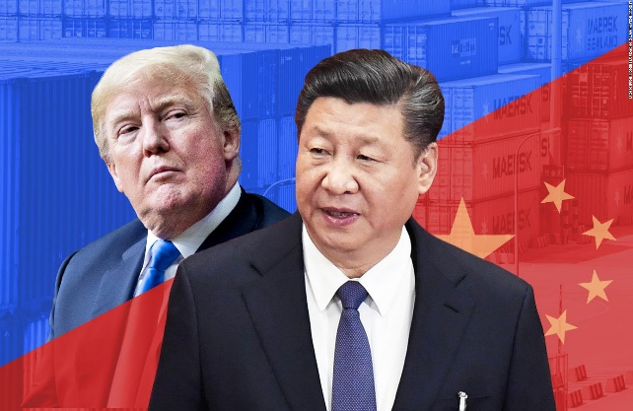

Motivation
Can self-sufficiency be the better alternative to dependency on imports and politically unreliable trading partners?
For which products? Can self-sufficiency reached at relatively low costs?
https://edition.cnn.com/videos/tv/2018/03/26/news-stream-intv-kwok-stout-china-us-tariff-trade-war-fears.cnn
Wikipedia.org: 2021 Suez Canal obstruction
Many disruptions of international trade chains:
Pandemic,
US-chinese „trade war“,
clogged Suez-canal,
war in Ukraine and sanctions
Double research gap:
Only little literature on trade reduction.
Only little literature on extreme scenarios. Can our standard models even depict them?
Notes:
That‘s all to combat risk but that‘s not the only thing we should look at but also find out what would happen in equilibrium

Slide 3
Methods and Scenario
Scenario: Drastic import reductions for most food and feed products.
Model: Common Agricultural Policy Regionalised Impact Model CAPRI
  Partial Equilibrium Model
  European Supply Module and Global Market Module
Implemented by setting a prohibitive import tariffs.

Slide 4
Results: Different Reactions of Commodity Groups
Relatively unaffected in EU:
  Cereal, vegetables and fruit, dairy
  EU is a net exporter
Directly affected:
  Oilseeds: mainly soybean. Rapeseed and sunflower as substitutes
  EU is a net importer
Indirectly affected by oilseed stop:
  Meat and upstream products: oils, oilseed cakeEU is a net exporter

Slide 5
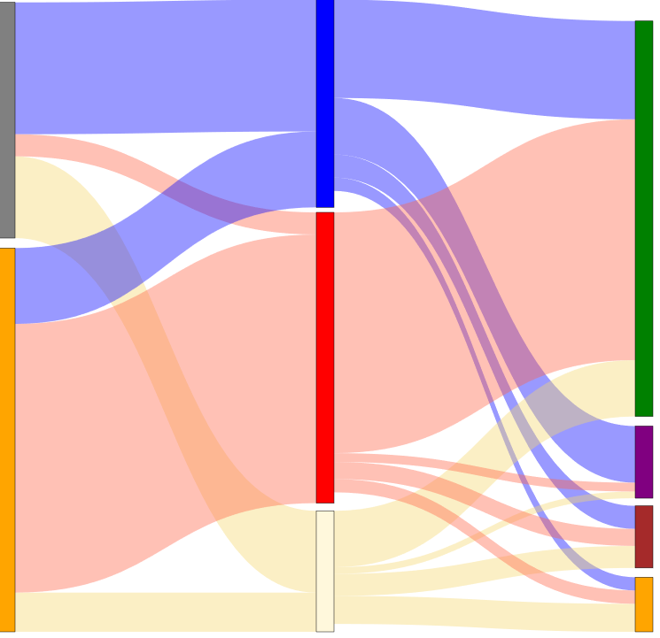
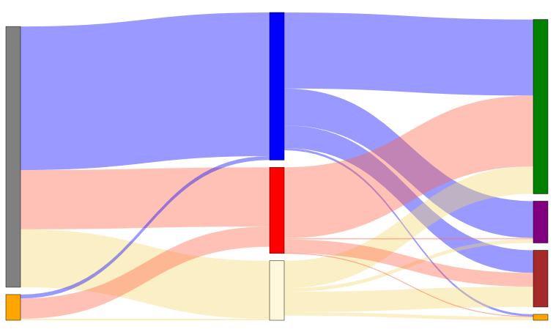
Results: EU market balance for oilseeds changes.
Figure 1: EU market balance for oilseeds, in quantities
rapeseed
rapeseed
production
production
feed
feed
soybean
processing
soybean
human
consumption
sunflower
imports
exports
processing
imports
human consumption
sunflower
exports
Notes:
All goods (all oilseeds) are subject to the import stop, but some are affected more than others.
Some “uses” of these goods are more affected (here: feed and exports) than others (human consumption, processing)

Slide 6
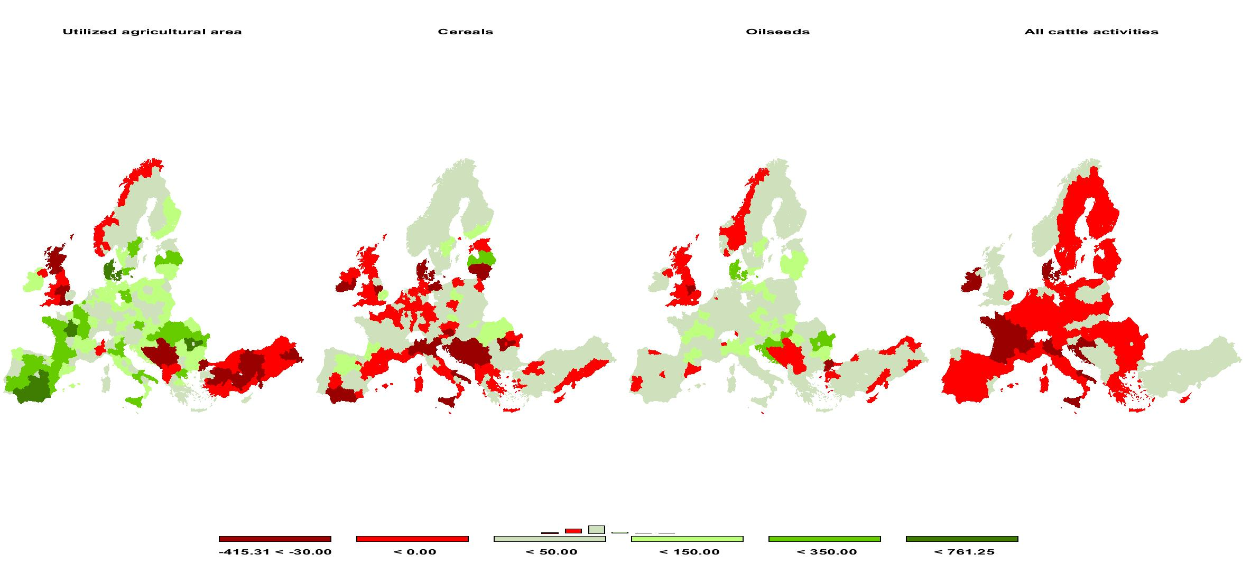
Results: Supply increases in EU for oilseeds and overall.
Figure 2: EU supply changes, absolute differences in 1000 ha resp. 1000 t
Utilized Agricultural Area Cereals Oilseeds All cattle activities
-30 0 50 150 350
Notes:
Increased production of oilseeds (51%) (mainly rapeseed) comes from substitution in production and from more intensive use of land/more land used.
Also increase in overall production.
For cereals: some re-allocation but no big increase of domestic production (only 1%)
Cattle activity decreases, because less feed is available (refer to sankey diagram)
Brexit, turkey: EU-trading partners produce less (overall) resp. more (cattle). First hint for effect on trading partners

Slide 7

Results: Net exports to EU decrease.
Figure 3: Net exports to EU in 1000 t
Notes:
Global trade declines, even though there is some trade diversion
Net trade: Imports of EU decrease strongly. Exports from EU also decrease but not so much. This means for other countries: net imports from EU increase resp. net exports to EU decrease. Net trade income decreases resp. expenses increase.

Slide 8

Results: Net exports to EU decrease.
Figure 3a: Net exports to EU in 1000 t
Notes:
Notable exception to that: meat and dairy exports from EU → silver lining
import substitution and infant industry argument
In this simulation, these gaps are partly filled by imports from other countries, but also through domestic production.

Slide 9
Results: Prices increase in EU and for animal products, decrease mostly in other world regions
Table 1: Percentage changes in producer prices
 | EU | High Income Countries | Middle Income Countries | Least Developed Countries | World
Cereals | 7% | -1% | 0% | -3% | 0%
Oilseeds | 74% | -6% | -3% | -4% | 2%
Other arable field crops | 11% | -1% | -1% | 0% | -1%
Vegetables and Permanent crops | 31% | 0% | -1% | 1% | 1%
All other crops | -1% | 0% | 0% | 0% | 0%
Meat | 26% | 1% | 1% | 1% | 3%
Other Animal products | 14% | 0% | 0% | 2% | 2%
Fish and other acquatic products | 0% | 0% | 0% | 0% | 0%
Dairy products | 7% | 1% | 0% | 0% | 1%
Oils | 33% | 0% | -2% | 0% | 2%
Oil cakes | 69% | -5% | -6% | -7% | -4%
Secondary products | 10% | 0% | -1% | 0% | 0%
Notes:
Prices increase in EU, animal product prices typically decrease in other parts of the world, too. Otherwise, prices remain stable or decrease.
Prices increase in EU, but generally decrease in other regions.
Exception: meat (also dairy, other animal products, oils).
That means mostly a deterioration of terms of trade for the trading partners of the EU

Slide 10
Results: Welfare decreases strongly for EU and worldwide
Figure 4: Welfare in 1000 €, absolute differences
Notes:
Eu welfare losses are mainly due to vegetables (EU is net importer and prices go up) and meat (EU is net exporter and exports decrease)
EU‘s welfare losses determine global welfare change

Slide 11
Results: Welfare decreases strongly for EU and worldwide
Figure 4a: Welfare in 1000 €, absolute differences
Notes:
Oilseeds are responsible for welfare losses in HIC and MIC (cannot export them), however these countries process more of their oilseeds to oil cakes now.
Only MIC profit from EU import stop. This follows the increase in trade income.
Welfare in LDC decreases due to more expensive vegetable imports

Slide 12
Results: Global GHG emissions increase, driven by re-allocation of meat production
Figure 5: GHG emissions in EU, absolute differences in 1000 t
Notes:
Main driver meat: production decreases in EU. EU meat exports decrease and production is shifted to other parts of the world. Comparative inefficiency in terms of environment
Other agricultural production in EU increases through intensification and more land use. This increases overall EU GHG emissions.
Global increase in GHG of 11 Mio t when reduction in global commodity transport is accounted for.

Slide 13
Discussion
Conclusion
  In an isolationist EU policy an import reduction of soybean has by far the biggest implications for both the EU and ist trading partners.
Limitations
  Possible under-estimation due to inflexible human demand and Armington assumption
  GHG coefficients are static and results depend on estimates.
Outlook
  Re-run the simulation with a flexible human demand function, following function of animal feeding
  Sensitivity analysis regarding elasticities of demand and supply
  Double check GHG results with other GHG coefficients (currently IPCC)

Slide 14

Thank you for your attention
ferike.thom@hu-berlin.de
Economic and Environmental Consequences of the ECJ Genome Editing Judgment in Agriculture.
Gocht, A.; Consmüller, N.; Thom, F.; Grethe, H.,
Agronomy 2021, 11, 1212. https://doi.org/10.3390/agronomy11061212

