Slide 1


А monetary policy rule in a CGE model
Ragchaasuren Galindev (PEP; ERI-Mongolia, World Bank)
Bernard Decaluwe (Laval University)

Slide 2
I. Introduction
  All Walrasian CGE models have a numeraire
  a price to which all the remaining prices are relative
  cannot be determined endogenously because of the interrelationship of the equilibrium conditions
Notes:
– i.e., an equilibrium condition is a linear combination of another.
Suppose there N market. The efficiency conditions are satisfied. If N-1 market is in equilibrium the remaining one is in equilibrium.
One equilibrium condition becomes redundant so that numeraire can be any price to be determined from any market equilibrium condition.

Slide 3
I. Introduction
  All Walrasian CGE models have a numeraire
  satisfy the Walras law.
  The numeraire is usually either consumption price index or the nominal exchange rate.
  In real models (i.e., no nominal rigidities), the choice of numeraire does not matter.
Notes:
– i.e., an equilibrium condition is a linear combination of another.
Suppose there N market. The efficiency conditions are satisfied. If N-1 market is in equilibrium the remaining one is in equilibrium.
One equilibrium condition becomes redundant so that numeraire can be any price to be determined from any market equilibrium condition.

Slide 4

I. Introduction
What are the implications of real life nominal rigidities in the short-run?
Answer: we could consider nominal rigidities in CGE models.
But the same shock could have different effects depending on the choice of numeraire.
  So what is numeraire in this context?
  Can we really use a real CGE model in this case?
Notes:
Such models must pass the nominal homogeneity test (i.e., the classical dichotomy in the long-run).
Nominal exogenous variables must maintain their ratios to numeraire in the closure.

Slide 5
I. Introduction
  This paper argues that:
  The numeraire represents the target of monetary authority.
  A redundant equilibrium condition has a flipside – a money market equilibrium condition.
  The numeraire is a target of central banks (CB).
  Different numeraire means different targets.
  the nominal exchange rate vs. consumption price index

Slide 6

I. Introduction
  The numeraire can change exogenously and can have real effects because of nominal rigidities.
  This can be interpreted that a CB is adjusting its target.
Depending on central bank’s target, the same shock could have different real effects.
However, a money market operation is still implicit.

Slide 7
I. Introduction
There is a body of CGE literature that endogenises the numeraire by developing detailed financial markets (see Thissen, 1999; Xiao, 2009).
These are called financial CGE models.
  The numeraire is replaced by explicit financial market equilibrium conditions and hence monetary policy actions are explicit.
  Such financial models, however, can be data intensive.

Slide 8
I. Introduction
We propose a simple approach to introduce an explicit monetary policy in CGE models.
The numeraire in the model is replaced by a Taylor-type interest rate rule (e.g., Taylor, 1992).
The Taylor rule is a kind of monetary policy rule used by CB.
We consider the PEP-1-t (a recursive dynamic CGE in Decaluwé et al., 2013) model calibrated to a Mongolian SAM.

Slide 9
I. Introduction
CB control a short-term interest rate to reduce GAPS on
  exchange rate between desired and actual
  inflation
  output
The weights attached to the gaps are important.
Notes:
Whether a central bank cares the inflation gap more or less than the output gap is determined by the weights attached to the gaps.
It is common that central banks care more about inflation and acts more aggressively to inflation by adjusting the interest rate.

Slide 10
I. Introduction
  The modern DSGE models consider it commonly (e.g., Christiana et al., 2005, Smets and Wouters, 2007).
  We show that a real model can be a special case of the current model.
  This can be applied in other real CGE models like IFPRI, ORANI, MANAGE and MAMS for short-run analyses.

Slide 11
I. Introduction
  Sufficiently high weight on the inflation gap, the current model replicates the PEP-1-t model in which CPI is the numeraire.
  Sufficiently high weight on the the exchange rate depreciation gap, the model is the same as the PEP-1-t model in which the nominal exchange rate is the numeraire.
  If we assume that a CB does not care about the gaps, the model is the PEP-1-t model in which the real interest rate is the numeraire.

Slide 12
I. Introduction
The nominal interest rate is linked with the real interest rate through the Fisher equation with expected inflation rate.
The real interest rate determines the Tobin-Q condition through the user cost of capital.
Given the expected inflation rate, a change in the nominal interest rate can change in the real interest rate which affects the Tobin-Q and hence real investment.

Slide 13
II. Model extensions

Slide 14
II. Model extensions

Slide 15
II. Model extensions
Taylor rule:

Slide 16
II. Model extensions
Notes:
FDI is exogenous and fixed as in the BGP. Net capital flow, on the other hand, is endogenous and depends on the ratio of domestic and foreign nominal interest rates as follows:
where is the exogenous foreign nominal interest rate that satisfies the UIP (Uncovered Interest Parity) condition and the parameter exhibits the degree of flexibility in the financial market for investors in shifting their assets across economies. Larger the elasticity, the faster the assets move and the difference between expected interest rates diminish quickly.

Slide 17
II. Model extensions
Notes:
Another additional variable for the balance of payments equation is a change in the official foreign reserves is defined as the difference between the current account balance and financial account balance.
In a fully flexible exchange rate system, it is set to zero.
In a system where the central bank intervenes the exchange rate market to some extent, it could be either exogenous or an endogenous depending on the exchange rate.

Slide 18
IV. Simulations
The PEP-1-t model can be a special case of the current model.
PEP-1-t model – numeraire
SIM1. CPI
SIM2. Nominal exchange rate
SIM3. Interest rate
Monetary policy rule

Slide 19
IV. Simulations
  We simulate the two models over 20 periods.
  The shock is 10% increase in government spending in T=3.
  Nominal rigidities
  Nominal wage is fixed
  Nominal government spending fixed
  Nominal current account balance is fixed
Notes:
Note that PEP is for the PEP-1-t model and M-PEP is for the monetary version of the PEP-1-t model.

Slide 20
IV. Simulations
Real GDP
(% deviations from BGP)

Slide 21
IV. Simulations
Nominal exchange rate

Slide 22
IV. Simulations
Real interest rate

Slide 23
IV. Simulations
Consumption price index

Slide 24
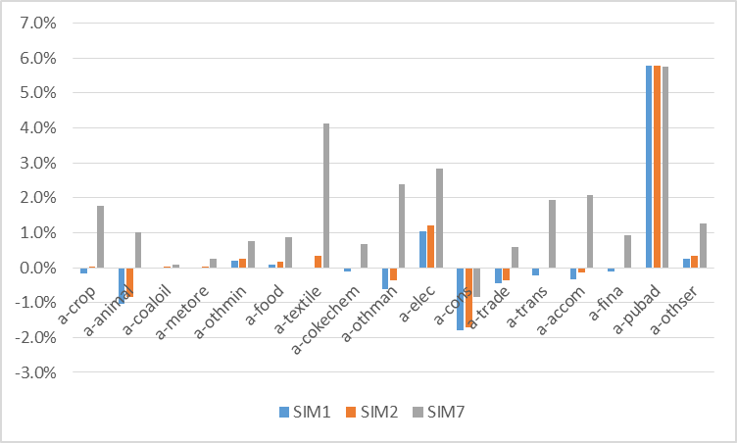
IV. Simulations
Production by sectors in period 3
(% deviation from the steady state values)

Slide 25
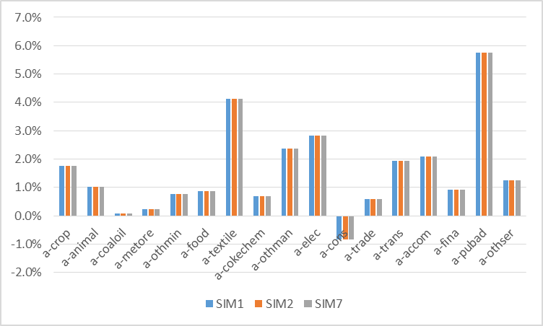
IV. Simulations
Production by sectors in period 3
(% deviation from the steady state values)

Slide 26
IV. World inflation
Let us consider the impact of a foreign inflation in
SIM1
SIM2
SIM7
All import prices increase 10% in period 3.

Slide 27
IV. World inflation
Macroeconomic variables in period 3
(% change from BAU)
 | SIM1 | SIM2 | SIM7
Nominal GDP at market prices | -7.6 | -3.0 | 5.3
Real GDP at base prices | -2.7 | -1.3 | 0.9
Employment | -5.2 | -2.6 | 1.8
Nominal investment | -8.9 | -3.9 | 5.0
Nominal government income | -5.5 | -0.7 | 7.8
Nominal household income | -6.4 | -2.2 | 5.3
Consumption price index | 0.0 | 4.3 | 11.7
GDP deflator | -5.5 | -2.2 | 3.7
Nominal exchange rate | -5.7 | 0.0 | 10.1
Real interest rate | 323.2 | 272.2 | 200.8
Nominal wage rate | 0.0 | 0.0 | 0.0

Slide 28
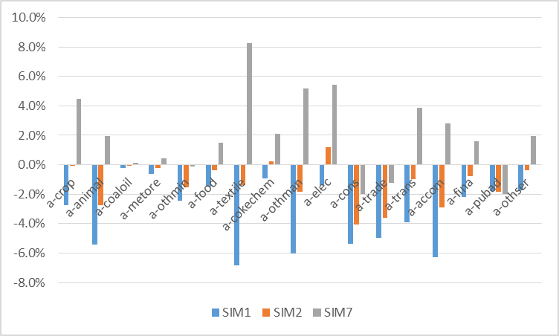
IV. World inflation
Production by sectors in period 3
(% deviation from the steady state values)
Notes:
Interestingly, if we shock the numeraires in SIM1 and SIM2 by those generated in SIM7, the results in SIM1 and SIM2 in Table 1 and Figure 13 converge to those of SIM7.

Slide 29
V. Conclusions
The paper introduces a Taylor-type monetary policy rule into the standard PEP-1-t model.
This replaces the exogenous numeraire.
It shows that the PEP-1-t model is a special case of the current model.
In the presence of nominal rigidities, the choice of numeraire matters.
The Taylor-rule maybe more suitable for short-run analyses in the presence of nominal rigidities.

