Slide 1


Multi-scale analysis of U.S. climate policy:
Gridded implications for land systems change, water use and nitrogen leaching
Presented by Maksym Chepeliev in collaboration with Uris Baldos, Iman Haqiqi, Thomas Hertel,
Jing Liu and Dominique van der Mensbrugghe
Purdue University
AERE 2022 Summer Conference
June 1-3, 2022, Miami, Florida

Slide 2
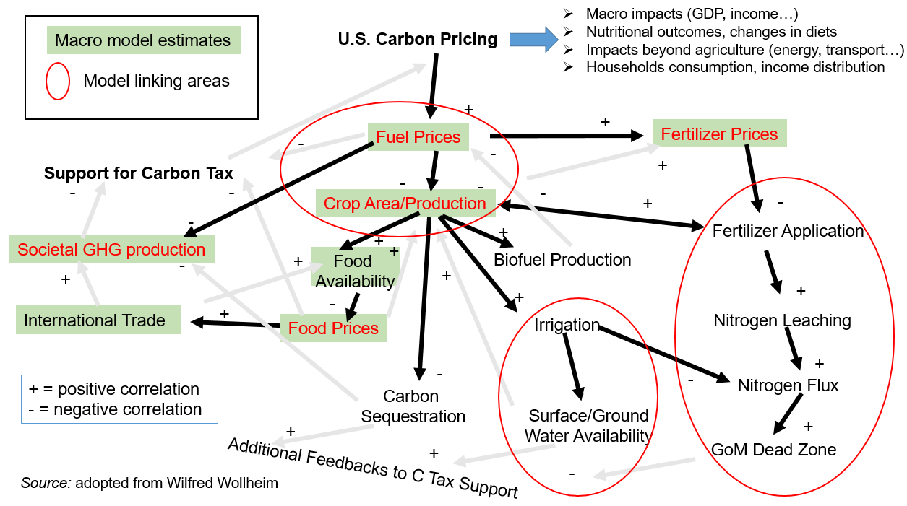
Can climate policy succeed where other policies have failed?
U.S. administration has ambitious climate plans, including 2050 carbon neutrality goal
Agriculture is the largest emitter of non-CO₂ GHGs, but these gases are hard to abate
However with carbon pricing covering CO₂ emissions only (e.g. like in the EU ETS), agriculture would be impacted via multiple channels (Figure->)
What are implications of carbon pricing on agriculture in U.S.?
What is the spatial distribution of such impacts?
What are the spillover effects on the Rest of the World?
Carbon pricing interactions with food and agriculture

Slide 3
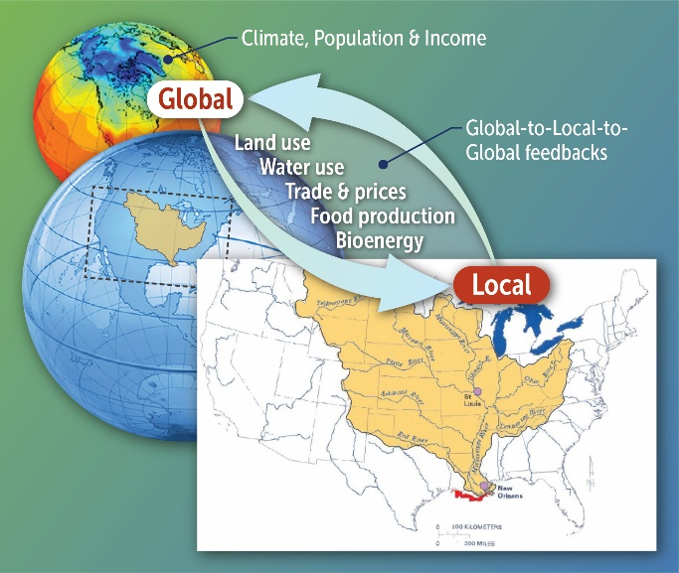
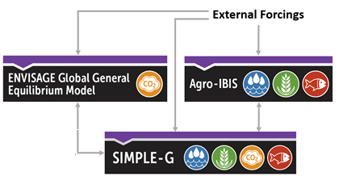
Multi-model framework is needed to capture these complex interactions
Carbon pricing (global force) drives local food, energy and water systems stresses (ENVISAGE model)
Local responses are shaped by specific biophysical and socio-economic conditions (Agro-IBIS and SIMPLE-G models)
Accumulation of local responses feeds back to regional and Global systems – impacts on the Rest of the World (SIMPLE-G international trade module)
Notes:
Welcome to the Conference on the Long Run Sustainability of US Agriculture! I feel extremely fortunate that we have been able to proceed with this event. It has been nearly two years in the planning, and Allison Roberts – our tireless organizer – and I were very disappointed this past week when it looked like we might have to cancel due to the hurricane. However, our good fortune has come at the cost of extreme misfortune for many along the coast of North and South Carolina and we are thinking of those friends, colleagues and fellow countrymen today. We certainly hope for a speedy recovery from the storm.
I want to begin by acknowledging those who have made this event possible. Primary funding has come from the Andrew Mellon Foundation, with additional conference support from USDA-NIFA. I’d like to thank our program officer at NIFA, Robbin Shoemaker, for helping to conceive of this event and encouraging me along the way. NIFA also funded the underlying research which we will be drawing on in the presentations today. Logistical support has been provided by the Purdue Policy Research Institute led by Rosealee Clawson, who is here today. Most importantly, PPRI made available to us Allison Roberts whom all of you know remotely and who has been the tireless organizer of this event. Alli is also available to deal with any issues that might arise during the course of today’s event.
Finally, I want to call to your attention GLASS – Global to Local Analysis of Systems Sustainability, the umbrella project for this event and the institution which will carry forward this work following today’s meeting. You’ll be hearing more about GLASS throughout the course of the day.

Slide 4

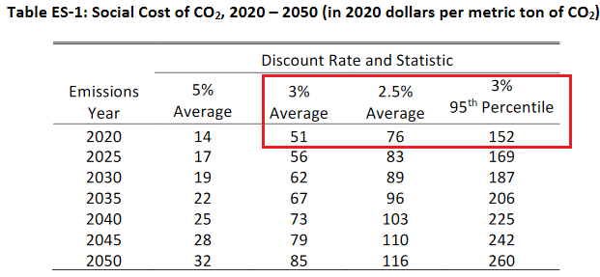
Mitigation scenarios capture EU carbon pricing and US SCC estimates
Impacts of EU mitigation on prices in US, percent change
Reference case
EU climate mitigation policy
EU economy wide carbon price as of April 2022:
89 EUR per ton of CO₂ + carbon border adjustment (CBA)
New reference
US climate mitigation policy
Three carbon pricing scenarios + CBA
Outputs and linking variables
Source: Interagency Working Group on Social Cost of Greenhouse Gases, United States Government

Slide 5

Mitigation policies increase prices of energy and ammonia fertilizer
Prices of energy, fertilizer, land, labor, capital

Slide 6
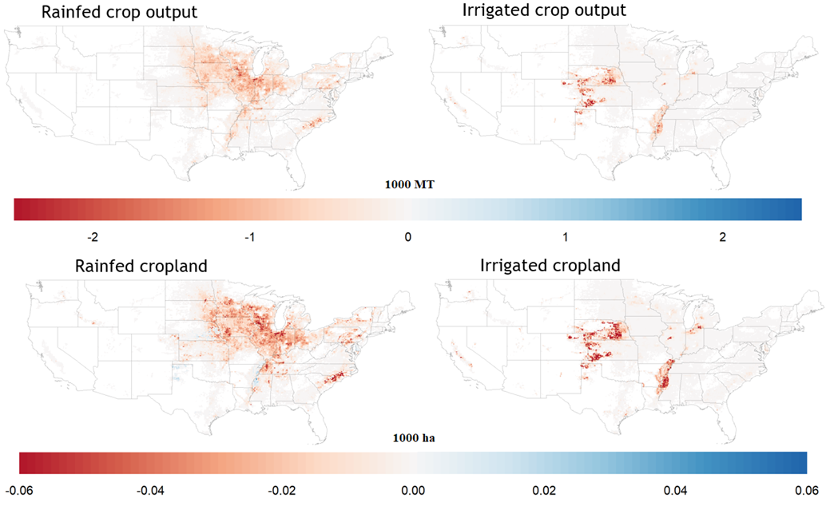
High heterogeneity of impacts across grid cells ($76 carbon price)

Slide 7
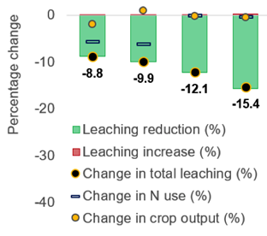
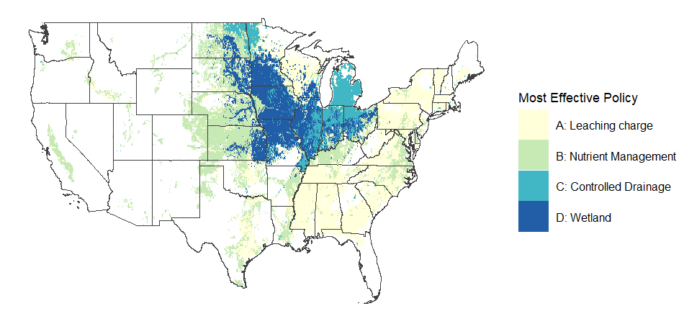
Can carbon pricing help improving water quality?
The ‘wicked’ hypoxia problem
Leaching tax
Nutrient mng
Wetland
Ctrl drainage
Large amounts of nitrate lost from soils in the Corn Belt created ‘dead zones’ (hypoxia) in the Gulf of Mexico
No silver bullet can achieve the Hypoxia Task Force Goal of reducing N load to the Gulf by 45% by 2035
Wetland alone can reduce N load by 15%, and up to 30%, if combined with other conservation practices but still cannot make the HTFG
Does carbon policy have the dual benefits of reducing GHG emissions and improving water quality? How effective compared with conservation policies?
Notes:
Export yield & leaching response functions for each of the 48,371 grids, and embedded in SIMPLE-G-CS
Carbon pricing imposes changes on fertilizer prices, reducing fertilizer application (SIMPLE-G)
Because of greater N use efficiency at lower rates of fertilization additional leaching reductions occur (AgroIBIS)
However, because much N would have been prevented from reaching the coast due to removal in streams and groundwater, only a portion of the total reduction in leaching is observed as a reduction in export (WBM) ( – and only coincidently approximates the proportional reduction in applied fertilizer)

Slide 8
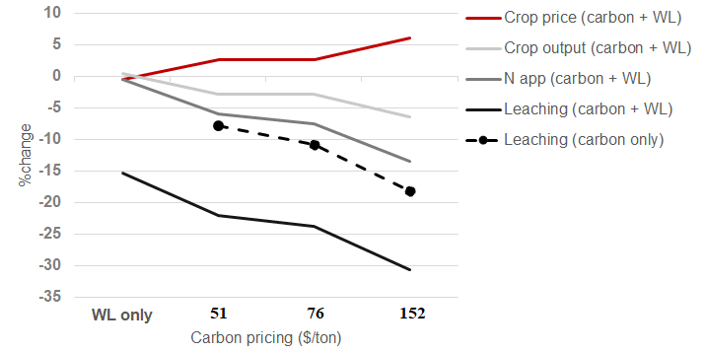
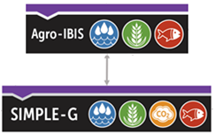
Combined policies have much larger impacts on N application and crop production than wetland alone
A $152 carbon pricing
  nearly doubles the price of N fertilizer
  leads to more leaching mitigation
  (-18%) than wetland alone (-15%)
Increasing N fertilizer costs put pressure on food price
  N application -6%~ -13%
  Crop output -3% ~ -6%
  Crop price +3% ~ +6%
Increase N fertilizer price by
30% 45% 91%

Slide 9
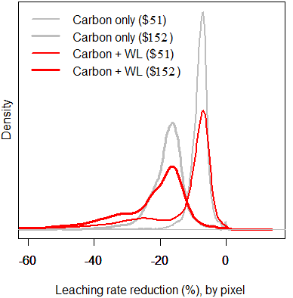
Mitigation is attributed more to lower leaching rate than less cropland
$51
$152
$51
$152
Leaching rates reduce more at higher carbon pricing & exhibit larger variance due to spatially varied mitigation effect of wetlands
Over 90% of the mitigation is contributed by lower leaching rate (kg of leaching /ha)
This fraction is even higher under combined policies

Slide 10
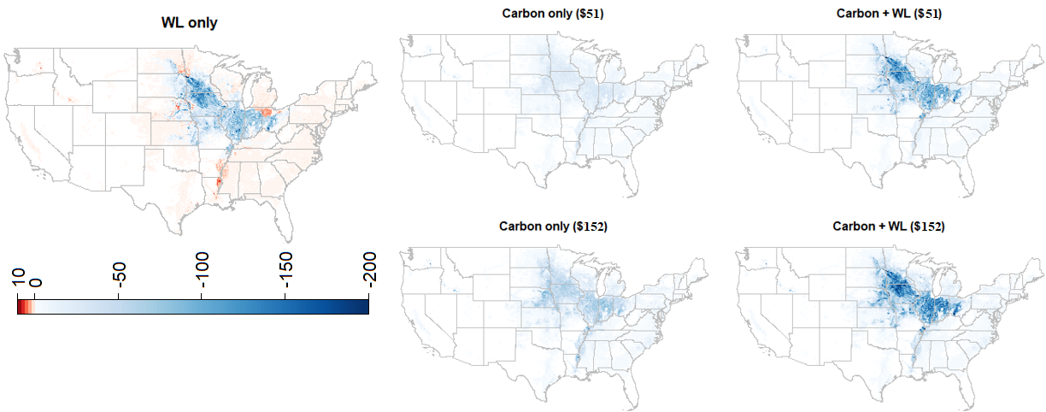
Combined policies impede the spatial spillover effect caused by site-specific conservation practices
(Tons of nitrate leaching / pixel)
Production is displaced to the fringe of corn belt where not affected by the cost of WL
The comparative advantage disappears with the presence of carbon pricing

Slide 11
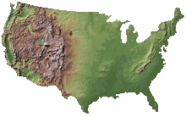

Feedback to global economy: Leakage and food security impacts overseas
Local-to-global impacts US carbon price of $100 per tCO₂ (SIMPLE-G):
  Decrease in global crop output -12 Million MT
  Greater global agricultural GHGs +8.6 Million MT CO2-eq. per year
  Increased hunger in food insecure regions +0.72 Million Persons
Prices of energy, fertilizer, land, labor, capital
Changes in Crop Output
United States
-35 Million MTs
(-3.0%)
Rest of World
+23 Million MTs
(+0.1%)

Slide 12
Conclusion
Even without explicitly targeting agriculture, mitigation policies could have important impacts on food, land and water systems
U.S. carbon pricing raises cost of crop production particularly for N fertilizer inputs, as well as energy
  Local: Reduction in cropland use, irrigation water use, nitrogen application, leaching and exports => “Environmental co-benefits”
  Global: Crop production partially moves from U.S. to Rest of World, resulting in emissions leakage; rising global crop prices lead to increased undernourishment
Limitations to address in the future work
  More granular representation of fertilizer production and trade patterns.
  Coupling with the Water Balance Model (WBM) at the grid cell level to simulate the amount of leachate runoff.
  Additional sensitivity analysis.

Slide 13
Thank you!
mchepeli@purdue.edu

