Slide 1
The Plastic Intensity of Industries in the US: The Devil Wears Plastic
Dominic White and Niven Winchester

Slide 2
Structure
Motivation
Literature Review
Data
Methodology
Results
Conclusions
1

Slide 3
Motivation
Consumer facing industries such as supermarkets, have been subject to policies involving plastic bags and packaging.
This paper contributes to an understanding of extended producer responsibility by calculating the plastic intensity of industries (the value of plastic inputs per dollar of industry output).
The results may help policy makers identify sectors of concern when formulating strategies to curb plastic pollution.
2

Slide 4
Literature Review
Of all plastics ever produced, 30% are currently in use, 59% are in landfills or in the environment, 10% have been incinerated, and 1% have been recycled and are currently in use (Geyer, Jambeck & Law, 2017).
The main plastics in the ocean include polypropylene, polyethylene, polystyrene, polyester, polyamide, acrylic, polyvinyl chloride and polyethylene terephthalate. (Erni-Cassola et al. 2019; Morét-Ferguson et al., 2010).
The techniques we use to calculate plastic intensity in this paper build on methodologies developed for input-output analysis (Leontief & Ford 1970; Herwich and Peters 2009; Bullard, Penner & Pilati 1978; and Pomponi et al., 2022).
3

Slide 5
Data
Analysis employs the Eora Global Supply Chain Database, a multi-region input-output table (MRIO) (Lenzen et al., 2012; and Lenzen et al., 2013).
Focus on the US individual country input-output table with information on 428 different industries and commodities including 13 plastic commodities.
Seven plastic commodities which are more likely to contribute to plastic pollution include coated paper and plastic film, plastic bottles, polystyrene, plastic resin, plastic packaging materials, plastic fibres and filaments, and synthetic rubber.
4

Slide 6
Methodology
Each industry may use plastics directly or indirectly.
Direct use of plastic occurs when an industry uses inputs of a plastic commodity.
Indirect use of plastic occurs when an industry uses an input that was produced, in part, using plastics.
The technique developed in this paper builds on methodologies used to estimate embodied carbon emissions, energy, and waste.
Lenzen and Rueda-Cantuche (2012) describe how these techniques can be adapted for multi-commodity output MRIO data.
5

Slide 7
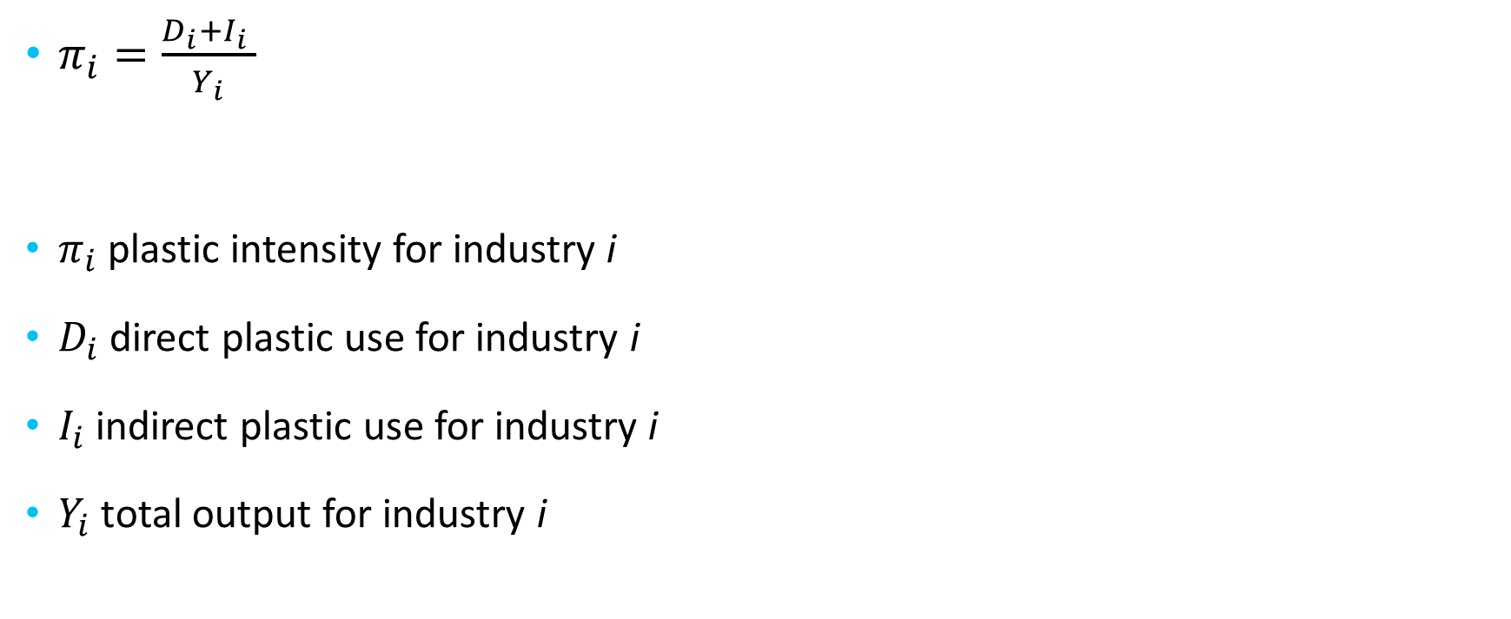
Methodology
$π_{i}=\frac{D_{i}+I_{i} }{Y_{i}}$
$π_{i}$ plastic intensity for industry i
$D_{i}$ direct plastic use for industry i
$I_{i}$ indirect plastic use for industry i
$Y_{i}$total output for industry i
6

Slide 8
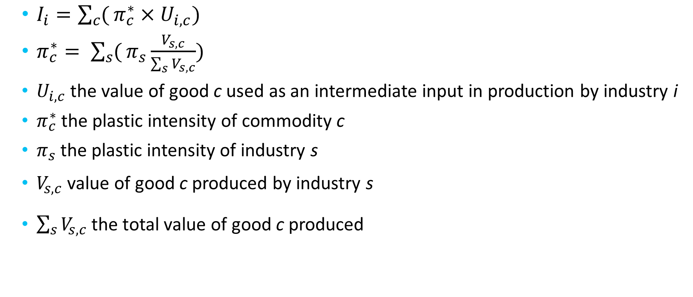
Methodology
$I_{i}=\sum_{c}{(}π_{c}^{∗}×U_{i,c})$
$π_{c}^{∗}= \sum_{s}{(}π_{s}\frac{V_{s,c}}{\sum_{s}{V_{s,c}}})$
$U_{i,c}$ the value of good c used as an intermediate input in production by industry i
$π_{c}^{∗}$ the plastic intensity of commodity c
$π_{s}$the plastic intensity of industry s
$V_{s,c}$value of good c produced by industry s
$\sum_{s}{V_{s,c}}$the total value of good c produced
7

Slide 9
Plastic intensity by industry and by plastic type
8

Slide 10
Plastic intensity by industry by polluting plastic type
9

Slide 11
Plastic fibres and filaments intensity and value of plastic input by industry
10

Slide 12
Plastic bottles intensity and value of plastic input by industry
11

Slide 13
Coated paper and plastic film intensity and value of plastic input by industry
12

Slide 14
Plastic packaging materials intensity and value of plastic input by industry
13

Slide 15
Polystyrene intensity and value of plastic input by industry
14

Slide 16
Plastic resin intensity and value of plastic input by industry
15

Slide 17
Synthetic rubber intensity and value of plastic input by industry
16

Slide 18
Conclusions
Food and drink related industries are plastic intensive for some plastic commodities, but they do not dominate the list of the most plastic intensive industries as might be expected.
Clothing and fabric manufacturing related industries are highly plastic intensive, especially for plastic fibres and filaments.
These results indicate that future policies should focus on discouraging plastic use in clothing and fabric related industries.
They also demonstrate the value of using input-output data to determine plastic intensity.
17

