Slide 1
Can the AfCFTA change the track of African integration?
8 June 2022
GTAP Annual Conference 2022
Trudi Hartzenberg
trudi@tralac.org

Slide 2
Overview
Africa’s integration agenda – from the Abuja Treaty to the AfCFTA
What is the AfCFTA?
A new direction for Africa’s integration?

Slide 3
Africa’s Regional Integration Agenda
Regional integration: important feature of development strategy of African countries
Regional Economic Communities (RECs) anchor Africa’s integration initiatives - towards achievement of the African Economic Community
Abuja Treaty - blueprint for continental integration but never implemented
RECs are Member-driven, featuring dominance of hegemons
Work in progress in all RECs – flexibility is important to Member States
Liberalisation – protectionist tensions
Development agenda now features regional industrialisation ambitions
Integrating unequal partners is a complex and challenging endeavour
Continental Integration therefore extremely ambitious

Slide 4
AfCFTA and African integration
AU Flagship Project: to integrate economies of all AU Members via a free trade area (FTA)
Anchored in a Treaty concluded by sovereign States
Member-driven
Obligations implemented progressively
Establishes an FTA; foundation for a Customs Union - later (policy space implications)
AfCFTA design: a co-existence model (RECs continue - Art 19 (2) - and REC FTAs are designated building blocks of AfCFTA)
Institutional architecture: link to AU institutions (no supra-nationality)
Addressing real barriers to integration (trade facilitation agenda – eliminating NTBs); adding new legal instruments (Digital Trade, Women, Youth and Trade)

Slide 5

“Especially impressive results were forecast by simulating a modest 20% reduction in the costs associated with the particular African problem of transit time delays at customs, terminals and internal land transportation. These gains are significantly above both just intra-African tariff elimination and what may be thought of as the more traditional non-tariff barriers that we modelled individually and separately.”
https://www.tralac.org/publications/article/7287-the-continental-free-trade-area-a-gtap-assessment.html

Slide 6

Governing Principles of the AfCFTA: Article 5
The AfCFTA shall be governed by the following principles:
Driven by Member States of the African Union
RECs' Free Trade Areas (FTAs) as building blocs for the AfCFTA
Variable geometry, flexibility and special and differential treatment
Transparency and disclosure of information
Preservation of the acquis
Most-Favoured-Nation (MFN) and National Treatment
Reciprocity
Substantial liberalisation
Consensus in decision-making
Best practices in the RECs, in the State Parties and International Conventions binding the African Union.

Slide 7
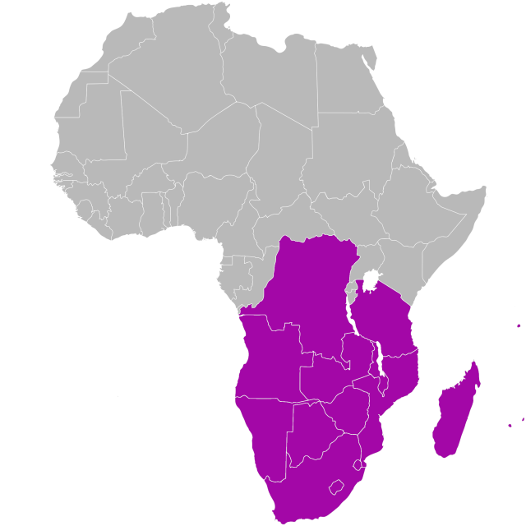
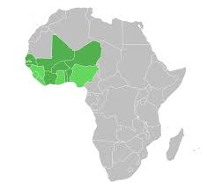
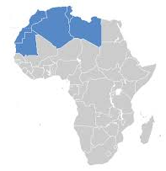
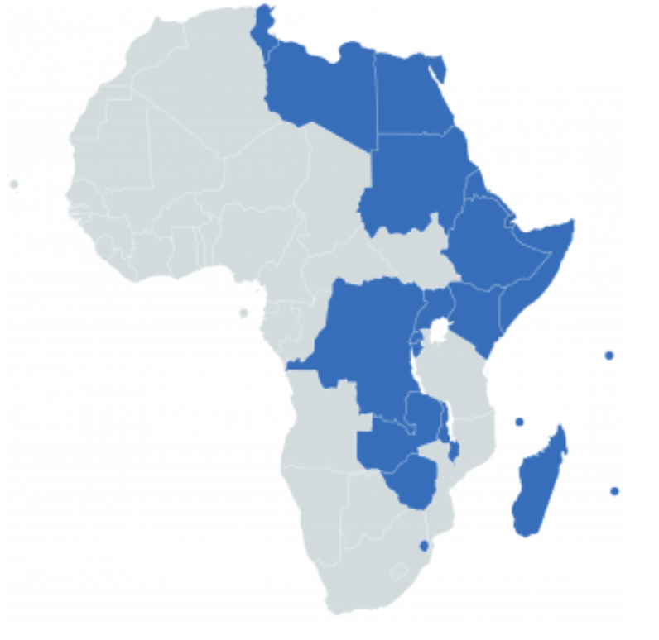
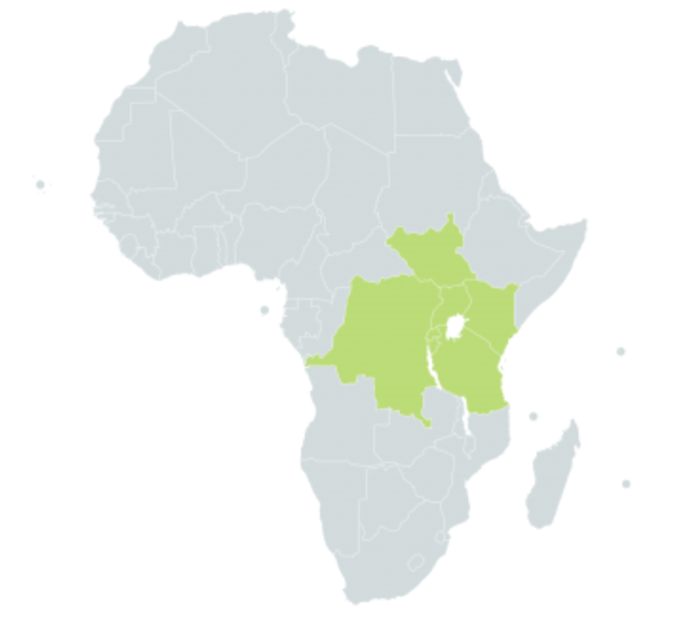
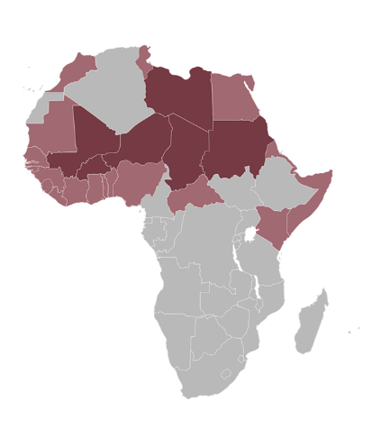
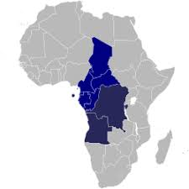
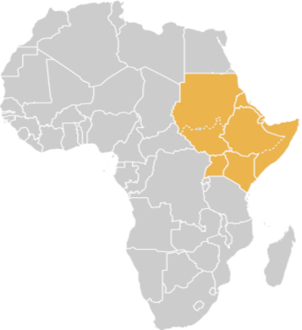
8 RECs are recognised alongside the AfCFTA
REC FTAs are building blocks of the AfCFTA
COMESA
AMU
ECOWAS
SADC
CEN-SAD
EAC
IGAD
ECCAS
What of the other integration arrangements?

Slide 8
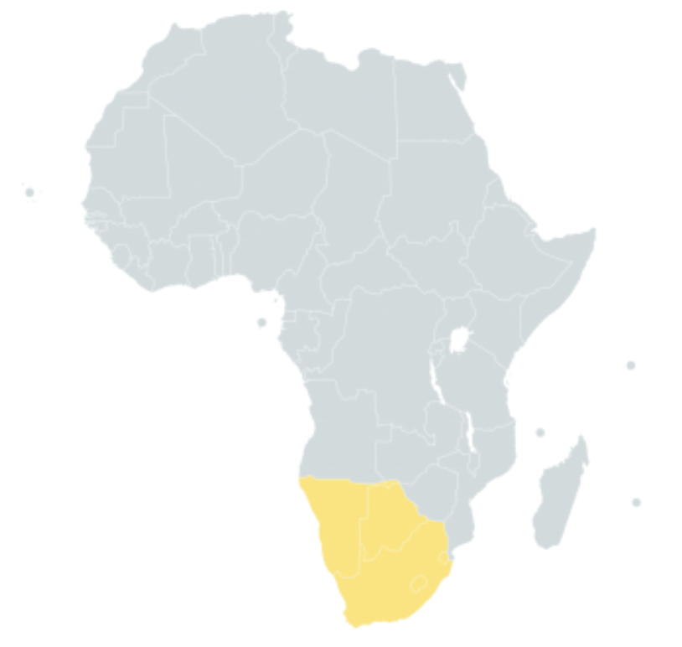
What of other integration initiatives?
Example: Southern African Customs Union
Oldest functioning customs union in the world (dates from 1890s)
No trade in services agenda
Aspects of fiscal integration: SACU is
also an excise union
All but Botswana are members of the
Common Monetary Area

Slide 9
The AfCFTA – a new direction for Africa’s integration?

Slide 10
Legal Architecture of the AfCFTA
Agreement establishing the AfCFTA
Phase 1
Phase 2
Phase 3
Protocol on Competition Policy
Protocol on Digital Trade
Protocol on Trade in Goods
Protocol on Trade in Services
Protocol on Rules and Procedures on the Settlement of Disputes
Protocol on Investment
Protocol on Women on Youth in Trade
Protocol on Intellectual Property Rights
Annexes
Schedules of Specific Commitments
MFN Exemptions
Air Transport Services
List of Priority Services
Framework Document on Regulatory Cooperation
Annexes
Schedules of Tariff Concessions
Rules of Origin
Customs cooperation and mutual administrative assistance
Trade Facilitation
Non-tariff barriers
Technical Barriers to Trade
Sanitary and Phytosanitary Measures
Transit
Trade Remedies
Guidelines for implementation of Trade
Remedies
Annexes
Working Procedures of the Panel
Expert Review
Code of Conduct for Arbitrators and Panellists
Complementary Initiatives

Slide 11
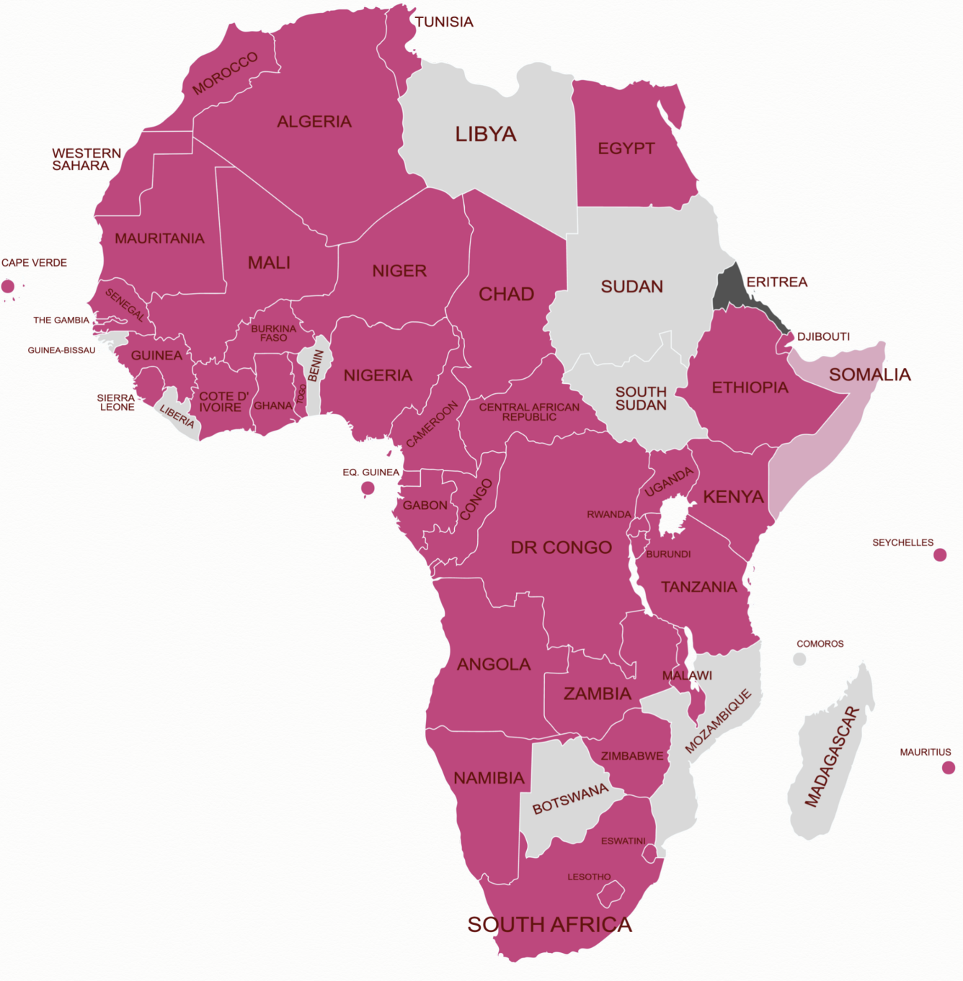
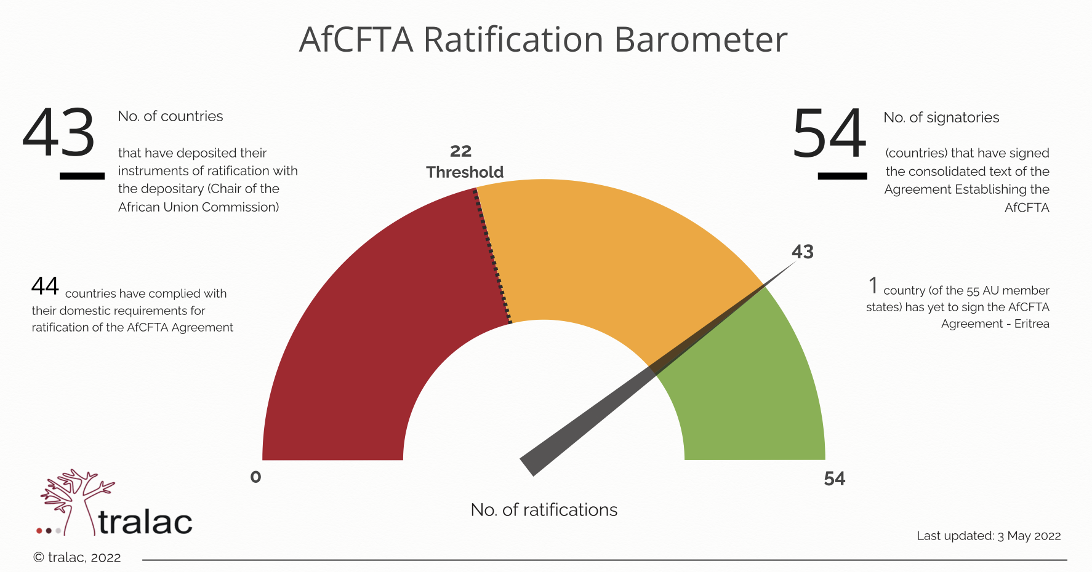
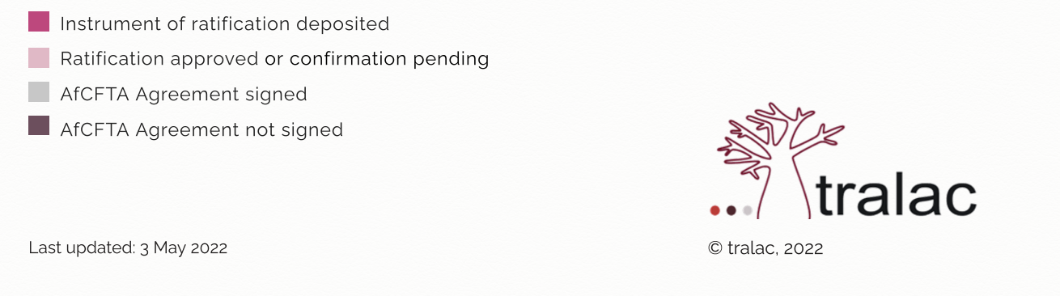
AfCFTA
Ratification Update

Slide 12
Where does the AfCFTA stand?
2012 AU Assembly Decision: to expeditiously establish CFTA
Negotiations began (under AU Commission) in 2015. And progressed well
Extra-ordinary Summit (March 2018): AfCFTA presented for adoption, opened for signature and ratification
Agreement entered into force 30 May 2019 (but tariff concessions, Rules of Origin and specific commitments for priority services sectors still under negotiation)
5 Dec 2020: Assembly approved launch of trade from 1 Jan 2021 - did not happen
Negotiations continue (State and non-State Parties participate)

Slide 13
Towards “commercially meaningful trade”….
Council of Ministers for Trade convened in Accra 28-29 Jan 2022
To assess negotiations on outstanding issues & agree to start commercially meaningful trading under AfCFTA – to make recommendation to AU Summit
Agreed that trading under AfCFTA regime proceeds on basis of agreed rules of origin covering 87.8% of total tariff lines. Take necessary steps & gazette the schedules of tariff concessions, in accordance with the applicable national legislation
Trade in Services negotiations at an advanced stage. 46 member states have submitted Schedules of Specific Commitments. These negotiations are to be concluded by 30 June 2022
AU Summit Decision on the AfCFTA (5-6 Feb 2022) – acceptance of CoM recommendation for the start of commercially meaningful trade, but no date for the start of trade (back to CoM)

Slide 14
Expanding agenda: Digital Trade and Women and Youth in Trade
Protocol on Digital Trade
From a Protocol on e-commerce (2020) to a Protocol on digital trade
The AfCFTA Council of Ministers responsible for Trade has established the Committee on Digital Trade to facilitate the negotiations on digital trade
Protocol on Women and Youth in Trade
Stakeholder engagement taking place
Scoping the agenda (June 2022)
Aim: Complete negotiations by end September 2022

Slide 15
What is delaying the AfCFTA and why?
All AU Members are participating in negotiations
Decisions are taken by consensus
Deals to be based on reciprocity
The process is Member-driven (Art 5)
The level of ambition is high (liberalise 90% tariff lines)
Members are at different levels of economic development
National development priorities are important, political economy is complex
REC integration agendas and neighbourhood effects remain important (reflected in intra-Africa trade)

Slide 16
Is it time to take a bold decision – for trade (in goods) under the AfCFTA to start now?
Starting dates have come and gone. The latest one was in February this year.
Delaying the implementation of this ambitious deal has consequences. Negotiation fatigue may be setting in
Practical considerations
Is it time to take a bold decision for trade in goods under the AfCFTA to start?
Who takes this decision and how?
Tariff concessions consistent with the new threshold would have to be verified and confirmed by the AfCFTA Secretariat, so that preparations for the start of trade can be made at national level.

Slide 17
What has the AfCFTA brought to the integration agenda?
AfCFTA has generated renewed political interest in and support for regional integration
Global interest in the AfCFTA (more than 80% of Africa’s trade is with global partners)
More emphasis on trade facilitation, elimination of NTBs, frameworks for regulatory cooperation
AfCFTA becoming a framework for continental industrialisation
Services and digital trade: a developing agenda (however most African countries do not participate in WTO plurilaterals)

Slide 18
Concluding remarks: AFCFTA’s role in recalibrating Africa’s integration agenda cont’d
Principle: preservation of the Acquis
AfCFTA recognises different streams of integration on the continent – no one size fits all
REC FTAs and Customs Unions continue and grow (appetite for new customs unions is weak …)
Institutions matter: Council of Ministers and AU Assembly, and Secretariat (departure from REC model?)
A well-designed AFCFTA (with additional legal instruments as required eg climate, sustainable development, labour and social provisions) may well emerge - fit for Africa’s development purpose

Slide 19
Concluding remarks: AFCFTA’s role in recalibrating Africa’s integration agenda cont’d
AfCFTA does not create a platform for Africa to speak with one voice on trade matters with global partners (African Union has no mandate to negotiate legal arrangements on behalf of Africa)
But it does bring new emphasis on governance improvements, regulatory cooperation and harmonisation
The spirit of Abuja remains important - but the AfCFTA seems to be shaping a pragmatic framework for Africa’s integration in a post-pandemic world, with complex geopolitical reconfiguration – hopefully trade and climate will be added to its agenda too

