Slide 1
Policy scenarios for promoting the circularity of plastics
Eleonora Mavroeidi, Rob Dellink, Elisa Lanzi, Ruben Bibas
10 June 2022

Slide 2
Outline
Motivation
Methodology
Results of the circular plastics policy scenarios:
Regional Action scenario
Global Ambition scenario
Summary

Slide 3
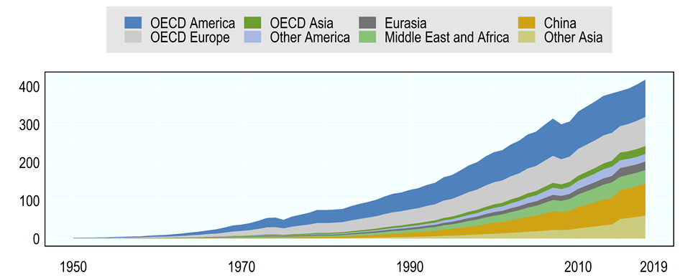
Motivation
Annual global use of plastics including fibres and additives has been growing continuously in the last decades and has reached 430 Million tonnes (Mt) in 2019.
Widespread use of plastics and inadequate end-of-life waste management has led to persistent plastic pollution with adverse impacts on marine wildlife, livelihoods and potentially human health.
Literature projections link plastic waste to GDP per capita
Global political target: Osaka Blue Ocean Vision
  reduce additional pollution by marine plastic litter to zero by 2050

Slide 4
Modelling methodology
Global assessment (currently 15 regions)
2060 time horizon
COVID
Structural change assumptions on demand and production
Demographics
Macro model
ENV-Growth
Multisectoral model
ENV-Linkages
Labour
Economic projections
Capital accumulation
Plastics projections
Total factor productivity
Plastic use data
4

Slide 5
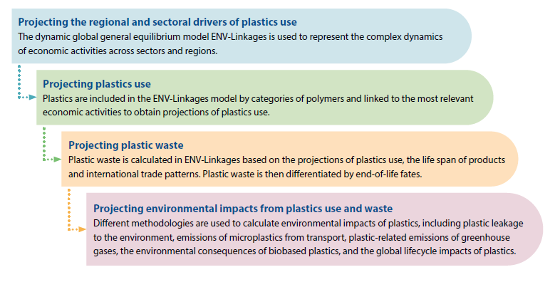
Methodology

Slide 6
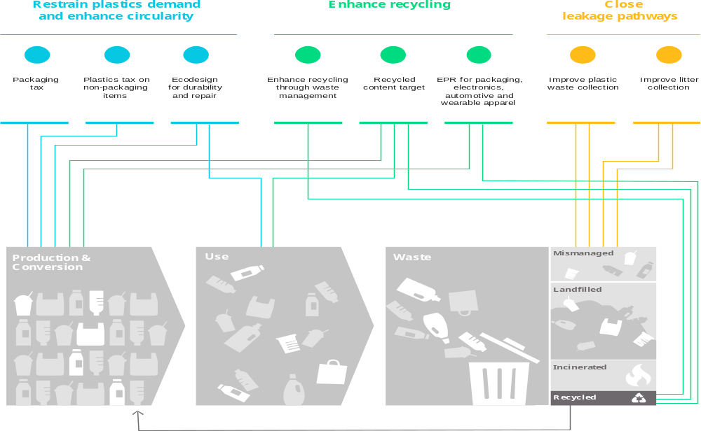
The circular plastics policy packages targets plastics throughout products lifecycle

Slide 7
Policy package design
Pillar | Policy instrument | Regional Action scenario | Global Ambition scenario
Restrain plastics production and demand and design for circularity (hereafter Restrain demand) | Packaging plastics tax | EU: USD 1 000/tonne by 2030, constant thereafter Rest of OECD: USD 1 000/tonne by 2040, constant thereafter Non-OECD: USD 1 000/tonne by 2060 | Global: USD 1 000/tonne by 2030, doubling by 2060
 | Non-packaging plastics tax | OECD: USD 750/tonne by 2040, constant thereafter Non-OECD: USD 750/tonne by 2060 | Global: USD 750/tonne by 2030, doubling by 2060
 | Ecodesign for durability & repair | Global: 10% lifespan increase, 5‑10% decrease in demand for durables, increase in demand for repair services such that ex ante total expenditures are unchanged | Global: 15% lifespan increase, 10-20% decrease in demand for durables, increase in demand for repair services such that ex ante total expenditures are unchanged
Enhance recycling | Recycled content target | OECD: 40% recycled content target Non-OECD: 20% recycled content target | Global: 40% recycled content target
 | EPR for packaging, electronics, automotive and wearable apparel | OECD + EU: 3020% points increase in recycling, tax on plastics inputs – USD 300/tonne by 2030, constant thereafter, subsidy on waste sector such that the instrument is budget neutral | Global: 3020% points increase in recycling, tax on plastics inputs - USD 300/tonne by 2030, constant thereafter, subsidy on waste sector such that the instrument is budget neutral
 | Enhance recycling through waste management | EU, Japan & Korea: 60% recycling rate target by 2030, 70% by 2060 Rest of OECD, China: 60% recycling rate target by 2060 Rest of non-OECD: 40% recycling rate target by 2060 | EU, Japan & Korea: 60% recycling rate target by 2030, 80% by 2060 Rest of OECD, China: 80% recycling rate target by 2060 Rest of non-OECD: 60% recycling rate target by 2060
Close leakage pathways | Improved plastic waste collection | OECD: full reduction of mismanaged waste shares* Non-OECD: halving of mismanaged waste shares* | Global: full reduction of mismanaged waste shares*
 | Improved litter collection | High income countries collection rates increase 5%-points; middle income countries income-scaled increase | Low income countries collection rates increase 10%-points; high income countries collection rates increase 5%-points; middle income countries income-scaled increase
Global Ambition vs Regional Action:
Increased ambition
Global coverage
in all pillars
* Waste streams from uncollected litter and from markings and microbeads are not included in this policy as they are not managed as waste.

Slide 8
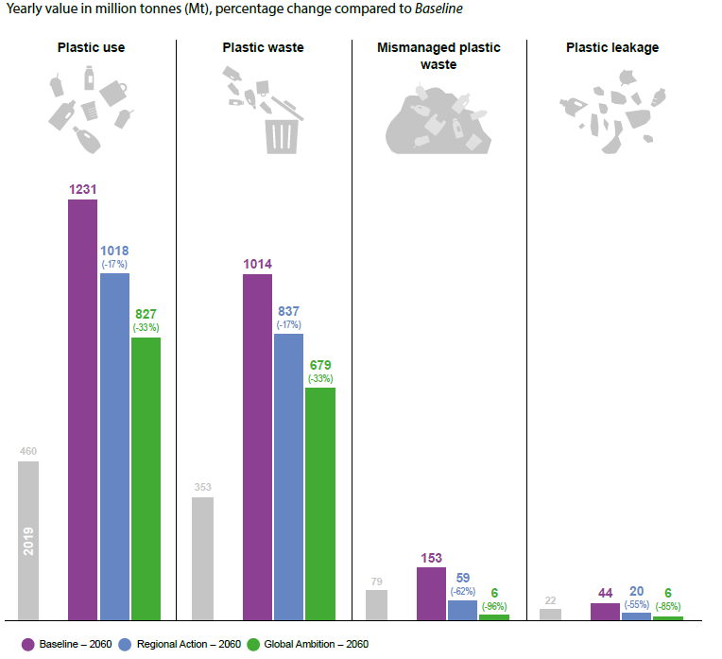
Combining policies that target different lifecycle stages can drastically reduce plastics leakage to the environment

Slide 9
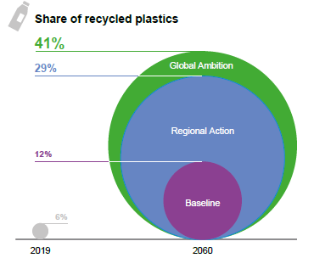
Policy action can increase the share of recycled plastics substantially
Regional Action:
The market-share of recycled plastics increases to 29% and mismanaged waste falls below 2019 levels, largely thanks to improved waste management in non-OECD countries.
Despite these positive impacts, plastics use and waste are projected to still more than double from 2019 levels.
Global Ambition:
Nearly 60% of waste is projected to be recycled and the market share of recycled plastics to surge to 41% by 2060.
Mismanaged waste and plastic leakage to the environment fall to near zero.

Slide 10
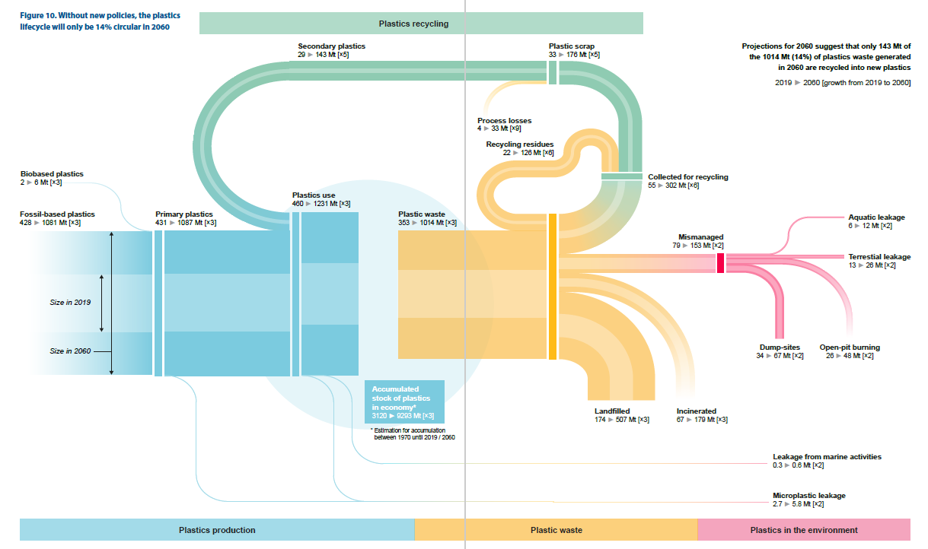
Without new policies, the plastics lifecycle will only be 14% circular in 2060

Slide 11
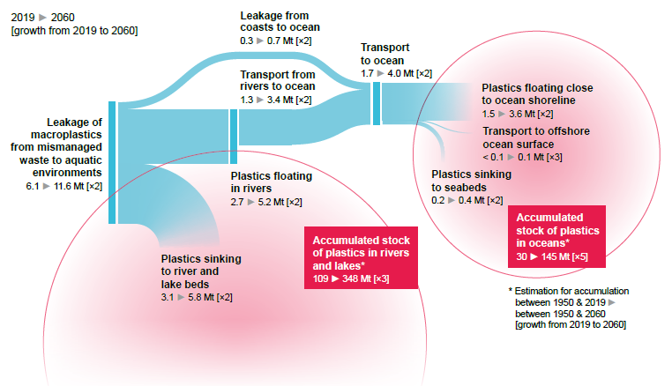
Leakage into aquatic environments is projected to double between 2019 and 2060

Slide 12
Policy scenarios

Slide 13
The Regional Action scenario reduces plastic use, waste and mismanaged waste, but not enough to eliminate mismanaged waste and thus leakage to the environment
Percent change in 2060 w.r.t. Baseline (2060 Volumes in Mt)
World
Plastics use
-17% (1018 Mt)
Plastic
waste
-17%(837 Mt)
Leakages to environment
-55% (20 Mt)
Leakages to aquatic environments
-60% (11.6 Mt)
Mismanaged waste
-63% (59 Mt)
GDP
-0.3 % (1.4 trillion USD)
Employment
-0.1%
Consumption
-0.6 %
Notes:
- Reduction in plastics consumption (17%) and waste (-18%)
- Substantial decrease in mismanaged by 65% mainly driven by reductions in non-OECD economies
- Recycling rates are boosted by 87% compared to baseline
- Small macroeconomic costs (-0.2% reduction in GDP)
* Plastics prices increase by 18% compared to baseline
Updates w.r.t. November:
Lower plastics use and thus waste volumes
Smaller effect of pillars 3 &4 on plastics consumption
Pillar 3 is more effective in boosting recycling and reducing mismanaged waste

Slide 14
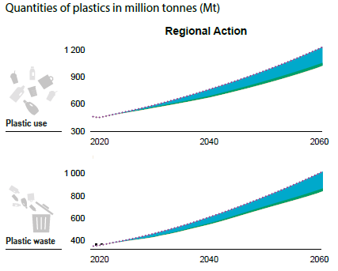
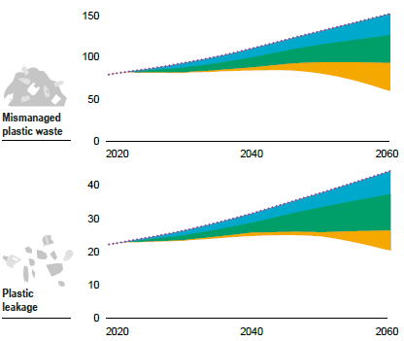
Regional Action: All pillars contribute to reducing plastic leakage to the environment
Notes:
Mismanaged plastic waste falls substantially while recycling increases

Slide 15
The Global Action scenario almost eliminates mismanaged waste and thus leakage to the aquatic environments
Percent change in 2060 w.r.t. Baseline (2060 Volumes in Mt)
World
Plastics use
-33% (827 Mt)
Plastic
waste
-33%(679 Mt)
Leakages to environment
-85% (6.4 Mt)
Mismanaged waste
-96% (6Mt)
Leakages to aquatic environments
-98% (0.2 Mt)
GDP
-0.8 % (3.4 trillion USD)
Employment
-0.2%
Consumption
-1 %
Notes:
- Reduction in plastics consumption (17%) and waste (-18%)
- Substantial decrease in mismanaged by 65% mainly driven by reductions in non-OECD economies
- Recycling rates are boosted by 87% compared to baseline
- Small macroeconomic costs (-0.2% reduction in GDP)
* Plastics prices increase by 18% compared to baseline
Updates w.r.t. November:
Lower plastics use and thus waste volumes
Smaller effect of pillars 3 &4 on plastics consumption
Pillar 3 is more effective in boosting recycling and reducing mismanaged waste

Slide 16
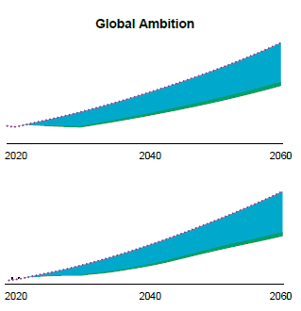

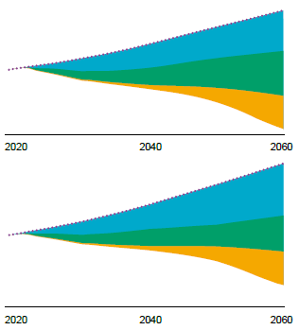

Global Action: All pillars contribute to reducing substantially plastic leakage to the environment

Slide 17
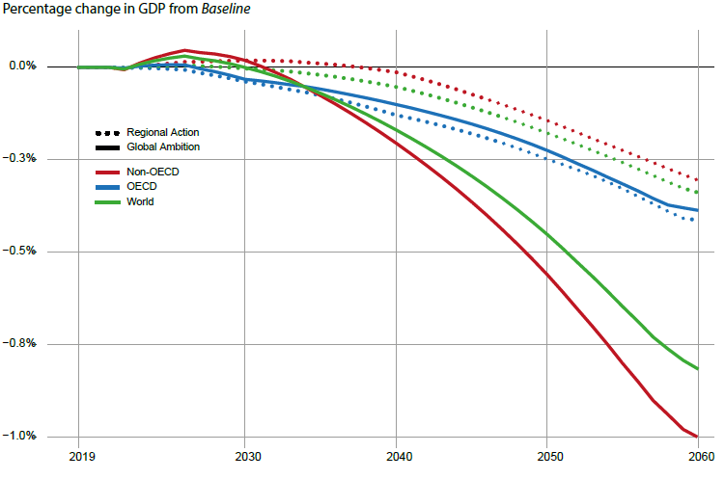
The costs of both regional and globally coordinated action are lower than 1% of global GDP

Slide 18
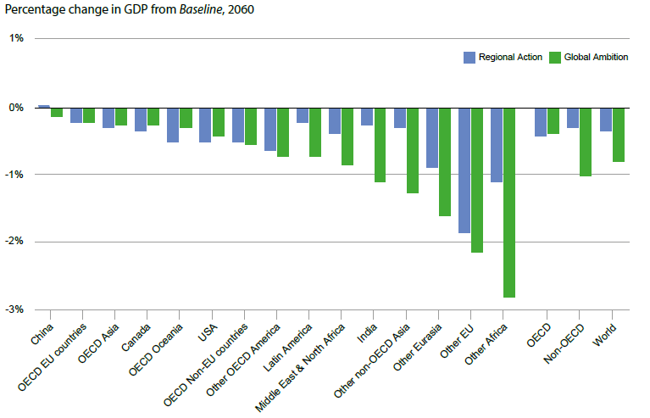
The costs of the Regional Action and Global Ambition scenarios on regional GDP are higher in non-OECD countries

Slide 19
Main messages
A broad range of policies is needed to reduce leakage of plastics to the environment as low as possible at reasonable cost
Plastics are an essential part of our economy: even in a circular policy pathway plastics use – and thus plastic waste – keeps increasing
In the Global Action scenario, plastic leakage to the environment is projected to decrease to near zero levels by 2060, with annual leakage of plastics into the aquatic environment falling by 98% compared to the Baseline in 2060. However, in the interim stocks of plastics will continue to accumulate in the aquatic environment, reaching 300 Mt in 2060, which is slightly more than double the 2019 level.
Additional measures to clean up the remaining plastics leakage to the marine environment could remove all new marine plastics pollution
Notes:
Note for last bullet:
while the costs of this clean up are likely to be high, they are roughly three times smaller than the costs linked to the economic and environmental damage caused by plastic pollution. Waste treatment costs per tonne of plastics are substantially lower than for cleaning up, making prevention the most rational option.

Slide 20
Thank you!
Notes:
Welcome

Slide 21
Background

Slide 22
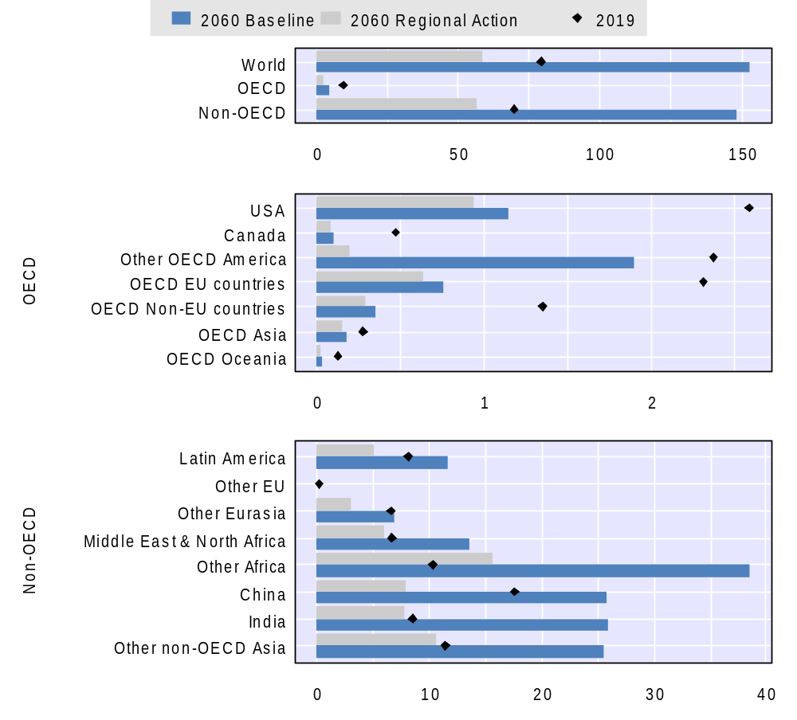
Regional Action: Mismanaged waste volumes are projected to fall most in non-OECD countries in the Regional Action scenario
Mismanaged plastic waste in million tonnes (Mt)

Slide 23
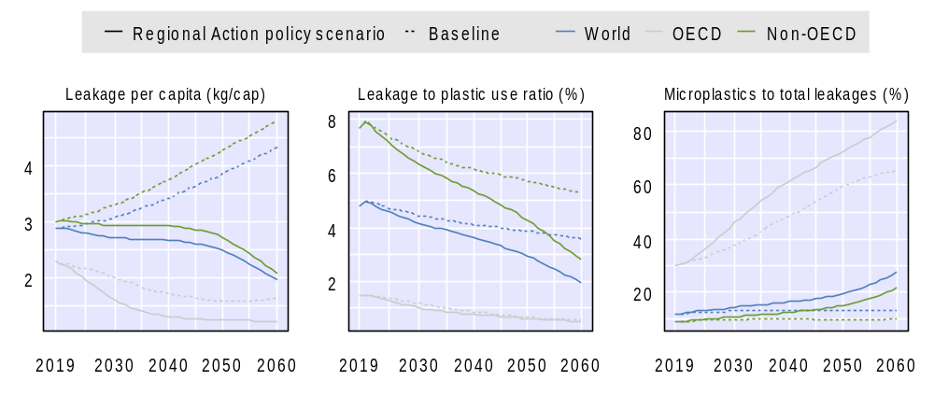
The Regional Action scenario will lower plastic leakage per capita, and decouple leakage from GDP and plastics use
Plastic leakage to the environment

