Slide 1


How Bilateral Trade Deals Get in the Way of Multilateral Agreements
Jayson Beckman, Maros Ivanic, Saleem Shaik
USDA Economic Research Service
June 9, 2022

Slide 2

Can countries unilaterally negotiate better trade deals than multilateral agreements?
Historically, there have been attempts for liberalizing global trade through global agreements (i.e., GATT, WTO)
With the failure of the Doha Round, countries moved towards regional and bilateral agreements
Are regional trade agreements helping the world reach a global agreement or preventing it?

Slide 3
Previous theoretical work is not conclusive
Aghion et al. (2007): global free trade may or may not be attained depending on whether trade coalitions produce additional welfare (superadditivity); bilateral negotiations may create “stumbling blocks” or “building block” of countries
Saggi (2010): global free trade may not be possible under multilateral trade agreement with asymmetries in countries endowments; however, bilateral agreements lead to free trade
This is essentially an empirical question—the answer will likely depend on the details of the existing protection, taxes, and countries’ endowments, preferences

Slide 4
Approach
To keep things simple, we consider the TPP group (12 countries) and ten commodities
We calculate welfare gains of the envisioned multilateral agreement
As an alternative, we allow countries to negotiate their own bilateral agreements:
  Any country can approach another country with a proposal for a bilateral agreement
  The countries agree on a deal that maximizes the proposing country’s own welfare without reducing the welfare of the other country
  Countries negotiate in the same sequence until no country wants to change anything (Nash equilibrium)
Because the order of negotiations may matter, we consider several random orders of negotiations

Slide 5
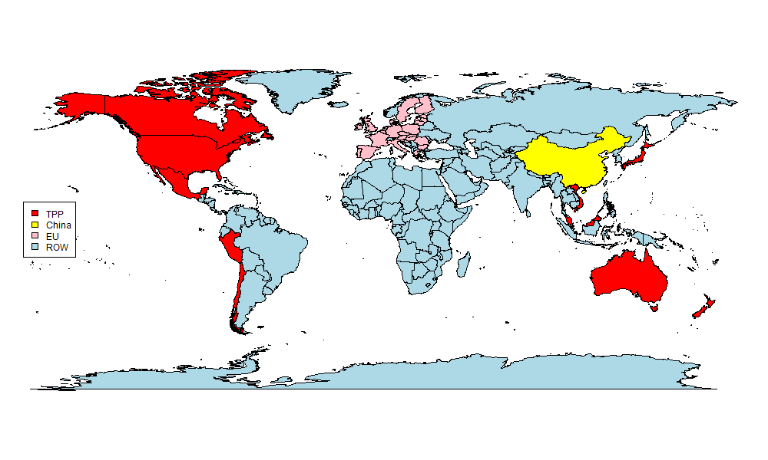
Regional aggregation

Slide 6
Illustration of our bargaining game
Randomize the country order:
Negotiations start with Vietnam negotiating with Peru
Vietnam considers all 1,024 permutations of commodities to be either included or excluded from the agreement with Peru
Vietnam identifies the welfare-maximizing option which does not make Peru worse off
The bilateral agreement is adopted and Vietnam moves to negotiating with Australia; New Zealand concludes the round with negotiating with Malaysia
The round is repeated until no country wants to make any further changes
Vietnam
Peru
Australia
USA
Chile
Singapore
Canada
Brunei
Japan
Mexico
Malaysia
New Zealand

Slide 7
Liberalized rates are exogenous
We use final tariffs negotiated under the TPP
We assume countries would offer these tariff rates to all partners if the commodity is included in the bilateral agreement
 | Australia | Burnei | Canada | Chile | Japan | Malaysia | Mexico | New Zealand | Peru | Singapore | Vietnam | USA
Rice | 0 | 0 | 0 | 0 | 243.25 | 0 | 0 | 0 | 0 | 0 | 0 | 0
Other crops | 0 | 0 | 0 | 0 | 0 | 0 | 0 | 0 | 0 | 0 | 0 | 0
Other agriculture | 0 | 0 | 0 | 0 | 0.00 | 0.00 | 0 | 0 | 0 | 0 | 0 | 0
Beef | 0 | 0 | 0 | 0 | 4.77 | 0 | 0 | 0 | 0 | 0 | 0 | 0
Other meat | 0 | 0 | 0.00 | 0 | 0.00 | 0 | 0 | 0 | 0 | 0 | 0 | 0
Dairy | 0 | 0 | 23.87 | 0 | 0 | 0 | 0 | 0 | 0 | 0 | 0 | 0
Processed food | 0 | 0 | 0.09 | 0 | 0 | 0.00 | 0 | 0 | 0 | 0 | 0.00 | 0
Resources | 0 | 0 | 0 | 0 | 0.00 | 0 | 0 | 0 | 0 | 0 | 0 | 0
Manufacturing | 0 | 0 | 0.00 | 0 | 9.03 | 0.00 | 0 | 0 | 0 | 0 | 0 | 0
Services | 0 | 0 | 0 | 0 | 0 | 0 | 0 | 0 | 0 | 0 | 0 | 0
0.00 indicates the presence of a tariff within the sector, but the overall rate is 0

Slide 8
Technical implementation
GTAP model (classic)
GTAP database (version 11)
  15 countries, 10 commodities
Reduction of tariffs to agreed levels (tms)
Run the negotiations in R
  Randomize countries’ order
  Evaluates each country’s options
  Updates the agreements
  Stops when no one wants to make any more changes

Slide 9
Scenarios
Closure
  Long-run, standard GTAP parameters
  Use tms variable to change import tariffs
One multilateral scenario
  Reduce tariffs among TPP countries to the agreed levels
  One GTAP simulation
Several bilateral scenarios:
  Randomize the order of the twelve TPP countries
  Run until Nash equilibrium is reached a sequence of bargaining games where each country evaluates up to 1,024 possible trade options
  Numerous GTAP simulations taking days to solve

Slide 10
Example of a reached bilateral agreement
Bilateral
Multilateral
 | Allocative efficiency | Terms of Trade | Investment | Total
Australia | 547 | 658 | -14 | 1,191
Brunei | 0 | -111 | 37 | -73
Canada | 221 | 1,162 | 6 | 1,388
Chile | 263 | 9,050 | 148 | 9,461
Japan | 9,286 | -1,716 | 260 | 7,830
Malaysia | 250 | -310 | 3 | -57
Mexico | 139 | 807 | -71 | 875
New Zealand | 28 | 294 | -15 | 308
Peru | 3 | 147 | -10 | 140
Singapore | 244 | 685 | -45 | 884
Vietnam | 504 | 4,058 | 20 | 4,581
USA | 442 | -1,847 | -648 | -2,052
Total | 11,927 | 12,877 | -329 | 24,476
 | Allocative efficiency | Terms of Trade | Investment | Total
Australia | 547 | 680 | -17 | 1,210
Brunei | 0 | -112 | 37 | -75
Canada | 340 | 1,498 | 35 | 1,873
Chile | 263 | 9,083 | 150 | 9,496
Japan | 9,569 | 1,279 | 451 | 11,299
Malaysia | 257 | -333 | -3 | -79
Mexico | 122 | 636 | -53 | 705
New Zealand | 46 | 315 | -14 | 347
Peru | 5 | 169 | -10 | 164
Singapore | 323 | 852 | -59 | 1,116
Vietnam | 505 | 3,860 | 22 | 4,387
USA | 478 | -2,557 | -975 | -3,053
Total | 12,455 | 15,370 | -436 | 27,390

Slide 11
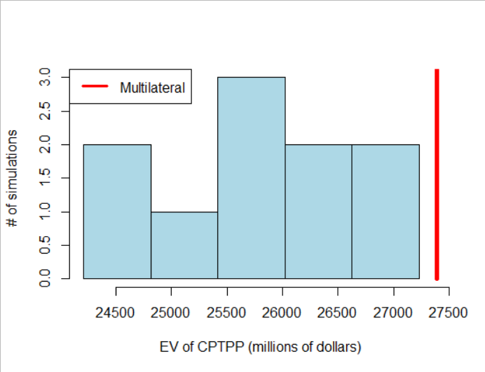
Comparison of welfare from bilateral and multilateral agreements
Countries negotiating alone reach most of the benefits but typically not all
The lowest welfare gain: $24.2 billion vs $27.4 multilateral
The highest welfare gain $27.2 billion is very close to the multilateral gain

Slide 12
Is the multilateral agreement the best possible?
We ran 660 simulations to exclude one product from the agreement in a single country pair
In 80 cases, the exclusion increased welfare
However, in 72 cases, the exclusion would benefit third countries and would not be negotiated under our framework
In eight cases excluding a commodity from a bilateral agreement would benefit the trading partners
Superadditivity may therefore occasionally be violated at a very granular level

Slide 13
Does superadditivity hold at a higher level?
We have seen that superadditivity may be violated at a very detailed level
We test whether it holds at the aggregate level
  We run ten simulations excluding one commodity at a time
  We run twelve simulations excluding one country at a time
In each case we find that welfare is reduced by excluding any single sector/country from the free trade agreement

Slide 14
Conclusions
Using the GTAP database and model, it is not very likely that TPP countries acting alone will reach bilateral trade agreements on par to a multilateral agreement in terms of welfare, but they will get close
  Frequent stumbling blocks arise preventing further integration
The multilateral agreement is not welfare-maximizing and can be further improved
  It is an unanswered question if countries can reach the welfare-maximizing agreements—which countries should lead the negotiations?
We appear to run into the limits of superadditivity of welfare in trade agreements when we get to the details of trade agreements in the real world
  While expanding free trade is welfare-increasing at broad levels (e.g., countries, sectors), this may not work for individual commodities and country pairs

Slide 15




Like, Share, & Follow ERS
www.ers.usda.gov
www.ers.usda.gov/data-products/charts-of-note
@USDA_ERS
linkedin.com/company/usda-economic-research-service
Subscribe For Weekly E-mail Notifications: www.ers.usda.gov/subscribe
Job Info: http://ers.usda.gov/about-ers/careers-at-ers
Notes:
Before I close, I’d like to note a few ways you can stay up-to-date with ERS research.
On social media, you can find us on Twitter (@USDA_ERS) and LinkedIn (USDA Economic Research Service).
You can also visit our website – www.ERS.USDA.gov – to find full copies of our reports or subscribe to specific products of interest.
Our multimedia page includes a variety of webinars, podcasts and videos as well.
Here in the next few months, be on the lookout for a new Webinar Data Series, which will highlight the ins and outs of our most popular data products.
I’d also like to give a shoutout to our new Charts of Note Mobile App – coming soon to Google Android & Apple app stores in the next few months.
Once available, this app – free of cost -- will deliver the latest ERS research straight to your mobile device. With this app, you can easily search ERS’s full library of charts, mark your favorites and share them on social media.
Remember to keep ERS in mind in your future pursuits – whether as a helpful resource or potential career path. We’re always seeking the best and the brightest minds to advance our research.
For a list of current ERS openings, visit our career webpage listed at the bottom of this slide.

Slide 16
Questions?
Presenter Name / Authors
Contact Details

