Slide 1
ECONOMIC AND ENVIRONMENTAL IMPACTS OF BIOFUELS PROMOTION IN NIGERIA: A RECURSIVE DYNAMIC GTAP APPROACH
BY
FALOBI, EMMANUEL OMONIYI
ADENIKINJU, A F. PhD
FALODE, O. A. PhD
CPEEL, UNIVERSITY OF IBADAN. NIGERIA
25th Annual Conference on Global Economic Analysis. June 8 – 10, 2022

Slide 2
Disclaimer
Please take note that:
All views expressed in this presentation are entirely those of the authors only. They do not necessarily represent those of CPEEL or University of Ibadan.
Thanks.

Slide 3
Presentation Outline
Introduction and Motivation
Methodology
Simulation of Policies
Results
Conclusions
Model Overview
Data and Parameters

Slide 4
Presentation Outline
Introduction and Motivation
Methodology
Simulation of Polices
Results
Conclusions
Model Overview
Data and Parameters

Slide 5
Introduction and Motivation
Biofuels promotion is critical in Nigeria’s energy mix & receiving global attention
They contribute to climate protection through the reduction of greenhouse gas (GHG) emissions and reduce dependency on fossil fuels and, also reduce oil price volatility
Also, they enhance the security of energy supply
Hence biofuels policy seek to promote renewable policy in most countries, to augment the Oil & Gas, and Power Sectors ever increasing energy demand and Nigeria is no exception
This necessitated the enactment of the Nigerian Biofuel Policy and Incentives (2007)

Slide 6
Introduction and Motivation
The Policy Initiative had set a bioethanol target of 1.27 billion liters per year to achieve a blend of 10% Ethanol (E-10) in gasoline by 2010 using cassava and sugar cane as main feedstocks
Several studies abound in the literature on biofuels (e.g. Taheripour et. al., (2007); Padella M et. al., (2012; Arndt C. et. al., (2008), Hertel, Tyner, and Birur (2010) but none has so addressed the economy-wide impacts of biofuels promotion and its environmental impacts on Nigeria’s economy
This study seeks to fill this knowledge gap using a dynamic tool like the CGE Model to examine the economy-wide and sector-level implications of the biofuel policy and promotion for plausible policy decision-making in a developing economy like Nigeria.

Slide 7
Motivation
The recursive-dynamic features make it easily amenable to modify the standard GTAP model to accommodate renewable energy (biofuel) policy analysis
GEMPACK employs a constant difference of elasticities (CDE) demand system which allow for the introduction of own-price and income elasticities
Flexibility inherent in the core GTAP data base to accommodate several extensions (e.g. GTAP-E, GTAP-BIO, GTAP-POWER, GTAP-AEZ) to analyze climate change mitigation / GHG emissions, energy policies, and land use
Interdependencies amongst economic sectors, economic agents, and economic markets are easily captured
Novel research on Nigeria’s Biofuel Policy (2007)

Slide 8
Motivation
Main Objective
To investigate the economic and environmental impacts of biofuel promotion in Nigeria focusing on impacts of biofuel policy on indirect land use changes and GHG emissions
Specific Objectives
To examine the net effect of biofuel promotion on household real income
To examine the net effect of biofuel promotion on GHG emissions; and
To assess the effect of biofuel promotion on the forest sub-sector

Slide 9
Presentation Outline
Introduction and Motivation
Methodology
Simulation of Polices
Results
Conclusions
Model Overview
Data and Parameters

Slide 10
RD-GTAP Model Overview
Adoption of year-on-year capital accumulation leveraging Aguiar et al., (2020)
RD Model based on sequence of time-based comparative static equilibria
Endogenous capital accumulation will drive growth in capital stock (investment & capital flow relation usually has a 1-year gestation lag)
In static GTAP model, end of period capital stock is determined by the capital accumulation function, where:
The beginning period capital stock (kb) does not change as the aggregate capital supply/endowment (qe(‘capital”,r) is fixed
Hence, the need to add dynamic equation linking net investment changes within the year to year on year growth in qe(“capital”,r) and kb.
Kt+1 =(1−δ)Kt + It
ΔKt = It −δKt
ke =(1− INVKERATIO)*kb+ INVKERATIO*qinv

Slide 11
RD-GTAP Model Overview cont’d
Characterized by nested CES and CET functional forms (representing Production behavior and land supply respectively)
Leverages GTAP-E for inter-fuel substitution, capital-energy substitutability/complementarity, trade elasticities, carbon tax revenues & expenditure and carbon emission trading (Burniaux and Truong, 2002)
Households are represented by Nonhomothetic Constant Difference of Elasticities (CDE) function form
Land-use biofuel sectors are fully represented

Slide 12
Presentation Outline
Introduction and Motivation
Methodology
Simulation of Polices
Results
Conclusions
Model Overview
Data and Parameters
Introduction and Motivation
Methodology
Simulation of Polices
Results
Conclusions
Model Overview
Data and Parameters

Slide 13
Data and Parameters
Core data for this research derive mainly from the revised Social Accounting Matrix (SAM) for Nigeria (2011) (Nwafor et.al. 2010; Siddig et. al., (2012)
Updated 2010 Input-Output Table and National Accounts data provided by Nigeria Bureau of Statistics (NBS) and the Central Bank of Nigeria (CBN)
GTAP version 9 Database – disaggregates 140 Countries/, Regions 57 Commodities/Sectors and 8 Factors of Production for Three (3) Benchmark Years: 2004, 2007, and 2011
GTAP 9 Production Sector has 4 distinct blocks, namely:
  A fully disaggregated energy sector identifying biofuels as a separate sub-sector;
  Disaggregated agricultural sector identifying biofuel feedstock as a sub-sector;
  Disaggregated energy-intensive manufacturing sectors such as Iron and Steel, pulp and paper, etc;
  A fuller representation of land types and uses, including croplands, forestlands, pasturelands, and grasslands.

Slide 14
Set Elements of the Aggregated GTAP Model
The lists of the main Sets follow from the data aggregation that was applied to the model
Detail description of each set category is contained in the “sets.har” file of the GTAP Model
REGION (Set REG) | SECTORS (Set TRAD_COMM) | FACTORS (Set ENDW_COMM)
Nigeria (NGA) Rest of World (RoW) | Agriculture Crude Petroleum Natural Gas Oil Refining Manufacturing Electricity Transport Services Public Admin | Land Labor Capital Energy BIO
Source: Author – Aggregation from GTAP 9 model data base

Slide 15
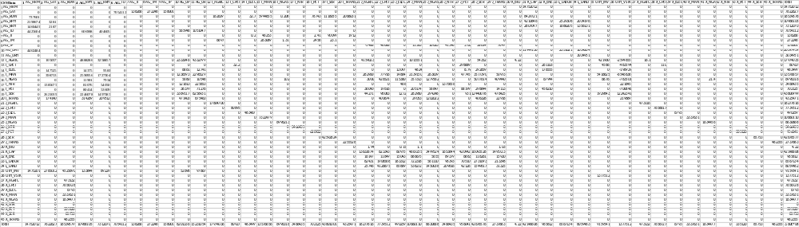
Data and Parameters cont’d
Nigeria’s SAM (CSV Data Format)
Elasticity parameters are exogenous describing supply and demand responsiveness to changes in relative prices and income.
Elasticity parameters needed for this study are obtained from both the GTAP 9 database and existing studies in the literature.

Slide 16
Production Data Input in Nigeria’s 2 x 9 SAM (N Million)
- Supply-side of Nigeria’s economy
SAM Entry | A C T I V I T I E S |  |  |  |  |  |  |  |  | Definition
 | Agric | CPET | NGAS | PET | MAN | ELEC | TRANS | SER | NTR
Commodities - Total | 4,525,431 | 1,022,809 | 3,098,319 | 415,574 | 4,034,026 | 145,060 | 973,869 | 22,147,464 | 1,375,856 | Intermediate Inputs
Agric | 4,159,039 | - | - | - | 1,015,551 | - | - | 54,352 | -
CPET | 110 | - | - | 298,689 | - | - | - | - | -
NGAS | 3,021 | 426,521 | 1,279,562 | - | 357,313 | 115,360 | 409,440 | 5,077,614 | -
PET | 36,090 | 19,616 | 58,847 | 68,199 | 205,174 | - | 14,113 | 298,844 | -
MAN | 282,900 | 77,916 | 263,639 | 47,745 | 2,139,150 | 14,864 | 50,973 | 3,577,390 | -
ELEC | - | - | - | 9 | 4,824 | 13,097 | - | 292,859 | -
TRANS | - | 400,674 | 1,202,022 | - | 29,053 | - | 22,918 | 406,328 | -
SER | 44,271 | 98,083 | 294,248 | 931 | 282,960 | 1,272 | 476,425 | 12,440,078 | -
NTR | - | - | - | - | - | 466 | - | - | 1,375,856
Factors - Total | 13,758,000 | 6,668,635 | 5,516,327 | 540,461 | 6,614,520 | 345,199 | 1,756,367 | 20,492,498 | 2,049,031 | Factor Payments | Value-Added
Land | 25,746 | 4,126,875 | 1,450,037 | 42,126 | 538,272 | 85,869 | 31,325 | 1,549,617 | 209,616
Labor | 82,431 | 1,906,568 | 561,110 | 70,510 | 722,318 | 183,312 | 213,398 | 2,731,093 | 96,393
Capital | 13,633,674 | 623,343 | 3,499,524 | 420,942 | 4,667,255 | 60,975 | 1,495,723 | 16,093,528 | 1,653,644
Energy | 16,147 | 11,849 | 5,655 | 6,883 | 686,675 | 15,043 | 15,920 | 118,261 | 89,379
Biofuel | 2 | - | - | - | 1 | 0 | 1 | - | -
Production Tax (TP) | (5,468) | 48,068 | 16,023 | 6 | 11,563 | - | 7,647 | 38,614 | 41,548 | Production & Sales Taxes
Direct Tax (TD)
Indirect Tax (TI) | - | - | - | 2 | 46,253 | 0 | 1,912 | 90,099 | -
Import Tax TM) | 6,697 | - | 1 | 2,458 | 263,069 | - | - | 23 | -
T O T A L | 18,284,660 | 7,739,512 | 8,630,669 | 958,502 | 10,969,432 | 490,260 | 2,739,795 | 42,768,698 | 3,466,435 | Gross Value of Output
Notes:
Supply Side:
This brings out the linkages amongst various industries through their demands for intermediate inputs and competition for the primary factor inputs of production that are required to turn intermediate inputs into final products.

Slide 17
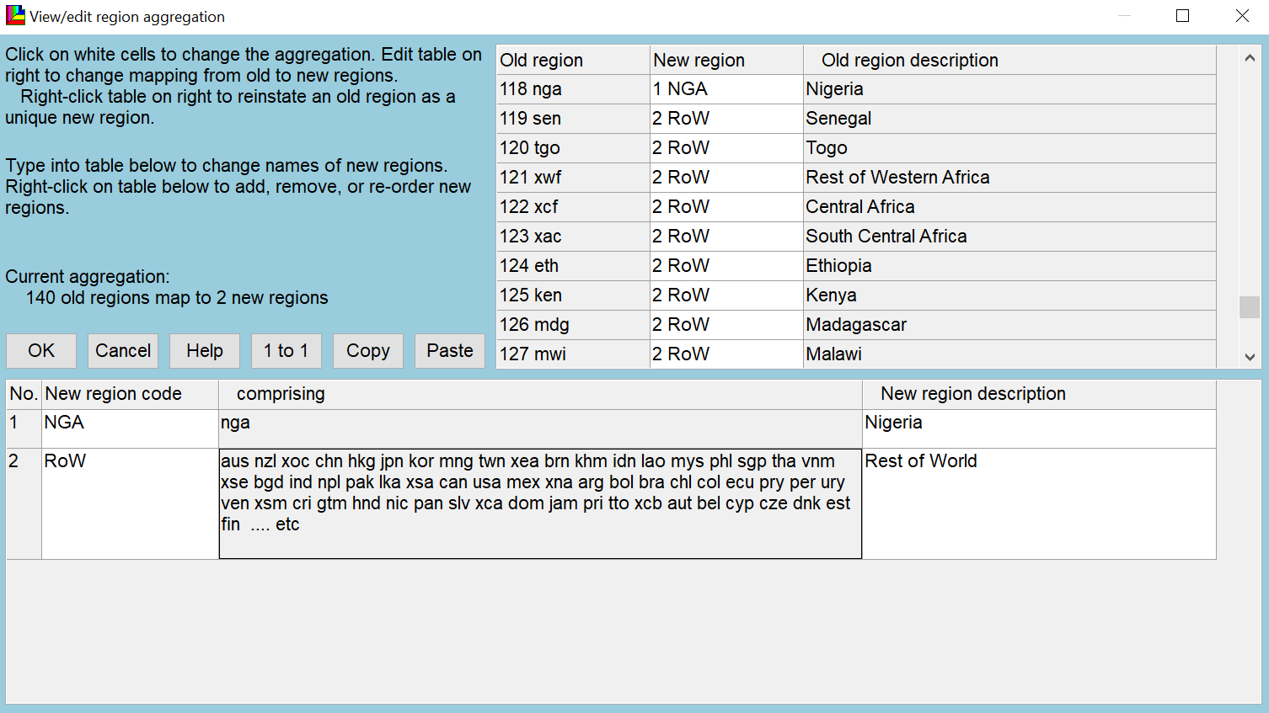
Data Aggregation Scheme
- Regional Aggregation Scheme
Regional Data Aggregation Scheme
2-Region Aggregation of Nigeria’s SAM
140 old regions of GTAP 9 were mapped into 2 new Regions (Nigeria, NGA; and Rest of the World, RoW)

Slide 18
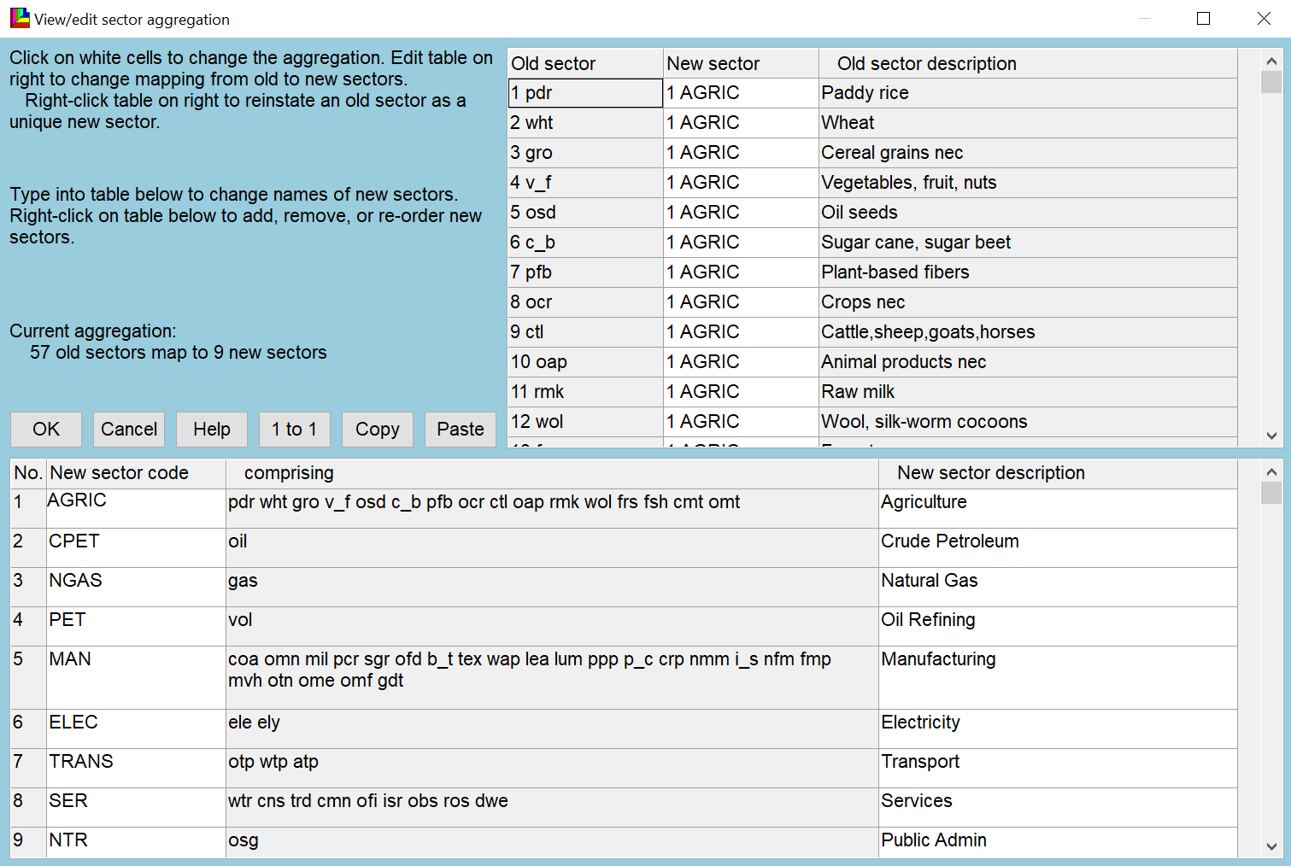
Data Aggregation Scheme
- Sectoral Aggregation Scheme
Sectoral Aggregation Scheme
9-Sector Aggregation of Nigeria’s SAM
57 old sectors were mapped into 9 new tradeable commodity aggregation sectors

Slide 19
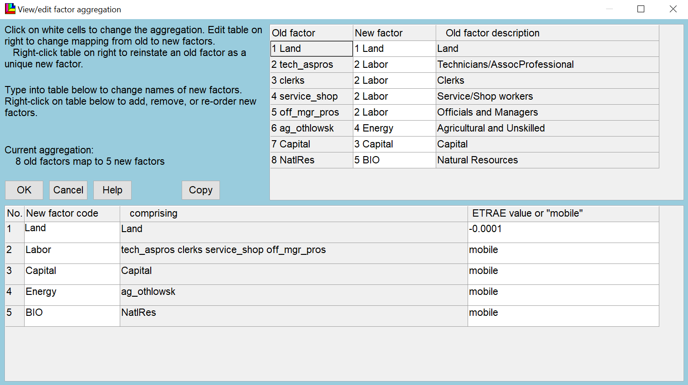
Data Aggregation Scheme
- Primary Factor Aggregation Scheme
Primary Factor Aggregation
Primary Factor (Endowment Commodities) Aggregation
8 old factors have been mapped into 5 new factors.
Land is considered a sluggish endowment and sector-specific with an assumed factor mobility elasticity parameter value of -0.0001 whilst other aggregated primary factors are assumed to be mobile.

Slide 20
Elasticity Parameters
We employ utility functions and elasticity parameter values that best describe consumer preferences in Nigeria
4 Types of behavioral parameters exist in the literature (Hertel, T. 2016):
  Elasticities of substitution in both consumption and production – determines the responsiveness of the nested CES utility and production functions
  Transformation (mobility) elasticities for endowment commodities – determines the degree of mobility of primary factors across sectors
  Flexibilities of regional investment – determines the flexibility of regional investment
  Consumer demand elasticities - based on the CDE expenditure function and naturally calibrated to income and own-price elasticities of demand (Hertel et al. 1991).

Slide 21
Elasticity Parameters for Nigeria Sectors
Elasticity | Agric | CPET | NGAS | PET | MAN | ELEC | TRANS | SER | NTR | Total
Supply parameters
Factor Substitution (ESUBVA) | 0.331 | 0.2 | 0.2 | 1.12 | 1.18 | 1.26 | 1.68 | 1.38 | 1.26 | 8.61
Intermediate input substitution (ESUBT) | 0 | 0 | 0 | 0 | 0 | 0 | 0 | 0 | 0 | 0
Demand parameters
Consumer Income (INCPAR) | 0.616 | 1.38 | 1.57 | 0.754 | 1.1 | 1.48 | 1.38 | 2.18 | 2.11 | 12.57
Consumer Substitution (ISUBPAR) | 0.84 | 0.686 | 0.661 | 0.794 | 0.735 | 0.672 | 0.686 | 0.591 | 0.595 | 6.26
Import Substitution (Import vs. domestic goods) (ESUBD) | 2.74 | 5.2 | 17.2 | 3.3 | 3.11 | 3.7 | 1.9 | 1.91 | 1.9 | 40.96
Import Substitution (among trade partners) (ESUBM) | 5.63 | 10.4 | 34.4 | 6.6 | 6.53 | 8.66 | 3.8 | 3.8 | 3.8 | 83.62
Source: Author's compilation from Elasticity Parameter Output File in GTAP 9 Model Data Base

Slide 22
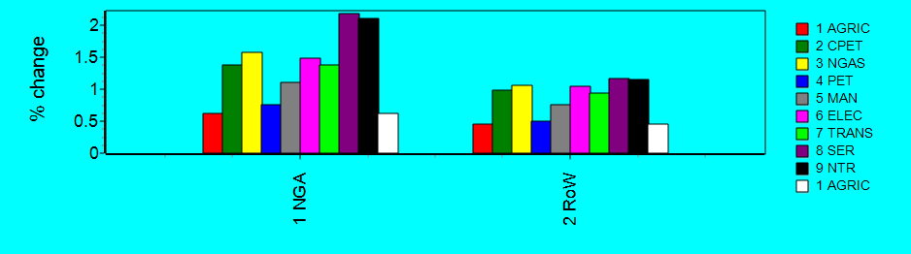
Consumer (CDE) Income Parameter (INCPAR) Elasticities
INCPAR | 1 NGA | 2 RoW | Total
1 AGRIC | 0.616 | 0.45 | 1.07
2 CPET | 1.38 | 0.989 | 2.37
3 NGAS | 1.57 | 1.06 | 2.63
4 PET | 0.754 | 0.498 | 1.25
5 MAN | 1.1 | 0.761 | 1.86
6 ELEC | 1.48 | 1.04 | 2.51
7 TRANS | 1.38 | 0.936 | 2.31
8 SER | 2.18 | 1.17 | 3.35
9 NTR | 2.11 | 1.15 | 3.26
Total | 12.6 | 8.06 | 20.6
INCPAR_{i} – a parameter related to the income elasticity of demand for good i.
Larger INCPAR_{i} parameter value implies larger income elasticity of demand
Income insensitive (necessity) goods: 0 < INCPAR_{i} < 1
Income sensitive (luxury) goods: 1 < INCPAR_{i}
Homothetic demand: INCPAR_{i} = 0 for all i
Restrictions: 0 < INCPAR_{i}
Source: Adapted from Burfisher, pg. 104 (2011)

Slide 23
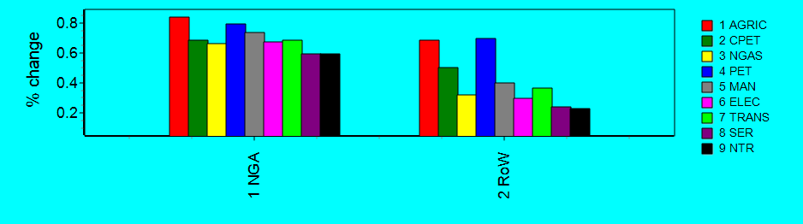
CDE Consumer Substitution Parameter (SUBPAR) Elasticity
SUBPAR | 1 NGA | 2 RoW | Total
1 AGRIC | 0.84 | 0.687 | 1.53
2 CPET | 0.686 | 0.499 | 1.19
3 NGAS | 0.661 | 0.319 | 0.981
4 PET | 0.794 | 0.698 | 1.49
5 MAN | 0.735 | 0.399 | 1.13
6 ELEC | 0.672 | 0.296 | 0.969
7 TRANS | 0.686 | 0.366 | 1.05
8 SER | 0.591 | 0.238 | 0.83
9 NTR | 0.595 | 0.225 | 0.821
Total | 6.26 | 3.73 | 9.99
SUBPAR_{i} – a parameter related to the compensated own and cross-price elasticities of substitution defined for good i
Larger SUBPAR_{i} parameter value implies larger (absolute value) of compensated own-price elasticity.
Leontief complements: SUBPAR_{i} = 1 for all i
goods become substitutes as SUBPAR_{i} and SUBPAR_{j} become smaller.
Independent goods: SUBPAR = 0 for all i.
Restrictions: Either SUBPAR_{i} < 0 or
0 < SUBPAR_{i} < 1 for all i
Notes: CDE collapses to a Cobb-Douglass utility function when all INCPAR_{i} =1 and SUBPAR_{i} = 0; to a Leontief utility function when INCPAR_{i} = 1 and SUBPAR_{i} = 1; and to a CES utility function when all INCPAR_{i} = 1 and SUBPAR are identical for all i

Slide 24
Presentation Outline
Introduction and Motivation
Methodology
Simulation of Polices
Results
Conclusions
Model Overview
Data and Parameters

Slide 25
Methodology
The Model
Model Assumption
Based on Neo-classical assumption of economic agents’ behavior of constant returns to scale and perfect competition in both factor and output markets, zero excess profits, and balanced budget for each agent; as well as production & consumption structures
Economic agents in the model consist of producers, 4 representative households, investors, government and rest of the world
Demands for commodities by producers, the households, investors, the government derive from optimization of profit (or cost) and utility functions
  Producers maximize profits (or minimize cost) subject to competitive markets and constant returns to scale production technologies
    For multi-product industries producers assume a constant elasticity of transformation (CET) composite of products technology

Slide 26
Methodology
The Model cont’d
  Household maximizes utility subject to its budget constraint
  Investors and the government minimize cost subject to certain constraints
Model Description
Model is a single country, multi-sector, global recursive dynamic general equilibrium framework and implemented with GEMPACK
Model is calibrated to the revised version of Nigeria’s 2010 social accounting matrix (SAM) of Nwafor, et al., (2010), Siddig, et al., (2012), and Adenikinju et al., (2014), as well as GTAP 9 Input-Output database
Model is robust, and sufficiently flexible to accommodate new regions and sectors as the need arises in the future

Slide 27
Methodology
Production Structure
Production structure is represented by a nested CES functional form – allowing substitutability between inputs
Land supply is represented by a CET structure which assumes imperfect substitution for different land types (croplands, grasslands, and pasturelands)
We assume that the intermediate inputs and the value-added factor-energy bundle are complementary
As the energy commodities have been disaggregated, inter-fuel substitution issues come into consideration (Burniaux and Truong, 2002)
Hence, at the top-level, of the production structure, non-energy intermediate inputs and value-added factor-energy composite are aggregated following a Leontief (fixed proportion) technology

Slide 28
Methodology
Production Structure cont’d
For a cassava-based feedstock ethanol production, the CES functional form applies since it is considered a substitute
Households demand derive from Stone-Geary function or Non-homothetic constant difference of elasticities (CDE) function
There is a detailed representation of land-use biofuel sectors
Lastly, the model captures bilateral and international trade.

Slide 29
Methodology
Production Structure cont’d
Nested CES Production Structure
Output
Leontief
Total Non-Energy Intermediate Input
Value Added + Factor-Energy Composite
CES
CES
Domestic
Foreign
Capital-Energy
Land
Labor
Natural Resources
CES
CES
Energy Composite
Capital by Vintage
Unskilled Labor
Skilled Labor
Notes:
The nested CES functional form – allows substitutability between inputs
Top Level ==> Substitution among Non-Energy intermediate inputs;
Level 1 ==> Substitution between factors and a composite
"capital + energy" good;
Level 2 ==> Substitution between capital and a composite
energy good;

Slide 30
Methodology
Land Supply AEZ Structure cont’d
Nested Land Supply CET Structure
Land
CES
Agro-Ecological Zone
CET
Pasture
Forest
Cropland
CET
Grains & Oilseeds
Sugar Crops
Cassava
Fruits & Vegetable
CET
Corn
Wheat
Other Coarse Grains
Oilseeds
Notes:
For the Land-use Change model, we consider both the Substitution Effect (i.e. the change in land-use distribution amongst different crops existing arable land; and the Expansion Effect of using more arable land made for cultivation and its impact on other types of land
The CET structure assumes imperfect substitution for different land types (croplands, grasslands, and pasturelands)
AEZs are mapping of global land based on agro-ecological characteristics (such as precipitation, temperature, soil type, etc)
The land data complimenting GTAP economic database has 18 AEZs representing the combination of 6 lengths of growing period categories with 3 climatic regimes (Tropical, Temperate & Borea).

Slide 31
Methodology
Nested CES Structure for Energy Demand
Nested CES Energy Structure
Energy Composite
CRESH
Electric Bundle
Non-Electric Bundle
CES
Coal
Gas
Oil & Biofuel Bundle
CES
Ethanol/Gasoline Bundle
Other Oil Bundle
Biodiesel/Diesel Bundle
CES
CES
Bioethanol
Gasoline
Biodiesel
Diesel
Notes:
Level 1 ==> substitution between electricity and a composite non-electric good;
Level 2 ==> Substitution between coal and a non-coal composite;
Level 3 ==> Substitution between remaining fuels (crude oil, natural gas and petroleum products).

Slide 32
Methodology
Nested CDE Structure for Household Demand for Private Goods
Nested CDE Structure for Household Demand
Household Demand
CDE
Transport Bundle
Energy Composite
Other Goods
CRESH
CES
Mode 1
. . .
Mode 4
Goods 1
. . .
Goods N

Slide 33
Methodology
Nested Leontief Structure for Government Demand
Nested Leontief Government Demand
Government Demand
LEONTIEF
Transport Bundle
Energy Composite
Other Goods
CRESH
CES
Mode 1
. . .
Mode 4
Goods 1
. . .
Goods N

Slide 34
Presentation Outline
Introduction and Motivation
Methodology
Simulation of Polices
Results
Conclusions
Model Overview
Data and Parameters

Slide 35
Simulations
Baseline Policy Scenarios
Baseline Scenario
Provides a benchmark against which we can compare other biofuel scenarios
  This will help us to characterize the growth of the economy to 2026 based on the Bioethanol target of 1.27bn liters per annum for a 10% ethanol (E10) blend gasoline mandate and without the biofuel policy scenarios so identified
Biofuel Simulation Scenarios:
Cassava Scenario (SIM_1): Land use expansion allocated to Cassava cultivation over 2007 – 2026 time horizon
Sugarcane Scenario (SIM_2): Land use expansion allocated to Sugarcane cultivation over 2007 – 2026 time horizon
Combined Scenario (SIM_3): Captures the combined effect of all biofuel interventions on the economy structure
Notes:
We are using different land mobility assumptions to capture the likely impacts of biofuel expansion on the GHG emissions and forestry sub-sector
Specifically, three land mobility assumptions are being imposed on the model:
Fully employed and activity specific (Immobile)
Not fully employed & mobile across sectors; and
Fully employed and mobile across sectors.
According to Fargione et al., (2008) land-use conversion from native land users to biofuel crops leads to GHG emission.

