Slide 1


Estimating Protection in Services Sector: A PPML Analysis
Bushra Faizi
Co-authors: Dr. Eskandar Shah, Dr. Nasim Shah Shirazi
25th Annual GTAP conference June 8th-10th,2022

Slide 2
NTMs in services
Modes: cross-border supply, consumption abroad, commercial presence, and natural presence
NTMs in services: (Restrict supply or increase cost, impede trade)
STRI – Barriers in services-five policy areas Restriction on foreign entry Barriers to competition Restrictions on people movement Regulatory transparency Other discriminatory measures Also, Capital requirements (Telecom Industry) Foreign equity cap (e.g Insurance) Nationality requirements (e.g Executives) Domestic regimes License requirement

Slide 3
Interpretation of AVEs
Proportional increase in domestic price due to policy relative to the price in the absence of regulation
Different in goods and services (Services are highly differentiated and intangible)
Different than welfare analysis – higher AVEs do not infer welfare distortion
NTMs affect both supply curve through the various costs associated with compliance and the demand curve through signaling or catalyst effect (Cadot et al.,2018, p. 8)”

Slide 4
Estimation of AVEs in services: Literature
Price-raising effect - higher AVEs in developing countries
Limited empirical discussion calculating AVEs
WB and OECD Services Trade Restrictiveness Index (STRI) –
Limitations of STRI approach: Resource consuming, assigning arbitrary codes to the qualitative information- Fontagné et al., (2013)
CGE models, modeling regulations using import and export taxes or as an iceberg cost
Indirect method: Park (2002) Residuals method
Limitation: Residuals include info other than protection-
Fontagné et al., (2001, 2016) FE method with OLS using GTAP 9
Limitation OLS: Vulnerable to unobserved effects
Santos Silva and Tenreyro (2006) suggest PPML
PPML satisfies the structural gravity model (MRT)
This research: GTAP 10, new sectors and countries, PPML-

Slide 5
1
Research Question
Objective
3
Contribution
2
What is the price raising effect of NTMs in services?
To estimate the AVEs in services sectors using GTAP 10 and the latest methodology
Empirical contribution
New data, econometrics technique and covers more countries
Is it linked with development?

Slide 6
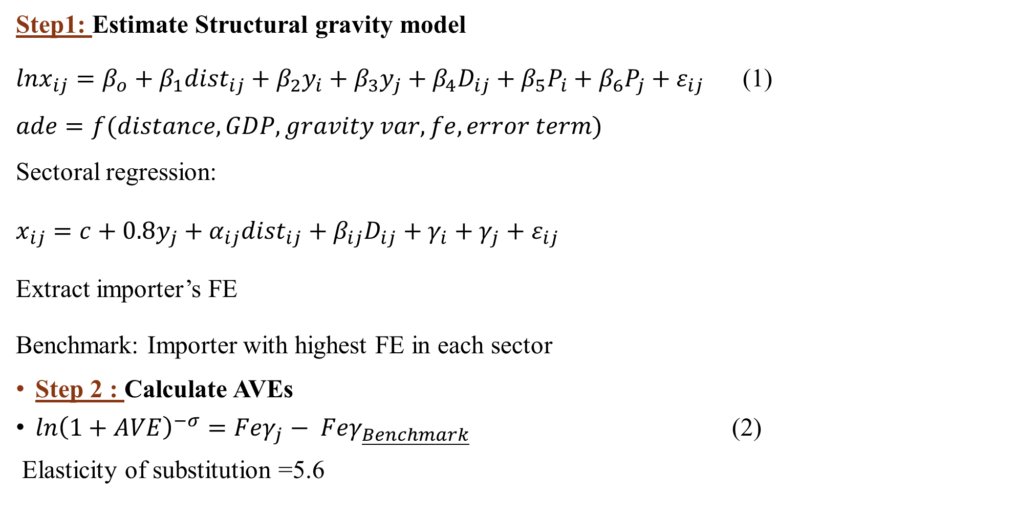
Methodology
Step1: Estimate Structural gravity model
${lnx}_{ij}=β_{o}+β_{1}{dist}_{ij}+β_{2}y_{i}+β_{3}y_{j}+β_{4}D_{ij}+β_{5}P_{i}+β_{6}P_{j}+ε_{ij}$ (1)
$$ade=f(distance, GDP, gravity var, fe, error term)$$
Sectoral regression:
$x_{ij}=c+{0.8y}_{j}+α_{ij}{dist}_{ij}+β_{ij}D_{ij}+γ_{i}+γ_{j}+ε_{ij}$
Extract importer’s FE
Benchmark: Importer with highest FE in each sector
Step 2 : Calculate AVEs
$ln{\left(1+AVE\right)}^{−σ}=Feγ_{j}− Feγ_{\underline{Benchmark}}$ (2)
Elasticity of substitution =5.6

Slide 7



Data sources
Gravity Variables
Bilateral trade in services
GDP

Slide 8
Services sectors
 | Code | Description
1 | AFS | Accommodation, Food and service activities
2 | ATP | Air transport
3 | CMN | Information and communication
4 | CNS | Construction: building houses factories offices and roads
5 | EDU | Education
6 | ELY | Electricity; steam and air conditioning supply
7 | GDT | Gas Distribution: distribution of gaseous fuels through mains; steam and hot water supply
8 | HHT | Human health and social work
9 | INS | Insurance: includes pension funding, except compulsory social security
10 | OBS | Other Business Services: real estate, renting and business activities
11 | OFI | Other Financial Intermediation: includes auxiliary activities but not insurance and pension funding
12 | OSG | Other Services (Government): public administration and defense; compulsory social security, education, health and social work, sewage and refuse disposal, sanitation and similar activities, activities of membership organizations , extra-territorial organizations and bodies
13 | OTP | Other Transport: road, rail ; pipelines, auxiliary transport activities; travel agencies
14 | ROS | Recreation & Other Services: recreational, cultural and sporting activities, other service activities; private households with employed persons (servants)
15 | RSA | Real estate activities
16 | TRD | Trade: all retail sales; wholesale trade and commission trade; hotels and restaurants; repairs of motor vehicles and personal and household goods; retail sale of automotive fuel
17 | WHS | Warehousing and support activities
18 | WTP | Water transport
19 | WTR | Water supply; sewerage, waste management and remediation activities
20 | DWE | Dwellings: ownership of dwellings (imputed rents of houses occupied by owners)

Slide 9
Results and Discussion
Step 1: Gravity Estimation
Sectors | distance | Comcol | contiguity | rta
CMN- Communication | 0.18** | 0.04 | 0.52*** | 0.43***
CNS- Construction | 0.15** | 0.36* | 0.41*** | 0.27**
TRD- Trade | 0.08 | -0.02 | 0.52*** | 0.36***
INS – Insurance | 0.30** | 0.60*** | 0.91*** | 0.32***
OBS- Business serv | 0.16*** | 0.06 | 0.46*** | 0.39***
OFI- Financial Inter | 0.30*** | 0.67** | 0.67*** | 0.60***
OSG- other serv | 0.56** | 0.15 | 1.34*** | 0.49***
AFS- Accom, food | -0.00 | -0.08 | 0.62*** | 0.28***
ELY- Electricity | -0.40 | 1.64*** | 2.69*** | 0.28**
WTP – Water transport | 0.14*** | 0.04 | 0.37*** | 0.31***
ATP- Air transport | 0.16* | 0.05 | 0.57*** | 0.24***
OTP- other transport | 0.12 | 0.04 | 0.80*** | 0.26***
GDT- Gas | 0.27 | -0.17 | 0.79*** | 0.27*
HHT- health | 0.15 | 0.00 | 0.90*** | 0.36***
WHS- Warehousing | 0.08 | -0.11 | 0.75*** | 0.22***
WTR- Water supply | 0.14 | -0.07 | 0.90*** | 0.30***
RSA- Real estate | 0.06 | 0.16 | 0.80*** | 0.30***
ROS- Recreation | 0.11* | -0.05 | 0.76*** | 0.33***
EDU- Education | 0.40** | 0.15 | 1.04*** | 0.41***
1. Dist. Proxy for info cost
Smaller distance effect with PPML
Example: Education
Mode1: E-learning
Mode 2: e,g Chinese students in the US
Global trade- Mode 1 (27%), Mode 2 (10%)
Technology facilitates-
2. rta and contiguity increase trade
(consistent with literature)

Slide 10
Results and Discussion
Step 2: Setting benchmark
Benchmark countries (AVEs=0)
High ESUB , low AVEs
Benchmark countries in each sector: zero AVEs (interpretation)
Compare all countries in each sectors to the benchmark
AVEs- relative not absolute
Sectors | Benchmark
CMN- Communication | Luxemburg
CNS- Construction | Azerbaijan
TRD- Trade | Ireland
INS – Insurance | Ireland
OBS- Business serv | Ireland
OFI- Financial Inter | Luxemburg
OSG- other serv | Kuwait
AFS- Accom, food | Ireland
ELY- Electricity | Albania
WTP – Water transport | Greece
ATP- Air transport | Hong Kong
OTP- other transport | Singapore
GDT- Gas | Georgia
HHT- health | Singapore
WHS- Warehousing | Singapore
WTR- Water supply | Singapore
RSA- Real estate | Oman
ROS- Recreation | Luxemburg
EDU- Education | Kuwait

Slide 11
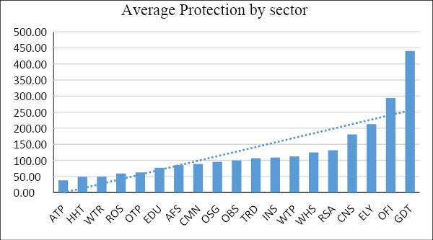
Results and Discussion
Cost of regulation in services (AVEs)

Slide 12
Results and Discussion
Cost of regulation in services (AVEs)
 | Open economies |  |  |  | Restrictive economies
Sectors | LUX | SGP | BEL | IRL | BGD | ZMB | PAK | TJK
CMN- Communication | 0.00 | 25.10 | 17.96 | 28.68 | 217.89 | 237.84 | 124.99 | 104.02
CNS- Construction | 32.37 | 92.39 | 79.46 | 154.11 | 325.39 | 351.10 | 316.24 | 32.37
TRD- Trade | 27.29 | 10.28 | 42.53 | 0.00 | 163.68 | 215.82 | 168.31 | 280.74
INS – Insurance | 11.72 | 37.35 | 71.45 | 0.00 | 280.74 | 101.38 | 242.27 | 144.89
OBS- Business serv | 11.00 | 12.21 | 20.03 | 0.00 | 154.67 | 281.57 | 78.29 | 140.15
OFI- Financial Inter | 0.00 | 124.99 | 132.44 | 80.24 | 527.74 | 432.14 | 479.23 | 315.33
OSG- other serv | 42.22 | 57.17 | 51.80 | 52.46 | 74.46 | 213.08 | 95.76 | 207.69
AFS- Accom, food | 9.80 | 24.28 | 40.37 | 0.00 | 171.83 | 163.11 | 130.93 | 243.02
ELY- Electricity | 71.45 | 330.03 | 89.07 | 73.70 | 760.35 | 336.63 | 163.11 | 162.54
WTP – Water transp | 35.87 | 1.31 | 28.40 | 68.50 | 235.64 | 243.76 | 205.02 | 268.53
ATP- Air transport | 2.42 | 16.44 | 8.14 | 27.85 | 23.48 | 151.91 | 121.59 | 92.81
OTP- other transport | 15.18 | 0.00 | 7.44 | 27.57 | 144.36 | 71.45 | 107.15 | 139.63
GDT- Gas | 43.46 | 137.04 | 101.38 | 83.80 | 1498.64 | 1391.21 | 407.29 | 35.28
HHT- health | 3.31 | 0.00 | 9.08 | 9.80 | 111.24 | 108.05 | 80.24 | 179.62
WHS- Warehousing | 60.98 | 0.00 | 60.28 | 73.33 | 240.79 | 231.29 | 188.89 | 297.66
WTR- Water supply | 4.22 | 0.00 | 9.32 | 10.52 | 113.55 | 108.05 | 77.91 | 171.24
RSA- Real estate | 70.34 | 60.63 | 79.07 | 71.82 | 237.10 | 240.79 | 194.60 | 28.68
ROS- Recreation | 0.00 | 9.32 | 19.25 | 26.19 | 137.04 | 63.44 | 98.33 | 194.60
EDU- Education | 30.94 | 36.46 | 38.55 | 43.46 | 74.08 | 185.14 | 86.22 | 192.05

Slide 13
Conclusions
Protection is heterogeneous across the sectors
Distance is not an impediment in services trade (mode 1 and mode 2) (Tharakan,2005; Boulatoff, 2021)
The liberalized sector is air transport, and the restrictive sector is gas (Fontagne et.al, 2011,2016; Peridy and Ghineim,2013)
Higher AVEs in services with PPML compared to OLS estimation (Bratt,2017)
Lower the per capita income, the higher the AVEs in services
On average, the most restrictive sector is the Gas sector with average AVE of 440 percent
Most open sector is Air transport with average AVE of 38 percent.
Taking the average of AVEs in all sectors, Luxemburg, Singapore, Belgium, and Ireland are the most open economies while Bangladesh, Zimbabwe, Pakistan, and Tajikistan are more restrictive.
Future research: AVEs can be used in CGE for welfare analysis

Slide 14
Thank you
GTAP community and organizers of the conference
Bushra Faizi

