Slide 1
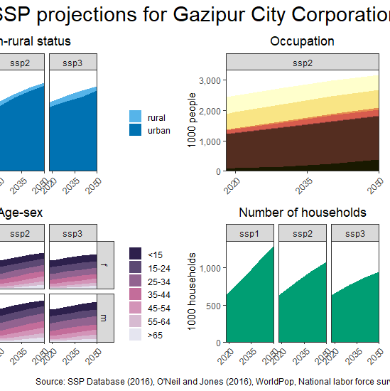



Subnational projections of income and poverty for Ethiopia: A CGE-spatial microsimulation approach
Presentation prepared for the 25th Annual Conference on Global Economic Analysis, June 8-10, 2022
Michiel van Dijk, Marijke Kuiper, Thijs de Lange and Jason Levin-Koopman

Slide 2

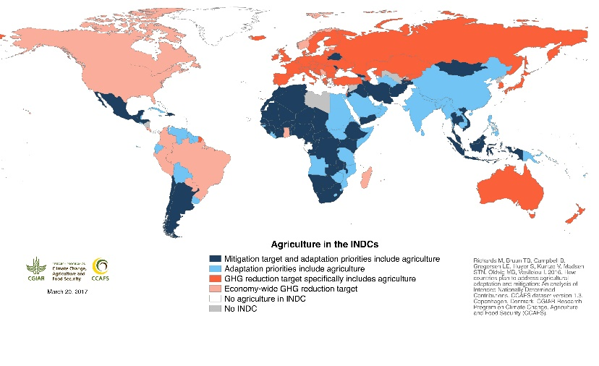
Introduction
Many countries are developing national food security, SDG and climate (NDCs) action plans and strategies
Gold standard for ex-ante policy assessments are simulation models combined with scenario analysis
Conventional (macro-level) simulation models are not able to take into account household heterogeneity and spatial detail, which is demanded for national-level analysis

Slide 3
Aim
To develop a modelling approach that takes into account global, national and local drivers of income to simulate income distribution and poverty at subnational scale, answering questions such as:
Which districts are most likely to achieve SDG1 and SDG10?
What is the impact of decreasing economic growth caused by COVID-19 on the spatial distribution of poverty?
Are there overlaps between climate and poverty hotspots?

Slide 4
Background: Combining two research streams
Spatial microsimulation
Micro-macro poverty assessments
Objective: Impact analysis of local social policies
Method: Reweighting/sampling of surveys to fit census data
Time horizon: Static with a few dynamic applications
Data: Household surveys and population census
Scale: Local (e.g. city), regional, and national analysis
Actors: National statistical agencies, universities
Examples: SimBritain, SimAthens, SimAlba, SpatialMSM, SMILE
References: Ballas et al. (2005), Harding et al. (2011) Tanton and Edwards (2013), Lovelace and Dumont (2018)
Objective: Analysis of macro-economic shocks on poverty
Method: Adjustment/reweighting of household surveys informed by macro-economic projections and simulation
Time horizon: Dynamic with a few static applications
Data: Nationally representative household surveys
Scale: Global and national analysis
Actors: World Bank, IFPRI
Examples: LINKAGE-GIDD, MIRAGRODEP-POVANA, World Bank country studies
References: Bussolo et al. (2010), Hallegate and Rozenberg (2017), Laborde and Martin (2018)
Spatial reweighting algorithm
Combination of household surveys with population census data
Micro-macro linkages
Macro socio-economic projections
Spatial Simulation of Income Distribution (SSID) model
Notes:
Global Income Distribution Dynamics (GIDD)

Slide 5
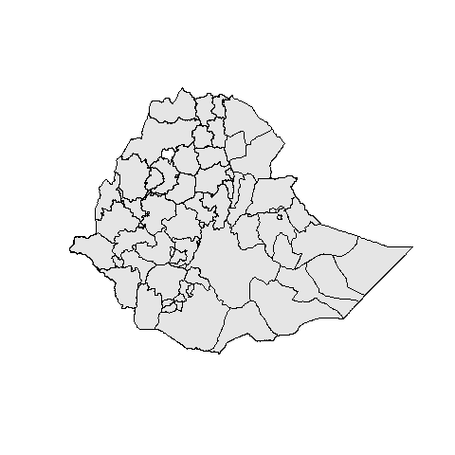
Demographic and occupation projections
Household survey
MAGNET CGE model
Subnational benchmark projections
Wage and food price projections
Spatial iterative proportional updating of household survey weights
Per capita income projections
Simulated subnational income distribution projections
Maps and analysis

Slide 6
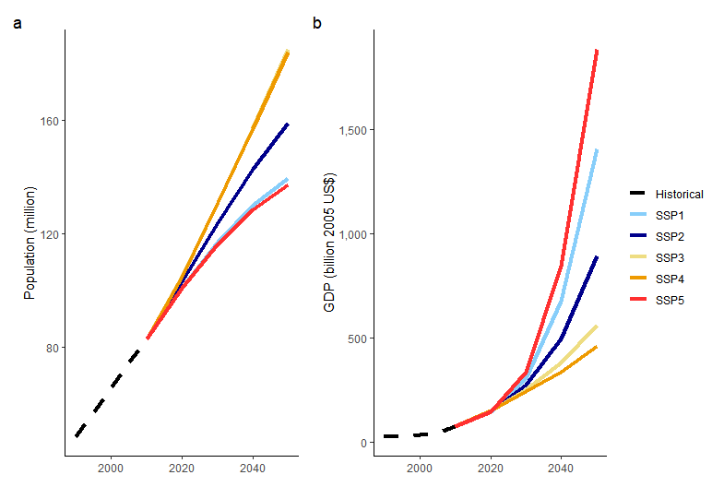
Demographic and occupation projections
Input data
Household survey
MAGNET CGE model
Shared-Socioeconomic Pathways (SSP) projections for national population and GDP
New SSP occupation projections
Gridded population from WorldPop
2018-2019 Ethiopia Socio-economic Survey (LSMS-ISA): 7,527 households
Subnational benchmark projections
Wage and food price projections
Spatial iterative proportional updating of household survey weights
Per capita income projections
Simulated subnational income distribution projections
Maps and analysis

Slide 7
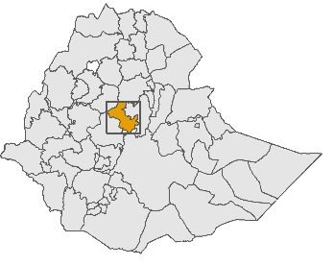

Demographic and occupation projections
Subnational projections
Household survey
MAGNET CGE model
Harmonization of national and spatial SSP projections
Key drivers:
  Urbanization
  Occupation change
  Sex-age distribution
  Number of households
Subnational benchmark projections
Wage and food price projections
North Shewa
Spatial iterative proportional updating of household survey weights
Per capita income projections
Simulated subnational income distribution projections
Maps and analysis
Notes:
Discuss key drivers, e.g structural change

Slide 8
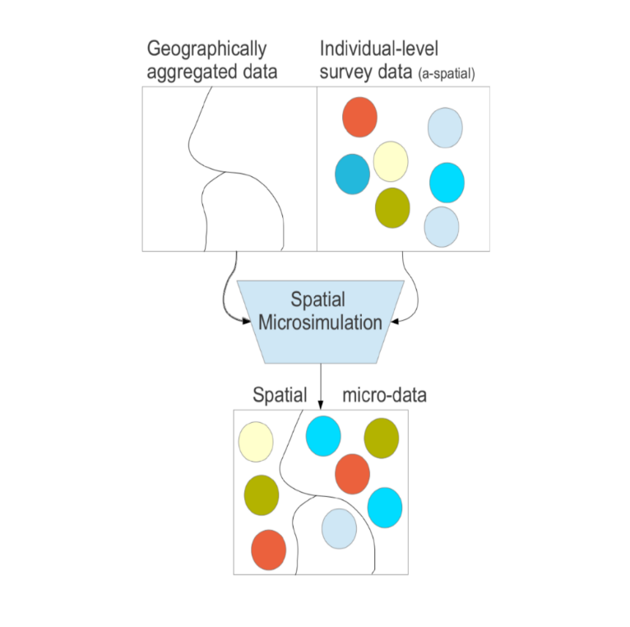
Demographic and occupation projections
Spatial microsimulation
Household survey
MAGNET CGE model
E.g. subnational information on age, sex, urban-rural status, education, referred to as the benchmark
Subnational benchmark projections
Wage and food price projections
Referred to as the seed
Spatial iterative proportional updating of household survey weights
Per capita income projections
Reweighting of survey data using IPF (=RAS)
Simulated subnational income distribution projections
Maps and analysis
Socio-economic variable
of interest
i.e. income
Source: Lovelace and Dumond (2018) and authors

Slide 9
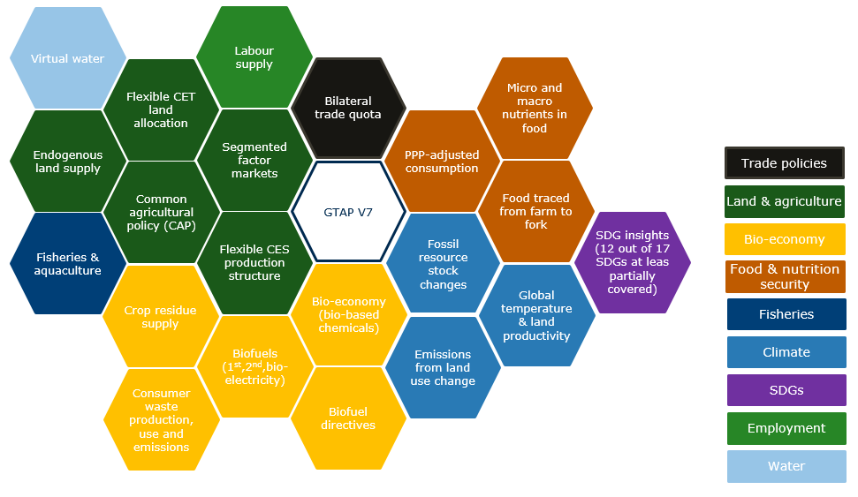
Demographic and occupation projections
CGE MAGNET model
Household survey
MAGNET CGE model
GTAP based with extensions
Added number of workers by sector (data from IMPACTECON) for 5 labour types
Labour supply in workers is shocked, and labour endowments in $ values endogenized
Simulation of change in wages as a consequence of structural change
Subnational benchmark projections
Wage and food price projections
Spatial iterative proportional updating of household survey weights
Per capita income projections
Simulated subnational income distribution projections
Maps and analysis
MAGNET modules

Slide 10
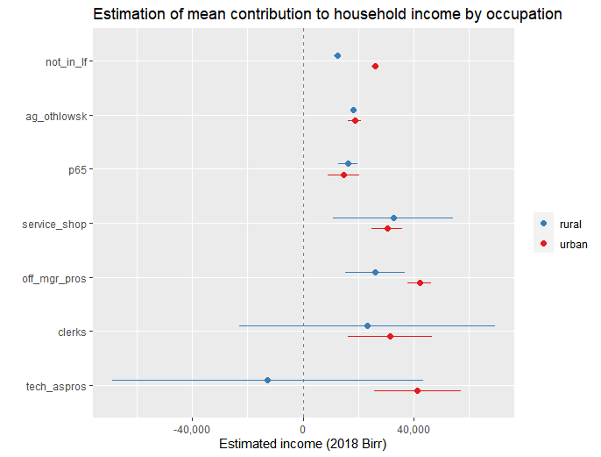
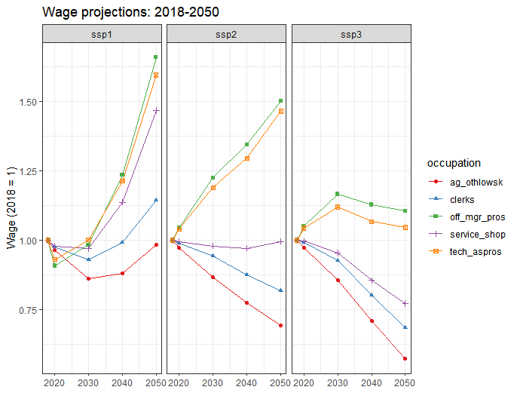
Demographic and occupation projections
Updating household income
Household survey
MAGNET CGE model
Estimation of mean contribution to household income by occupation
Updating household income by means of occupation-specific wage projections from MAGNET
Subnational benchmark projections
Wage and food price projections
Spatial iterative proportional updating of household survey weights
Household
income projections
Simulated subnational income distribution projections
Maps and analysis
Notes:
Need to update, new figures for ETH

Slide 11
Demographic and occupation projections
Subnational income projections
Household survey
MAGNET CGE model
Subnational benchmark projections
Wage and food price projections
Spatial iterative proportional updating of household survey weights
Per capita income projections
Simulated subnational income distribution projections
Maps and analysis

Slide 12
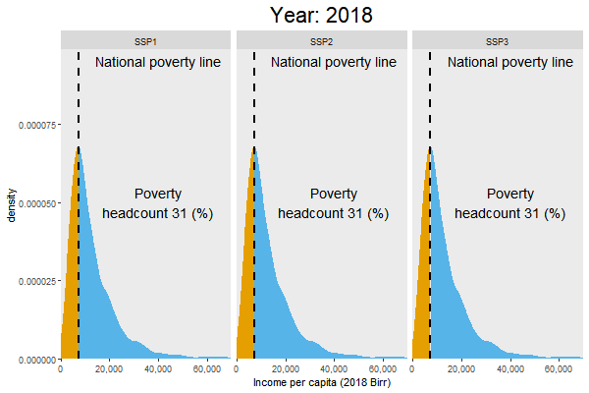
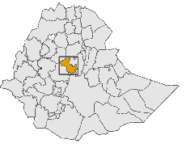
North Shewa:
Income distribution by SSP scenario: 2018-2050
Regional distributional patterns determined by the combined effect of:
Demographic change
Urbanization
Structural economic change
Change in wages per occupation

Slide 13
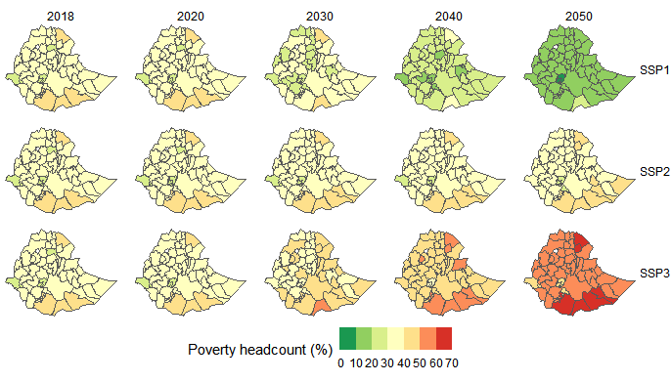
Spatial distribution of poverty headcount over time and space by SSP scenario: 2018-2050

Slide 14
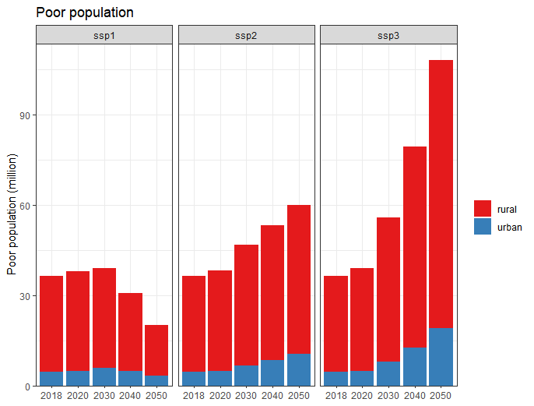
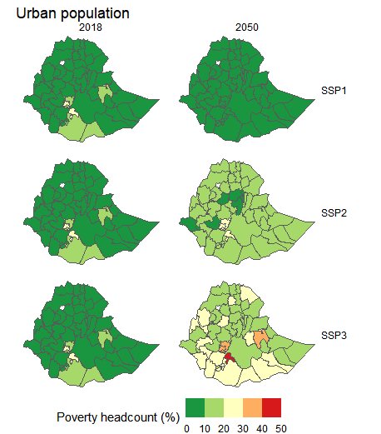
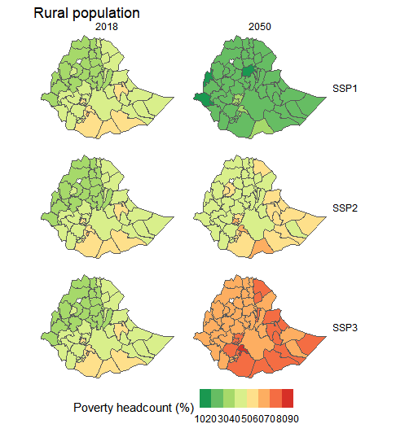
Spatial distribution of poverty headcount over time and space by SSP scenario and urban rural status: 2018-2050

Slide 15
Conclusions
Innovative approach that combines CGE modelling with dynamic spatial microsimulation to produce subnational projections of income and poverty.
Limitations
  CGE model wage projections are not spatially explicit.
  Top-down approach – no feedback loops from micro to macro.
  Household income change is driven by wage change only. No information on capital income of households.

Slide 16
Future research
Refine scenarios by adding regional con/divergence assumptions for SSP1/SSP3 scenarios.
Simulate impact of redistributive policies (taxes and subsidies) on future income distribution.
Combine income projections with food consumption data to produce food demand and food security projections.
Decomposition of drivers

Slide 17
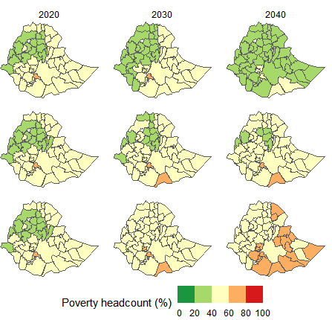
Thank you!
Questions?
Michiel van Dijk
michiel.vandijk@wur.nl

