Slide 1
Revisiting the environmental bias of trade policies based on an environmentally extended GTAP MRIO Data Base
Maksym Chepeliev and Erwin Corong
Center for Global Trade Analysis, Purdue University
25th Annual Conference on Global Economic Analysis (Virtual Conference)
June 8-10, 2022

Slide 2
Introduction
An environmental bias of trade policies
    In most countries import tariffs and non-tariff barriers (NTBs) are much lower on dirty than on clean goods (Shapiro, 2021).
    This creates an implicit subsidy to CO₂ emissions in international trade.
    “Dirtiness” is defined as fossil fuel combustion CO₂ emission intensity per dollar of commodity’s value.
We revisit this fact by using a newly-developed environmentally-extended GTAP accounts
Extend coverage to non-CO₂ GHGs and air pollutants.
Use more up-to-date set of tariff and non-tariff barriers; extend regional and temporal coverage.
Implement two distinct approaches to estimating emission intensities.
Implement an ENVISAGE-MRIO simulation analyzing impact of the trade bias removal.

Slide 3
Environmental bias: broad considerations
How do we define bias?
  Qualitatively VS quantitatively: case of “0” tariffs
What could be the source of the bias?
  Unintentional VS upstream/downstream lobbying
Domestic environmental regulations and trade bias
Carbon pricing and CBAM.
Fiscal and non-fiscal measures: excise taxes, extraction duties, environmental regulations -> how/whether should they be accounted?
Does the level of commodity aggregation matter?
  Sectors VS individual commodities
Level of coverage
  Emission scopes; CO2 vs non-CO2 GHGs; air pollutants

Slide 4
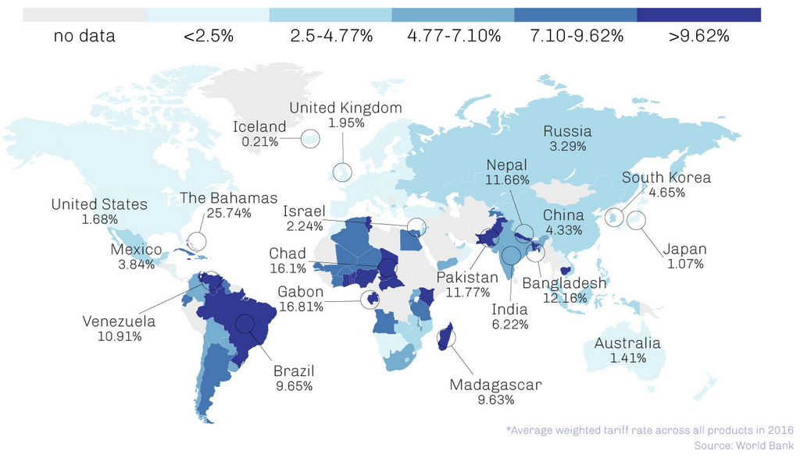
How do the current tariffs look like?
World average tariff: <3%.

Slide 5
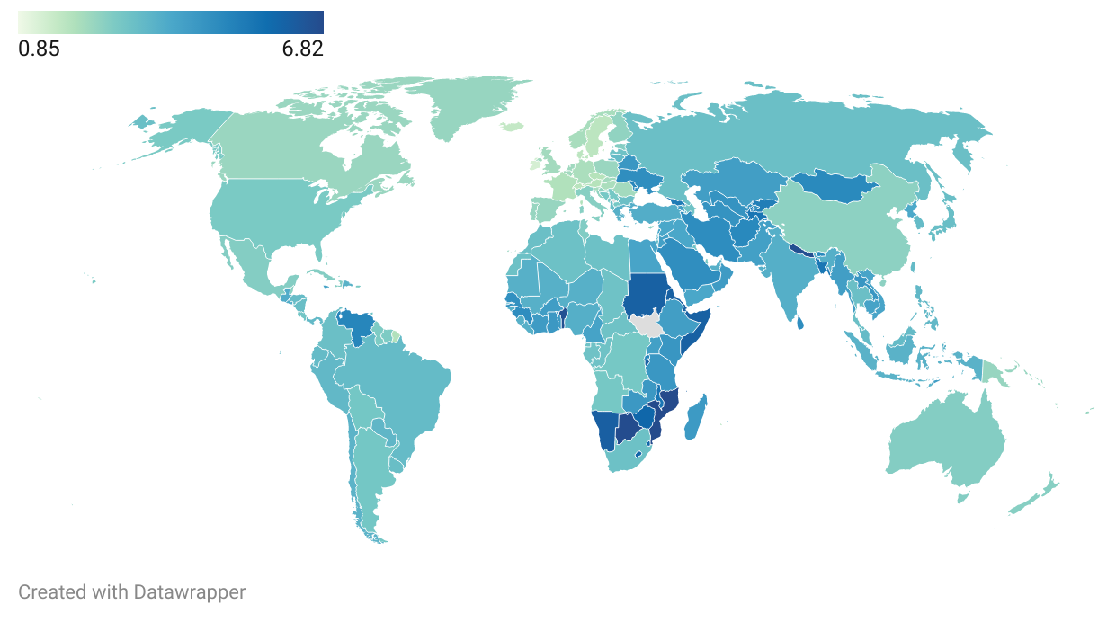
What would the tariffs be @$52 SCC price?
World median tariff: 3.2%.
World average tariff: 2.7%.

Slide 6
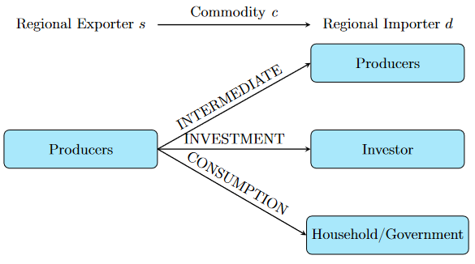

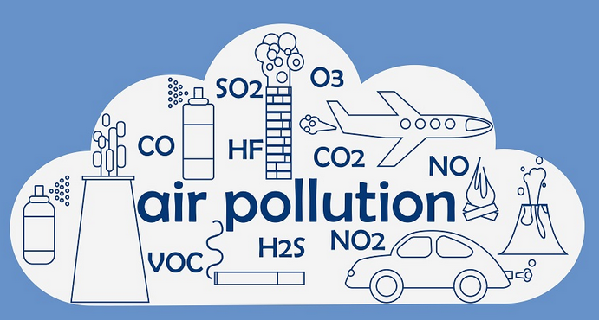
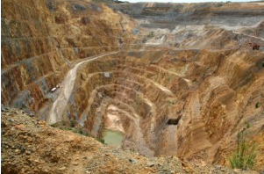
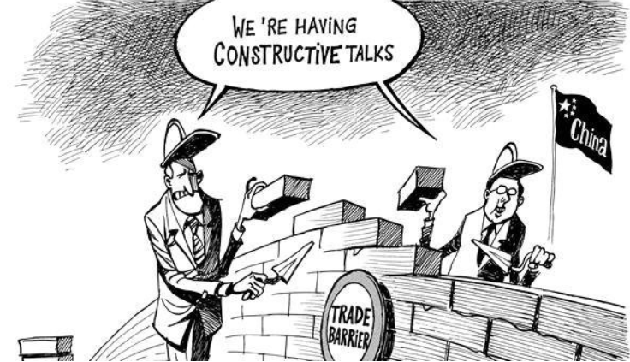
Environmentally-extended GTAP framework
GTAP 10a MRIO
(Carrico et al., 2020)
Global MRIO
(A matrix: 9650x9650)
Non-CO₂ GHGs
+ process CO₂
(Chepeliev, 2020)
Key features:
141 regions
65 commodities
4 reference years
Tariffs + NTBs
EEBT vs full MRIO
4 GHGs + 9 air pollutants
Environmentally-extended GTAP accounts
Air pollutants
(Chepeliev, 2022)
Materials’ accounting
(GTAP-CE; Chepeliev, 2022)
Non-tariff barriers
(Cadot et al., 2018)
ENVISAGE-MRIO CGE model

Slide 7
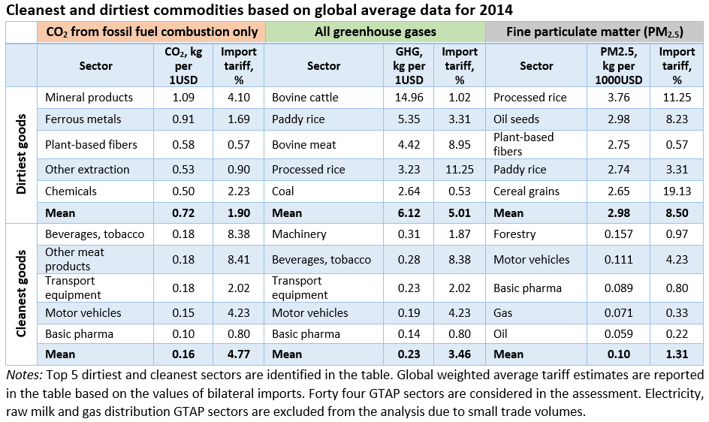
CO₂ vs all GHGs accounting matters

Slide 8
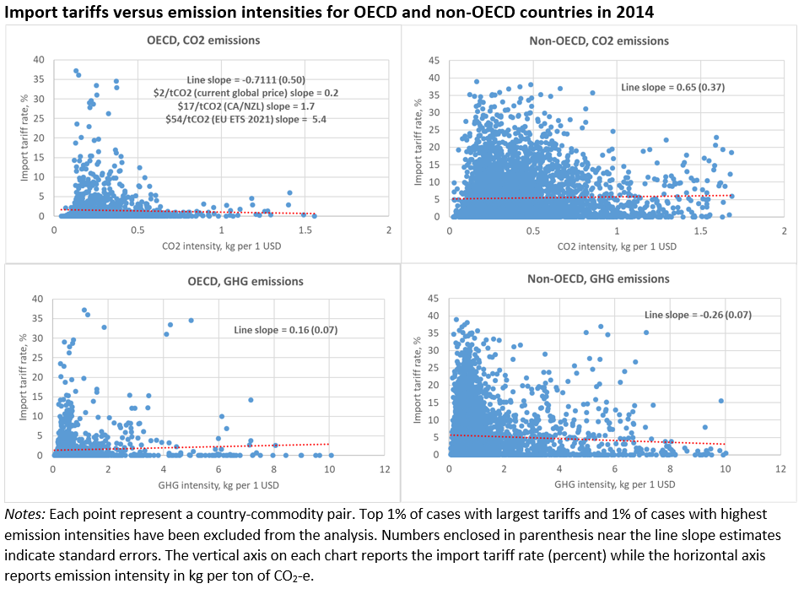
Heterogeneity in trade bias across regions and GHGs

Slide 9
Environmental bias across years: Global average

Slide 10
Inclusion of NTBs: supports CO2 vs GHG patterns

Slide 11
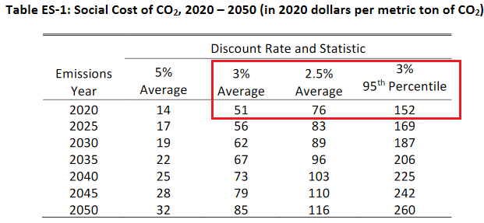

Scenario framework
Source: Interagency Working Group on Social Cost of Greenhouse Gases, United States Government
GTAP-MRIO
22 regions and 27 sectors
Selected sectors treated as agent-specific

Slide 12
Double dividends of the bias removal at the global level

Slide 13
There are winners and losers

Slide 14
Countries become more involved into GVCs
Notes: Forward GVC participation = Domestic value added embodied in third country exports (% of exports).
Backward GVC participation = imported inputs in exports (% of exports).

Slide 15
Manufacturing sectors increase GVC participation

Slide 16
Conclusion and next steps
Emissions’ coverage matters:
  Evidence of environmental bias of trade policies for CO₂ emissions.
  Positive relation for aggregate GHGs: largely driven by high tariffs on agricultural commodities.
  Positive relation between tariff and emission intensity is observed for PM_{2.5}.
Elimination of the trade bias can result in double dividends:
  Global welfare increases; GHG emissions reduce.
  There are winners and losers across countries.
  GVC participation increases, manufacturing sectors benefit the most
Next steps:
  Explore the full MRIO framework (vs EEBT featured in this presentation).
  Extend environmental dimension (biomass, food loss and waste, etc.)

Slide 17
Thank you!
Questions/Comments?
mchepeli@purdue.edu

