Slide 1
Incorporating Job Search Frictions and Unemployment into the GTAP Model
-- By Marinos Tsigas and Wen Jin “Jean” Yuan
The views expressed in these slides do not reflect the views of the U.S. International Trade Commission or any of its individual Commissioners. Simulation scenarios intended to illustrate possible insights.

Slide 2
Outline
Motivation of our Work
Structure of the GTAP-L model We Developed
Simulation:
  A 25 percent increase in the power of the U.S. tariff rates on imports of Wearing Apparel (WAP GTAP sector) from all sources
  Comparison of Results between the Standard GTAP and the GTAP-L model
Further Work to Improve GTAP-L

Slide 3
Labor Markets in the Standard GTAP Model
In a standard GTAP simulation:
  The number of workers is not changing
  The number of employed workers is not changing
Employed labor reallocates across producing sectors without any frictions
  Perfect labor mobility across sectors
The sum of the sectoral employment expansions equals the sum of the sectoral employment reductions
Thus, there is no change in economywide employment

Slide 4
Labor Frictions in the Standard GTAP Model
Several authors have incorporated labor market frictions by way of imperfect labor mobility across sectors
In these simulations, these frictions result in different wages from sector to sector
Still, the sum of the sectoral employment expansions equals the sum of the sectoral employment reductions
Thus, there is no change in economywide employment

Slide 5
Matching Function from the Job Search and Matching Literature
We aim to incorporate a matching function into the GTAP model framework
The theory explaining frictions in the labor market/job search and matching process dates back to the 1960s. Workers who seek a job are matched to job vacancies. The aggregate matching function gives the number of job matches formed in terms of the number of job vacancies and the number of job seekers (Petrongolo and Pissarides, 2001):
Matches = f(Vacancies, Seekers)
In a frictionless standard GTAP model, at the equilibrium wage, the number of matches is equal to the number of job seekers and to the number of job vacancies. In the GTAP-L model we developed, the number of matches is less than the number of job seekers and the number of vacancies.

Slide 6
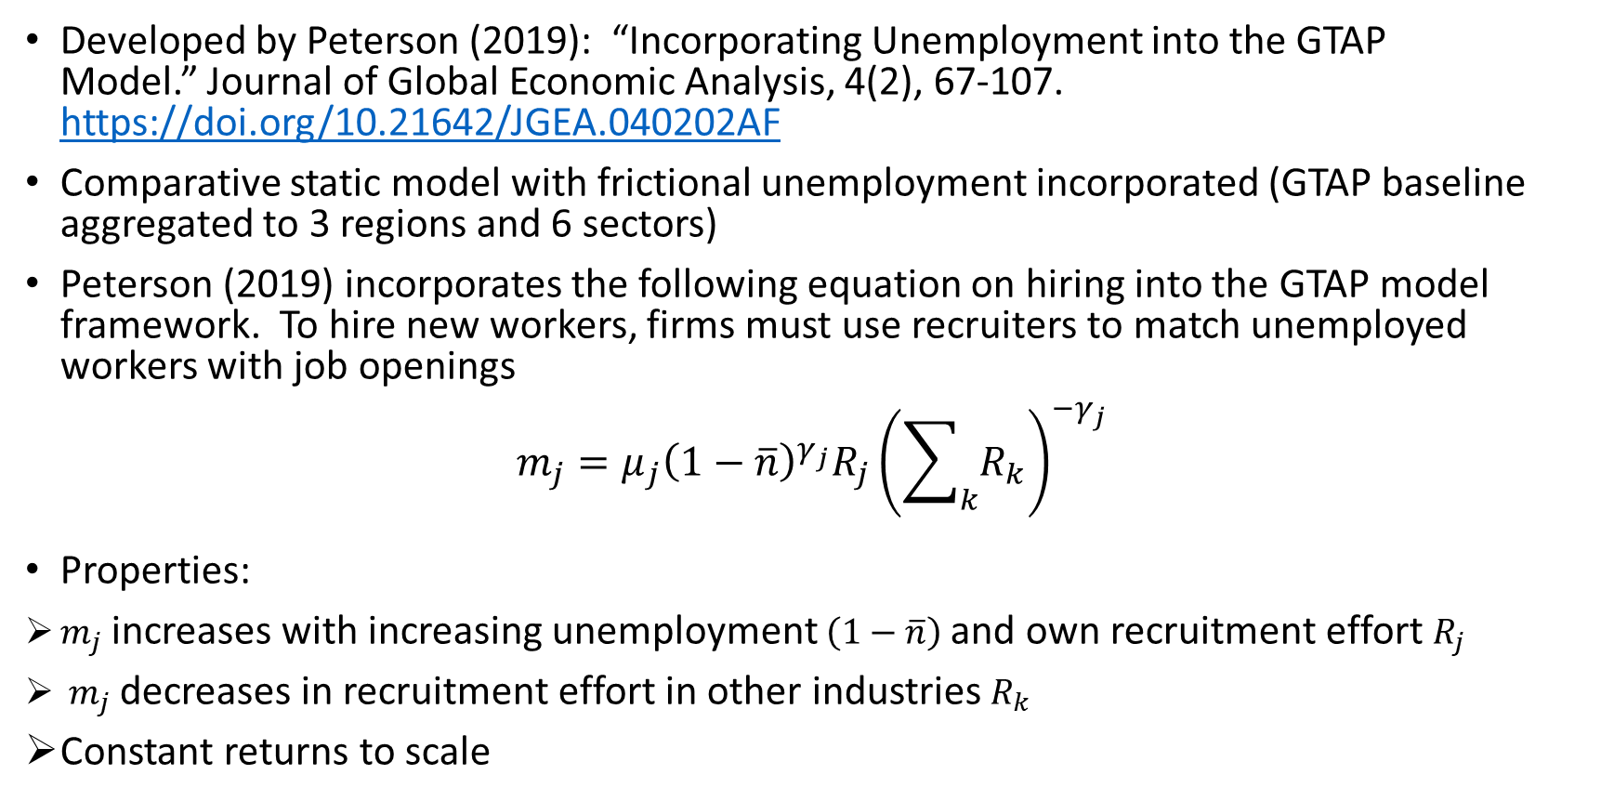
Labor Frictions in the Peterson (2019) Model
Developed by Peterson (2019): “Incorporating Unemployment into the GTAP Model.” Journal of Global Economic Analysis, 4(2), 67-107. https://doi.org/10.21642/JGEA.040202AF
Comparative static model with frictional unemployment incorporated (GTAP baseline aggregated to 3 regions and 6 sectors)
Peterson (2019) incorporates the following equation on hiring into the GTAP model framework. To hire new workers, firms must use recruiters to match unemployed workers with job openings
$$m_{j}=μ_{j}{\left(1−\overline{n}\right)}^{γ_{j}}R_{j}{\left(\sum_{k}{R_{k}}\right)}^{−γ_{j}}$$
Properties:
$m_{j}$ increases with increasing unemployment $\left(1−\overline{n}\right)$and own recruitment effort $R_{j}$
$m_{j}$ decreases in recruitment effort in other industries $R_{k}$
Constant returns to scale

Slide 7
Features in the Peterson (2019) Model
Yuan et al., (2022) analyzed the potential effects of hypothetical U.S.-EU trade changes applying the Peterson model.
  The equation on hiring incorporated into the Peterson model is derived from Hafstead and Williams (2018), a forward-looking dynamic model framework which might not be consistent with the comparative static GTAP model.
  Existing labor is sector specific; recruiters account for 1 percent of the labor force
  We find it very difficult to build a database with more countries/sectors for the Peterson model and/or extend it in various ways.
  We build our own framework which is an alternative to the Peterson model; it is more straightforward and easier to use

Slide 8
GTAP-L, an Extension of the GTAP Model
In GTAP-L, unemployment arises because of frictions in the labor market
GTAP-L incorporates labor market frictions in a different way than imperfect labor mobility across sectors
As a result of these frictions, the sum of the sectoral employment expansions is not equal to the sum of the sectoral employment reductions

Slide 9
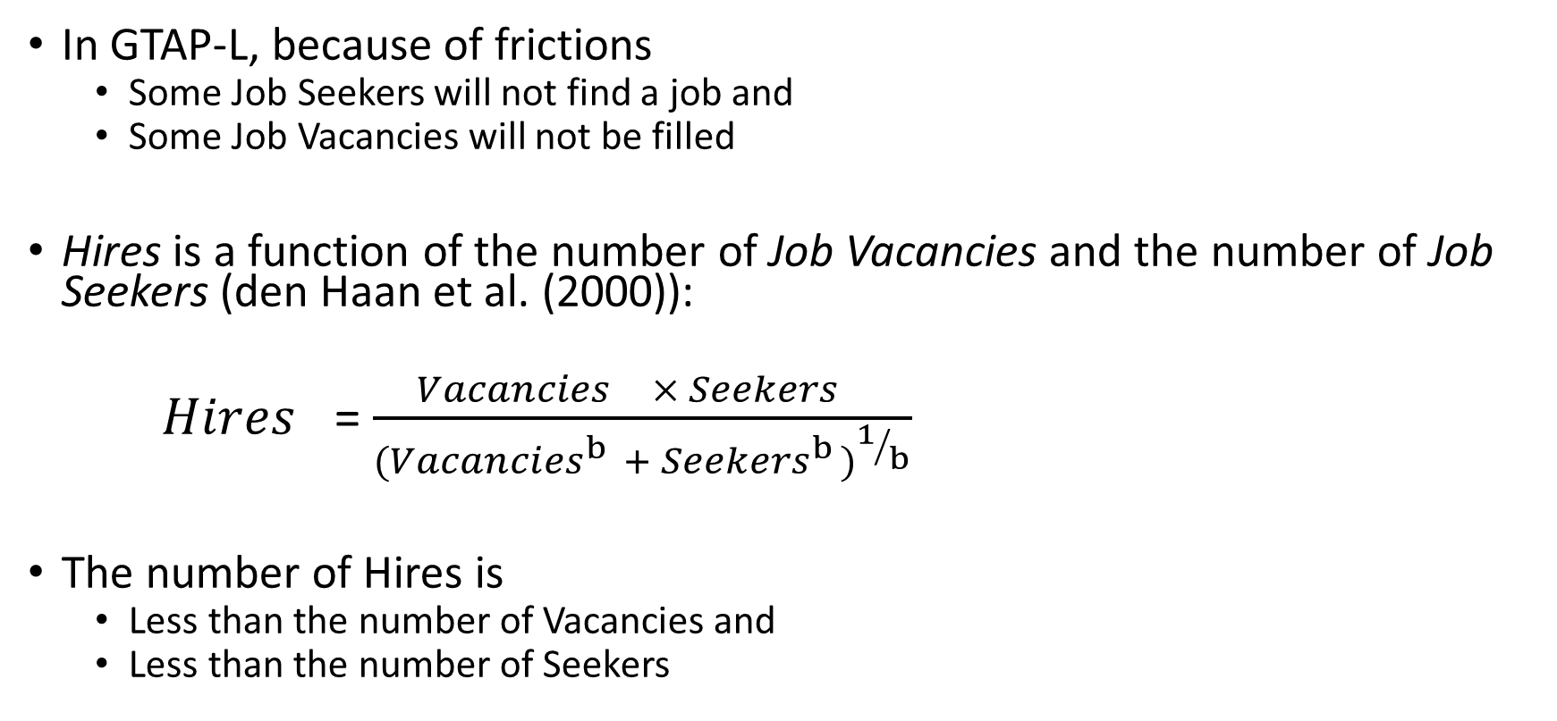
Labor Market Frictions in GTAP-L
In GTAP-L, because of frictions
  Some Job Seekers will not find a job and
  Some Job Vacancies will not be filled
Hires is a function of the number of Job Vacancies and the number of Job Seekers (den Haan et al. (2000)):
${Hires}_{}$= $\frac{{Vacancies}_{} × {Seekers}_{}}{{({Vacancies}_{}^{b} + {Seekers}_{}^{b})}^{1/b}}$
The number of Hires is
  Less than the number of Vacancies and
  Less than the number of Seekers

Slide 10
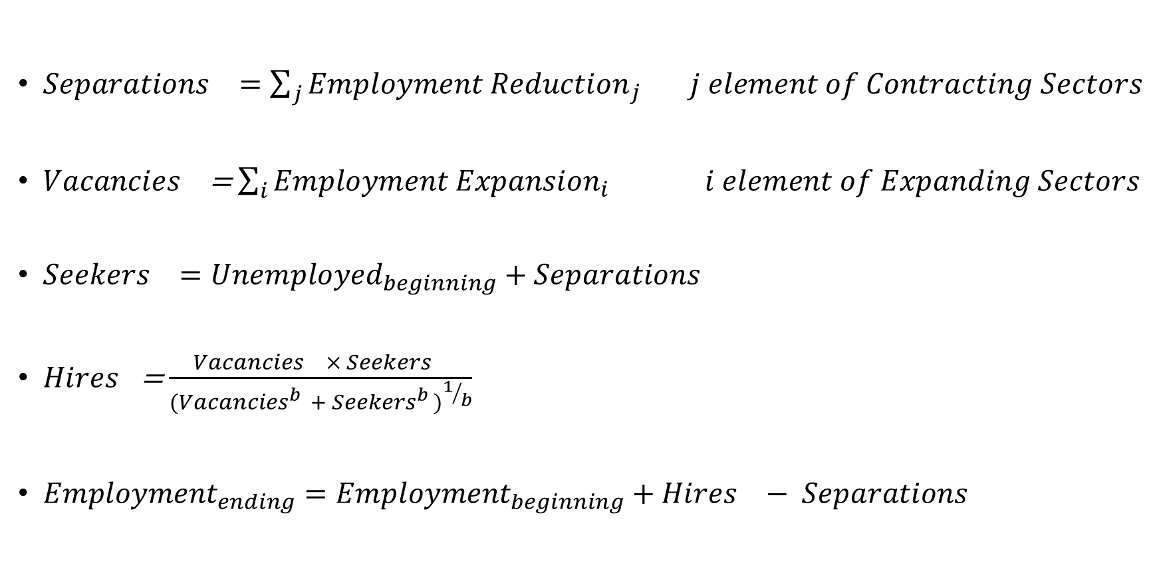
GTAP-L Relationships
${Separations}_{}=\sum_{j}{{Employment Reduction}_{j}}$ $j element of Contracting Sectors$
${Vacancies}_{}$ = $\sum_{i}{{Employment Expansion}_{i}}$ $i element of Expanding Sectors$
${Seekers}_{}={Unemployed}_{beginning}+{Separations}_{}$
${Hires}_{}$= $\frac{{Vacancies}_{} × {Seekers}_{}}{{({Vacancies}_{}^{b} + {Seekers}_{}^{b})}^{1/b}}$
${Employment}_{ending}={Employment}_{beginning}+{Hires}_{}− {Separations}_{}$

Slide 11
An Illustrative Experiment with GTAP and GTAP-L
Simulate a U.S. tariff rate increase
  A 25 percent increase in the power of the U.S. tariff rates on imports of Wearing Apparel (WAP GTAP sector) from all sources
    Power of a 10 percent tariff rate is 1.10
Comparative static
Dataset
  65 GTAP sectors
  7 regions: United States, Canada, Mexico, Great Britain, European Union-27, China, and a rest of the world

Slide 12
Comparison of GTAP to GTAP-L simulated effects
GTAP wage effects are qualitatively similar to GTAP-L wage effects
Magnitude of GTAP-L wage effects are driven by unemployment consequences
Labor market frictions determine unemployment consequences
GTAP-L real income effects different from GTAP’s

Slide 13
Standard GTAP Simulated U.S. Effects
Higher U.S. tariffs on Wearing Apparel from all sources

Slide 14
GTAP-L Simulated U.S. Effects
Higher U.S. tariffs on Wearing Apparel from all sources

Slide 15
GTAP vs. GTAP-L Simulated U.S. Effects
Higher U.S. tariffs on Wearing Apparel from all sources

Slide 16
Further Work to Improve GTAP-L
Test GTAP-L by simulating several different scenarios
Improve specification of baseline unemployment data
  Unemployed Workers, Separations, Vacancies, Hires by labor type
Simulate recursive-dynamic scenarios
Expand number of labor types
Improve specification of friction parameter
Allow for changes in labor force participation rate

Slide 17
Thank you

Slide 18
Number of Sectors Expanding or Contracting Employment
Standard GTAP simulation
 | Expanding Employment | Contracting Employment
Unskilled | 12 | 52
Skilled | 12 | 52
GTAP-L simulation
 | Expanding Employment | Contracting Employment
Unskilled | 24 | 40
Skilled | 7 | 57

Slide 19
Standard GTAP: Employment changes by sector, 1,000 workers

Slide 20
GTAP-L: Employment changes by sector, 1,000 workers

