Slide 1
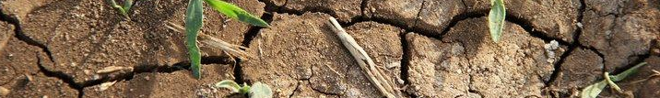
Climate change and central banking in Africa
Channing Arndt, Faaiqa Hartley, Konstantin Makrelov, Bruno Merven, Kenneth Strzepek, and Tim Thomas
27th Annual Conference on Global Economic Analysis
June 5-7, 2024

Slide 2
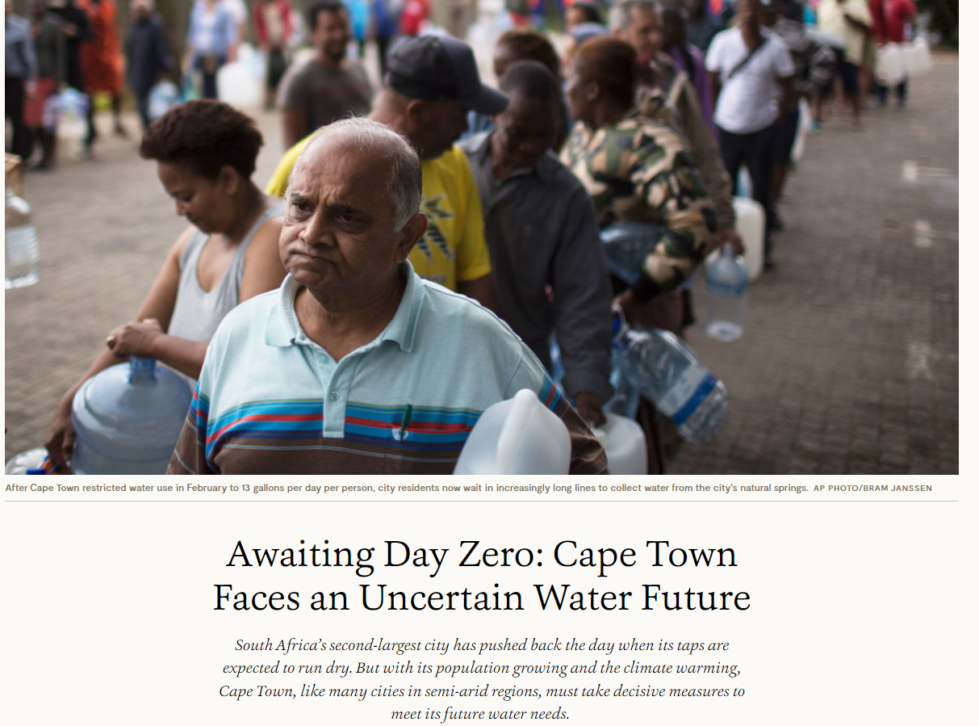
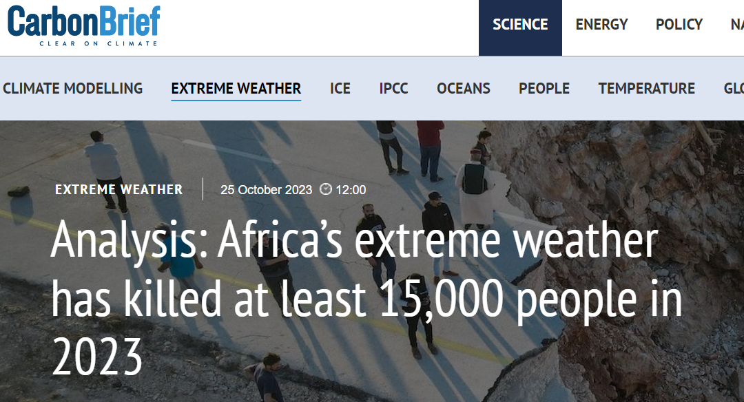
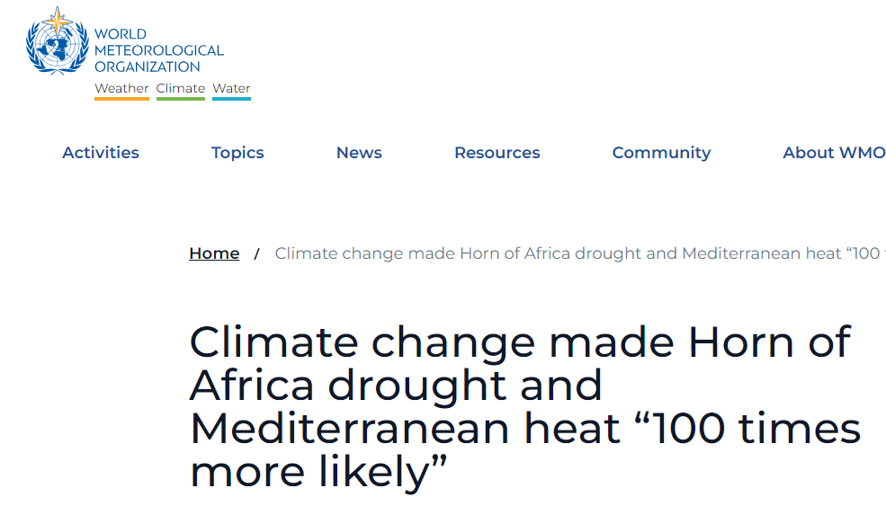
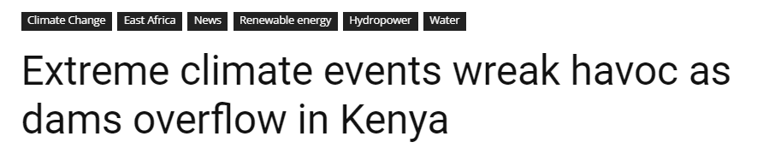
Impacts of climate change are already being felt…
Notes:
On average near-surface air temperatures across the continent increased by 0.3ºC per decade in the 1991-2022 period, compared with the 0.2ºC increase experienced in the 1961-1990 period and the global average increase of 0.2ºC. Temperature increases differed across the continent, ranging between 0.2ºC per decade in Southern Africa and 0.4ºC per decade in North Africa (WMO, 2023). Over the past three decades, Africa also experienced an increase in frequency and intensity of extreme events with 80 such disasters being reported in 2022 alone. These events included heavy rainfall, floods, tropical cyclones, droughts, heatwaves, wildfires, and sandstorms. The economic damages resulting from these events are estimated to be US$8.5 billion. GDP per capita in the region is reported to be 13.6% lower in the 1991-2022 period because of climate change (Trisos et al. 2022).

Slide 3
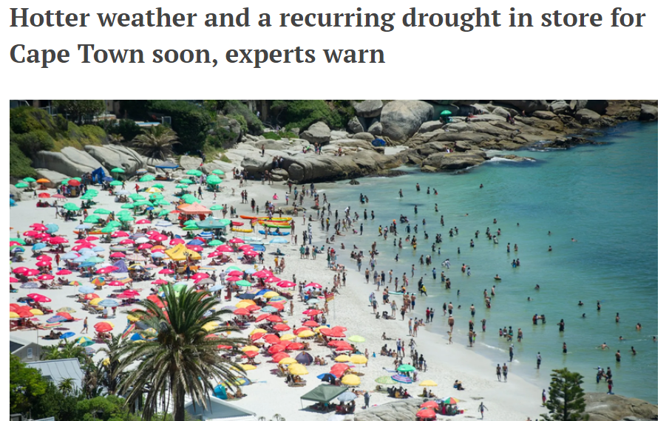
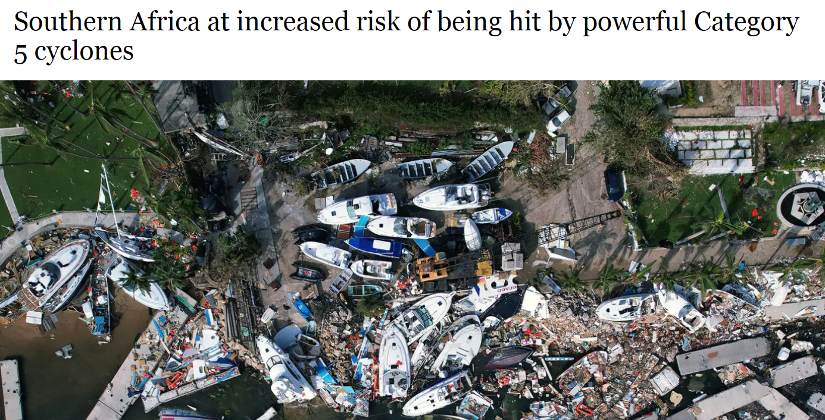
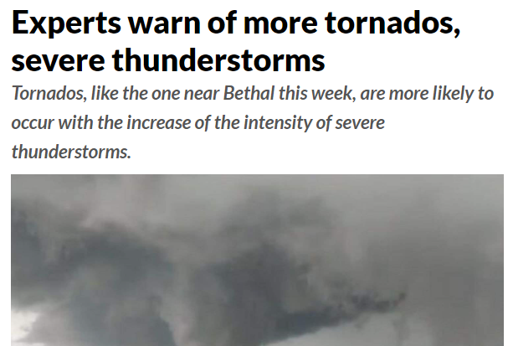

… Future impacts are expected to be worse as temperatures increase and the frequency and severity of extreme events rise
Notes:
The IPCC (Trisos et al. 2022) projects continued increases in temperature across Africa with most countries expected to experience record high temperature climates earlier than wealthier countries further north. Rising temperatures, along with precipitation uncertainty and increases in extreme events will lead to broader and more severe negative impacts including lower economic growth, increased inequality and poverty, and reduced food production. The physical impacts of climate change have direct impacts on key sectors in Africa. These include agriculture, energy, and tourism.

Slide 4
Africa expected to be more adversely affected by climate change
More severe climate changes relative to northern hemisphere
Exposure to more climate vulnerable sectors
  Many countries dependent on agriculture, particularly rainfed agriculture
  While most energy still dependent on coal, crude oil, and gas (>50% of total energy), hydropower is a key source of power accounting for ~20% (more in East and Southern African)
  Key tourist destination - biodiverse regions which inhibit several species of plant and animal life endemic to region. Tourism contributes ~8.5% to total GDP and employs nearly 9 million workers
Less resilient: lower adaptive capacity and weaker infrastructure (High poverty and inequality, Tighter fiscal and monetary environment, Poor infrastructure)
Transitioning to low carbon economies and adapting to climate change requires significant investments which cannot be fully financed by local governments, but financial markets and institutions are less sophisticated, fiscal, and monetary space is more constrained, inflation is higher, and borrowing costs are larger
Exposure to global changes (Often a price taker, Dependent on global trade)

Slide 5
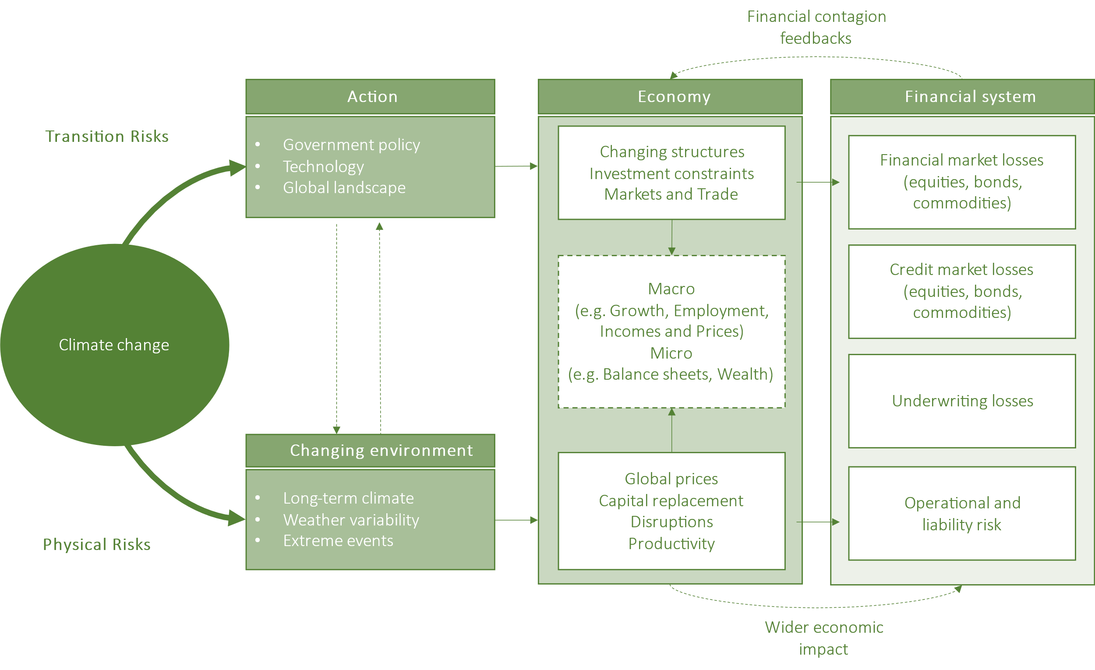
Why does this matter for central banks?
Notes:
Explain difference between impacts
Mechanisms affecting financial system and why these are risks central banks should worry about

Slide 6
Traditional central banking assessment tools by themselves are insufficient for climate analysis
Climate change is characterized by
  large and unprecedented change shocks
  high levels of uncertainty
  short but also long-term impacts
Appropriate risk assessment and management tools must link climate, real structural economic, financial sector and risk dynamics. Assessment tools must be capable of
  identifying country specific climate scenarios
  assess the economic impacts of these scenarios
  translate these impacts to the financial sector to measure vulnerability and exposure
One approach: link traditional macroeconomic and financial stability models with frameworks designed to assess the physical and transition impacts of climate change
Country specific integrated assessment models that include computable general equilibrium (CGE) models are useful
  Link biophysical to economic
  Include country specific characteristics
  Account for heterogenous within country: include granular detail
  CGE models include detailed supply side information, are structural and capable of looking at a large array of scenarios
  For many African countries CGE models exist

Slide 7
Global IAMs not appropriate for country level policy
The spatial resolution for impacts is very coarse spatial resolution and focuses on including high-level impacts as feedbacks to the economy.
In some cases, the impact modelling via biophysical models is done at a very high-resolution global grid.
Global top-down model outputs are in most case of limited value for detailed national and sub-national impact analysis.
The global boundaries conditions such as world market energy and agricultural prices are however crucially important foundations for such national analyses.
Model name | Hosting institution | Model category | Solution algorithm
AIM/CGE (The Asia-Pacific Integrated Assessment/Computable General Equilibrium) | National Institute for Environmental Studies (NIES), Japan | General equilibrium | Recursive dynamic
GCAM (The Global Change Assessment Model) | Pacific Northwest National Laboratory – USA (PNNL), USA | Partial equilibrium | Recursive dynamic
IMAGE/TIMER (Integrated Model to Assess the Global Environment) | Netherlands Environmental Assessment Agency (PBL), Netherlands | Partial equilibrium | Recursive dynamic
MESSAGE-GLOBIOM (Model for Energy Supply Strategy Alternatives and their General Environmental Impacts - Global Biosphere Management Model) | International Institute for Applied Systems Analysis (IIASA), Austria | General equilibrium | Intertemporal optimization
REMIND- MAgPIE (The Regionalized Model of Investment and Technological Development - Model of Agricultural Production and its Impacts on the Environment) | Potsdam Institute for Climate Impact Research (PIK), Germany | General equilibrium | Intertemporal optimization
WITCH-GLOBIOM (The World Induced Technical Change Hybrid model - Global Biosphere Management Model) | European Institute on Economics and the Environment (FEEM), Italy | General equilibrium | Intertemporal optimization

Slide 8
Case study: South Africa
Methodological framework applied to South Africa
NGFS Harmonization
(global scenarios and assumptions)
RSA Climate Analysis
Transition, Chronic and Acute Physical
Detailed local context, assumptions and impacts
Existing local models for mitigation and physical climate analysis
  SACReD
  SATIM-GE
Link to RSA NiGEM
  Provide indicators more familiar to central bank analysis
NGFS scenarios provide global context
  ensures analysis is aligned with international community
GDP, Population, Primary energy consumption by fuel, Useful energy, Carbon taxes
RSA NiGEM
Local nominal economic impacts
Direct emissions costs
Indirect costs
Capital expenditures
Revenues
Net income
Nominal GDP, Inflation,
Financial asset prices
RSA Climate Stress Analysis
Bottom-up by private sector
Top-down by central bank

Slide 9
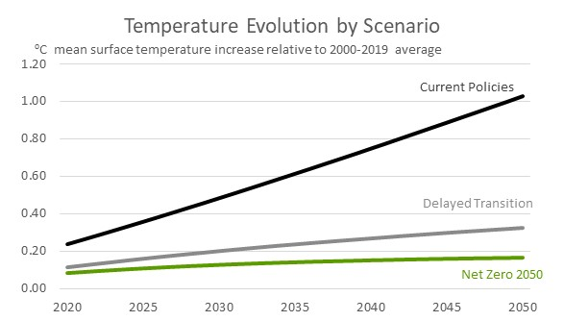
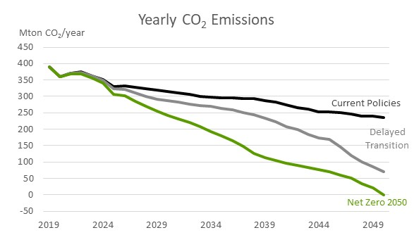
Climate scenarios aligned to NGFS, but customized for South Africa
Current Policies
Extant policies not fully enforced
No new climate policies
Technology change is slow
Low use of CO2 removal technologies
→ No transition to a carbon-neutral economy; no transition impacts, but severe physical impacts
Net Zero 2050
Immediate policy action, gradually more stringent, orderly and timely
Technology change is rapid
Medium to high use of CO2 removal technologies
→ Limits global warming to 1.5°C, global net zero CO2 by 2050; more subdued physical risks that
Delayed Transition
Higher transition risk → delays in implementation of policies and adoption of new technologies until 2030
Strong policies post-2030 to compensate
Limit global warming to below 2°C
→ Disorderly implementation, high variation across countries and sectors

Slide 10
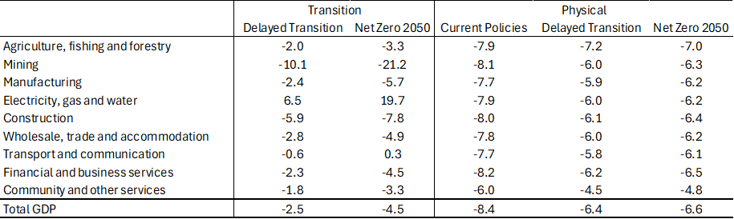
Impacts on GDP and economic structure
Change in sector GDP
Transitioning to low carbon requires increased mitigation effort and increased power sector investment
Current Policies includes least cost energy plan with no forced emissions decline. Does not include cost of inaction (e.g. CBAM)
Net Zero 2050 requires larger mitigation effort, these scenarios do not include confidence impact under Delayed Transition (disorderly)
Physical impacts largest under Current Policies
Looking at select climate scenario, specific scenario shows similar physical impacts between Delayed Transition and Net Zero 2050 due to impacts of flooding on infrastructure

Slide 11
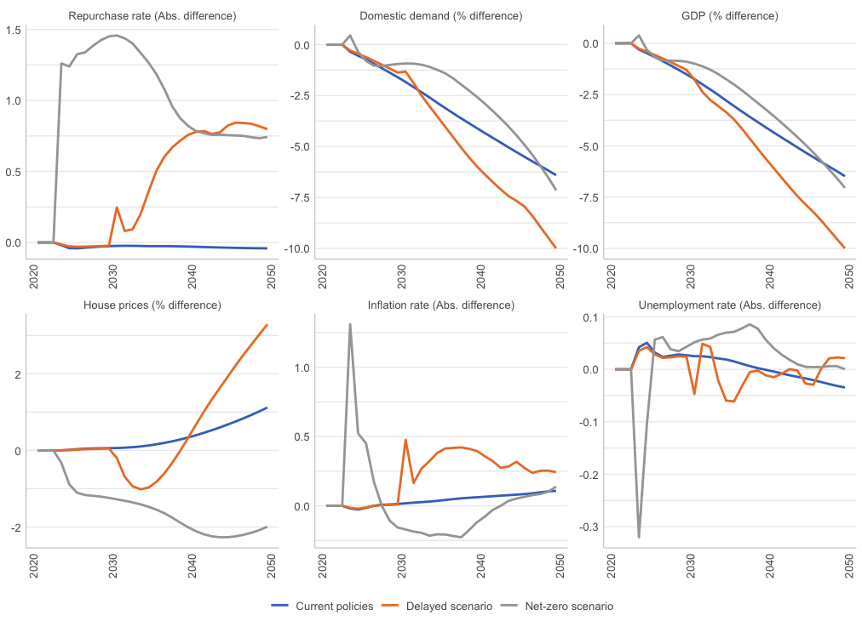
Implications for macro-financial economic indicators used in stress-testing
Climate change raises the risk of price instability
  Inflationary pressures are driven by the transition, specifically the rise in the carbon tax rate
  Physical impacts found to have a small deflationary impact due to their large negative impact on domestic demand and GDP
Higher inflation leads to higher interest rates, raising the cost of borrowing and negatively affecting domestic demand and GDP
Higher interest rates, lower incomes and losses in asset value increase the risk of credit defaults
  Higher interest rates increase debt obligations, while lower domestic demand and economic activity reduce available incomes.
  Loss in asset valuations reduces net worth and the potential to meet debt obligations.
  This coupled with the narrowing interest margins banks could experience under higher interest rates raises risks for the banking sector.
Still need to make these graphs prettier

Slide 12
Conclusion
Climate change is expected to have large and unprecedented impacts on economies and economic structures, particularly in developing countries the global south
These impacts create risks to the financial sector and the mandates of central banks through their impacts on economic activity, incomes, price stability and asset valuations
Understanding the vulnerability of the financial and banking system is necessary for central banks to delivery on price and macro economic stability
The complexity of climate change, however, requires the use and development of new tools or frameworks that enable analysis to account for changes in global environments but that focus on local impacts and outputs needed by central bankers
The example of South Africa highlights the potential risks. The analysis however only considers one climate outcome, and more work needs to be done to consider the uncertainty aspect of climate change within a central banking impact perspective.

