Slide 1

The implications of a global dietary shift on regional economy and environmental sustainability:
The case of Australia
Yingying Lu| 27th Annual GTAP Conference, USA
June 6, 2024

Slide 2
Motivation
Why Australia?
Dietary shift as a strategy of emissions reduction | The environmental implications of dietary shifts is still uncertain | The regional environmental implications of a dietary shift needs further investigation | The research of regional economic implications of dietary shift is very limited
Food systems are responsible for 25 % to 42 % of the total human induced greenhouse gas (GHG) emissions (Crippa, Solazzo et al., 2021) Clark, Domingo et al. (2020) even showed that without the reduction of food systems’ emissions the global 1.5°C climate target will not be able to achieved anyway. | Gatto, Kuiper et al. (2023)’s study found that economy-wide greenhouse gas emissions would actually increase if the world shifts towards the EAT-Lancet diet (Willett, Rockstrom et al. 2020) due to rebound effect. | In a review, Aguirre-Sánchez, Teschner et al. (2023) shows a wide range of climate mitigation potential in the current dietary guidelines across countries. | Most studies focused on the health aspect or environmental implications of dietary shifts.
Agriculture exports accounts for 11.6% of its total exports
72% agriculture production is exported
Agriculture emissions accounts for 18% in Australia’s total GHG emissions
78% of beef and veal production is exported
Notes:
Australia's challenges are becoming larger and more complex – and require science to radically transform to focus around larger, multidisciplinary teams. CSIRO’s six national challenges capture our approach to addressing these problems.
​
Source: CSIRO Annual Report 2022-23, pages 20-21 and 75-80 and Corporate Plan 2023-24 pages 7, 8-13

Slide 3
Research questions
What has been studied for Austrlia?
Food availability and environmental impacts of a healthy dietary shift in Australia (e.g. Candy, Turner et al. 2019, Ridoutt, Baird et al. 2021).
What is missing in studies on Australia?
The economic aspect of the dietary shift.
The impact assessment of a global dietary shift rather than a shift within Australia only.
What are the economic and environmental impacts of a global dietary shift on Australia?

Slide 4
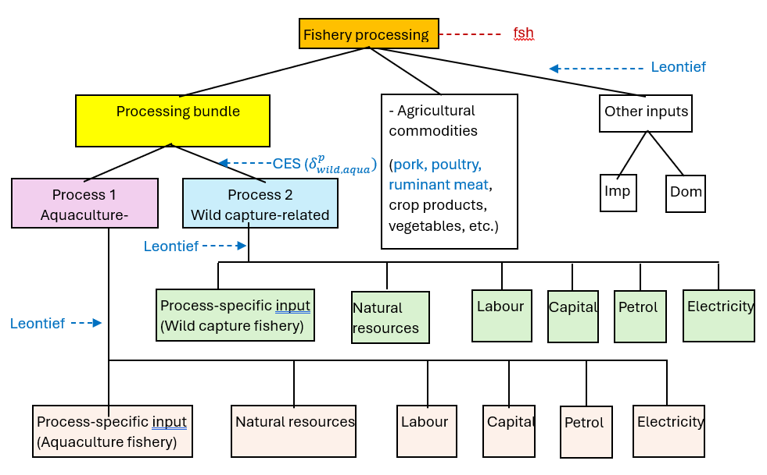
GTEM-FOOD – production
Cattle meat (cmt)
Fishery (fsh)
Live_pig
Other animals (oap)
beef
lamb
aqua
wild
Live_poultry
Other meat (omt)
Meat_pig
Meat_poultry
Stage 1: splitting sectors
Stage 2: creating two “processing bundles”

Slide 5
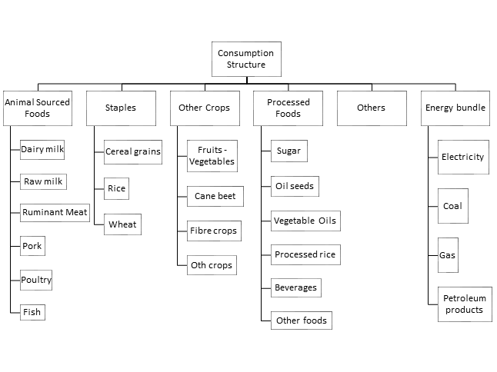
GTEM-FOOD – consumption
CDE
CES
CES
CES
CRESH
CES
Duy et al. (2021) “An introduction to GTEM-Food”: https://www.gtap.agecon.purdue.edu/resources/res_display.asp?RecordID=6278

Slide 6
EAT-Lancet Diet – world
Data source: Supplementary data from the paper by Willet et al. (2019): https://doi.org/10.1016/S0140-6736(18)31788-4.

Slide 7
Mapping of the diet categories
GTEM sector | EAT-Lacent commodities
Wheat | wheat
Oth_grains | othr_grains, maize
Veg_fruit | vegetales, fruits, roots, nuts_seed, legumes
Oil_seeds | soybeans
Oth_crops | othrcrp
Live_poultry | eggs
Meat_cattle | beef, lamb
Meat_pork | pork
Meat_poultry | poultry
Fishery | fish
Veg_oils | oil_veg, oil_palm
Dairy_milk | milk
Proc_rice | rice
Sugar | sugar

Slide 8
EAT-Lancet Diet – by region
Data source: Supplementary data from the paper by Willet et al. (2019): https://doi.org/10.1016/S0140-6736(18)31788-4.

Slide 9
EAT-Lancet Diet - Australia
AUS | Benchmark – 2050 (kcal/d_w) | FLX Diet – 2050 (kcal/d_w) | % change
Wheat | 327.4132 | 510.2887 | 56%
Oth_grains | 37.63559 | 58.65681 | 56%
Veg_fruit | 206.013 | 531.5843 | 158%
Oil_seeds | 1.375772 | 91.33278 | 6539%
Live_poultry | 16.84975 | 16.84975 | 0%
Meat_cattle | 214.7667 | 15.12481 | -93%
Meat_pork | 117.1845 | 8.252648 | -93%
Meat_poultry | 164.1219 | 42.76349 | -74%
Fishery | 20.45587 | 27.63456 | 35%
Veg_oils | 501.7435 | 430.7553 | -14%
Dairy_milk | 276.2132 | 126.326 | -54%
Proc_rice | 76.68614 | 119.5189 | 56%
Sugar | 293.0736 | 114.8826 | -61%
Total | 2530.277 | 2093.971 | -17%
How realistic it is?
Note: Gatto, Kuiper et al. (2023)’s study implemented the diet shift by 2030 to reduce the gap between EAT-Lancet diet by 1/3 in all the regions.

Slide 10
Baseline calibration
GDP
  Updated SSP2 projection after 2020, using IMF historical real GDP growth rates before 2020
Population
  Updated SSP2 projection after 2020, using UN historical population growth rates before 2020
Diet
  EAT-Lancet benchmark diet (BMK)
Energy efficiency
  Assumptions consistent with IEA latest energy efficiency trend
Agriculture efficiency
  Crop sector land productivity, livestock and fishery efficiency is calibrated using IMPACT model’s SSP2 projection
GHG emissions
  MESSAGE-GLOBIEM current policy scenario from Network for Greening the Financial System (NGFS)
  Exclude emissions from LULUCF

Slide 11
Baseline overview
Change of Australia’s Ag and food related exports under baseline

Slide 12
Dietary shift scenarios
Scenarios to be
implemented
Implemented scenarios
Global dietary shifts towards EAT-Lancet recommendation (DT1), by 2050
Towards 1.5 degree scenario with a global carbon tax
Same as DT1, but only high-income countries/regions have EAT-Lancet dietary shift (DT2)
Dietary shift under the 1.5 degree scenario
Shocks are implemented as household demand shift in a cost-neutral way

Slide 13
Preliminary results - Global
Global consumption of shocked commodities
cumulative% change relative to baseline in 2030 | Target by 2050 | DT1 | DT2
 | EAT-Lancet (2100 kcal/d_w) | 2030 | 2030
Wheat | -22% | -9.0% | 0.4%
Oth_grains | -16% | -14.9% | 0.1%
Veg_fruit | 61% | 7.6% | 5.7%
Oil_seeds | 226% | 38.2% | 3.7%
Live_poultry | -41% | -19.5% | -4.6%
Meat_cattle | -59% | -34.5% | -11.8%
Meat_pork | -79% | -37.4% | -17.9%
Meat_poultry | -19% | -12.7% | -4.9%
Fishery | 49% | 5.9% | 1.1%
Veg_oils | 47% | 7.0% | 0.3%
Dairy_milk | -8% | -1.1% | -0.5%
Proc_rice | -40% | -13.9% | -0.2%
Sugar | -33% | -21.8% | -5.5%
-0.18%
-0.49%
-0.17%
-0.57%
DT1: global diet shift towards FLX;
DT2: diet shift towards FLX in high-income regions

Slide 14
Preliminary results - Australia
-0.28%
-0.65%
-0.37%
-0.83%
Australia would have larger % emissions reduction but lower % GDP losses than the world average by 2030 in the scenario where all the regions have the dietary shift. But both the % GDP loss and emissions reduction is larger than the world average in the scenario where only high-income regions shift diet.
The emissions reduction are mainly from non-CO₂ emissions which is mostly from livestock sectors for Australia.

Slide 15
Preliminary results – Australia
Cumulative % change of sector output, exports and imports relative to baseline by 2030
% change relative to baseline by 2030 | DT1 |  |  | DT2
 | output | exports | imports | output | exports | imports
Wheat | -2.26 | -2.83 | -0.27 | -0.51 | -0.62 | -0.29
Oth_grains | -2.50 | -3.03 | 4.9 | -1.18 | -1.18 | 4.16
Veg_fruit | 8.17 | 4.34 | 14.33 | 7.43 | 2.14 | 14.73
Oil_seeds | 4.12 | 6.83 | 8.09 | 0.93 | 2.07 | 8.16
Live_poultry | -7.75 | -12.1 | 0.33 | -5.92 | -3.51 | -0.38
Meat_cattle | -4.94 | -11.82 | 13.77 | -2.72 | -3.78 | 15.59
Meat_pork | -0.20 | -24.23 | -29.94 | 0.67 | -9.65 | -28.68
Meat_poultry | -12.28 | -6.97 | -37.72 | -10.54 | -7.43 | -36.57
Fishery | -2.16 | -7.38 | -16.86 | -1.10 | -2.52 | -14.98
Veg_oils | -1.29 | 6.94 | -2.02 | -1.27 | 1.35 | -1.73
Dairy_milk | 2.07 | 5.03 | -4.79 | 2.56 | -2.67 | -1.69
Proc_rice | -17.10 | -11.19 | 0.93 | -15.64 | -3.14 | 0.5
Sugar | -11.22 | -14.46 | -10.53 | -10.93 | -1.00 | -10.9

Slide 16
Take-home message
The global dietary shift has a larger environmental implications than its economic ones by 2030.
Australia’s economy and GHG emissions will surfer larger impacts than the world on average in the scenario where only high-income regions shift diet as these regions are its main meat exports destinations.
Large reduction in exports (especially those commodities that the diet shift away) and increase in imports in those commodities that are encouraged to increase in the diet shift make Australia’s terms of trade worse and therefore a negative impact on GDP.
The contraction of livestock sectors are also causing the economy’s investment decrease as these sectors are capital intensive in Australia.

Slide 17
Next steps……
Refine the mapping of diet shocks and establish the nutrition and calory accounts in the model
  Oth_foods and Beve_tobacco?
Consider land use change from the dietary shift
  Integrate with a land use change model to address land use change and the related GHG emissions
Put the scenario in the context of 1.5-degree climate scenario
  Add a scenario that follows the 1.5-degree pathway by using a global carbon tax
  Still target 1.5-degree pathway and add the EAT-Lancet dietary shift
Explore more options of dietary shift for Australia/global
  e.g. pescatarian diets (PSC), vegetarian diets (VEG), vegan diets (VGN)
The policy instruments to achieve the dietary shift
  Tax/subsidy on certain categories of food that would facilitate the diet shift
Another paper…

Slide 18
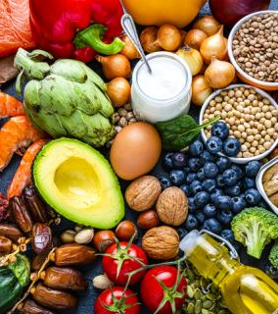
Thank you
Environment Business Unit
Dr. Yingying Lu
    Email: yingying.lu@csiro.au

