Slide 1
Counting the Cost of Climate Risk in U.S. Agriculture
Presentation for GTAP Conference
Presenter: Alma Cortes Selva – BMO Climate Institute
Research in collaboration with students from the Center for Responsible Business- Haas School of Business from the University of California Berkeley
BMO Climate Institute | External | June 2024

Slide 2
Agenda & contents
Background
Agriculture is one of the sectors that will be most affected by extreme weather events made worse by climate change
Most providers offer answers in terms of relative and absolute risk for assets in the agricultural sector
Academic papers provide crop productivity but not monetary impact
Overview
Physical risk analyzed: heat, wildfire, drought (more hazards are possible- we use the hazards available from Climate Engine)
Make it a straightforward process (with clear assumptions)
Exercise performed at the county level
Scenarios
Physical risk RCP 4.5 and RCP 8.5
In line with the new scenarios from NGFS phase IV

Slide 3


Research objectives
“What are the impacts of climate change on agriculture in the U.S. using RCP 8.5 and RCP 4.5 and geo-spatial hazard data and agricultural census data?”
  Provides projected revenue loss based on climate hazard impact in 2050
  Considers two scenarios: RCP 8.5 and RCP 4.5 and in line with NGFS scenarios
  Identifies geographic locations at risk of hazards as well as provides a monetary quantification of the losses at the county level

Slide 4
Why is this research important?
Serves to compare and validate methodologies
It allows comparison of what would happen if sustainable practices were included in a scenario – vendors normally have to keep this assumption static for companies/borrowers since it is not possible to change after initial values are given. (For example, SIC or NAICS Codes remain static as well initial level of revenues, debt)
It allows for detailed sectoral growth, not possible with the methodologies used by vendors since the assumptions are normally aligned at the macro level and inputted into integrated assessment models
Results are at the county level and do not include client information – similar methodology used by S&P, Moody’s, etc.
This way of modelling provides added flexibility for one-time shocks, becoming more common for central bank climate stress testing exercises:
  Bank of England Scenario: Flood scenario in the shorter run and effects on banks and insurers
  Hong Kong Scenario: During the 5-year assessment horizon, precipitation and tropical cyclones in Hong Kong with severity sufficient to cause damages to properties occurring more often than those observed historically

Slide 5




Sources of data
Census of Agriculture
Hazard data from Climate Engine
Covers the different characteristics and conditions among U.S. farmers, e.g.: market value of agricultural products sold by category:, cotton, tobacco, other crops, vegetables, fruits, greenhouse & nursery, trees, livestock & poultry, etc.
It covers 3 different hazards: wildfire (“High Fire Risk” future projections from CMIP6), drought (“Severe Drought” future from CMIP6). For heat the data that we used was from the Hsiang et al. 2017, which includes the effect on yields from heat at the county level
National Oceanic and Atmospheric Administration (NOAA) and Climate.gov
Food and Agricultural Organization (FAO)
NOAA provides costs from disaster events from wildfire and drought from 1980-2024. Climate.gov provides historic information about the different hazards
Data about agricultural production to 2050 under two scenarios Business as Usual (BAU) and Towards Sustainability Scenario (TSS)

Slide 6
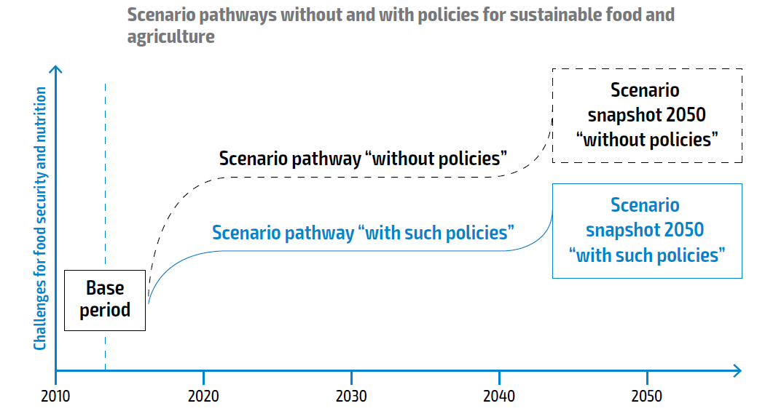
FAO scenarios
Business as usual (BAU): socio-economic, technological and environmental patterns that fail to address many challenges for food access and utilization. Economic growth is moderate. Fossil fuel are the main energy source for decades, with renewable sources slowly emerging. Adoption of conservation practices stagnates, emissions continue to increase, with world’s average temperature increasing 3-4 degrees by 2100
Towards sustainability (TSS): The world develops while addressing sustainability concerns. GDP per capita grows as in BAU but the growth rate is lower in HIC and higher LMIC. Potential for GHG sequestration is high due to suitable crop technologies, reforestation and afforestation. Widespread conservation practices and increased R&D investments lead to a sharp decrease in GHG emissions. Low-input precision agriculture, agroforestry, intercropping, organic agriculture and climate-friendly production are favored

Slide 7
Methodology
Wildfire and Drought
Use Ag Census data to obtain market value of agricultural products sold for the different farm categories
Forecast to 2050 using FAO data available for different categories
Temperature
Forecast to 2050 using FAO data available for different categories
Use Ag Census data to obtain market value of agricultural products sold for the different farm categories
Use hazard data from Climate Engine using CMIP6 projections
Use agricultural yields percentages at the county level from Hsiang et al (2017)
Use information from NOAA, Climate engine and climate.gov to measure economic impact
Use information from Hsiang et al. 2017, climate.gov to measure economic impact

Slide 8
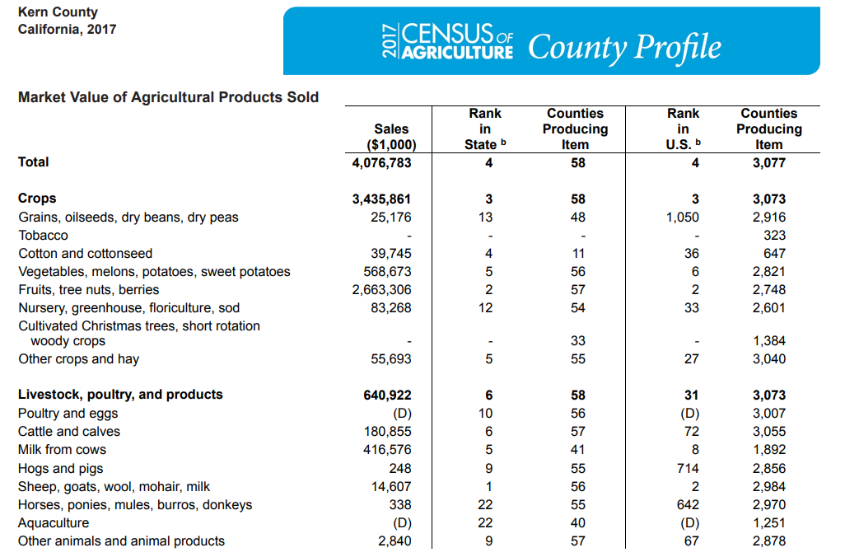
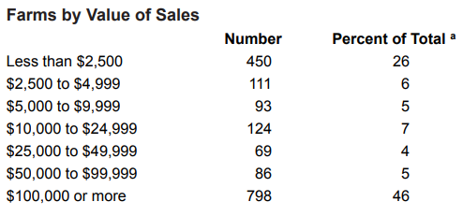
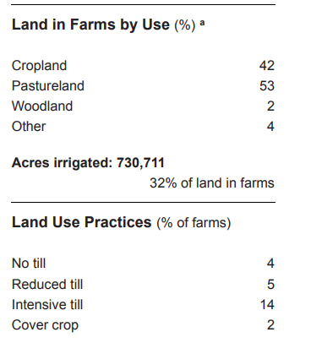
Kern County California

Slide 9
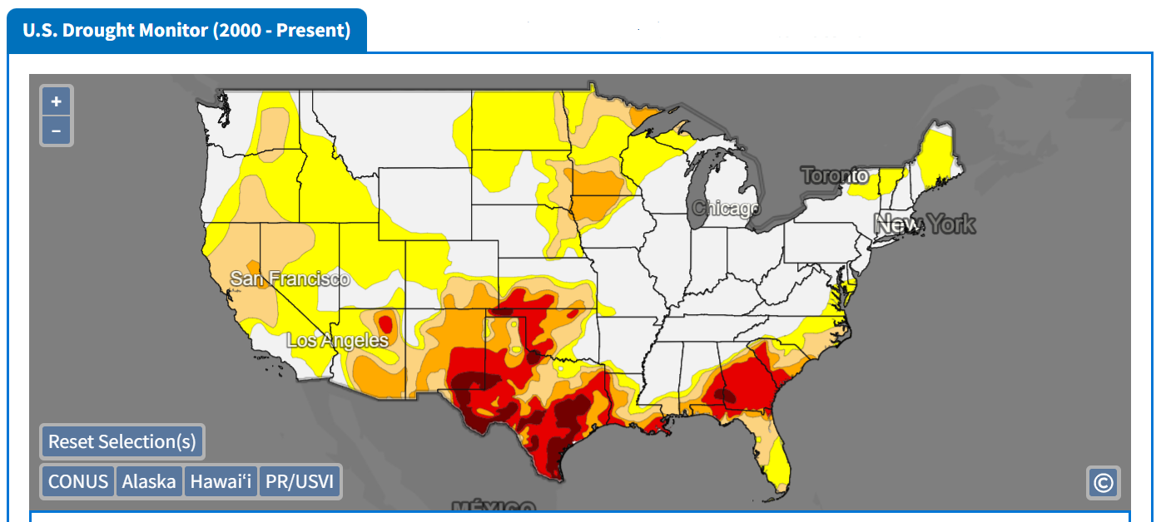
Historical Drought Map
https://drought.gov

Slide 10
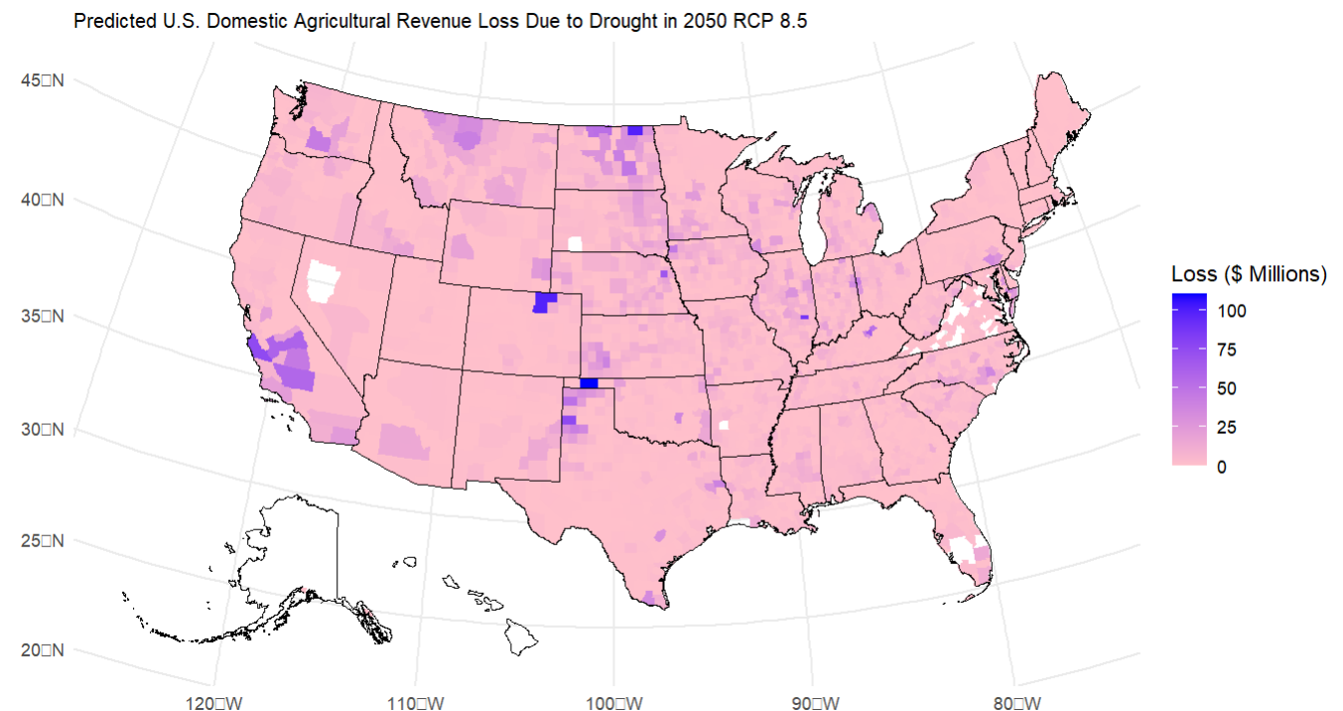
Drought losses in 2050 under RCP 8.5

Slide 11
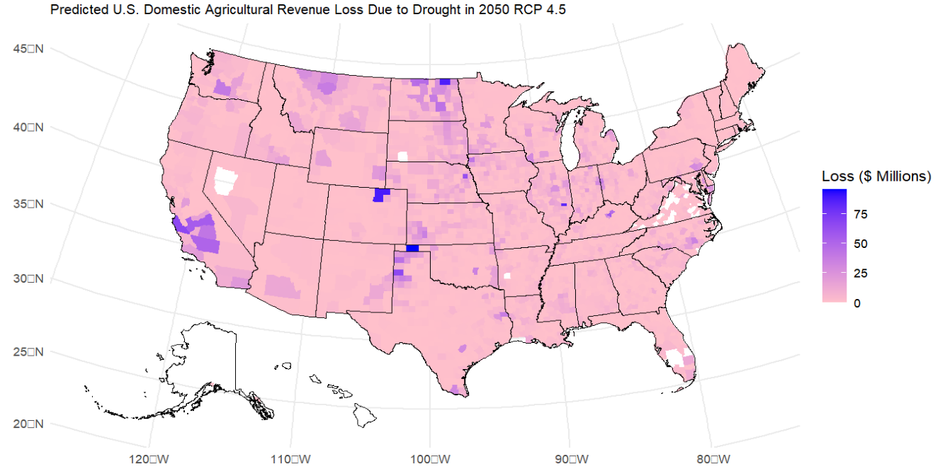
Drought losses in 2050 under RCP 4.5

Slide 12
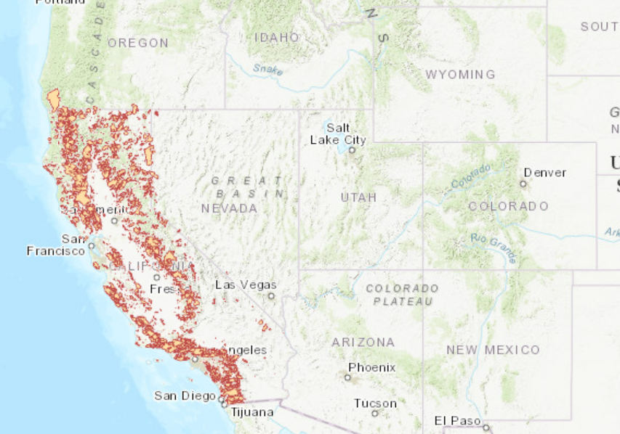
California Fire Perimeters (1898-2020)
https://databasin.org

Slide 13
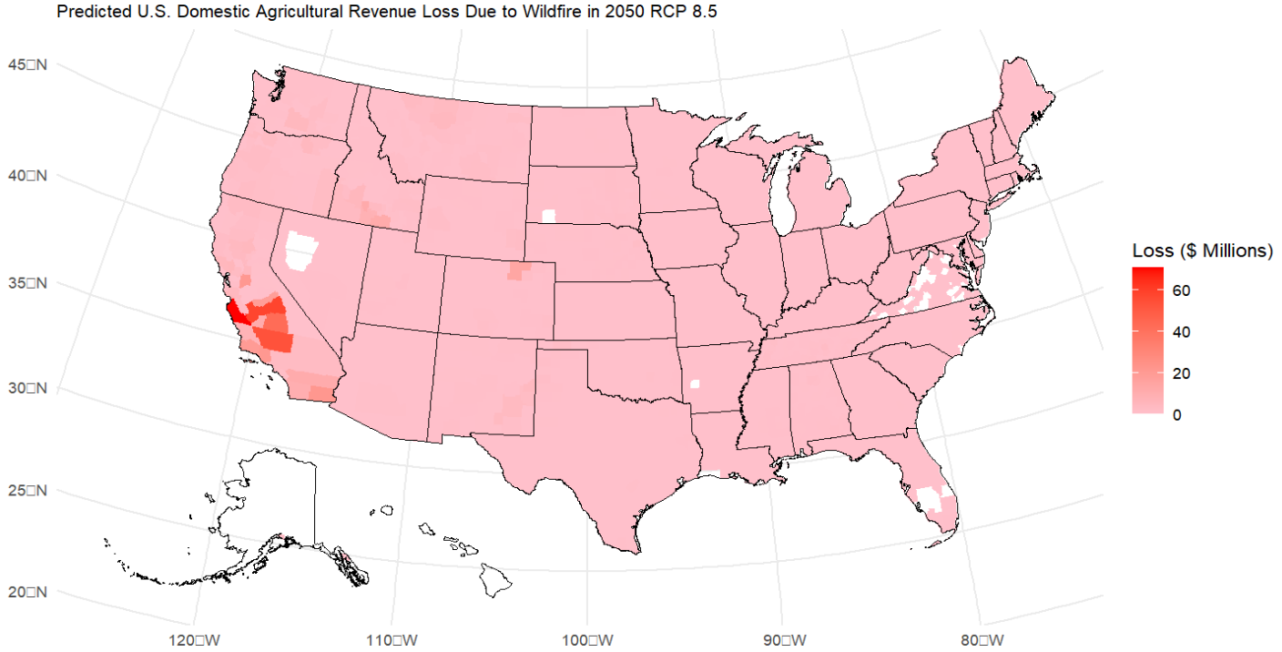
Wildfire losses in 2050 under RCP 8.5

Slide 14
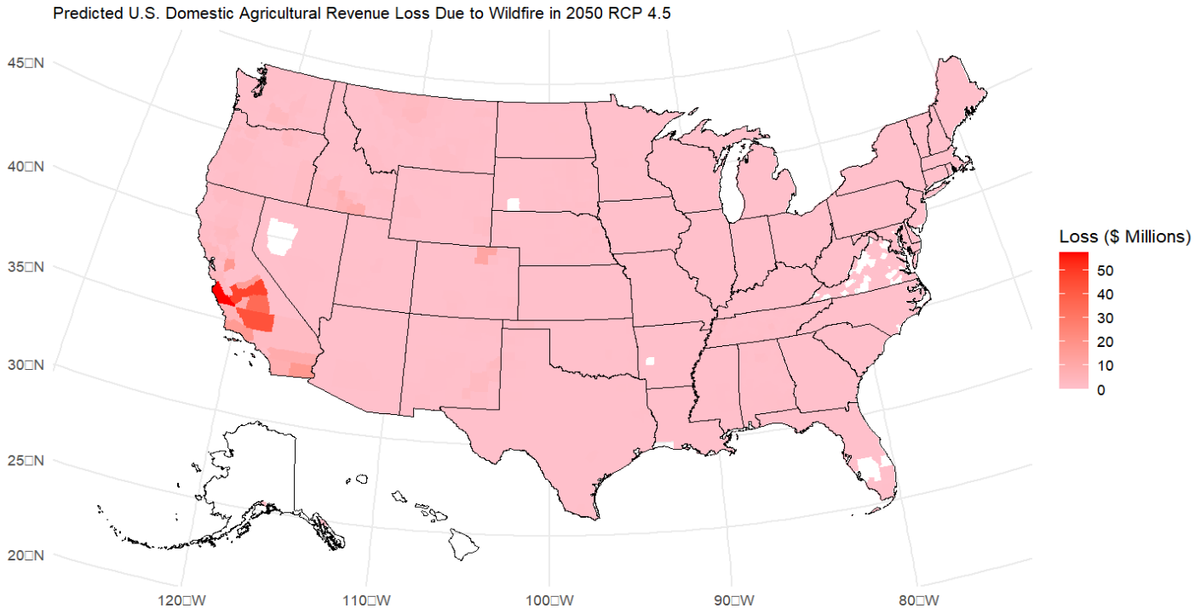
Wildfire losses in 2050 under RCP 4.5

Slide 15
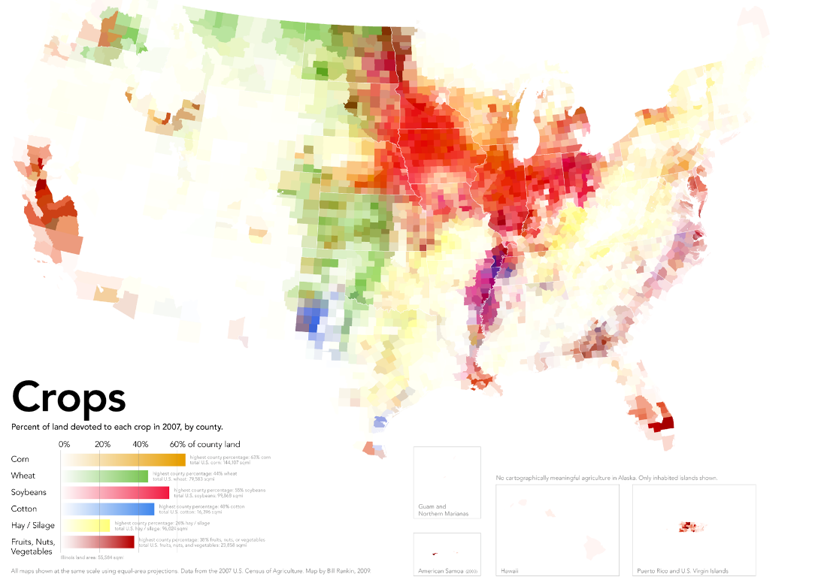
Crops Harvested in the USA
https://cdn1.vox-cdn.com/assets/4565283/crops_by_county.png

Slide 16
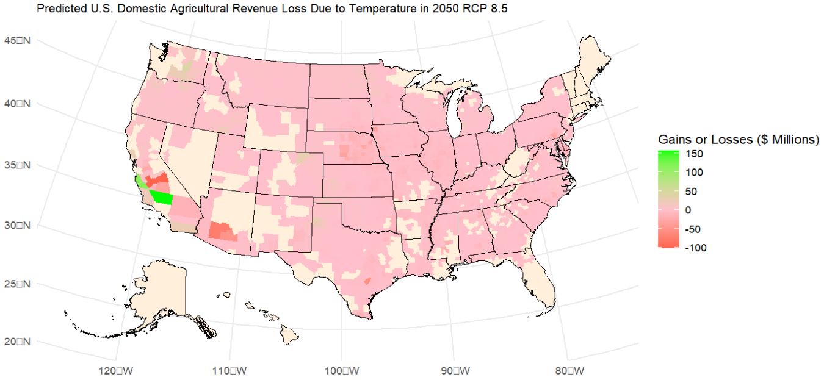
Heat gains (losses) in 2050 under RCP 8.5
Notes:
Temperature, rainfall and CO2 fertilization
Agricultural impacts are estimated by applying future climate data to dose response functions of yields for maize, wheat, cotton, and soybeans and combining them according to land area. The dose response functions include the effects of moderate and extreme temperatures, precipitation and CO2 fertilization.

Slide 17
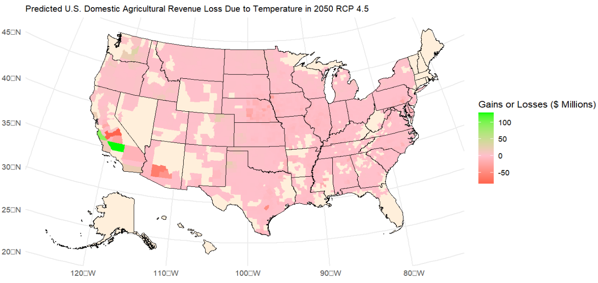
Heat gains (losses) in 2050 under RCP 4.5

Slide 18
Kern County California

Slide 19
Conclusions
Drought is the hazard that will produce the highest losses for counties in the USA by 2050. Potentially reaching almost 1$20 millions in losses in counties like Texas County (OK), with livestock being the most affected sector. The losses are reduced but are still considerable under RCP 4.5.
California will remain as the state most affected by wildfires, with significant losses especially in counties like Monterey, CA; with significant reduction in the production of vegetables and fruits in this region.
Heat, especially changes in temperature, will change the yields of the different crops produced. However, unlike drought and wildfire it will not always produce a negative impact. In some regions the increase in temperature will produce an increase in the yield and a change in the type of crops harvested due to the change in temperature. In a state like Arizona, however, the increase in temperatures will have severe effects on crop yield and livestock production.
We developed a straightforward approach that allows for monetary quantification at the county level. Quantification is important since it helps the efforts at all levels (farm level, policy makers, companies) towards mitigating the effects of climate change.

Slide 20
Appendix

Slide 21
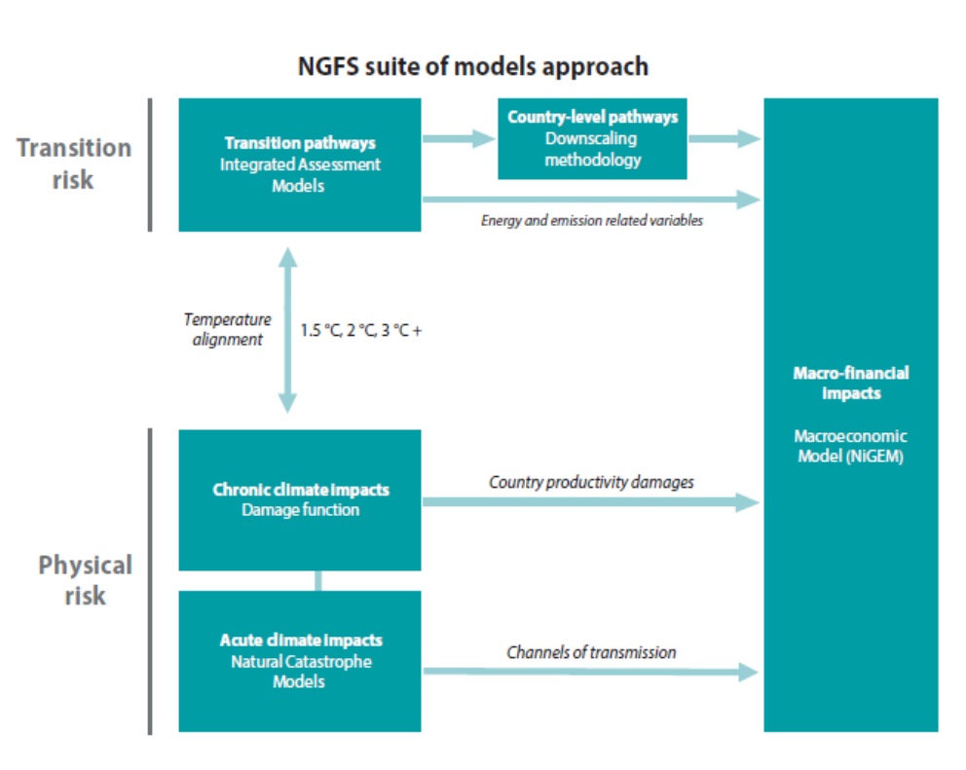
Different climate models being used in climate stress testing
Include acute and chronic physical risk models. Acute physical risk is assessed for four hazards at country level with various channels of transmission. Chronic physical risk via an aggregated damage function. Both sets of model's project physical risk based on the Global Temperature Paths (GMTs).
Focusing on acute physical risk, droughts and heatwaves are estimated to represent the largest source of risk across regions, and for North America drought is the principal*.

Slide 22
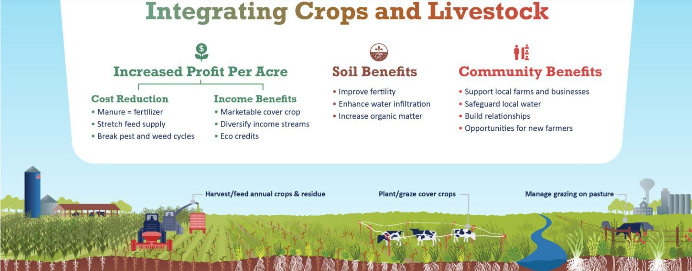
Benefits of sustainable practices
https://grasslandag.org/blog/new-infographic-illustrates-reintegration-of-livestock-and-crops/

Slide 23
Hazards definitions
Current wildfire probabilities are the number of observed instances of "High Fire Risk" classification (Fire Weather Index >= 21.3) divided by the number of data points in the record (1992-2022)
Current drought probabilities are the number of observed instances of "Severe Drought" based on SPEI 6-month data, divided by the number of data points in the record (2002-2022)
Current extreme heat probabilities are the number of observed instances of "Heat Danger" classification (Heat Index >= 103 F) divided by the number of data points in the record

