Slide 1
Estimating Elasticities for Tradable Services in Policy Simulations
27th Annual Conference on Global Economic Analysis
Saad Ahmad and Samantha Schreiber
June 2024
This presentation is solely meant to represent the opinions and professional research of individual authors. It is not meant to represent in any way the views of the U.S. International Trade Commission or any of its individual Commissioners.

Slide 2
Motivation
The Armington elasticity of substitution (σ) is a key model parameter that governs how consumers shift between domestic and imported varieties of a product following a change in relative prices (tariffs, domestic policies, NTMs)
It can determine aggregate welfare changes for a large class of structural gravity-based models (ACR, 2012)
McDaniel and Balistreri (2003) find that the chosen value of σ can impact the welfare gains or losses in CGE simulations
A higher σ means products are more substitutable, less differentiated with larger effects from trade shocks

Slide 3
Motivation (continued)
Given its importance, several empirical studies have developed robust methods for estimating σ using trade data
Soderbery (2015) applies the Feenstra System of Equations method on U.S. imports to obtain estimates of σ for various HS classifications
Fontagne at al. (2022) use bilateral tariffs and trade data to provide estimates of σ for different aggregations—including GTAP sectors
However, these studies focus on goods, not services:
  Popular estimation methods can not be applied on services trade (no information on prices, lack of tariffs)
  Often difficult to find disaggregated trade data for services
  Some services are not traded across borders

Slide 4
Contribution
The lack of information on trade elasticities for services sectors is a concern given that modern trade agreements include provisions affecting the ability of firms to trade services across borders
Without having credible estimates on σ for services sectors, policy practitioners may find it difficult to accurately determine the economic effects of modern trade agreements
Our paper contributes to this effort by providing new estimates on σ for GTAP services sectors
We then utilize these estimates of σ in a policy simulation examining the effects of a trade agreement between the United States and the United Kingdom that liberalizes cross-border services trade

Slide 5
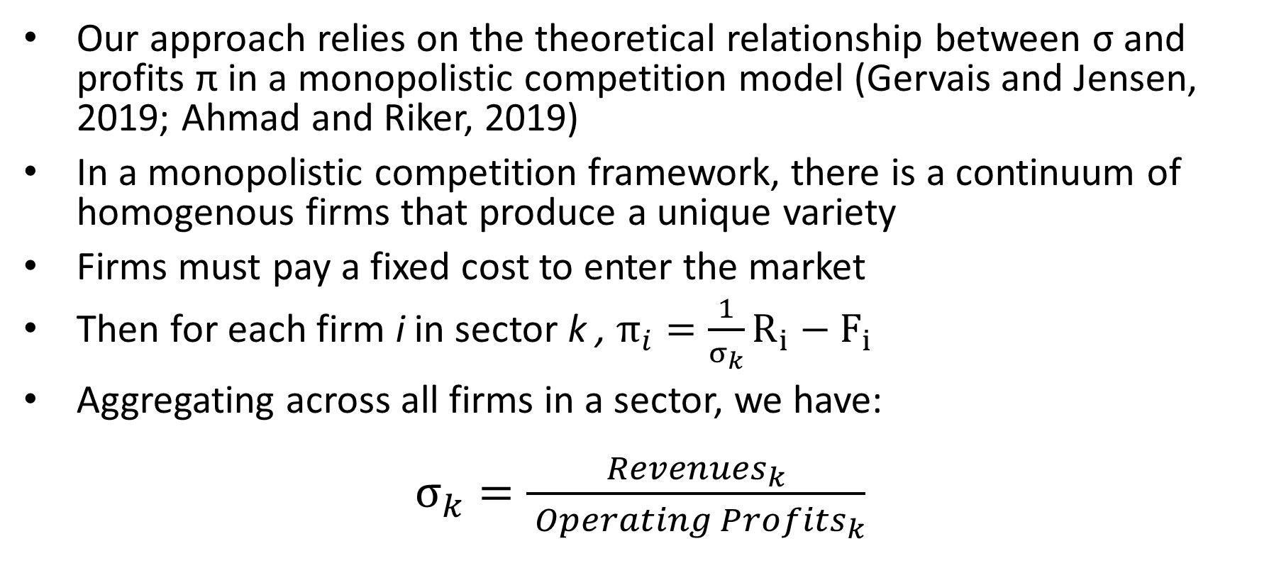
The Markup Method for Estimating σ
Our approach relies on the theoretical relationship between σ and profits π in a monopolistic competition model (Gervais and Jensen, 2019; Ahmad and Riker, 2019)
In a monopolistic competition framework, there is a continuum of homogenous firms that produce a unique variety
Firms must pay a fixed cost to enter the market
Then for each firm i in sector k , $π_{i}=\frac{1}{σ_{k}}R_{i}−F_{i}$
Aggregating across all firms in a sector, we have:
$σ_{k}=\frac{Revenues_{k}}{ Operating Profits_{k}}$

Slide 6
Data
Following Gervais and Jensen (2019), we rely on the Bureau of Economic Analysis (BEA) to get data on industry revenues and gross operating surplus at the 3-digit NAICS level
σ is estimated for each 3-digit NAICS services sector using the BEA data for the 10 most recent years available (2013-2022)
Our preferred estimate for a 3-digit NAICS sector is the median value of the annual estimates over the 10-year period
For the GTAP elasticity estimates, we concord the BEA data to the relevant GTAP services sectors (NAICS→ISIC→GTAP)

Slide 7
NAICS Estimates
Table 1: Summarizing elasticity estimates by 2-digit NAICS sector
NAICS Sector | Description | Mean σ | Median σ | Min σ | Max σ
23 | Construction | 5.42 | 5.42 | 5.42 | 5.42
42 | Wholesale trade | 4.79 | 4.79 | 4.79 | 4.79
44-45 | Retail trade | 7.49 | 6.00 | 4.83 | 13.12
48-49 | Transportation | 6.50 | 5.22 | 1.89 | 18.29
51 | Information | 3.04 | 3.06 | 2.80 | 3.26
52 | Finance and insurance | 8.27 | 5.45 | 2.63 | 19.57
53 | Real estate and leasing | 1.98 | 1.98 | 1.68 | 2.27
54 | Professional services | 5.08 | 5.08 | 5.08 | 5.08
55 | Management of companies | 15.87 | 15.87 | 15.87 | 15.87
56 | Administrative services | 6.61 | 6.88 | 5.77 | 7.18
61-62 | Education and health care | 13.78 | 10.71 | 6.87 | 27.41
71-72 | Recreation and food services | 6.31 | 6.29 | 3.28 | 9.39
81 | Other personal services | 7.11 | 7.11 | 7.11 | 7.11
Notes:
Add median, std dev, max and min in the table

Slide 8
GTAP Estimates
Table 2: Estimates of σ by GTAP Sector
GTAP Sector | Description | σ
afs | Accommodation, food | 7.37
atp | Air transport | 5.54
cmn | Information and communication | 2.91
cns | Construction | 5.42
edu | Education | 8.15
hht | Human health and social work | 9.69
ins | Insurance | 4.13
obs | Other business services | 4.83
ofi | Other financial intermediation | 5.30
otp | Land transport | 4.70
ros | Recreation and other services | 5.84
rsa | Real estate activities | 1.68
trd | Wholesale and retail trade | 5.19
whs | Warehousing and support activities | 18.29
wtp | Water transport | 7.26
Notes:
Mean GTAP estimate = 6.42 (3.84)
Core tradable services that are most impacted by trade agreement are bolded in table 2
Can be compared to default GTAP elasticities:
Domestic-import: 1.9 for all services sectors
Import-import: 3.8 for all services sectors

Slide 9
Policy Simulation
Determine the effects of a trade agreement between the UK and USA that liberalizes cross-border trade in services (no changes in goods trade in the experiment)
GTAP Model 7 and GTAP database version 11 (2017) with 65 sectors, 12 aggregated regions, 5 factors
The US-UK services FTA simulation is run twice: with core services sectors having either default GTAP σ values or our estimated σ values using the markup method
Default GTAP elasticities were treated as non-nested (σ_{d}=σ_{m}) to be comparable with the new estimates
Notes:
Note: We are using the standard GTAP model that assumes perfect competition. An interesting extension to this research would be to use a monopolistic competition CGE model instead so that the assumption for the parameter estimation matches the assumption in the simulation model. We can use the same price margins from the EOS estimation in the CGE model.

Slide 10
Policy Shocks
We use a gravity model to estimate the average effect of trade agreements with services provisions on cross-border trade in services by GTAP sector (USITC TPA 2021 report)
Find a statistically significant reduction in trade barriers for most GTAP core services sectors
Reductions in cross-border trade barriers are expressed as ad valorem equivalents by GTAP sector and used as policy shocks in the simulation
We shock AMS in the model as it is a technology change variable that reduces the effective price of services imports—capturing efficiency-enhancing measures from the US-UK FTA
Notes:
These shocks should be considered a lower bound, since U.S. and UK FTAs tend to have more commitments on services trade

Slide 11
Gravity Estimates of NTMs
Table 3: Estimates of the average impact of an FTA with services provisions on trade barriers
GTAP Sector | Description | AVE from Gravity Model | Default Elasticity | New Elasticity
cmn | Information and communication | -18.37 | 3.80 | 2.92
ins | Insurance | -3.94 | 3.80 | 4.13
obs | Other business services | -11.69 | 3.80 | 4.83
ofi | Other financial intermediation | -9.63 | 3.80 | 5.30
trd | Wholesale and retail trade | -5.98 | 3.80 | 5.19
Largest AVE shocks from the gravity model are for cmn, obs, and ofi
ofi and trd sees the largest increase in σ
cmn is the only sector with a smaller σ than default GTAP
Notes:
A significant impact is not observed for construction services, likely because a commercial presence abroad is typically needed to provide these services in foreign markets; the data on cross-border services trade do not include sales for a domestic firm having a commercial presence abroad.

Slide 12
One-way Liberalization
Effect of UK services liberalization
Table 4: Change in US and UK exports (% change)
GTAP Sector | Default: US exports to UK | Default: UK exports to US | New : US exports to UK | New: UK exports to US
cmn | 49.77 | 1.09 | 33.71 | 1.01
ins | 9.93 | 1.08 | 10.88 | 1.42
obs | 31.09 | 0.91 | 42.40 | 1.44
ofi | 24.88 | 1.08 | 38.14 | 1.84
trd | 15.84 | 0.89 | 23.51 | 1.53
Table 5: Macro effects
Effects | Default: US | Default: UK | New: US | New: UK
QGDP (% change) | 0.0007 | 0.0771 | 0.0008 | 0.0738
PGDP (% change) | 0.0528 | -0.2248 | 0.0648 | -0.2770
EV ($ mil) | 1,586.93 | 840.41 | 1,931.58 | 448.11
Notes:
OFI had the biggest increases in the EOS value, also the biggest increases in QXS outcome

Slide 13
Two-way Liberalization
Effect of US-UK services liberalization
Table 6: Change in US and UK exports (% change)
GTAP Sector | Default: US exports to UK | Default: UK exports to US | New: US exports to UK | New: UK exports to US
cmn | 51.63 | 50.69 | 35.39 | 34.62
ins | 11.69 | 10.30 | 13.04 | 11.53
obs | 32.73 | 31.69 | 44.71 | 43.41
ofi | 26.47 | 26.07 | 40.68 | 40.17
trd | 17.46 | 16.00 | 26.02 | 24.06
Table 7: Macro effects
Effects | Default: US | Default: UK | New: US | New: UK
QGDP (% change) | 0.0112 | 0.1010 | 0.0112 | 0.1017
PGDP (% change) | -0.0023 | 0.1868 | -0.0034 | 0.1853
EV ($ mil) | 2338.57 | 3940.34 | 2299.49 | 3946.85

Slide 14
Conclusions and Future Work
Estimated Armington elasticity of substitution for services sectors at the NAICS and GTAP level
  Mean GTAP estimate of 4.63 higher than default GTAP values
  Considerable hetrogenity across sectors
In a hypothetical simulation of a new US-UK services FTA, we show that trade elasticities for services sectors can impact the magnitude of changes in trade flows and macroeconomic outcomes
Next steps:
  Some micro-adjustments for a cleaner NAICS-GTAP concordance
  Estimate σ for services sectors in other economies (UK)
  Use a CGE model with monopolistic competition instead of perfect competition to match the approach taken for estimation
Notes:
Core sectors

