Slide 1
Impact of Non-Tariff Measures on ASEAN Trade: A Panel Data Approach
Pattawee Puangchit and Erwin Corong
Center for Global Trade Analysis (GTAP)

Slide 2
ASEAN Economic Community (AEC)
1992: ASEAN Free Trade Area (AFTA) was signed
1999: Completing 10-ASEAN member countries
2010: ASEAN Trade in Goods Agreement (ATIGA) was established
  Liberalized trade by streamlining and improving provisions such as the tariff liberalization, rules of origin, customs harmonization, and addressing non-tariff barriers (NTBs)
2015: ASEAN Economic Community (AEC) was formed
  To promote economic integration among ASEAN member states with free movement of goods, services, investment, skilled labor, and freer flow of capital

Slide 3
ASEAN Economic Community (AEC)
2020 (ASEAN Plus): Regional Comprehensive Economic Partnership (RCEP)
  Reducing tariffs, standardizing customs rules and procedures, and promoting economic cooperation with ASEAN’s FTA partners (China, Japan, South Korea, Australia, and New Zealand)

Slide 4
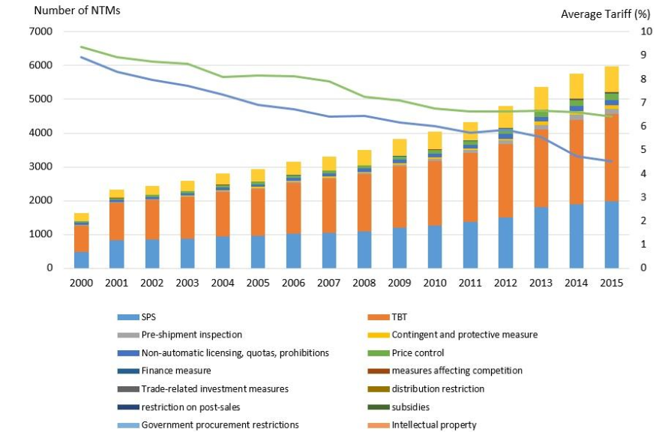
Figure 1: Average Tariff Rate (%) and Number of NTMs in ASEAN
Source: Ing, L. Y., O. Cadot, R. Anandhika and S. Urata (2016)

Slide 5
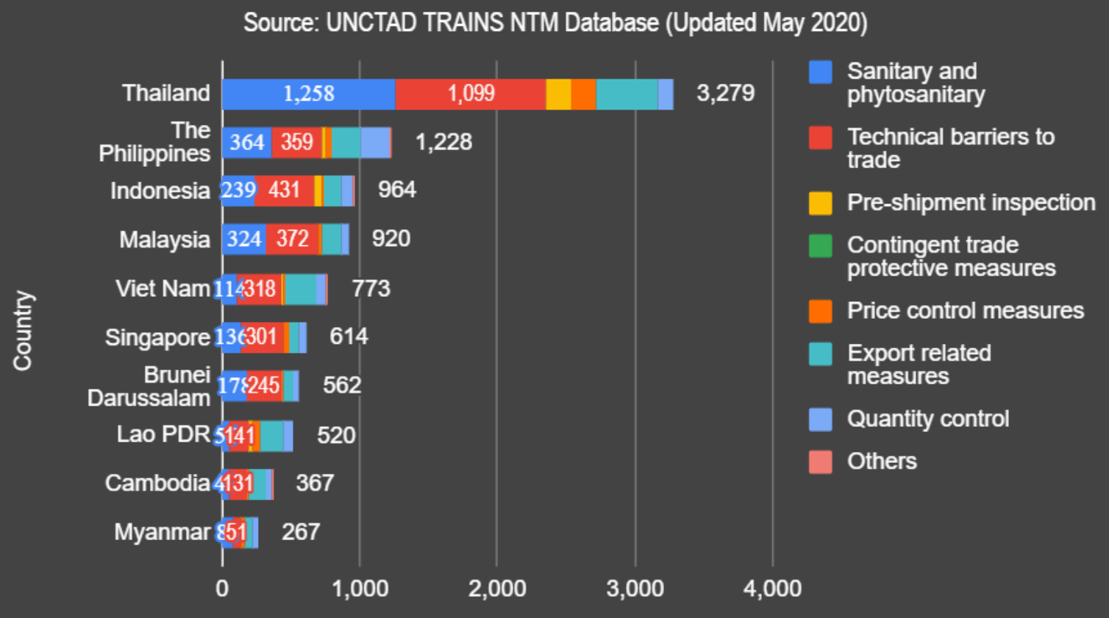
Figure 2: NTMs by ASEAN Countries
Source: UNCTAD TRAINS NTM Database (2020)

Slide 6
Panel Data for Estimating NTM AVEs
Capturing Longitudinal Effects: NTMs often have delayed impacts on trade flows (lagged variables)
Inclusion of Time Fixed Effects: Time-varying factors
Controlling for Unobserved Heterogeneity: Bilateral trade dynamics
Increased Degrees of Freedom

Slide 7
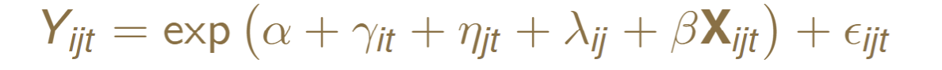
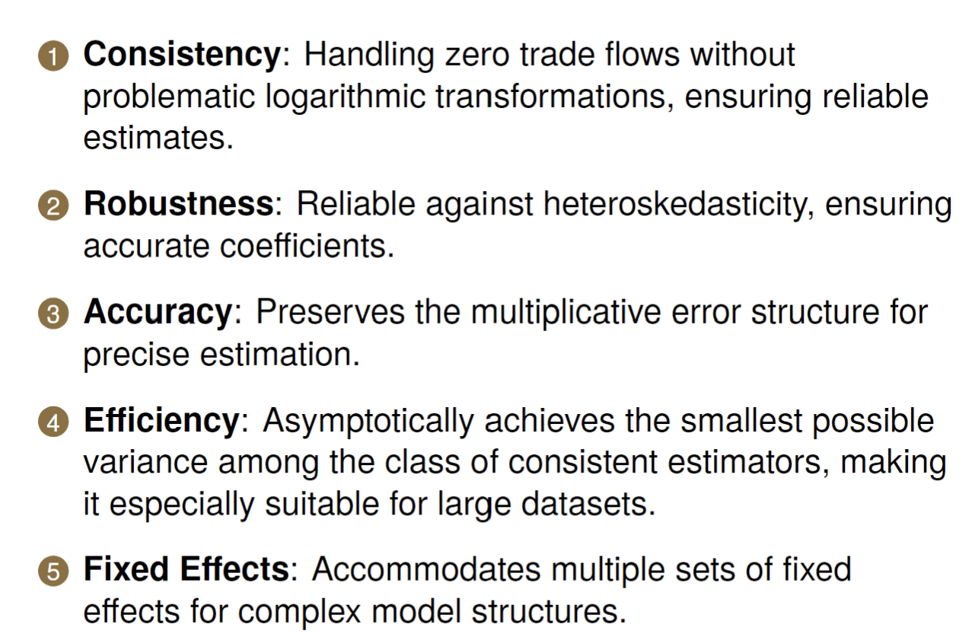
PPML Gravity Model: Quantity-based

Slide 8
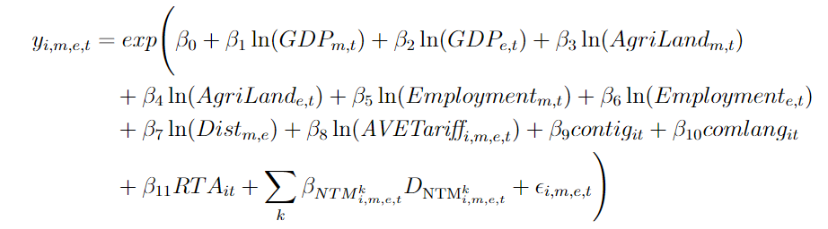
PPML Gravity Model: Quantity-based
AVETariff refers to Most-Favored Nation tariff (MFN) rate of product i, at HS6 level for bilateral trade partners (m,e) in year t.
Notes:
The AVEtariff refers to …

Slide 9
PPML Gravity Model: Quantity-based
gsec
DNTM, being equal to one if the importing country m applies NTM division k, on imports of product i at HS6 level from exporting country e, in year t.

Slide 10
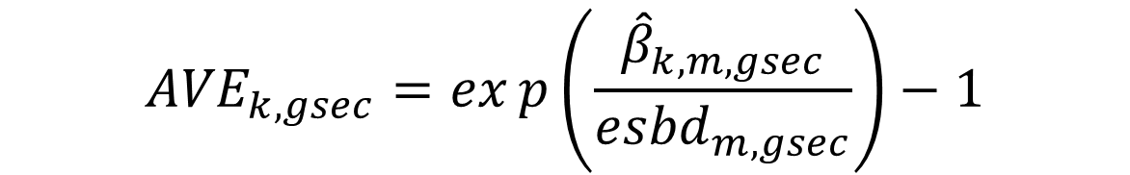
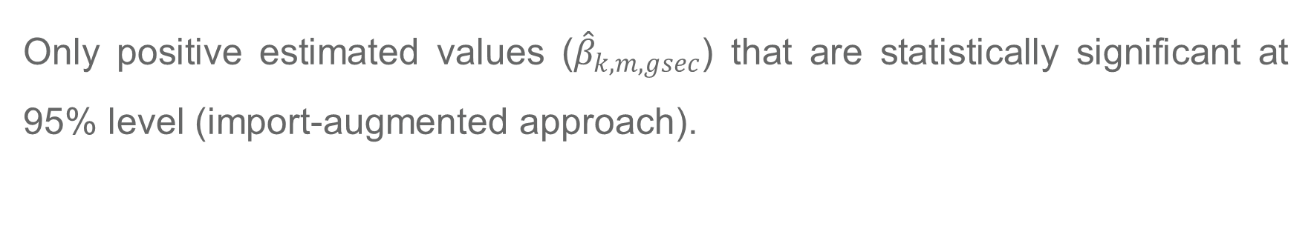
AVEs of NTM
$${AVE}_{k,gsec}=exp\left(\frac{{\hat{β}}_{k,m,gsec}}{{esbd}_{m, gsec}}\right)−1$$
Only positive estimated values (${\hat{β}}_{k,m,gsec}$) that are statistically significant at 95% level (import-augmented approach).
Where k is NTM at detailed measure level (sub-headings)

Slide 11
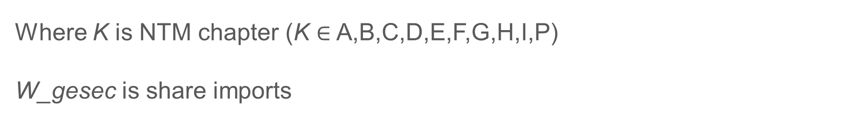
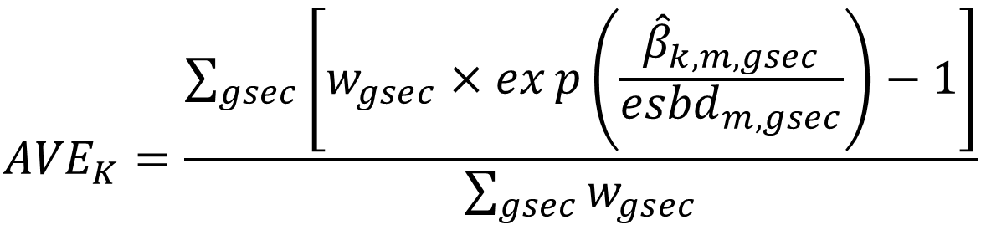
Weighted Average AVEs of NTM
$${AVE}_{K}=\frac{\sum_{gsec}{\left[w_{gsec}×exp\left(\frac{{\hat{β}}_{k,m,gsec}}{{esbd}_{m, gsec}}\right)−1\right]}}{\sum_{gsec}{w_{gsec}}}$$
Where K is NTM chapter (K $∈$ A,B,C,D,E,F,G,H,I,P)
W_gesec is share imports

Slide 12
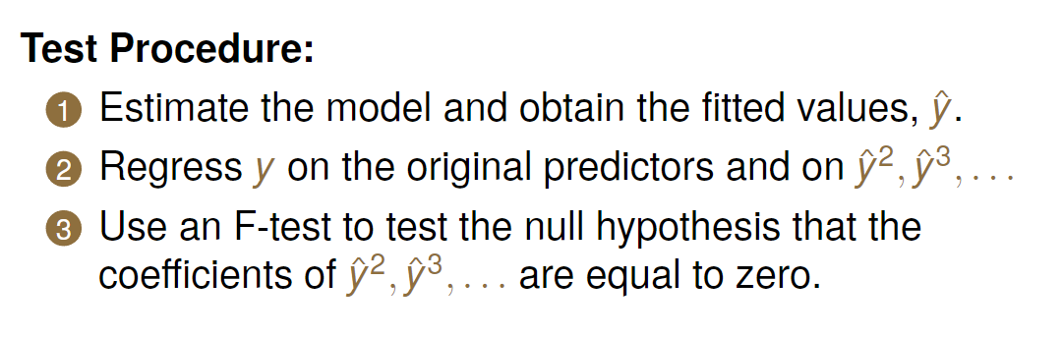
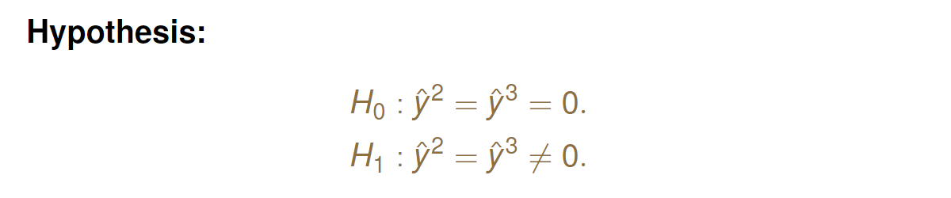
RESET Test

Slide 13
Data
Imports at the HS-6 level for each importer-exporter pair from 2015 to 2021 from UNComtrade
Focusing on imports by nine ASEAN countries (excluding Cambodia due to data inconsistencies) from 183 trade partners
There are 5,466 unique products at HS6 level
Using the GTAPv11 Data Base to map product to 46-GTAP sectors
156 unique NTMs are collected from TRAINS database (UNCTAD)

Slide 14
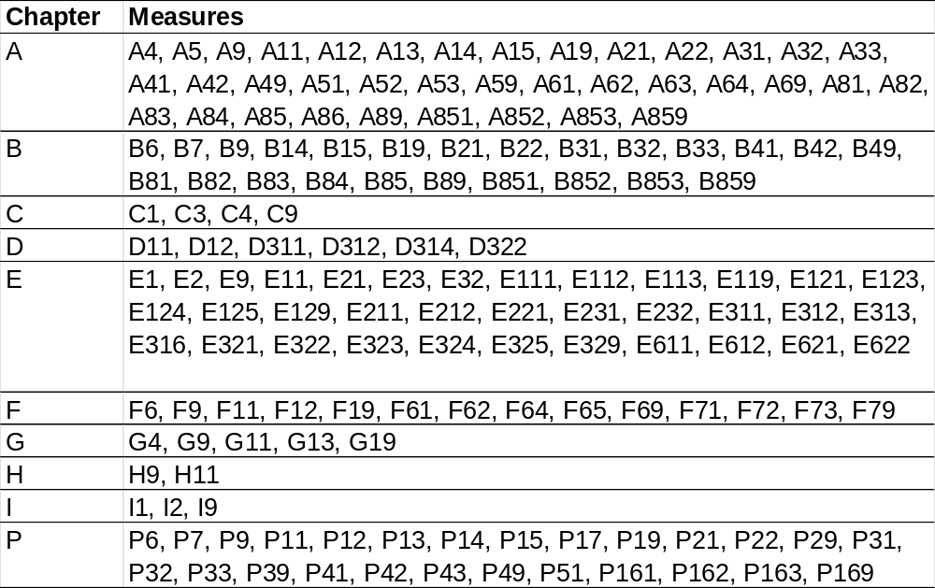
Data
Figure 3: Detailed Measure Level Classification of NTMs Included in the Model
Counts
37
24
4
6
35
14
5
2
3
26

Slide 15
Data
Dummy of NTM is obtained by indicating the starting and ending date of each NTM
The elasticity of demand (‘esbd’) is derived from GTAP-2017 estimation.

Slide 16
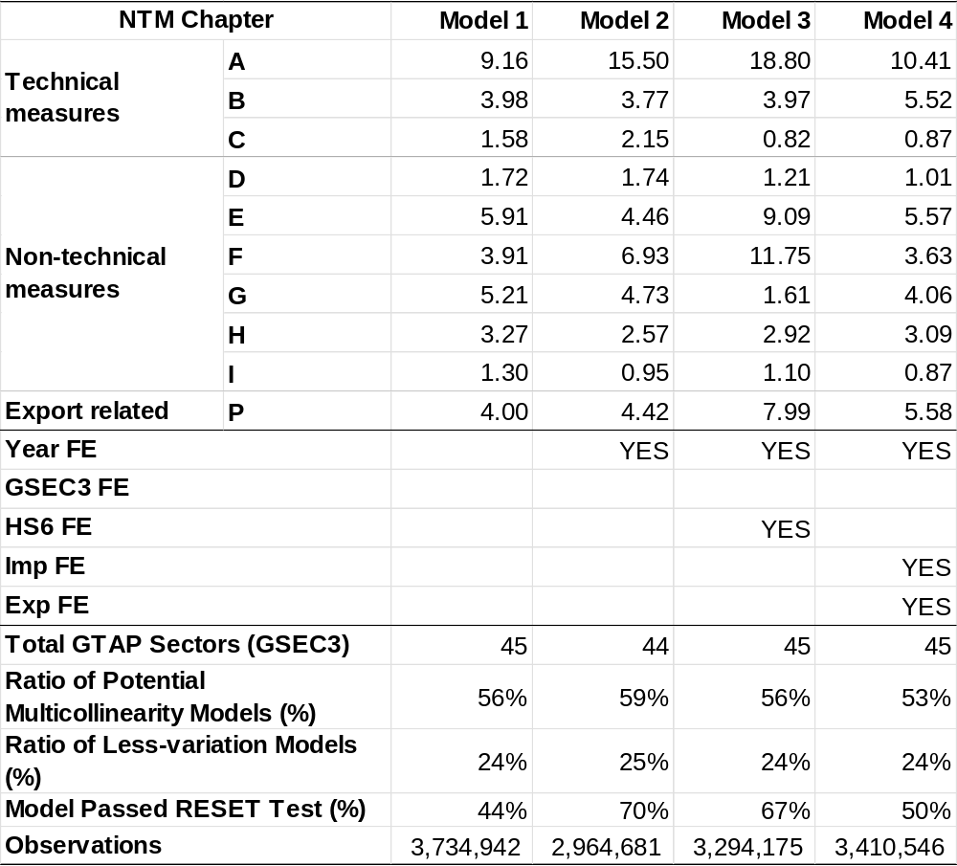
Results: Weighted Average AVEs

Slide 17
Results: Weighted Average AVEs
Technical measures
“Non-technical Measures”
Export-related Measures

Slide 18
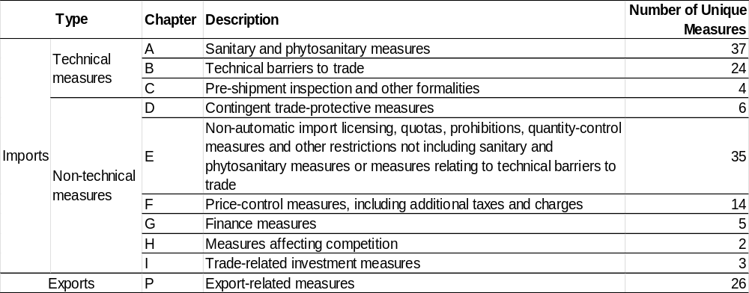
Aggregated NTMs
65 dummies
Non-technical measures
Export-related Measures
The number of unique NTM measures refers to NTMs that are available in HS6 level from 2015-2021 used in the author’s model.

Slide 19
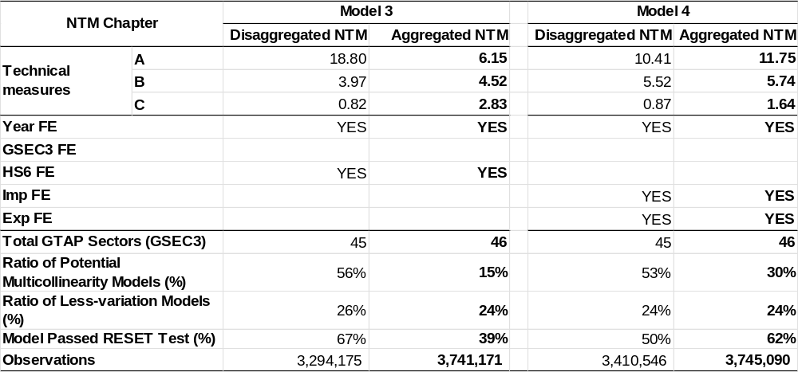
Results: Weighted Average AVEs

Slide 20
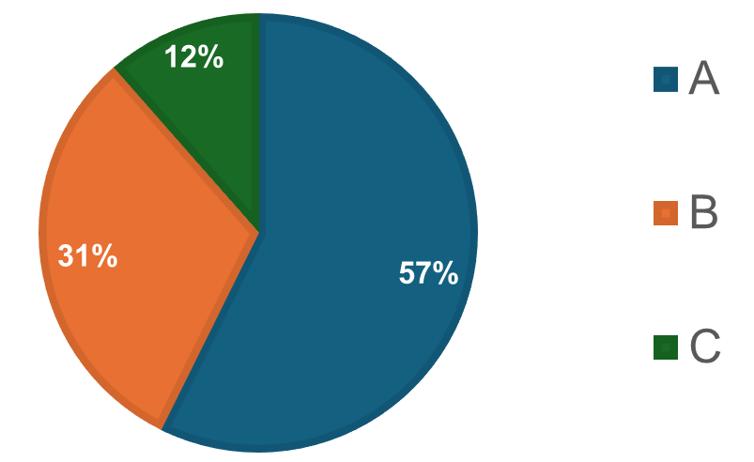
Results: Weighted Average AVEs
: SPS
: TBT
: Pre-shipment

Slide 21
Summary of Findings
Technical measures, especially SPS, have the largest impact on ASEAN imports across all models
Models with importer, exporter, and year fixed effects (Model 4), show better accuracy, lower multicollinearity errors, and improved model specification.
Multicollinearity vs Loss of details

Slide 22
Appendix: Mapping HS6 to GSEC3
Classification | HS6 | HS4 | GSEC3
H6 | 010121 | 0101 | CTL
H6 | 010129 | 0101 | CTL
H6 | 010130 | 0101 | CTL
H6 | 010190 | 0101 | CTL
H6 | 010221 | 0102 | CTL
H6 | 010229 | 0102 | CTL
H6 | 010231 | 0102 | CTL
H6 | 010239 | 0102 | CTL
H6 | 010290 | 0102 | CTL
H6 | 010310 | 0103 | OAP
H6 | 010391 | 0103 | OAP
H6 | 010392 | 0103 | OAP
H6 | 010410 | 0104 | CTL
H6 | 010420 | 0104 | CTL
H6 | 010511 | 0105 | OAP
H6 | 010512 | 0105 | OAP
H6 | 010513 | 0105 | OAP
H6 | 010514 | 0105 | OAP
... | … | … | …

Slide 23
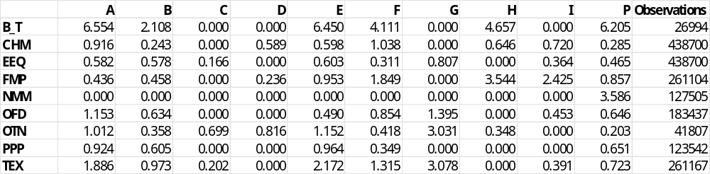
Appendix
Model 4: Disaggregated ratio of NTM impacts (AVEs) by GTAP sectors

Slide 24
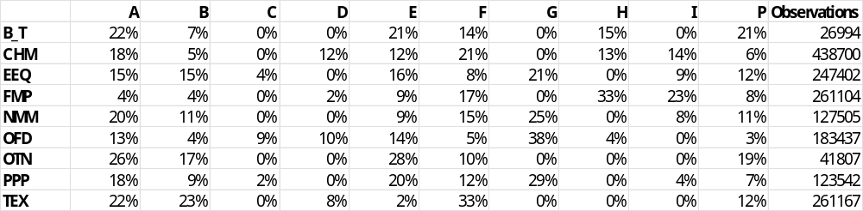
Appendix
Model 4: Disaggregated ratio of NTM impacts (%) by GTAP sectors

Slide 25
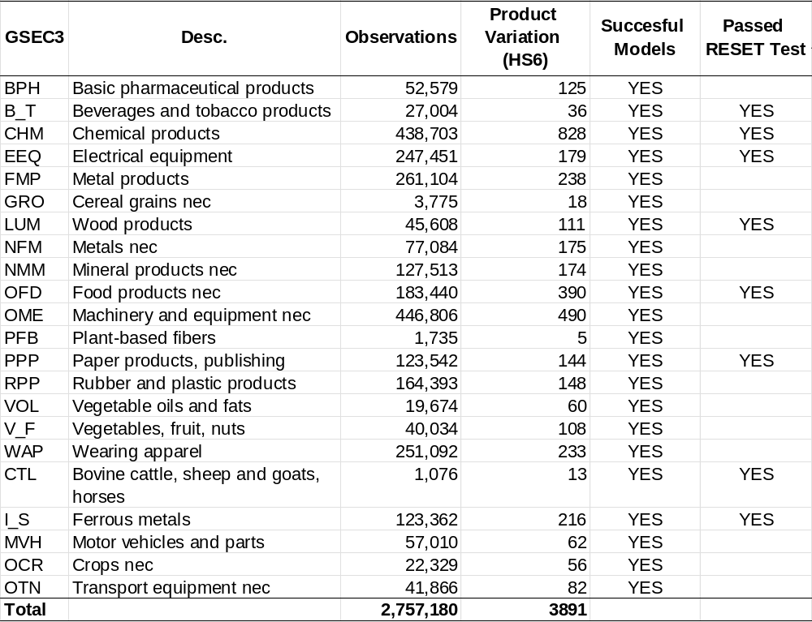
Appendix
Successful models
Model 4 – Aggregated NTM

Slide 26
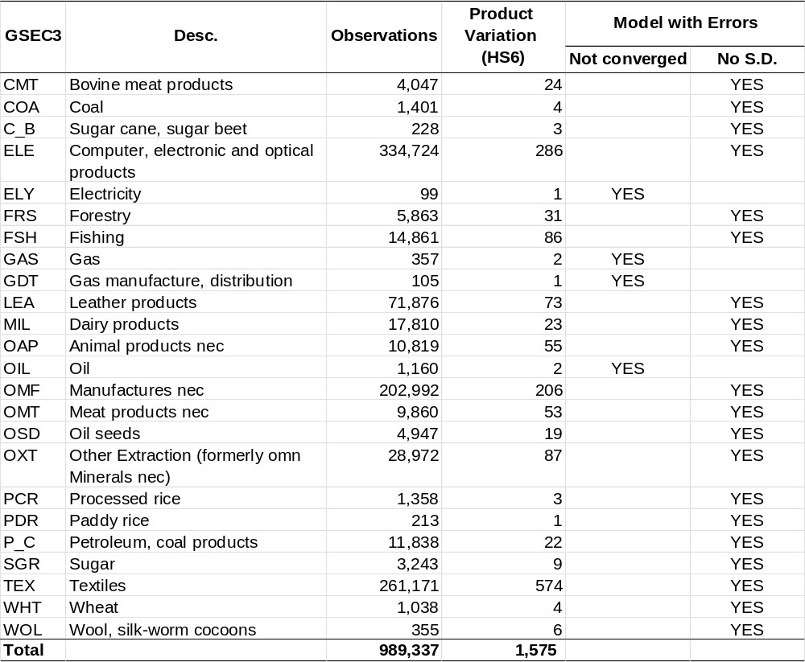
Appendix
Unsuccessful models
Model 4 – Aggregated NTM

Slide 27
Limitations
High correlation among NTMs
Limited variation in some GTAP sectors
Sector-specific characteristics

Slide 28
Methodology in Progress
Mapping H4 to GSEC3 instead of H6 to increase observations in each sector
Pre-defining NTM sections for each GTAP sector based on previous literature and NTM relevant to GSEC3

