Slide 1
Quantity-based Land Allocation System: Bringing Realistic and Consistent Land Allocation to the GTAP Model
Kristiina Ala-Kokko (Kansas State University)
Jayson Beckman, Maros Ivanic, Noé J Nava (Economic Research Service)
27th Annual GTAP Conference
June 4, 2024
​
This research was supported by the USDA, Economic Research Service. The findings and conclusions in this manuscript are those of the authors and should not be construed to represent any official USDA or U.S. Government determination or policy.
Notes:
Tips for converting from standard size to widescreen
Click “Design” Tab
Click “Slide Size”
Click “Widescreen (16:9)”
Resize images for widescreen
Click on “View” tab
Click “Slide Master”
Right-click on the image on the master slides (slides 1 and 2)
Click “Size and Position”
Check “Lock aspect ratio”
Use arrow key on “Scale Height” box and image will automatically resize to correct proportion. Increase percentage until the image fits the screen.
To resize the footer, increase percentage to 133%.

Slide 2
Land allocation remains an important policy topic
Competition for land among forests/crop varieties/livestock
  Biofuel policies
  Deforestation
Current treatment in the GTAP model appears incomplete
  Single/nested CET structure with uniform/round parameters
  Correction for quantities to overcome issues with land accounting in AEZ model
We propose an improvement by estimating a richer transformation structure
  Possibility for more complex and transformation possibilities
  Quantity based approach allowing land accounting

Slide 3
Nested CET in GTAP-AEZ/BIO model
-0.2
A series of nests with one elasticity parameter (CET)
  Same values for all regions and AEZs
The matrix of return elasticities is very restricted
Land accounting does not work out without additional work
  Generally total land does not equal sum of allocated land
σ₁
-0.5
forest
σ₂
-1
pastureland
σ₃
crops

Slide 4
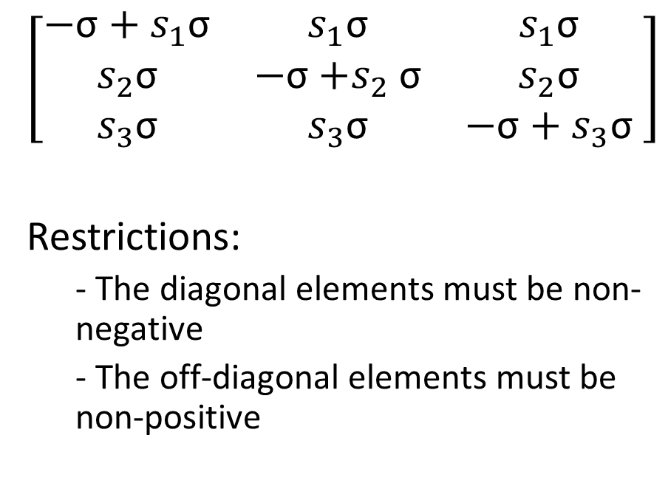
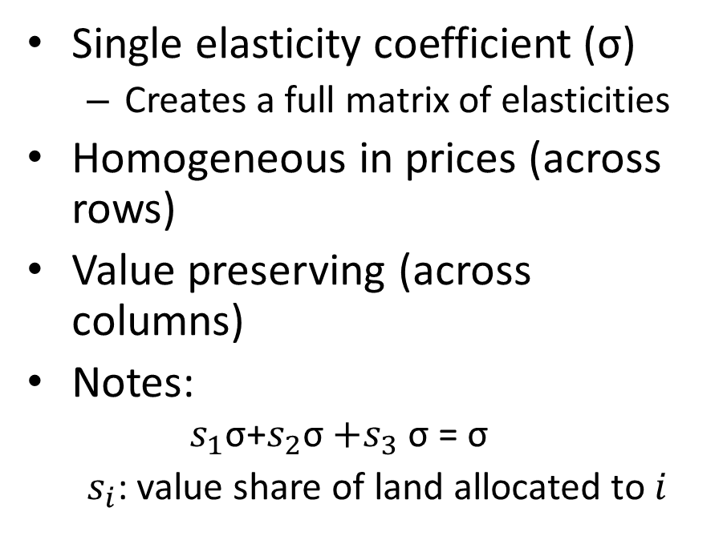
Elasticity matrix is restricted under simple CET
Single elasticity coefficient (σ)
  Creates a full matrix of elasticities
Homogeneous in prices (across rows)
Value preserving (across columns)
Notes:
  $$s_{1}\text{σ}\text{+}s_{2}\text{σ}{+s}_{3}\text{σ}\text{ =} \text{σ}$$
  $s_{i}$: value share of land allocated to $i$
$$\left[\begin{matrix}\text{−}\text{σ}+s_{1}\text{σ} & s_{1}\text{σ} & s_{1}\text{σ} \\ s_{2}\text{σ} & \text{−}\text{σ}{+s}_{2}\text{σ} & s_{2}\text{σ} \\ s_{3}\text{σ} & s_{3}\text{σ} & \text{−}\text{σ}+s_{3}\text{σ}\end{matrix} \right]$$
Restrictions:
  - The diagonal elements must be non-negative
  - The off-diagonal elements must be non-positive

Slide 5
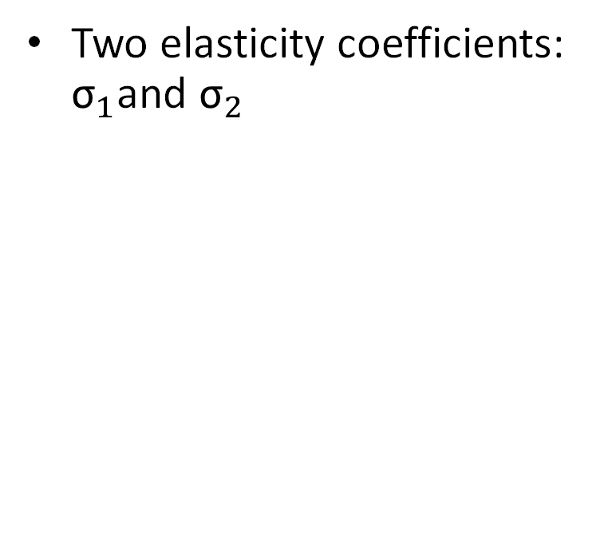
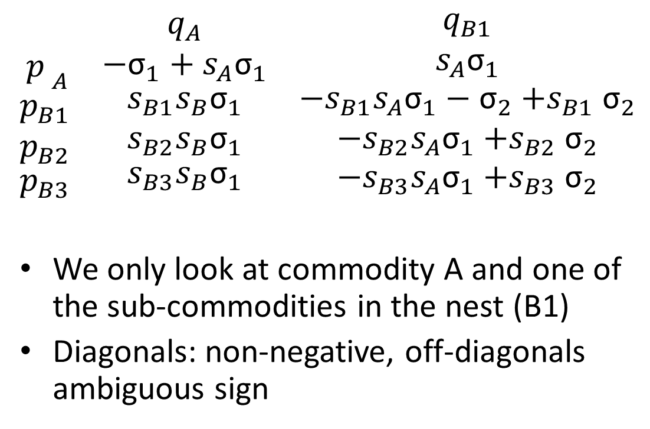
Nested CET gives one more parameter for a more flexible elasticity matrix
Two elasticity coefficients: ${\text{σ}}_{1}$and ${\text{σ}}_{2}$
$$\begin{matrix}{\begin{aligned} \\ p\end{aligned}}_{A} \\ \begin{aligned}p_{B1} \\ p_{B2}\end{aligned} \\ p_{B3}\end{matrix}\begin{matrix}\begin{aligned} \\ \end{aligned} \\ \begin{aligned} \\ \end{aligned} \\ \end{matrix}\begin{matrix}\begin{aligned}q_{A} \\ {\text{−}\text{σ}}_{1}+s_{A}{\text{σ}}_{1}\end{aligned} \\ \begin{aligned}s_{B1}{s_{B}\text{σ}}_{1} \\ s_{B2}{s_{B}\text{σ}}_{1}\end{aligned} \\ s_{B3}{s_{B}\text{σ}}_{1}\end{matrix}\begin{matrix}\begin{aligned} \\ \end{aligned} \\ \begin{aligned} \\ \end{aligned} \\ \end{matrix}\begin{matrix}\begin{aligned}q_{B1} \\ s_{A}{\text{σ}}_{1}\end{aligned} \\ \begin{aligned}−s_{B1}s_{A}{\text{σ}}_{1}−{\text{σ}}_{2}{+s}_{B1}{\text{σ}}_{2} \\ {−s}_{B2}s_{A}{\text{σ}}_{1}{+s}_{B2}{\text{σ}}_{2}\end{aligned} \\ {−s}_{B3}s_{A}{\text{σ}}_{1}{+s}_{B3}{\text{σ}}_{2}\end{matrix}$$
We only look at commodity A and one of the sub-commodities in the nest (B1)
Diagonals: non-negative, off-diagonals ambiguous sign
σ₁
B
A
σ₂
B1
B2
B3

Slide 6
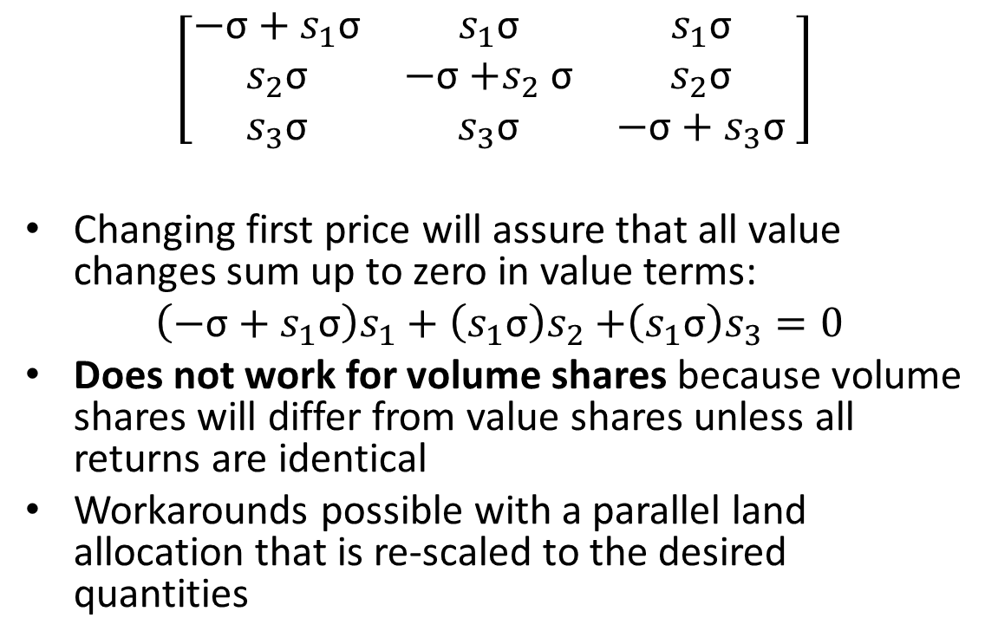
Land accounting does not work in CET
CET elasticity matrix assures homogeneity in values and prices but not quantities
  If returns change, the total quantities of distributed land will not sum up to total land
$$\left[\begin{matrix}\text{−}\text{σ}+s_{1}\text{σ} & s_{1}\text{σ} & s_{1}\text{σ} \\ s_{2}\text{σ} & \text{−}\text{σ}{+s}_{2}\text{σ} & s_{2}\text{σ} \\ s_{3}\text{σ} & s_{3}\text{σ} & \text{−}\text{σ}+s_{3}\text{σ}\end{matrix} \right]$$
Changing first price will assure that all value changes sum up to zero in value terms:
$\left(\text{−}\text{σ}+s_{1}\text{σ}\right)s_{1}+\left(s_{1}\text{σ}\right)s_{2}$ $+\left(s_{1}\text{σ}\right)s_{3}=0$
Does not work for volume shares because volume shares will differ from value shares unless all returns are identical
Workarounds possible with a parallel land allocation that is re-scaled to the desired quantities

Slide 7
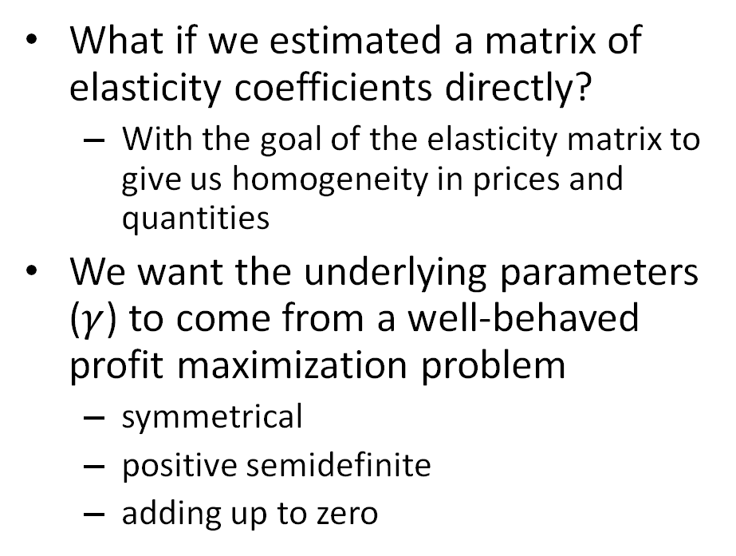
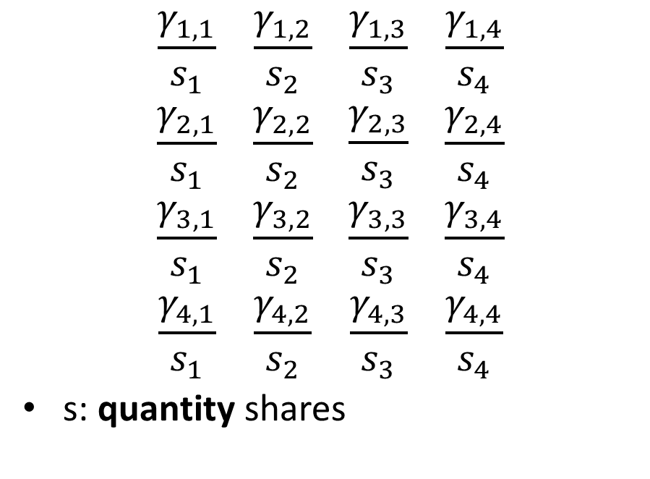
Quantity-based land allocation system
What if we estimated a matrix of elasticity coefficients directly?
  With the goal of the elasticity matrix to give us homogeneity in prices and quantities
We want the underlying parameters ($γ$) to come from a well-behaved profit maximization problem
  symmetrical
  positive semidefinite
  adding up to zero
$$\begin{matrix}\frac{γ_{1,1}}{s_{1}} \\ \frac{γ_{2,1}}{s_{1}} \\ \begin{aligned}\frac{γ_{3,1}}{s_{1}} \\ \frac{γ_{4,1}}{s_{1}}\end{aligned}\end{matrix}\begin{matrix} \\ \\ \begin{aligned} \\ \end{aligned}\end{matrix}\begin{matrix}\begin{aligned}\frac{γ_{1,2}}{s_{2}} \\ \frac{γ_{2,2}}{s_{2}}\end{aligned} \\ \frac{γ_{3,2}}{s_{2}} \\ \frac{γ_{4,2}}{s_{2}}\end{matrix}\begin{matrix} \\ \\ \begin{aligned} \\ \end{aligned}\end{matrix}\begin{matrix}\begin{aligned}\frac{γ_{1,3}}{s_{3}} \\ \frac{γ_{2,3}}{s_{3}}\end{aligned} \\ \frac{γ_{3,3}}{s_{3}} \\ \frac{γ_{4,3}}{s_{3}}\end{matrix}\begin{matrix} \\ \\ \begin{aligned} \\ \end{aligned}\end{matrix}\begin{matrix}\begin{aligned}\frac{γ_{1,4}}{s_{4}} \\ \frac{γ_{2,4}}{s_{4}}\end{aligned} \\ \frac{γ_{3,4}}{s_{4}} \\ \frac{γ_{4,4}}{s_{4}}\end{matrix}$$
s: quantity shares

Slide 8
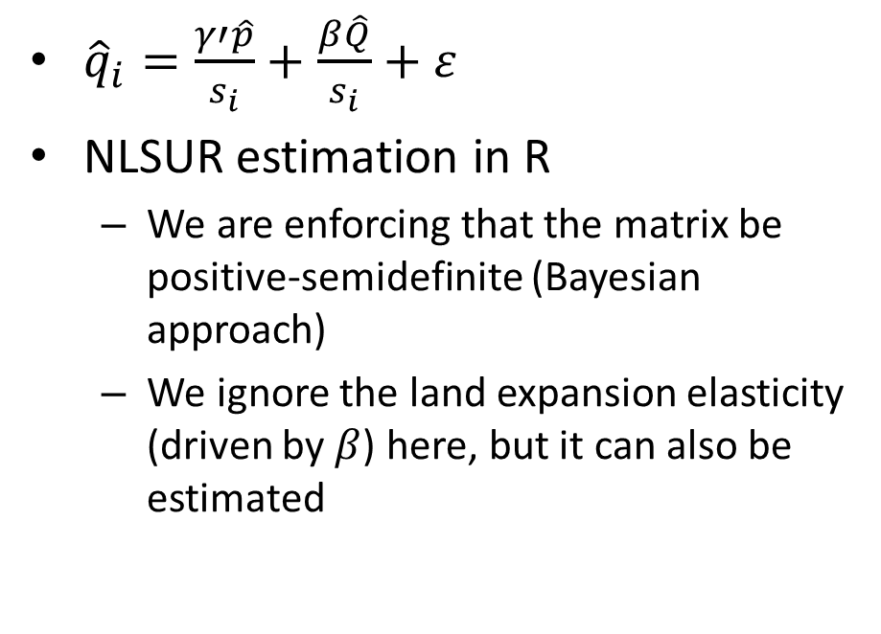
Estimation procedure
Data:
  Five versions of the GTAP-LU database
  Crop areas (header AREA)
  Pasture and forest areas (header LCOV)
  Returns to land (header EVFP)
  We ignored a slight inconsistency between crop land in headers AREA and LCOV
We differenced the data because we cannot rule out non-stationarity
${\hat{q}}_{i}=\frac{γ′\hat{p}}{s_{i}}+\frac{β\hat{Q}}{s_{i}}+ε$
NLSUR estimation in R
  We are enforcing that the matrix be positive-semidefinite (Bayesian approach)
  We ignore the land expansion elasticity (driven by $β$) here, but it can also be estimated

Slide 9
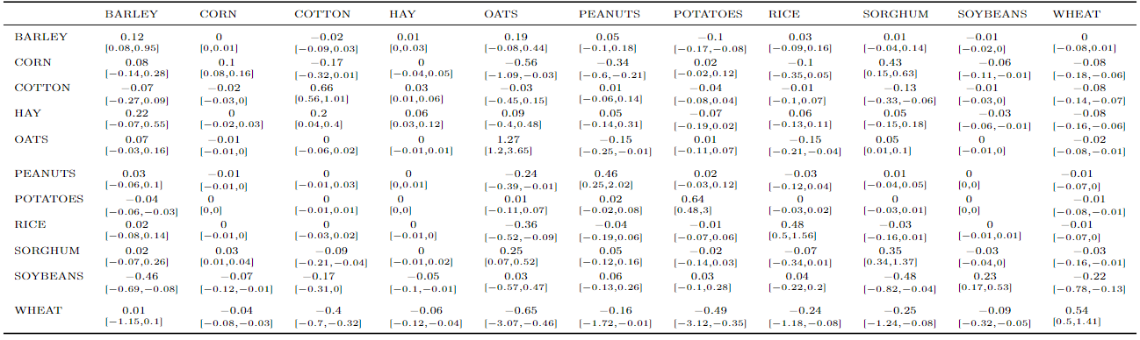
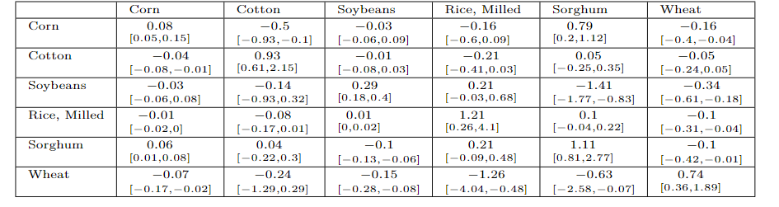
This estimation worked well with good data (USDA & FAO)
Elasticities estimates for major crops using NASS data and PSD/FAO data are very similar

Slide 10
Estimating the same structure using GTAP-LU data
We consider two parts of the nest for presentation only
  Eight individual crops from the GTAP database (bottom nest in GTAP-AEZ)
  Crops as a total, pastureland, forest (top nest in GTAP-AEZ)
Estimation by eighteen AEZs
  Each country is an observation (not all countries have each AEZ; excluded from estimation)
  We use four differences between five data points (2004, 2007, 2011, 2014, 2017)

Slide 11
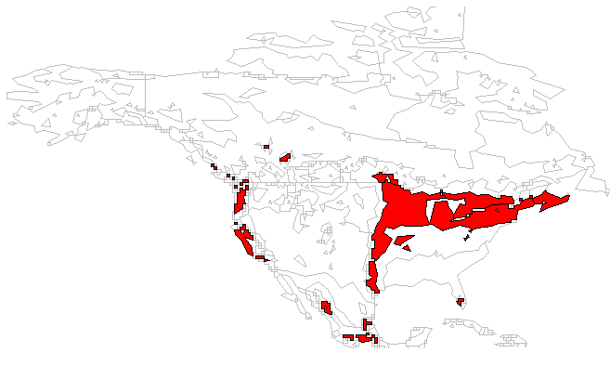
Estimation results for AEZ 10—United States
Corn/GRO | USDA | FAO | GTAP | CET
Lower 10% | 0.08 | 0.05 | 0.01
Median | 0.1 | 0.08 | 0.02 | 0.77
Upper 10% | 0.16 | 0.15 | 0.03
Wheat | USDA | FAO | GTAP | CET
Lower 10% | 0.5 | 0.36 | 0.05
Median | 0.54 | 0.74 | 0.17 | 0.97
Upper 10% | 1.41 | 1.89 | 0.31
Soy/OSD | USDA | FAO | GTAP | CET
Lower 10% | 0.17 | 0.18 | 0.01
Median | 0.23 | 0.29 | 0.04 | 0.73
Upper 10% | 0.53 | 0.4 | 0.08

Slide 12
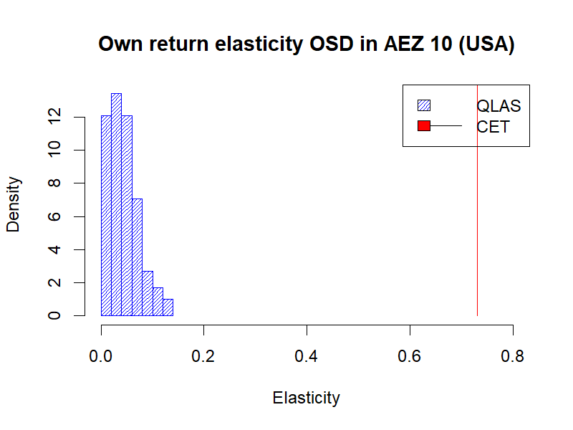
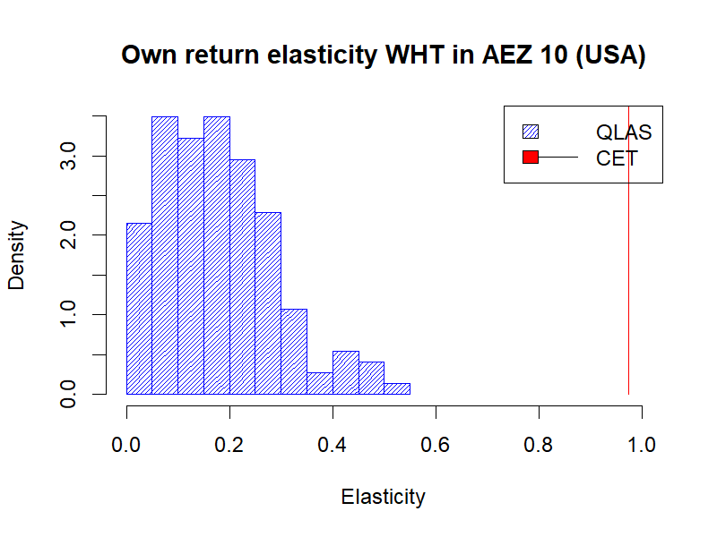
QLAS vs CTE (σ=-1) (GTAP data, AEZ 10, USA)

Slide 13
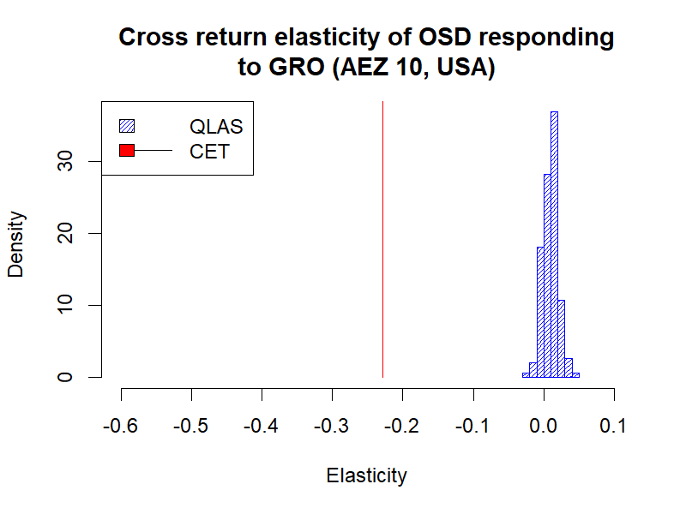
Cross-return elasticities also appear off
Cross return elasticities for corn and soybeans appear to be low (we expect them to be close to zero due to their complementarity)
Elasticity of soybeans/OSD area to corn/GRO returns:
 | USDA | FAO | GTAP | CET
Lower 10% | -0.12 | -0.06 | -0.01
Median | -0.07 | -0.03 | 0.01 | -0.23
Upper 10% | -0.01 | -0.08 | 0.02

Slide 14
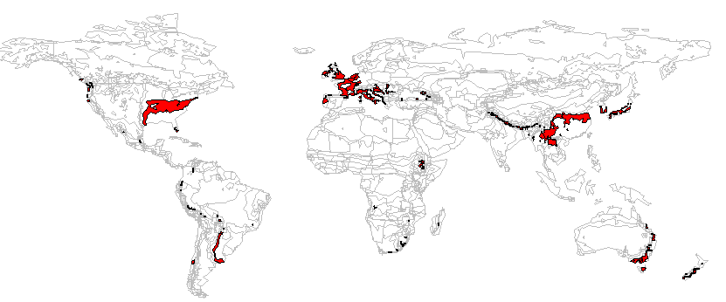
Forest-Ag Land Estimation results for AEZ 11
 | Crops | Forestland | Pastureland
Crops | 0.012 (0.004 – 0.054) | 0.008 (0.003 – 0.062) | -0.022 (-0.084 – -0.006)
Forestland | 0.011 (0.004 – 0.054) | 0.008 (0.003 – 0.062) | -0.022 (-0.085 – -0.007)
Pastureland | -0.023 (-0.109 – -0.008) | -0.015 (-0.124 – -0.006) | 0.044 (0.013 – 0.167)
Elasticity estimates and 80 percent confidence bounds
 | Crops | Forestland | Pastureland
Crops | 0.104 (0.045 – 0.250) | -0.131 (-0.174 – -0.046) | -0.301 (-0.361 – -0.215)
Forestland | -0.166 (-0.192 – -0.088) | 0.166 (0.088 – 0.192) | -0.166 (-0.192 – -0.088)
Pastureland | -0.039 (-0.127 – -0.015 | -0.015 (-0.054 – -0.004) | 0.452 (0.329 – 0.479)
Elasticities implied by the GTAP parameters/CET structure with (σ₁=-0.2 and σ₂=-0.5) much larger
GTAP values (10 – 90 percentiles)

Slide 15
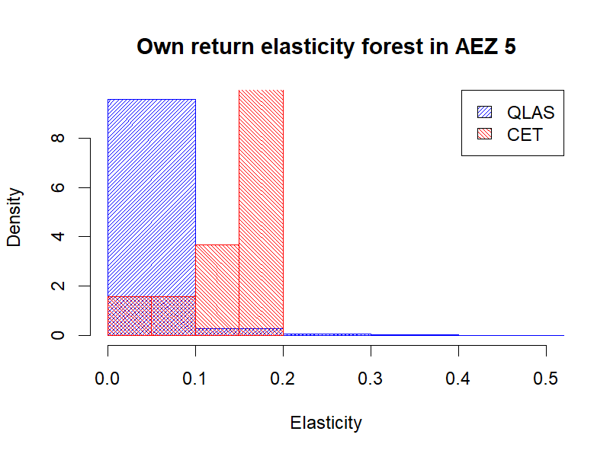
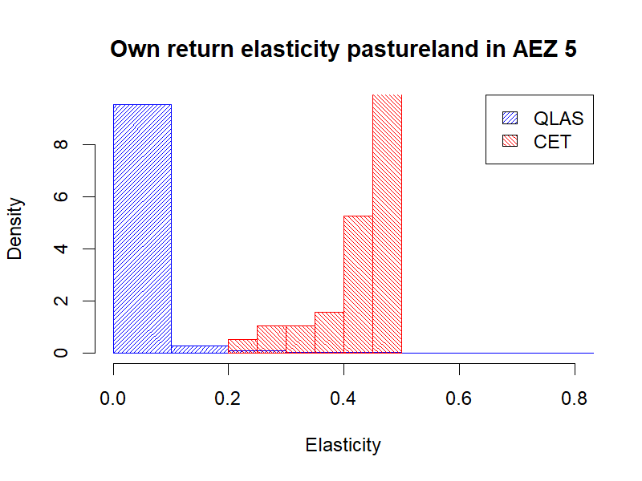
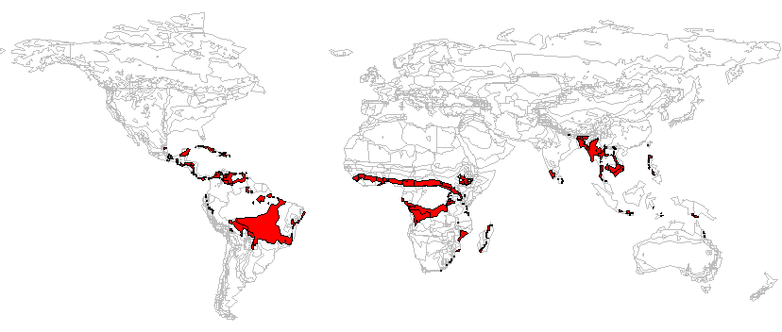
Very similar story in AEZ 5

Slide 16
Conclusions
Estimation of QLAS could help us with more accurate modeling of land allocation issues in GTAP
  Elasticities in transforming land among forest, pasture and crop appear smaller than assumed in the GTAP parameter database and CET transformation structure
  In principle we could have region-specific elasticity parameters to make the correction in the CET system to partly overcome the problem
At the crop level, CET is not capable of allowing for low/positive cross-return elasticities observed in data
  QLAS is able to fix the problem
Moving to quantity-based model would make the models simpler
  No need to have a parallel land allocation to CET for accounting purposes
Some work remains to clean GTAP data (or find another source) for consistent estimation
  Some small values in GTAP-LU estimation may be introducing bias
  Double cropping currently ignored

Slide 17




Like, Share, & Follow ERS
www.ers.usda.gov
www.ers.usda.gov/
data-products/charts-of-note
@USDA_ERS
linkedin.com/company/
usda-economic-research-service
Subscribe to Weekly E-mail Notifications: www.ers.usda.gov/subscribe
Learn About Careers at ERS: www.ers.usda.gov/about-ers/careers-at-ers
Notes:
Single Slide Closing Option
Before I close, I’d like to note a few ways you can stay up-to-date with ERS research.
Visit our website – www.ERS.USDA.gov – to explore our research and find full copies of our reports.
View a variety of webinars on ERS reports and data products by going to the multimedia section of our newsroom page.
Go to www.ers.usda.gov/subscribe and subscribe to email updates about specific products of interest such as the Livestock, Dairy, and Poultry Outlook (edit according to your audience’s interests).
You can even subscribe to receive articles from our Amber Waves Magazine and ERS Charts of Note.
Speaking of Charts of Note, I’d like to give a shoutout to our new Charts of Note Mobile App – available in Google Android & Apple app stores.
This app – free of cost – delivers the latest Charts of Note straight to your mobile device. You can search the entire Charts of Note library, mark your favorites and share them on social media.
As always, ERS continues to shape our research program and products to best serve a variety of consumers who rely on our research to make or influence public policy and program decisions every day. This app is just one of many ways we work to get our research to those who need it most.
On social media, you can find us on X (@USDA_ERS) and LinkedIn (USDA Economic Research Service). Follow us to learn about ERS research, events, and more.
Remember to keep ERS in mind in your future pursuits – whether as a helpful resource or potential career path. We’re always seeking the best and the brightest minds to advance our research.
For a list of current ERS openings, visit our careers webpage listed at the bottom of this slide.

Slide 18
Presenter Name
USDA Economic Research Service
Job Title
Email address (if needed)

Slide 19
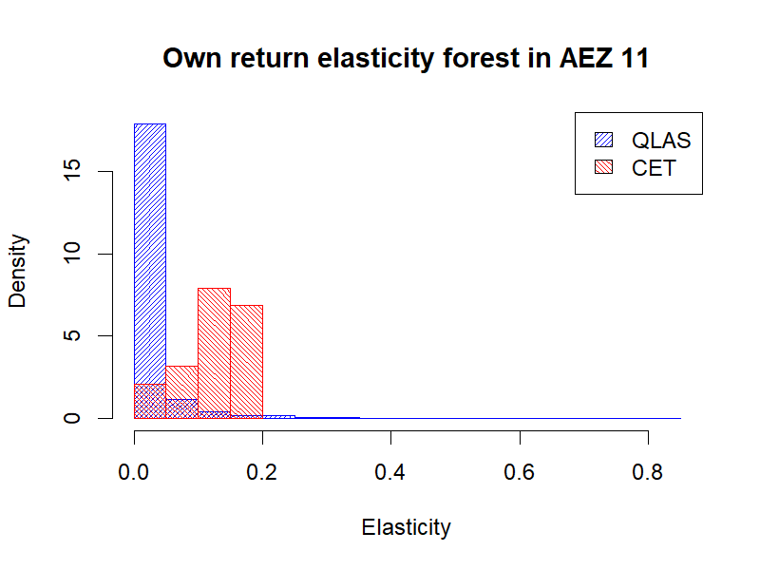
Comparison of top-level elasticities from CET and QLAS (AEZ 11)
Different elasticities for each country/AEZ
Typically, lower top-level elasticities in QLAS than implied by CET with (σ₁=-0.2 and σ₂=-0.5)

