Slide 1
Topic :
Regional Economic Integration and Global Value Chains - A CGE Analysis of the proposed SADC Customs Union.
Authors : Privilage Hove

Slide 2
SADC Overview
1980 SADCC, 1992 then became SADC.
Major objectives – to promote economic integration, peace and security.
The assumed SADC CET: 0% for capital goods, 0% for raw materials, 10% for intermediate products and 25% for finished goods.

Slide 3
Presentation Outline
Motivation of the study.
Key research Objectives and Questions.
Related literature.
GVC participation.
CGE methodology.
Results and discussion
Conclusion.

Slide 4
Motivation of Study
SADC Industrial road map (2018) points to agriculture and food as key products to promote global value chains (GVCs) in the region.
Yet, there is no research that quantitatively assesses the participation and integration of SADC in GVCs or that formulates any evidence-based policy recommendations on how to increase such participation based on the CGE approach.
Important to understand SADC’s contribution to trade flows in terms of value-added and the effects of the common external tariff following the formation of the customs union (CU).

Slide 5
Key Objectives
measuring the participation of SADC in agri-food global value chains and specifically its backward and forward participation, using the bilateral gross exports decomposition method by Borin and Mancini (2019) applied to the UNCTAD Eora database.
analyzing the possible effects of the proposed customs union on SADC countries’ agri-food global value chain participation of SADC countries, with a specific focus on backward and forward participation, using a computational general equilibrium model (CGEM).
analysing the influence of the CET on the regional and global production networks of the SADC region, and its effects on the advantages derived from participating in GVCs
exploring potential policy recommendations and strategies for enhancing SADC countries’ competitiveness and effectiveness in agri-food global value chains, with a focus on sustainable economic growth and maximizing the benefits of global value chain participation.

Slide 6
Research Questions
How can we characterize SADC countries’ participation in agri-food global value chains, encompassing both backward and forward linkages, through the application of the bilateral gross exports decomposition method and the UNCTAD Eora database?
What are the potential effects of the proposed common external tariff (CET) on the participation of SADC countries in the agri-food global value chain, particularly with respect to backward and forward linkages, as assessed using CGEM?
How can the CET impact the SADC region's integration into regional and global production networks, and the associated advantages from participation in GVCs?
What are policy recommendations can be derived from the study’s findings to improve the competitiveness, sustainability and inclusivity of SADC countries’ participation in agri-food global value chains?

Slide 7
Related Literature
Concept of GVCs (Gereffi et al, 2005).
Theories of GVCs : Kano et al (2021).
Drivers of GVCs (De Marchi et al, 2018).
Regional trade agreements (RTAs) and GVCs (Desoyres et al, 2021).
Benefits of CU (Kano et al, 2020).
Empirical research - Noguera (2012) and Johnson (2014), de Melo and Twum (2020), Osnago, Rocha and Ruta (2016), Laget et al. (2018).

Slide 8
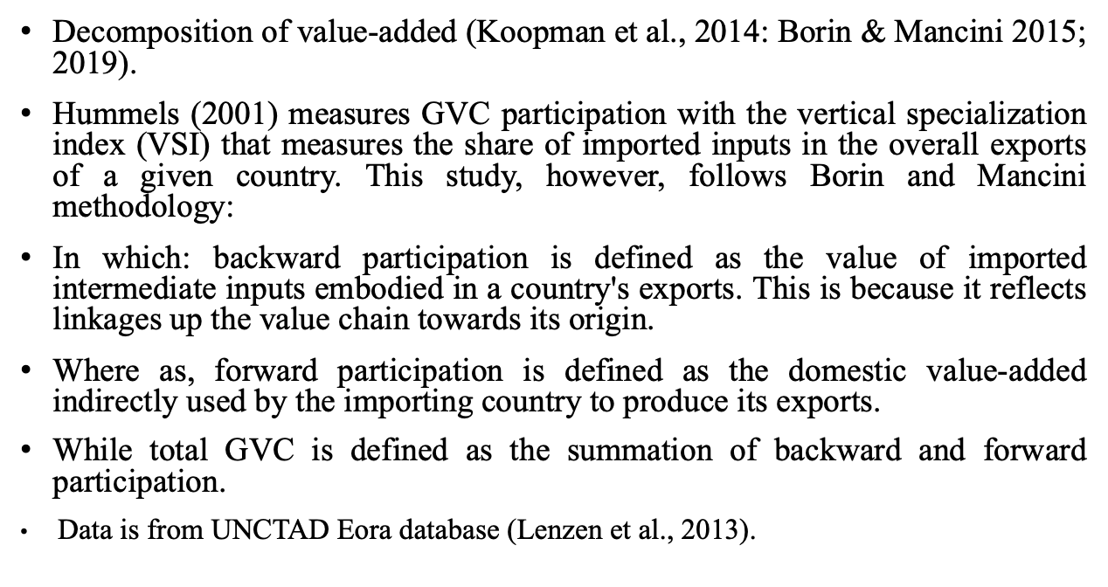
GVC participation
Measurements and participation indicators
Decomposition of value-added (Koopman et al., 2014: Borin & Mancini 2015; 2019).
Hummels (2001) measures GVC participation with the vertical specialization index (VSI) that measures the share of imported inputs in the overall exports of a given country. This study, however, follows Borin and Mancini methodology:
In which: backward participation is defined as the value of imported intermediate inputs embodied in a country's exports. This is because it reflects linkages up the value chain towards its origin.
Where as, forward participation is defined as the domestic value-added indirectly used by the importing country to produce its exports.
While total GVC is defined as the summation of backward and forward participation.
Data is from UNCTAD Eora database (Lenzen et al., 2013).

Slide 9
Backward and Forward participation
Increase in Backward participation btwn 1990 & 1995- IGAD 9%, SADC 2%, AMU & CEN-SAD 1%.
AMU and CENSAD – rich in oil and gas essential inputs in manufacturing process. – encouraged FDI.
IGAD more challenges in accessing finance and technology which limit their ability to move up value chains (IMF,2023).
AMU and CENSAD – geographically closer to Europe and has historical ties with the EU facilitating their integration into GVC by supplying intermediates goods and services to the EU.
While SADC and IGAD are located in Sub-Saharan Africa which has historically isolation from global trade and faced greater barriers to entry into global production networlks.

Slide 10
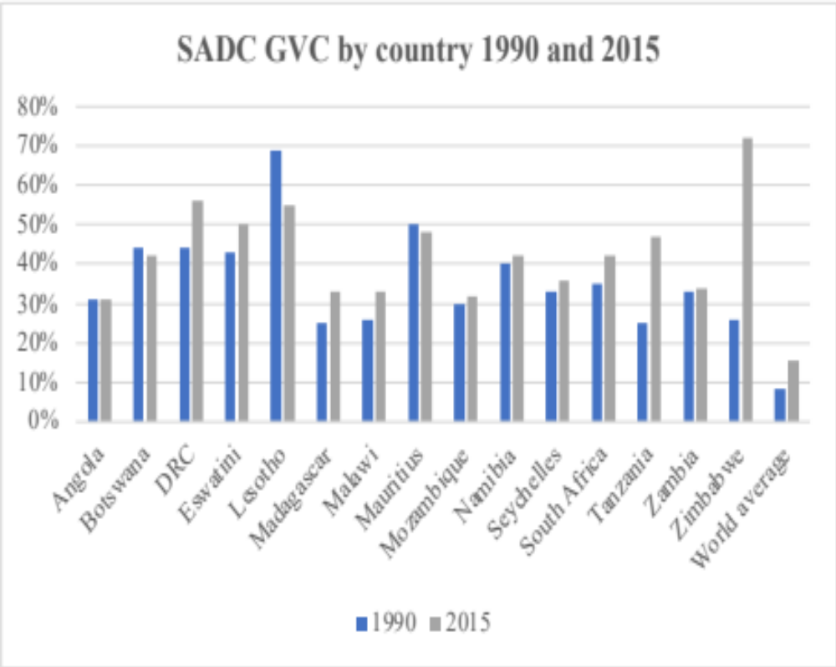
SADC countries’ GVC participation.
Increase in GVC participation attributed to increased investment in infrastructure, improved access to technology and the development of a skilled workforce.
Growth of African market enhanced the participation in GVCs – expansion of middle class created a growing demand of consumer goods leading to increased investment in manufacturing and other sectors (Nader 2019).
Leading SADC countries to participate in GVCs particularly in industries such as textiles, agric and mining.
Countries with better economies have had more opportunities to integrate into GVCs (SA, Botswana, Mauritius) – diversification from clothing to textiles – Mauritius.
DRC – significant increase- abundance of natural resources (IMF 2016) – H/ever political instability affects its full potential.

Slide 11
By sector - Agri-food GVC participation.
Increase in GVCs over the years- 1990 vs 2015 inline with Pahl and Timmer (2019) – increasing specialization and competitive advantage aspects.
More countries participate in GVCs thru agric sector more than food & beverages. – agric used as inputs on food production.
IGAD and SADC increased in agric due to high agricultural productivity and potential for value addition and processing of agric products, and its significant agric resources e.g. fertile land and water.
Modernization agric practices and increased investment in food industry, and also many high incomes countries, creating employment and income generation(World Bank 2020).
CENSAD and AMU – low level of agric productivity limiting value addition and process of agric products – linked to high political instability and conflicts which could have negatively impacted the agric sector.

Slide 12
By country – Agric and food GVCs.
Increase in GVC indicating their greater integration into GVCs .
Increased in production in agric sectors due to shift in consumer preferences towards healthier , value-added and processed food (Sinja, J et al, 2020).
Hence, the demand for these higher value products has contributed to the growth in GVC shares for agriculture and food and beverages in SADC countries.
Botswana, Lesotho and Seychelles have seen substantial increase in the GVC shares for the food and beverages sector than agriculture, indicating a specialization in processed and value-added food products.
Other countries such as Madagascar and Mozambique have shown relatively stable GVC shares in both sectors

Slide 13
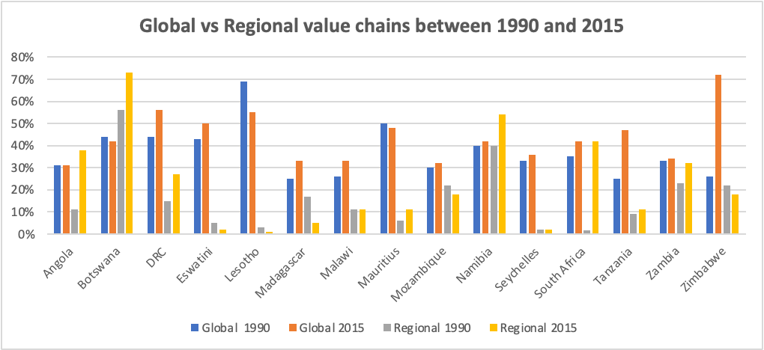
Global vs RVCs – 1990 &2015.
Bots, Namibia & Angola demonstrate a higher inclination towards RVCs while others exhibit a stronger presence in GVCs.
Show the dynamic nature of value chain strategies among SADC countries- some solidyfying their positions on global markets.
Prioritize their GVC participation, aligning with their export-oriented strategies that emphasize accessing global markets, attracting foreign investment and capitlizing on economies of scale. (SADC 2015).
They actively seek partnerships with multinational corportations and FDI to access advanced technologies and skills, enabling them to engage in higher value-added activities within GVCs.

Slide 14
Some Stylized facts.
Overall, GVC rates have increased overtime for all four regions - AMU and SADC have higher GVC participation, while CEN-SAD and IGAD have lower participation rates.
The geographic location, natural resources, economic policies, governance and economic structure of each REC contribute to these differences.
As for forward participation, AMU & CEN-SAD have higher rates due to their rich in natural resource that attracted investment while leading to higher value-addition. IGAD & SADC lower participation rate due to historical trade isolation and barriers in Sub-Saharan Africa.
Backward participation rates for all regions are relatively low, suggesting a limited position in the production of intermediate goods and services. Challenges in infrastructure, technology and human capital may limit their competitiveness and participation in GVCs.
More participation in forward than backward participation. – AMU and CEN-SAD focus more exporting raw material while IGAD and SADC more in backward participation due to influence of RTA, policies promoting industrialization and access to inputs, the level of economic dvpt and the income level of selected regions.
Factors such as investment in infrastructure, improved technology access, skilled workforce development, and the growing African market have contributed to this growth.
However, some countries such as Malawi and Mozambique lag behind due to limited access to technology, poor infrastructure and a lack of skilled workers
All SADC countries have averagely witnessed growth in agriculture and food & beverages GVCs.
In comparison with RVCs, SADC countries have focused more on participating in GVCs due to their export-oriented strategies and the potential benefits of accessing larger markets and advanced technologies.

Slide 15
Methodology
Data and modelling method
Use of GTAP MRIO & GTAP VA module based on CGE. This CGE takes into account the intercountry- input output tables.
GTAP VA model enables the use of source-based approach which shows the value-added by the country of origin.
Use of GTAP database v10 in its MRIO version.
Aggregation of data - sectoral aggregation- 26 sectors- 11 agricultural products and 7 food products, then textile and clothing, light manfc, heavy manfc, extraction and transport, Cmmn, util & transport, and then other services.
Regional aggregation- six selected SADC countries maintained as single regions- Botswana, Malawi, Tanzania, SA, Zim & RSACU, rest of SADC aggregated into single region, rest of Africa, EU_28, latin America, North America, Asia (east and south) and then the rest of the world.
Factors of production- Land, unskillab, Sklab, Capital and NatRes.

Slide 16
Methodology conti'
Indicators related to value-added in exports (GVCs used in the analysis):
Forward participation - domestic value-added in intermediate goods and services that is exported to a partner country, which then re-exports it to the ultimate market, embodied in other commodities or services.
Backward participation participation- the value of imported intermediate inputs embodied in a country's exports, as it reflects linkages back up the value chain towards its origin.
Regional backward participation is calculated as inputs/intermediate goods sourced destined in the SADC region and incorporated in their exports.
Regional forward participation is calculated as the domestic value-added in exports originating in the SADC countries and exported to external countries/regions.
Regional backward participation in agri-food sectors calculated as the shares of foreign value-added in exports originated inside the region.
Regional forward participation in agri-food sectors calculated as the domestic value-added in agri-food exports originating in the SADC countries and exported to external countries/regions.

Slide 17
Simulations and variations
Labour and capital are presumed as perfectly mobile whilst land has an elasticity of transformation of -1 (by default)
Natural resources has elasticity of transformation of -0.001.
SADC CET implemented as shocks.
1st simulation. | All the CE tariffs are shocked (0% raw materials, 0% capital goods, 10% intermediate goods and 25% final goods) less 6% (weighted average tariffs) of the sensitive products. Factors are mobile and fully employed. Gragg’s method (as by default) is used. Base year 2014.
2st simulation(variation 1). | Different from the first simulation, we consider labour unemployment. Swap qe (“UnSkLab”, REG) = pebfactreal (“UnSkLab”, reg).
^{3rd} simulation (variation 2) - (Gehlhar, 1997). the model becomes more flexible in capturing changes in consumer behaviour and trade patterns | Augmenting Armington elasticities by 20%. (for all sectors and for the eight regions at regional level.

Slide 18
Results - Changes in Backward Participation by country.
Significant increase in regional than Global backward participation.
They resulted from the relative price changes resulting from the extent of tariff adjustments. – which facilitate the free mvmnts of goods within the region there by reducing costs of regional trade and incentivizing exporters to utilize local products.
Significance: inputs inside the region becomes more cost effective compared with those from extra-regional producers- aligns with custom union’s goal of improving production capabilities, economies of scale and the cost structure within the SADC countries.
Consequently, this implies a reduction in factors of production among products.
+ve impact on regional exports while also influencing certain extra-regional exports in line with Dimaran and Mevel (2008). E.g. SA’s FVA in exports destined to Zim, Bots and RSACU to increase by more than 50%. – CET in directing SADC countries’ towards regional markets.
For extra regional exports, SA and RSADC are expected to experience an increase more than other countries exp towards the EU_28, South Asia and the RoA.
Changes relative to economic size of the countries.
 | Scn 1 (global) | ScN 1 (regional) | Scn 2 (global) | ScN 2 (regional) | ScN 3 (global) | ScN 3 (regional) | Actual values (2014) global | Actual values (2014) Regional
SA | 1.37% | 73,08% | 1,37% | 73,07% | 1,32% | 72,56% | 18,06% | 3,49%
Tanzania | 0.04% | 0,79% | 0,04% | 0,79% | 0,04% | 1,25% | 35,10% | 2,85%
Zimbabwe | 0.04% | 2,51% | 0,04% | 2,52% | 0,04% | 2,81% | 50,07% | 51,95%
Botswana | 0.05% | 2,26% | 0,05% | 2,28% | 0,05% | 2,32% | 28,98% | 5,20%
Malawi | 0.02% | 0,38% | 0,02% | 0,38% | 0,02% | 0,41% | 13,56% | 3,63%
RSACU | 0.05% | 5,50% | 0,05% | 5,50% | 0,04% | 4,36% | 50,14% | 0,72%
RSADC | 0.87% | 15,49% | 0,87% | 15,47% | 0,87% | 16,29% | 10,13% | 15,12%

Slide 19
Conti’ - Changes in Backward Participation by country.
Underscore the potential of the customs union to drive economic development, knowledge sharing, and DVA, thereby contributing to overall GDP growth, employment opportunities, and enhanced productive capacity.
Changes relative to economic size of the countries, insignificant to Malawi.
Variations – recognizable changes at regional level on agri-food sectors.
Armington elasticities – comparison with and without CU – SA and RSACU slightly decrease both at regional and Global level.
Due to increased mnopoloy power these countries gain on the demand side, compared with other SADC countries, allowing for greater control over market demand and prcing dynamics.
Also, their supply response is reduced indicating a lower ability to adapttheir production level to respond to changes in market conditons compared with other regional members.
 | Scn 1 (global) | ScN 1 (regional) | Scn 2 (global) | ScN 2 (regional) | ScN 3 (global) | ScN 3 (regional) | Actual values (2014) global | Actual values (2014) Regional
SA | 1.37% | 73,08% | 1,37% | 73,07% | 1,32% | 72,56% | 18,06% | 3,49%
Tanzania | 0.04% | 0,79% | 0,04% | 0,79% | 0,04% | 1,25% | 35,10% | 2,85%
Zimbabwe | 0.04% | 2,51% | 0,04% | 2,52% | 0,04% | 2,81% | 50,07% | 51,95%
Botswana | 0.05% | 2,26% | 0,05% | 2,28% | 0,05% | 2,32% | 28,98% | 5,20%
Malawi | 0.02% | 0,38% | 0,02% | 0,38% | 0,02% | 0,41% | 13,56% | 3,63%
RSACU | 0.05% | 5,50% | 0,05% | 5,50% | 0,04% | 4,36% | 50,14% | 0,72%
RSADC | 0.87% | 15,49% | 0,87% | 15,47% | 0,87% | 16,29% | 10,13% | 15,12%

Slide 20
Conti’ changes in Forward Participation by Country.
CET increases intra-regional trade - more significant changes in SA & RSACU and this increase appear at the expense of global engagement.
Reinforcing effect on already strong regional relationships, e.g., SA’s exports to Zim and Malawi; and RSADC to Zim and Botswana.
Strengtherning regional export platfom and support the region into high value-added industries., Globally- Bots, Malawi and Zim are facing challenges.
Extra-regional, more significant changes registered by SA and RSADC (esp to EU_28, America and East Asia) leading to competitive advantages and greater ability to compete in international markets.
Changes in Forward Participation are less than changes in Backward Participation in line with Antràs and de Gotari (2020).
Variations – no significant changes at country level.
overall reflects potential benefits and opportunities brought about by the new policy indicating improved involvement and contribution of SADC in production and value creation process with the GVCs.
 | ScN 1 (global) | ScN1 (regional) | ScN2 (global) | SCN2 (regional) | ScN3 (global) | ScN3 (regional) | Actual values (2014) GLOBAL | Actual values (2014) Regional
South Africa | 1.14% | 26,0% | 1,14% | 26,03% | 1,15% | 24,45% | 25,25% | 0,15%
Tanzania | 0.08% | 2,5% | 0,08% | 2,53% | 0,07% | 1,22% | 14,25% | 0,15%
Zimbabwe | 0.04% | 4,7% | 0,04% | 4,72% | 0,04% | 4,12% | 30,56% | 3,60%
Botswana | 0.17% | 12,4% | 0,17% | 12,41% | 0,17% | 8,43% | 15,13% | 0,15%
Malawi | 0.02% | 0,7% | 0,02% | 0,71% | 0,02% | 0,50% | 21,18% | 0,20%
RSACU | 0.05% | 6,8% | 0,05% | 6,79% | 0,04% | 4,23% | 13,73% | 0,13%
RSADC | 1.56% | 46,8% | 1,56% | 46,80% | 1,55% | 57,05% | 26,08% | 2,00%

Slide 21
Conti’ Backward Participation by sector
CET promotes access to foreign inputs (from extra –regions) – the policy also promotes intra-region backward participation – in line with de Melo and Twum (2020) on EAC and COMESA.
Changes are related to endowment effects – leading to significant disparities in labour quantity and marginal product, there by affecting production and real incomes.
Scn 3 – changes due to changes in demand or use of domestic and imported intermediates in SADC countries.
Also due to terms of trade – where export price rise relative to import prices lead to increased purchasing power and potentially demand for imported goods further influencing the the balance between domestic and foreign intermediate use.
 | Agriculture |  |  |  | Food and Beverages
Scenarios | SCN 1 | SCN 2 | SCN3 | ACTUAL VALUES | SCN1 | SCN2 | SCN3 | ACTUAL VALUES
South Africa | 3,18% | 3,18% | 3,30% | 15,92% | 4,00% | 3,99% | 4,20% | 14,61%
Tanzania | 9,35% | 9,35% | 9,50% | 15,04% | 21,31% | 21,31% | 27,60% | 43,46%
Zimbabwe | 9,88% | 9,89% | 10,80% | 17,73% | 33,31% | 33,32% | 35,80% | 58,52%
Botswana | 0,32% | 0.32% | 0,20% | 17,47% | 2,40% | 2.40% | 2,00% | 40,35%
Malawi | 10,20% | 10,19% | 10,20% | 6,78% | 50,41% | 50,39% | 51,40% | 19,76%
RSACU | 0,99% | 0.99% | 1,00% | 24,65% | 12,29% | 12,29% | 10,70% | 39,26%
RSADC | 0,70% | 0,70% | 0,70% | 6,57% | 3,04% | 3,04% | 2,80% | 22,52%

Slide 22
All sectors 1st scenario – global -agri-food Backward Participation.
Oilseeds, wool and silk, and meat show averagely higher +ve changes than other products.
Limits the access to inputs acquired abroad used in the agric and food sectors as domestic inputs become cheaper.
More +ve changes in sectors are registered in countries such as SA, Zim and RSADC.
Fewer +ve changes are registered in Malawi and Tanzania.
Sectors: veg, fruits and nuts, crops, veg oil and fats, and food products – more -ve changes SA, Zwe and RSACU.
Reason: new policy lowers the demand for imported intermediate goods sourced abroad used in these sectors as they will increase their demand for domestic inputs (inside the region).
CSN 2 shift in factors of production leading to high demand of skilled labour and capital in agric products. Scn 3 substitutional effects.
 | South Africa | Tanzania | Zimbabwe | Botswana | Malawi | RSACU | RSADC
paddyrice | 0,08% | 0,45% | 0,00% | 0,00% | 0,00% | 0,00% | 0,00%
Wheat | 1,18% | 0,39% | 0,00% | 0,00% | 0,00% | 1,71% | 0,40%
Cerealgrain | 4,77% | 2,71% | 0,00% | 0,00% | 0,00% | 0,00% | 1,89%
Vegfrutsnuts | 27,68% | 3,74% | 6,52% | 0,00% | 4,44% | 0,95% | 4,55%
Oil_seeds | 0,16% | 3,63% | 0,00% | 0,00% | 1,08% | 0,00% | 0,55%
Sugrcane | 0,00% | 0,00% | 0,00% | 0,00% | 0,00% | 0,00% | 0,00%
plant_b_fibr | 0,65% | 10,08% | 7,09% | 0,00% | 1,39% | 0,00% | 2,34%
Cropsnec | 1,34% | 8,91% | 6,96% | 0,00% | 9,58% | 0,00% | 6,57%
Meat | 1,49% | 0,62% | 0,00% | 35,93% | 0,00% | 1,21% | 3,33%
animal_prdct | 2,59% | 0,00% | 2,06% | 6,26% | 0,00% | 0,00% | 1,06%
Wool_silkwm | 5,62% | 0,00% | 0,00% | 0,00% | 0,00% | 4,47% | 0,30%
Ctle_shp_gts | 0,23% | 0,41% | 0,00% | 0,00% | 0,00% | 0,00% | 1,00%
Veg_oil_fats | 5,07% | 28,80% | 0,68% | 0,00% | 2,37% | 0,00% | 2,74%
Dairyproduc | 2,42% | 0,00% | 0,00% | 0,00% | 0,00% | 0,00% | 0,59%
Rawmilk | 0,00% | 0,00% | 0,00% | 0,00% | 0,00% | 0,00% | 0,00%
Procrice | 2,92% | 0,95% | 0,00% | 0,00% | 0,00% | 0,00% | 0,17%
Sugar | 3,67% | 0,00% | 22,12% | 0,00% | 6,91% | 55,45% | 12,84%
Meatprodcts | 1,53% | 0,00% | 0,00% | 4,06% | 0,00% | 0,00% | 0,46%
Foodprodcts | 26,22% | 16,84% | 2,91% | 39,04% | 1,05% | 35,21% | 45,73%
Bev_tobacco | 12,38% | 22,47% | 51,67% | 14,70% | 73,19% | 0,99% | 15,48%

Slide 23
Total Forward Participation by sector
Agric sectors: positive changes -results in line with those of Laget et al (2018) –confirming DTA positive effects on FP.
Food sectors: more significant changes in Zim and Malawi less in Bots.
Some higher positive chnages in Agric than in food e.g SA vice versa for RSACU. – their increase in domestic valu—added in exports increased in these exports.
SCN 2 – emphasize the significance of considering labour market conditions and their potential influence on trade dynamics.
Importance of considering context of each country, and tailor strategies accordingly to mitigate any adverse effects of unemployment on trade outcomes.
 | Agriculture |  |  |  | Food and Beverages
Scenarios | SCN1 | SCN 2 | SCN 3 | ACTUAL VALUES | SCN1 | SCN 2 | SCN 3 | ACTUAL VALUES
South Africa | 1,16% | 1.16% | 1,14% | 26,13% | 0,74% | 0.74% | 0,71% | 12,55%
Tanzania | 11,88% | 11.88% | 12,05% | 17,53% | 3,62% | 3.62% | 3,66% | 13,32%
Zimbabwe | 4,87% | 4.86% | 4,86% | 3,02% | 16,01% | 16,00% | 16,55% | 14,66%
Botswana | 0,24% | 0.24% | 0,24% | 20,70% | 0,30% | 0,30% | 0,30% | 10,65%
Malawi | 7,62% | 7.61% | 7,52% | 28,02% | 9,56% | 9.55% | 9,71% | 15,99%
RSACU | 1,32% | 1.32% | 1,42% | 28,93% | 2,98% | 2.97% | 3,28% | 13,57%
RSADC | 0,86% | 0.86% | 0,87% | 27,52% | 0,55% | 0.55% | 0,57% | 16,03%

Slide 24
Conclusion
SADC Customs Union & Trade - eliminates tariffs, creating a single market and boosting regional trade , Increased demand for intermediate goods enhances backward participation in regional value chains.
Country-Specific Impacts - Benefits vary by country based on economic structure (e.g., South Africa gains more, while smaller economies like Malawi may face challenges); & Tariff adjustments must be carefully managed to balance benefits and minimize harm.
Regional vs. Global Trade – new policy would expand global market expansion, strengthens intra-SADC trade more effectively than global integration ; However, reduced engagement with external partners (e.g., Latin America) raises concerns about SADC’s global positioning.
Policy Considerations - Address disparities between larger and smaller economies to ensure equitable benefits ; Promote trade facilitation and value-added sectors to support sustainable growth.
Sector-Specific Focus - Agri-food value chains are key to fostering regional cooperation, food security, and economic sustainability ; Targeted efforts needed to boost agricultural innovation, production, and market access.
Overall Economic Impact - Positive outcomes include increased GDP, employment, and value addition ; Some countries struggle to advance in downstream production, requiring strategic support.

Slide 25
Conti’ conclusion
Businesses can seamlessly integrate by sourcing raw materials regionally and exporting finished products to markets like the EU_28.
Increased market access fosters competition, underscoring the need to enhance competitiveness.
Even though the policy offers substantial benefits, it also presents complex challenges and implications that require nuanced policy design and diplomatic finesse.
Strategic investment in technology and infrastructure is crucial to lowering trade costs and attracting investors.
Since the analysis used the exante analysis, continuous monitoring and evaluation, including data collection and stakeholder consultations, are essential for evidence-based policy adjustments.

