Slide 1
Trade Effect of the European Union Deforestation Regulation on African Coffee & Cocoa Exports
GTAP Conference 2025
Dr. Rodgers Mukwaya
Economic Affairs Officer
UNECA

Slide 2
Why EU Deforestation Regulation (EUDR), matters
The European Union Deforestation Regulation (EUDR), will be implemented from 30 December 2025 for large and medium enterprises and 30 June 2026 for small and micro enterprises
EUDR restricts imports linked to recent deforestation - coffee, cocoa, palm oil, soy, rubber, timber and beef/ leather
Source: UNCTADStat, 2024

Slide 3
African Exports to the EU by values and Share (USD, %, 2021-2023)
Source: UNCTADStat, 2024

Slide 4
Country distribution of African coffee exports to the EU by share (%, 2022)
Source: UNCTADStat, 2024

Slide 5
CGE Literature on EUDR
CGE studies show modest to severe macro impacts:
Argentina: GDP –0.5 % (De la Vega 2024)
Ethiopia: Exports –9.5 % to –18.4 % depending on scenario (Debowicz & Engeda 2024)
Source: UNCTADStat, 2024

Slide 6
Problem statement
In most African countries, agricultural commodities are produced by small scale farmers
In Ethiopia, Africa’s largest coffee producer and exporter the crop is produced by 4 million small scale farmers
De Oliveira et al., (2024) commodities produced by a higher share of small holder farmers had a lower probability of compliance
Fauzi & Mugume, (2024) EUDR will lower productivity of smallholder farmers in Uganda and Indonesia .
How will EUDR compliance costs affect African coffee & cocoa trade?
What are the trade, GDP and welfare effects across Africa?
Source: UNCTADStat, 2024

Slide 7
GTAP Model & Data
GTAP 7 CGE static model with GTAP 11 database (2017 baseline)
Aggregated crop sector (OCR) used for shocks
Trade efficiency parameter (ams) adjusted to model compliance costs
Two stylised scenarios modelled (differential vs uniform costs)
Source: UNCTADStat, 2024

Slide 8
GTAP Simulation Scenarios
Scenario 1:
The difference in productivity between small scale farmers and large-scale farmers implies that the EUDR compliance cost(fixed cost), will have a larger impact on total costs of small-scale farmers relative to large farmers
Higher income countries will face lower relative compliance costs, while lower income African countries will face higher relative compliance costs
GTAP Simulation: African exporters face 50 % ↓ trade efficiency(ams); ROW exporters ↓ 10 %
Source: UNCTADStat, 2024

Slide 9
Results: Change in Exports of Cash crops (%)
African exports ↓ 24 %
Source: UNCTADStat, 2024

Slide 10
Change in value of GDP (%)
Source: UNCTADStat, 2024

Slide 11
Change in Welfare (USD, Millions)
African welfare loss USD 2.1 billion
Source: UNCTADStat, 2024

Slide 12
GTAP Simulation Scenarios
Scenario 2: All exporters face 10 % ↓ trade efficiency
Africa exports ↓ 5.1 %
GDP falls are modest (≤ 0.6 %) but widespread
African welfare losses ↓ $0.4 bn; EU ↓ $1.5 bn
Source: UNCTADStat, 2024

Slide 13
Change in Exports of Cash crops (%)
Source: UNCTADStat, 2024

Slide 14
Change in value of GDP (%)
Source: UNCTADStat, 2024

Slide 15
Change in Welfare (USD, Millions)
Source: UNCTADStat, 2024

Slide 16
Short‑Term Policy Responses
Low‑interest credit for smallholders’ compliance costs
Capacity‑building on sustainable practices & traceability
Stimulate digital traceability services via tax breaks
Set up price‑shock contingency funds
Source: UNCTADStat, 2024

Slide 17
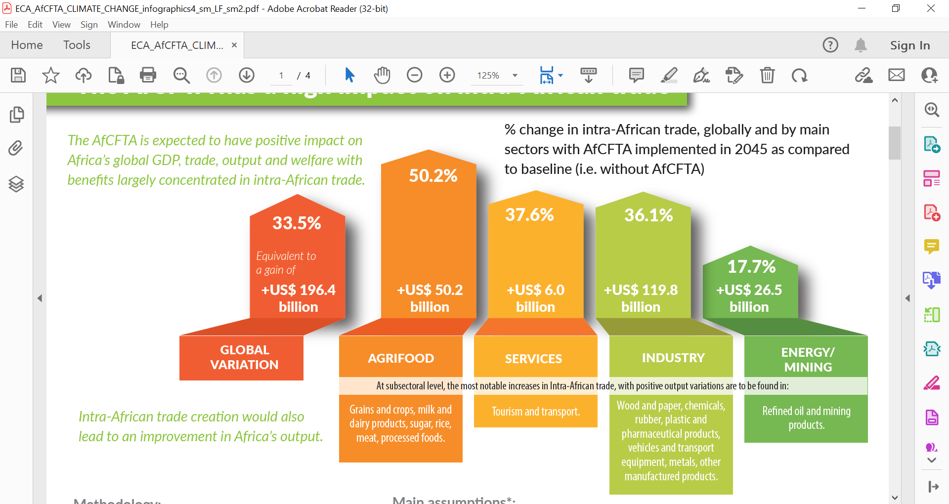
Long‑Term Strategy
Leverage AfCFTA to diversify markets & value‑addition
Invest in processing capacity to move up the value chain
Source: ECA-CEPII’s calculations based on MIRAGE-Power (2023)
Source: UNCTADStat, 2024

Slide 18
Rodgers Mukwaya
Regional Integration and AfCFTA Cluster

