Slide 1


Public Spending on social protection and their impacts on economic growth in Morocco:
A SAM multiplier and CGE model Analysis
Paper selected for presentation at 28th Annual Conference on Global Economic Analysis "Accelerating Economic Transformation, Resilience, Diversification, and Job Creation"
Kigali, Rwanda
June 25-27, 2025
EL BAOUCHARI Nabil, RAOUF Radouane and Wilfried Aki Lela KOUADIO
Laboratory of Economic Analysis and Modelling (LEAM), Department of Economics, Mohammed V University in Rabat (Morocco).
Laboratory of Economic policy analysis and modelling (LEPAM), Department of Economics, University of Bouaké (Côte d'Ivoire)
nabil.elbaouchari@um5s.net.ma r.raouf@um5r.ac.ma
akilelawil@gmail.com

Slide 2
Plan of presentation :
Introduction
Context and Research question
Theorical framework and Empirical studies
Methodology and data
Simulations and results
Keys findings and policy implications
El Baouchari, N., Raouf, R., & Aki Lela Wilfried, K., (2025). Public Spending on social protection and their impacts on economic growth in Morocco: A SAM multiplier and CGE model Analysis

Slide 3
Introduction
Countries must ensure a minimum social protection level for individuals, as it is a human right recognized in the Universal Declaration of Human Rights (1948) and under international human rights law.
The ultimate goal of social protection is to combat poverty and inequality and improve social inclusion for all people. (United Nations, 1948; ILO, 2020; OECD, 2019)
According to the Inter-Agency Social Protection Assessment Initiative (ISPA), social protection is defined as a set of policies and programs to prevent and protect all individuals — especially vulnerable groups — from poverty, vulnerability, and social exclusion during different stages of life. (ISPA, 2016).
El Baouchari, N., Raouf, R., & Aki Lela Wilfried, K., (2025). Public Spending on social protection and their impacts on economic growth in Morocco: A SAM multiplier and CGE model Analysis

Slide 4
Introduction
The 2030 Agenda for Sustainable Development Goals (SDG) highlights the crucial role of social protection in achieving its goals.
Public investment in social protection helps to end poverty (SDG target 1.3), improve health and well-being (SDG target 3.8), promote gender equality (SDG target 5.4), support decent work and economic growth (SDG target 8.5), and reduce inequality (SDG target 10.4).
Despite some progress since the launch of the 2030 Agenda in 2015, major gaps in social protection coverage and funding persist globally. While 23 low- and middle-income countries have achieved universal coverage for at least one benefit, the ILO (2017) reports that 4 billion people, or 55% of the world’s population, still face daily risks due to lack of protection.
El Baouchari, N., Raouf, R., & Aki Lela Wilfried, K., (2025). Public Spending on social protection and their impacts on economic growth in Morocco: A SAM multiplier and CGE model Analysis

Slide 5
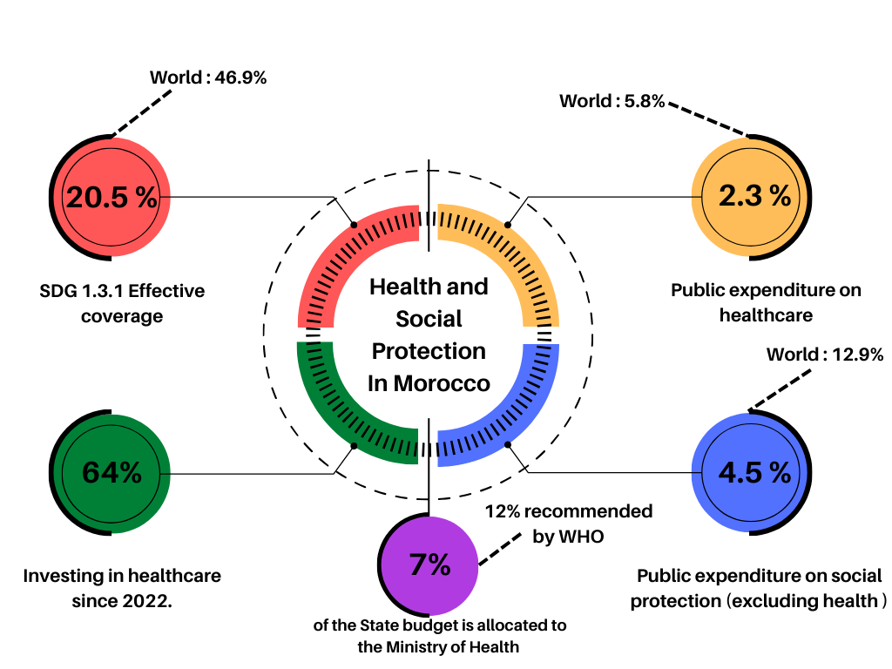
Context and Research Problem
In Morocco, the current health and social protection systems faces substantial resource gaps, especially in human resources.
Despite an increased budget in recent years, investment in health remains relatively low (between 4% and 6% of GDP from 2000-2019). As of recent data (Figure 1), only 7% of the state budget is allocated to the Ministry of Health, falling short of the 12% recommended by the World Health Organization (WHO). Public expenditure on healthcare stands at 2.3%, significantly lower than the global average of 5.8%. Furthermore, public expenditure on social protection, excluding health, is at 4.5%, below the world average of 12.9%.
Figure 1: Key Health and Social Protection Statistics in Morocco
El Baouchari, N., Raouf, R., & Aki Lela Wilfried, K., (2025). Public Spending on social protection and their impacts on economic growth in Morocco: A SAM multiplier and CGE model Analysis

Slide 6
Context and Research Problem
Given the socio-economic situation described and the efforts from the Moroccan government to expand social programs in the last decades, some crucial questions remain:
Can social expenditures, in fact, stimulate Morocco’s economy and generate inclusive growth and development?
Do varied categories of governmental social expenditures present different responses regarding their impacts on promoting economic growth in Morocco?
What are the social expenditures with the most significant effect on Morocco aggregate considering an additional unit of public spending?
El Baouchari, N., Raouf, R., & Aki Lela Wilfried, K., (2025). Public Spending on social protection and their impacts on economic growth in Morocco: A SAM multiplier and CGE model Analysis

Slide 7
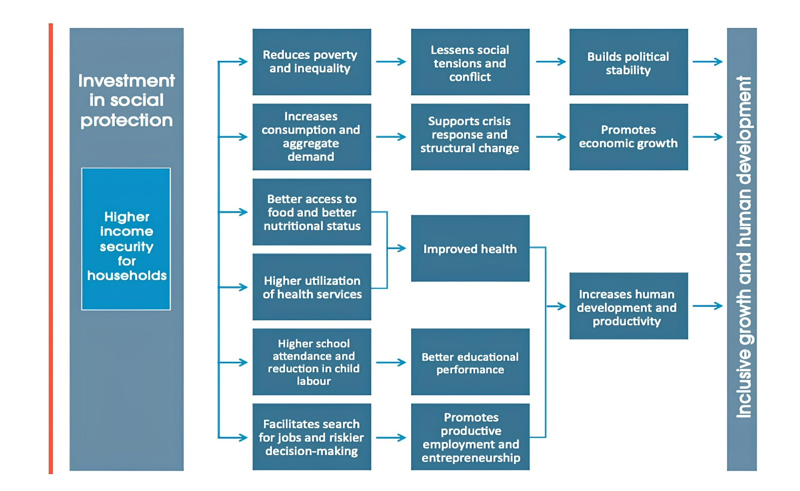
Theorical framework
Figure 3:The effects of social protection on economic growth
Source: Ortiz et al. 2019) based on ILO (2016)
El Baouchari, N., Raouf, R., & Aki Lela Wilfried, K., (2025). Public Spending on social protection and their impacts on economic growth in Morocco: A SAM multiplier and CGE model Analysis

Slide 8
Empirical studies
Several studies demonstrated that social protection could accelerate economic growth, including works by Cashin (1994), Castles and Dowrick (1990) and Perotti (1994). Some authors find significant multiplier effects for social expenditures, with impact multipliers close to one (Gechert et al., 2018; Adams and Wong, 2018).
However, in some cases, the accumulated multiplier is close to zero, while in others, the effect persists above zero (Adams and Wong, 2018; Pereira and Wemans, 2013). Moreover, a few authors report a statistically insignificant negative accumulated effect (Claus et al., 2006; Bruckner and Tuladhar, 2010).
The International Trade Union Confederation (ITUC, 2021) evaluated the impact of social protection investments - cash programmes - on economic growth in eight countries—Bangladesh, Colombia, Costa Rica, Georgia, Ghana, India, Rwanda, and Serbia—using a dynamic CGE model combined with a Multiplier model. The findings reveal that investing 1 percent of GDP in social protection policies generates a multiplier effect on GDP ranging between 0.7 and 1.9.
In general, to our knowledge, there are no studies for Morocco examining the effect of social protection expenditures on economic growth. This paper aims to fill this apparent gap in the literature.
El Baouchari, N., Raouf, R., & Aki Lela Wilfried, K., (2025). Public Spending on social protection and their impacts on economic growth in Morocco: A SAM multiplier and CGE model Analysis

Slide 9
Methodology and data
SAM multiplier
Multiplier models (also known as multiplier framework) described as matrix models by Thorbecke (1985), assess the consequences of a change in demand on the economy by assuming that any change in the demand for goods results in a proportional change in income use, inputs, and outputs, based on the relationships within the base-year structure of the Social Accounting Matrix (SAM).
Assumptions of the model:
The multiplier process is developed here on the many assumptions. In particular:
Prices are fixed and any changes in demand lead to changes in physical output rather than prices.
Factor resources are unlimited or unconstrained, so that any increase in demand is matched by increased supply.
Input coefficients of producers and consumption patterns of households are unaffected by exogenous changes in demand (i.e., linkage effects are linear and there is no behavioral change).
El Baouchari, N., Raouf, R., & Aki Lela Wilfried, K., (2025). Public Spending on social protection and their impacts on economic growth in Morocco: A SAM multiplier and CGE model Analysis

Slide 10
Methodology and data
CGE model
We extend the PEP-1-t Model, a recursive dynamic CGE model, of Decaluwe et al. (2013);
The PEP-1-t model is a one country, multi-sector, dynamic computable general equilibrium (CGE) model;
It distinguishes several categories of workers and capital.
Also, PEP-1-t is capable of taking into account a broad set of tax instruments, and it models all possible transfers between institutions (agents);
Firms are assumed to operate in a perfectly competitive environment;
Nested production structure;
Recursive Dynamics.
El Baouchari, N., Raouf, R., & Aki Lela Wilfried, K., (2025). Public Spending on social protection and their impacts on economic growth in Morocco: A SAM multiplier and CGE model Analysis

Slide 11
Simulations and results
In this study, we conduct simulations using a SAM multiplier and CGE model to examine the potential economic impacts of increased public spending on social protection. The scenarios are as follows:
Sim 1: | Increase public spending on social protection by 1% of GDP.
Sim 2: | Increase cash transfer from government to households by 1% of GDP.
El Baouchari, N., Raouf, R., & Aki Lela Wilfried, K., (2025). Public Spending on social protection and their impacts on economic growth in Morocco: A SAM multiplier and CGE model Analysis

Slide 12
Keys findings and policy implications (Multiplier Model )
Growth Rates of Macroeconomic Aggregates from Baseline (%)
Growth Rates of Factor Income from Baseline (%)
Factor | Sim 1 | Sim 2
Unskilled work (USK) | 1.07 | 0.77
Medium skilled work (MSK) | 2.52 | 0.48
Skilled work (SK) | 1.31 | 0.49
Capital | 1.45 | 0.89
Household Income | 1.50 | 0.71
Indicator | Sim 1 | Sim 2
GDP (base price) | 1.49 | 0.78
GDP (market price) | 1.40 | 0.55
Consumption | 1.34 | 1.88
Value Added (VA) | 1.48 | 0.78
Production | 1.25 | 0.78
Imports | 0.54 | 0.61
Private Savings | 1.22 | 1.89
Growth Rates of Taxes Instruments from Baseline (%)
Instrument | Sim 1 | Sim 2
TM (Customs Duties) | 0.68 | 0.60
TI (Indirect Taxes) | 1.17 | 0.58
TD (Direct Taxes) | 1.28 | 1.14
Other Instruments | 0.92 | 0.85
Total Tax Revenue | 1.11 | 0.70
Source: Developed by the authors (Multiplier model based on Morocco's 2019 SAM)
El Baouchari, N., Raouf, R., & Aki Lela Wilfried, K., (2025). Public Spending on social protection and their impacts on economic growth in Morocco: A SAM multiplier and CGE model Analysis

Slide 13
Keys findings and policy implications (CGE Model)
Public spending on social protection on social protection
Variables | Baseline | Simulation | var (%)
Gross output | 101001 | 101082 | 0.080
Employment | 21093 | 21093 | -0.002
Public revenue | 417979 | 419767 | 0.428
Public saving | 26148 | 27898 | 6.693
Private investment | 313327 | 314719 | 0.444
Public investment | 16574 | 16590 | 0.097
Real GDP (MP) | 1313127 | 1314371 | 0.095
Real GDP (BP) | 1214779 | 1215741 | 0.079
Income | 331692 | 331709 | 0.005
Consumption | 238386 | 238346 | -0.017
Saving | 33938 | 33928 | -0.030
Welfare | - | - | 12.298
El Baouchari, N., Raouf, R., & Aki Lela Wilfried, K., (2025). Public Spending on social protection and their impacts on economic growth in Morocco: A SAM multiplier and CGE model Analysis

Slide 14
Keys findings and policy implications (CGE Model)
Government cash transfers on social protection
Variables | Baseline | Simulation | var (%)
Gross output | 101001 | 101067 | 0.065
Employment | 21093 | 21093 | -0.002
Public revenue | 417979 | 419704 | 0.413
Public saving | 26148 | 27400 | 4.787
Private investment | 313327 | 314509 | 0.377
Public investment | 16574 | 16589 | 0.091
Real GDP (MP) | 1313127 | 1314092 | 0.073
Real GDP (BP) | 1214779 | 1215562 | 0.065
Income | 331692 | 331921 | 0.069
Consumption | 238386 | 238394 | 0.004
Saving | 33937.7 | 33933.5 | -0.012
Welfare | - | - | 12.367
El Baouchari, N., Raouf, R., & Aki Lela Wilfried, K., (2025). Public Spending on social protection and their impacts on economic growth in Morocco: A SAM multiplier and CGE model Analysis

Slide 15
Keys findings and policy implications
Our findings provide compelling evidence that increased public spending on social protection can stimulate economic growth in Morocco. The multiplier effects generated by both overall social protection spending and targeted cash transfers lead to positive impacts on key macroeconomic aggregates, consumption, income, and production across various sectors in Morocco.
Furthermore, the simulations suggest potential for social protection spending to improve income of household and in turn, may reduce vulnerability. These findings highlight the importance of social protection not just as a social welfare measure, but also as a driver of economic development in Morocco.
The key recommendations in this study are as follows.
First, combining social protection policies for contributing more significantly impact to economic growth and development.
Second, fiscal reforms are essential to create greater fiscal space to fund these Social programs.
El Baouchari, N., Raouf, R., & Aki Lela Wilfried, K., (2025). Public Spending on social protection and their impacts on economic growth in Morocco: A SAM multiplier and CGE model Analysis

Slide 16
Thank you for your
attention
El Baouchari, N., Raouf, R., & Aki Lela Wilfried, K., (2025). Public Spending on social protection and their impacts on economic growth in Morocco: A SAM multiplier and CGE model Analysis

