Slide 1


Nature-aware MANAGE-WB Model
Ragchaasuren Galindev
Wolfgang Britz
Tijen Arin
GTAP Annual Conference. June 25-27, 2025. Kigali, Rwanda

Slide 2
“MORE” general equilibrium model
Most CGE models ignore the feedback from the nature in response to external and policy shocks in the economy
The feedback from the nature could be a component in the TFP – i.e., the Solow residual
One would ask an ecosystem service (ESS) modeler to quantify the feedback
We would need to exchange inputs with that ESS modeler, but it could require time and patience

Slide 3
Interlinked Model Workflow
Macro
Model
Aggregate LULC Change
Land-Use Land-Cover
(LULC) Model
Granular LULC data
Ecosystem Service
(ES)
Model
ES Change

Slide 4
Literature
IEEM+ESM approach (Banerjee, Cicowiez, & Dudek, 2019; Banerjee, Cicowiez, et al., 2020a; Banerjee, Bagstad, et al., 2020; Banerjee, Cicowiez, Macedo, et al., 2022)
Most relevant one is World Bank report (2023) conducted by Banerjee and Cicowiez – India’s NDC targets (afforestation + forest restoration)
  IEEM + Dyna-Clue as a LULC model + InVEST as ESS model

Slide 5
Nature-aware MANAGE-WB model
MANAGE-WB is a single country CGE model used by the WB for policy analyses
We first tried to replicate the World Bank report (2023) by Banerjee and Cicowiez which followed the traditional approach of exchanging inputs with an ESS modeler which proved to inefficient (time consuming)
We worked with a team of ESS modelers led by Justin Johnson and now MANAGE-WB is hard-linked with ESS models so one can run the workflow on one computer.
MANAGE-WB is a MORE general equilibrium model.

Slide 6


land use vs. land cover in MANAGE-WB
A country’s land is divided into land cover types. For example, in GTAP:
  Cropland
  Pastureland
  Forest
  Builtupland
  Shrubland
  SavnGrassLnd
  unManagedForest
  Otherland (water, glassier)
Land cover drivers
unManaged land - driven by land cover drivers

Slide 7
Demand for productive LAND in MANAGE-WB
  Economic sectors
    Crops
    Livestock
    Forestry
  use productive land as a factor of production
  Demand for land is determined from this multi-layer flexible production nest (CES functions)
Output
Non-energy intermediate
inputs
Value added & Energy
Armington demand
Unskilled labor
Land
Capital, Skilled labor, Energy
Male
unskilled labor
Capital, Skilled labor
Energy
Capital
Skilled labor
Armington demand
Male
skilled labor

Slide 8
Demand for productive LAND in MANAGE-WB
MANAGE-WB can consider either
  Economywide productive land (f-land) OR
  AEZ (Agro Economic Zone) specific productive land (aez-land)
Both enter in Value added & Energy bundle for production activities
If AEZ land is considered, production process has another layer of decision on “which AEZ”

Slide 9
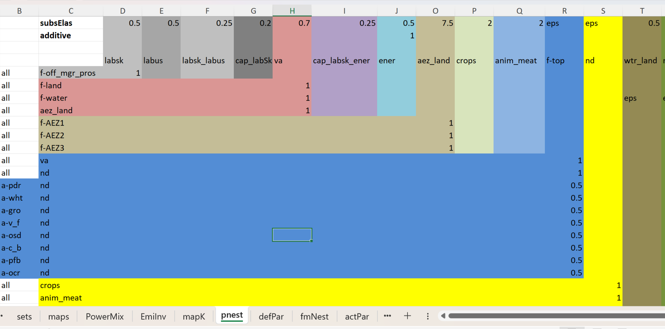
Demand for LAND in flexible nesting of MANAGE-WB

Slide 10
Land supply in MANAGE-WB
f-land
Forestry activity
agrLand
cropLand
grasLand
wheat
paddy
cattle
oap
Notes:
“Elasticities of transformation are less than 1” means that substitution of one type of land for another is rigid.

Slide 11
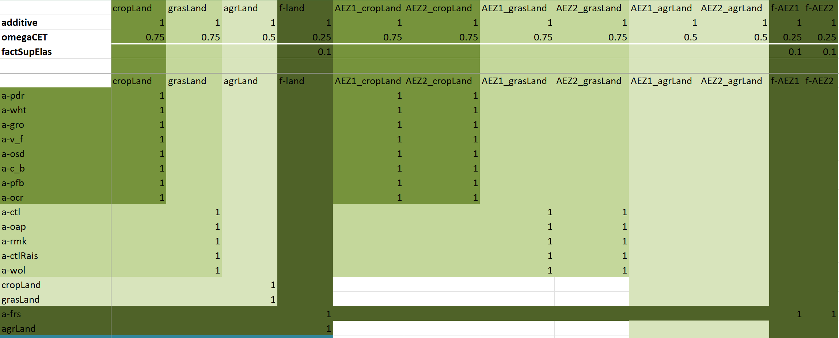
Land supply in MANAGE-WB
Notes:
“Elasticities of transformation are less than 1” means that substitution of one type of land for another is rigid.

Slide 12
MANAGE-WB + LULC + ESS
MANAGE-WB
Change in cropLand
InVEST
EcoSystem Services model
Change in grasLand
SEALS
(LULC model)
Change in forest
Change in urbanLand
Feedback effects (shocks)
Change in productivity

Slide 13
Applications of nature-aware MANAGE-WB
Application 1: Replicating “Reforestation and Forest Restoration project in India” considered in World Bank (2023) by Banerjee and Cicowiez
Application 2: Testing the nature-aware MANAGE-WB with an ad hoc simulations
Application 3: Testing the hard-linked workflow

Slide 14
Application 1: NDC targets in India
Land use changes by scenarios (in million ha)

Slide 15
Application 1: Erosion

Slide 16
Application 1: Pollination

Slide 17
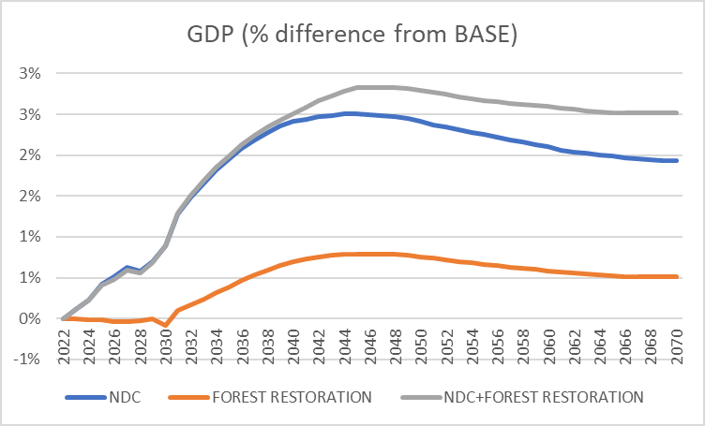
Application 1: GDP impact

Slide 18
Application 1: Regulating service impact
Regulating ecosystem services (% change in GDP from the baseline)
 | Crop pollination
 |  | NDC | 0.08% | 0.08% | 0.07%
 |  | Forest Restoration | 0.00% | 0.00% | 0.00%
 |  | NDC+Forest Restoration | 0.08% | 0.15% | 0.14%
 | Erosion mitigation
 |  | NDC | 0.15% | 0.14% | 0.09%
 |  | Forest Restoration | 0.01% | 0.07% | 0.05%
 |  | NDC+Forest Restoration | 0.17% | 0.31% | 0.21%

Slide 19
Application 2: Endogenous land allocation
We test MANAGE-WB in following 3 scenarios: a hypothetical policy intervention – the subsidy rate to the crop sector increases in 5 folds permanently in 2026.
Scenario 1: The aggregate land supply remains constant. However, the land use between crops, livestock and forest is endogenous.
Scenario 2: The aggregate land supply is endogenous – i.e., it is an isoelastic function of the economywide real rental rate with an elasticity of 0.2.
Scenario 3: Same as scenario 2, but the supply elasticity is 0.5. The allocation of land between uses (crops, livestock and forest) was also endogenous.

Slide 20
Application 2: Endogenous land allocation

Slide 21
Application 2: Endogenous land allocation

Slide 22
Application 2: Endogenous land allocation

Slide 23
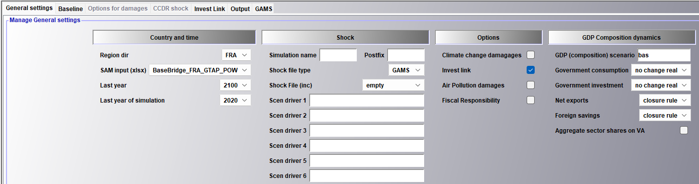
Application 3: Hardwiring

Slide 24
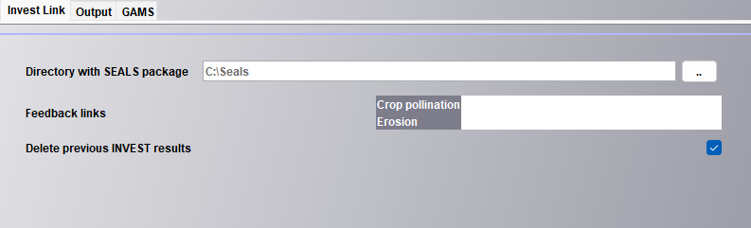
Application 3: Hardwiring

Slide 25
Why Hardwiring
Enhanced Efficiency: Hardwiring the models significantly reduces manual effort, enabling even beginner Python users to run models with minimal training. This streamlines the workflow and saves time and resources.
Quick Onboarding: Beginner Python users can operate the models effectively after just two days of training, resulting in faster implementation and reduced learning curve.
Scalable for Broader Applications: The approach is designed to be adaptable across other countries, providing a seamless framework for linking macroeconomic and ecosystem models, promoting scalability and broader usability.

Slide 26
Why Hardwiring
Extension to Other Ecosystem Services: This methodology is extendable to other ecosystem services (ESs), such as water regulation and habitat provision, allowing for a comprehensive understanding of landscape changes.
Data Flexibility: The project uses global data. However, the code would work with local LULC datasets. The latter requires recalibrating the model and some additional time.

Slide 27
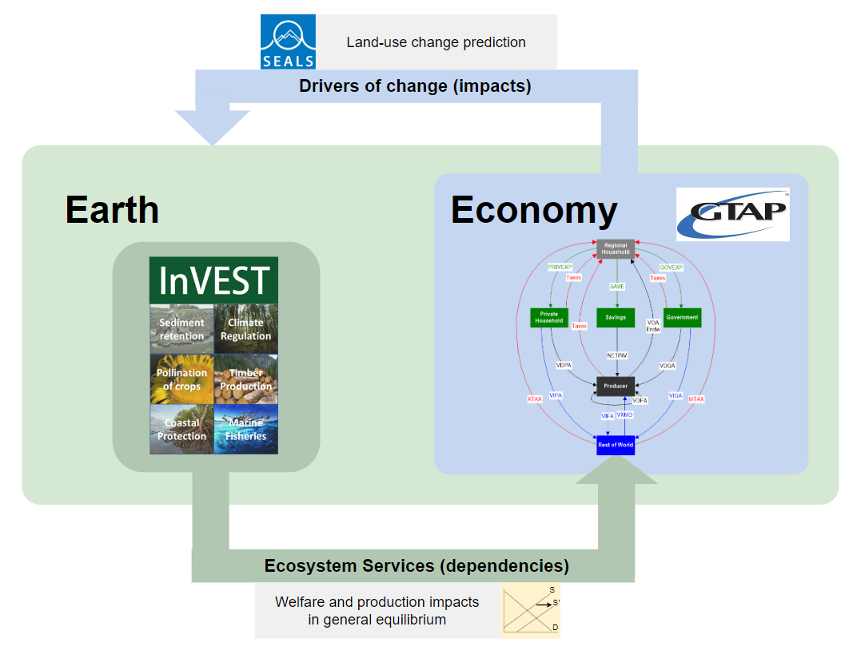
Link between MANAGE-WB and ES models: downscaling
Created new model extends this downscaling:
    SEALS: Spatial economic allocation landscape simulator (von Jeetze et al. 2023, Suh et al. 2020)
Key advances:
    Empirically calibrated with time-series data
    Can incorporate grid-cell level interventions (Riparian buffers)

Slide 28
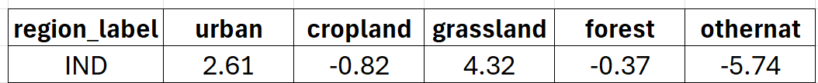
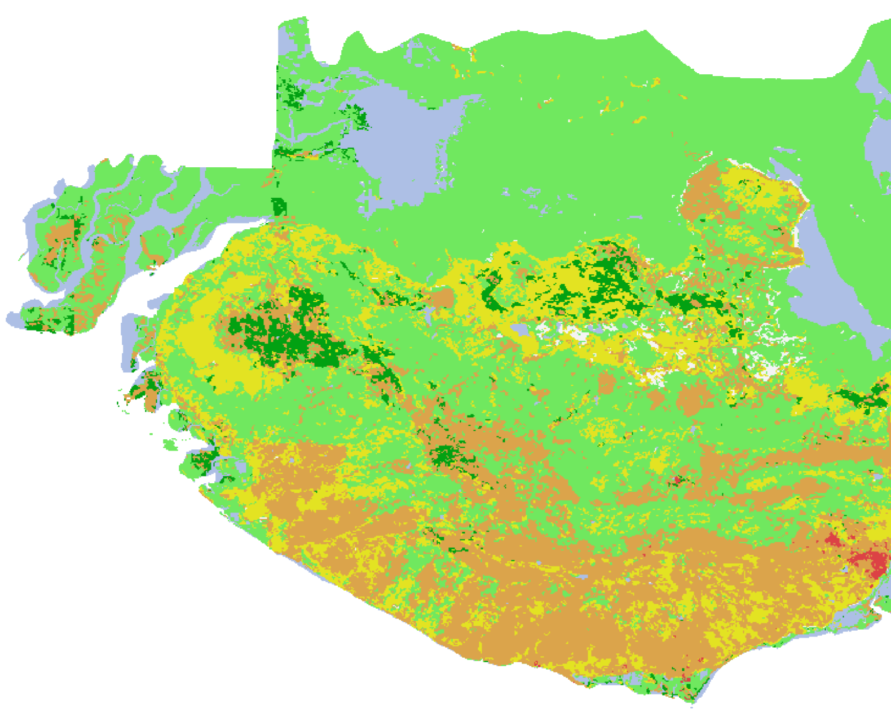
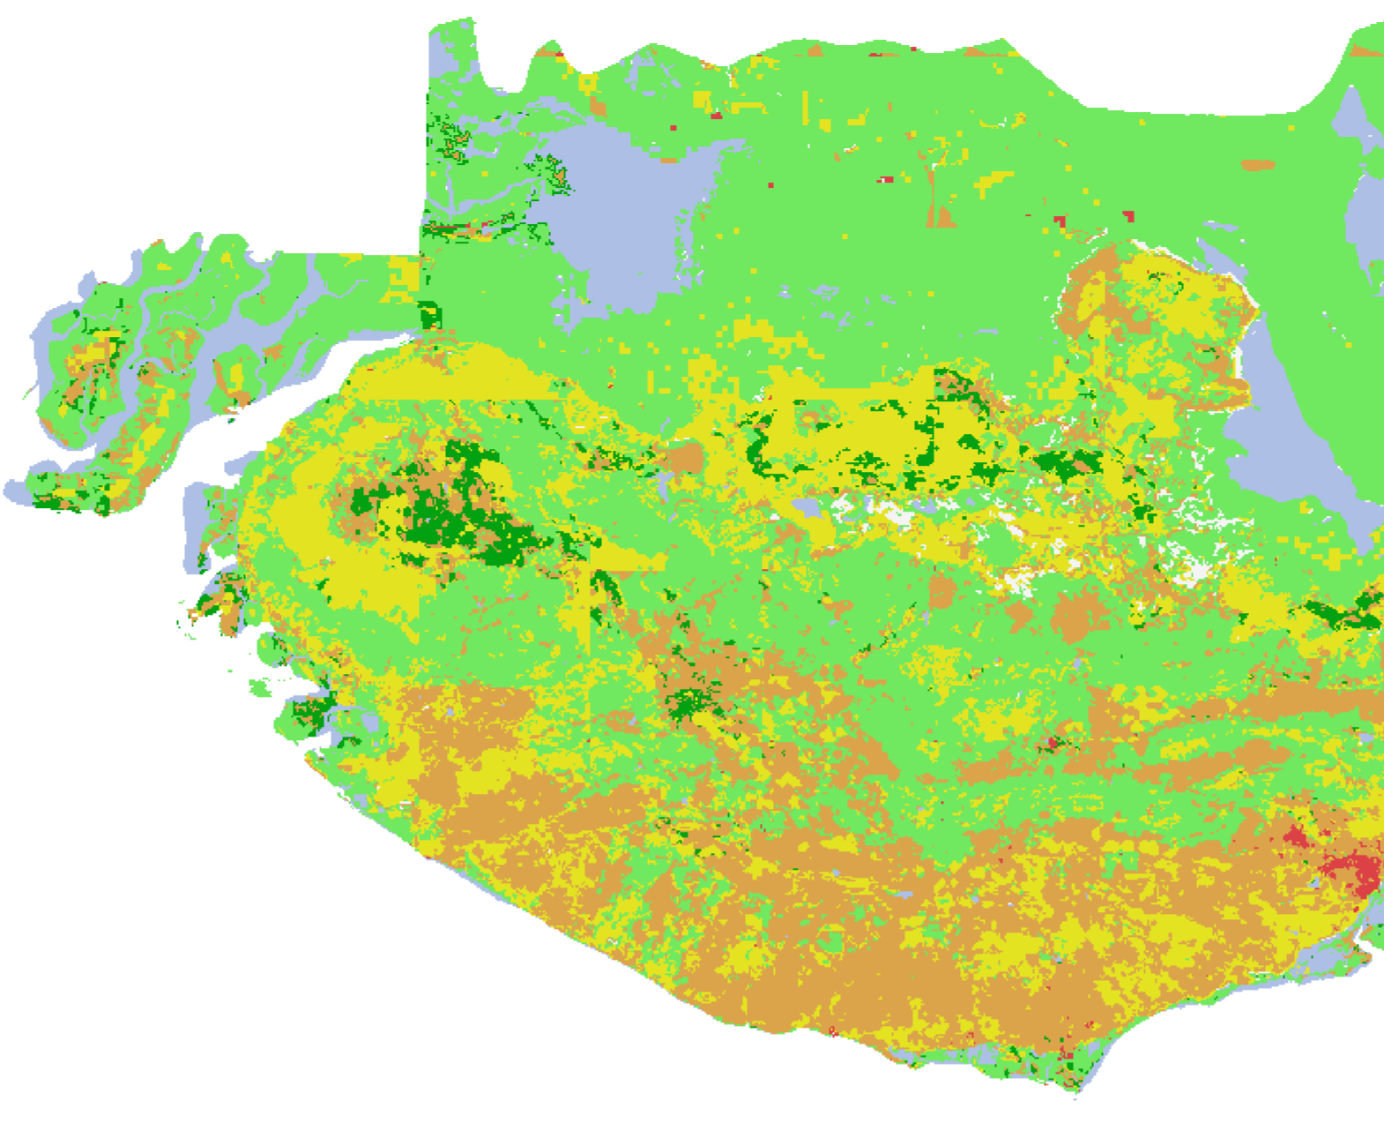
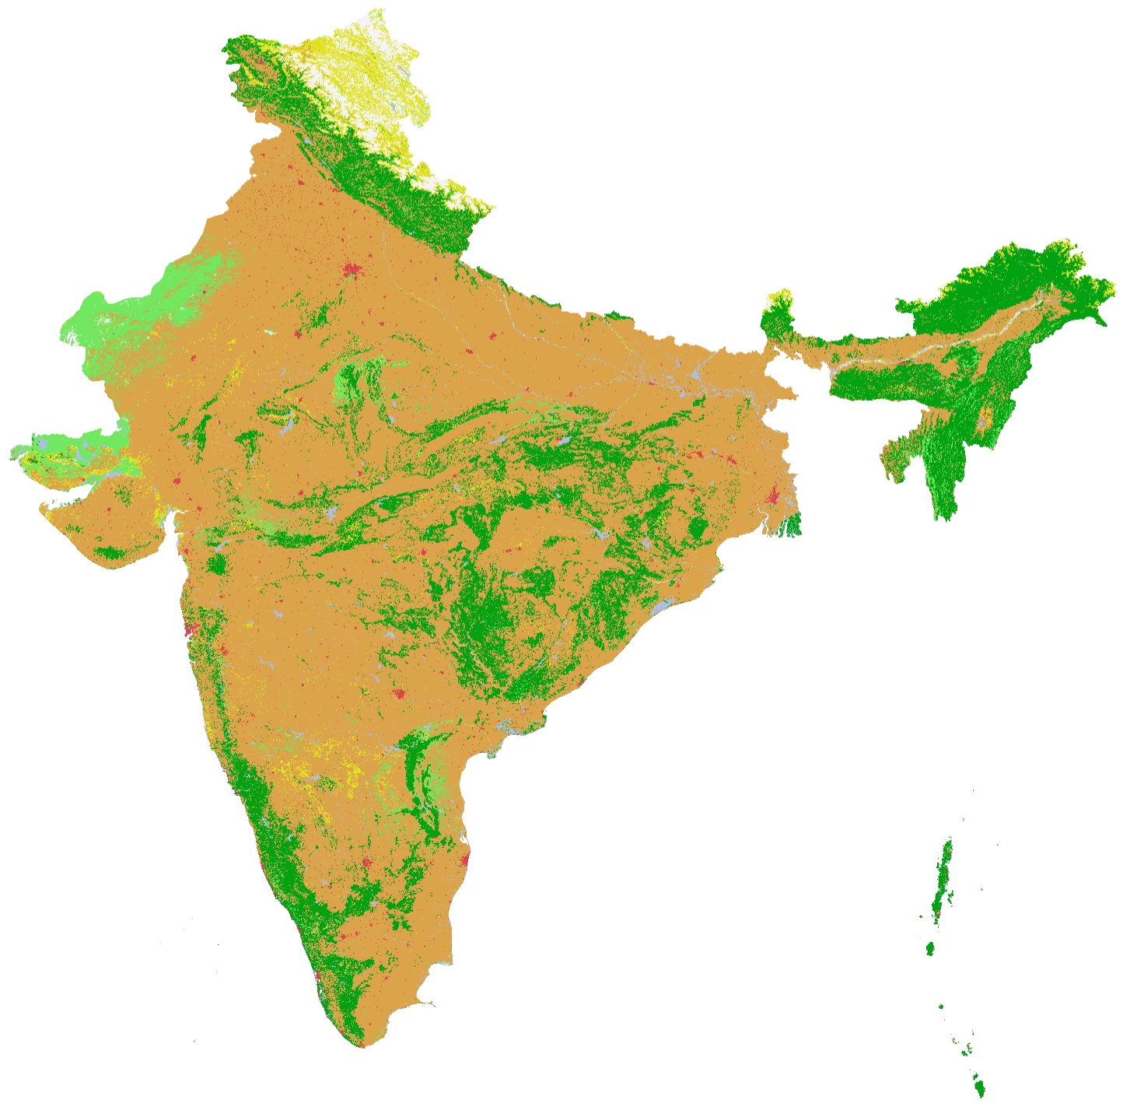
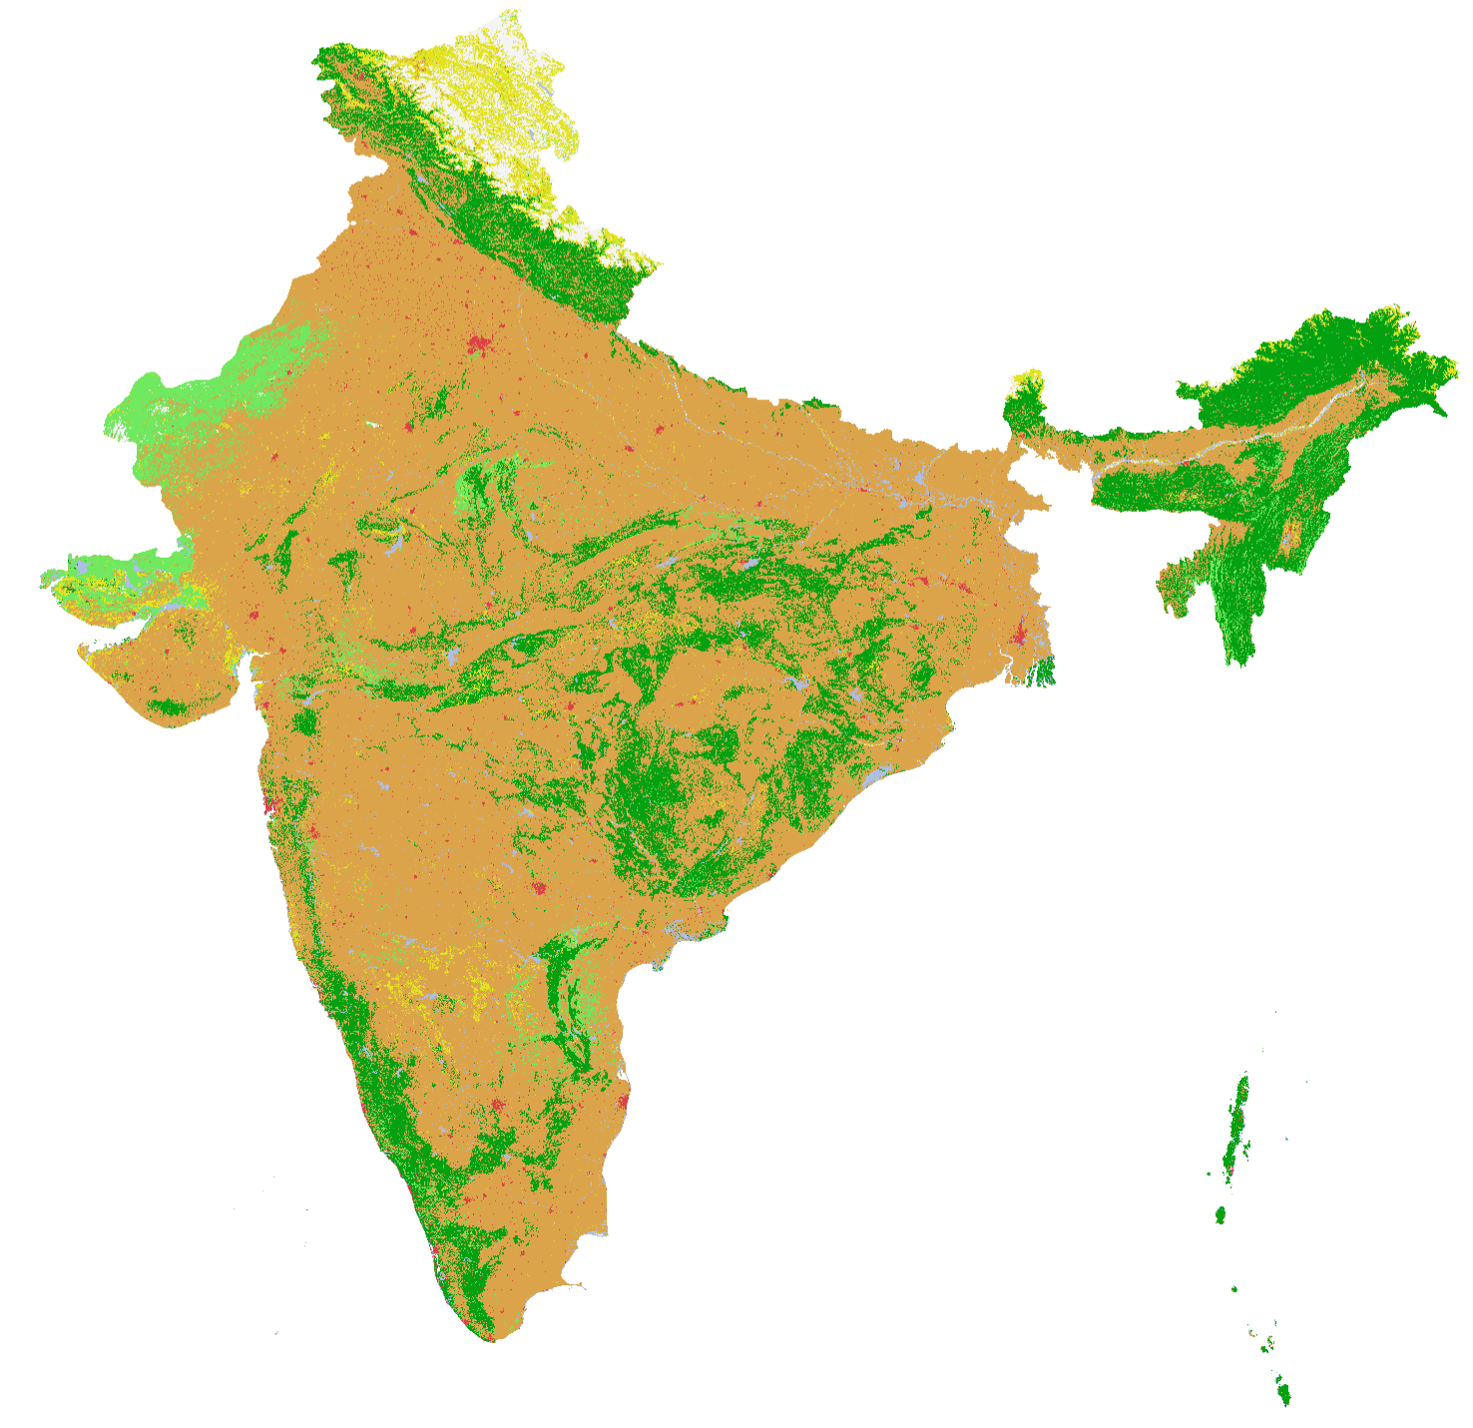

SEALS Output
MANAGE Output (change in land use in Million Ha)
2017
2022

Slide 29
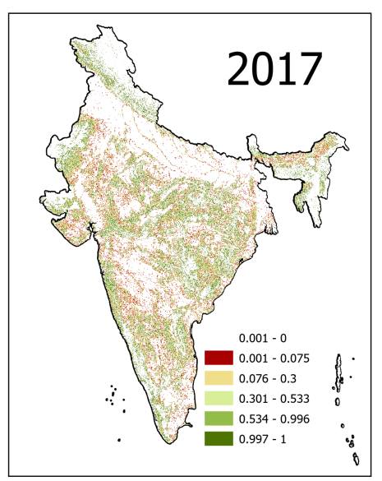
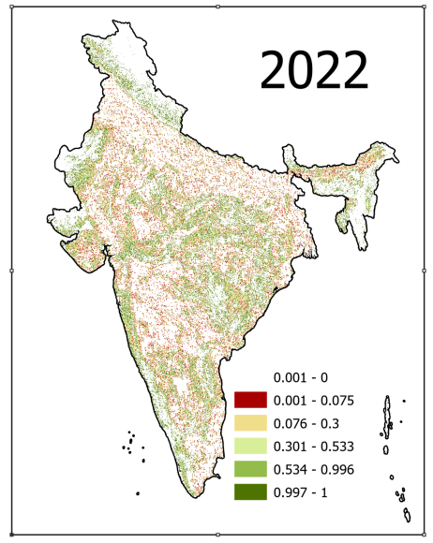
Pollination model output - pollination sufficiency
Shock value: = 0.991

Slide 30
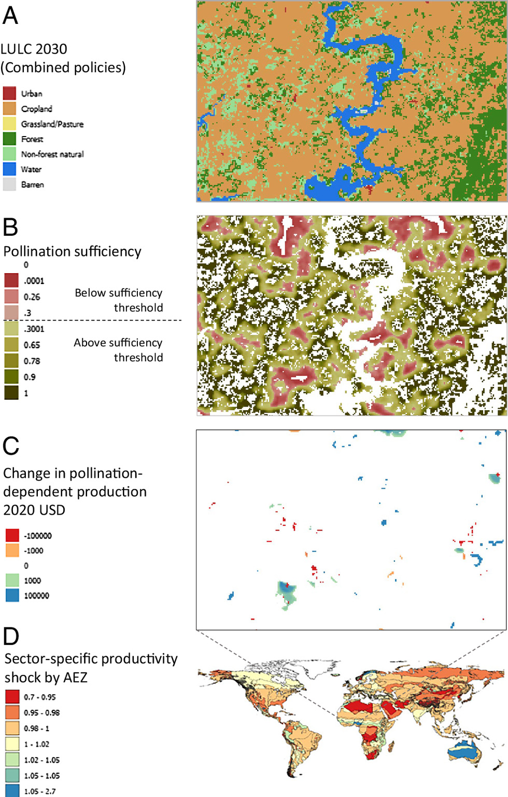
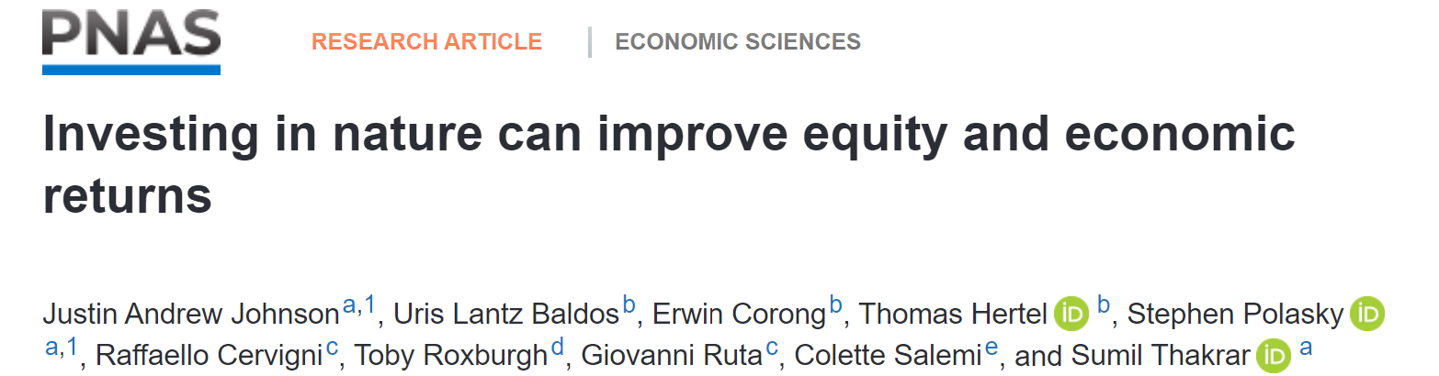
Pollination economic (shock)
Impact pathway:
Change in LULC --> Change in Pollination Sufficiency --> Change in yield of pollination dependent crops --> Change in CGE Production Functions as reduced productivity, specific to each crop and region.
Pollination Shock value: 0.991
Pollination shock multiplier = (1- Shock) = 0.009

Slide 31
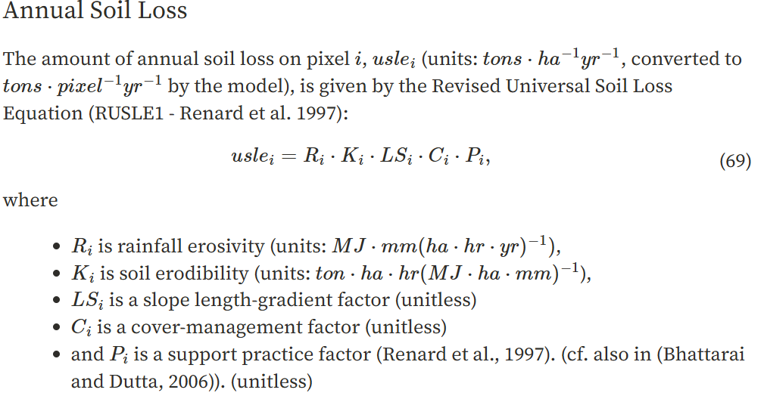
Erosion Reduction – InVEST Sediment Delivery Ratio Model

Slide 32
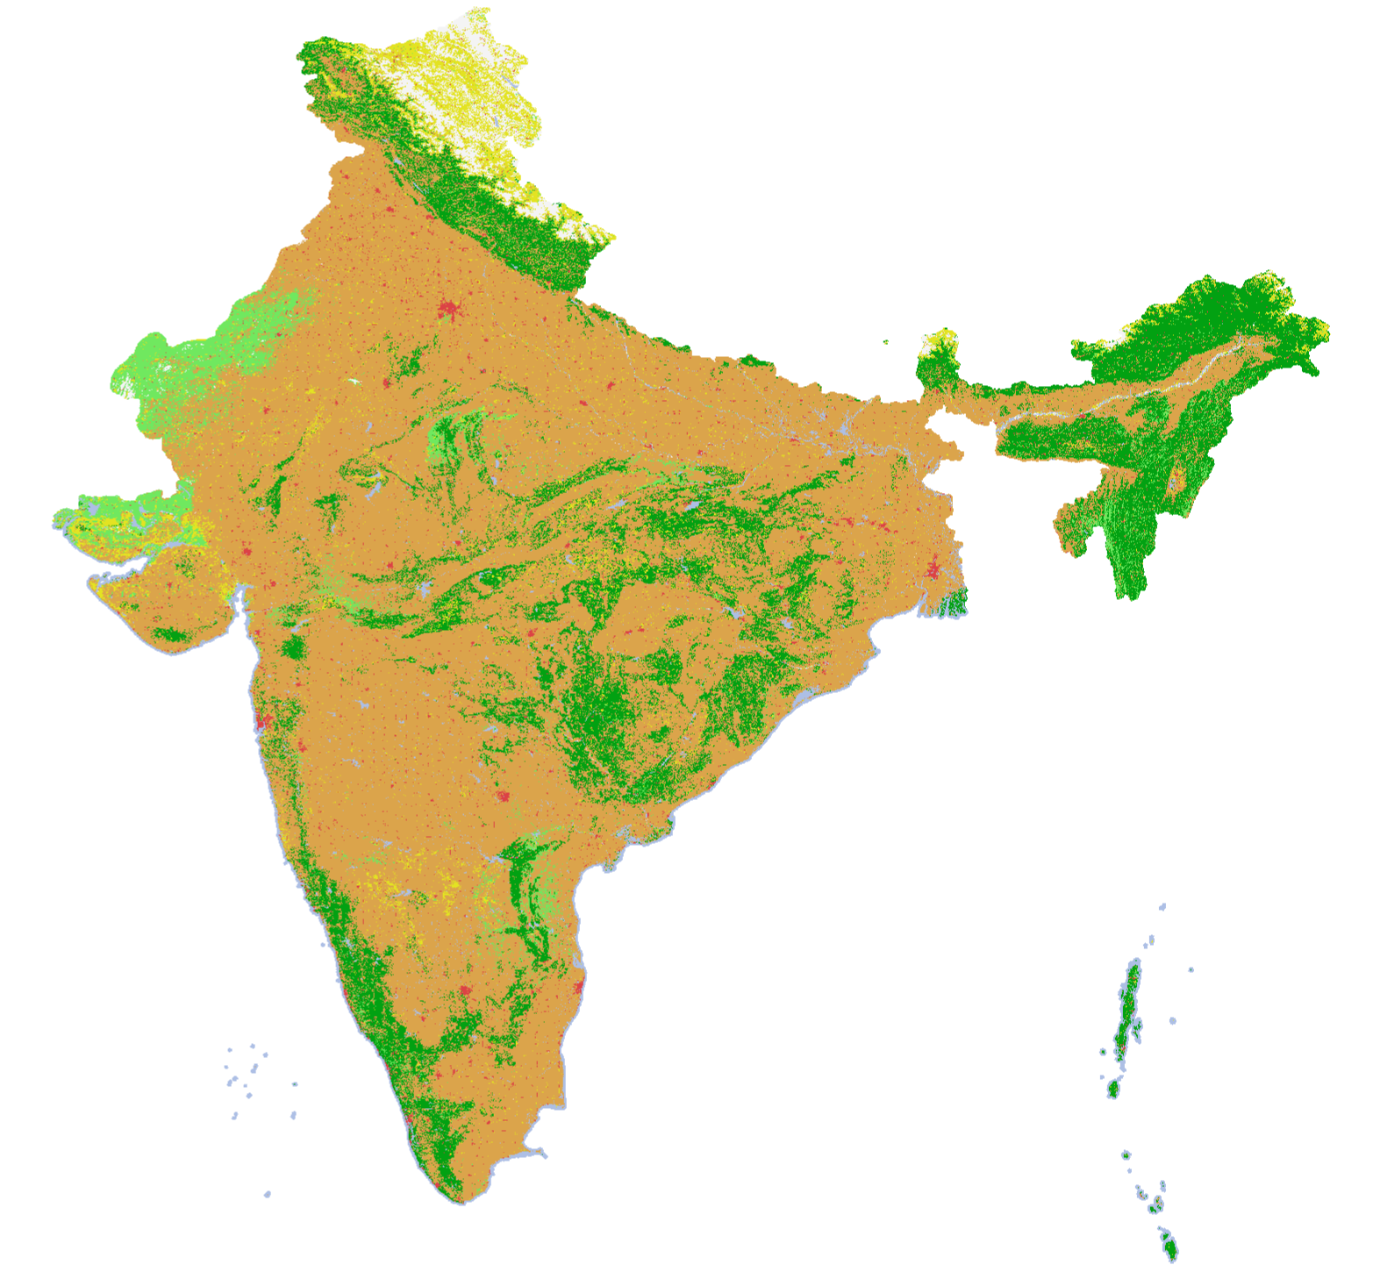
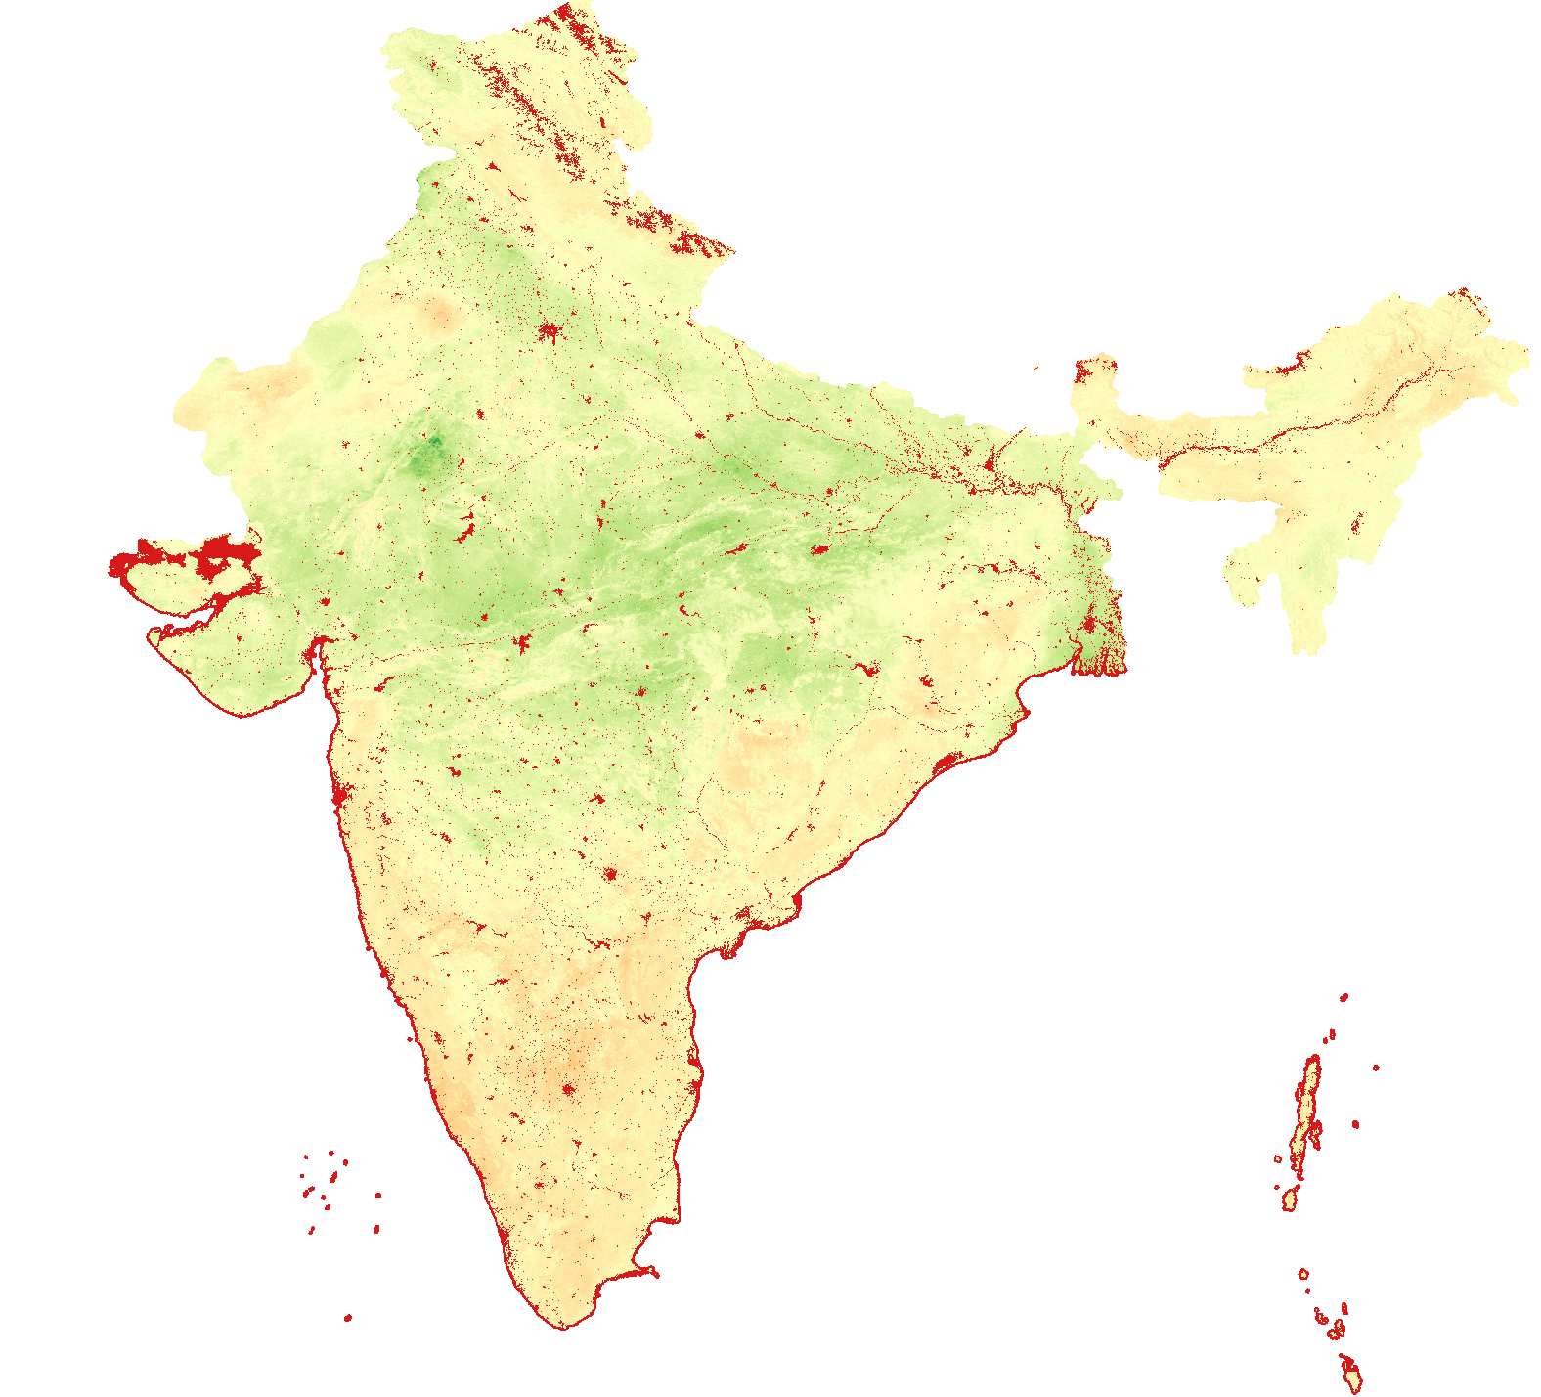
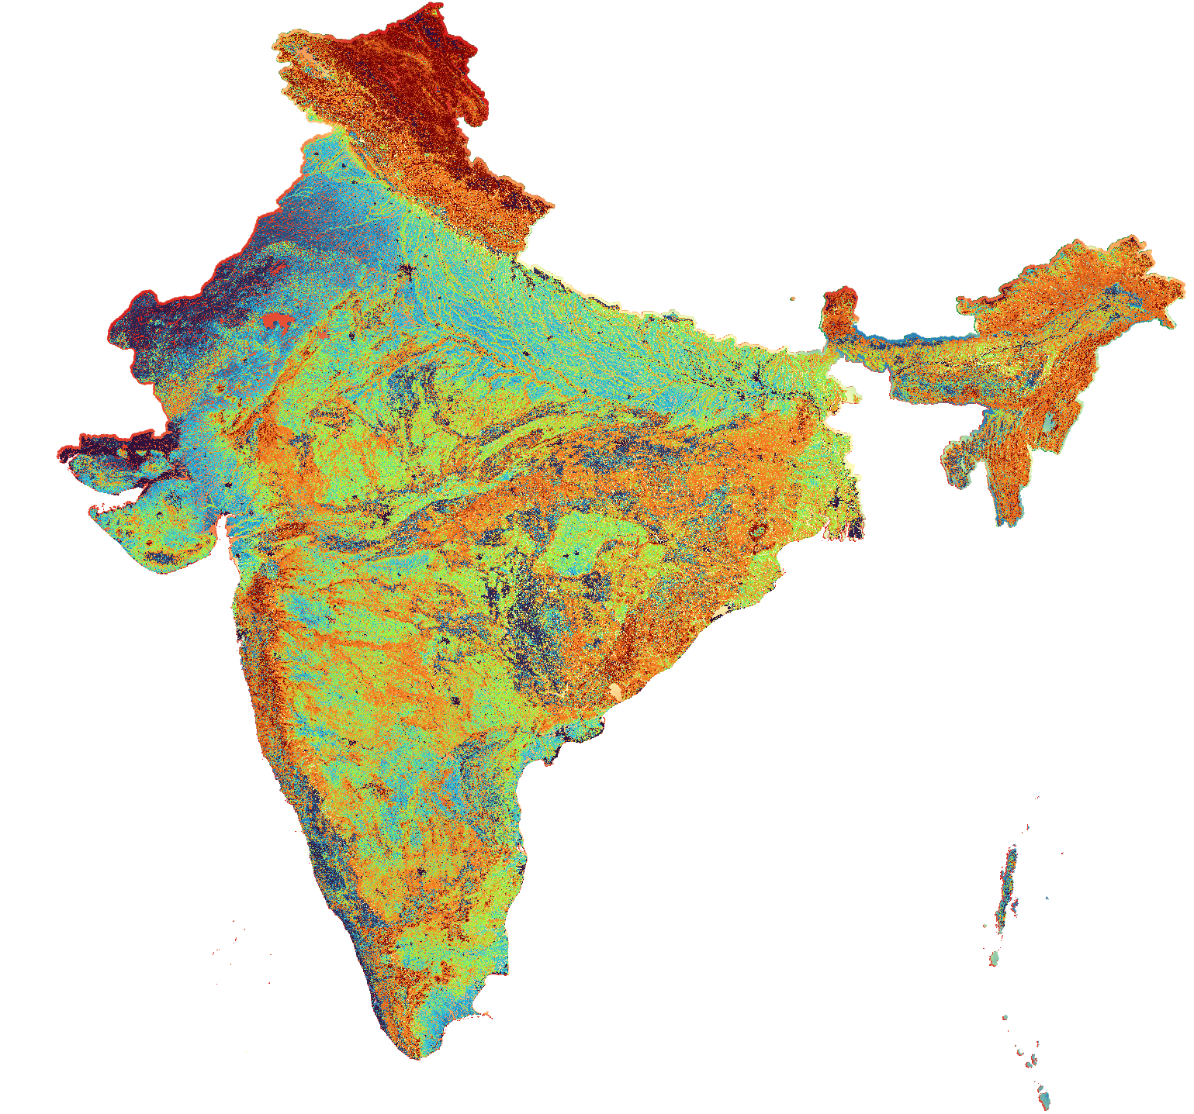
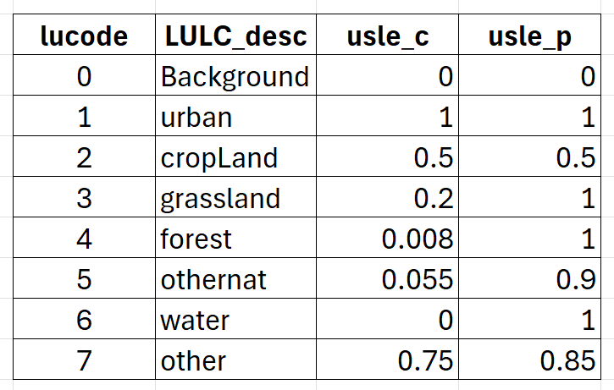
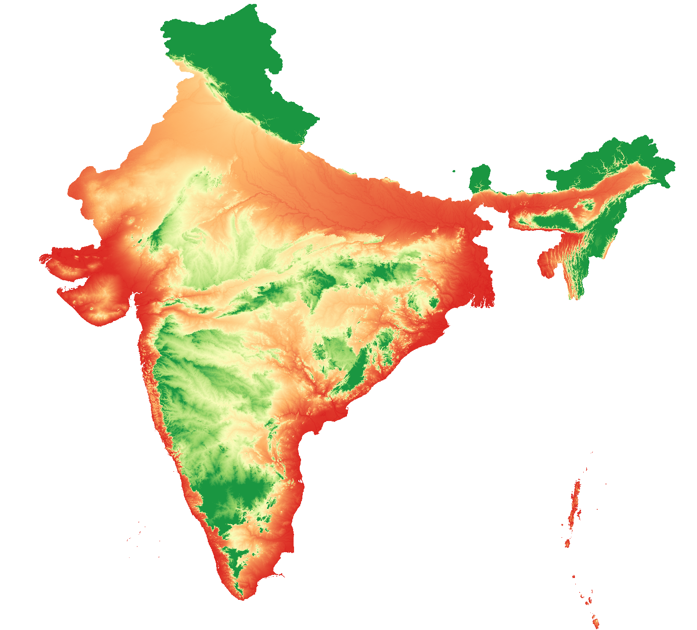
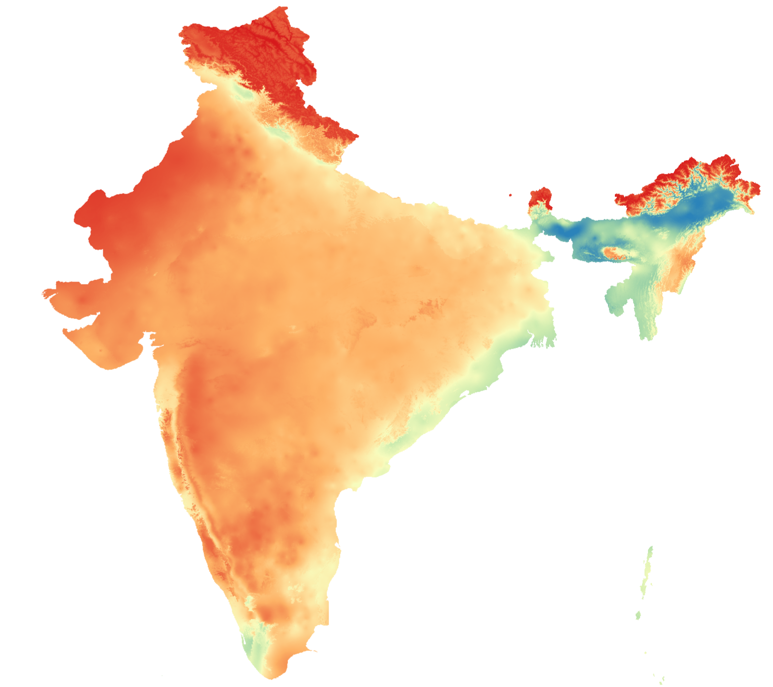
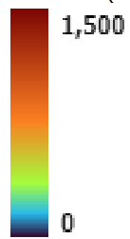
Erosion Control (SDR) model output
LULC
Soil
Erodibility
2022
Biophysical Table:
cover management (c) and support practice (p) factor
Soil erosion (usle)
tons per ha per yr
Elevation
Rainfall
Erosivity

Slide 33
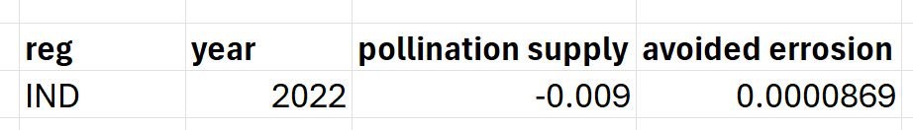
Shock Output from SEALS to MANAGE
The linkage code will create a CSV file that can be used in MANAGE iteratively.
MANAGE
Output (t+0)
Net LULC change (million hectares) hectares)
SEALS+InVEST
Input (t+0)
Shock file into MANAGE-WB
MANAGE
Input (t+1)
SEALS+InVEST
Output (t+1)

Slide 34
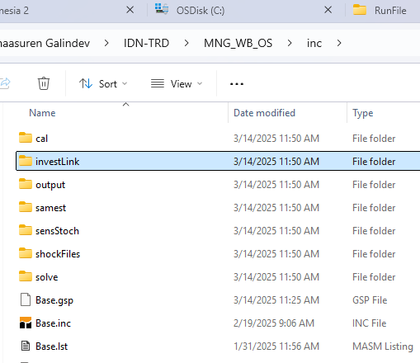

Application 3: MANAGE-WB+SEALS+InVEST
inc/investLink/setupSeals.inc
inc/investLink/toInvest.inc
inc/investLink/fromInvest.inc

Slide 35
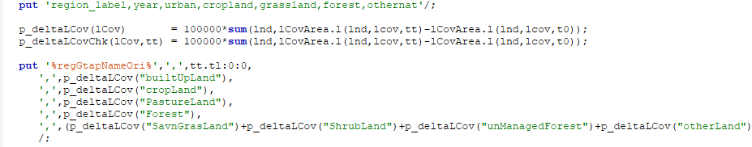

… toInvest.inc

Slide 36
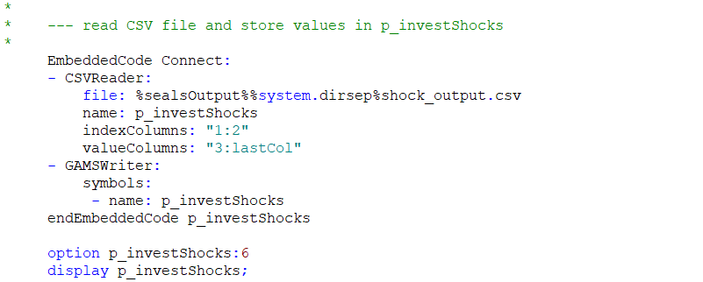
… fromInvest.inc

Slide 37
Thank you!

