Slide 1

Market Power and Fossil Fuel Subsidy Reforms
A CGE Approach with Endogenous Markups
Robin Argueyrolles, 20.05.2025

Slide 2
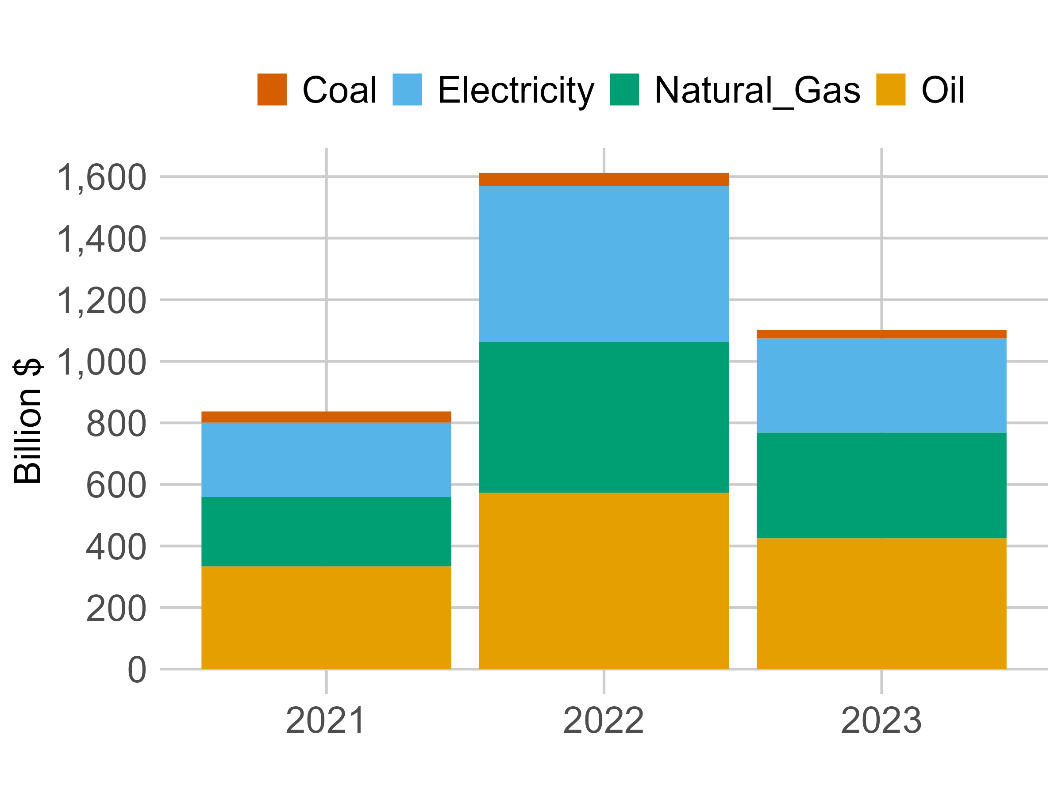
Introduction
Fossil Fuel Subsidies (FFS) reached 1.6 $ trillion globally in 2022 (OECD data)
Petroleum: highest recipient (40%)
2022: High energy prices
Protect vulnerable households
Despite a fall in 2023, FFS remained above the historical average
Notes:
(13.10.2024) for sale at 1,49m euros for those interested (lotto winner hiding among us??)

Slide 3
Literature - Background
Literature broadly supplies a reform: Economic, Social, Environmental, Political
Much of which was completed using CGE to capture leakages, linkages, welfare
BUT relying on the Walrasian tradition of perfect competition
Oil sector, however: Barriers to entry, IRS, monopoly profit
CGE & market power
Increasing returns to scale
Melitz
Small group monopolistic competition
Question: What is the impact of small-group monopolistic compt. on FFSR?
(Golombek et al. 2018; Branger et al. 2020)
(Harris 1984; Cox, Harris, 1985; Harrisson et al. 1996)
(Akgul et al. 2016; Balstreri et al. 2011; Bekkers, Francois 2018)
(Hoffman 2002, Markusen 2024)
Notes:
Imp. Compt. & OPEC behavior critical to climate policy

Slide 4
Model
Markusen Extended Market Power (MEMP) model: MCP-based static CGE model
Fully open access available here
Regions | Commodities | Primary Factors
OPEC+ | Oil | Labor
Rest of World (ROW) | Transport fuel | Capital
 | Rest of Energy | Crude oil
 | Rest of Economy
Consumption: Households, Government, and Firms
=> Nested CES function subject to different Armington elasticity
Production: Nested combination of Leontief, Cobb-Douglas, and CES
=> Subject to fixed costs a priori committed to primary factors
Notes:
Aim: Not predictive accuracy but identify mechanism and direction of effects.
OPEC+ based on US Energy Information Agency definition = OPEC + Declaration of cooperation.
Input, output, and sales taxes.
Closures: Fixed endowments + Fixed saving/investment => Fixed current account
=> Economic effect of a policy for a given level of foreign borrowing and investment

Slide 5
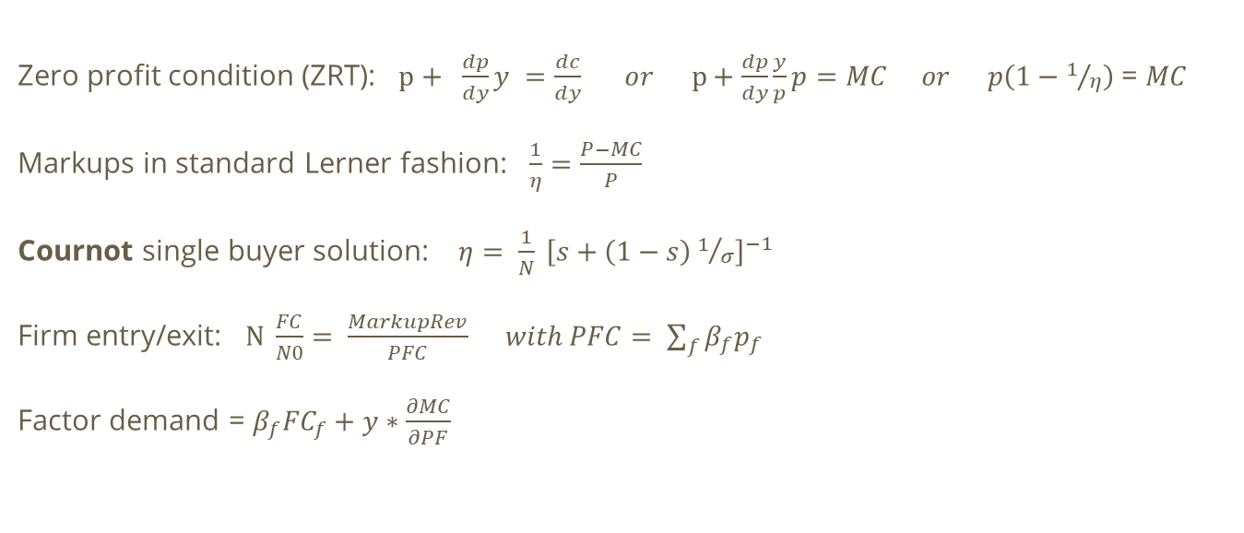
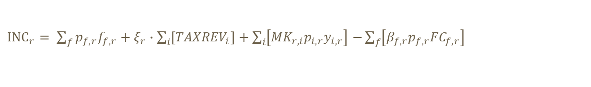
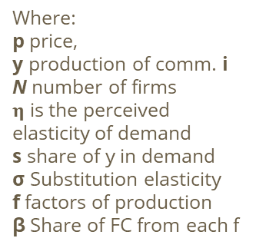
Framework - Imperfect Compt.
Zero profit condition (ZRT): $p+ \frac{dp}{dy}y =\frac{dc}{dy} or p+\frac{dp}{dy}\frac{y}{p}p=MC or p\left(1−1/η\right)$ = $MC$
Markups in standard Lerner fashion: $\frac{1}{η}=\frac{P−MC}{P}$
Cournot single buyer solution: $η= \frac{1}{N} {\left[s+\left(1−s\right)1/σ\right]}^{−1}$
Firm entry/exit: $N \frac{FC}{N0}= \frac{MarkupRev}{PFC} with PFC= \sum_{f}{β_{f}p_{f}}$
Factor demand = $β_{f}{FC}_{f}+y∗\frac{∂MC}{∂PF}$
Where:
p price,
y production of comm. i
N number of firms
$η$ is the perceived elasticity of demand
s share of y in demand
σ Substitution elasticity
f factors of production
β Share of FC from each f
${INC}_{r}= \sum_{f}{p_{f,r}f_{f,r}+ξ_{r}∙\sum_{i}{\left[{TAXREV}_{i}\right]+\sum_{i}{\left[{MK}_{r,i}p_{i,r}y_{i,r}\right]}}}$ $−\sum_{f}{\left[{β_{f,r}p}_{f,r}{FC}_{f,r}\right]}$
2022 (simulated) SAM => Markups: OPEC+ (48%) RoW (42%)
Notes:
$p^{′}y =\frac{dp}{dy} ∗\frac{y}{p}∗p η$ = eta = how much demand reacts to producers changing the price of y
Cournot compete on quantity,
As markup revenue grows, new firms enter the market, and demand for fixed costs rises. Markups update to the new number of entries, which in turn influences other variables, including firm scale, within the general equilibrium framework,
Markup = Sum of the individual elasticities times the share of quantity sold to that buyer

Slide 6
Global Reform - Oil
Global fossil fuel consumption subsidy reform: OPEC+ 20%, ROW 4.8% (IEA + OECD data)
 | OPEC+ |  |  |  | ROW
 | Domestic prod. |  | Imported |  | Domestic prod. |  | Imported
 | Price | Q $BN | Price | Q $BN | Price | Q $BN | Price | Q $BN
Perfect comp. | 12.6% | -185 | 18.4% | -1 | 3.1% | -76 | -2.7% | 70
Imperfect comp. | 12.2% | -180 | 18.5% | -1 | 3.2% | -79 | -3.1% | 82
Incomplete pass-through: Price of domestically produced oil rises
OPEC 12% vs subsidy 20%
ROW 3% vs subsidy 4.8%

Slide 7
Global Reform - Oil
 | OPEC+ |  |  |  | ROW
 | Domestic prod. |  | Imported |  | Domestic prod. |  | Imported
 | Price | Q $BN | Price | Q $BN | Price | Q $BN | Price | Q $BN
Perfect comp. | 12.6% | -185 | 18.4% | -1 | 3.1% | -76 | -2.7% | 70
Imperfect comp. | 12.2% | -180 | 18.5% | -1 | 3.2% | -79 | -3.1% | 82
Consumption ‘Leakage’
Import in ROW rises by 70 $billion as price falls by 2.7%
Roughly eq. to the chg. in OPEC+ & domestic reform:
(12.6 – 20) + 4.8 = - 2.6
Notes:
In OPEC+ almost 0 imports in benchmark

Slide 8
Global Reform - Oil
 | OPEC+ |  |  |  | ROW
 | Domestic prod. |  | Imported |  | Domestic prod. |  | Imported
 | Price | Q $BN | Price | Q $BN | Price | Q $BN | Price | Q $BN
Perfect comp. | 12.6% | -185 | 18.4% | -1 | 3.1% | -76 | -2.7% | 70
Imperfect comp. | 12.2% | -180 | 18.5% | -1 | 3.2% | -79 | -3.1% | 82
Markups absorbs part of the inflationary shock
OPEC+: Smaller rise in P (0.4%) and fall in quantity (5 $bn)
=> Translates into an even further drop in importer price in ROW
ROW: Import price drops more (0.4%) and import rise (12$bn)
=> ROW overall consumption grows by 13 $bn (82-79)
Notes:
In OPEC+ almost 0 imports in benchmark

Slide 9
Global Reform - Oil
 | OPEC+ |  |  |  | ROW
 | Domestic prod. |  | Imported |  | Domestic prod. |  | Imported
 | Price | Q $BN | Price | Q $BN | Price | Q $BN | Price | Q $BN
Perfect comp. | 12.6% | -185 | 18.4% | -1 | 3.1% | -76 | -2.7% | 70
Imperfect comp. | 12.2% | -180 | 18.5% | -1 | 3.2% | -79 | -3.1% | 82
Consumption in imp. comp. falls less
ROW consumption grows by 13 $bn (82-79)
OPEC consumption falls by 5 $bn less
=>Globally fall in consumption 7.7% smaller: 192 $bn (6.5%) vs 178 $bn (6%)
Notes:
In OPEC+ almost 0 imports in benchmark

Slide 10
Global Reform - Markups & Firm entry/exit
Notes:
Concentration rises & the remaining firms move down their average cost curves (productivity effect)

Slide 11
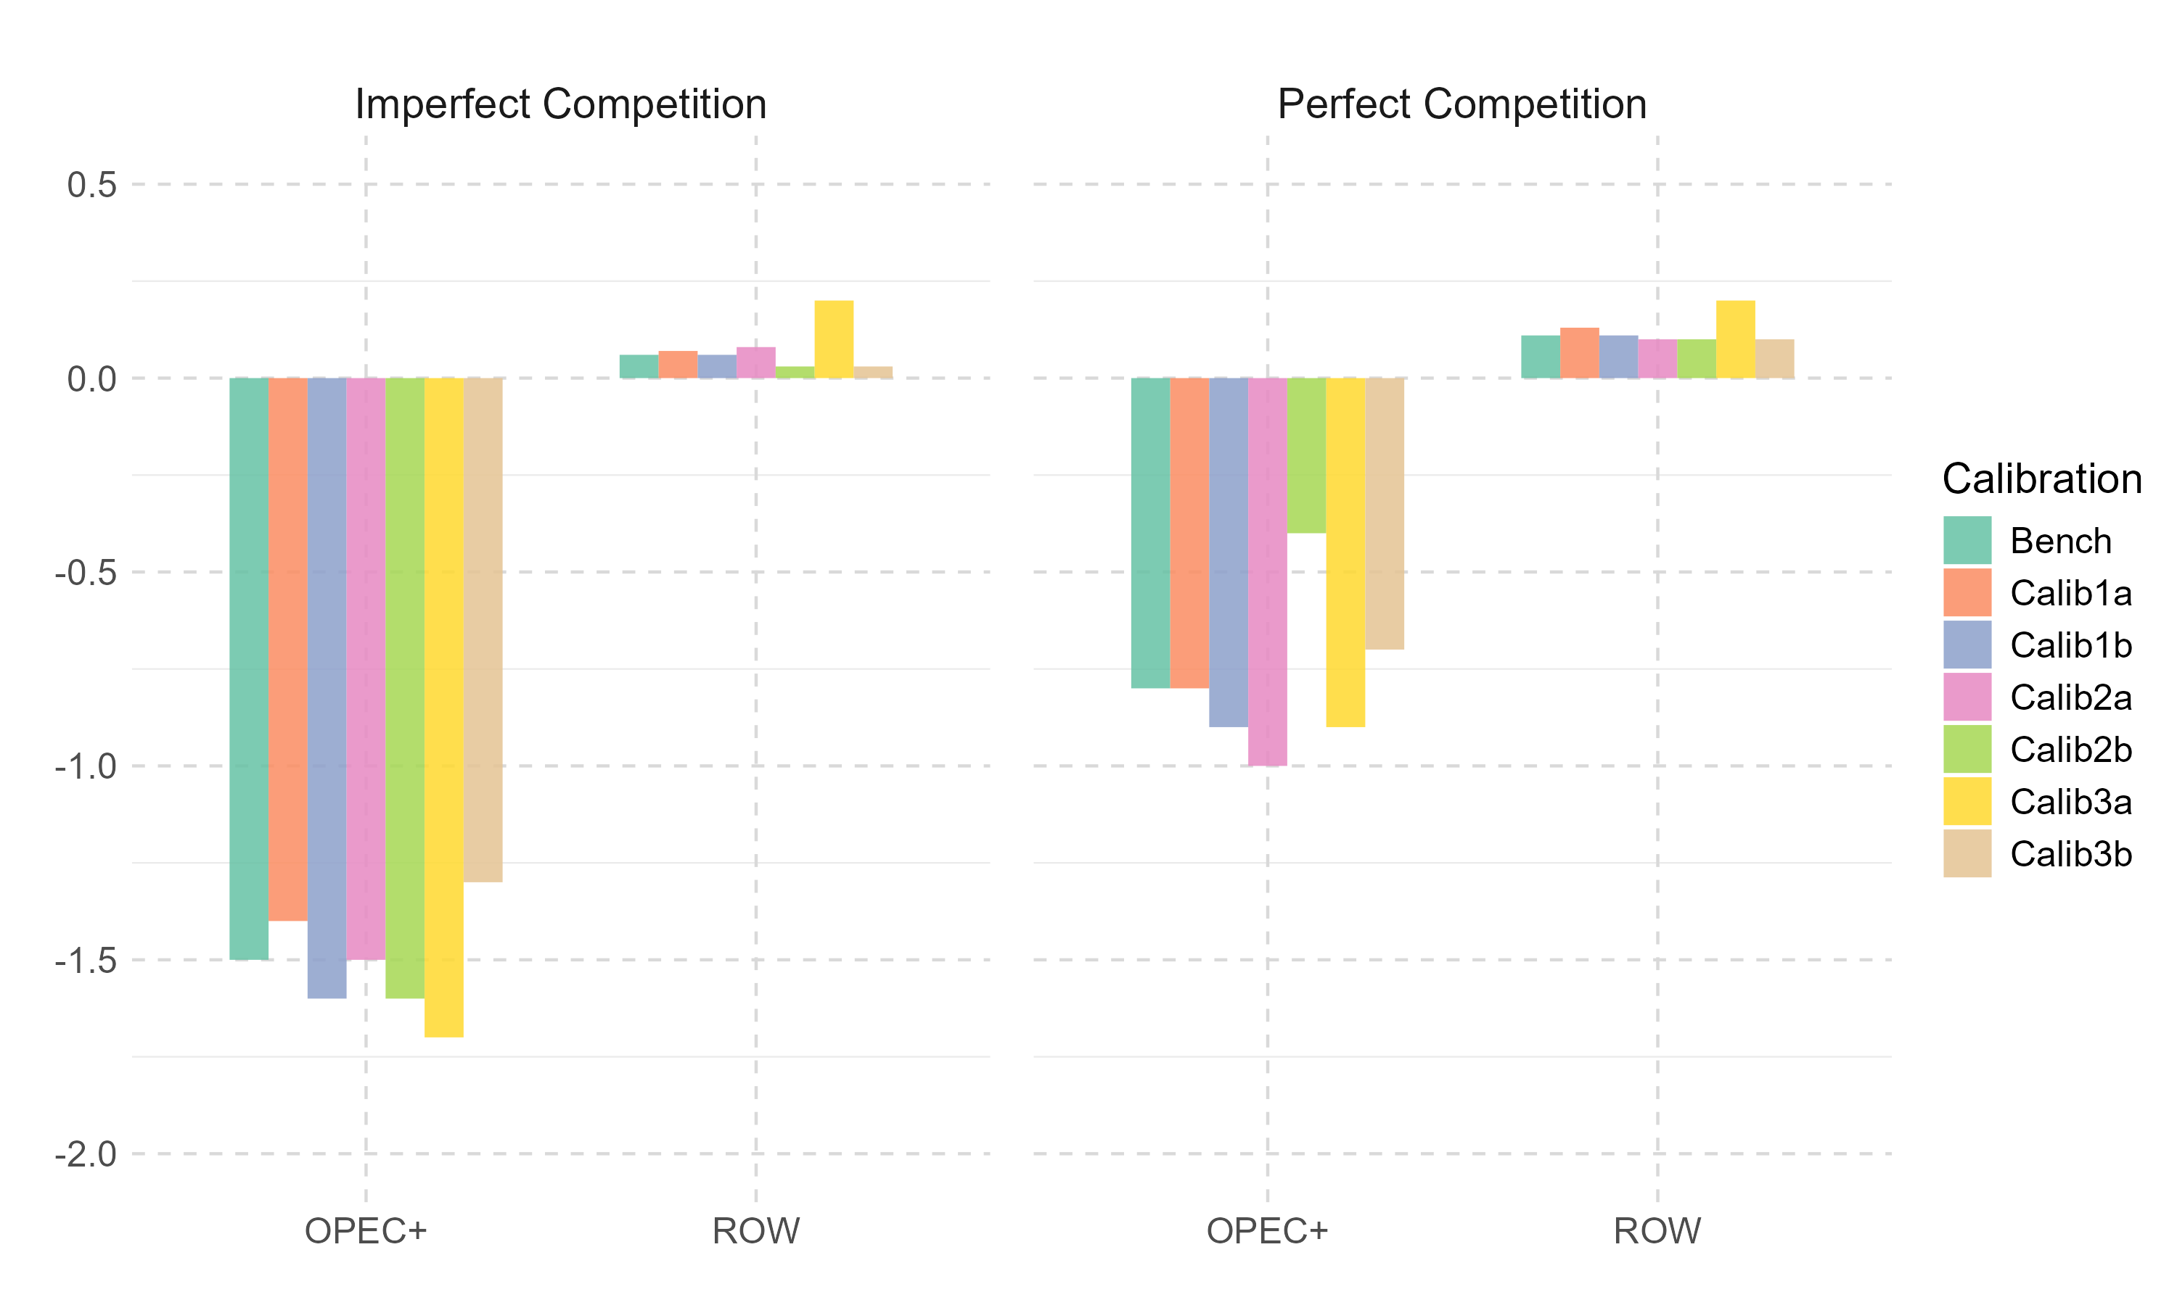
Global Reform - GDP
Calibration | Description
Calib 1a | Lower final cons. elasticity
Calib 1b | Higher final cons. elasticity
Calib 2a | Lower VA/CRU elasticity
Calib 2b | Higher VA/CRU elasticity
Calib 3a | Lower interm. cons. elasticity
Calib 3b | Higher interm. cons. elasticity

Slide 12
Conclusion
So far, CGE literature on FFSER completed using perfect competition
The energy sector, especially when considering the crude oil market
Not a typical Arrow/Debreu GE model
Markups are reasonably easy to include in an MCP-based CGE model
BUT difficult to calibrate
Markups absorb part of the inflationary shock
=> Lower the effectiveness of the reforms to lower fossil fuel cons.
Reinforcing market failures & need for industrial policies

Slide 13

End
Thank you for your time today. Please share your questions!
Notes:
Each method better fits a specific story/context.

Slide 14
References (1)
Argueyrolles, R. 2025. “MEMP model – Two regions static Computable General Equilibrium (CGE) model with Cournot-Walras competition (Version V1).” Zenodo. https://doi.org/10.5281/zenodo.14869419
Argueyrolles, R., Heimann, T., and Delzeit, R. 2025. “Impact of Gasoline and Diesel Subsidy Reforms on Global Biofuel Mandates.” GCB Bioenergy 17. https://doi.org/10.1111/gcbb.70019
Babiker, M. 2005. “Climate change policy, market structure, and carbon leakage.” Journal of International Economics 65: 421-445. doi:10.1016/j.jinteco.2004.01.003
Banger, N., Flacke, R., and Graber, N. 2020. “Monopoly power in the oil market and the macroeconomy.” Energy Economics 85. https://doi.org/10.1016/j.eneco.2019.104597
Bekkers, E., and Francois, J. 2018. “A Parsimonious Approach to Incorporate Firm Heterogeneity in CGE-Models.” Journal of Global Economic Analysis 3: 1-68. https://doi.org/10.21642/JGEA.030201AF
Böhringer, C., Rosendahl, K., and Schneider, J. 2014. “Unilateral Climate Policy: Can OPEC Resolve the Leakage Problem?” The Energy Journal 35: 79-100. https://www.jstor.org/stable/24695028
Burniaux, J., and Château, J. 2014. “Greenhouse Gases Mitigation Potential and Economic Efficiency of Phasing- Out Fossil Fuel Subsidies.” International Economics 140: 71–88. https://doi.org/10.1016/j.inteco.2014.05.002
Chepeliev, M., and Mensbrugghe, D. 2020. “Global Fossil-Fuel Subsidy Reform and Paris Agreement.” Energy Economics 85: 104598. https://doi.org/10.1016/j.eneco.2019.104598

Slide 15
References (2)
Cooke, E., Hague, S., Cockburn, J., Lahga, A., and Tiberti, L. 2014. “Estimating the impact on poverty of Ghana’s fuel subsidy reform and a mitigating response.” PEP Working Papers 164187, Partnership for Economic Policy (PEP). https://ssrn.com/abstract=3167429
Cox, D., and Harris, R. 1985. “Trade Liberalization and Industrial Organization: Some Estimates for Canada.” Journal of Political Economy 93: 115-145. DOI:10.1086/261290
Dixon, P., and Rimmer, M. 2024. “Small Group Monopolistic Competition in a GTAP Model: Meeting the Markusen Challenge.” CoPS Working Paper No. G-347
Durand-Lasserve, O., and Pierru, A. 2021. “Modeling world oil market questions: An economic perspective.” Energy Policy 159: 112606. https://doi.org/10.1016/j.enpol.2021.112606
Fouré, J., Dellink, R., Lanzi, E., and Pavanello, F. 2023. “Public Finance Resilience in the Transition Towards Carbon Neutrality: Modelling Policy Instruments in a Global Net-Zero Emissions.” OECD Environment Working Papers no. 214. https://doi.org/10.1787/7f3275e0-en.
Golombek, R., Irarrazabal, A., and Ma, L. 2018. “OPEC’s market power: An empirical dominant firm model for the oil market.” Energy Economics 70: 98-115. https://doi.org/10.1016/j.eneco.2017.11.009
Harris, R. 1984. “Applied General Equilibrium Analysis of Small Open Economies with Scale Economies and Imperfect Competition.” The American Economic Review 74: 1016-1032. https://www.jstor.org/stable/559
Harrison, G., Rutherford, T., and Tarr, D. 1996. “Increased Competition and Completion of the Market in the European Union: Static and Steady State Effects.” Journal of Economic Integration 11: 332-365

Slide 16
References (3)
Hoffmann, A. 2002. “Imperfect competition in computable general equilibrium models - a primer.” Economic Modelling 20: 119-139. https://doi.org/10.1016/S0264-9993(01)00088-8
Markusen, J. 2023. “Incorporating Theory-Consistent Endogenous Markups into Applied General-Equilibrium Models.” Journal of Global Economic Analysis 8: 60-99. https://doi.org/10.21642/JGEA.080202AF
Meyer, T. 2017. “Explaining energy disputes at the World Trade Organization.” Int Environ Agreements 17: 391-410. DOI 10.1007/s10784-017-9356-y
Montes de Oca, L., Hagen, A., and Holz, F. 2024. “The Political Economy of Fossil Fuel Subsidy Removal: Evidence from Bolivia and Mexico.” IMF working paper DOI: https://doi.org/10.5089/9798400290480.001
Mundaca, G. 2017. “Energy subsidies, public investment and endogenous growth.” Energy Policy 110: 693-709. https://doi.org/10.1016/j.enpol.2017.08.049
Rentschler, J. 2016. “Incidence and impact: The regional variation of poverty effects due to fossil fuel subsidy reform.” Energy Policy 96: 491-503. http://dx.doi.org/10.1016/j.enpol.2016.06.025
Siddig, K., Aguiar, A., Grethe, H., Minor, P., and Walmsley, T. 2014. “Impacts of Removing Fuel Import Subsidies in Nigeria on Poverty.” Energy Policy 69: 165–178. https://doi.org/10.1016/j.enpol.2014.02.006.
Victor, D. 2009. “The Politics of Fossil-Fuel Subsidies.” http://dx.doi.org/10.2139/ssrn.1520984

Slide 17



Production Structure
Commodity
Leontief
Capital-labor-resource
Intermediates
CES $σ$= 0.51
CES $σ$ = 5
Capital-labor
Natural resources
Intermediate n
…
Intermediate 1
Cobb-Douglas
CES$σ$ =2
Capital
Labor
Domestic
Imported

Slide 18
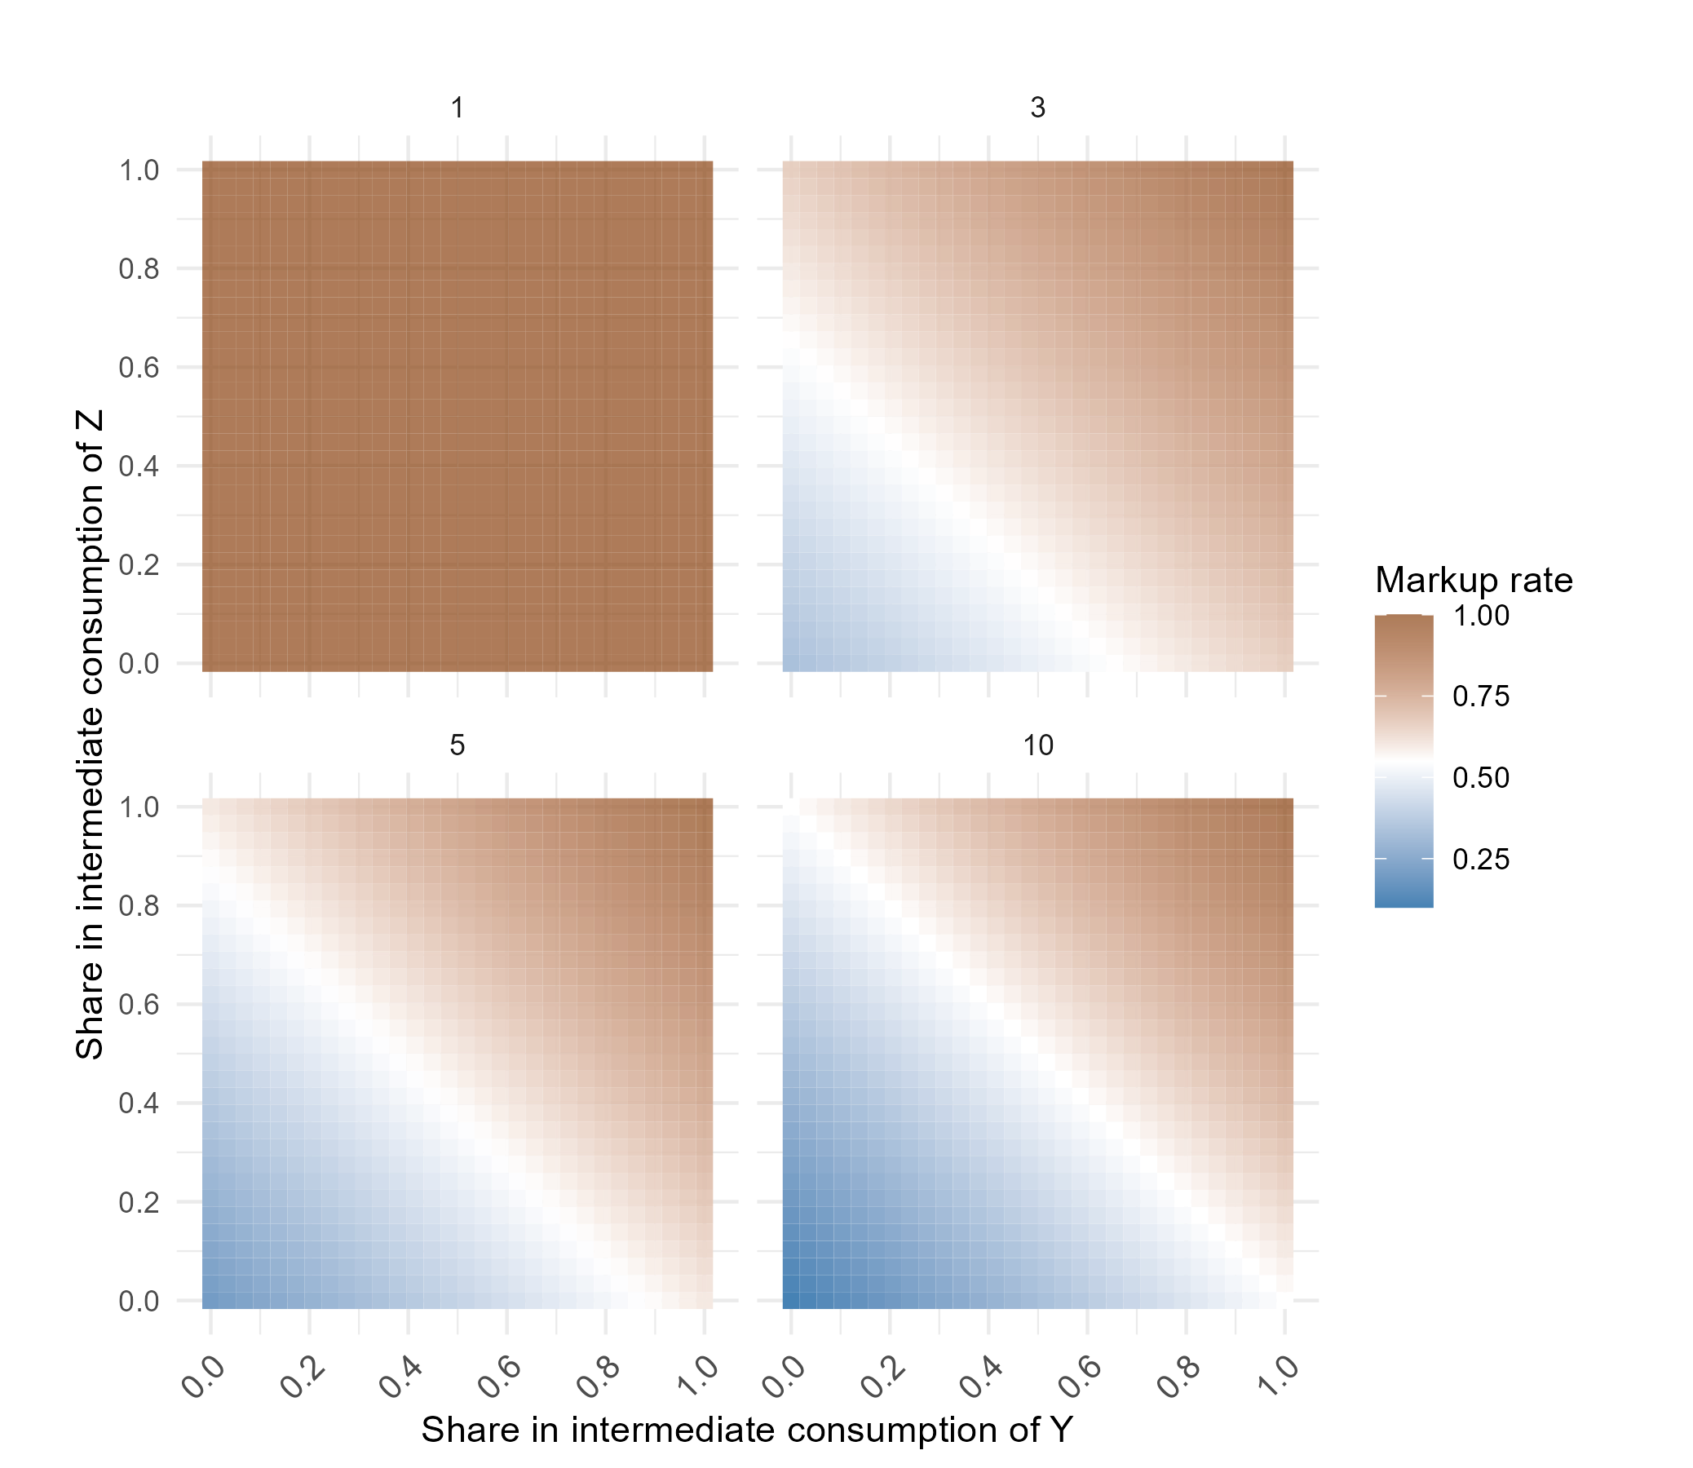
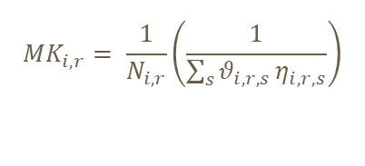
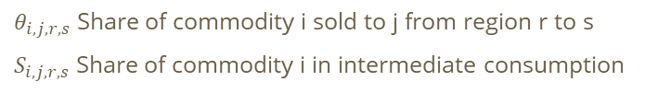
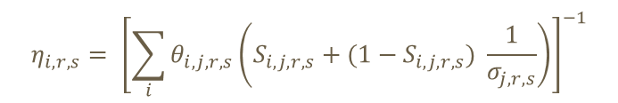
Model markups
Markup = Sum of the individual elasticities times the share of quantity sold to that buyer
$${MK}_{i,r}= \frac{1}{N_{i,r}}\left(\frac{1}{\sum_{s}{θ_{i,r,s}}η_{i,r,s}}\right)$$
Share in transport fuels (64-66%) !
$$η_{i,r,s}= {\left[\sum_{i}{θ_{i,j,r,s}}\left(S_{i,j,r,s}+(1−S_{i,j,r,s}) \frac{1}{σ_{j,r,s}}\right)\right]}^{−1}$$
$θ_{i,j,r,s}$ Share of commodity i sold to j from region r to s
$S_{i,j,r,s}$ Share of commodity i in intermediate consumption
of sector j in region s coming from r
Benchmark replication: 2022 simulated SAM
=> OPEC+ (48%) RoW (42%)

Slide 19
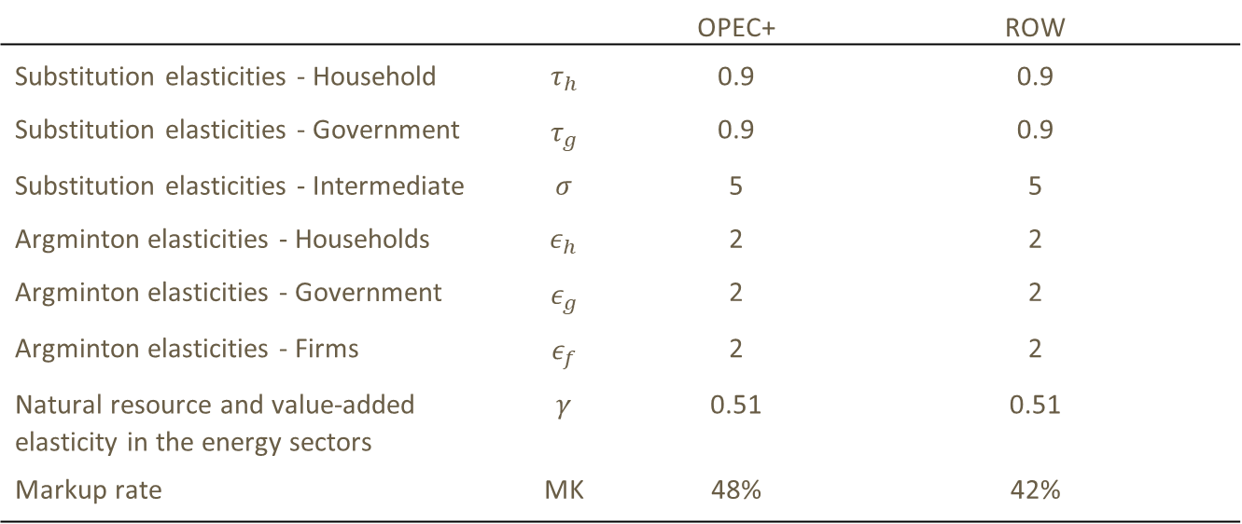
Benchmark Calibration
 |  | OPEC+ | ROW
Substitution elasticities - Household | $$τ_{h}$$ | 0.9 | 0.9
Substitution elasticities - Government | $$τ_{g}$$ | 0.9 | 0.9
Substitution elasticities - Intermediate | $$σ$$ | 5 | 5
Argminton elasticities - Households | $$ε_{h}$$ | 2 | 2
Argminton elasticities - Government | $$ε_{g}$$ | 2 | 2
Argminton elasticities - Firms | $$ε_{f}$$ | 2 | 2
Natural resource and value-added elasticity in the energy sectors | $$γ$$ | 0.51 | 0.51
Markup rate | MK | 48% | 42%

Slide 20
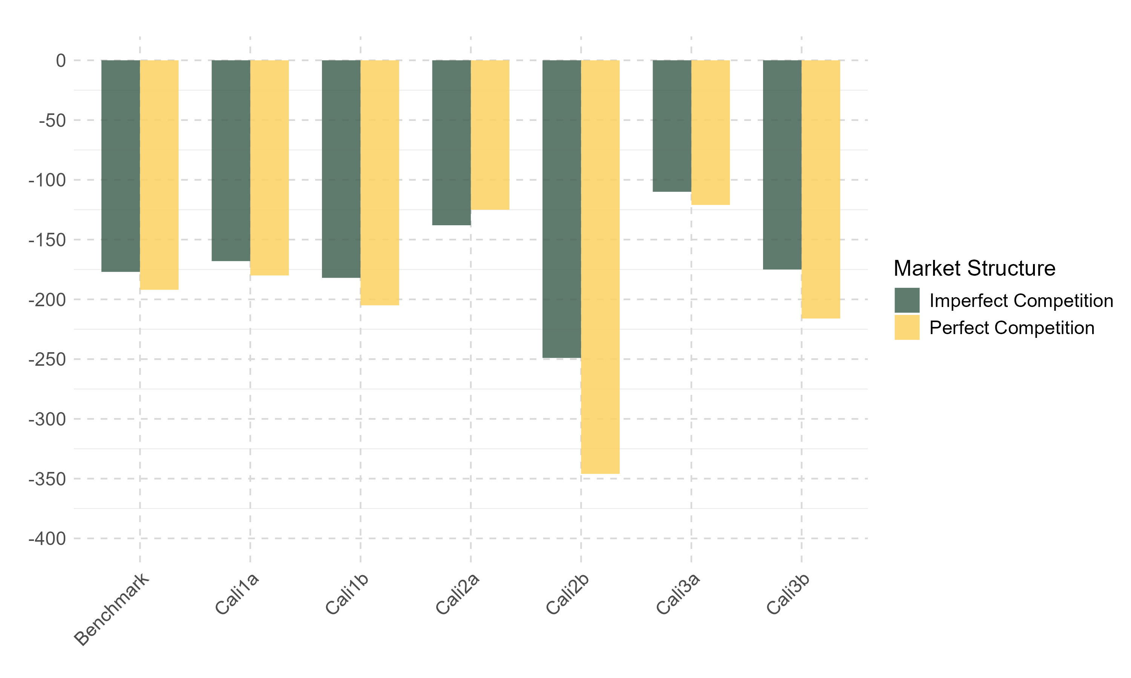
Oil Consumption Sensitivity
Calibration | Description
Calib 1a | Armington and substitution elasticity in final consumption lowered to 0.2
Calib 1b | Armington and substitution elasticity in final consumption increased to 5
Calib 2a | Elasticity of substitution between natural resources and capital-labor lowered to 0.2.
Calib 2b | Elasticity of substitution between natural resources and capital-labor increased to 5
Calib 3a | Lower Armington elasticity for intermediate consumption from 2 to 0.5.
Calib 3b | Higher Armington elasticity for intermediate consumption from 2 to 5.

Slide 21
Illustrative SAM
 | X | Y | Z | W | FC | CONS | MKR
PX | 100 | -50 | -50
PY | -50 | 1000 | -75 | -875
PZ |  | -75 | 700 | -625
PW |  |  |  | 1500 |  | -1500
PK | -16(-20+4) | -375 | -250 |  | -4 | 645
PL | -24(-30+6) | -500 | -325 |  | -6 | 855
PMK | -10 |  |  |  |  |  | 10
PFC |  |  |  |  | 10 |  | -10

Slide 22
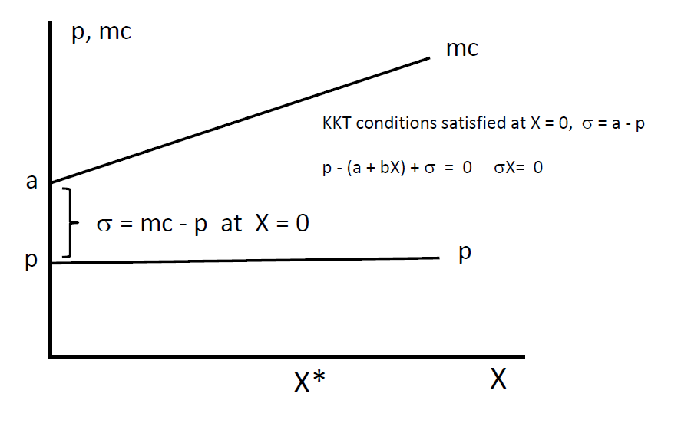
Mixed-complementarity Problem (MCP)
Square system of equations with complementarity conditions instead of optimization
Max profit (Revenue – Cost) equivalent to FOC: P = MC
If P = MC then produce positive Q otherwise not (complementarity)
Natural interpretation as a condition for arbitrage-free e*
+ Allows for corner solution + non-zero values
Two-stage process:
1. Moving away from objective function (production/utility)
to value functions (e.g. cost/expenditure)
2. Going from value functions to optimal choices
i.e demand for goods/factors

Slide 23
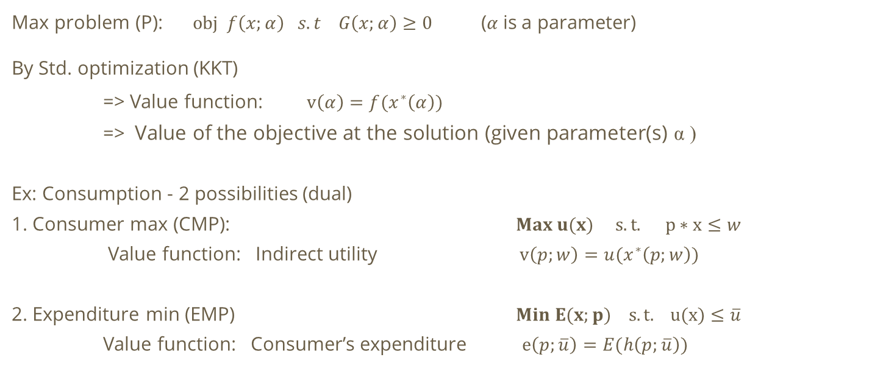
MCP stage 1
Max problem (P): $obj f\left(x;α\right) s.t G\left(x;α\right)≥0$ (𝛼 is a parameter)
By Std. optimization (KKT)
=> Value function: $v\left(α\right)=f(x^{∗}\left(α\right))$
=> Value of the objective at the solution (given parameter(s) α )
Ex: Consumption - 2 possibilities (dual)
1. Consumer max (CMP): $Max u(x) s.t. p∗x≤w$
Value function: Indirect utility $v\left(p;w\right)=u(x^{∗}\left(p;w\right))$
2. Expenditure min (EMP) $Min E(x;p) s.t. u(x)≤\overline{u}$
Value function: Consumer’s expenditure $e\left(p;\overline{u}\right)=E(h\left(p;\overline{u}\right))$
Notes:
Moving away from objective function to value functions
Maximize f subject to some function G also depending on our decision variable and parameter (G could be multidimensional).
the value function gives the value of the objective function as a function of the parameters
The solution function gives the solution x as a function of the parameters;

Slide 24

MCP stage 2 – Aka. Knowing your Lemmas
Minimization (cost/expenditure) => Shepard’s lemma
Maximization (Utility/Profit) => Roy’s identity / Hotelling lemma
The partial derivatives of the value functions give us
Minimization
Cost: Conditional demand for input given output level
Expenditure: Hicksean (compensated) demand.
Conditional D for goods given utility level
Maximization
Profit: Optimal supply of output (given input price), demand for input (given output)
Utility: Marshalian (uncompensated) demand. D given income level

