Slide 1
Ozone pollution reduction partially offsets the negative impact of climate mitigation on global hunger
The 29th Annual Conference on Global Economic Analysis
Shujuan Xia
Atmosphere and Ocean Research Institute, The University of Tokyo

Slide 2
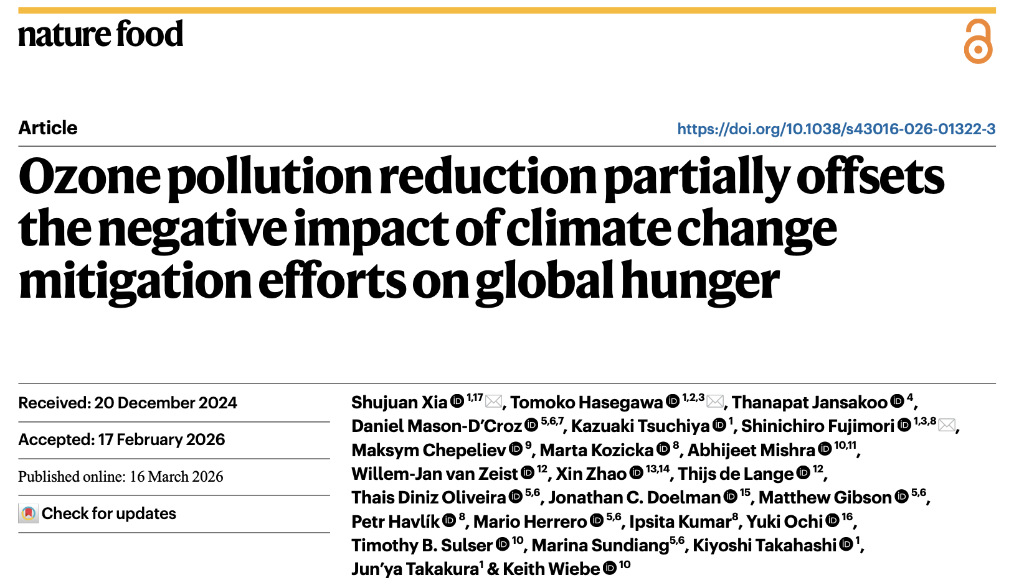

Slide 3
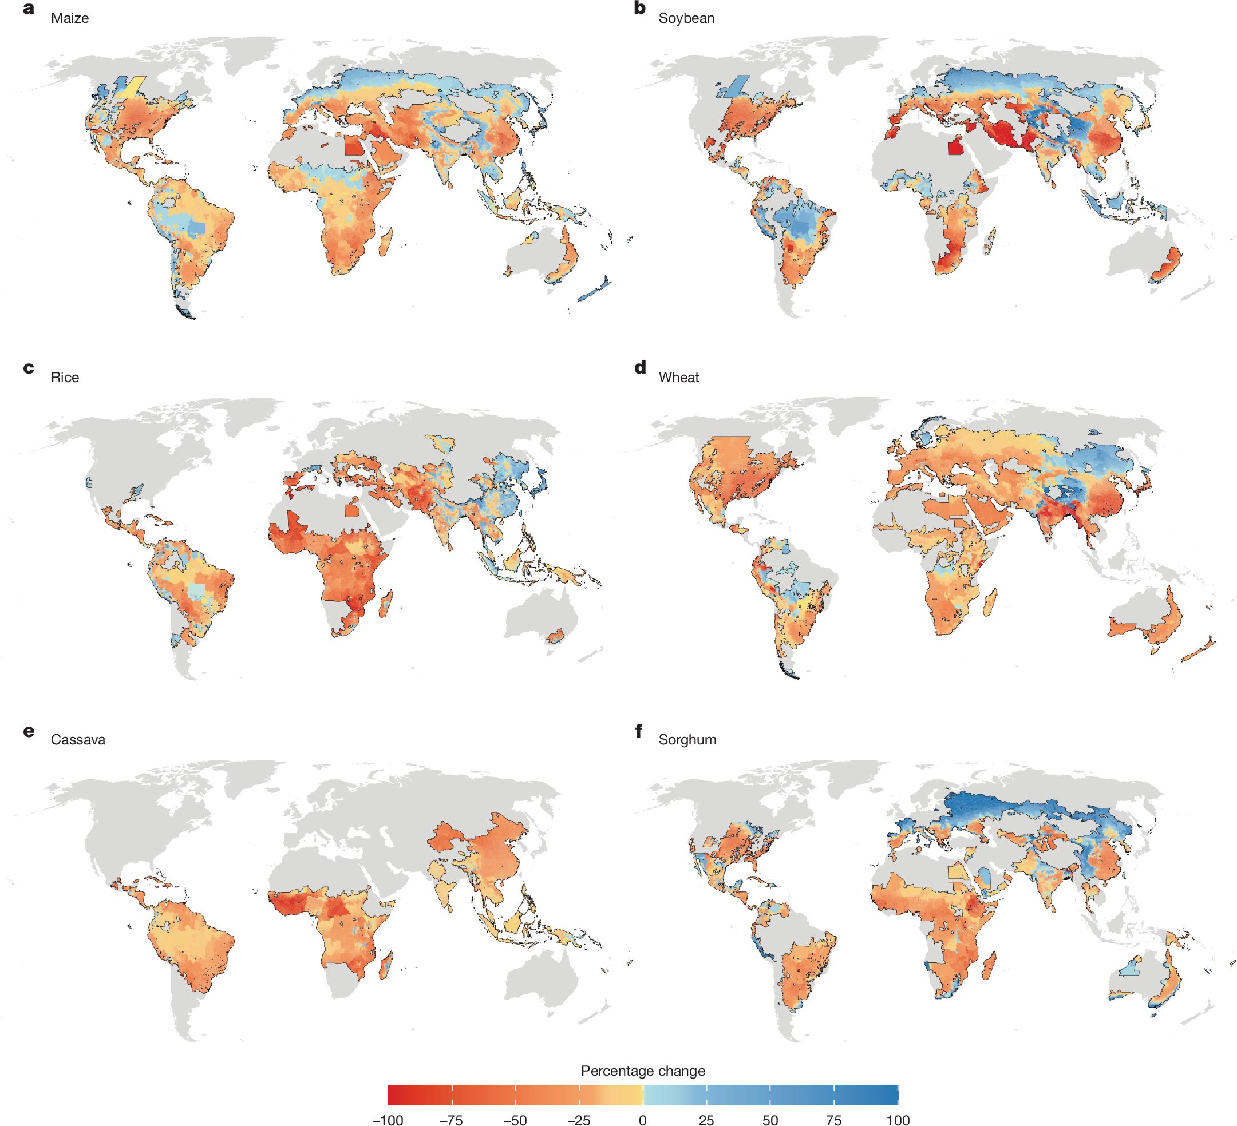
Projected end-of-century change in crop yields
accounting for adaptation
Hultgren et al., 2025. Nature
Climate scenario：SSP8.5

Slide 4
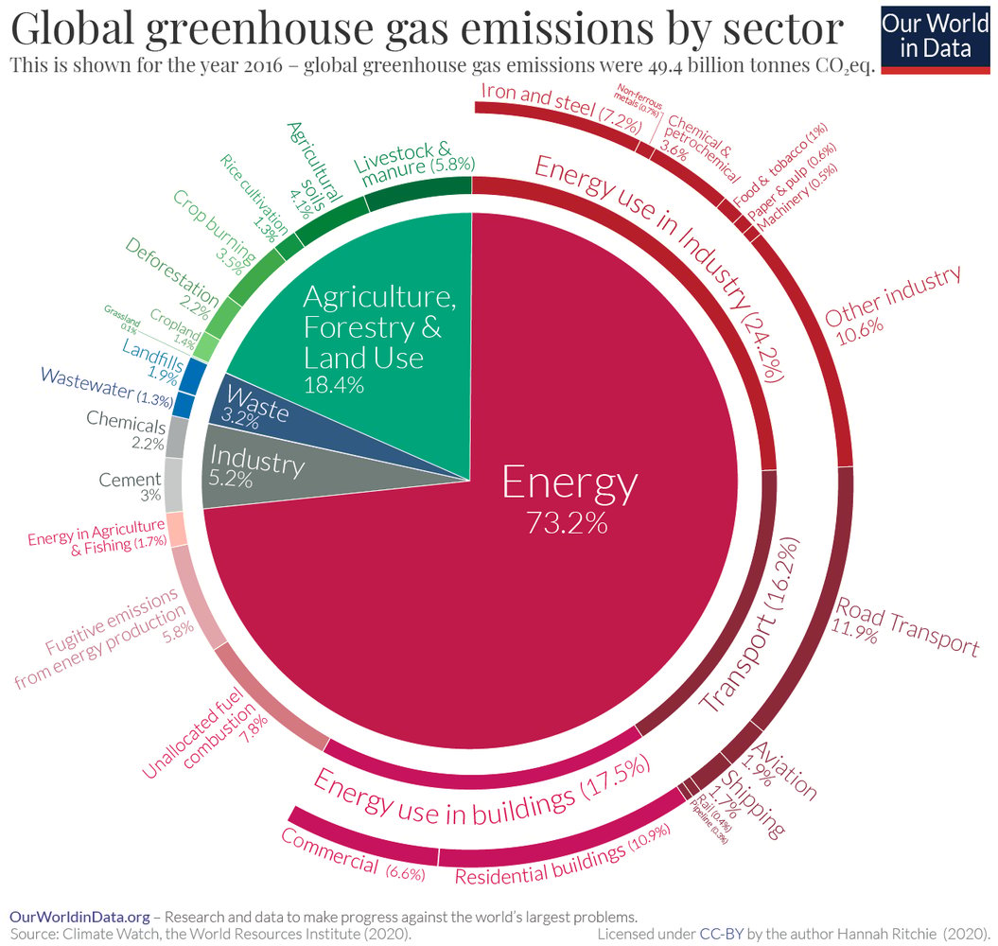
Climate change mitigation strategies
Energy-sector mitigation
Expansion of renewable energy
Promotion of electrification and energy-saving measures
Agriculture, forestry & land-use mitigation
Reduction of agricultural CH₄ and N₂O emissions
Afforestation and reforestation
Production of bioenergy crops
Land competition with
food production
Hasegawa et al., 2015

Slide 5
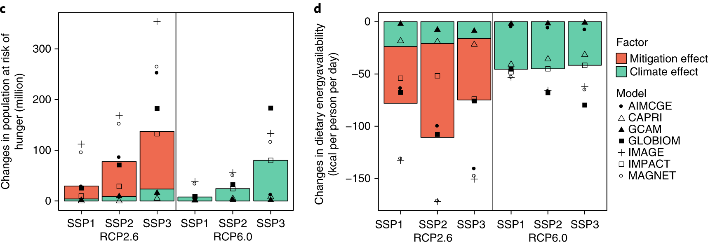
Land-use competition and rising hunger
Change in hunger risk (2050)
Change in food availability (2050)
Million people
kcal/capita/day
RCP2.6: 2℃ climate target scenario
RCP6.0: high emission scenario
SSP： Socioeconomic scenario
Hasegawa et al., 2018
Climate change mitigation effect：
Warming effect↓→Limit food supply reductions→Hunger risk↓
Land-use competition↑→Price↑→Food availability↓→Hunger risk↑

Slide 6
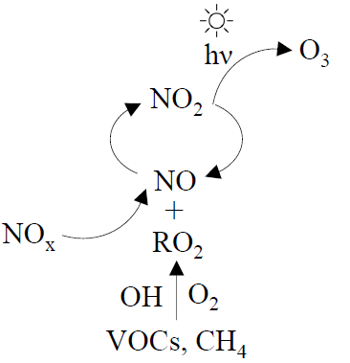
Mitigation-induced surface ozone reductions
Warming scenario without emission reductions
Formation of
surface ozone
With GHG emission reductions
  Emission
Climate change mitigation reduces air pollutants and lowers surface ozone concentrations.
Notes:
地表面オゾンとは、地表付近の大気中に存在するオゾンであり、NOxやVOCs、CH₄などの前駆物質が太陽光のもとで光化学反応を起こすことによって生成される二次汚染物質である。

Slide 7
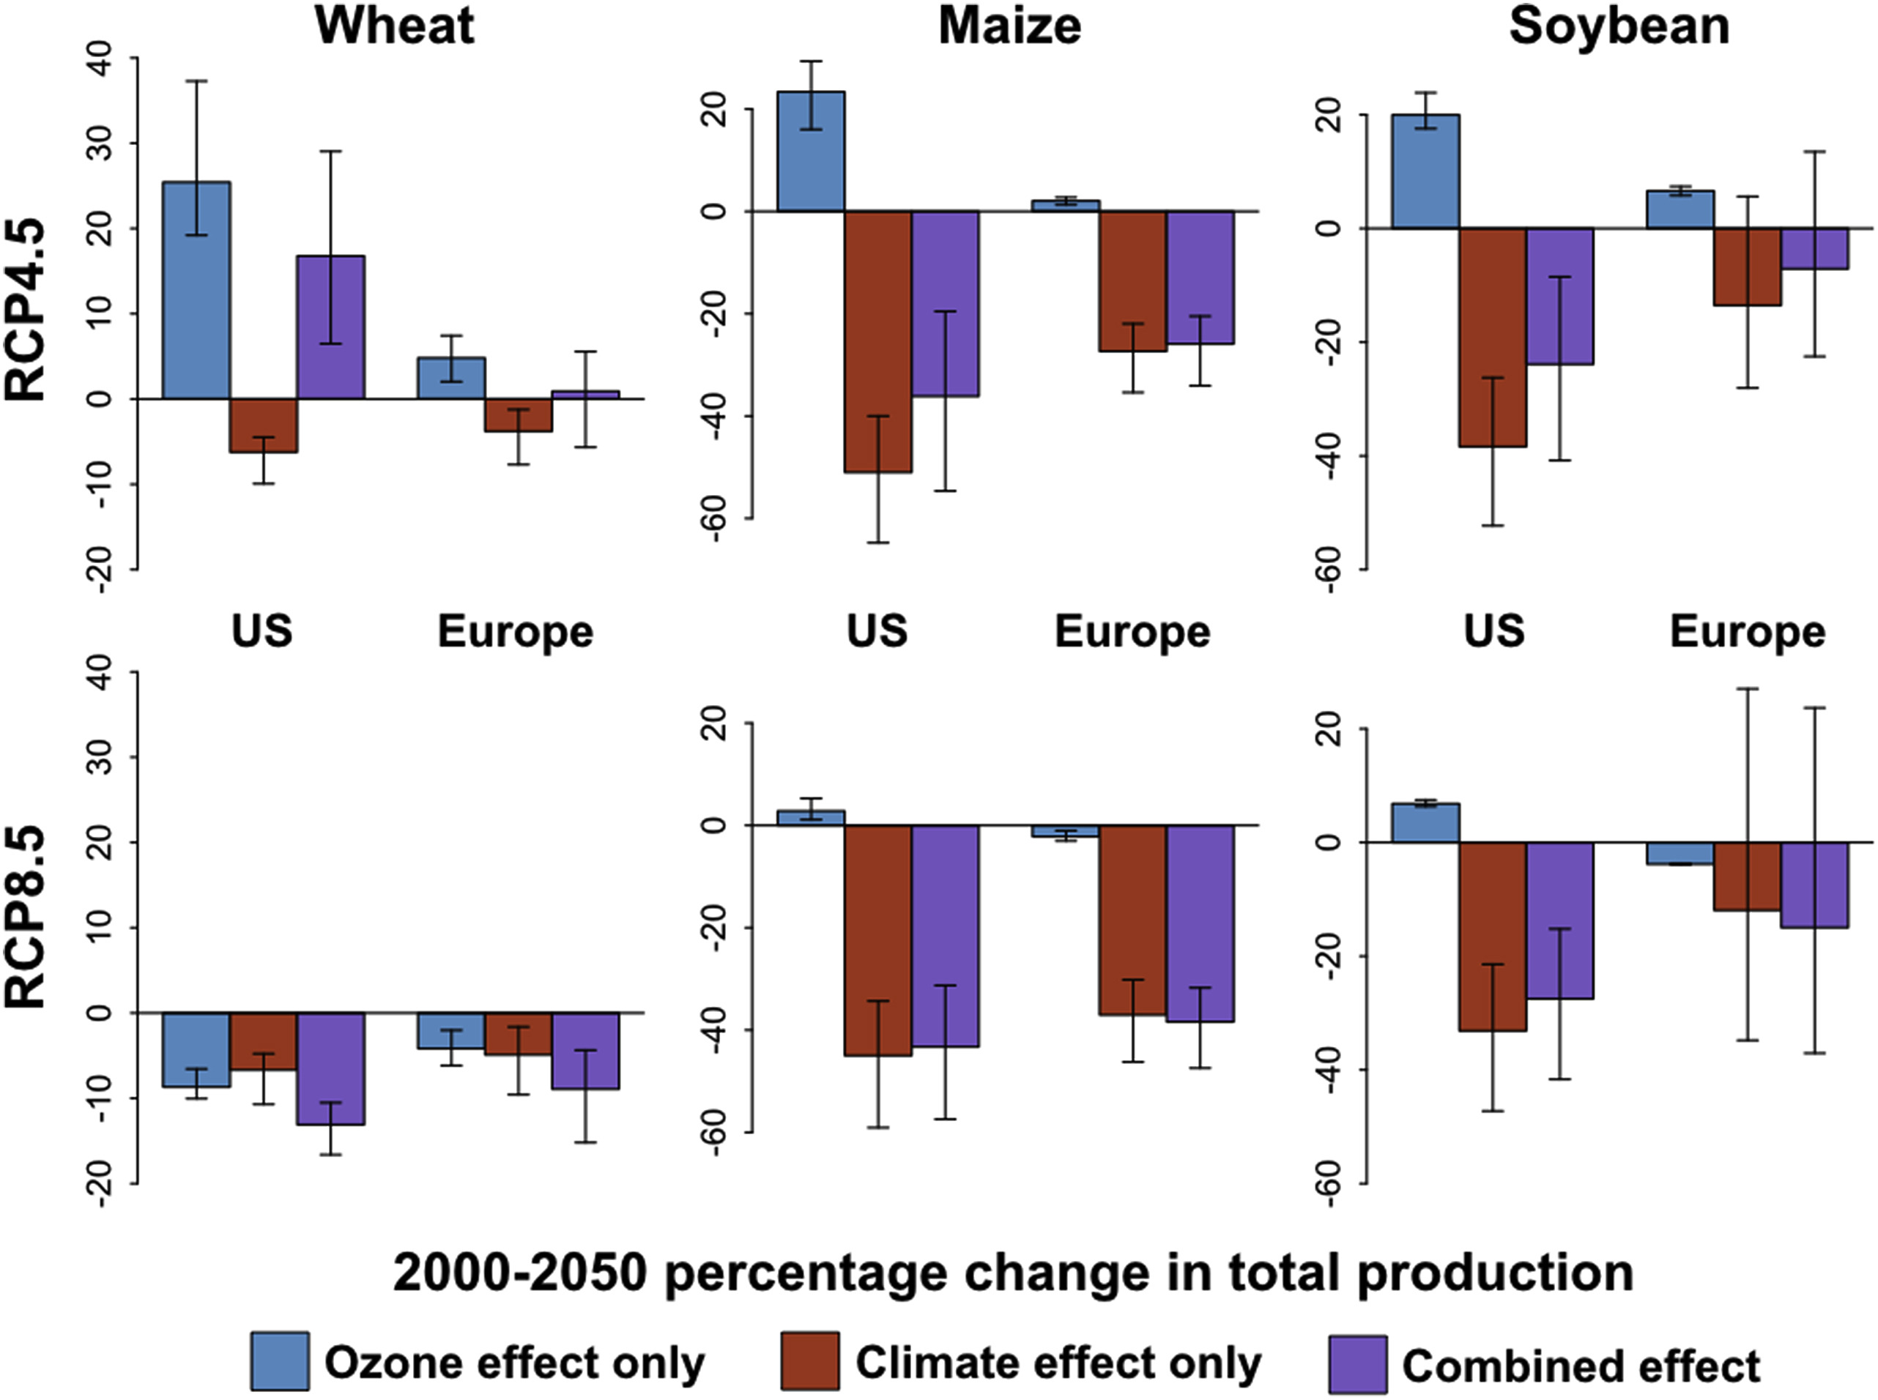
Crop production gains from ozone reductions
Tai et al., 2017
Not assessed in previous IAM-based projection studies
Can it offset the negative impacts of mitigation measures?

Slide 8
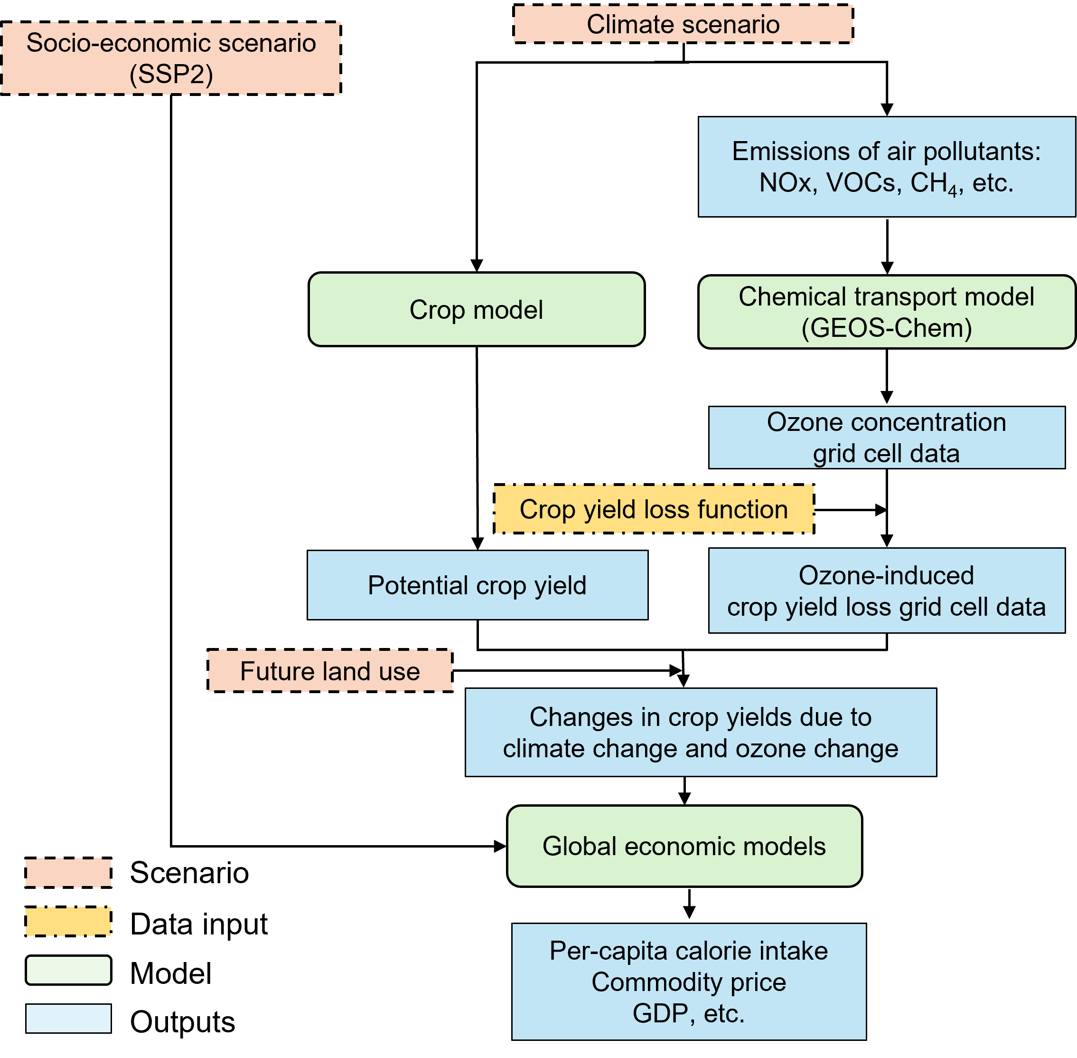
Research framework
Baseline scenario：
No climate change and
no climate change mitigation
Difference
Climate change scenario RCP7.0：
Climate change effect
Ozone change effect
1.5℃ climate target scenario：
Climate change effect
Ozone change effect
Mitigation effect

Slide 9
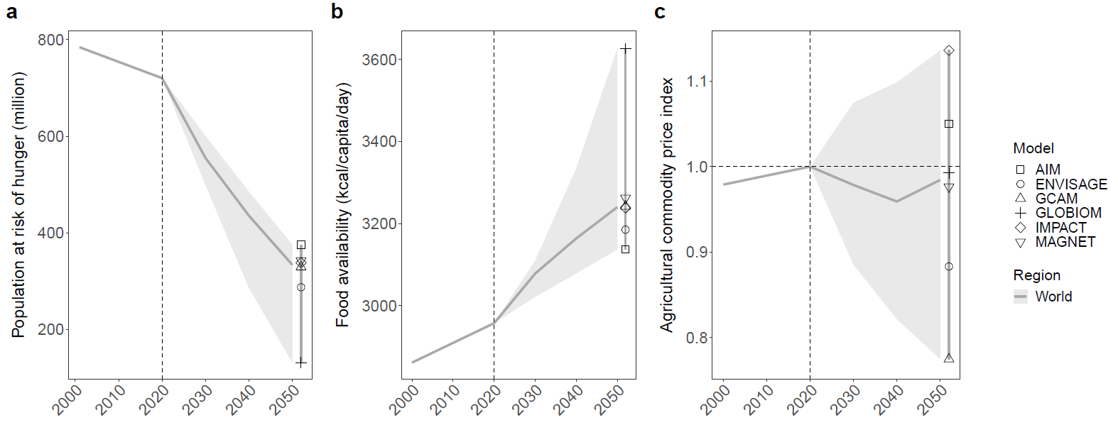
Results: Baseline scenario projections for 2050
Income growth and increased food supply in reduce global hunger risk, with the decline continuing through 2050.
By 2050, the hunger-risk population decreases to about 334 million people, equivalent to 4% of the global population.

Slide 10
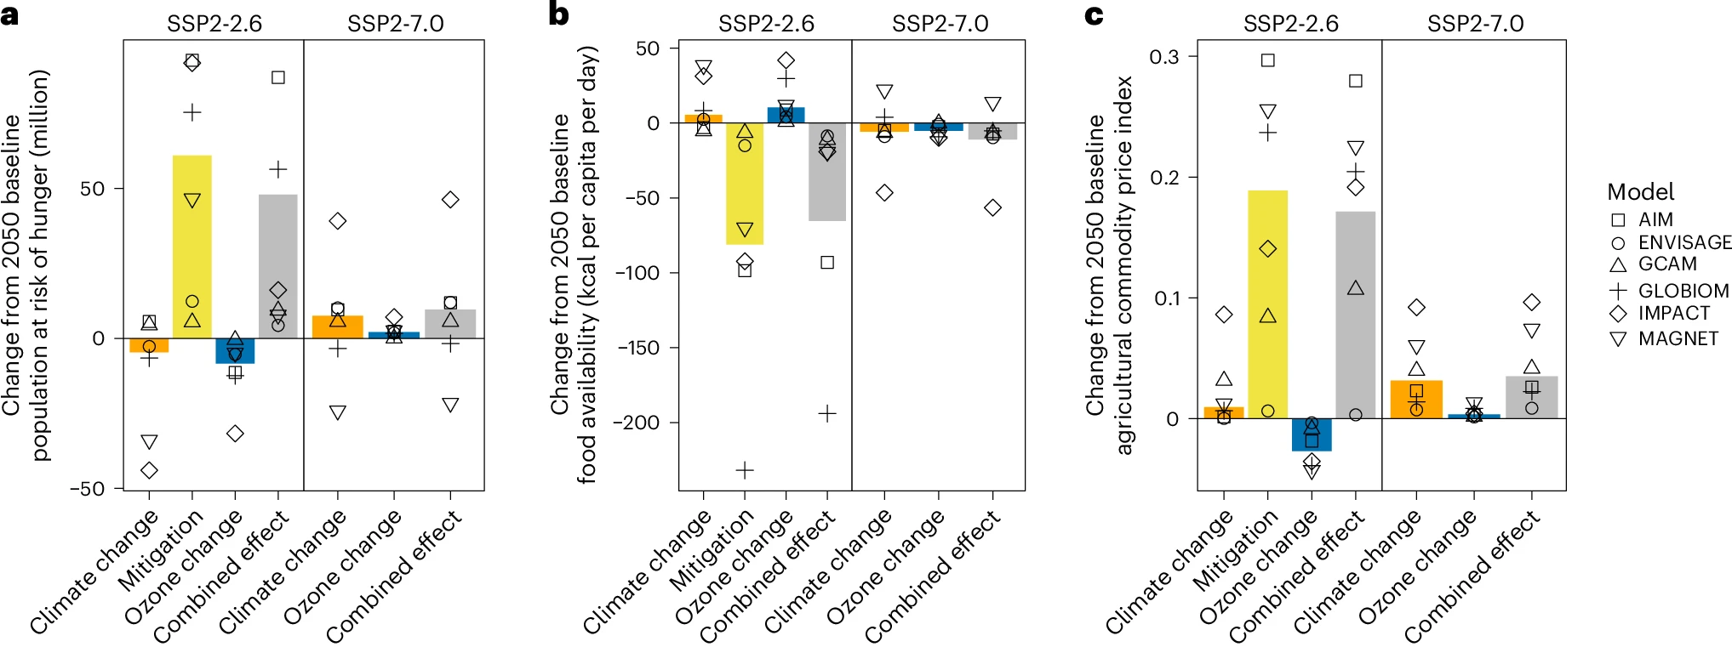
Results: changes relative to the 2050 baseline scenario
Mitigation-induced price increases reduce food supply and increase the hunger-risk population by about 17% (56 million people) in 2050.
Crop yield gains from ozone reductions decrease the hunger-risk population by 8.4 million people, offsetting 15% of the mitigation-induced increase.

Slide 11
Summary
Not assessed in previous IAM-based projection studies
Can it offset the negative impacts of mitigation measures?
Benefits from ozone reductions partially offset the adverse impacts of mitigation.
The results support previous findings that mitigation measures may reduce food supply and increase hunger risk.
Food security impacts should be considered from the policy design stage when advancing future climate mitigation.
Agricultural productivity improvements, efficient land use, food loss reduction, and dietary shifts could help reduce adverse food security impacts.

Slide 12



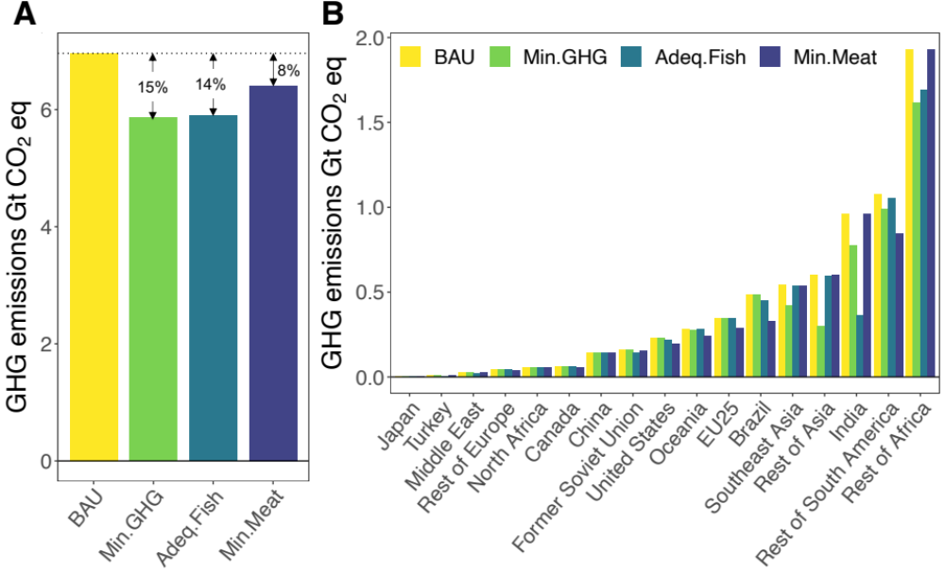
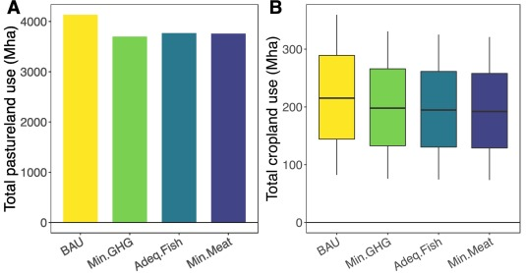
Example: Dietary shifts can reduce environmental pressure
Replace ruminant meat with small pelagic fish
10% replacement of global ruminant meat by small pelagic fish by 2050.
→ Up to 15% reduction in ruminant-related GHG emissions.
→ Up to 10% reduction in ruminant-related land use.
Xia et al., (2023)

