Slide 1


29th Annual Conference
on Global Economic Analysis
Impacts of Different Spatial Resolution
on Land-Use Downscaling
Shurui ZHAO
Tomoko HASEGAWA, Shinichiro FUJIMORI, Koga YAMAZAKI *, Ryo TOTAKE
*Kyoto University, Japan (Presenter)

Slide 2
Background: Mitigation measures in the AFOLU sector
The IPCC-SRCCL states that in around 2015, 12% of land area excluding ice was cropland, 37% was grazing land, 22% was managed forest, and 28% was unutilized land.
A previous study (IPCC-AR6 Chapter 7) estimated that greenhouse gas emissions from agriculture, forestry, and other land use (AFOLU) accounted for 13-21% of total anthropogenic GHG emissions between 2010 and 2019 (Nabuurs et al. 2020).
Future land use changes (Popp et al. 2017)
Future land use changes for each SSP were estimated by comparing five integrated assessment models (IAMs).
As a result, it was shown that by 2100, global agricultural land area will decrease by 15% compared to 2005 under SSP1 and increase by 22% under SSP3.

Slide 3
Background: Land use allocation model coupled with IAM
IAM
Estimate future human socio-economic activities.
We would like to input land use and gas emissions estimated by IAM into ESM !!
However, due to differences in resolution between the two model types, we are unable to do so directly.
Land Use
(Gas Emissions)
ESM
Simulate physical and chemical phenomena on Earth

Slide 4
Background: Land use allocation model coupled with IAM
We would like to input land use and gas emissions estimated by IAM into ESM !!
IAM
☆Resolution: Regions
However, due to differences in resolution between the two model types, we are unable to do so directly.
Regional Land Use
(Gas Emissions)
ESM
☆Resolution: Grid

Slide 5
Background: Land use allocation model coupled with IAM
IAM
☆Resolution: Regions
We would like to input land use and gas emissions estimated by IAM into ESM !!
However, due to differences in resolution between the two model types, we are unable to do so directly.
Regional Land Use
Land Use Allocation Model
Downscaling regional land use to grid level
Gridded land use
The land use allocation model can provide grid-based land use to the ESM with the coupling of IAM.
ESM
☆Resolution: Grid

Slide 6
Background: Land use allocation model coupled with IAM
IAM
☆Resolution: Regions
We would like to input land use and gas emissions estimated by IAM into ESM !!
However, due to differences in resolution between the two model types, we are unable to do so directly.
Regional Land Use
The land use allocation model can provide grid-based land use to the ESM with the coupling of IAM.
Land Use Allocation Model
Downscaling regional land use to grid level
Gridded land use
The impact of differences in the spatial resolution of the input IAM outputs on the land-use distribution following downscaling has not yet been fully clarified.
ESM
☆Resolution: Grid

Slide 7
The Purpose of This Study
The Purpose of This Study
This study examines the impact of differences in the spatial resolution of inputs to land-use allocation models on land-use downscaling results.
This study aims to clarify the effects of changes in the spatial resolution of the input data on the following
Degree of Agreement Between Model Estimates and Actual Values
Patterns in Land Use Projection Distributions
Environmental Impact Assessment

Slide 8
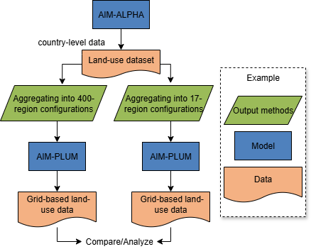
Method: Overview of the Study
Basin Mode
Region Mode
AIM-ALPHA: A partial equilibrium model of agricultural markets and Land Use
AIM-PLUM: Land Use Allocation Model
PREDICTS: Biodiversity Model
Projection period: 2005–2100
Region: Worldwide
Socioeconomic Scenarios: SSP2,
Moderate socioeconomic scenario, does not assume additional policies by individual countries or take climate change into account
Figure: Overview of the study

Slide 9
Method: Models -AIM-
The Agricultural Market and Land Use Partial Equilibrium Model
(AIM-ALPHA, Totake et al. 2025)
A sequential dynamic partial equilibrium model with one-year time steps
The model includes 166 countries and regions on the demand side and 400 production units on the supply side
Food production is classified into 13 types of primary crops, 6 types of livestock products, and 3 types of processed goods
Global Land Use Allocation Model (AIM-PLUM, Hasegawa et al. 2016)
Based on profit maximization, this model takes land conversion costs into account.
It allocates land use across a grid, considering crop types and biological-physical productivity.
Constraints are set on the proportion of each land use type.

Slide 10
Method: Image of Downscaling – Region and Basin mode-
Region Mode
100
 |  | 200
Aggregated
into 17 regions
20 |  | 30 | 35
10 |  | 5
40 |  | 20 | 50
 |  | 5
 |  | 20 | 55
 |  | 10
20 |  | 30 | 35
10 |  | 5
40 |  | 20 | 50
 |  | 5
 |  | 20 | 55
 |  | 10
AIM-Alpha Output
Land-Use by each basin
Basin Mode

Slide 11
Method: Image of Downscaling – Region and Basin mode-
Region Mode
100
 |  | 200
5 | 5 | 5 | 5 | 5
5 | 5 | 5 | 5 | 5
10 | 10 | 10 | 10 | 10
 |  | 15 | 15 | 20
 |  | 15 | 15 | 20
 |  | 15 | 15 | 20
100
20 |  | 30 | 35
10 |  | 5
40 |  | 20 | 50
 |  | 5
 |  | 20 | 55
 |  | 10
Downscaled to a 0.5x0.5 grid using AIM-PLUM
200
AIM-PLUM Input
3 | 7 | 4 | 2 | 9
1 | 10 | 4 | 3 | 7
13 | 7 | 10 | 10 | 14
 |  | 11 | 17 | 22
 |  | 14 | 13 | 10
 |  | 16 | 17 | 30
100
20 |  | 30 | 35
10 |  | 5
40 |  | 20 | 50
 |  | 5
 |  | 20 | 55
 |  | 10
AIM-Alpha Output
200
Basin Mode

Slide 12
Method: Models -PREDICTS-
PREDICTS (Projecting Responses of Ecological Diversity In Changing Terrestrial Systems)
​A modeling framework for analyzing the impacts of land-use change and related factors on biodiversity
Develop a Total Abundance model for species abundance and a Compositional Similarity model for species composition, and calculate the Biodiversity Index (BII)

Slide 13
Method: Evaluation Indicators –Kappa Coefficient-
Kappa Coefficient (Cohen’s Kappa Coefficient, Cohen et al. 1960)
The Kappa coefficient is a measure used to evaluate the degree of agreement between two matrices of categorical data, such as land use classifications, after adjusting for chance agreement.
Its values range from −1 to 1, with values closer to 1 indicating a higher degree of agreement.
In this study, the Kappa coefficient was used to measure the degree of agreement between estimated and actual land use values.

Slide 14
Method: Evaluation Indicators –Global Moran’s I-
Global Moran’s I (Moran et al. 1950)
This is a spatial autocorrelation index used to quantify the degree of similarity in values between adjacent locations in spatial data.
A positive value indicates that similar values are spatially clustered, while a negative value indicates a dispersed distribution.
0.5 | 0.5 | 0.5 | 0.5 | 0.5
0.5 | 0.8 | 0.8 | 0.8 | 0.5
0.5 | 0.8 | 1.0 | 0.8 | 0.5
0.5 | 0.8 | 0.8 | 0.8 | 0.5
0.5 | 0.5 | 0.5 | 0.5 | 0.5
←High spatial autocorrelation
(Concentrated)
1 | 0 | 1 | 0 | 1
0 | 1 | 0 | 1 | 0
1 | 0 | 1 | 0 | 1
0 | 1 | 0 | 1 | 0
1 | 0 | 1 | 0 | 1
Low spatial autocorrelation
(High and low values alternate in distribution) →
Moran’s I is close to 1
Moran’s I is close to -1

Slide 15
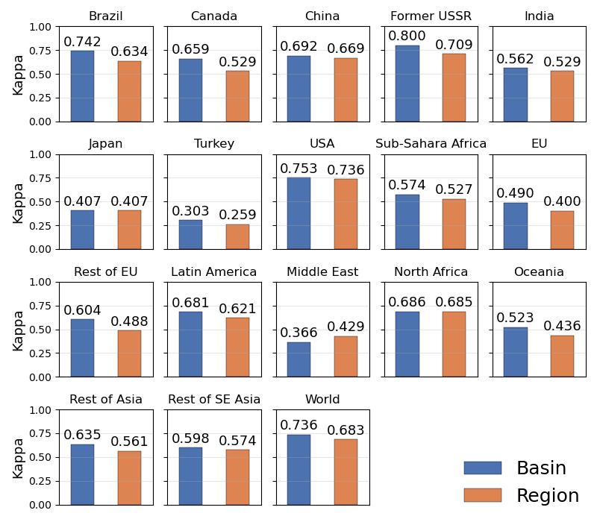
Results: Degree of Agreement with the Base Year
Figure: Kappa coefficient relative to the base year

Slide 16
Results: Degree of Agreement with the Base Year
Since it has only one basin, both outputs are the same
Figure: Kappa coefficient relative to the base year

Slide 17
Results: Degree of Agreement with the Base Year
Overall, the downscaled results from Basin mode show spatial patterns that closely match the observed data for the base year.
Figure: Kappa coefficient relative to the base year

Slide 18
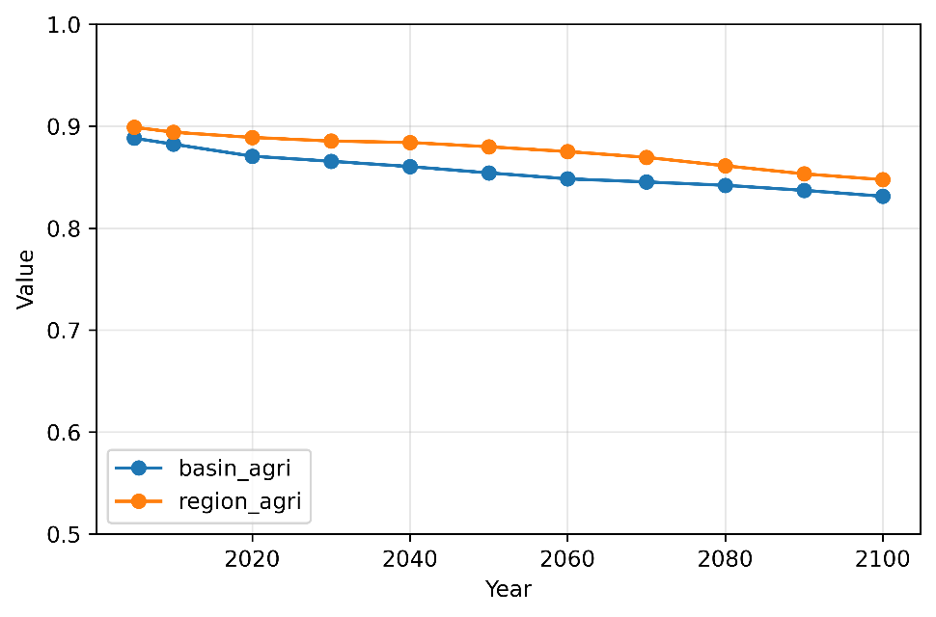
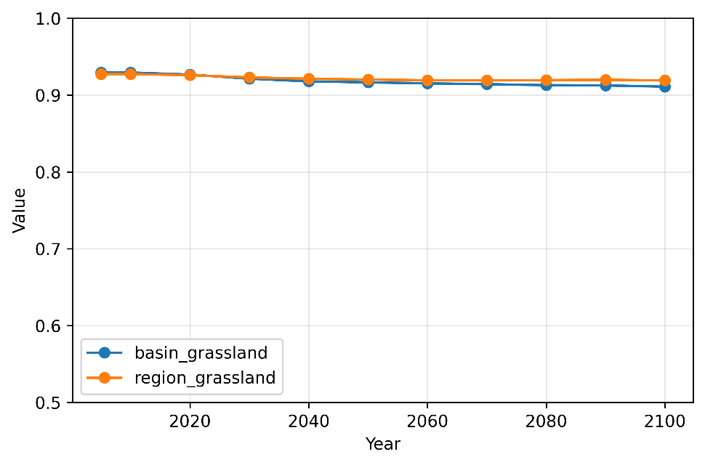
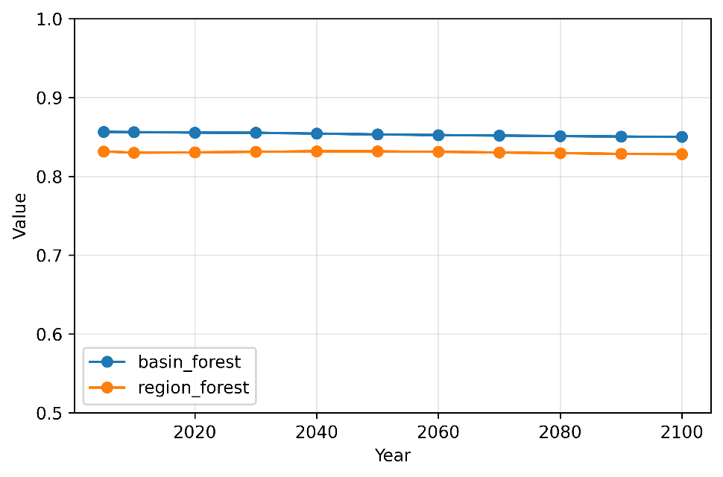
Result: Global Moran’s I values for both modes (world)
Crop Land
Grass Land
With regard to cultivated land, future distributions tend to be more dispersed. Distributions in Basin mode are more dispersed than those in Region mode.
Forest
Figure: Changes in Global Moran’s I for cropland, pasture, and forest

Slide 19
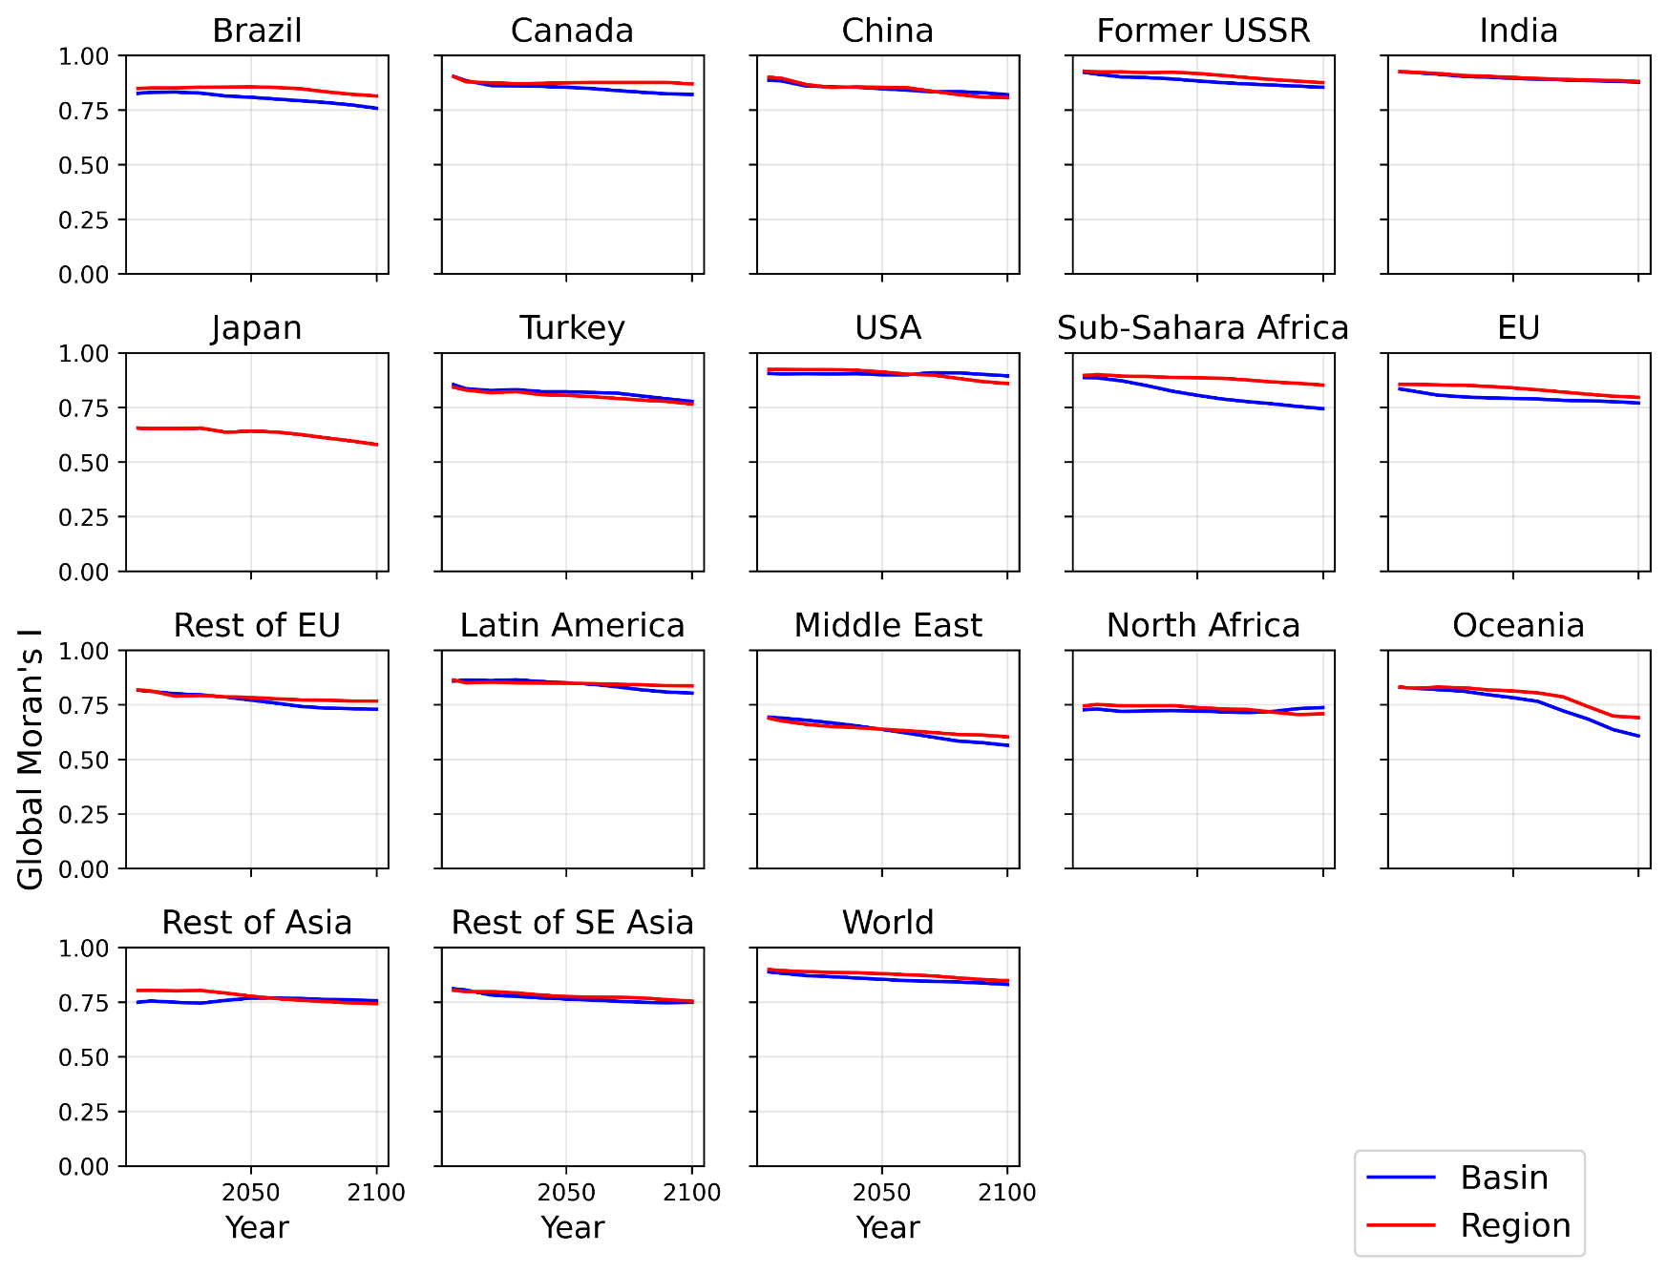
Result: Global Moran’s I values for both modes (by region; Crop Land)
In many regions, the distribution of the Basin mode tends to be more dispersed than that of the Region mode in the future.
Figure: : Global Moran’s I value changes in cropland

Slide 20
Result: Global Moran’s I values for both modes (by region; Crop Land)
Region Mode
Spatial variations are averaged to estimate land use at a broad regional scale
Distribution becomes concentrated
Basin Mode
Spatial variations are preserved to estimate land use at the basin level
Distribution becomes dispersed
Figure: : Global Moran’s I value changes in cropland

Slide 21
Result: Impact on the Environmental Impact Assessment
2005
Region
Basin
2100
Region
Basin
Figure: Estimated BII under both modes

Slide 22
Result: Impact on the Environmental Impact Assessment
2005
2100
Figure: The difference in BII between modes

Slide 23
Result: Impact on the Environmental Impact Assessment
2005
2100
Figure: The difference in BII between modes
The gap between Mode A and Mode BII is expected to widen in the future
The results show that the difference reaches up to 4% in the year 2100, indicating that the spatial resolution of the input land use data affects both the downscaling and the BII.

Slide 24
Conclusion
By increasing the spatial resolution of the input data, the model’s land-use downscaling results were closer to the actual values for the base year.
Because the constraints on data downscaling were reduced, the Basin mode can directly incorporate information such as trade and domestic demand estimated by upstream models. As a result, the distribution of land use estimates tended to be more dispersed compared to the Region mode.
Differences in the spatial resolution of the input land use estimates affect the results of the subsequent environmental impact assessment.

Slide 25
Thank You for Your Attention
Koga YAMAZAKI
Kyoto University, Japan
Email: yamazaki.kouga.78s@st.Kyoto-u.ac.jp

Slide 26
References

Slide 27
Background: Importance of Estimating Land Use Change
The Role of Land Use
Land makes a major contribution to human well-being by supporting food production, freshwater supply, and ecosystem functions.
Land use sector accounts for approximately 13–21% of global anthropogenic greenhouse gas emissions.
Estimating Land-Use Change
Population growth and rising food demand are increasing pressure on land, including agricultural expansion and land-use conversion.
To achieve sustainable land use, it is important to quantitatively assess how climate policies and socioeconomic changes affect land use [2].

