Slide 1

Policy options to face trade and climate impacts in Mexico: The case of maize*
Marcos Esau Dominguez Viera¹, Michiel van Dijk¹, Willem-Jan van Zeist¹, Daniel Mason-D'Croz²
¹Wageningen Social & Economic Research, ²Cornell University
GTAP Conference. Kyoto, Japan, 15 June 2026
*This work was supported by the Wellcome Trust [310024/Z/24/Z]. See https://wellcome.org/

Slide 2
1. Setting the scene
Maize’s self-sufficiency, productivity and costs

Slide 3
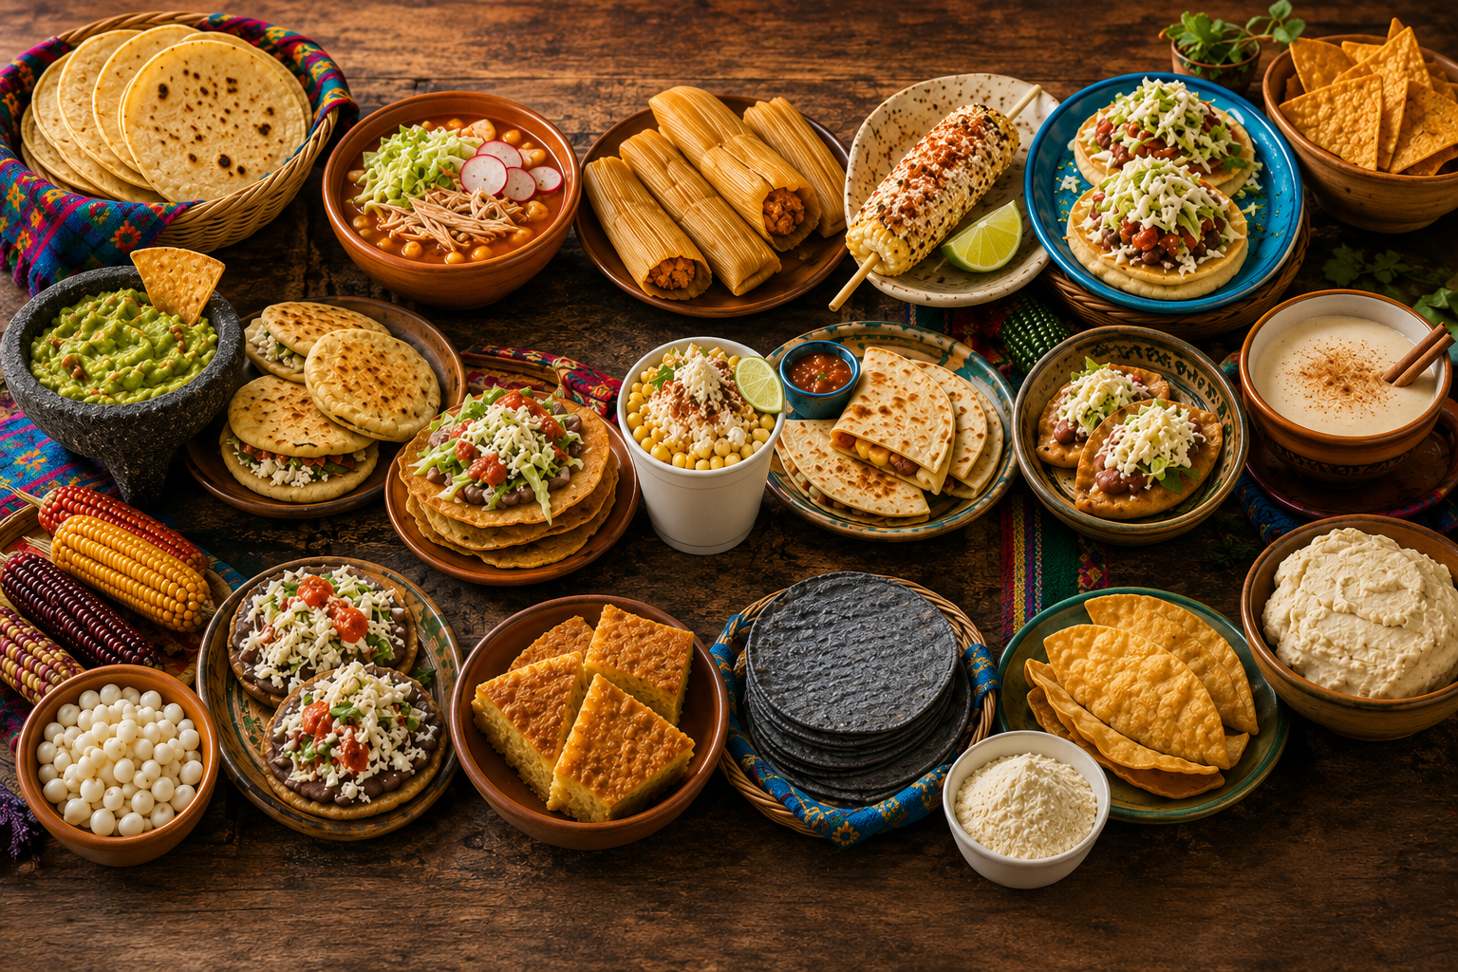
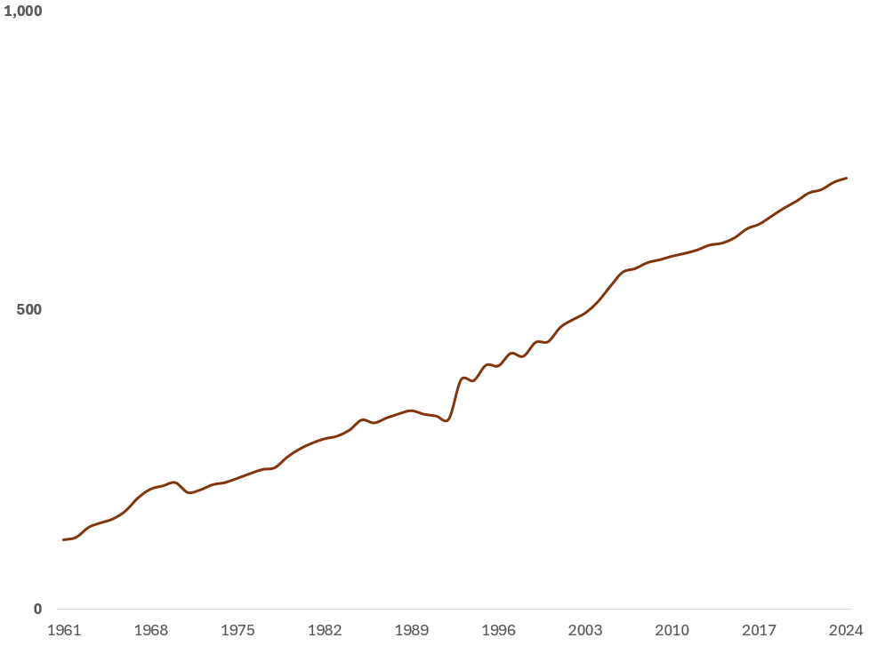
Maize in the Mexican food system
The Backbone of the Mexican Cusine
Feed for livestock
(Million live animals)
Source: Created with ChatGPT.
Source: FAOSTAT.

Slide 4
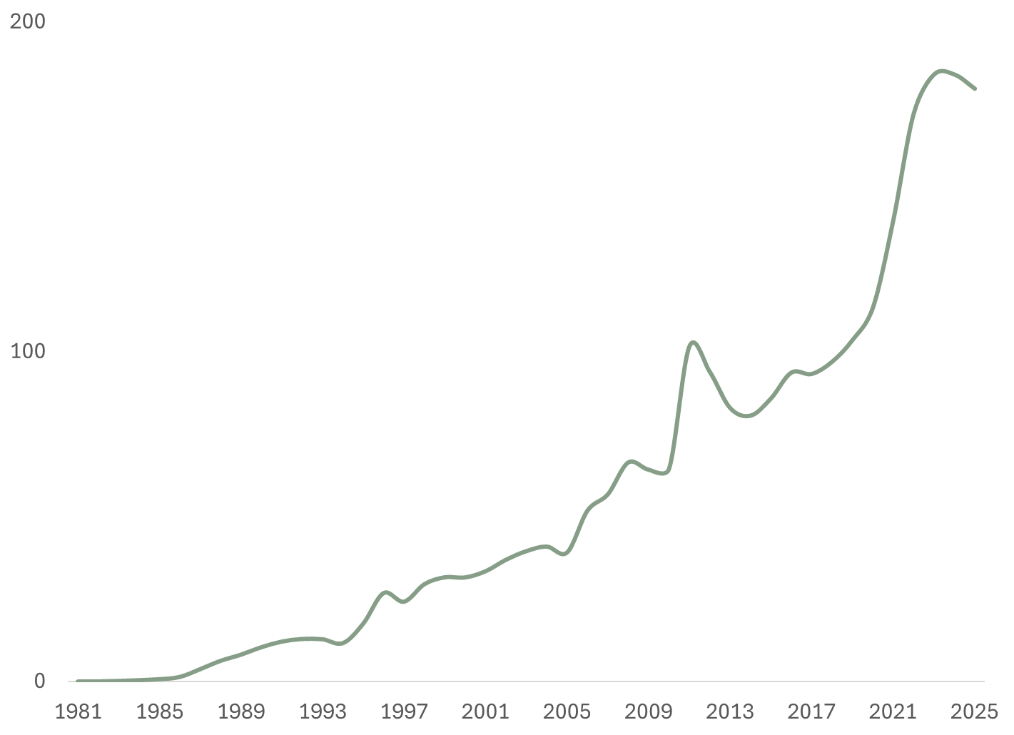
Maize: rising prices in Mexico challenge food affordability
Maize producer prices
(Index 2019=100)
Source: INEGI, Mexico.

Slide 5
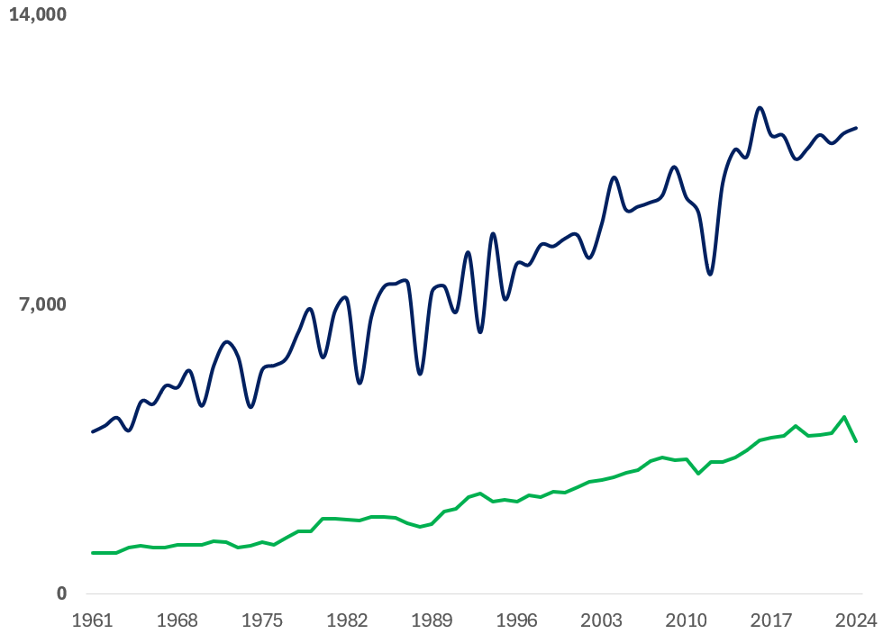
Maize: productivity gap vs U.S. expands
Maize yield
(Kg/Ha)
U.S.
3x
Mexico
Source: FAOSTAT.

Slide 6
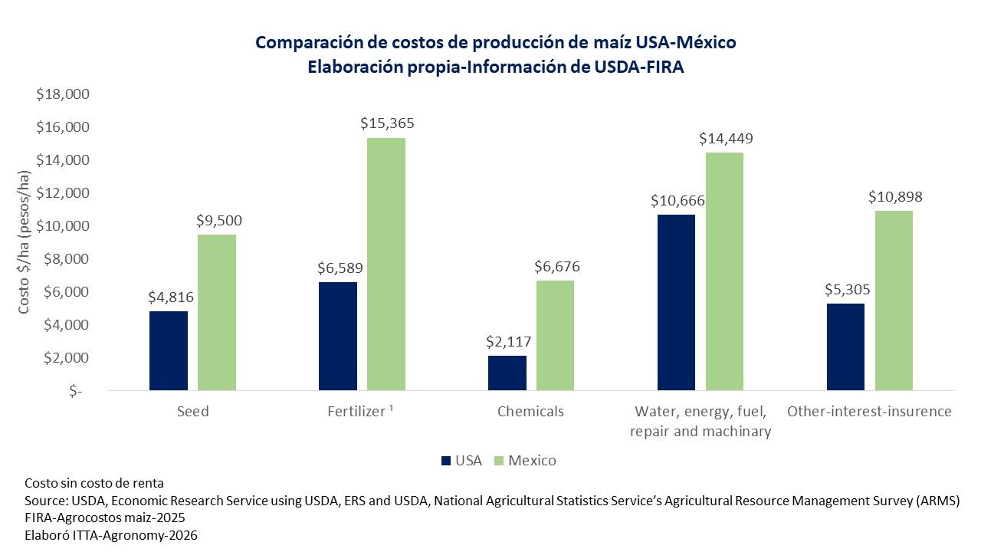
Maize: (2x) higher production costs in Mexico vs U.S.
Maize production costs, 2026
(MXN pesos/ha)

Slide 7
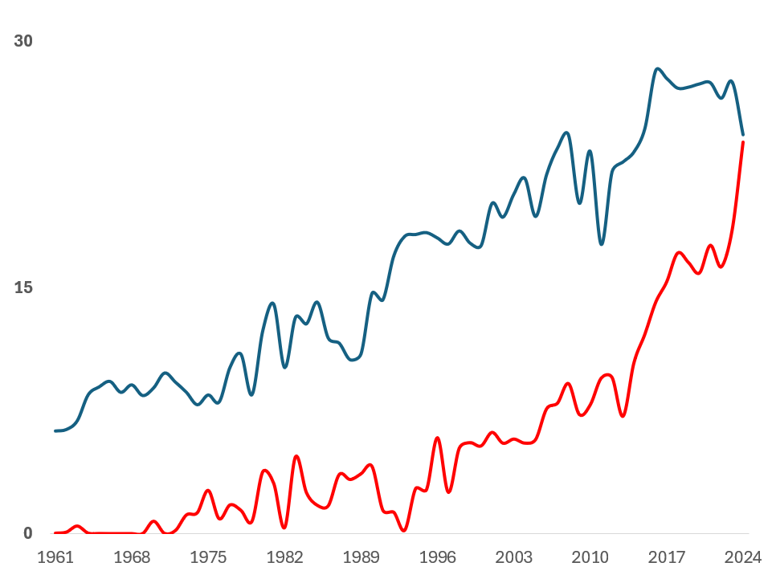
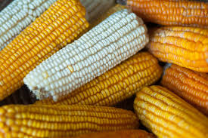
Maize: Imports catching up with production in Mexico
Maize production & imports
(Million tonnes)
Production
A hotter climate begins*
Imports
NAFTA
Source: FAOSTAT.
*Temperature change 0-1 degree Celsius almost every year with respect to average 1961-2010

Slide 8
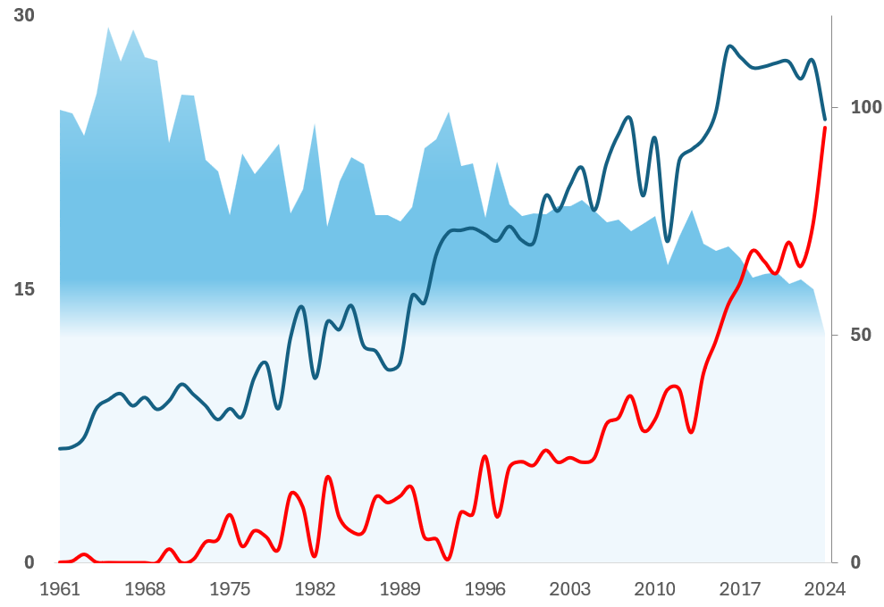
Maize: self-sufficiency down to 50%
Maize production & imports
(Million tonnes)
SSR(%)
Production
Self-sufficiency ratio (SSR)
Imports
Source: FAOSTAT.

Slide 9
2. Exploration of trade and climate scenarios towards 2050
Application with MAGNET model

Slide 10
Modelling features
MAGNET: GTAP-based model with multiple modifications (e.g., bioeconomy, consumption functions, sector splits).
Paper-specifics:
  Maize and Beans splitted out of Other grains and Pulses, respectively.
  Database 11C. Base year 2017 with 2023 uptades for sugar taxes and key changes from NAFTA to T-MEC.

Slide 11
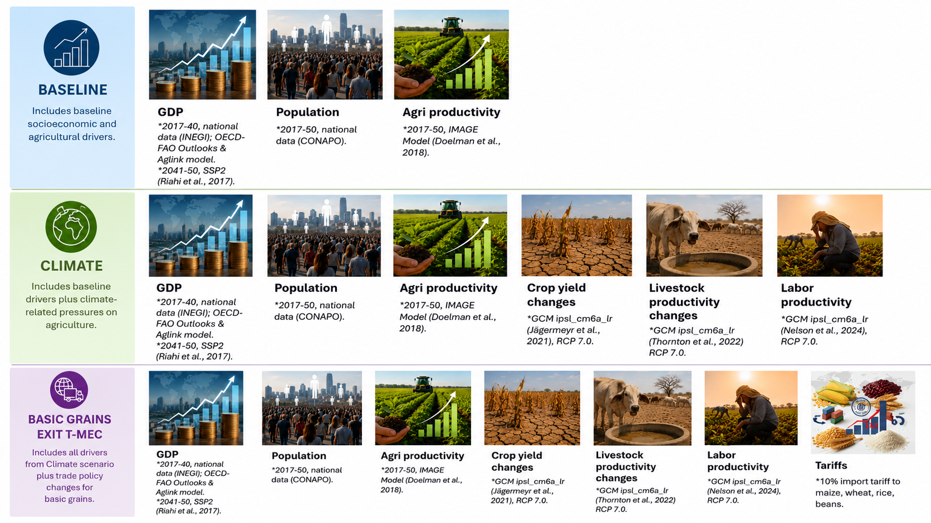
Scenarios 2017-2050

Slide 12
Scenarios 2017-2050

Slide 13
Scenarios 2017-2050

Slide 14
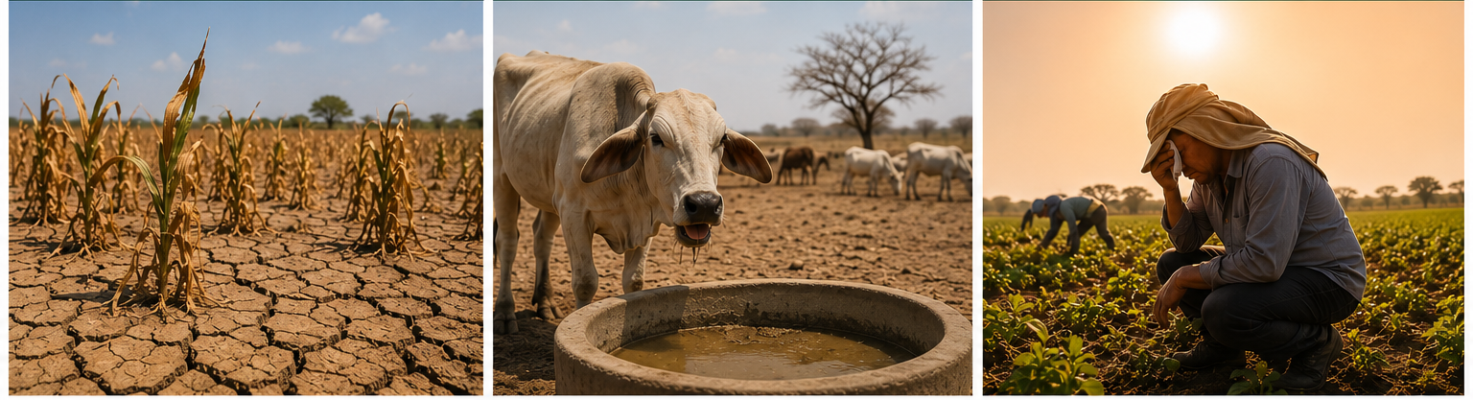
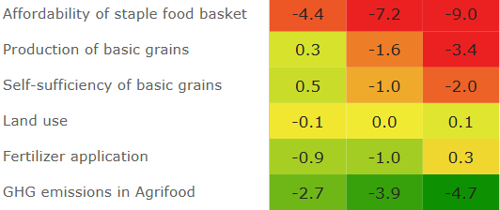
Climate
Negative impacts on food security in most extreme scenarios
GHG emissions decline
Indicators
(% Change vs Baseline in 2050)
Climate (RCPs)
2.6 7.0 8.5
*
**
**
Food Security
Environment
*Includes basic grains, beef, pig and chicken meats; milk, vegetables, roots, fruit and sugar.
**Includes wheat, maize, rice and beans.

Slide 15
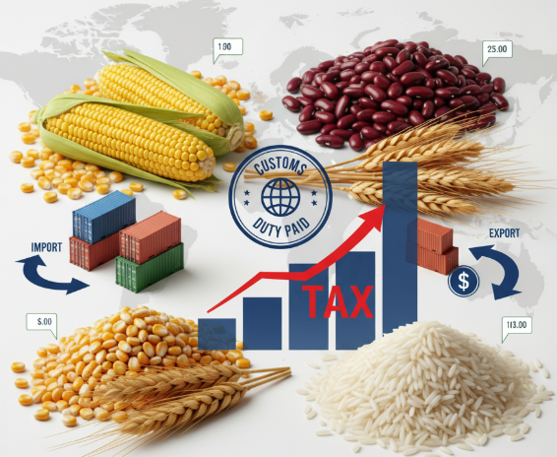
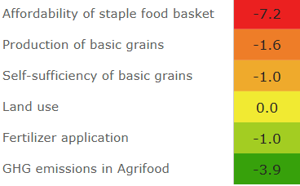

Basic grains exit T-MEC
Improvements in self-sufficiency, but food affordability deteriorates.
Slight intensification on fertilizer use
+
Indicators
(% Change vs Baseline in 2050)
Climate (RCP 7.0)
Exit
T-MEC*
Food Security
Environment
*Includes shocks of Climate (RCP 7.0)

Slide 16
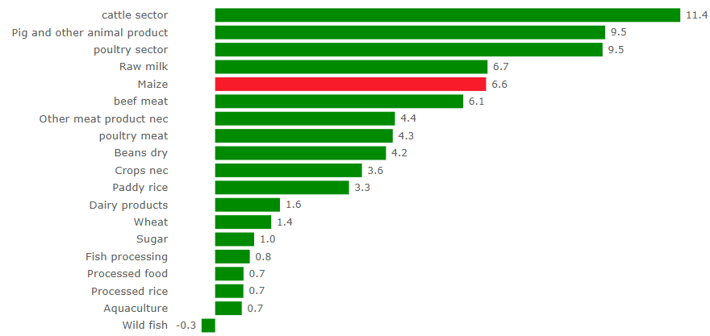
Agri-foods producer prices
(% Change Climate vs Baseline in 2050)
Climate^{(RCP 7.0)}
Maize expected to see biggest price rise among non-livestock foods

Slide 17
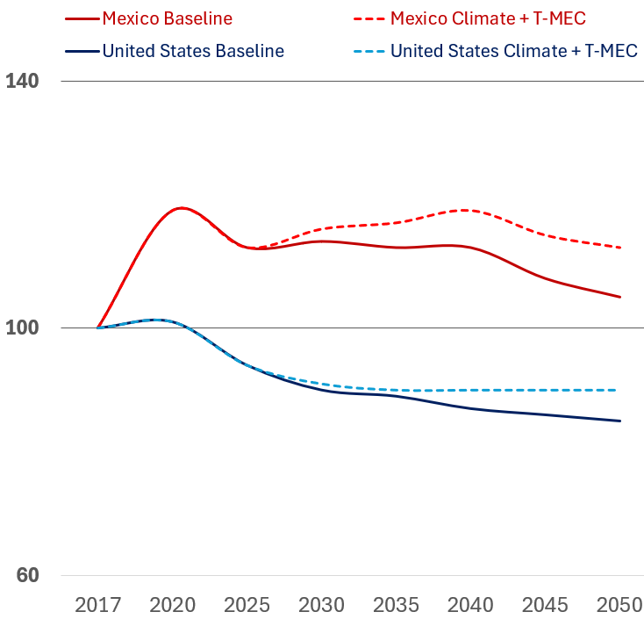
Climate^{RCP 7.0} + Exit of T-MEC make maize even cheaper in the U.S. vs Mexico
Maize Producer prices (2017=100)
Mexico
-20,4%
-19,0%
U.S.

Slide 18
Thanks for your time
Dr. Marcos Esaú Domínguez Viera
Wageningen Social & Economic Research, The Netherlands
marcos.dominguezviera@wur.nl
This work was supported by the Wellcome Trust [310024/Z/24/Z]

