Slide 1

29th GTAP Conference
Paving the way to efficiency
Evaluating Transport Infrastructure Projects in Argentina
Using Web-Scraped Data
Juan I. Mercatante
IIEP (UBA & CONICET)
María Laura Ojeda
IIEP (UBA & CONICET)
María Priscila Ramos
IIEP (UBA & CONICET)
Carlos Adrián Romero
IIEP (UBA & CONICET)

Slide 2

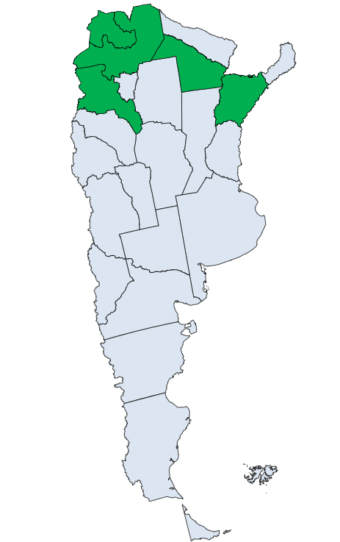
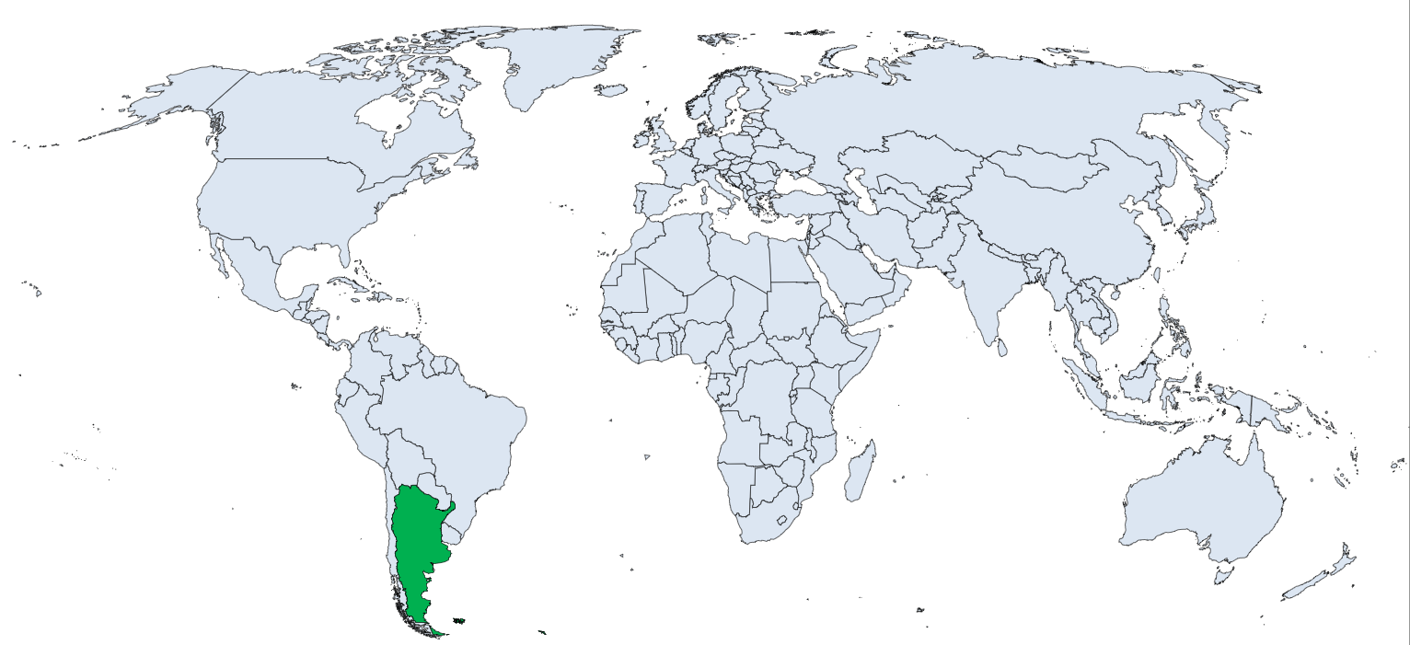


SETTING THE SCENE
The Norte Grande is the poor northern macro-region — and our focus.
First, where are we?
Argentina is the 8th-largest country on Earth — goods often travel 1,000–2,000 km by road from farm to port.
~850,000
km² in the Norte Grande
≈ Germany + Italy combined
10M
people live there
across the NOA + NEA provinces
25–33%
poverty incidence
the highest rates in Argentina
Paving the Way to Efficiency · GTAP Conference
2

Slide 3



1 · MOTIVATION
Why study transport in the Norte Grande?
2nd-highest logistics costs in Latin America
Nearly 3× the OECD average — and only about one-third of roads are paved.
The north pays a 50% logistics penalty
Costs up to 50% higher than in the neighbouring central regions.
An export economy on fragile roads
10.25 M tonnes/yr (maize, soy, wheat) move on a thin, low-quality network.
Roads create 'wider economic benefits'
Beyond cheaper trips: productivity, incomes, welfare — plus spillovers to other regions.
Paving the Way to Efficiency · GTAP Conference
3

Slide 4



2 · CONTRIBUTIONS
Research Question
What are the economy-wide effects of upgrading specific road corridors in the Norte Grande — for each province and for Argentina as a whole?
Route-specific cost shocks
Web scraping reconstructs the actual routes carriers take and maps 46,000+ flows to real road segments — not stylized distance assumptions.
Five new provincial SAMs (2018)
Catamarca, Chaco, Corrientes, Jujuy & Salta — a novel, replicable dataset for regional economic analysis in Argentina.
A transparent engineering → CGE bridge
A systematic way to turn project-level engineering estimates into economy-wide shocks — portable to other data-scarce countries.
Paving the Way to Efficiency · GTAP Conference
4

Slide 5


3 · METHODOLOGY
A four-step pipeline
STEP 1
STEP 2
STEP 3
STEP 4
›
›
›
Data
Model
Scenarios
Results
Build 5 regional Social Accounting Matrices (2018)
Calibrate 5 province-level CGE models in GAMS
Web-scrape routes; map flows to upgraded corridors
GDP, sectoral value added, household income, taxes
Paving the Way to Efficiency · GTAP Conference
5

Slide 6
3 · METHODOLOGY — DATA & MODEL
Five provinces, one consistent framework
Social Accounting Matrices
CGE Models
One SAM per province, base year 2018
  Catamarca · Chaco · Corrientes · Jujuy · Salta
Same 14-sector structure + a 'Rest of Argentina' account for interprovincial trade
Captures the circular flow: sectors, households, government, rest of world
Built from official sources, anchored to a national 2018 SAM
A contribution in itself — a replicable regional dataset
Five models calibrated to the five SAMs (solved in GAMS)
Representative firms, constant returns to scale; labour + capital
Households, government & rest of world optimise under budget constraints
Captures direct + indirect (2nd- and 3rd-order) effects across markets
Results read as deviations from a no-investment counterfactual
Paving the Way to Efficiency · GTAP Conference
6

Slide 7
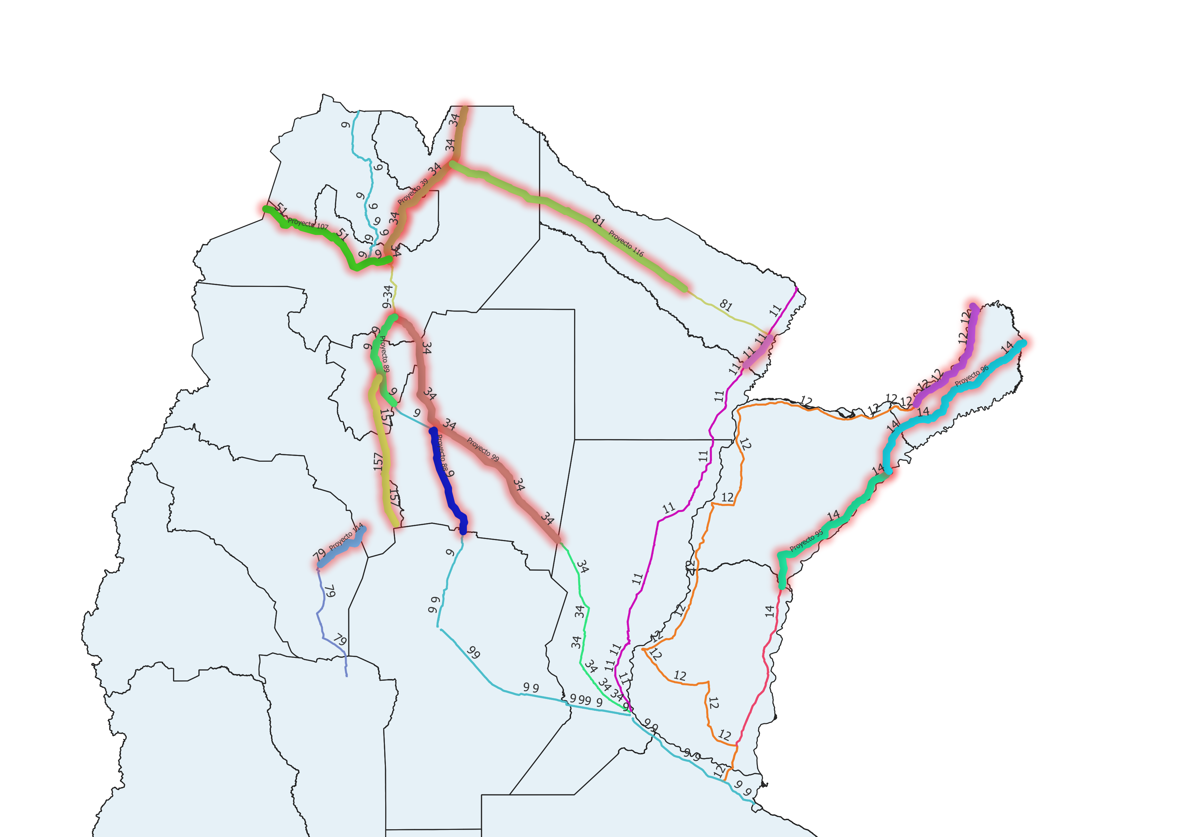



4 · SCENARIO DESIGN — THE DATA
What we started with
46,000+
origin–destination flows
Tonnes traded between 123 urban centres, for 147 product categories, across the whole country.
13
road projects evaluated
Specific corridors with engineering-based cost-reduction estimates from Sant & García (2024).
3
tradable sectors mapped
The 147 products were collapsed onto Agriculture, Mining and Manufacturing to match the SAMs.
The hard part: we had to know which of these thousands of flows actually pass through each upgraded corridor — and for how many kilometres. That can't be assumed; it must be reconstructed.
Paving the Way to Efficiency · GTAP Conference
7

Slide 8


4 · SCENARIO DESIGN — WEB SCRAPING
What we did
1
2
3
4
Query Google Maps
→
Intersect corridors
→
Apply cost cuts
→
Aggregate to shocks
For each O–D pair, a script retrieves the most time-efficient road route across the national network.
Check whether each route passes through an upgraded project — and compute the kilometres on it.
Apply Sant & García (2024) parameters to the on-corridor kilometres to get a per-route efficiency gain.
Weight by trade flows to build province-level transport-cost shocks for the CGE models.
Paving the Way to Efficiency · GTAP Conference
8

Slide 9
5 · RESULTS
Road upgrades pay off — broadly
+1.04%
+2.36%
+0.68%
Provincial GDP
Real household income
National GDP
across the 5 modelled provinces
welfare gains beyond output
via interprovincial spillovers
Household income rises more than GDP — lower transport costs pass through to consumer prices and factor returns.
National > provincial — the region is a transit corridor, so cheaper roads also help freight that merely passes through.
Source: own elaboration. Figures are deviations from a no-investment counterfactual.

Slide 10
5 · RESULTS — BY PROVINCE
Gains are large but uneven
Why Jujuy & Salta lead
They sit on the main NW freight corridor (RN 34) linking the north to Buenos Aires & Santa Fe.
Project 99 on RN 34 is the single most impactful upgrade — a 14.4% cost cut on a typical journey.
Impact tracks two things: the size of the cost cut and the freight volume using the corridor.
Provinces on smaller or more local corridors gain less.
Paving the Way to Efficiency · GTAP Conference
10

Slide 11
5 · RESULTS — BY SECTOR
Transport leads; agriculture follows
Reading the pattern
Transport (+8.45%) — the shock enters here directly, as higher productivity of road services.
Agriculture (+2.48%) — transport-intensive, with long farm-to-market distances.
Manufacturing & mining gain through input–output linkages.
The rest of the economy moves little — it depends less on freight.
Paving the Way to Efficiency · GTAP Conference
11

Slide 12


6 · CLOSING REMARKS
Takeaways
Road upgrades deliver broad gains
+1% provincial GDP, +2.4% household income, +0.68% national GDP — concentrated where corridors carry the most freight.
Web scraping sharpens the shocks
Grounding cost shocks in real routing replaces stylized distance assumptions and improves credibility.
A replicable toolkit
Five new provincial SAMs plus a transparent engineering→CGE bridge, portable to other data-scarce settings.
Where next
Development of Multi-regional SAMs to evaluate in multiregional CGE.
Paving the Way to Efficiency · GTAP Conference
12

Slide 13

Thank you
Questions & discussion welcome
Paving the Way to Efficiency — MESi, IIEP (UBA–CONICET)

