Slide 1
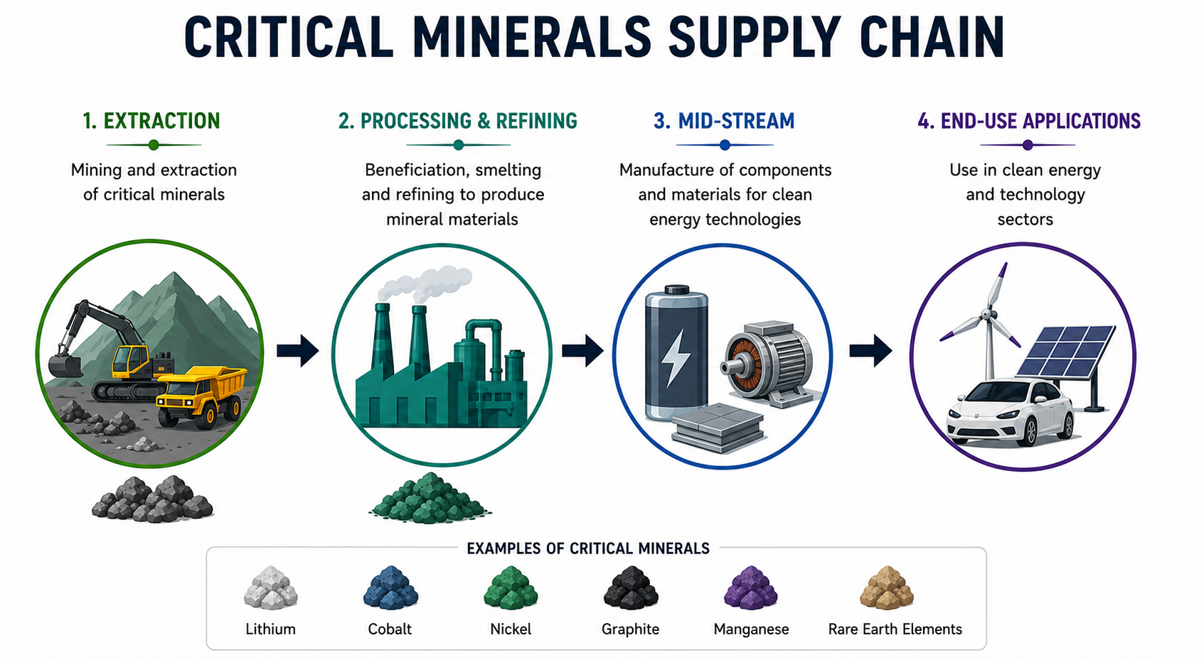
Extension of GTAP to include critical minerals (GTAP-CM)
Krzysztof Wojtowicz (WTO)
Eddy Bekkers (WTO)
Nihal Yilmaz (WTO)
Maksym Chepeliev (GTAP)
29th GTAP conference, June 17-19 2026, Kyoto
Disclaimer: The views expressed in this presentation do not necessarily reflect the views of
WTO Members and are without prejudice to their rights and obligations under the WTO.

Slide 2
Main steps:
1. Choice of the supply chain
2. Collecting raw data inputs
3. Data reconciliation
4. Running msplitcom
5. Results
6. GTAP 12 update
Notes:
Here

Slide 3
1. Choice of the supply chain (minerals and technologies)
We have identified four main steps in which minerals are transformed and used in technologies:
1.1. Mining (minerals)
1.2. Refining (processed minerals)
1.3. Midstream (intermediate technologies)
1.4. Downstream (end-use technologies)

Slide 4
1.1. Mining
Selection of critical minerals was driven by:
  Importance for downstream technologies
  Relative scarcity
  Regional concentration
  Global output value
  Expected demand growth
Based on reports from: IRENA, JRC, USGS.
GTAPCM | GTAP-CE moo sector | GTAP CM | GTAP-CE nmn sector
man | Manganese | lit | Lithium
nik | Nickel | gra | Graphite
cob | Cobalt | rre | Rare earth elements
zin | Zinc | pho | Phosphorus
chr | Chromium | mgm | Magnesium
tit | Titanium
nio | Niobium
sil | Silver
gal | Gallium
pgm | Platinum group metals
Notes:
In current database only six minerals are related to tech nologies, other are only on the mining stage. We have 15 CM.

Slide 5
1.2. Refining
Out of the broad list of selected critical minerals, seven the most important are analyzed in depth. We have also created new sector - artificial graphite.
 | xch |  |  |  |  |  | mpp |  | Other
 | lir | cor | mnr | nir | rer | xchR | sir | mppR
Lithium (lit) | x |  |  |  |  |  |  |  | x
Cobalt (cob) |  | x |  |  |  |  |  | x | x
Manganese (man) |  |  | x |  |  |  |  | x | x
Nickel (nic) |  |  |  | x |  |  |  | x | x
Silver (sil) |  |  |  |  |  |  | x |  | x
Rare earths (rre) |  |  |  |  | x |  |  |  | x
Natural graphite (gra) |  |  |  |  |  |  |  |  | x
Artificial graphite (agp) |  |  |  |  |  |  |  |  | x

Slide 6
1.3. Mid-stream technologies
Minerals (refined) are used in two mid-stream technologies: lithium batteries and permanent magnets. Table below shows material intensity of those technologies.
Source: Sun, Xin, Minggao Ouyang, and Han Hao (2022). “Surging lithium price will not impede the electric vehicle boom." Joule 6.8: 1738-1742
 |  |  | Lithium-ion batteries (kWh) |  |  |  |  | Permanent magnets (kg)
 |  |  | LCO | LMO | LFP | NMC | NCA | mag
kg | Lithium | lir | 0.11 | 0.11 | 0.10 | 0.14 | 0.14
 | Cobalt | cor | 0.96 |  |  | 0.20 | 0.13
 | Manganese | mnr |  | 1.40 |  | 0.28
 | Nickel | nir |  |  |  | 0.51 | 0.68
 | Graphite | gra+agp | 0.94 | 0.92 | 1.09 | 0.99 | 0.97
 | Rare earths | rer |  |  |  |  |  | 0.3
Notes:
Technology used to calculate inputs.

Slide 7
1.4. Downstream technologies
 |  | Electric cars | Plug-in hybrids | Electric buses | Solar panels | Nacelles (wind turbine) | Other
 |  | evl | pvl | evb | sop | egs
Batteries | LCO |  |  |  |  |  | x
 | LMO |  |  |  |  |  | x
 | LFP | x | x | x |  |  | x
 | NMC | x | x |  |  |  | x
 | NCA | x | x |  |  |  | x
Magnets (rare earths) | mag | x | x | x |  | x | x
(refined) silver | sir |  |  |  | x |  | x
Notes:
Calculation of demand for mid-stream technologies was top-down

Slide 8
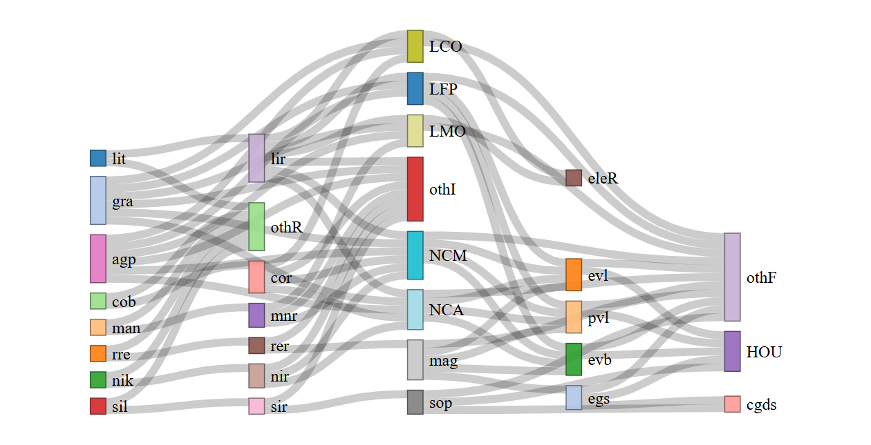
Supply chain (qualitative)
mining refining mid-stream down-stream

Slide 9
2. Data inputs
We have collected data on production, bilateral trade and total supply of each product:
(r,v,q) – data availability: r - country level, v – values, q – quantities
*OS – other sources: scientific reports, articles, web.
**- for some minerals HS code was not available
 | Production | Trade | Total supply
Mining | USGS (r,q), OS* | CEPII (r,v,q)**
Refining |  | CEPII (r,v,q)
Midstream | JRC, BNEF, OS | CEPII (r,v,q) | IEA (q)
Downstream | BNEF | CEPII (r,v,q) | IEA, IRENA (r,q)

Slide 10
2. Production and trade cost, supply structure.
 | Production costs | Trade costs | Supply structure
msplitcom header | CWGT, XWGT | TWGT | RWGT, XWGT
Mining | GTAP | GTAP, OECD | Own assumptions
Refining | Mineral input + GTAP | GTAP | Mid-stream demand + literature
Mid-stream | Refined input + literature + GTAP | GTAP | Down-stream demand + own assumptions
Down-stream | Mid-stream + literature + GTAP | GTAP | Own assumptions
Notes:
Barry, James J., Grecia R. Matos, and W. David Menzie (2015). A Crosswalk of Mineral Commodity End Uses and North American Industry Classification System (NAICS) codes. No. 2015-1163. US Geological Survey.
Tamba, Marie, et al. (2022) "Economy-wide impacts of road transport electrification in the EU." Technological forecasting and social change 182: 121803.
Wentker, Marc, Matthew Greenwood, and Jens Leker (2019). "A bottom-up approach to lithium-ion battery cost modeling with a focus on cathode active materials." Energies 12.3: 504.

Slide 11
3. Data reconciliation routines apply a number of basic assumptions/sanity checks.
For every product in the extended database, the flows are constructed using the following criteria:
Production is used domestically or exported.
Output is not lower than exports.
For the country-commodity cases with no output, trade flows are discarded (priority given to the USGS production data).
Costs (inputs) are equal to the output value (production) (supply = demand).
Flows are tracked both in quantities (we convert gross weight to material content based on available studies) and in values.

Slide 12
4. msplitcom
There are the following relations between msplitcom headers and GTAP parameters:
Output from demand side:
Output from supply side:
Use from import:
VOM = | VDFM | VDPM | VDGM | VXMD
 | XWGT/RWGT | RWGT | RWGT | TWGT
VOM = | VDFA | VIFA | EVFA | PTAX
 | CWGT/XWGT | CWGT/XWGT | CWGT | CWGT
VIMS = | VIFM |  | VIPM | VIGM
TWGT | XWGT | RWGT | RWGT | RWGT

Slide 13
5. Results

Slide 14
5. Results

Slide 15
5. Results

Slide 16
5. Results

Slide 17
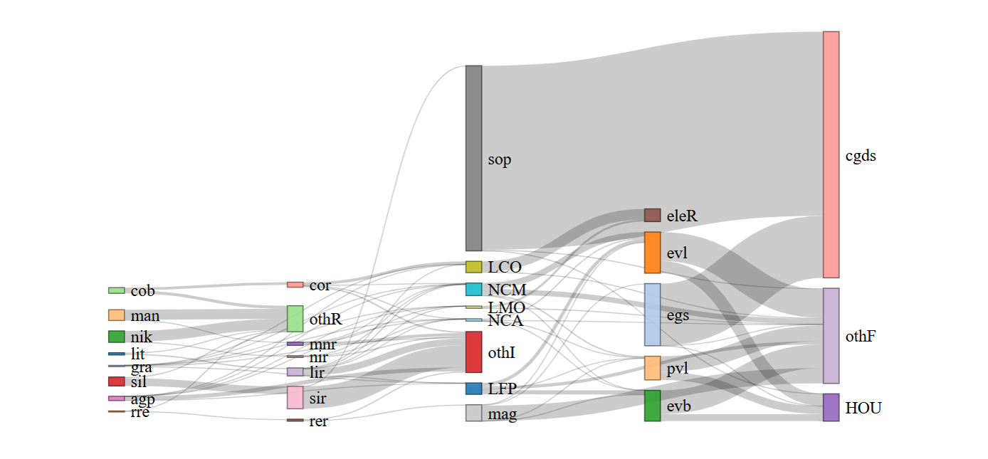
5. Results
Global supply chain based on the GTAP-CM database.

Slide 18
5. Results
Mining production by regions (m$).
AFR – Africa, AOC – Australia and Oceania, SAM – South America, EUR – Europe, NAM – North America, ASI – Asia

Slide 19
5. Results
Refinery production by regions (m$).
.

Slide 20
5. Results
Mid-stream production by regions (m$).

Slide 21
5. Results
Final goods production by regions (bn $).

Slide 22
6. Preliminary work on GTAP 12 (global output mining - m$)

Slide 23
6. Preliminary work on GTAP 12 (global output refining m$)

Slide 24
Further work
Extension of GTAP-CM with 2023
  Due to the rapid changes in the renewable energy and digital sectors, it is important to construct the GTAP-CM database for 2023, allowing for a more up-to-date and realistic starting point for modelling exercises.
Extension with semiconductors
  To study the upstream effects of digitalization and AI, semiconductors should be explicitly included in the database representation, together with the critical minerals employed in the production of semiconductors.
Reserves of minerals and extraction curves
  Mining and refining of critical minerals can expand and shift depending on demand and policies. To study this, we need to incorporate a database of reserves of critical minerals combined with extraction curves indicating how responsive supply is to changes in prices.

Slide 25
Further work
Investment matrix
  To study the emission effects of policies affecting the costs of renewable energy equipment (batteries, solar panels, wind turbines) the existing database and model should be extended with sector specific investments.
  Most of the renewable energy equipment used by renewable energy sectors (solar and wind) is capital (80%).
  At the same time, most CGE models such as GTAP work with a capital accumulation equation at the national level, implying that there is no direct impact of the price of renewable energy equipment on the costs to produce solar and wind energy and thus on emissions
  By developing an investment matrix, distinguished the sourcing of investments by sector, and including a sectoral capital accumulation equation into the modelling framework, this omission can be addressed.

Slide 26
Thank you !

Slide 27
3.1.1. Mining
We start with the following data:
 | Production | Export
Value |  | $
Volume | Mineral content (tonnes) | Gross weight (tonnes)
Price

Slide 28
3.1.1. Mining
We adjust trade volumes to get the mineral content:
Source: Alvarez, Jorge, et al (2026). "Geoeconomic fragmentation and commodity markets." Journal of International Money and Finance: 103555.
 | Production | Export
Value | $ | $
Volume | Mineral content (tonnes) | Mineral content (tonnes)
Price | $/tonne | $/tonne

Slide 29
3.1.1. Mining
Then we further adjust data as follows:
We discard export from countries that don’t extract minerals (according to USGS)
We downscale export if volume exceeds production
We adjust trade data to mimic initial import structure
We adjust export volumes to have one export price

Slide 30
3.1.1 Mining
After calculating production and export for each region, we can calculate the total supply of each mineral in each region as:
Supply = Domestic sales (Production – Export) + Import
This is calculated in volumes (tonnes) and in values ($ basic prices).
We use the supply in volumes as an indicator of refinery production.

Slide 31
3.1.2. Refining
We start with the following data:
 | Production | Export
Value |  | $
Volume | Supply, mineral content (tonnes) | Gross weight (tonnes)
Price

Slide 32
3.1.2. Refining
We adjust trade volumes to get mineral content (based on the characteristic of refined product):
Then we adjust trade data and calculate total supply of refined minerals (similar approach to the mining).
 | Production | Export
Value | $ | $
Volume | Mineral content (tonnes) | Mineral content (tonnes)
Price | $/tonne | $/tonne

Slide 33
3.1.3. Mid-stream
For mid-stream technologies, only scarce data was available. For each product we have calculated production and supply separately.
Permanent magnets:
Based on global production estimates ($ and tonnes) and China’s share, we run optimization model that distribute global production across all regions such that:
Production is not smaller than export
China’s share in global production (volumes) is 90%
Total supply is calculated as: Supply = production + import – export.

Slide 34
3.1.3. Mid-stream
Batteries:
Based on general information available:
Global production of li-ion batteries by type (LCO, LMO, NMC, NCA, LFP) - (JRC)
Production shares for selected regions (CHN, USA, EUR, KOR, JPN) – (BNEF)
Use of batteries in transport (IEA)
Trade of li-ion batteries (aggregated over all types) (CEPII)
Price assumptions
Other assumptions (e.g. use of LFP for energy storage)
We create production, trade and supply flows for each region and each battery type.

Slide 35
3.1.4. Down-stream
Solar panels and wind turbines.
Based on:
(newly) installed solar panels (IRENA)
Trade data (CEPII)
Production shares (BNEF)
We calculate production, trade and supply flows for each region.

Slide 36
3.1.4. Down-stream
Electric cars:
Based on:
Sales of electric cars (IEA)
Trade data (CEPII)
We calculate production, trade and supply in each region.

Slide 37
4.1. RAS for domestic use
In the example below, we split a GTAP sector into three subsectors: A, B, C.
We use msplitcom headers (RWGT and XWGT) to calculate domestic sales (doms_A, doms_B, doms_C).
Then we make sure that the sum of domestic sales of new sectors is equal to parent’s sector:
doms_A+doms_B+doms_C = VDFM+VDPM+VDGM
Having defined row and column totals, for each region we run the above RAS procedure.
Domestic sales | VDFM |  | VDPM | VDGM
doms_A | XWGT | RWGT | RWGT | RWGT
doms_B | XWGT | RWGT | RWGT | RWGT
doms_C | XWGT | RWGT | RWGT | RWGT

Slide 38
4.2. RAS for trade.
For each region we define total export (exp_A, exp_B, and exp_C) based on TWGT header:
and run RAS procedure.
After finding flows in basic prices we calculate export taxes, transport margins and import taxes.
export | r1 | r2
 | VXMD | VXMD
exp_A | TWGT | TWGT
exp_B | TWGT | TWGT
exp_C | TWGT | TWGT

Slide 39
4.3. RAS for imported use.
From 4.2 we know total import of each subsector (imp_A, imp_B, imp_C).
It should be already that: imp_A+imp_B+imp_C = VIMS
(and VIMS = VIFM + VIPM + VIGM)
We use those as row constraints in RAS procedure that finds supply structure from import.
Total import | VIFM | VIFM | VIPM | VIGM
imp_A | XWGT | RWGT | RWGT | RWGT
imp_B | XWGT | RWGT | RWGT | RWGT
imp_C | XWGT | RWGT | RWGT | RWGT

Slide 40
4.4. RAS for costs.
From 4.1. and 4.2 we know output (out_A, out_B, out_C) for new sectors.
out_A = dom_A+exp_A
This is allocated across cost’s elements according to CWGT and XWGT parameters.
VOM = VDFA+VIFA+EVFA+PTAX
output | out_A | out_B | out_C
VDFA | CWGT | CWGT | CWGT
 | XWGT | XWGT | XWGT
VIFA | CWGT | CWGT | CWGT
 | XWGT | XWGT | XWGT
EVFA | CWGT | CWGT | CWGT
PTAX | CWGT | CWGT | CWGT

Slide 41
2. Database based on a variety of data sources
(4) Database split
Data: Split targets from Step 3.
(5) Construction of the final database
Data: Disaggregated database from Step 4.
(1) Data preparation (output splits)
Data: Volumes and values of output, bilateral trade data; unit values trade data
Construction of the production and trade targets using volume and price data.
GTAP Data Base split using MSPLITCOM.
(3) Targets’ reconciliation
Reconciliation of the production targets, supply/use structures and trade data
Data: GTAP-CE Data Base, data inputs from Steps 1 and 2.
Incorporation of the energy and emission flows for disaggregated sectors. Compilation of the final database.
(2) Data preparation (supply/use splits)
Data: Disaggregated individual country input-output tables, specific cost structure assumptions based on academic literature and reports research institutes.
Data sources: USGS, CEPII BACI, IRENA, BNEF, IEA, JRC.
Construction of the cost structure targets.

