Slide 1
Scaling MDB Renewable Energy Finance:
Economic and Environmental Implications
29th Annual Conference on Global Economic Analysis
Nicholas Pape, Ian Sue Wing,
Rishikesh Bhandary, Kevin Gallagher
Department of Earth and Environment, Boston University
Global Development Policy Center, Boston University

Slide 2
Research Questions
To what extent can scaled MDB renewable energy finance expand electricity supply in EMDEs?
Can it simultaneously achieve a development-climate win-win:
  Higher GDP and consumption in EMDEs?
  Lower global CO₂ emissions?

Slide 3
Motivation
Why this matters
Electricity demand in EMDEs is growing rapidly
Hundreds of millions still lack electricity access
MDBs are expected to play a larger renewable energy financing role
The effects of scaled MDB renewable energy finance remain unclear

Slide 4
Executive Summary
Effects in 2030 Relative to BAU
Indicator | Statistic | Results (Scenario Ranges)
Electricity Supply | Median Across 14 EMDEs | +1.63% to +2.18%
GDP | Median Across 14 EMDEs | +0.11% to +0.12%
GDP (Grants) | Median Across 14 EMDEs | +0.14%
Consumption | Median Across 14 EMDEs | -0.29% to -0.12%
Consumption (Grants) | Median Across 14 EMDEs | +0.12% to +0.14%
CO₂ Emissions | Global | -0.55% to -0.46%

Slide 5
Literature and Contribution
Existing Literature
Historical impacts of MDB/DFI financing on:
  Total, fossil fuel, and renewable generation
(Steffen and Schmidt 2019, Chen et al. 2021)
  CO₂ emissions through fossil fuel power financing
(Chen et al. 2020, Chen et al. 2021)
Contribution
Evaluates future scaling of MDB renewable energy finance
Uses a global CGE framework
Quantifies impacts on electricity supply, economic, and CO₂ emissions

Slide 6
Methodology Overview
Static global CGE model
22 regions (14 EMDEs excluding China and Russia)
10 sectors
2017 benchmark -> 2030 BAU
Three annual MDB renewable finance scaling scenarios
Compare outcomes to 2030 BAU

Slide 7
Scenarios
MDB Solar/Wind Finance Scenario | Annual Finance (2023-2030) | Goal
BAU | $2.12B | Continue historical annual solar/wind financing trends
Triple Agenda | $457.88B | Annual solar/wind $400B (2019 USD) across EMDEs
COP28 | $340.26B | Triple clean electricity capital stock by 2030, relative to 2023 levels, in each EMDE
Analytical Model | $489.58B | Clean electricity capital stock in each EMDE grows by inverse of their 2023 clean generation share of electricity generation sector production costs by 2030, relative to 2023 levels

Slide 8
Motivation for CGE Model Scenarios
Triple Agenda Goal: $300-$400 billion in annual zero-carbon generation financing across EMDEs excluding China by 2030
COP28 Goal: Triple global renewable capacity by 2030
Analytical Model:
  If elasticity of substitution b/w clean and dirty energy exceeds price elasticity of energy demand:
    Minimum clean energy supply growth rate needed to grow energy supply and achieve the development-climate win-win is inversely proportional to the clean energy share of the aggregate energy sector’s production costs

Slide 9
CGE Model Structure
Top Down: Static global CGE Model
  22 Regions (Including 14 EMDEs Excluding China & Russia); 10 Sectors
Bottom Up: Detailed economic representation of electric generation technologies with technology-specific electricity generation capital inputs
  Electricity output - CES composite of aggregate generation and T&D
  Aggregate generation - CES composite of eight generators’ outputs
  Each generators’ output - CES function of value-added composite, composite of non-energy and intermediate energy commodities
  Technology-specific capital used by solar and wind generators in EMDEs are split into MDB- and non-MDB-financed portions

Slide 10
Non-Financing Data Sources And Growth Assumptions
Economic accounts (benchmark year: 2017) – GTAP Version 11 (Incl. Power)
Grow non-technology-specific capital endowments (i.e., labor, jelly capital):
  IMF World Economic Outlook (real GDP, 2017 -> 2030)
Grow AEEI parameter (energy intensity decline factor):
  EIA (energy intensity, 2017 -> 2030)
Grow non-MDB solar/wind and non-solar/wind technology-specific capital:
  IRENA (installed capacity, 2017 -> 2023)
  IEA World Energy Outlook (installed capacity, 2023 -> 2030)

Slide 11
Financing Data
Grow MDB solar/wind technology specific capital in EMDEs (2017 -> 2030):
  OCI (2013-2022 MDB solar/wind financing)
Repayment outflows (drags on final consumption goods) in EMDEs in 2030:
  2025 IDA concessional finance terms - 2% interest rate; 40 yr period
Financing outflows and repayment inflows in donor regions in 2030:
  OECD ODA Database (2013-2022 donor financing in MDBs)

Slide 12
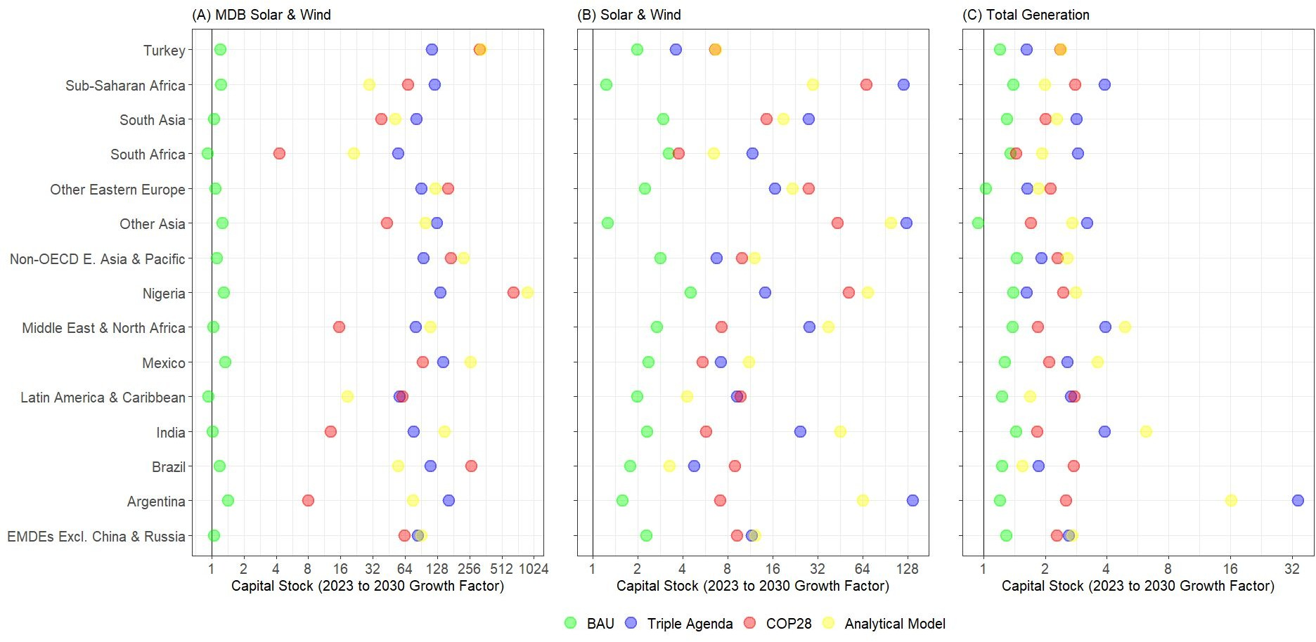
Changes in Generation Capital Stock

Slide 13
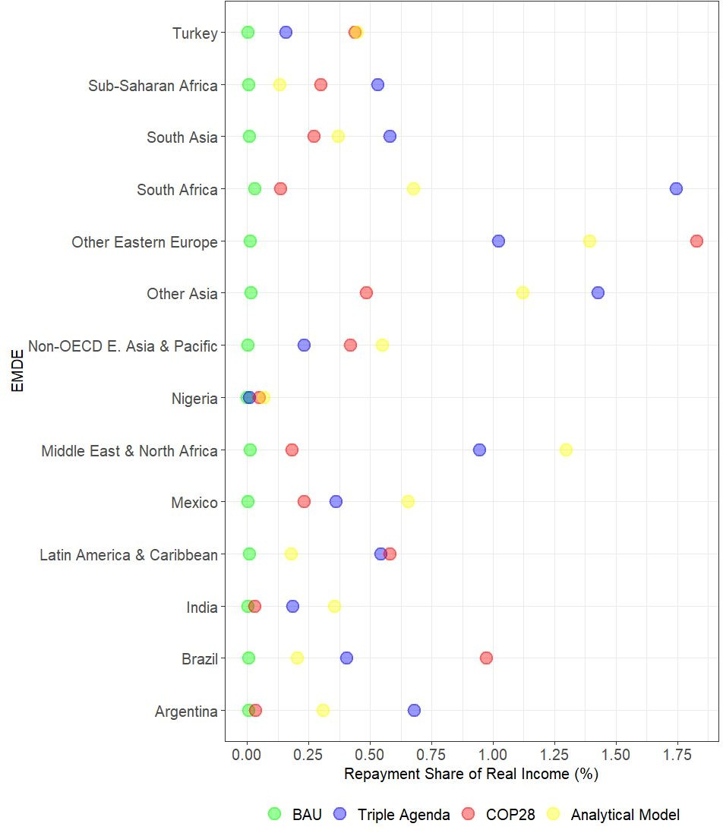
Repayment Share of Real Income in 2030

Slide 14
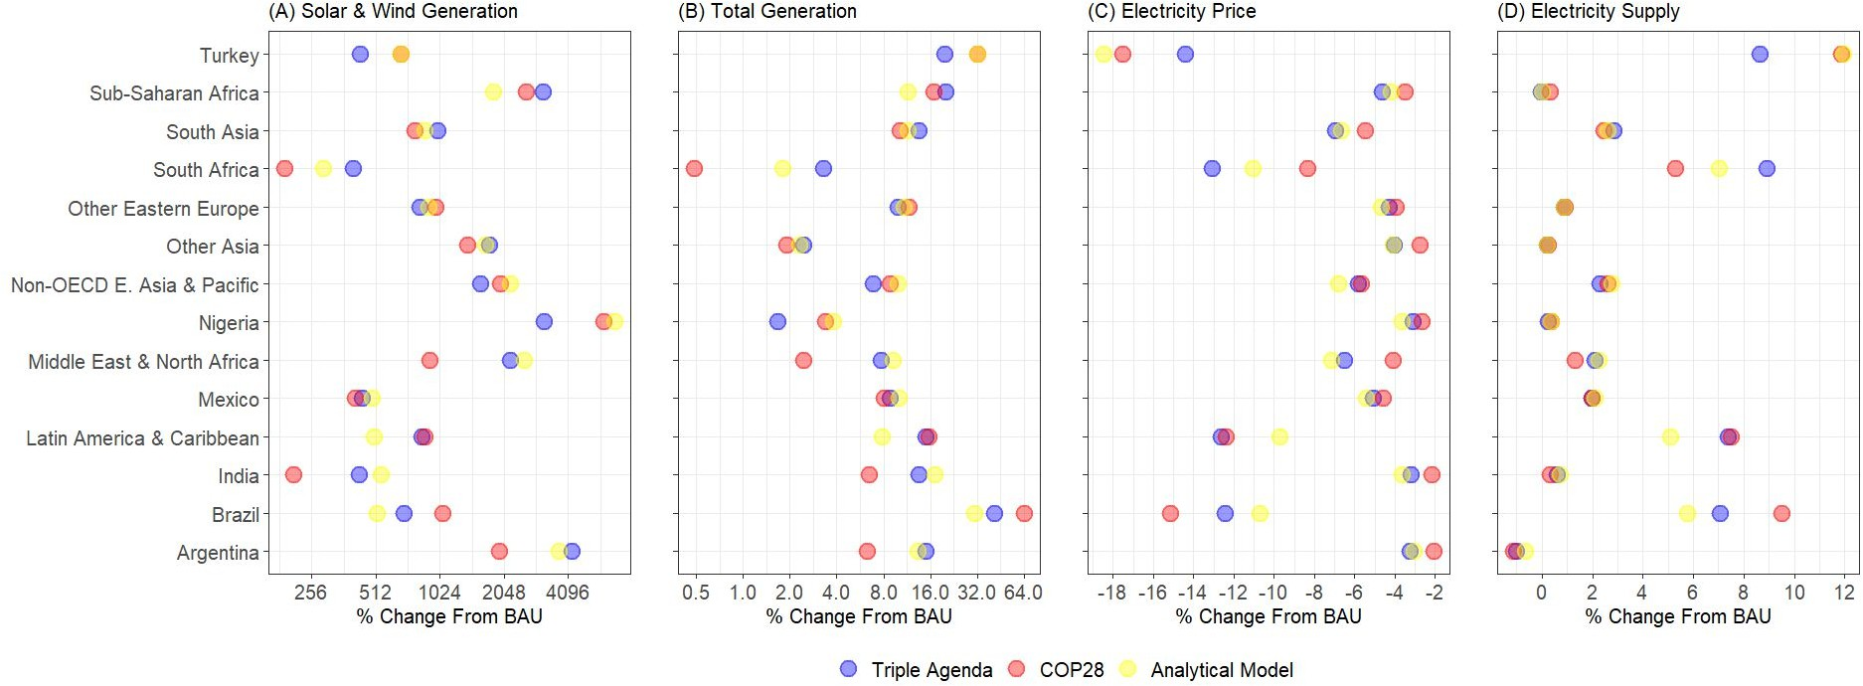
Changes in Electricity Sector Activity

Slide 15
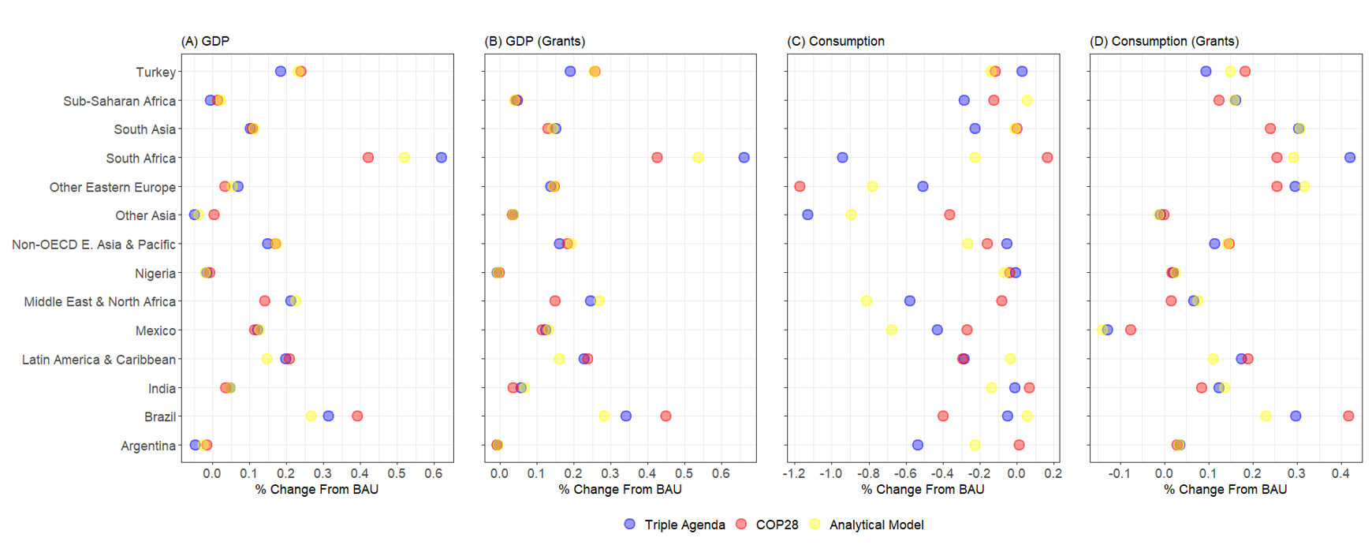
Changes in Economic Indicators

Slide 16
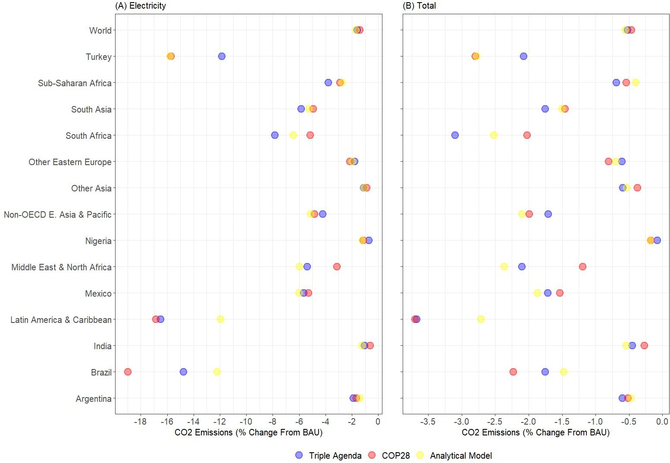
Changes in CO₂ Emissions

Slide 17
Conclusions
Increasing MDB renewable energy finance:
Increases electricity supply
Increases GDP
Mixed effects on consumption
  Declines under loans
  Increases under grants
Reduces CO₂ emissions

Slide 18
Acknowledgements
Nicholas Pape was supported by Boston University’s:
  Global Development Policy Center
  Graduate Program in Urban Biogeoscience and Environmental Health (BU URBAN)

Slide 19
References
Chen, X., Gallagher, K., and Mauzerall, D. (2020). Chinese Overseas Development Financing of Electric Power Generation: A Comparative Analysis. One Earth. Volume 3, Issue 4, 491 - 503.
Chen, X., Li, Z., Gallagher, K., and Mauzerall, D. (2021). Financing carbon lock-in in developing countries: Bilateral financing for power generation technologies from China, Japan, and the United States. Applied Energy. Volume 300, 117318.
Steffen, B. and Schmidt, T. (2019). A quantitative analysis of 10 multilateral development banks’ investment in conventional and renewable
power-generation technologies from 2006 to 2015. Nature Energy. 4(1),
75-82.

