Slide 1
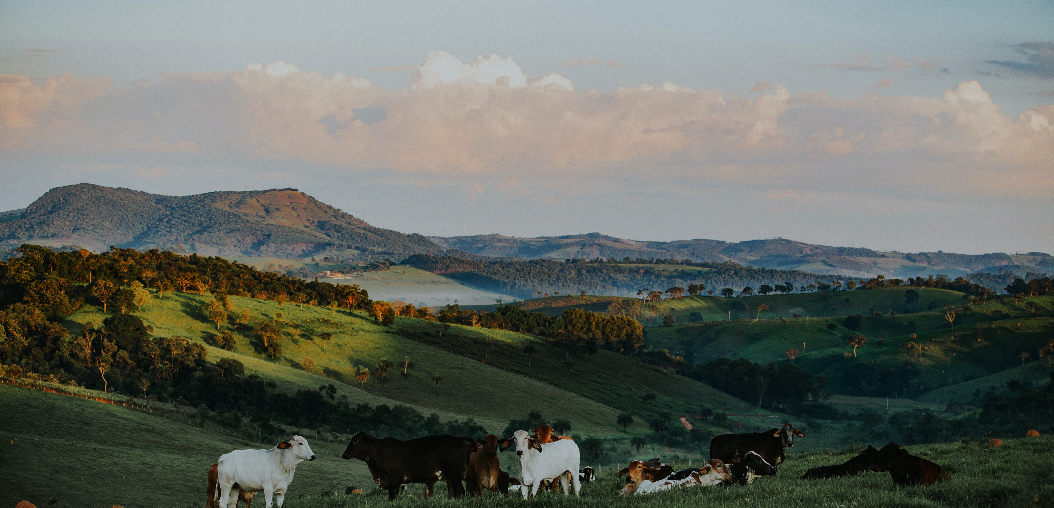



Global Livestock Systems circa 2020
29th Annual Conference on Global Economic Analysis | Kyoto, Japan | June 17-19, 2026
An integrated analysis of livestock production, feed use and GHG emissions
Authors: Bilotto, F., Cao, P., Gonzalez Fischer, C., Chang, J., Piipponen, J., Perkins, O., Fluet-Chouinard, E., Thornton, P., Herrero, M.
Franco Bilotto
Research Associate, Cornell University

Slide 2
Introduction
Livestock systems support nutrition, livelihoods, cultural identity, and economic development.
Their benefits and environmental trade-offs vary widely across species, production systems, and regions, and are increasingly influenced by climatic, socioeconomic, and geopolitical dynamics.
Current global and regional livestock assessments often mask key spatial differences in herd dynamics, feed sources, productivity, nutrient cycling, and emissions.
This limits our ability to assess place-specific adaptation and mitigation strategies.
Here, we developed a spatially explicit global livestock dataset circa 2020, linking biomass flows, productivity, manure nutrient flows, and GHG emissions across species, systems, and agroecological zones.

Slide 3






General objective
-Quantify global livestock production, biomass consumption and GHG emissions circa 2020
6 animal types
Cattle
Sheep
Goat
Buffalo
Poultry
Pig
Ruminant
Monogastric
4 livestock products
Multiple ruminant and monogastric production systems
Multiple global agroecological zones
Meat
Milk
Eggs
Wool

Slide 4
Why this matters for GTAP analysis and economic models
Building on a similar approach used in Herrero et al. (2013) dataset, updated and improved coefficients across livestock systems and regions can help models better estimate region-specific efficiencies and economic costs of producing a unit of meat or milk.
Ongoing collaboration with the GTAP team is exploring how these outputs can be incorporated into GTAP-related analyses.
GTAP-based analyses and economic models need consistent links between production, feed-use, and emissions.
This dataset provides biophysical livestock variables that can support more detailed representation of feed use, productivity and GHG emissions in these models.

Slide 5
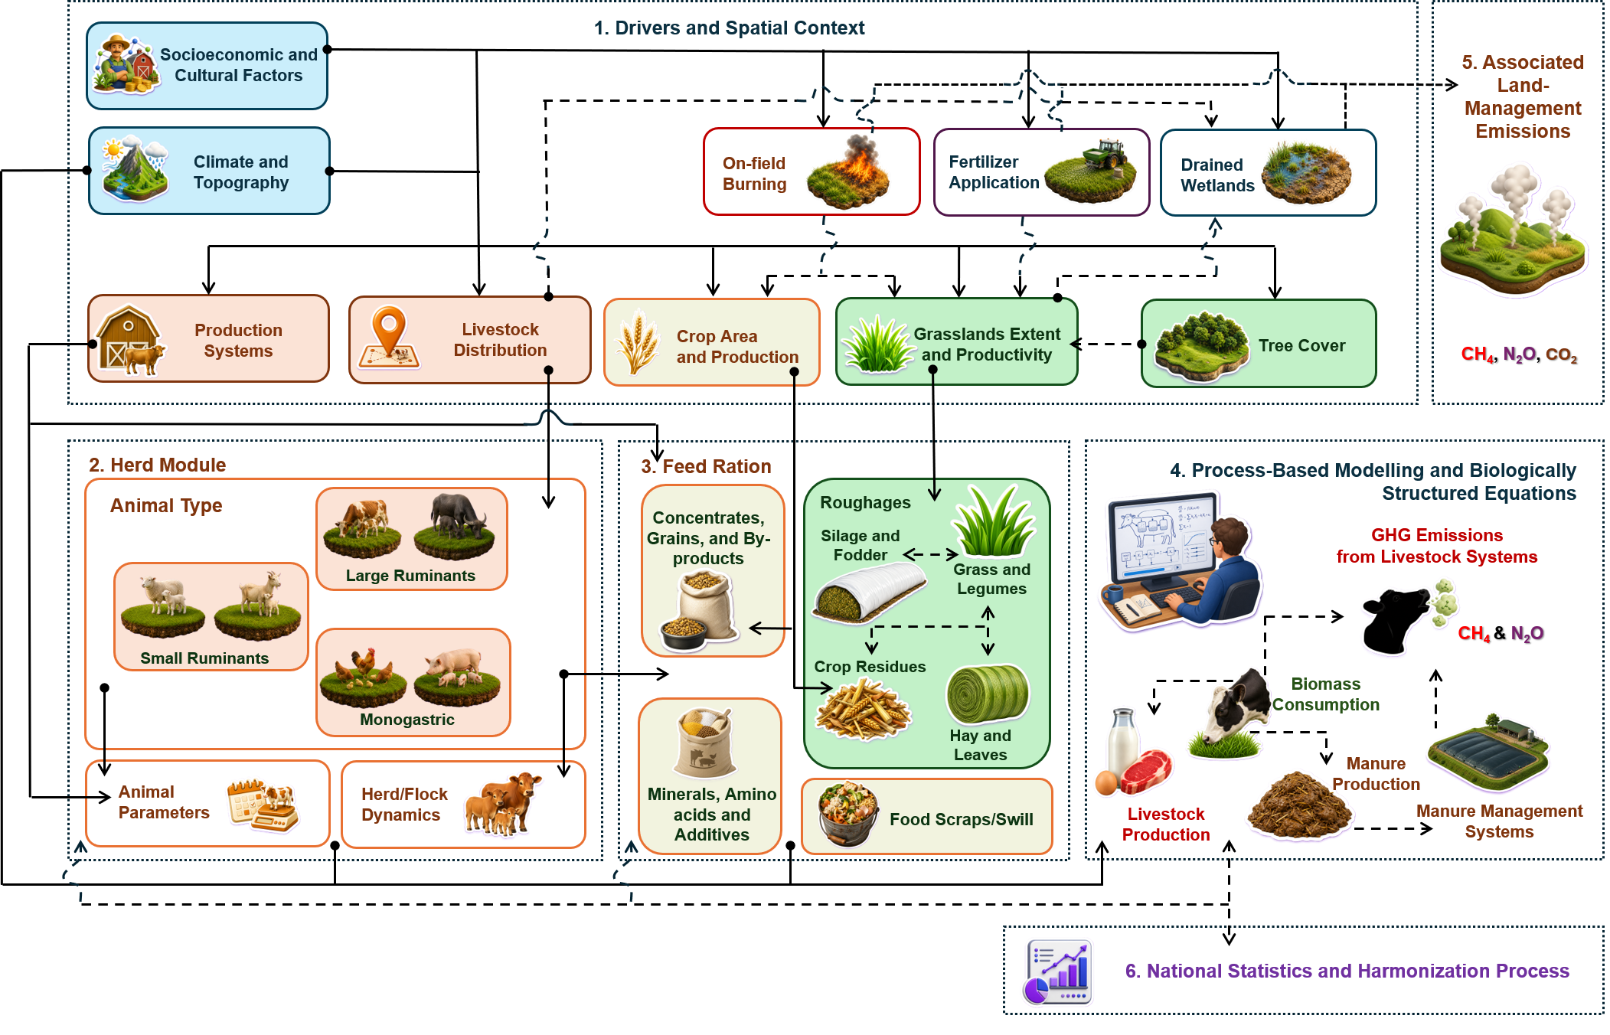
Workflow
NOTE: RESULTS ARE PRELIMINARY AND NOT FOR CITATION

Slide 6
The challenges addressed by this new dataset…
-Consistency of livestock productivity (bottom-up approach):
Animal performance is influenced by feed availability and nutritional quality, climate and topographic conditions, animal activity, age and physiological status, predominant breed type (i.e. cattle) and management practices
-Consistency of methane and nitrous oxide emissions with diet composition and animal physiology:
Ruminant degradation of individual feed items simulated using a validated nutritional model (RNS)
Differences in nitrogen partitioning, retention and excretion in manure by animal type and physiological status

Slide 7
Better feed system representation
Detailed description of feed items across main feed categories (>200 feed items)
For monogastric:
Animal-specific feed quality parameters to estimate metabolizable energy, nutrient partitioning and nitrogen excretion using nutritional equations (NRC).
Spatial allocation of locally produced grains and by-products (MapSPAM 2020, v2);
For ruminant:
Spatial explicit representation of grasslands extent and productivity (rangelands, converted rangelands, improved pastures), including vegetation type (C₃/C₄), legume content and the constraints caused by tree cover (HYDE v3.3, ORCHIDEE Model);
Explicit inclusion of hay, and supplements, including scavenging of shrubs and other vegetation, silage production and consumption (CROPGRIDS);
Linking cropping systems to crop residue availability.
Description of nutritional aspects in validated process-based model (RNS)

Slide 8
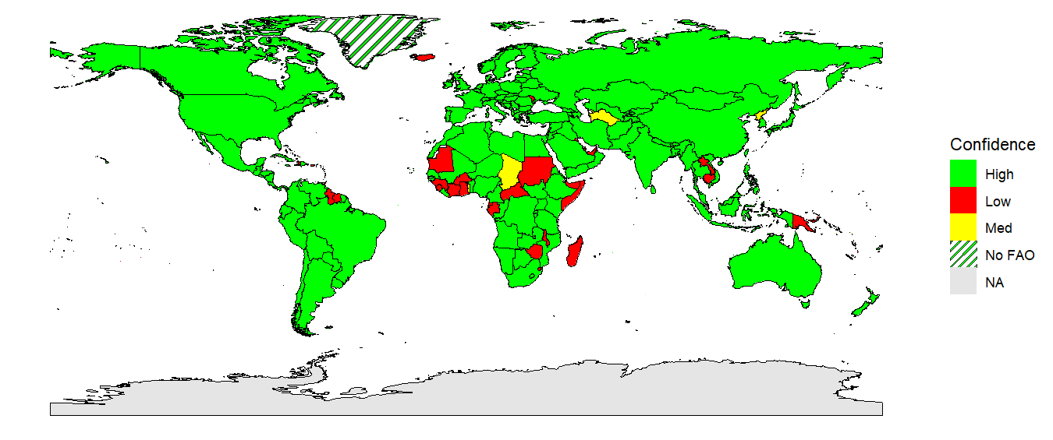
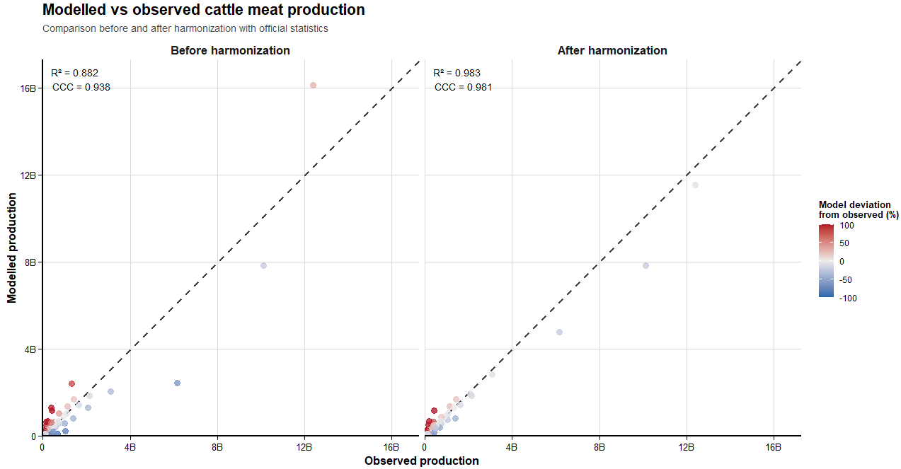
Harmonized Dataset with Official Statistics
-Harmonization of livestock production and feed availability:
Refined herd/flock parameters (new metadata) to reconcile modeled production with official national statistics (FAOSTAT, national reports);
Consistency between animal numbers, production, and feed availability (cross-checks with Food Balance Sheets/SUA for key feed items);
Avoidance of regional biases that can overestimate or underestimate emissions at the country level.
Harmonization of Chicken Meat Production
Matching coverage >98%
NOTE: RESULTS ARE PRELIMINARY AND NOT FOR CITATION

Slide 9
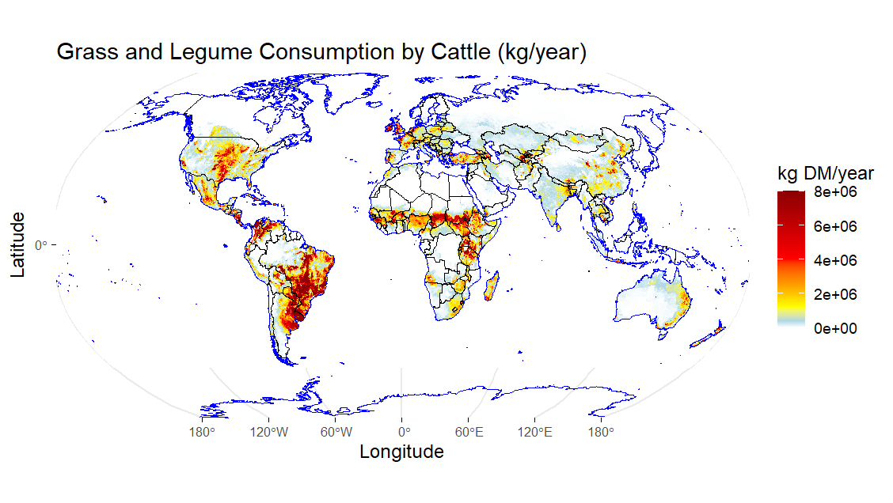
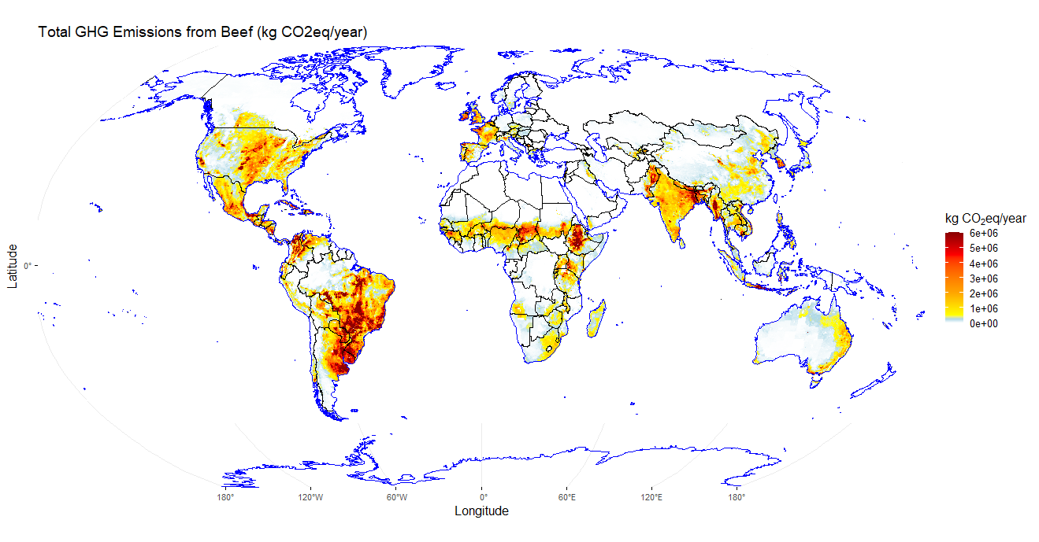
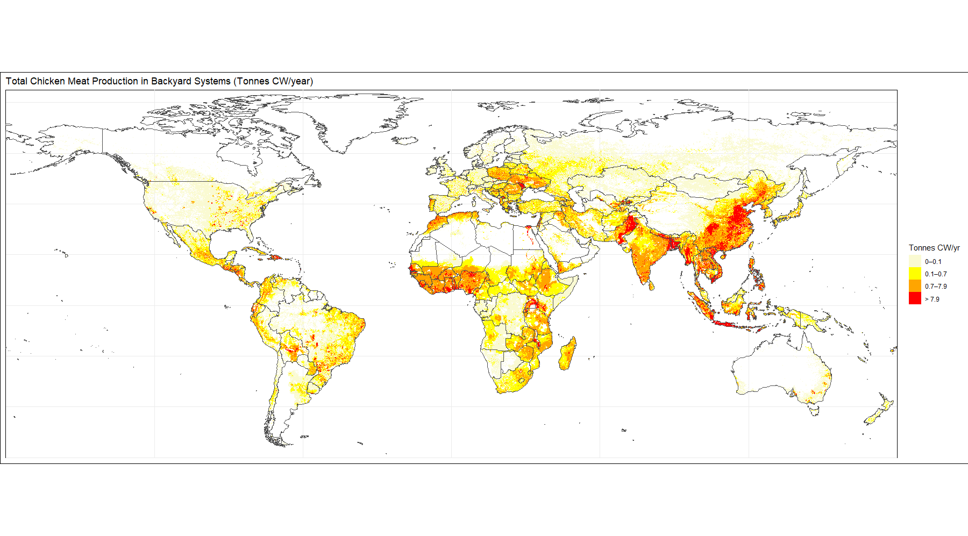
From Livestock Dynamics to Spatially Explicit Outputs
Methane emissions, beef cattle 2020 (Bilotto et al. in prep)
-Biological consistency
-Matching national statistics (e.g. total production, producing/slaughtered animals, feed availability and others)
Chicken meat production, backyard systems 2020 (Bilotto et al. in prep)
NOTE: RESULTS ARE PRELIMINARY AND NOT FOR CITATION

Slide 10
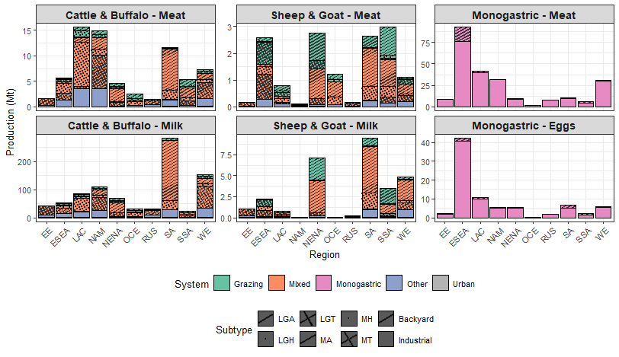
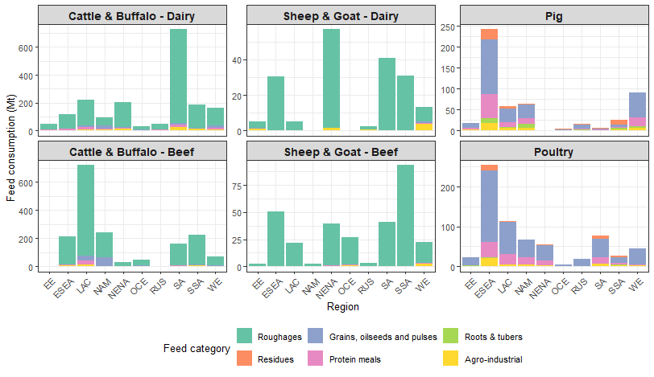
Regional Patterns in Livestock Production and Feed Use
Ruminants
(Grazing and Mixed)
Monogastric
NOTE: RESULTS ARE PRELIMINARY AND NOT FOR CITATION

Slide 11
What this brings to the FAIR data landscape
Improved interoperability and openness:
-Dataset with standardized structure, coded in R, new metadata, and a dedicated web repository;
-Designed to integrate seamlessly with existing FAIR feed, livestock, and environmental datasets.
A richer and more explicit representation of feed systems:
-Detailed description of feed items, nutritional aspects and their role in animal diets;
-Potential traceability of feed origin, processing, and use within livestock systems;
-Direct connection between crop production, residues, by-products, and livestock feeding.
A holistic, system-level perspective and biologically consistent:
-Integrates feed availability, animal performance, herd dynamics, and emissions within a single consistent framework;
-Captures biological, environmental, and management constraints simultaneously
Flexibility for future applications:
-Modular design supporting analyses from animal, feed, and market perspectives, with potential integration into GTAP and other economic modelling frameworks.
-Harmonized structure supports reuse, updates, and extension to new scenarios, regions, and research questions

Slide 12
Opportunities and practical implications
We developed a comprehensive dataset that enables us to:
Assess animal productivity and mitigation strategies resulting from changes in diet composition, ruminal conditions, herd dynamics, animal categories, breeds, and genetic potential;
Explore climate change impacts and adaptation strategies through multi-annual projections affecting feed availability, animal performance, and emissions;
Evaluate the effects of introducing new feed resources on animal performance and feed-use efficiency;
Trace the origin of feed items and link land-use change to regional shifts in diet composition. This could integrate upstream emissions into the analysis, distinguishing between local and non-local feed sources, including feed sourcing dynamics, and facilitate estimation of soil organic carbon changes;
Investigate pathways to circularity in livestock diets, including the use of alternative and residual feed resources;
Supports modelling disease dynamics and animal health interventions, through explicit representation of animal populations, herd structure, and production systems.

Slide 13

Acknowledgments
29th Annual Conference on Global Economic Analysis | Kyoto, Japan | June 17-19, 2026
We gratefully acknowledge all contributors and co-authors across the institutions that made this work possible.
This work was supported by:
Cornell Atkinson Center for Sustainability and the College of Agriculture and Life Sciences at Cornell University,
Land & Carbon Lab, an initiative convened by the World Resources Institute and the Bezos Earth Fund.
We also thank the Environmental Defense Fund for its partnership
Thanks for your attention! Questions?
Contact: fmb59@cornell.edu
URL: https://cals.cornell.edu/food-systems-global-change

