Slide 1
From Mines to Meals: Assessing the Food Security Impacts of Phosphate Rock Scarcity in a Global CGE Model
Mamadou Jallow & Kirsten Boysen-Urban
University of Hohenheim
Department of International Agricultural Trade and Food Security
GTAP 29th Annual Conference on Global Economic Analysis
17- 19th , June 2026

Slide 2
Introduction
Global population is projected to reach ~10.3 billion by 2100 (UN DESA, 2024).
Meeting the food needs of this people requires a significant increase in food production (estimated at 50-70%).
Phosphorus fertiliser is key in this drive (crucial for crop and livestock production). However, it is sourced from phosphate rock (PR) (Chen et al., 2017).
The continued supply of PR is constrained by three key factors:
PR is a finite resource (non-renewable)
Reserves concentration (geopolitical risk factor)
Market vulnerability

Slide 3
Phosphate rock: reserve concentration vs. production concentration
Reserve in millions metric tons
Takeaway: Countries with smaller reserve base may experience faster depletion, increasing future supply risks and dependence on reserve-rich exporters.
Own computation with data from USGS
Data source: U.S. Geological Survey, Mineral Commodity Summaries, 2018

Slide 4
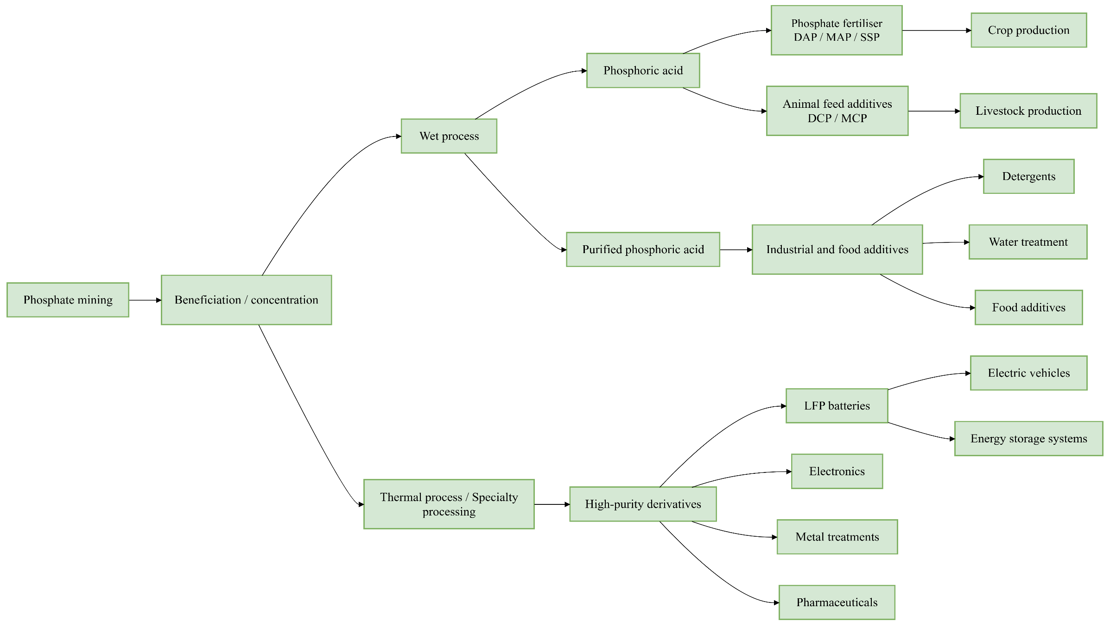
Phosphate rock mining value chain
The study focuses on the transmission from phosphate mining → fertilizer markets → agriculture sector.
80%
Consume 90% of mined PR
Consume 10% of mine PR
Own illustration with data from literature

Slide 5
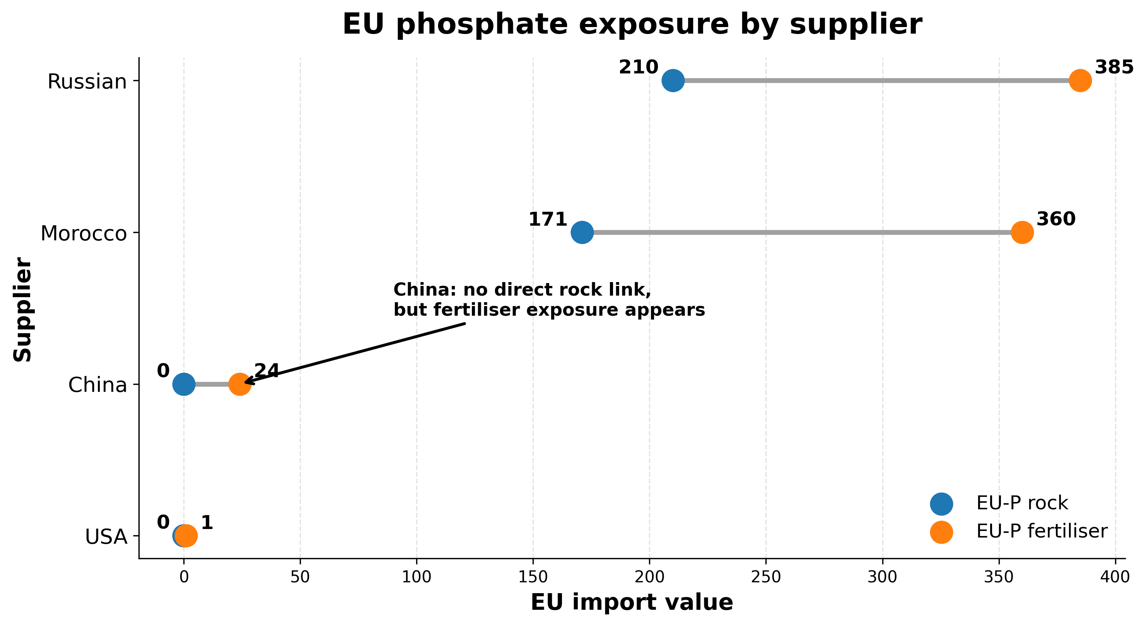
EU trade links with major phosphate producers (Millions USD): Highlighting exposure
Russia and Morocco are the EU’s dominant suppliers of phosphate rock and phosphate fertiliser.
China has no direct phosphate rock exports to the EU, but it is present in the EU’s phosphate fertiliser supply chain
Own computation with data from WITS

Slide 6
Research Gap
Most studies focus only on supply side with limited links to economic and agri-food demand (demand side) (e.g, Fixen & Johnston, 2012; Li et al., 2019; Walan et al., 2014; Illakwahhi et al., 2024).
The fertilizer markets are modelled, but PR remain hidden within aggregate mining sectors (e.g, Bartelings et al., 2016; von Lampe et al., 2014).
Some GTAP extensions improved the representation of minerals and metals, but PR not modelled as a distinct mining sector (e.g, Winning et al., 2017; Chepeliev, 2024).
PR mining remain hidden in GTAP-CE V11 database (Chepeliev, 2022)
PR is the main upstream raw material for phosphate fertilizer, without modelling it as a distinct sector, the model cannot clearly show how a reduction in PR mining affects fertilizer production, crop production, prices, consumption, and trade.
An explicit representation of phosphate rock production activities in the GTAP database and model is required to address this gap.

Slide 7
Research question and objectives
Question
How does a reduction in the technical efficiency of PR mining affect global agri-food markets?
Objectives
Extends the GTAP-CE V11 database by introducing an explicit PR mining sector:
Model the impact of phosphate rock depletion scenarios (-tfp) on agri-food markets.
Assesses changes in agri-food prices, output, consumption, and trade across regions.

Slide 8
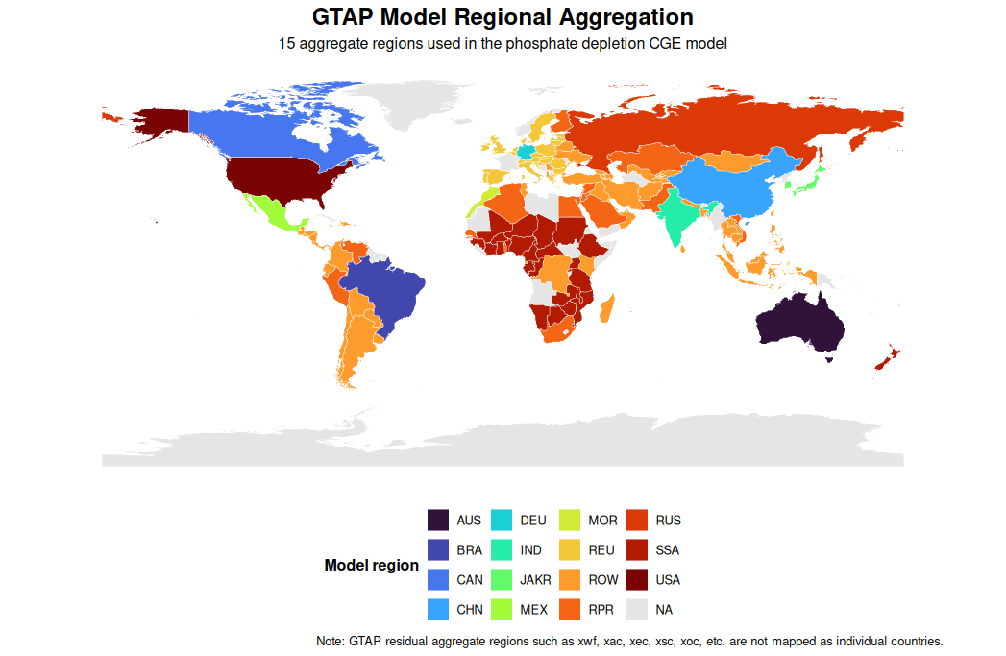
Methodology
Extend GTAP-CE v11 database (Chepeliev, 2022) with explicit representation of phosphate(Phos) mining
Current database 99 sectors across 160 regions
Sector split: – Non-metalic mineral mining(nmn)- (PR mining and rest of nmn)
Description
Model and database | GTAP model version 7 (Corong et al., 2017) with the extended GTAP-CE database v11 as the underline database
Model regions | 10 individual countries and 5 aggregated regions (focus on PR mining countries, and aggregate PR/P consumer regions)
Sectors | 18 sectors (all agri-food sectors, phosphate mining, and the three fertiliser industries)
Time horizon | 2017 base year (2017-2050)- Comparative static model
Policy Scenarios | Phosphate depletion scenarios implemented as reduction in total factor productivity in the model.
Evaluation | Analyse changes on output, prices, trade, consumption
Universität Hohenheim
7

Slide 9
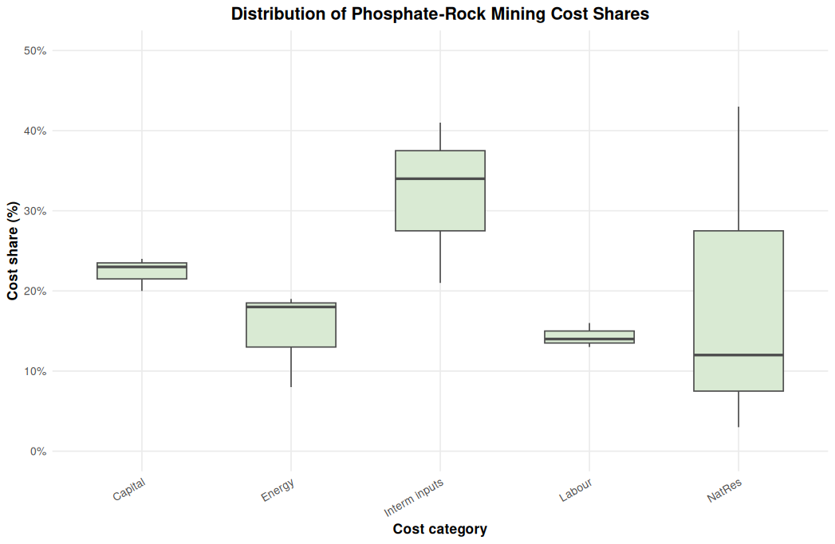
Data-Introducing phosphate mining in the database
PR production volumes (USGS, 2018), trade data (underground and above ground) and price computed from trade volumes and quantities (WITS).
We disaggregate, domestic and imported sales, trade, and cost associated with the new sectors. Implemented the split with the splitcom program (Horridge, 2008).
Fig 1: Distribution of estimated phosphate-rock mining cost shares across the three main phosphate producers.
Heterogeneos cost structure.
Intermediate inputs and capital drive phosphate mining costs with a median share of around 23 and 34% across regions.
The median share of natural resource is around 12%. Morocco about 43%.
Labour and energy cost shares are smaller.
The cost structure estimated through a bottom-up approach- Data sources from China Ministry of Ecology and Environment database, National Bureau of Statistics of China, Mosaic Company Florida phosphate mining technical report summary (2023) , U.S. Bureau of Labour Statistics (BLS), U.S. Energy Information Administration(EIA), USGS, ICL Group Ltd. (2025). Technical report summary.
8

Slide 10
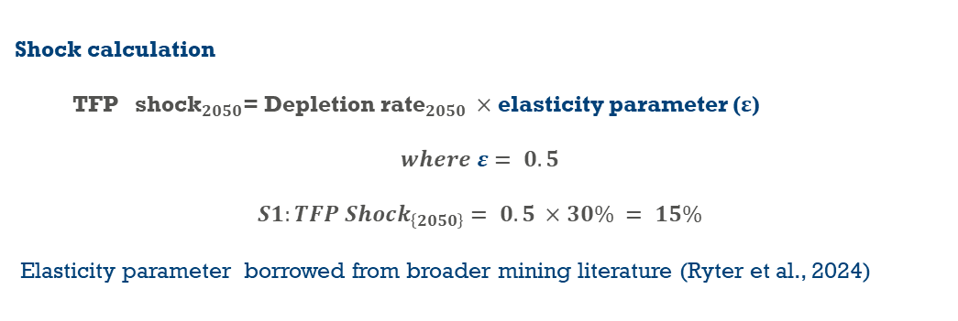
Simulation strategy
Scenarios | Shock | Description
S0: No depletion pressure | Base | 2017 reference year with projected growth in POP, GDP,CAP to 2050
S1: Low depletion pressure | 15% | Reduction in TPF (Represents longer depletion timelines) converted into 2050
Note: PR depletion reduces accessibility, ore quality, increase mining and beneficiation input requirements (higher input requirements for the same amount of PR mined)
Model implementation
Shock calculation
$\text{TFP} {\text{shock}}_{2050}\text{= }\text{Depletion} {\text{r}\text{at}\text{e}}_{2050} ×$ elasticity parameter (ε)
$$where ε= 0.5$$
$$S1:TFP Shock_{\left\{2050\right\}}= 0.5 ×30\% = 15\%$$
Elasticity parameter borrowed from broader mining literature (Ryter et al., 2024)
Shock aoall ("phos", region ) - Reduces output-augmenting technical efficiency in PR mining across mining regions
Data source: Base projection:- International Institute for Applied Systems Analysis (IIASA) projections reported by Kc et al. (2024), OECD long term macroeconomic projection (Delink et al. 2017) and Mogollón et al. (2018). Scenarios:- Vaccari (2009); Fixen and Johnston (2012)
9
Universität Hohenheim

Slide 11
Simulation results
FIG 2: World market price deviation from base across commodities
Universität Hohenheim

Slide 12
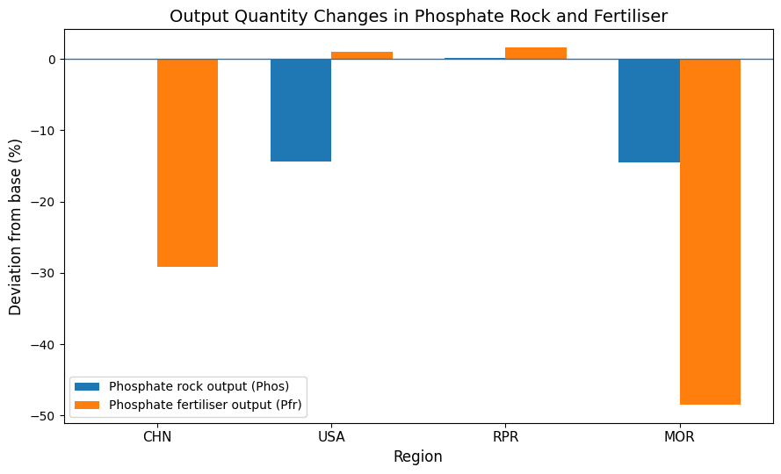
Figure 3. PR/Pfr sector output deviation from base

Slide 13
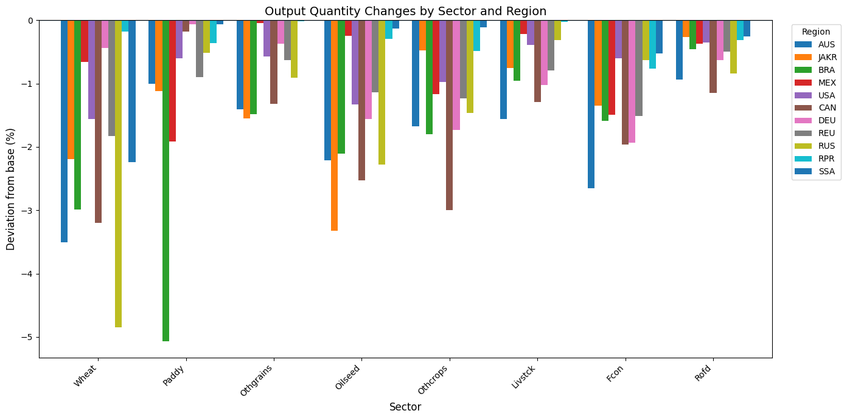
Figure 4. Agrifood sectoral output deviation from base
10
Universität Hohenheim

Slide 14
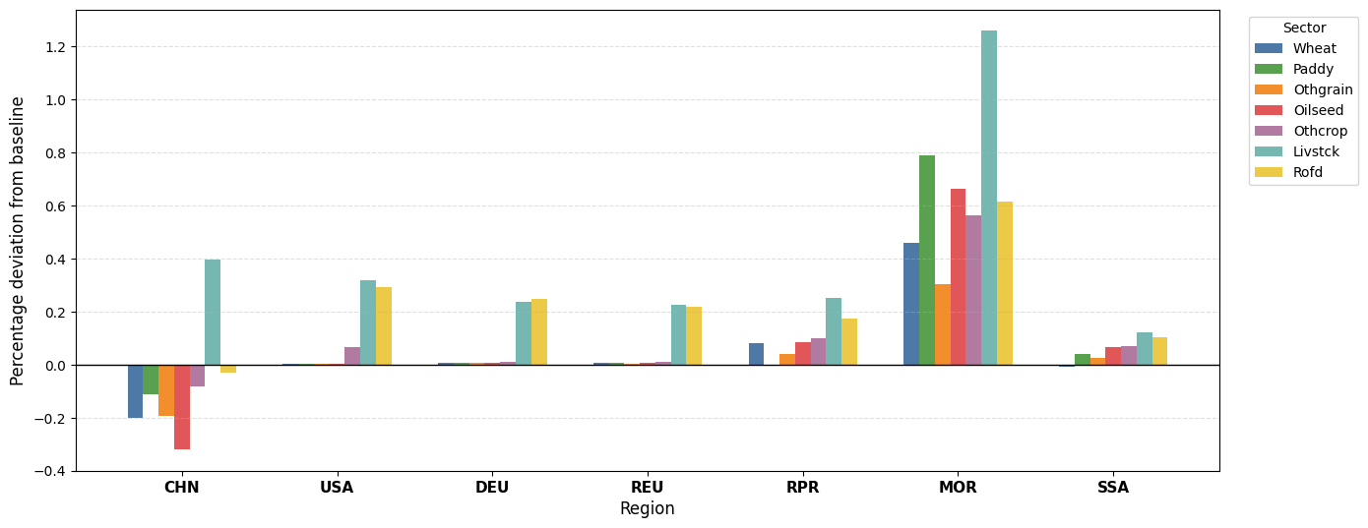
Fig 5. Agri-food consumption deviation from base
Consumption Effects

Slide 15
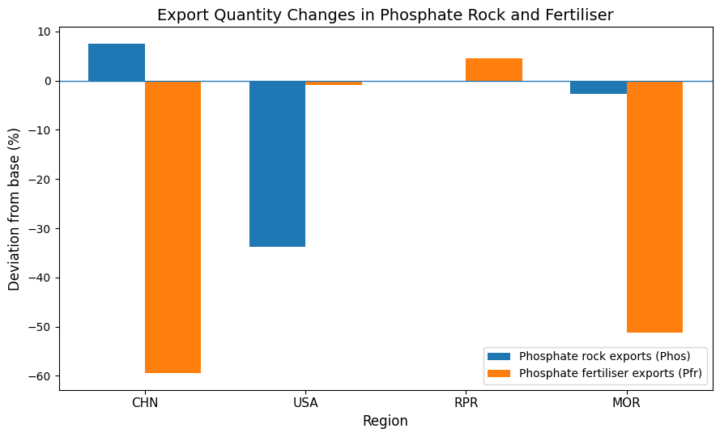
Fig 6: Phosphate rock and phosphate fertiliser exports deviation from base

Slide 16
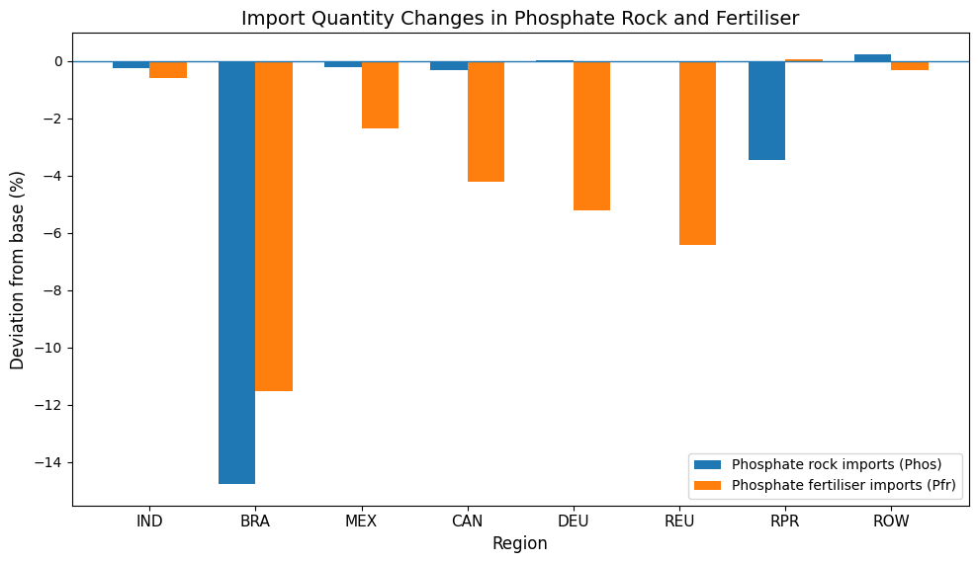
Fig 7: Phosphate rock and phosphate fertiliser imports deviation from base

Slide 17
Table 1: Import changes (%) across agrifood sectors
Import | CHN | JAKR | IND | USA | CAN | DEU | REU | RPR | MOR | SSA | ROW
Wheat | -2,959 | 0.266 | -2,271 | 2,972 | 2,763 | -0.695 | 0.37 | -0.136 | -11,699 | 1,671 | 0.064
Paddy | -5,640 | 2,953 | 1,369 | 4,171 | 2,819 | -0.511 | 1,509 | 9,989 | -21,093 | 1,765 | 1,103
Othgrains | -0.832 | -0.221 | -0.855 | 0.222 | -0.346 | -0.471 | -0.189 | -0.09 | -1,774 | 0.117 | -0.321
Oilseed | -1,026 | -0.302 | -0.905 | 1,594 | 0.83 | -0.855 | -0.135 | 0.087 | -8,243 | -0.003 | 0.305
Othcrops | -2,632 | 0.591 | -1,567 | 0.411 | -0.135 | -0.035 | 0.264 | 0.772 | -5,095 | 0.846 | 0.396
Livstck | -6,580 | 2,429 | -1,012 | 1,923 | 1,545 | 0.002 | 0.152 | 0.467 | -9,162 | 1,223 | 0.051
Fcon | -4,460 | 1,680 | 0.689 | 2,946 | 2,268 | 1,139 | 0.872 | 1,571 | -6,951 | 1,857 | 1,107
Rofd | -4,022 | 0.979 | -0.711 | 1,775 | 0.818 | 0.714 | 0.428 | 0.943 | -3,681 | 0.909 | 0.356

Slide 18
Table 2: Export changes (%) across agrifood sectors
Export | CHN | JAKR | IND | USA | CAN | DEU | REU | RPR | MOR | SSA | ROW
Wheat | 10.54 | -9.05 | 5.41 | -7.28 | -7.18 | -1.4 | -2.98 | -0.61 | 48.96 | -6.37 | 1.35
Paddy | 14 | -4.39 | 1.19 | -8.86 | -6.38 | -5.01 | -6.04 | -9.84 | 76.13 | -3.33 | 4.59
Othgrains | 3.55 | -4.05 | 2.86 | -1.06 | -1.52 | -0.31 | -0.71 | 0.42 | 12.53 | -0.05 | 0.82
Oilseed | 5.11 | -7.16 | 2.36 | -2.37 | -3.91 | -2.41 | -1.94 | -0.09 | 26.35 | -0.4 | 0.72
Othcrops | 5.25 | -2.23 | 2.01 | -2.65 | -4.71 | -2.66 | -2.25 | -1.34 | 17.75 | -1.76 | 0.01
Livstck | 11.31 | -0.57 | 1.67 | -2.94 | -3.83 | -1.93 | -1.86 | -1.47 | 19.92 | -1.69 | -0.5
Fcon | 8.67 | -3.66 | 0.41 | -6.13 | -5.54 | -3.98 | -4.05 | -2.71 | 22.93 | -3.37 | -0.53
Rofd | 7.46 | -0.95 | 2.21 | -2.66 | -2.61 | -1.7 | -1.22 | -1.27 | 11.63 | -1.17 | 0.12

Slide 19
Conclusion
This study extends the GTAP-CE V11 database by adding PR mining as a distinct sector, enhancing economy-wide analysis of the effects of PR depletion on agri-food markets.
The extended database permits explicit tracing of PR depletion shocks from mining through fertilizer production to the agricultural sector.
Using this framework, the study quantifies how a reduction in production efficiency in the mining sector changes production output, crop and input prices, consumption and trade flows across sectors and regions.
Key findings:
A 15% reduction in phosphate rock mining productivity lowers crop production in most regions.
Phosphate-fertilizer output falls substantially in the two major PR reserve holders, raising fertilizer production costs.
Agrifood sectors see a drop in across all phosphate rock import dependent regions.

Slide 20
Next step
Assess different approaches to implement the depletion rate
Simulate alternative assumptions regarding depletion rate
Account for regional difference about depletion rates
Account for differences regarding productivity parameter according to the literature

Slide 21
Questions and thoughts
Thank you all listening!
Email: mamadou.Jallow@uni-hohenheim.de

Slide 22
References
Bartelings, H., Kavallari, A., van Meijl, H., & Von Lampe, M. (2016). Estimating the impact of fertilizer support policies: A CGE approach (Presented at the 19th Annual Conference on Global Economic Analysis, Washington DC, USA). Purdue University, Global Trade Analysis Project (GTAP). Retrieved from https://www.gtap.agecon.purdue.edu/resources/res_display.asp?RecordID=4901.
Chepeliev, M. (2022). EU Green Deal and Circular Economy Transition: Implications for economic,emissions and material use patterns. Purdue University, West Lafayette, IN: Global Trade Analysis Project (GTAP).
Corong, E., Thomas, H., Robert, M., Tsigas, M., & Van Der Mensbrugghe, D. (2017). The Standard GTAP Model, version 7. Journal of Global Economic Analysis, 2(1), 1–119. https://doi.org/10.21642/jgea.020101af.
Dellink, R., Chateau, J., Lanzi, E., & Magné, B. (2017). Long-term economic growth projections in the Shared Socioeconomic Pathways. Global Environmental Change, 42, 200–214. https://doi.org/10.1016/j.gloenvcha.2015.06.004
Fixen, P. E., & Johnston, A. M. (2012). World fertilizer nutrient reserves: A view to the future. Journal of the Science of Food and Agriculture, 92(5), 1001–1005. https://doi.org/10.1002/jsfa.4532
Horridge, M. (2008). SplitCom: Programs to disaggregate a GTAP sector [Computer software]. Centre of Policy Studies, Monash University. (Original work published 2005)
Kc, S., Dhakad, M., Potancokova, M., Adhikari, S., Yildiz, D., Mamolo, M., Mamolo, M., Sobotka, T., Sobotka, T., Zeman, K., Zeman, K., Abel, G., Lutz, W., & Goujon, A. (2024). Updating the Shared Socioeconomic Pathways (SSPs) Global Population and Human Capital Projections
Mogollón, J. M., Beusen, A. H. W., Van Grinsven, H. J. M., Westhoek, H., & Bouwman, A. F. (2018). Future agricultural phosphorus demand according to the shared socioeconomic pathways. Global Environmental Change, 50, 149–163. https://doi.org/10.1016/j.gloenvcha.2018.03.007
Ryter, J., Bhuwalka, K., O’Rourke, M., Montanelli, L., Cohen‐Tanugi, D., Roth, R., & Olivetti, E. (2024). Understanding key mineral supply chain dynamics using economics‐informed material flow analysis and Bayesian optimization. Journal of Industrial Ecology, 28(4), 709–726. https://doi.org/10.1111/jiec.13517
U.S. Geological Survey. (2018). Mineral commodity summaries 2018: Phosphate rock. U.S. Department of the Interior. https://www.usgs.gov/centers/nmic/mineral-commodity-summaries.
United Nations, Department of Economic and Social Affairs, Population Division. (2024). World population prospects 2024: Summary of results (UN DESA/POP/2024/TR/No. 9). United Nations.
Vaccari, D. A. (2009). Phosphorus: A looming crisis. Scientific American, 300(6), 54–59. https://doi.org/10.1038/scientificamerican0609-54
Von Lampe, M., Kavallari, A., Bartelings, H., van Meijl, H., Banse, M., Ilicic-Komorowska, J., & van Tongeren, F. (2014). Fertiliser and biofuel policies in the global agricultural supply chain (OECD-Food, Agriculture and Fisheries Papers No. 69). OECD-Publishing. https://doi.org/10.1787/5jxsr7tt3qf4-en.
Winning, M., Calzadilla, A., Bleischwitz, R., & Nechifor, V. (2017). Towards a circular economy: Insights based on the development of the global ENGAGE-materials model and evidence for the iron and steel industry. International Economics and Economic Policy, 14(3), 383–407. https://doi.org/10.1007/s10368-017-0385-3

Slide 24
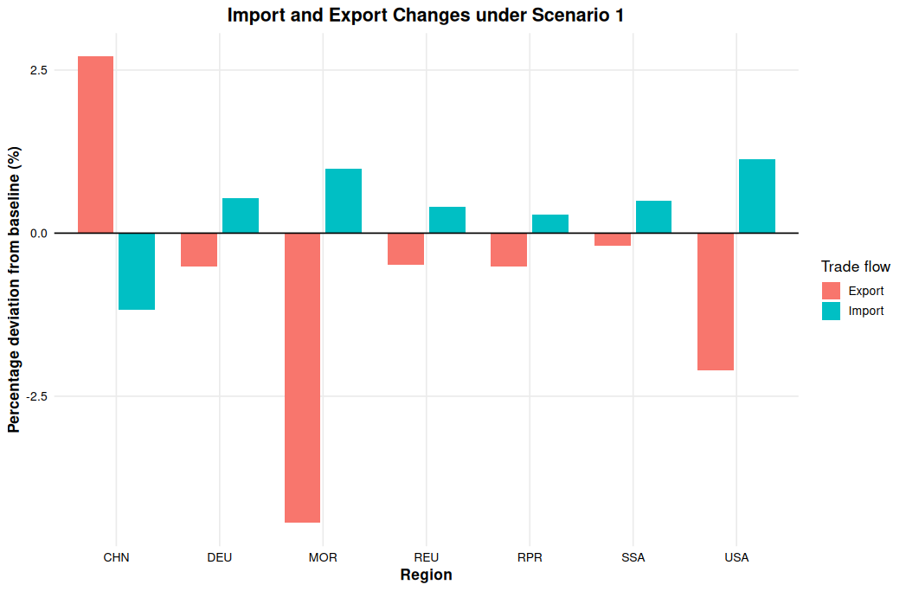
Trade Effects
Figure 6. Agri-food trade changes under Scenario 1, percentage deviation from reference scenario, 2050

Slide 25
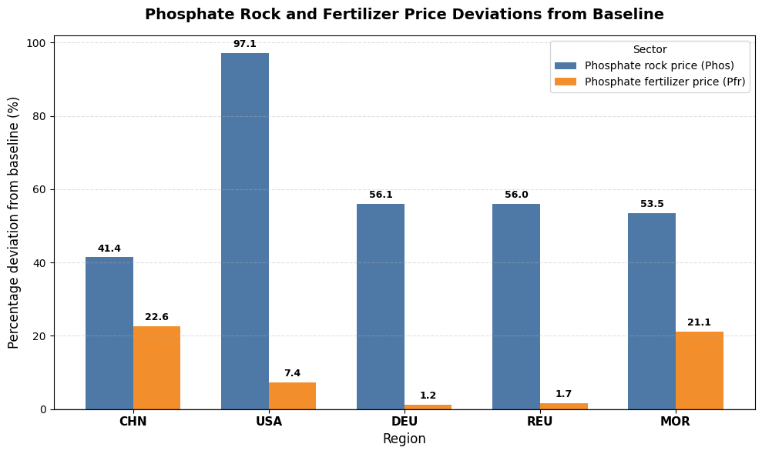
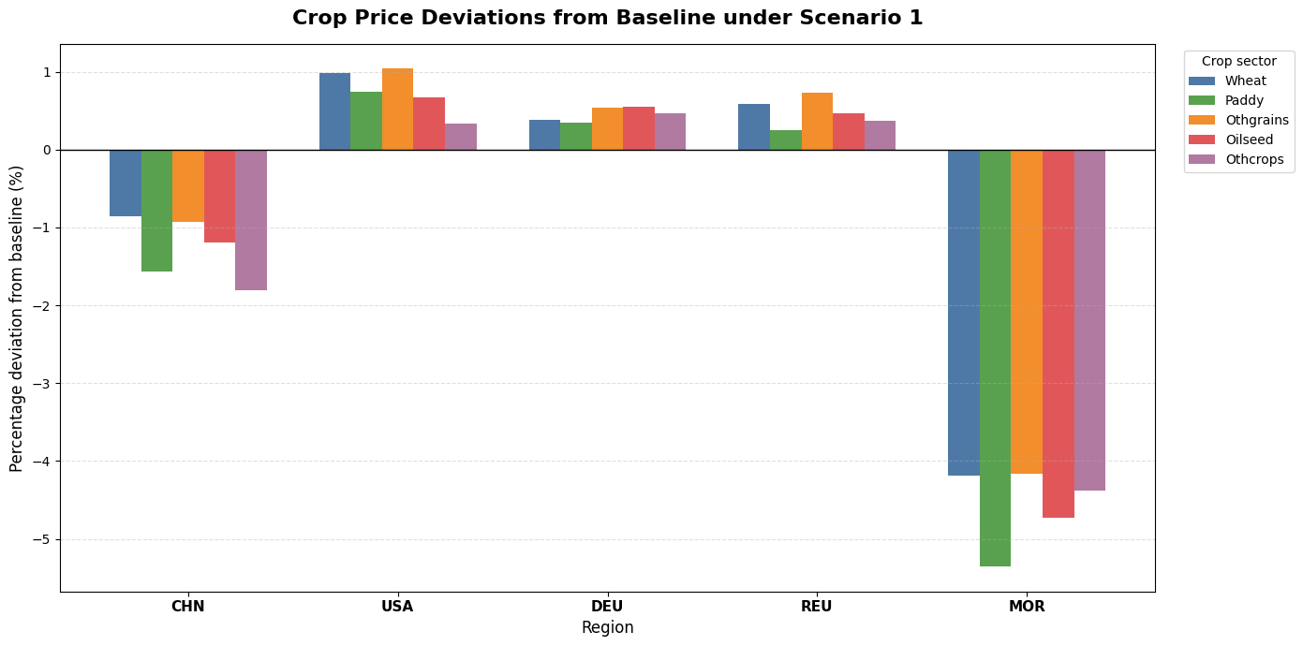
Price Effects
Figure 3. Phosphate rock and fertilizer price changes under Scenario 1, percentage deviation from reference scenario, 2050)
Figure 4. Crop price changes under Scenario 1, percentage deviation from reference scenario, 2050
PR prices rise strongly in all reporting regions,
The fertilizer-price response is uneven: it is strongest in China and Morocco, but much smaller in the USA and rest of Europe.
Crop prices increase slightly in the USA and Europe.
In China and Morocco, crop prices fall despite higher phosphate and fertilizer prices.
11
Universität Hohenheim

